Slide 1


NOVEL ENGINEERING
STEM Learning Through Stories
Sheri Omernik
Educational Sales Consultant

Slide 2

Sheri Omernik
Educational Sales Consultant

Slide 3
01
Intro to Novel Engineering
02
Tool Exploration
03
Process Overview
04
Practice Novel Engineering
05
Resources, Reflections, and Questions

Slide 4


Novel Engineering
Students engineer solutions for the problems characters face in stories
  Following the Design Thinking Process
  Using inexpensive, low or no tech tools/supplies
Created to contextualize Engineering in K-8 Classrooms
Developed in 2010 at Tufts University via NSF Grant
Notes:
“Contextualize Engineering in K8 Classrooms” – As Engineering course options grew in high schools, they recognized it was difficult to emulate at lower grade levels because students simply have less real world context and understanding of the types of projects Engineering solves/supports.
Novel engineering brings the benefits of engineering – problem solving, creative thinking, teamwork, etc. – to younger students within a context they do understand: the problems characters face in stories.

Slide 5
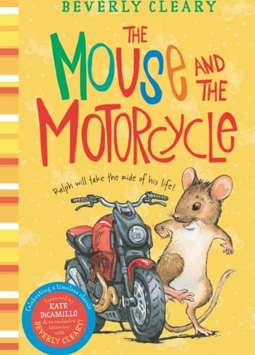
Novel Engineering
Problem identified by students:
Ralph needs help getting the motorcycle out of the wastebasket
Solutions designed by students:
Ramp to drive the motorcycle out of the wastebasket
Rubber-band launching device to get the motorcycle out of the wastebasket
Pulley to lift the motorcycle out of the wastebasket
Notes:
This is one of the many examples you can find on the Tufts Novel Engineering website.

Slide 6
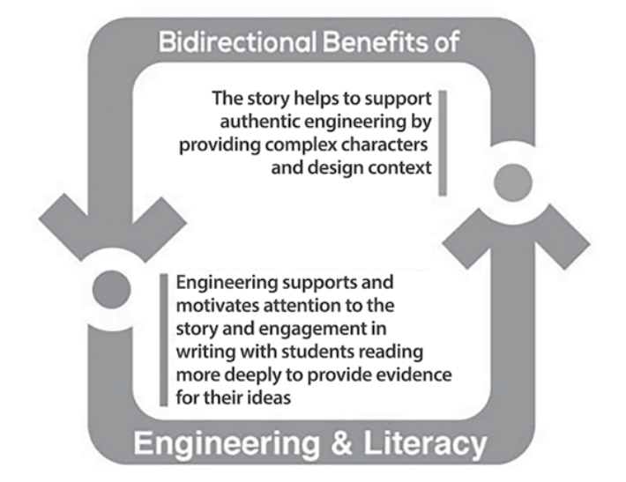
Novel Engineering
Notes:
Essentially, it’s a mutually beneficial relationship between Engineering & Literacy.

Slide 7
01
Intro to Novel Engineering
02
Tool Exploration
03
Process Overview
04
Practice Novel Engineering
05
Resources, Reflections, and Questions

Slide 8
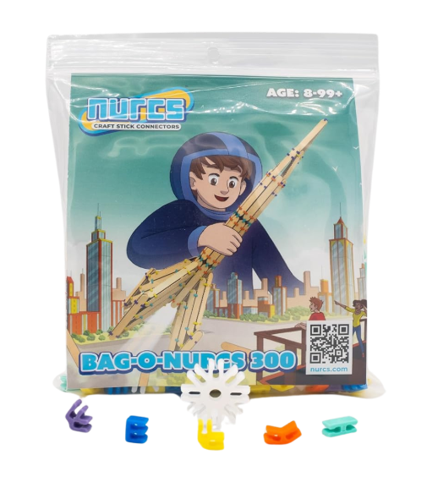
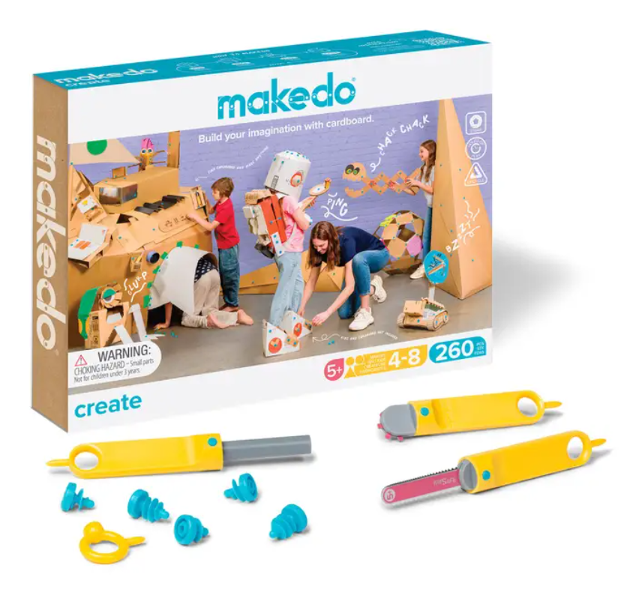
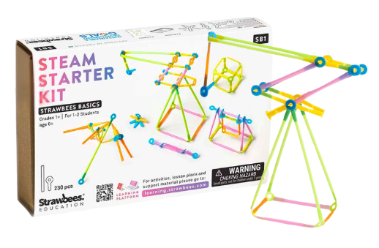



Tool Overview

Slide 9



Slide 10

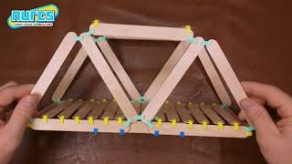
Notes:
This video doesn’t explain Nurcs, you just get to see them in action (it was the best video I could find). So I talked over it during IDEACon and explained that they have a variety of connectors in different angles. Affordable price point. Great for open ended making. Works with different size popsicle/craft sticks.

Slide 11


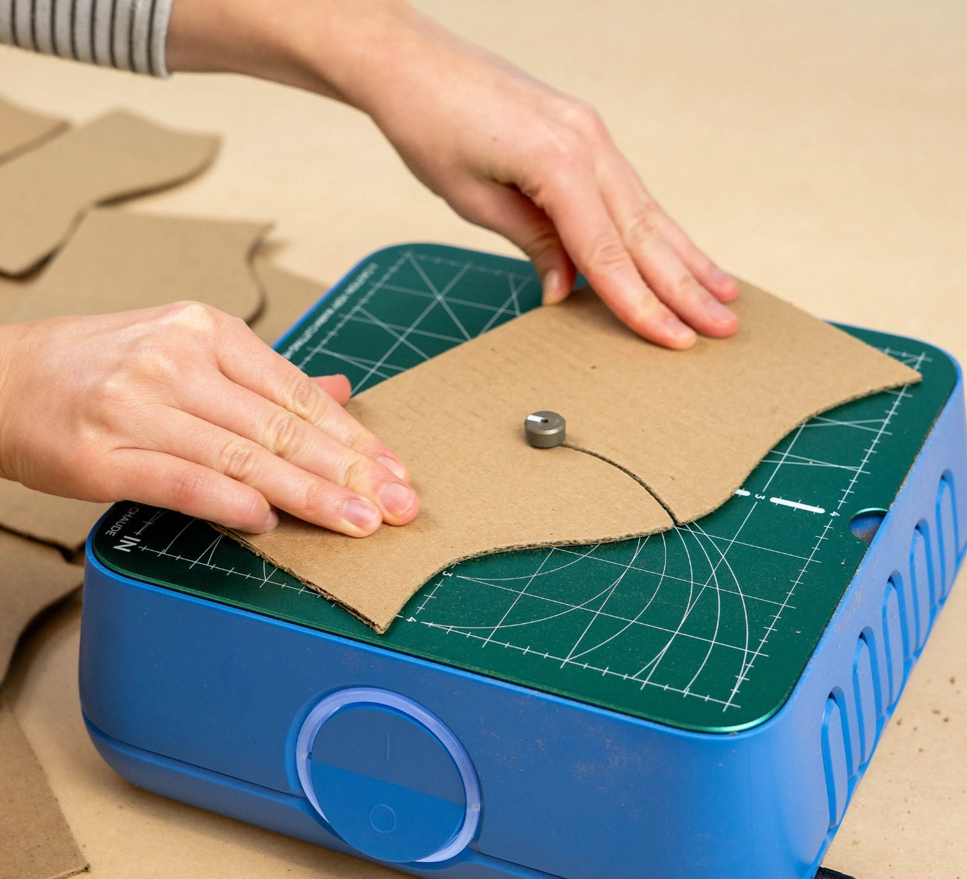
Pair Makedo with ChompSaw!

Slide 12

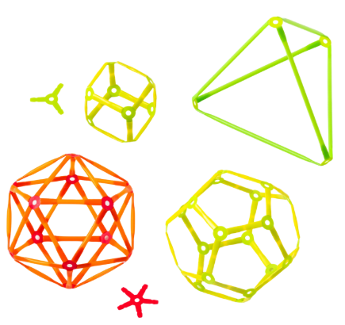
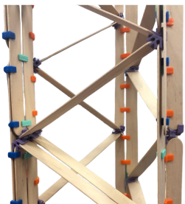

Warm-Up Challenge
Complete one of the following three challenges:
Build a 3D shape
Build a 1ft tall tower
Design a robot face

Slide 13
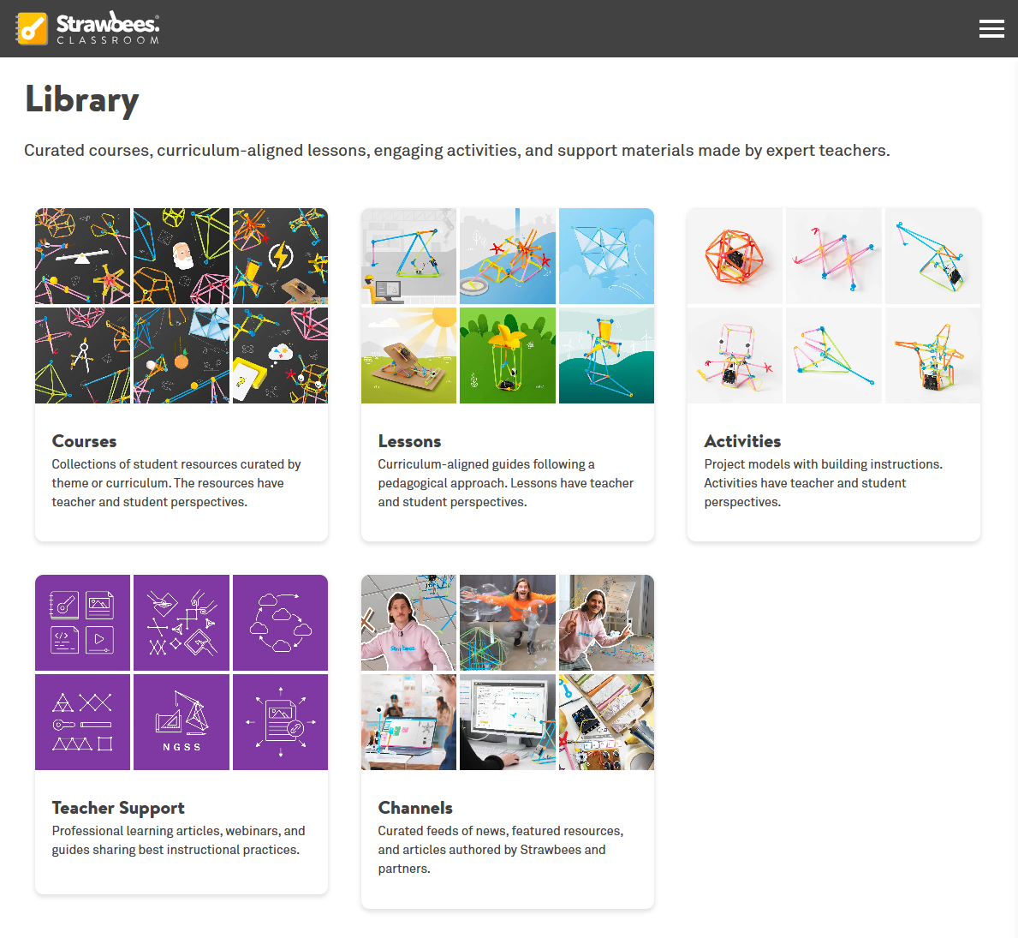
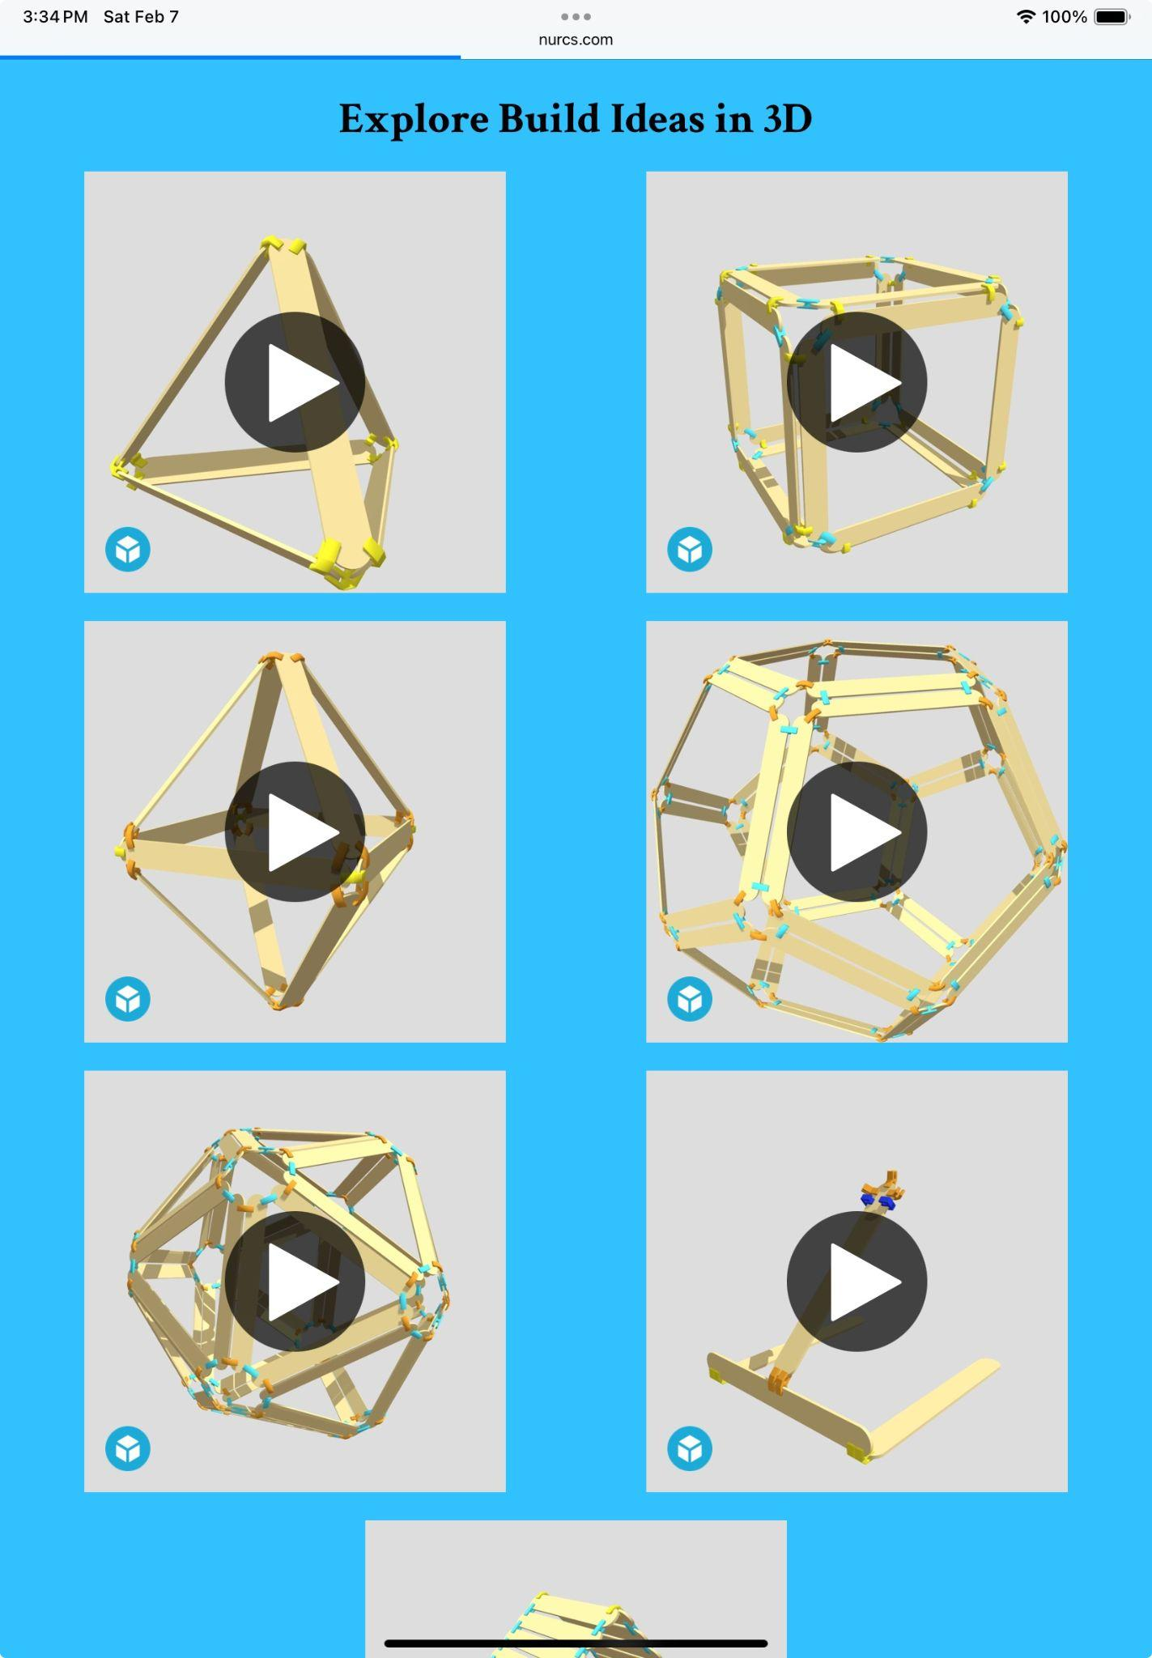
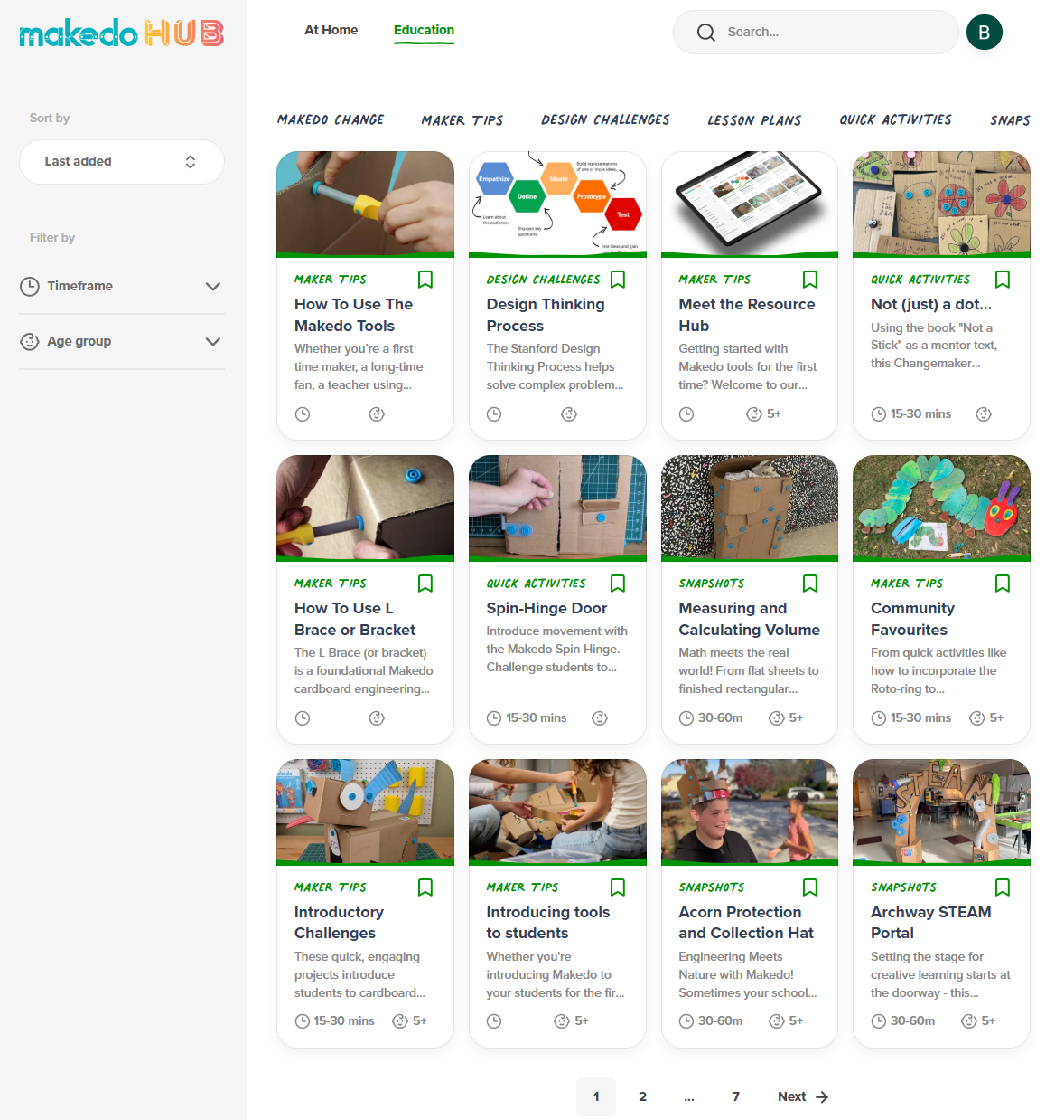
Hands-On Support
Notes:
Strawbees and Makedo have great, FREE learning hubs.
Nurcs is a newer company with fewer resources, but they are growing.

Slide 14
01
Intro to Novel Engineering
02
Tool Exploration
03
Process Overview
04
Practice Novel Engineering
05
Resources, Reflections, and Questions

Slide 15





01 EMPATHIZE
02 DEFINE
03 IDEATE
04 PROTOTYPE
05 TEST
DESIGN THINKING is a problem-solving process that involves understanding people's needs, brainstorming creative ideas, building simple prototypes, and testing to find the best solution.
It's a cycle of trying, learning, and improving until you get it better.
Notes:
Looks linear in a lot of models but it’s not. For the sake of this presentation, we are going to adopt this cycle that Ben has branded so beautifully, but for the record there are MANY models/frameworks for design thinking. I think this framework can be a really useful tool for you to support in designing any lessons or supporting any cross curricular projects and in particular, I think this is helpful for thinking through longer term projects too. We’ll talk more about where design thinking fits in really well later on.

Slide 16

Wonder is the story of Auggie, a fifth-grade boy who was born with a severe facial difference and is entering school for the first time.
Due to his facial structure, Auggie is very messy when he eats and feels embarrassed.
Samuel & Mateo want to address the discomfort Auggie feels while eating in the school cafeteria.
01 EMPATHIZE
02 DEFINE
03 IDEATE
04 PROTOTYPE
05 TEST
DESIGN THINKING is a problem-solving process that involves understanding people's needs, brainstorming creative ideas, building simple prototypes, and testing to find the best solution.
It's a cycle of trying, learning, and improving until you get it better.
Notes:
We will walk through the design thinking process using the book Wonder, following Samuel & Mateo as they work to address one of Auggie’s challenges.

Slide 17
01 EMPATHIZE
Learn characters’ needs, pains, concerns, etc.
  Closely read the text
  Pay attention to the character’s experiences
  Track the character’s emotions and reactions

Slide 18
01 EMPATHIZE
Learn people's needs, pains, concerns, etc.
  Conduct interviews
  Watch documentaries
  Read articles
Students think intensely about the characters and themes of acceptance and friendship.
They describe how they think Auggie feels, cite specific passages in the text, and infer the reason for those feelings — all of which help them empathize with Auggie.
They also generate a map of the cafeteria based on setting descriptions, consider the social landscape of an elementary school.
Novel Engineering
  Close read the text
  Notice character experiences
  Track emotions and reactions
Notes:
Talk about how the bolded words relate to ELA Common Core standards.

Slide 19
02 DEFINE
Frame the problem to be solved
  Identify the character’s challenge(s)
  Support your findings with textual evidence
  Define what you are going to solve, while understanding constraints found within the text

Slide 20
02 DEFINE
Frame the problem to be solved
  Synthesize research insights
  Identify needs and constraints
  Write a clear problem statement
Samuel: “He doesn’t like to eat with everyone.”
Mateo: “He could just eat in a classroom with a teacher.”
Samuel: “No, he is in school to be with the other kids. We need to make something so he can eat in the cafeteria.
Mateo: “He’ll be afraid people will look at him.”
Samuel: “We can make something that will let him eat and make it less messy.”
Novel Engineering:
  Identify the character’s challenge
  Support claims with text evidence
  Define design goals and constraints
Notes:
The CHALLENGE is to make Auggie more comfortable while eating.
A CONSTRAINT is that he should eat in the cafeteria with students.

Slide 21
03 IDEATE
Generate many possible solutions
  Brainstorm solutions without worrying about feasibility
  Build on others’ ideas
  Explore multiple solutions the same problem

Slide 22
03 IDEATE
Generate many possible solutions
  Brainstorm solutions without judgment
  Build on others’ ideas
  Explore multiple approaches
Samuel: “We can make something that will let him eat and make it less messy.”
Mateo: “Maybe something that catches food but blocks his mouth?”
Samuel: “A bib that has a face shield?”
Mateo: “If he wears a bib people might call him a baby.”
Samuel: “It could be like a fork but hides his mouth.”
Novel Engineering:
  Brainstorm solutions without judgment
  Build on others’ ideas
  Explore multiple approaches

Slide 23
04 PROTOTYPE
Build a low-fidelity prototype of your solution
  Work swiftly with easy to find materials
  Tweak the design as you go
  Remember, this is to share your ideas – this solution isn’t going to market

Slide 24
04 PROTOTYPE
Build a low-fidelity prototype of the proposed solution
  Work swiftly, scale down model as needed
  Tweak/iterate the design as you go
  Keep the end user in mind
Samuel: “It could be like a fork but hides his mouth.”
Samuel and Mateo iterate on their design:
  They want it to look as much like a traditional fork as possible so Auggie will not feel self-conscious.
  As they build their prototype, they include a small guard that helps keep food in his mouth.
Novel Engineering:
  Work swiftly, scale down model as needed
  Tweak/iterate the design as you go
  Keep the character in mind

Slide 25
05 TEST
Test solutions and refine designs
  “Test” designs by revisiting the characters needs
  Make changes if solution doesn’t fully satisfy needs
  Justify revisions with evidence from the book

Slide 26
05 TEST
Test solutions and refine designs
  Gather feedback
  Identify what works and what doesn’t
  Improve the solution
Samuel and Mateo tested the device with various foods (yogurt, apples, cheese) and recorded findings
They improved upon their first prototype by increasing the size of the food guard
Completed their testing by writing a journal entry as Auggie:
  Described how Auggie felt less fear during lunchtime
  Able to talk to a friend at the lunch table.
Novel Engineering:
  Test designs against the character’s needs
  Justify revisions with text evidence
  Refine based on constraints in the text

Slide 27
01
Intro to Novel Engineering
02
Tool Exploration
03
Process Overview
04
Practicing Novel Engineering
05
Resources, Reflections, and Questions

Slide 28
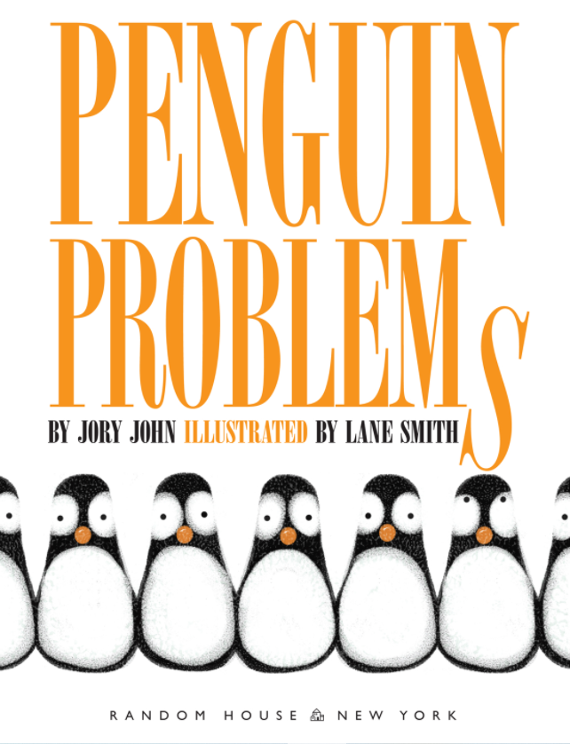
Penguin Problems
1. Empathize
  Close read the text
  Notice character experiences
  Track emotions and reactions
2. Define
  Identify the character’s challenge
  Support claims with text evidence
  Define design goals and constraints
Notes:
Typically, students would do these steps separately. Step 1 while reading (perhaps recording observations), and Step 2 after the book or during a natural break in the story for a project.

Slide 29


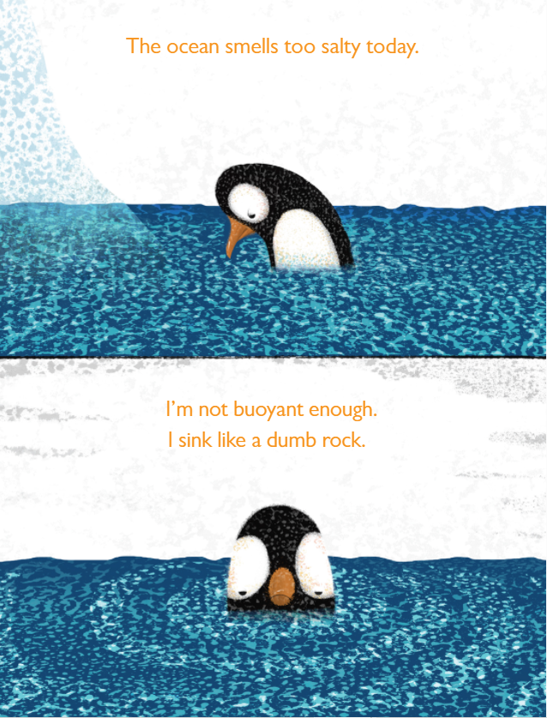
Penguin Problems
Notes:
Use this opportunity to discuss which problems they recorded the penguin facing.

Slide 30
Penguin Problems
3. Ideate
Brainstorm solutions without judgment
Build on others’ ideas
Decide on a solution to move forward with
Notes:
If working in paris/groups, encourage them discuss which problem they want to solve and how they plan to solve it. If working solo, they can probably dive into the next step.

Slide 31

Penguin Problems
4. Prototype
  Work swiftly, scale down model as needed
  Tweak/iterate the design as you go
  Keep the character in mind
Incorporate one of these tools
Notes:
Remind them that they are creating a prototype from low tech materials. It’s not going to market. It doesn’t need to look sophisticated. The goal is to create a visual of their idea so they can better explain their thinking to peers.

Slide 32
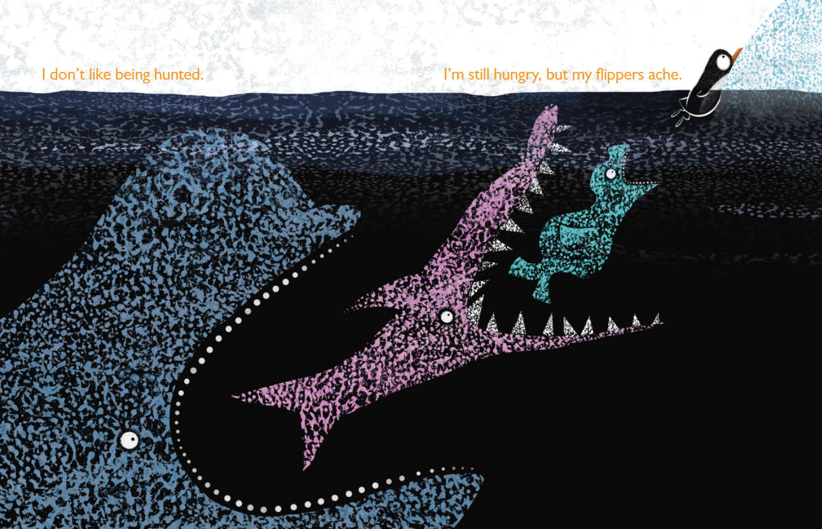
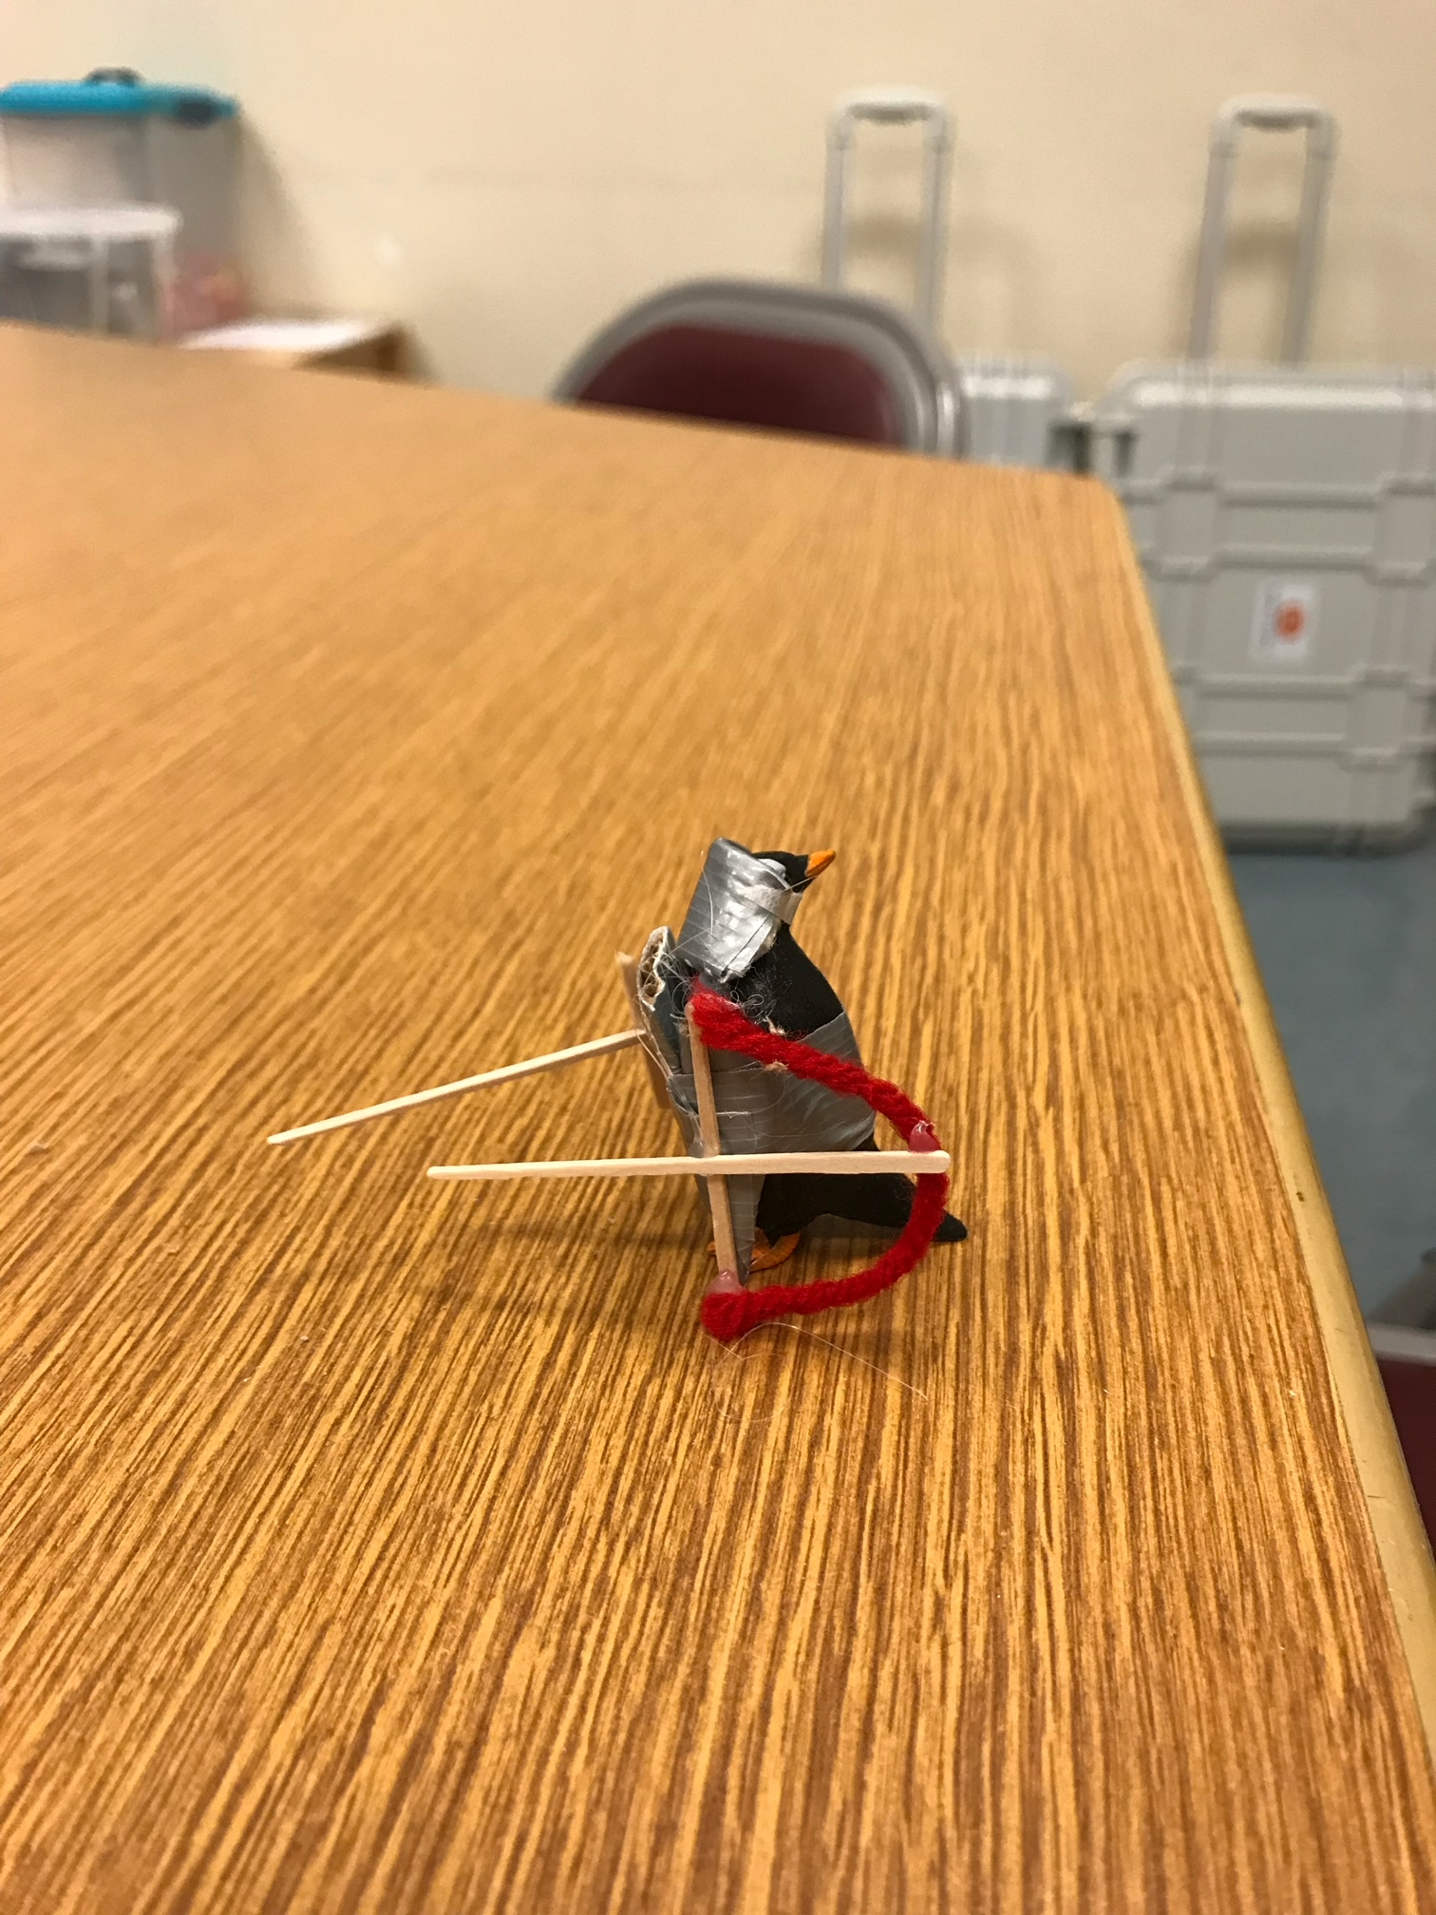
Penguin Problems
5. Test
  Test designs against the character’s needs
  Refine based on constraints in the text
  Justify revisions with textual evidence
Notes:
The solutions don’t need to be market ready. Encourage multiple iterations after feedback from teacher/peers to refine initial ideas.

Slide 33

Share Out
Explain the problem you chose and how you solved it.
What adjustments or changes did you make while building?
How might you incorporate Novel Engineering into your library?
How could you partner with classroom teachers to support their existing novel units or read alouds with Novel Engineering?
Are there any books you’re eager to try this with?
Other thoughts or reflections?
Notes:
I updated these to ask less about their experience building a prototype and more about how they could integrate novel engineering in their schools.

Slide 34
01
Intro to Novel Engineering
02
Tool Exploration
03
Process Overview
04
Practice Novel Engineering
05
Resources, Reflections, and Questions

Slide 35
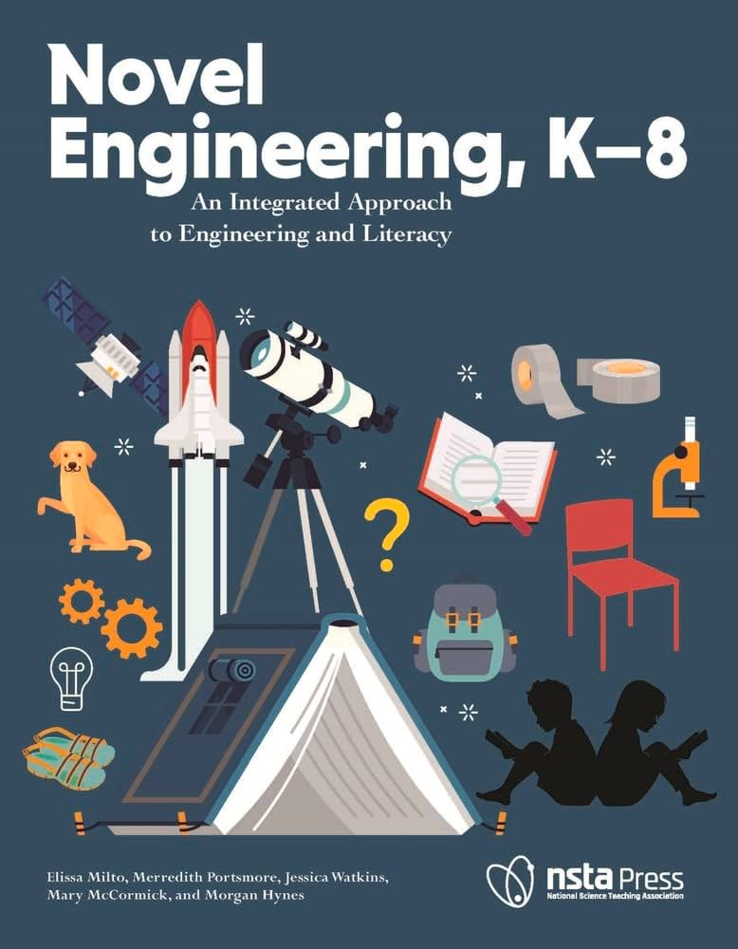
Resources
Five in-depth case studies:
  Novels
  Biography
  Nonfiction Historical Text
Intro and first chapter FREE!
  Tufts’ Novel Engineering website
Notes:
Great resource from the creators of Novel Engineering. Intro and first chapter are free to download – included in the Padlet.

Slide 36




Novel Engineering Ideas
Notes:
The problems and solutions for these books are detailed on Tufts website, but you don’t have to adopt a new book for novel engineering. Lean into the units/books you already teach – every book has a character with problems.

Slide 37
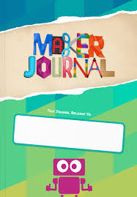
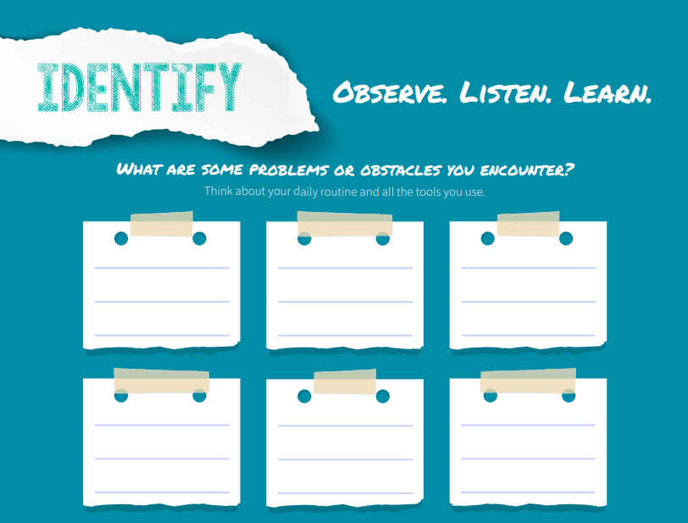
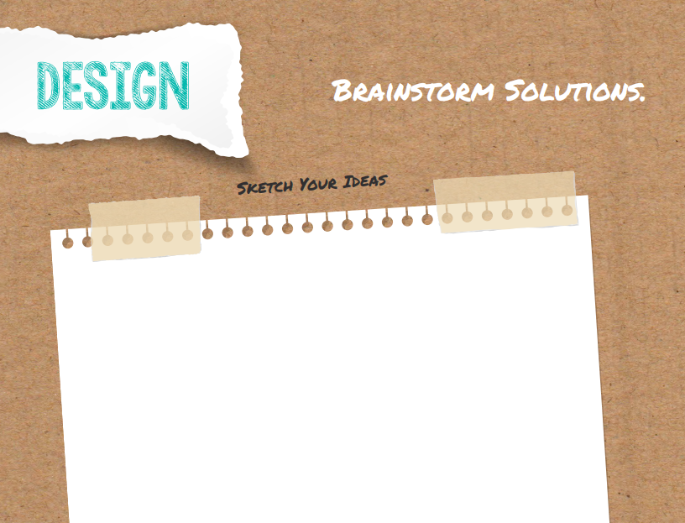
FREE Maker Journal
Download from MackinMaker.com
Uses the traditional Design Thinking Process – easily adapted for Novel Engineering.

Slide 38

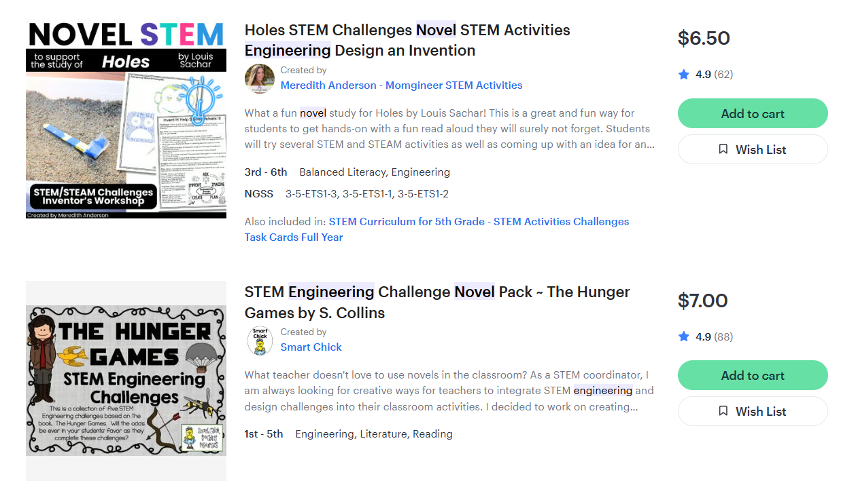
Teachers Pay Teachers
Notes:
If you’re looking for more ideas, or supplemental support for students.

Slide 39
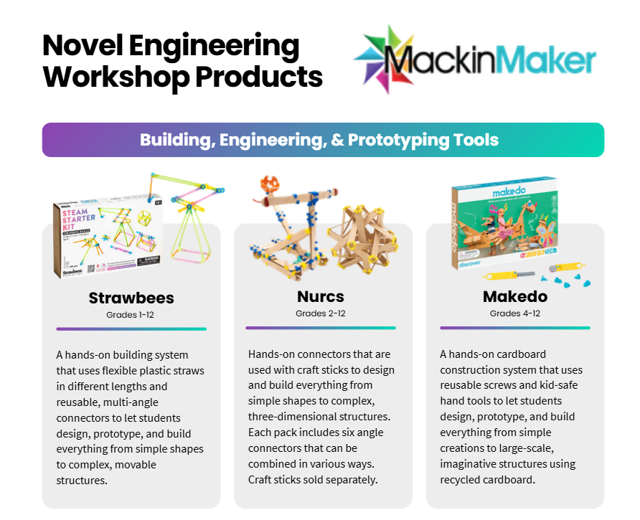
Today’s Tools

Slide 40
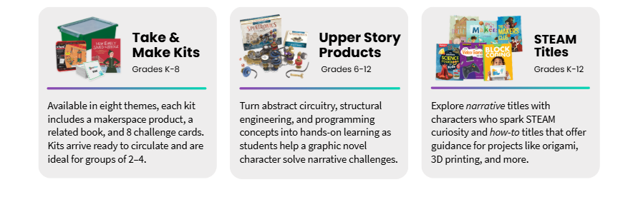
Literacy & STEAM
Notes:
We didn’t talk about these products, but if you’re looking for additional ways to connect Literacy & STEM these could be good fits.

Slide 41

Resources
tinyurl.com/NovelEngineerStories

Slide 42
Sheri Omernik | sheri.omernik@mackin.com
MackinMaker.com

Slide 43

Common Core State Standards
ELA-LITERACY.RL.3–8.1 Ask and answer questions to demonstrate understanding of a text, referring explicitly to the text as the basis for the answers.
ELA-LITERACY.RL.3–8.2 Determine a theme of a story, drama, or poem from details in the text; summarize the text.
ELA-LITERACY.RL.3–8.3 Describe characters in a story (e.g., their traits, motivations, or feelings) and explain how their actions contribute to the sequence of events.

Slide 44
Warm Up
Brainstorm a solution to the Challenge for the Client while being mindful of the Constraint.
Challenge
Client
Constraint
Create something to sit on
They are afraid of new things
A mermaid

Slide 45
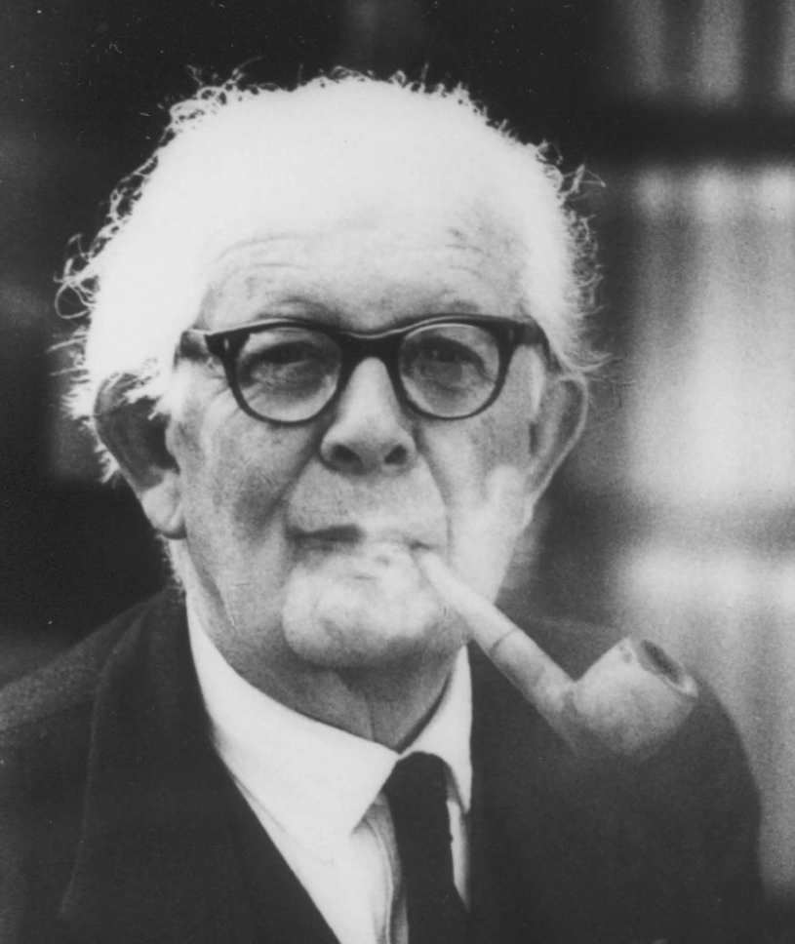
Constructivism
Constructivist learning theory holds that learners actively build knowledge through experiences, reflection, and interaction with their environment rather than passively receiving information.
“To understand is to invent.” - Jean Piaget
Notes:
Source: https://www.hand2mind.com/resources/hands-on-learning-manipulatives-enhance-literacy-instruction
Literacy – reading, writing, speaking, listening – is the foundation for all learning.

Slide 46
Hands-On Literacy
In Language Magazine, author Jennifer Nash explains that the educational theory of constructivism is rooted in “the belief that children learn best when they experience things firsthand and within a meaningful context, supporting the need for hands-on learning options in language arts.”
In 2009, researchers wanted to find out if using manipulatives could improve reading comprehension in the early grades. Children were given a set of farm toys. After a child read a sentence, the child acted out the sentence using the toys. This allowed the student to connect words to specific objects. On a follow-up reading comprehension test, children who used the physical manipulatives often performed one to two standard deviations better than children who read the same text but did not use the manipulatives (Glenberg et al. 2004, 2007; Marley et al. 2007).
Another study was conducted in 2011 by researchers Marley, Levin, Szabo, and Glenberg. Based on their previous research findings, the authors predicted that children who participated in an activity-based strategy would be able to recall more story events than students who just heard the story repeated. The results confirmed their prediction. They report, “evidence from our study suggests that first- and third-grade students who were given the opportunity to interact with objects described by the narrative passage did remember more story content than those who were not afforded the same opportunity.” The result was clear that students’ narrative recall was enhanced by their hands-on use of manipulatives.
Research into the benefits of hands-on learning—using manipulatives as well as incorporating physical movement into learning activities—demonstrates a higher level of student engagement and has been proven a successful strategy for literacy acquisition.
Notes:
Source: https://www.hand2mind.com/resources/hands-on-learning-manipulatives-enhance-literacy-instruction
Literacy – reading, writing, speaking, listening – is the foundation for all learning.

Slide 47
WHY Hands-On Learning
Slide 1: The “Why” – Hands-On Learning and Literacy
Title: Why Hands-On Learning Supports Literacy
Content:
Constructivism: “Children learn best when they experience things firsthand and within a meaningful context” — Jennifer Nash, Language Magazine
Key Idea: Hands-on activities make language learning meaningful and cognitively relevant.
Visual Ideas:
A small diagram showing a child reading + manipulating objects.
A quote callout for the Dr. Jennifer Nash (Educator, LEGO, etc.) sentence.
  constructivism is rooted in “the belief that children learn best when they experience things firsthand and within a meaningful context, supporting the need for hands-on learning options in language arts.”
Notes:
Source: https://www.hand2mind.com/resources/hands-on-learning-manipulatives-enhance-literacy-instruction
Literacy – reading, writing, speaking, listening – is the foundation for all learning.

Slide 48
Embodied Cognition
Slide 2 – Embodied Cognition: How Hands-On Learning Supports Literacy
Title: Embodied Cognition: Learning with Brain + Hands
Bullets:
Movement and manipulation are directly linked to understanding language, not just engagement.
Acting out stories or using manipulatives helps students visualize and internalize narrative concepts.
Research highlights impact:
  Glenberg et al., 2004/2007; Marley et al., 2007 → comprehension improves 1–2 standard deviations with manipulatives.
  Marley, Levin, Szabo, Glenberg, 2011 → students recall more story events when physically interacting with story objects.
Teachers can observe and support understanding through student discussions around the models.
Visual Ideas:
Triangle diagram: Brain ↔ Hands ↔ Text
Small icon of a student acting out a story with toys
Notes:
Source: https://www.hand2mind.com/resources/hands-on-learning-manipulatives-enhance-literacy-instruction
Literacy – reading, writing, speaking, listening – is the foundation for all learning.

Slide 49
Brains & Literacy
The field of embodied cognition provides a strong scientific foundation for why physical activities can enhance literacy:
Language comprehension involves sensorimotor systems — movements and actions are not separate from understanding meaning.
Embodied Cognition Research (Language + Sensorimotor Integration)
The field of embodied cognition provides a strong scientific foundation for why physical activities can enhance literacy:
Language comprehension involves sensorimotor systems — movements and actions are not separate from understanding meaning.
This makes activities that involve movement or manipulation cognitively relevant, not just fun.
👉 You can use this to back up WHY hands-on tying objects to text actually changes brain processing, not just classroom behavior.
Notes:
Source: https://www.hand2mind.com/resources/hands-on-learning-manipulatives-enhance-literacy-instruction
Literacy – reading, writing, speaking, listening – is the foundation for all learning.

Slide 50
Novel Engineering K-8 Book
In the United States, K–12 engineering education has gone from relative obscurity 20 years ago to part of the national science standards today. As it has evolved, we have seen that there are different ways of incorporating engineering into classrooms. Often, K–12 engineering activities are used as a vehicle to motivate or deliver science and math content, or they are stand-alone experiences for students to learn engineering with limited connections to science and math. In addition, they often do not emulate the experiences of real-world engineering. Professional engineers have rich contexts in which they design. They have multiple stakeholders with different needs they must translate into design requirements; they have constraints on materials, time, or solution types they need to account for and balance; and they must address regulations and ethical issues. Professional engineers in these contexts are skilled at finding problems, identifying requirements, and balancing trade-offs. Often, when we transpose engineering into K–12 settings, some of the richness and wonderful messiness of real-world engineering is lost in activities that specify the problem and all the requirements for students.
Novel Engineering represents a significant shift in thinking about how engineering knowledge can co-develop with other disciplines, usually literacy but frequently social studies or another core subject.
As students work on the text-based engineering projects, they also engage in productive and self-directed literacy practices. Novel Engineering tasks are truly interdisciplinary efforts in which students engage in both engineering and literacy activity. One teacher said, “That kids are using problem solving skills based on basic engineering strategies, and it’s an interdisciplinary unit combining science, math, and English language arts. … I think it’s great—[it] gets kids to think in a different way.”
Notes:
Source: https://www.hand2mind.com/resources/hands-on-learning-manipulatives-enhance-literacy-instruction
Literacy – reading, writing, speaking, listening – is the foundation for all learning.

Slide 51
Novel Engineering K-8 Book
Through our research, we’ve found that Novel Engineering benefits students in multiple ways. It provides a context for students to more deeply engage with assigned reading texts, whether they be in English language arts or history. The text serves as the basis for discourse, argumentation, and the sharing of ideas and thinking. In order to design for characters/clients, students need to make inferences and predictions based on what they’ve read that will influence their designs. There are many opportunities during a Novel Engineering unit for students to write, discuss what they have read, and argue for their point of view using evidence from the text.
Teachers have pointed out that Novel Engineering can reach students with different learning profiles—not just the “A students” who typically do well. For example, we’ve seen students with special needs excel at Novel Engineering; we’ve seen several instances of students with reading disabilities easily access a text supporting evidence for their design ideas. We’ve also seen students with significant organizational deficits manage the complex process of planning and realizing their ideas, which is often difficult to do when balancing multiple constraints ad steps.
Novel Engineering gives students the opportunity to enter into engineering design through literature, offering authentic engineering projects that do not have predetermined, “correct” answers.
While working on a Novel Engineering unit, students engage in engineering by drawing on their past experiences and understandings of the world and interact with classmates about what’s happening in the book and what they have built. As students work on text-based engineering projects, they also engage in productive and self-directed literacy practices, including noting key details in text, making inferences, and writing lists and other notes that support the design process. Novel Engineering projects are therefore interdisciplinary efforts in which students gain experience in both disciplines.
Notes:
Source: https://www.hand2mind.com/resources/hands-on-learning-manipulatives-enhance-literacy-instruction
Literacy – reading, writing, speaking, listening – is the foundation for all learning.

Slide 52
Novel Engineering K-8 Book
Constraints on teachers are growing and the freedom to choose what happens in the classroom is shrinking, so it may seem crazy to think of adding yet another initiative into the classroom. New initiatives must fulfill multiple functions. In our research classrooms, we saw that Novel Engineering was able to bridge several disciplines while also meeting educational standards, classroom goals, and individual goals.
Teachers have also said the Novel Engineering approach builds on their experiences and expertise rather than having them learn a completely new curriculum that does not necessarily work with the other curricula and structures that are already in place in their classrooms. Novel Engineering works well with existing curricula and plans since teachers get to choose the text and direction of student work; they can use texts students already know and are comfortable with rather than unfamiliar books from an assigned list. Teachers have also noted that Novel Engineering helps them develop a classroom culture that includes productive class discussions and peer critique.
For the literacy aspect of Novel Engineering, we have found that students productively engage with text in a variety of ways that align with Common Core State Standards. They take the perspective of characters and note relevant aspects of the physical setting as they plan and evaluate their designs. Spontaneous discussions emerge as students wrestle with unfamiliar concepts and vocabulary in an effort to better inform their designs. These discussions lead to students constructing an informed interpretation of the text.
Finally, Novel Engineering helps teachers look at their students in new ways. Many teachers have said that it helped them step back and notice what their students were doing and thinking. This more critical look at student thinking helps teachers understand why students make certain design decisions (related to both the text and the mechanics of the design) and why they have certain interpretations of the text. This more informed view of student thinking enables teachers to respond more appropriately to what students are doing and helps them guide their next moves. Teachers have also said that Novel Engineering helped them notice new things about their students, such as strengths or places for improvement, that did not come out in other classroom activities.
Notes:
Source: https://www.hand2mind.com/resources/hands-on-learning-manipulatives-enhance-literacy-instruction
Literacy – reading, writing, speaking, listening – is the foundation for all learning.

Slide 53

Hands-On Learning & Reading
Reading can be intimidating; hands-on experiences invite active engagement with texts (Nash).
Building, manipulating, or acting out stories makes abstract ideas concrete and easier to understand (Nash).
Movement and manipulation directly support language comprehension.
  Comprehension improves by 1–2 standard deviations when students use manipulatives while reading, and recall of story events increases (Glenberg et al.; Marley et al.).
Notes:
Source: https://www.hand2mind.com/resources/hands-on-learning-manipulatives-enhance-literacy-instruction
Literacy – reading, writing, speaking, listening – is the foundation for all learning.

Slide 54

Hands-On Learning & Writing
Discussions during hands-on phase help students develop ideas, vocabulary, and story coherence (Blake, Cannon).
Physical creations make student thinking visible, helping writers translate ideas into clear, organized text (Blake, Cannon).
Motivation translates to higher-quality writing; students see the value in the task (Lam & Law, 2007; Marley & Carbonneau, 2014).
Notes:
Source: https://www.hand2mind.com/resources/hands-on-learning-manipulatives-enhance-literacy-instruction
Literacy – reading, writing, speaking, listening – is the foundation for all learning.

Slide 55

Hands-On Learning & The Classroom
Encourages student-centered collaboration and discussion
Future Ready. Prepares students for 21st-century skills: problem-solving, creativity, analytical thinking (World Economic Forum)
Reach students with different learning profiles—not just the “A students”
Teachers act as facilitators, guiding exploration and supporting differentiated learning naturally.
Notes:
Source: https://www.hand2mind.com/resources/hands-on-learning-manipulatives-enhance-literacy-instruction
Literacy – reading, writing, speaking, listening – is the foundation for all learning.

Slide 56
Warm Up
Brainstorm a solution to the Challenge for the Client while being mindful of the Constraint.
What is your solution?
Challenge
Client
Constraint
Create something to sit on
They are afraid of new things
A mermaid

