Slide 1
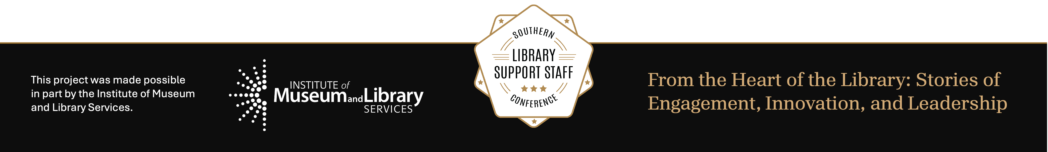
Rising to the Occasion: Personal Narratives of Transformative Practice
Michelle M. Joseph and Eric Larsen
MAY 27-28, 2026

Slide 2
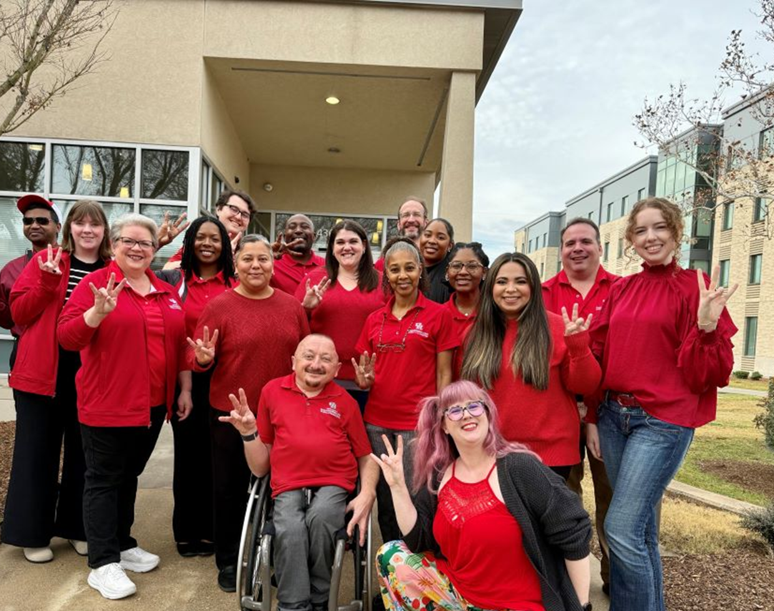
Justin DART ,Jr. Student Accessibility Center

Slide 3
What Is Assistive Technology
Any hardware or software that increases, maintains, or improves the functional capabilities of students with disabilities.

Slide 4
Why is Assistive Technology Important?
Assistive technology aims to allow people with disabilities to participate fully in all aspects of life (home, work, and community)
Why is Assistive Technology for visually impaired patrons important?
It increases the patron access to general Music curriculum and improve their academic importance. This provides greater independence

Slide 5
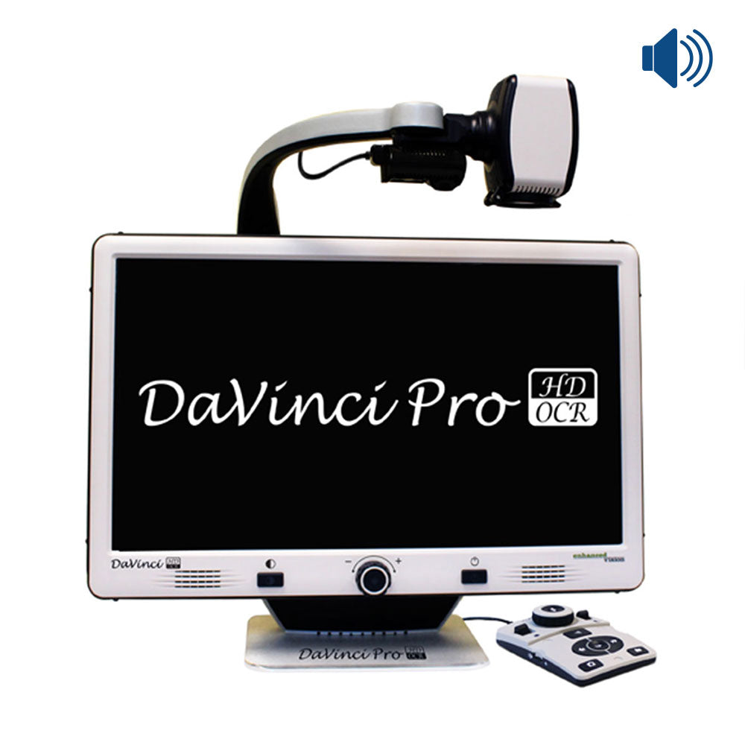
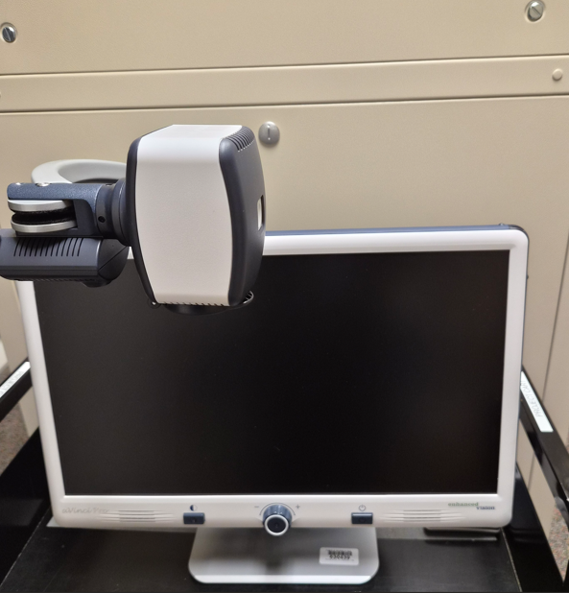
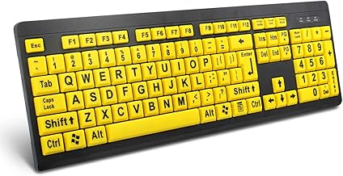
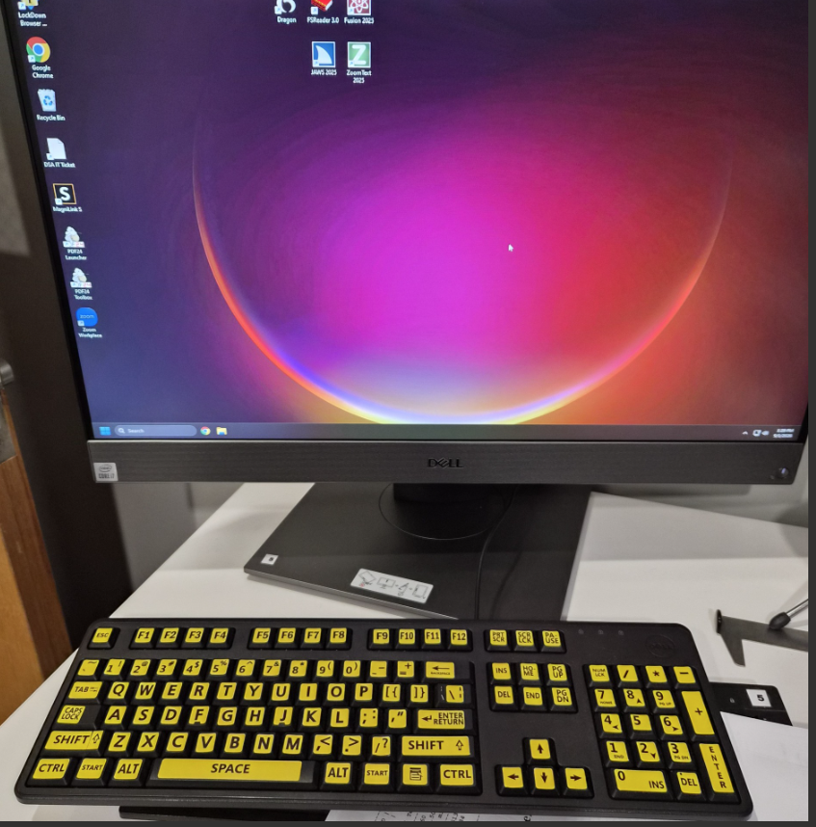
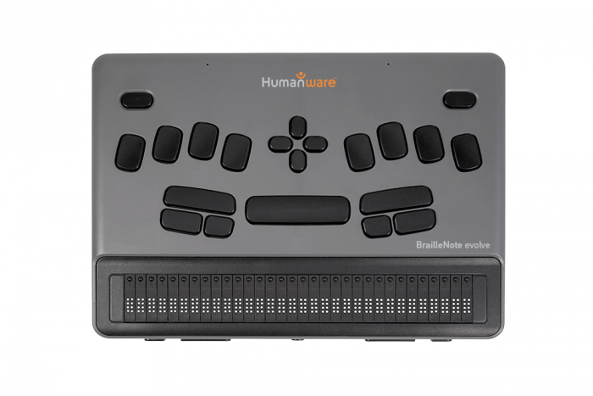
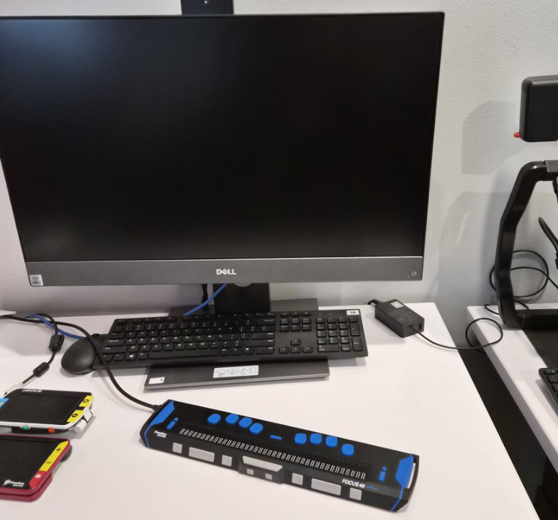
Types of Visibly Impaired Assistive Technology at DART Center
Da Vinci Pro
Portable Tactile Keyboard
Braille Technology

Slide 6
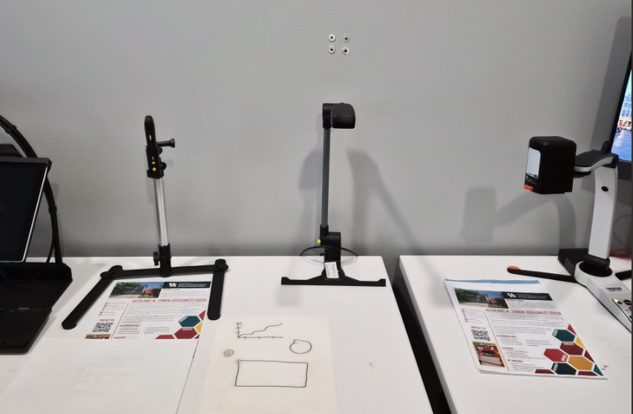
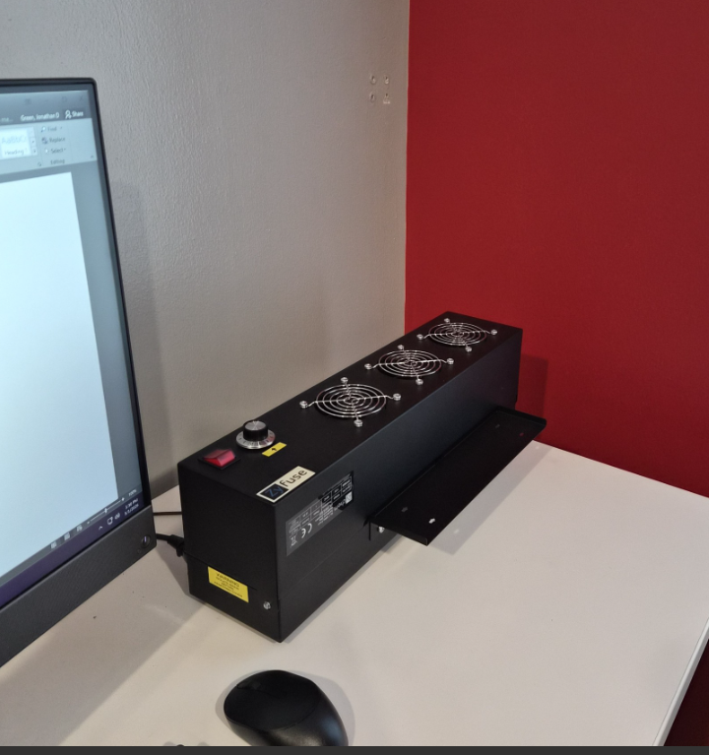
Other Equipments at DART Center
Magnifiers
Thermal Printer

Slide 7
Our Narrative
An enrolled graduate student requested assistance in sourcing assistive technology equipment to allow them to be successful in their coursework

Slide 8
The Process
Provision and Implementation
Training
Consideration
Evaluation

Slide 9
Considerations
Faculty and staff consulted the DART center , for the possible use of one of their Assistive technology for the visibly impaired
DART centered considered the use and portability of their Da Vinci Machine to be use in the Music library

Slide 10
Evaluation
DART center visited the Music library to evaluate the space where the machine will be used and where it will be stored.
Discuss and evaluated where the machine will house
How it will be checked out
And how it will be transported for use by students

Slide 11
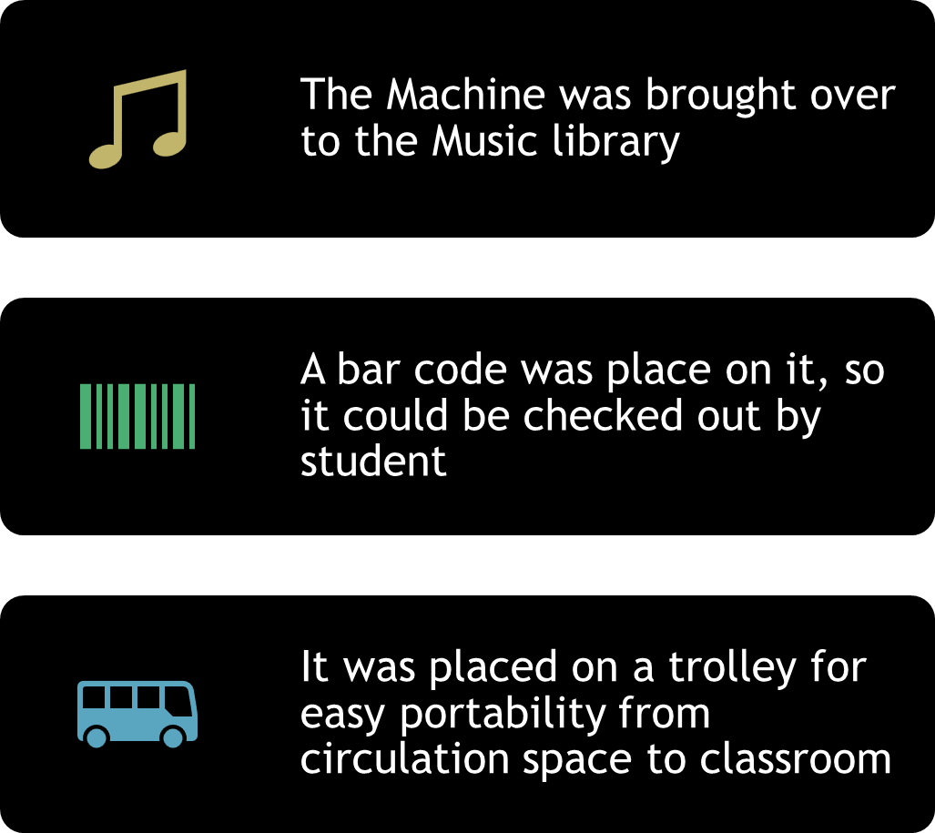
Provision and Implementation

Slide 12

Training
The student, faculty and library staff was trained on the use of the equipment.
The way in which the equipment is to be stored and used

Slide 13

Checkout Process

Slide 14
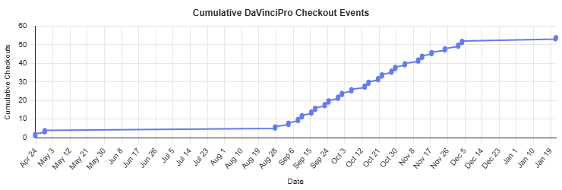
Usage Data

Slide 15
Statistical Analysis
Graph shows the number of cumulative checkouts from when the item was first included in the collection
The patron used the DaVinci Pro Machine more than 50 times during the 2025 Fall Semester

Slide 16
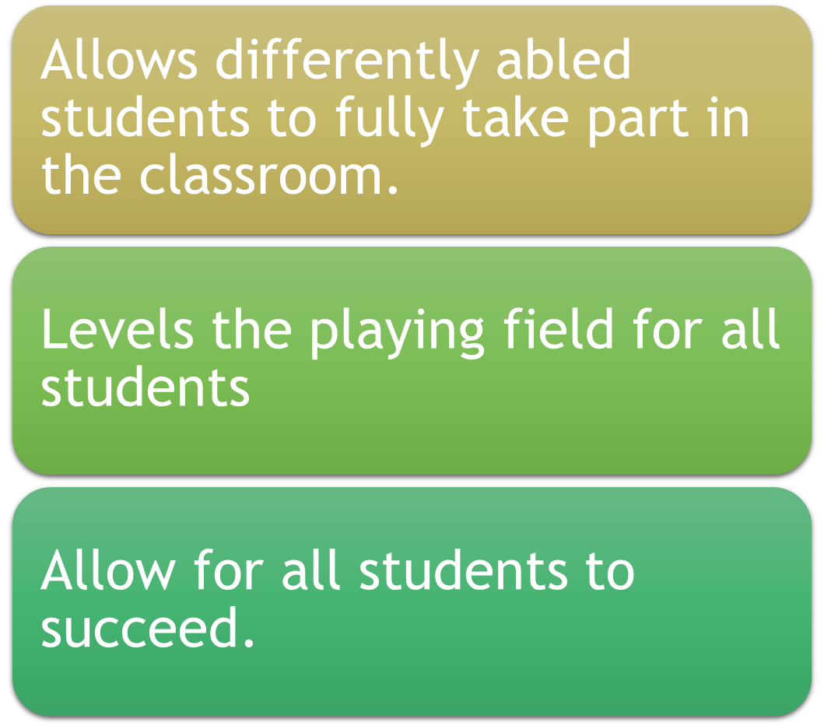
Value/Advantage of the Assistive Technology

Slide 17
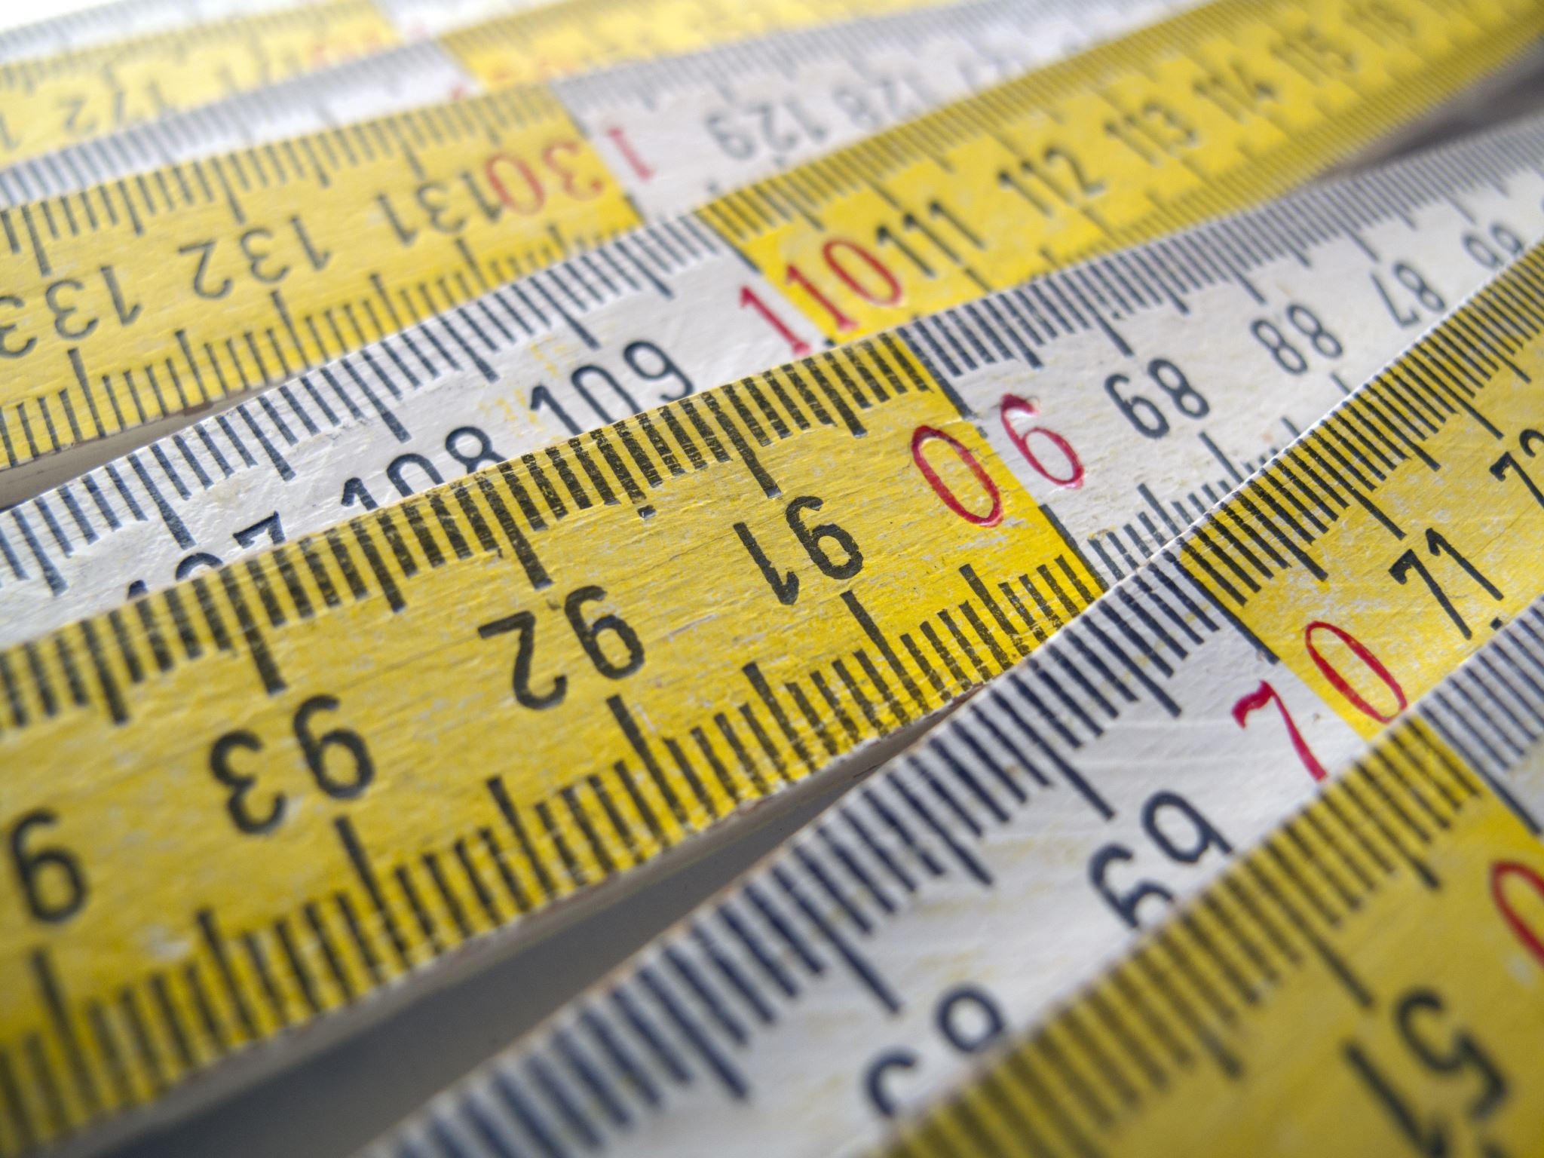
Menti Meter
https://www.mentimeter.com/app/presentation/alcn7h33o2kewbumy85mutzwznf5182a/edit?question=z3xc6h441ab4

Slide 18
Best Practices
Make training ongoing for library staff and faculty in using assistive technology.
1
Allow visually impaired students to teach using assistive
2
Know what works-make sure it has purpose and that it meets the student Unique's needs
3

Slide 19
References
National Library Service for the Blind and Print Disabled. (n.d.). Assistive technology products for information access. Library of Congress.
https://www.loc.gov/nls/services-and-resources/informational-publications/assistive-technology-products-information-access/

Slide 20

Michelle M. Joseph
Email: mmarajjo@Central.UH.EDU
Eric Larsen
Email: hmlarsen@Central.UH.EDU

