Slide 1
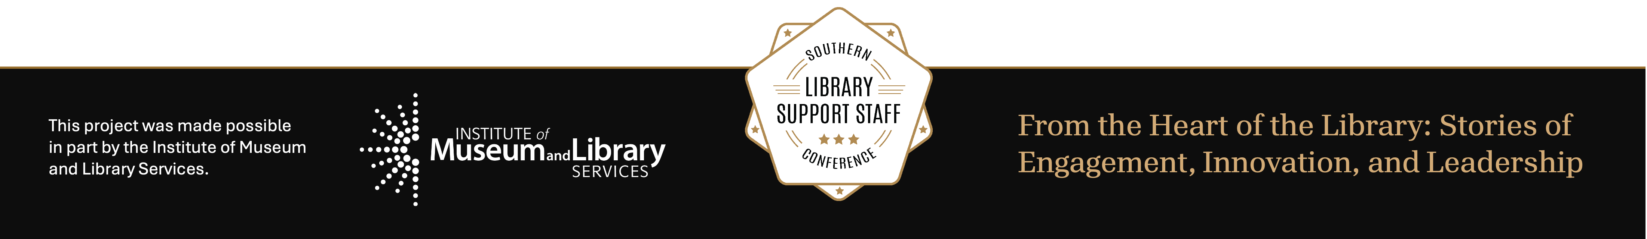
Finding New Ways to Connect Patrons with the Collection:
WKU Libraries Bones Study Hall
Daniel Newman
MAY 28, 2026
Notes:
Hi, my name is Daniel Newman, I am an Evening Library Assistant for WKU Libraries. I work in our Access Services department in stacks management, building security and as the Course Reserve Liaison. Before that I worked for the High Plains Library District in Weld County, Colorado as Bibliographic Services Clerk and Specialty Check-Out Clerk for the district’s “Library of Things” program.
Today’s session probably could have been a lightning talk, but I wanted to take the time to talk about a program we have started at WKU Libraries in the hopes of helping other academic libraries or public libraries find new creative ways to create programs to provide engagement with their collection.
This is the first time I have given a talk like this, so I do appreciate some grace.

Slide 2
Who Is This For?
Academic Libraries who are looking to find ways to engage their patrons with their collection resources.
Public libraries that have a “Library of Things” collections or other specialty collections

Slide 3
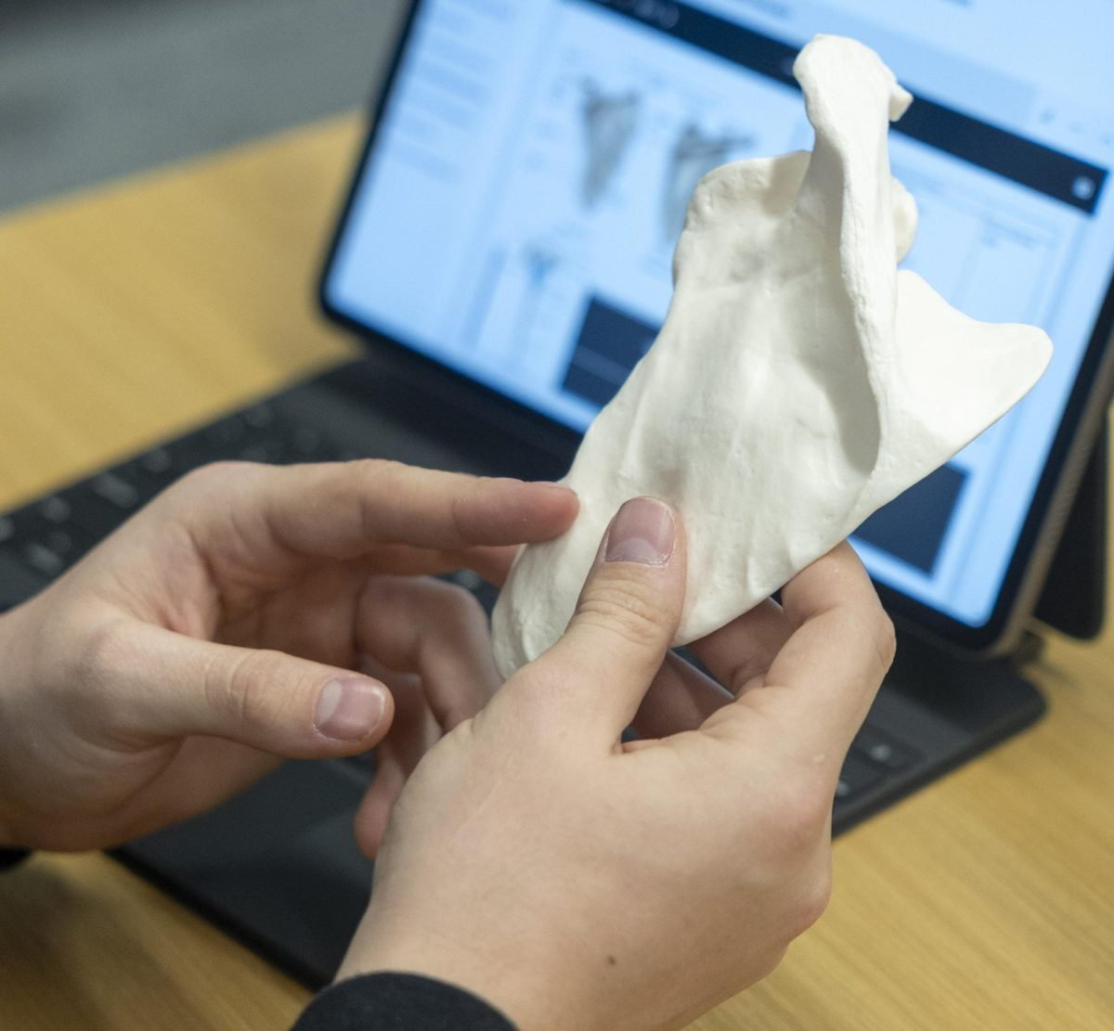
Learning Outcomes
How to assess the needs of your patrons
(What is it your patrons need that you don’t have, but you can get, to provide access to? What resources do you have that are overutilized to the point that some are denied access due unavailability?)
How to create an event or program to address those accessibility issues
How to evaluate the event or program’s success and its sustainability for the future
Notes:
I mostly want to help jump start ideas for other libraries by using our program as an example.

Slide 4
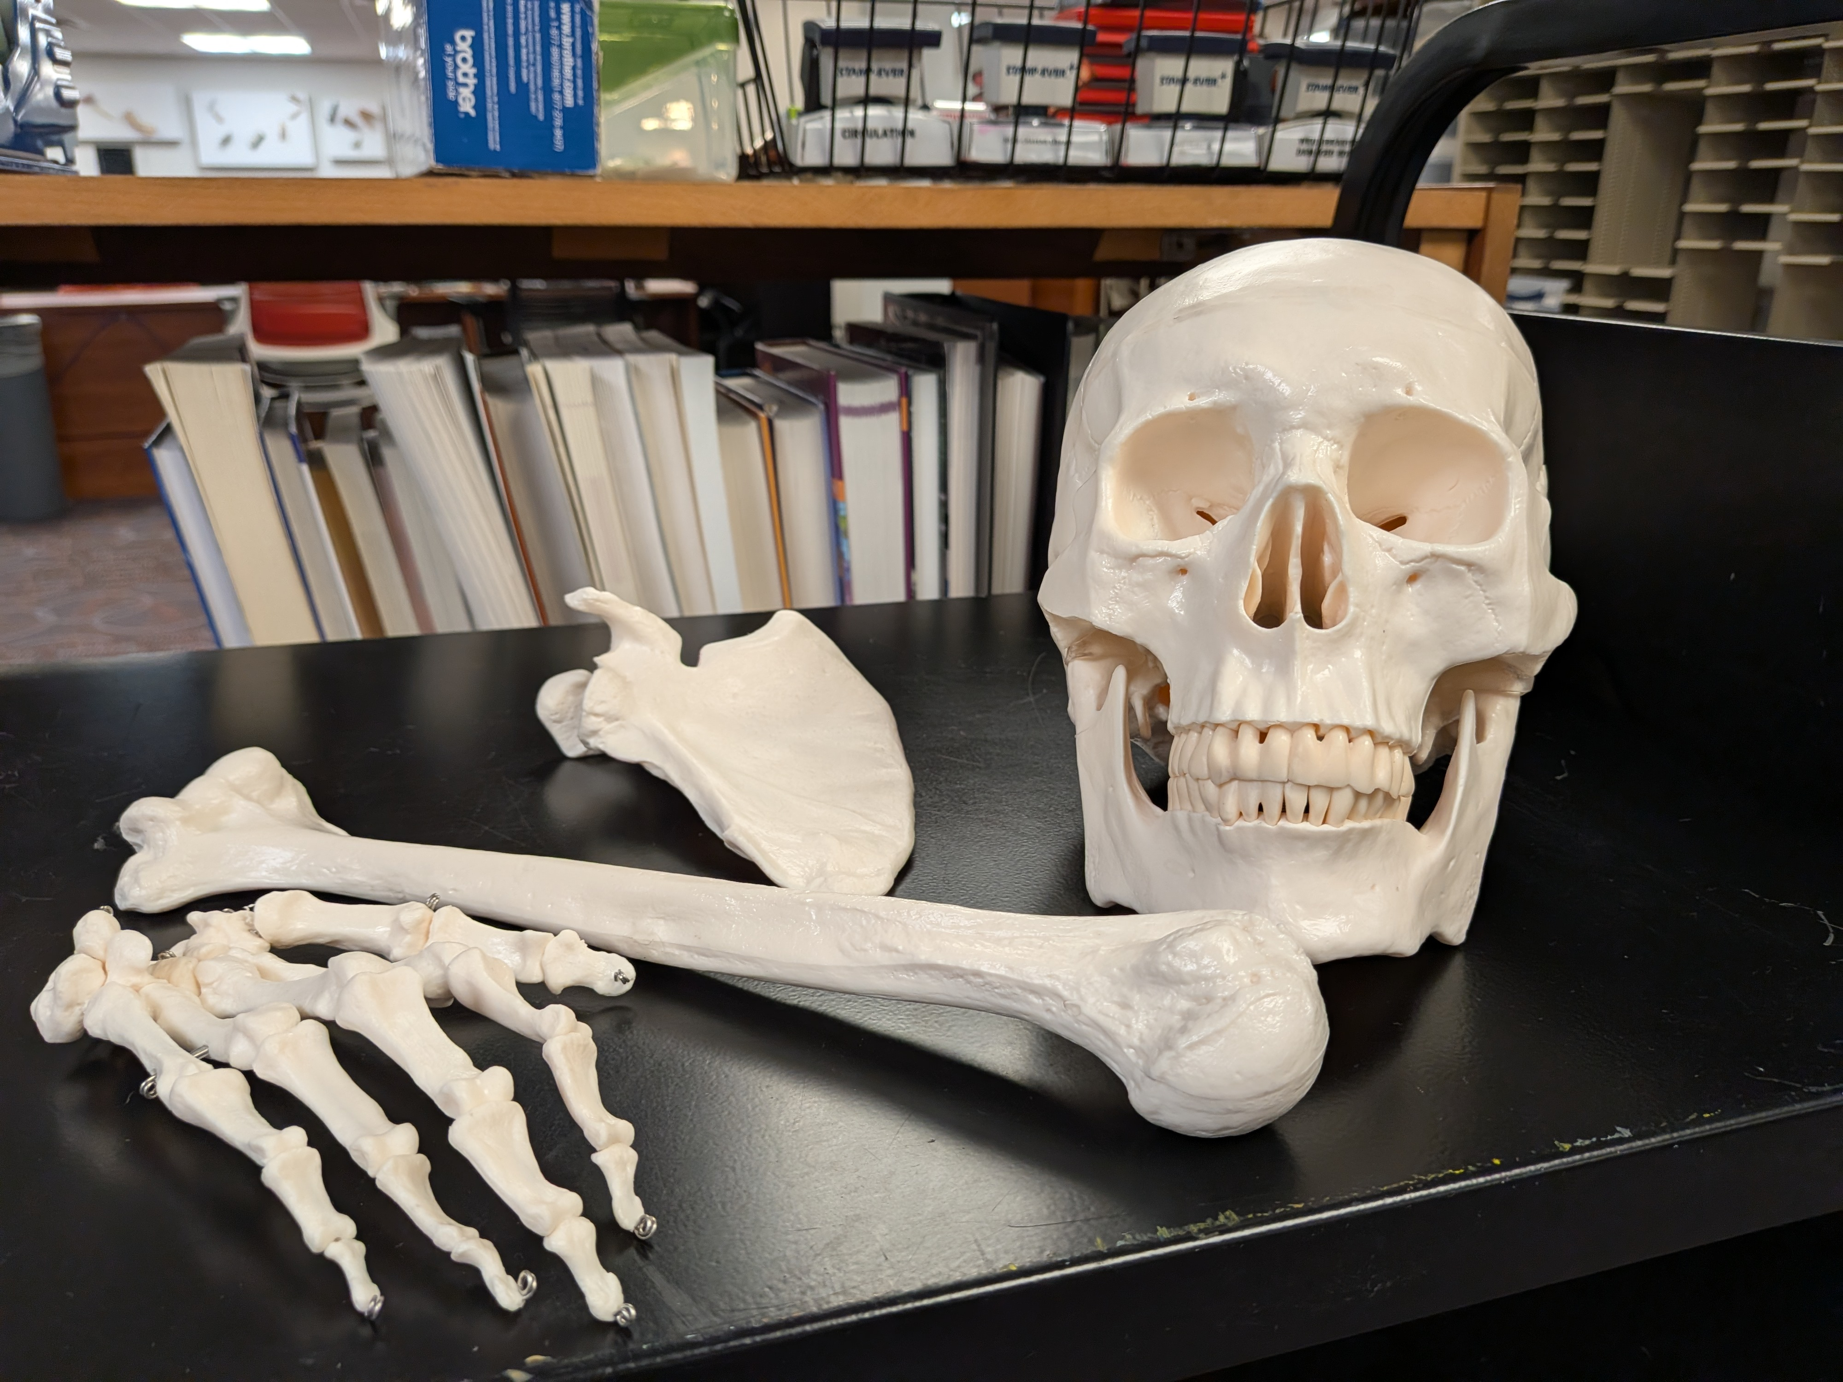
Assess Patron Needs
The professor for BIOL 131 provided anatomical bones kits to our course reserves for their students to use in the library to study for their quizzes in 2017.
The initial skeleton was in high use.
In 2023, additional skeletons were purchased to create additional kits.
Circulation of the kits remained high during the weeks that BIOL 131 was holding their quizzes.
Student demand for the kits exceeded our resources.
Notes:
WKU Libraries’ Course Reserves collections has Anatomy & Physiology Bones available to BIOL 131 students. WKU’s Nursing, Pre-Med and general Biology students all make use of the bones kits as part of their studies.
The professor for BIOL 131 provided the initial set of bones kits to our course reserves in 2017. Initially, providing a single skeleton’s worth of bones.
Student use of the bones to study for their A&P quizzes was high. Since 2023, we have purchased additional kits to meet demand.

Slide 5
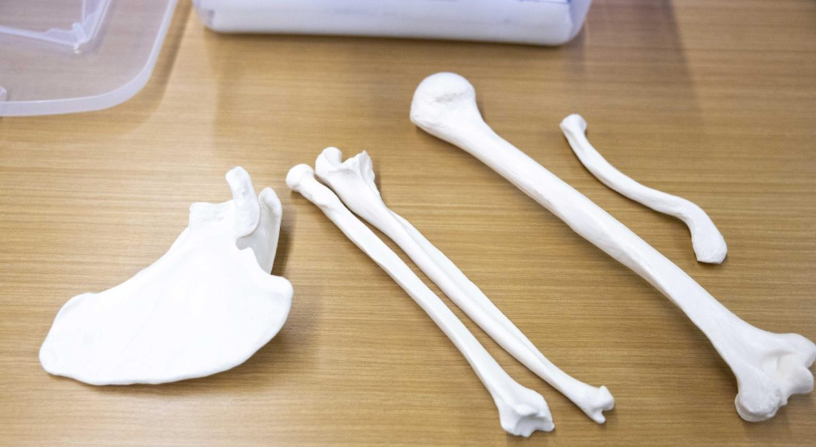
Identify the Problem
Students being denied needed resources due to lack of access and materials
Students leaving the library, not utilizing library spaces
Notes:
However, even with 6 full skeletons added, we were still turning students away.
Initially, we encouraged students to find their classmates who might already have the bones checked out and ask to study with them. However, many chose to just leave the library than do that.
So how do you meet the patrons’ needs? Is there a way to provide greater access to the materials we have?

Slide 6
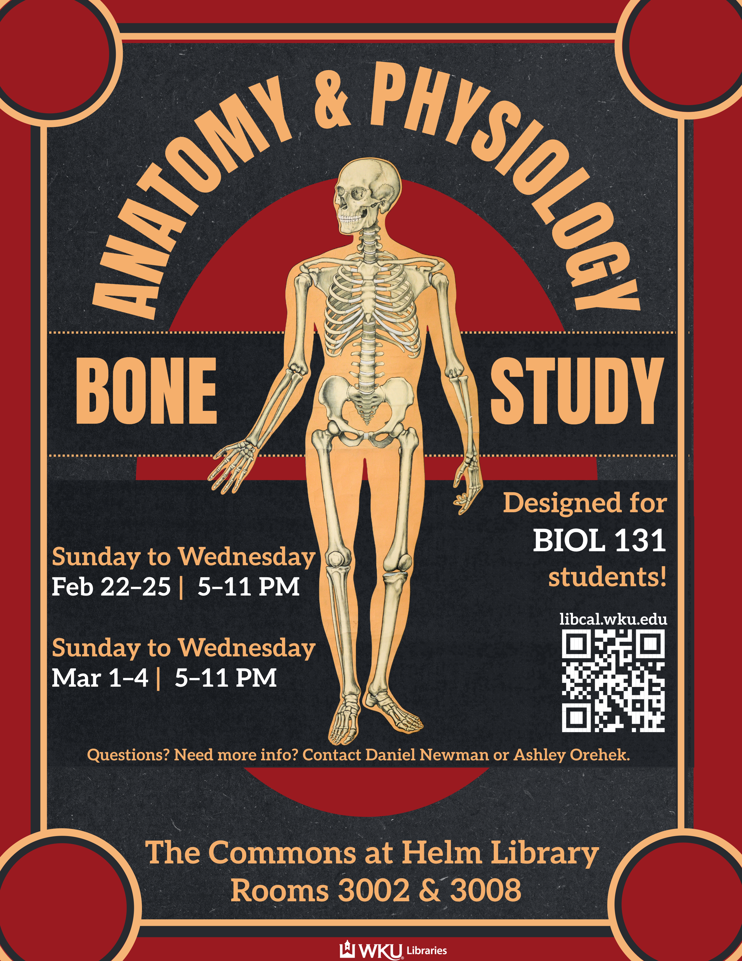
Finding A Solution
How can we maximize engagement with the materials?
Biggest Obstacles:
Insufficient kits to meet patron demand
Patron unwillingness to seek out classmates to study with
Solution:
Have a select portion of the kits available in a room to allow patrons to drop in and out as needed. No check out of the materials required.

Slide 7
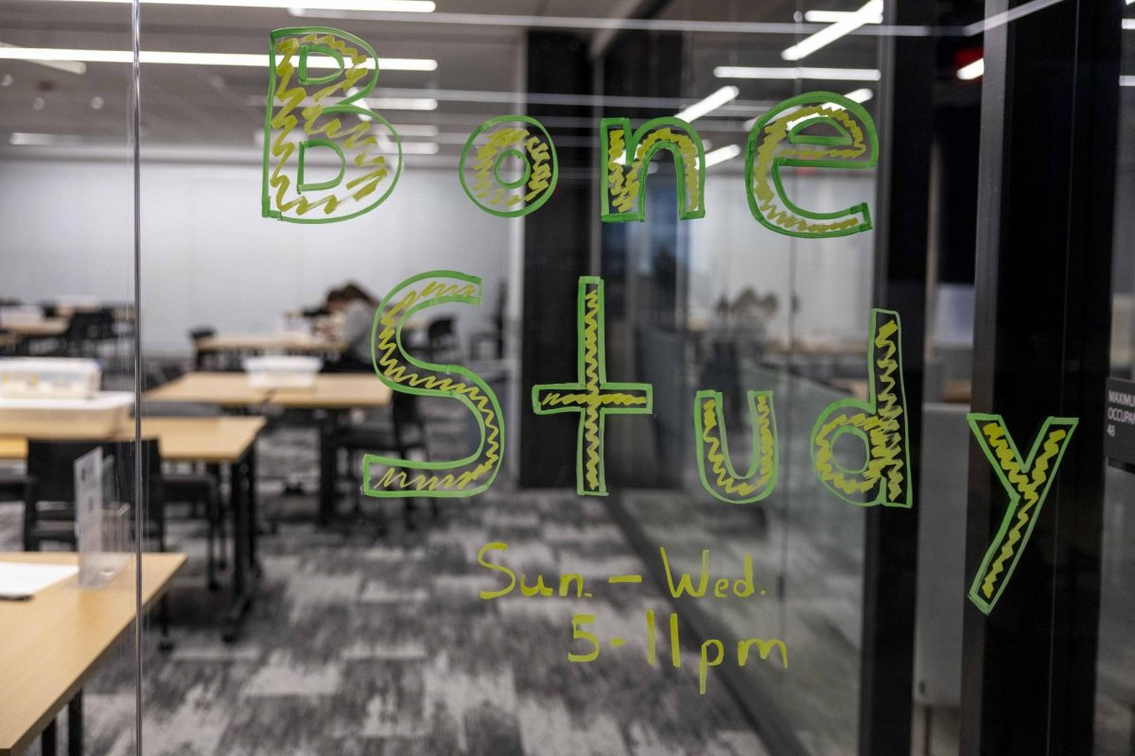
Planning The Event
Proposed the idea to our STEM Librarian who is the liaison with Ogden College of Science and Engineering.
Librarian coordinated with the course professor to find out when the anatomy quizzes would occur.
Worked with Access Services and DLPS to have staff and faculty monitor the room for the event.

Slide 8
Running the Event & After
Had advertisements made
Worked with Professor and TAs to have a class announcement about the event.
Tracked attendance with Suitable (event app) and feedback survey responses.
Evaluated attendance data to adjust the schedule for follow up events.
Used information on feedback survey to make additional adjustments.

Slide 9
Evaluating Program Success
BIOL 131 for Fall 2025 had 160 enrolled students, event attracted 41 unique patrons (71 students were tracked through the entire event), 25% of the enrolled students.
Looked at days that high attendance and no attendance.
Success of the first event in Fall 2025 prompted more support from library leadership and creation of a taskforce designed to oversee future events and outreach to patrons who use the A & P bones kits.

Slide 10
Evaluating The Program Success
When is the event worth the effort put into it?
Are enough people turning up?
Are any incentives you are providing encouraging participation?
Has the demographic you are trying to reach out to changed?
Notes:
Spring 2026 had roughly the same number of people turn up compared to Fall 2025. Despite having 2 sections and total of 230 students enrolled.
We had prize incentives to encourage participation, but that did not really translate into the anticipated increase of students.

Slide 11
Questions?
What are some ideas you have for your libraries?
What resources do you have that you know aren’t be utilized to their fullest potential?

