Slide 1
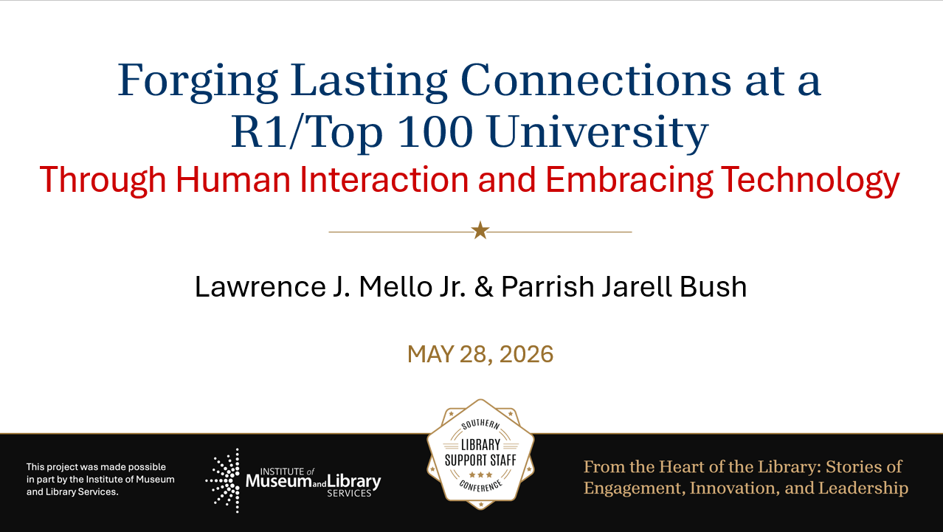

Slide 2

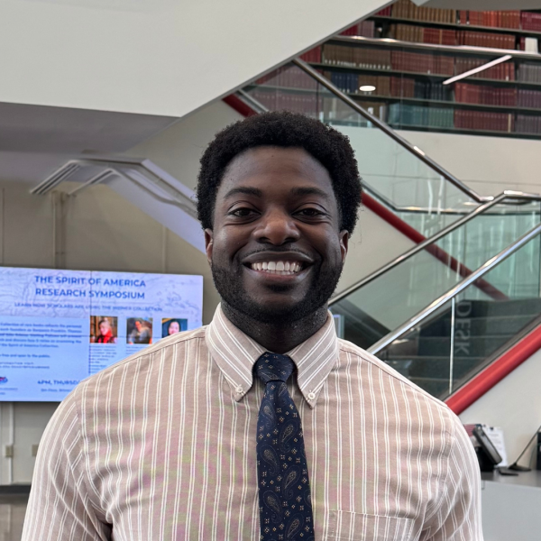

Lawrence J. Mello, Jr. B.A., M.A., M.I.L.S.
Liaison Coordinator and Government Documents Librarian
University Libraries at
Florida Atlantic University
lmello@fau.edu
Parrish Jarell Bush, B.A., M.F.A., M.I.L.S.
Broward Services Librarian
University Libraries at
Florida Atlantic University
bushp@fau.edu

Slide 3


Overview
This session draws on:
  Translating K–12 classroom experience into effective adult learning
  Large-scale university technology at a R1/Top 100 institution
  Strategic use of technology to extend human connection
Notes:
LARRY SLIDE
Parrish Bush brings a K–12 teaching background, while I bring an academic background in library instruction.
Together, we approach adult learning by focusing on relevance, autonomy, and practical application rather than classroom management.
Adult learners engage most strongly when they understand the “why” and can connect learning to immediate, real-world use.
At an R1/Top 100 university, technology must scale without sacrificing quality: it should support access, consistency, and efficiency across a large, diverse campus.
Technology should extend human connection, not replace it: use it to streamline routine tasks so more time stays available for mentoring, feedback, and relationship-building.

Slide 4


Essential Background:
Relationship-centered approach to library engagement
  Seven years in K–12 classrooms taught me what works — usually by learning what doesn't
  Meeting students where they are — linking learning to their lives, cultures, and world outside school
  Turning lectures into conversations where students build understanding together
  Seeing students' backgrounds and voices as assets, not deficits
Notes:
Parrish Slide

Slide 5

Essential Background:
Context: Rapid change reshaping services at an R1/Top 100 research institution
  The shift from static instruction to active, relationship-based learning requires us to design for participation, not just delivery.
  Technology is most effective when it supports human interaction rather than replacing it.
  Engagement increases when students are invited to contribute, question, and apply information rather than simply receive it.
Notes:
LARRY SLIDE
Students engage more deeply when they feel seen, welcomed, and included.
Interactive activities and thoughtful programming make learning feel relevant and inviting.
Refreshing teaching strategies keeps instruction dynamic and responsive to student needs.
Technology should make interaction easier, more personal, and more meaningful.
The goal is not just efficient content delivery, but stronger student connection and confidence.
When students feel supported, they are more likely to use library resources effectively.

Slide 6


Core Goal:
Genuine human connection through creative instruction + strategic technology
  When students feel seen through inclusivity, interactive activities, thoughtful programming, and refreshed teaching strategies, they engage more deeply — and when they engage, they learn.
  Technology should serve as a bridge that makes interaction easier, more personal, and more meaningful for students.
  The goal is not just to deliver content efficiently, but to create learning experiences that help students feel connected, supported, and confident using library resources.
Notes:
Parrish Speaks on First Bullet Point
Larry - Second Bullet Point.
Use technology to create easier, more natural two-way interaction.
Choose tools that help students feel noticed, supported, and engaged.
Let technology strengthen relationships, not replace them.
Make digital spaces feel more human and approachable.
The best use of technology is to increase connection, not just convenience.
BOTH - Third Bullet Point
Larry - Talking Points:
Focus on creating a welcoming learning experience, not just a fast transaction of information.
Help students feel like the library is a place where they belong and can succeed.

Slide 7

The Problem with Traditional Instruction
Over-reliance on one-shot library sessions
  One-shot sessions often rush through content — leaving little room for students to connect with it.
  Students disengage when instruction lacks interaction, relevance, or emotional investment.
  Library instruction is more effective when students can see its relevance to their classes, goals, and lived experiences
  Engagement increases when students are invited to contribute, question, and apply information rather than simply receive it.
Notes:
Parrish is doing the first two Bullet Points.
Larry is doing the last two Bullet Points:
Students tune out instruction that feels generic or disconnected from their coursework — they need to see the "so what" immediately
When library instruction is tied to a specific assignment, discipline, or real-world problem, retention and motivation spike
Connect research skills to career readiness, civic participation, and personal decision-making — not just academic survival

Slide 8


Human-Centered Engagement Strategies:
Showing Up in Student Spaces
  Meeting students in their spaces — org meetings, guest speaking — builds rapport and drives resource use.
  Collaborating on and at campus events.
Notes:
PARRISH takes the lead on this slide, with me chiming in if asked.

Slide 9


Collaborating on Campus Events
Building meaningful connections through interactive, relationship-centered programming that transforms passive instruction into active engagement opportunities for students across campus.
  Fact or Fiction Workshop
  AI in the Research Cycle
  FAU Haiku-Off
  Design the Footnote Competition
These collaborative events demonstrate how human-centered engagement strategies create deeper connections with students, moving beyond traditional one-shot instruction to foster lasting relationships and meaningful learning experiences.
Notes:
Parrish Slide / with me chiming in if asked.

Slide 10

More Event Types
Pop Culture + Academic Tie-Ins
  Using Netflix, Music, and Social Media to Teach Media Literacy and Misinformation
  Exploring Housing, Gentrification, and Community Through Hip-Hop and Local Culture
Low-Stakes Creative Spaces
  Late-Night Zine and Creative Expression Workshop in the Library
  Stress-Relief Poetry and Reflection Station During Finals Week
Notes:
Parrish slide with me, chiming in if asked.

Slide 11

More Event Types - Continued
Career & Real-Life Skill Events
  Using AI Tools to Build Resumes, LinkedIn Profiles, and Professional Materials
  Teaching Students How to Research Real-Life Topics Like Housing, Health, and Financial Information
Social + Academic Hybrids
  Casual Research Help Sessions with Food, Music, and Peer Conversation Before Finals
  Student Networking Event Connecting Research, Careers, and Campus Relationships
Notes:
Parrish slides with me, chiming in if asked.

Slide 12

More Event Types - Continued
Culturally Responsive Programming
  Connecting Family Stories, Oral Histories, and Culture to Academic Research
  Exploring Black South Florida History Through Archives and Community Discussion
Convenience-Based Pop-Ups
  Quick Citation and Research Help Tables in High-Traffic Student Areas
  Mobile Librarian Support Pop-Ups Near Student Lounges and Campus Spaces
Notes:
Parrish slides with me, chiming in if asked.

Slide 13




Designing More Engaging Learning Experiences Through FAU Library Technology
  Leveraging the Springshare software suite to engage with our student body through enhanced library instruction and research consultations.
  Creating Media content with the ScreenPal software suite, which allows us to create step-by-step database tutorial pages with screenshots and video walkthroughs for independent learners.
  Integrating polling tools and real-time feedback platforms (e.g., Mentimeter, Poll Everywhere) to increase student participation during instruction sessions.
Notes:
Larry's Slide:
SpringShare
SpringShare is an integrated suite of library-specific tools designed to streamline instruction, research support, outreach, and assessment — all under one platform
The suite includes tools that touch nearly every aspect of library service: research guides, appointment scheduling, chat reference, room booking, and analytics
Cloud-based and mobile-friendly, meaning students and librarians can access it from anywhere at any time
ScreenPal
ScreenPal (formerly Screencast-O-Matic) allows librarians to record their screen, webcam, or both simultaneously — making it ideal for walking students through database interfaces, LibGuides, or citation tools in real time
The built-in editor lets you trim footage, add captions, insert callout arrows and text highlights, and stitch clips together — no separate video editing software needed
The low technical barrier means any librarian on your team can produce professional-looking tutorials quickly, without relying on an IT department or multimedia specialist
Polling Tools:
Mentimeter allows librarians to build interactive presentations where students respond to polls, word clouds, quizzes, and open-ended questions in real time directly from their phones or laptops — no app download required
The visual, dynamic display of live responses energizes the room and creates a shared experience that a traditional slideshow simply cannot replicate
Poll Everywhere embeds directly into PowerPoint, Google Slides, and Keynote — meaning you never have to leave your presentation to launch a poll, keeping the session flow smooth and professional
Activities can include multiple choice, clickable image polls, Q&A walls, and ranking exercises, giving librarians a versatile toolkit for different instructional moments

Slide 14
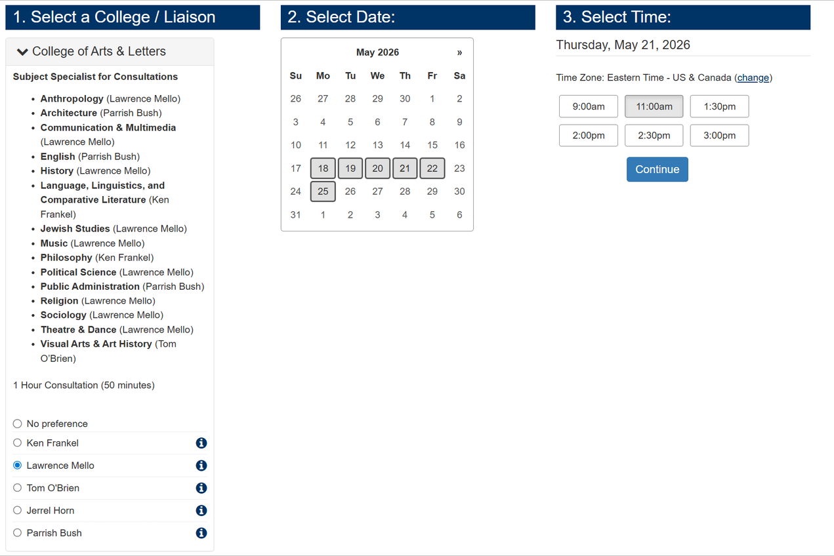
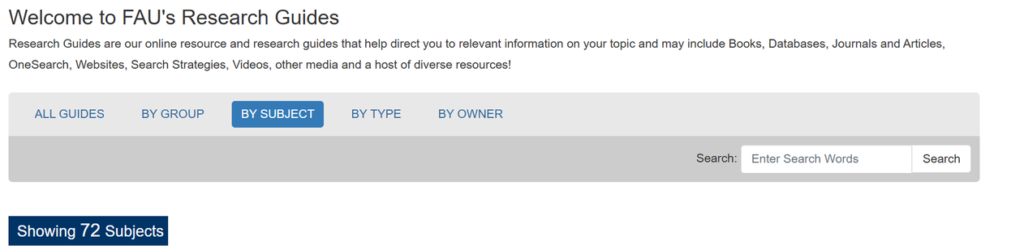

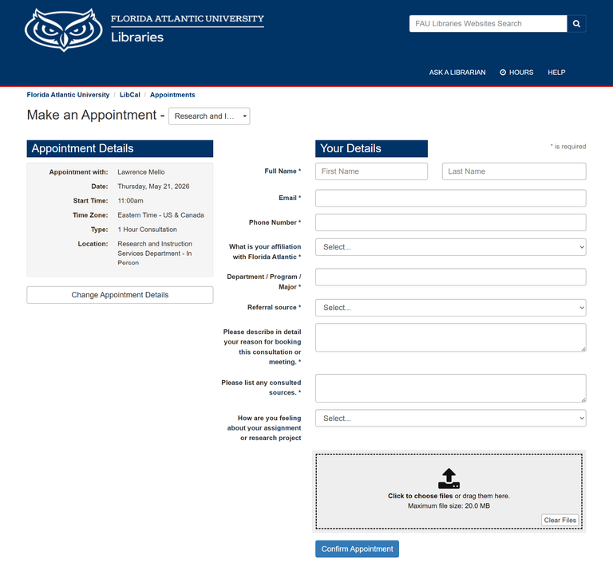
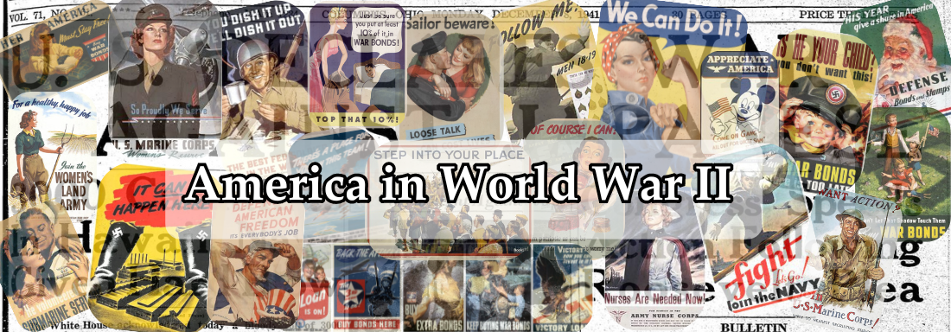
Technology as an Extension of Human Connection
LibGuides (Springshare) curated subject guides with targeted library resources
LibCal (Springshare) — real-time research consultation booking platform for students and faculty
Notes:
LARRY SLIDE
LibGuides allows librarians to build targeted, visually organized research guides tailored to specific courses, assignments, disciplines, or student populations — moving far beyond the one-size-fits-all library website experience
LibGuides / Research Guides
AT Florida Atlantic University Libraries, we have
282 Course and Subject Guides
The Top 10 Viewed Guides are subject guides from the Primary Source Collection.
With Primary Sources: America in World War II from May 21, 2025, through May 21, 2026, had over 46,235 views.
LIBCAL
LibCal's online appointment booking system allows students to schedule research consultations 24 hours a day, 7 days a week — eliminating the back-and-forth emails and phone tag that often discourage students from seeking help in the first place
Students can view real-time librarian availability, select a time that fits their schedule, choose between in-person or virtual appointments via Zoom integration, and receive an instant confirmation — the entire process takes less than two minutes
In just the short time of moving to LibCal, we had
149 appointments made and kept.

Slide 15
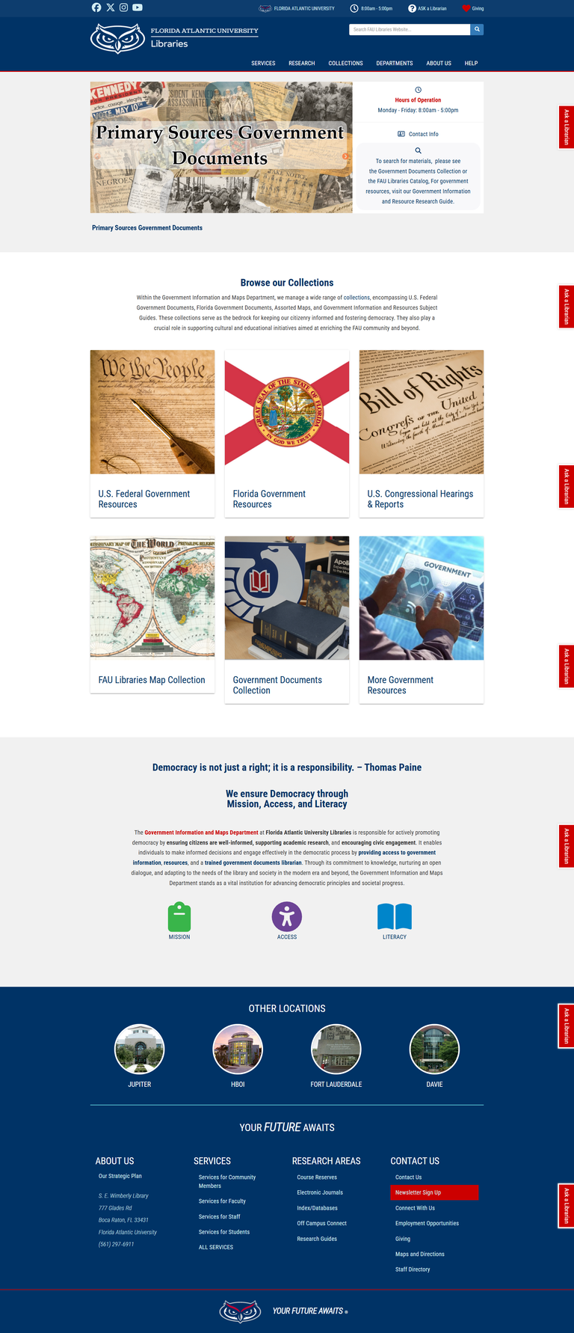
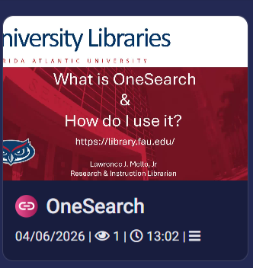
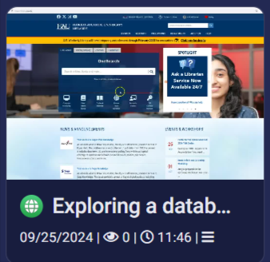
Technology as an Extension of Human Connection: Continued
  Library Web Redesign using Drupal, improving accessibility and navigation of online resources
  Tutorials created through ScreenPal
Notes:
LARRY's SLIDE
Website Redesign:
A library website is often the first point of contact a student has with library services — if it is confusing, outdated, or inaccessible, students disengage before they ever discover the depth of resources and support available to them
The Drupal redesign allowed us to incorporate user feedback, usability testing, and data on how students were navigating the old site — making design decisions grounded in actual student behavior rather than librarian assumptions about what students need
ScreenPal
ScreenPal gives librarians the ability to record their screen, microphone, and webcam simultaneously — making it ideal for creating database walkthroughs, LibGuide orientations, citation tool demonstrations, and step-by-step research process tutorials without needing a dedicated media production studio
ScreenPal's automatic caption generation ensures that every tutorial produced is immediately accessible to deaf and hard-of-hearing students, non-native English speakers, and learners in sound-sensitive environments — supporting ADA compliance without requiring a separate captioning workflow

Slide 16

Real-World Examples & Candid Reflections:
Successes from Implementation
  Flipped AI Workshop Series — 25–40+ students per session; 90%+ reported increased confidence applying AI tools
  Instructional Handouts — 97% reported improved understanding; materials reused in follow-up sessions
  Fact or Fiction Workshop — delivered across 3 classes; 95% reported increased engagement and retention
  FAU Haiku-Off — 12 competitors, 35+ attendees; strong demand for future events
Notes:
PARRISH SLIDE
Will chime in if asked.

Slide 17

Honest Challenges & Lessons Learned at a R1/Top 100 Research Institution
  Time and energy required for sustained engagement
  Prioritizing scalable outreach strategies (e.g., standardized instruction modules, reusable learning objects) ensures consistent support across a large and diverse student population.
  Clear communication channels and defined service models help manage expectations and prevent librarian burnout in high-demand environments
  Scale demands systems — relationships only reach as far as your infrastructure lets them
  Faculty buy-in is the multiplier — one engaged professor connects you to hundreds of students
  Technology consistency also builds workload trust
Notes:
LARRY HAS THE FIRST 3 BULLET POINTS WITH PARRISH THE LAST 3 BULLET POINTS
Library instruction done well is labor-intensive — every customized session, individual consultation, and tailored LibGuide represents a significant investment of librarian time that must be balanced against a full slate of competing responsibilities including reference, collection development, and faculty outreach
Sustained engagement with a large and diverse student population is simply not achievable through one-on-one or one-shot efforts alone — without scalable systems in place, the most motivated librarians will burn out and the most underserved students will still fall through the cracks
Establishing clear boundaries around instruction commitments, building in planning and assessment time, and distributing workload equitably across the library team are not luxuries — they are essential infrastructure for maintaining instructional quality over the long term

Slide 18



Learning Outcomes
  Identify ways to build meaningful student connections through instruction and outreach.
  Recognize how inclusive, interactive teaching practices improve student engagement and learning.
  Apply technology strategically to extend access, communication, and support.
  Develop programming and instruction that feel relevant, flexible, and student-centered.
  Examine sustained engagement strategies beyond one-shot instruction
Notes:
LARRY'S SLIDE
TAKE AWAYS:
1) Building Meaningful Student Connections — Intentional outreach and personalized instruction build trust with students, making the library a go-to resource rather than a last resort when research gets hard.
2) Inclusive, Interactive Teaching Practices — When students are invited to participate, question, and apply skills in real time, engagement deepens and information literacy sticks far longer than passive listening ever allows.
3) Strategic Technology Use — Tools like LibGuides, ScreenPal, and polling platforms are not add-ons — they extend the library's reach, remove access barriers, and deliver support to students at any hour from any location.
4) Relevant, Flexible, Student-Centered Programming — Instruction that connects to real assignments, real goals, and real student experiences communicates one powerful message — the library sees you, knows your needs, and is here to help you succeed.
5) Sustained Engagement Beyond the One-Shot — The one-shot session plants the seed; every consultation, tutorial, and follow-up interaction that follows is where genuine information literacy growth actually happens.

Slide 19


Learning Outcomes: Continuted
  Adapt collaboration techniques with student organizations and faculty
  Evaluate technology’s role in extending library outreach
  Explore models integrating human connection with digital tools
  Reflect on the benefits and challenges of large research institutions
  Leave with actionable ideas for strengthening library visibility and student success
Notes:
LARRY''s SLIDE
Adapting Collaboration With Students and Faculty — True collaboration means co-authoring the student experience alongside faculty and student organizations — not just promoting library services at them.
Evaluating Technology's Role in Outreach — The most powerful tool in your library isn't software — it's the trust you build with students before they ever open a database.
Integrating Human Connection With Digital Tools — Blended learning reaches its full potential only when students already feel they belong — technology amplifies connection, it cannot create it.
Reflecting on Large Research Institution Models — Size doesn't have to mean distance; the research institution students remember and return to is the one that found ways to feel genuinely human.
Actionable Ideas for Library Visibility and Student Success — Visibility isn't marketing — it's showing up consistently enough that students stop thinking of the library as a place and start thinking of it as a trusted presence in their academic journey.

Slide 20

Turning ideas into action:
Your takeaways
  How can we create ideas that work well in different types of libraries?
  How can libraries balance in-person help with technology use?
  What approach can libraries use to support student success through connection and new ideas?
  How do campus and community partnerships help increase the library’s impact?

Slide 21

References
  Bastone, Z., & Clement, K. (2024). Serving everyone or serving no one?. College & Research Libraries. https://crl.acrl.org/index.php/crl/article/view/25581/33488
  Hall, M. (2016). Differences in adult learning and motivation. CAEL (Council for Adult and Experiential Learning). https://www.cael.org/resouces/pathways-blog/differences-in-adult-learning-and-motivation#:~:text=Adult%20learners%20are%20results%2Doriented.%20They,Adult%20students%20are%20more%20self%2Ddirected.
  Park University. (2025). 7 adult learning strategies for professional development. Park University. https://www.park.edu/blog/adult-learning-strategies-for-professional-development/

Slide 22

Thank You
Lawrence J. Mello, Jr. B.A., M.A., M.I.L.S.
Liaison Coordinator and Government Documents Librarian
University Libraries at Florida Atlantic University
lmello@fau.edu
Parrish Jarell Bush, B.A., M.F.A., M.I.L.S.
Broward Services Librarian
University Libraries at Florida Atlantic University
bushp@fau.edu

