Slide 1

Thinking Outside the Chat Box:
Building Chatbots for Any Topic with Springshare
CJ Ellward
MAY 27, 2026

Slide 2
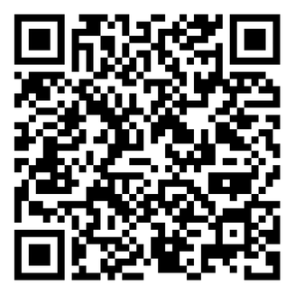
Handout

Slide 3
About Me
Academic library services since 2017
University of Florida since 2021
Current role since 2024
Public Service Coordinator at Marston Science Library
  Ask a Librarian site coordinator
  80+ participating librarians for 54 hours of service/week
  >10,000 AAL interactions annually
  Chatbot building, maintenance, data tracking

Slide 4
Introduction to Chatbots

Slide 5
Why use a chatbot?
Quick answers to FAQs
Service outside staff hours
Free up staff time for more complex questions
Our bots answer 80% of inquiries!
  (Previous 6 months of data)
Notes:
Chat usage increased at our library, mileage may vary

Slide 6

SpringShare’s Options
Rule-based chatbots only
  Not generative AI
  Scripted content only! Ensures accuracy of answers
FAQ integration
Self-contained
Notes:
- Bot will never do anything I don’t ask it to
- Impossible to hallucinate because it doesn’t generate any content
- FAQ integration – FAQs not used at my library, this kind of bot requires a lot of work that we will get to later!

Slide 7
How does it work?
Do you need help?
Flowchart model
Present options, script answers
Yes
No
End
What can I help you with?
Fines
Find Books
Library Hours

Slide 8
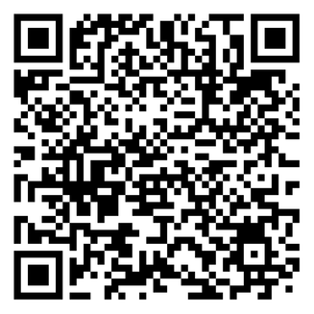
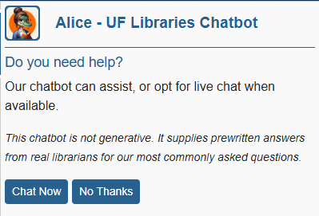
Demonstration
UF Libraries Primary Chatbot, “Alice”
Notes:
Linked on every UF Libraries page
Proactive slide, loads automatically if idle

Slide 9
Topic Areas to Target
Notes:
Our bot is general, but they can be specialized
Specialized is an easier way to start

Slide 10
Finding Your Topic Area
Start with the familiar
Look for step-by-step processes with little variability
Potential topics
  Circulation policy questions
  General library amenities (do you have…?)
  Online resource access, etc.
Notes:
Can be loaded into just one webpage – library guide, program people have questions about, etc.
Yes/no questions, questions with 1 answer or clear workflow
Online access: Use the library’s link, OpenAthens authentication

Slide 11
Finding Your Topic Area
Patron question data
Source from:
  Chat service
  LibAnswers tickets
  Email inquiries
  Any other question-tracking data
More likely to be impartial
Library professional data
Survey your colleagues
Note potential for bias, diversify when possible
  Shift times,
  Day of the week
  Employee position
  Recency bias
Notes:
Useful for larger, general services bots
Can still help narrow down the best answer phrases
Can help avoid jargon by looking at *how* patrons ask questions, more than *what* they ask

Slide 12
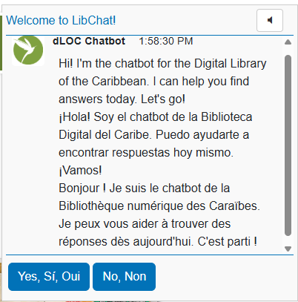
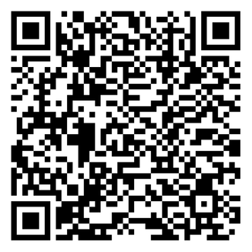
Demo:
Digital Library of the Caribbean
Specialized digital collection serving patrons world-wide
Navigation is tricky for patrons unfamiliar with databases
Made up 40% of chat inquiries prior to bot launch
Notes:
Note: bot & their widgets are not automatically translated, they will need to be manually changed and exist separately from one another

Slide 13
Flow Architecture

Slide 14
Vocabulary
Flow (n)
  The set of rules in place that make the chatbot work, the mechanisms behind the chatbot
Action (n)
  Term for each “thing” the bot does; the building blocks. Every time the bot sends a message, it is performing an Action
Output (n, v)
  General term for information shown to the user. Actions can contain outputs (such as messages); to send a message is to output information
Notes:
Flow: almost synonym for bot
Action: Springshare-specific

Slide 15
The Building Blocks
Action | Purpose
Question | Present options to patron, or accept patron input in a text box
Send Message | Output text-based messages, can send multiple messages from 1 action
Show Text | Output shorter text-based messages
Website Link | Output a short message followed by a separate hyperlink
Connect to Live Chat | If selected LibChat department is online, connects to chat; else performs additional action(s)
Submit a Ticket | Uses the queue form (or chatbot itself) to submit a ticket to specified queue
Displays in different location
HTML in messages
Notes:
Make into table, put aside about keyword building after table
- Website Link: Using HTML allows links to go inside regular messages instead of displaying separately

Slide 16
Question Action Types
Free-response/Keyword
Multiple Choice
Must manually define all keywords
  No engine for generating similar terms
Anticipate all possible user terms for a given output
  Ex) Check out/rent/borrow/lend
SpringShare only detects first keyword in the string
  Ex) “Can I borrow a charger at the library?”
  Output will always be for “borrow”
Script a set of keyword options
  Display to user as buttons
Lower chance for variable user behavior
Lower chance of users becoming frustrated
  Free response input acts like Natural Language Processing, but does not actually have advanced processing features
Notes:
Borrow and charger could be two keywords
Multiple choice acts like a flowchart, Keyword acts like a bad Google search
We do get feedback that people want to be able to type in their question, but we don’t do that for the reasons listed

Slide 17
Creating Questions
Text and options are made/edited in the Question Bank
Questions from the bank then can be added to Actions within the chatbot
Analogy: adding food to the menu (bank) vs. someone ordering it (action)
  Questions in the bank must be attached to an Action to be used

Slide 18
Putting Actions Together
A chatbot flow is a chain of actions, leading from one to the next
Next action can happen automatically, or after user input
  E.g. User selects an option from multiple choice question
Use an If-Then statement to tell the bot what to do
  If a user clicks on Yes, I need help, then perform Question: What can I help you with?
  If a user clicks on Help with library policies, then perform Send message: Library Policies

Slide 19
A Closer Look
Springshare’s back end
Notes:
https://answers.uflib.ufl.edu/admin/chatbrowse/chatbot
Quick demo bot

Slide 20
What Makes a Good Bot?

Slide 21
Best Practices
My suggestions, something different may work for you!
Keep the number of options low & option phrases short
  “I need help with library policies” vs. “Library policies”
Avoid jargon where possible
What does it make sense to combine? What should stay separated?

Slide 22
Best Practices
My suggestions, something different may work for you!
Our goal is to streamline the flow
  Click fatigue is real! Patrons will close the bot if it takes too long to find what they are looking for
Use the bot for brief explanations; add a website link for more complex information
  “Printers are available at all library locations. For specifications and pricing, view our printing guide.”

Slide 23
Thank you!
Contact me:
c.gott@ufl.edu

