Slide 1
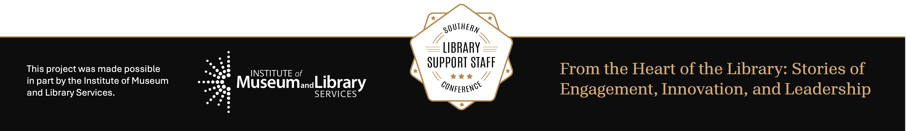
Whose Catalog?:
Homosaurus as a Pathway to LGBTQ+ Belonging
Jude Romines (they/them)
MAY 28, 2026

Slide 2
Please take what’s useful, leave what isn’t, and feel free to connect. ♡

Slide 3
What is Homosaurus?
Homosaurus is an international linked data vocabulary of LGBTQ+ terms.
Approved for use in OCLC, it functions as “a complement, alternative, opponent, and critique to/of LCSH [Library of Congress Subject Headings]” (Cifor & Rawson, 2023).
Marika Cifor & K.J. Rawson (2023) Mediating Queer and Trans Pasts: The Homosaurus as Queer Information Activism, Information, Communication & Society, 26:11, 2168-2185, DOI: 10.1080/1369118X.2022.2072753

Slide 4


Why does LCSH need a critique?
From its conception, LCSH as a system has centered white, male, western, cisgender, and heteronormative perspectives.
Slow to update (not without due effort by advocates), this gap has resulted in LGBTQ+ (and many other) experiences being structurally less discoverable.

Slide 5
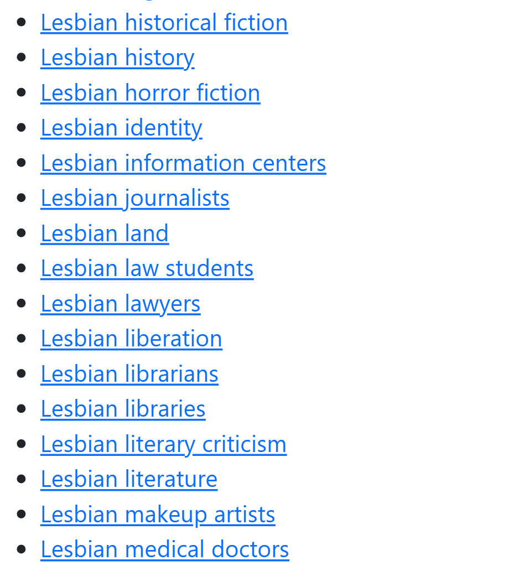
Expanding possibilities for discovery
Homosaurus enhancement:
  Lesbian horror fiction
  Black lesbians
  African American LGBTQ+ people
Useful to both retroactively enhance older materials while proactively cataloging new ones

Slide 6
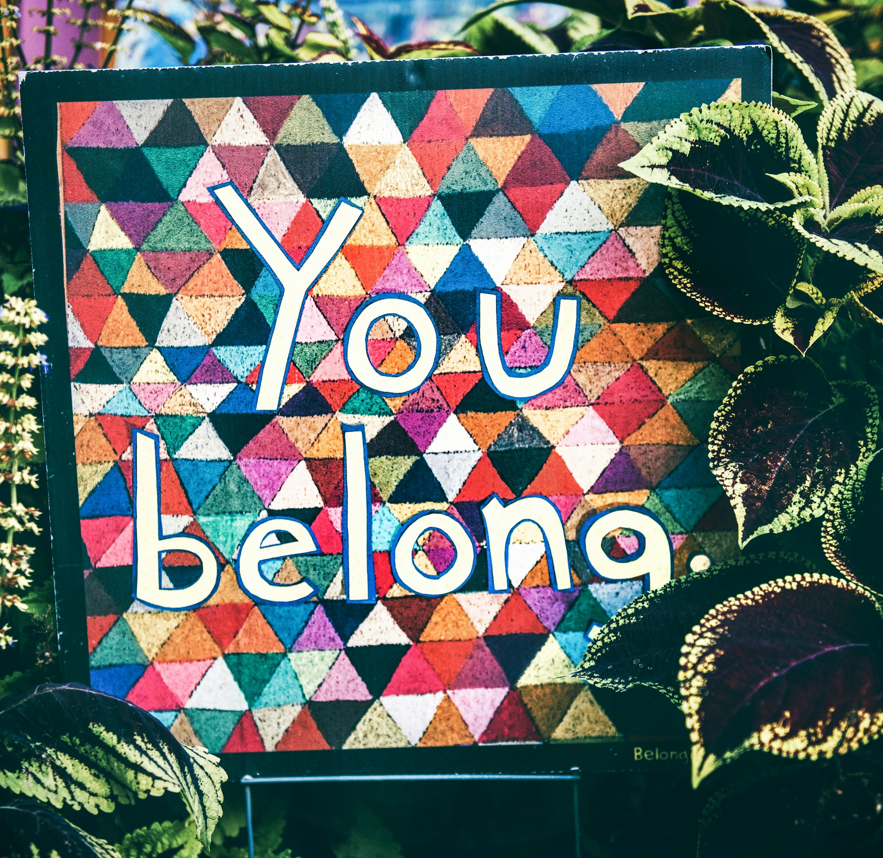
Homosaurus and belonging
“Invisible” cataloging work can translate to patrons as objectivity
Misrepresenting (or absent) metadata can therefore feel like an institutional judgment
Homosaurus as an intervention:
“You have value.”

Slide 7
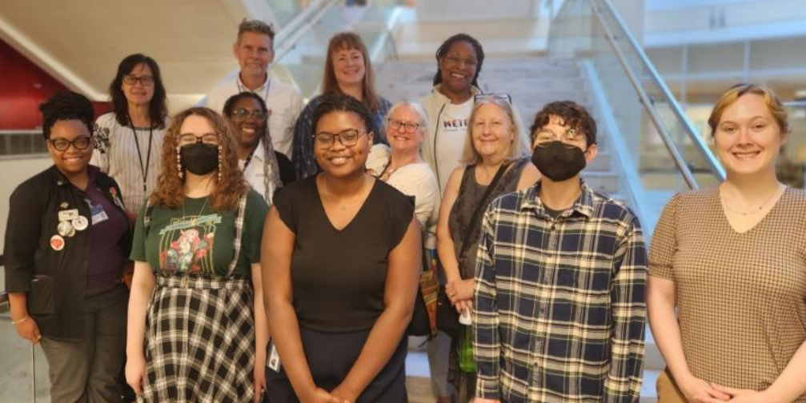
Professional development through belonging
Since 2023, Emory University Libraries has hosted graduate internships focusing on Homosaurus enhancement projects
Critical cataloging as an entry to cataloging nurtures a mature understanding of the profession’s tensions while validating the learner’s experience
Emory University Libraries 2024
intern cohort & faculty/staff

Slide 8
What it’s meant to use Homosaurus
Sage Hickok (he/they):
Queer horror fiction
“Learning about Homosaurus was actually what started getting me interested in cataloging and metadata[…] As a trans man, I found it really fulfilling to be able to work with LGBT materials, especially materials about trans experiences, and increase their visibility[…] I feel like working in stacks and literally seeing every day how some items are less visible on the shelf than others intersects with these questions in ways I wouldn't have noticed prior to my Homosaurus work.”
Niel White (she/they):
Multiracial LGBTQ+ people
“As a biracial queer in the library science field, metadata has shown itself as both essential and often lacking in specificity for researching people like myself in a library catalog. Implementing Homosaurus terms was a wonderful opportunity to gain technical skills while helping to expand on the representation of queer multiracial identities and give other biracial folks the opportunity to locate their varying identities in the record.”
Jude Romines (they/them):
Gender nonconformity
“Being queer and having different mental wiring, so to speak, it’s easy to see something so default, like LCSH, and assume my feelings about it are my own deficiency. It’s not the most crazy-making system I’ve encountered, but it is reassuring to see other people have said, ‘Oh, there’s a problem here. And we don’t have to be patient and good. We can work outside the problem and find a solution.’ I love that about library folks.”

Slide 9
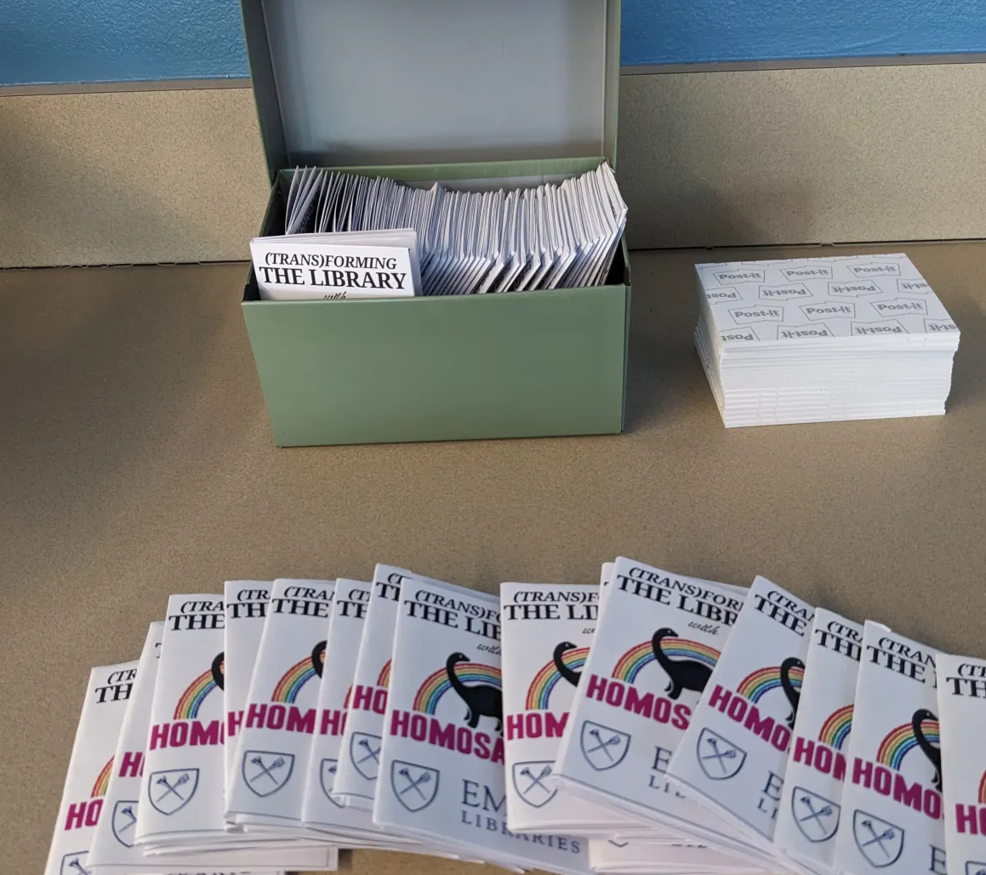
Education through belonging
Student outreach events
  Homosaurus workshop – March 2025
  Office of LGBT Life visit – April 2025
  Tabling with zines – Ongoing collaboration with outreach team
Response
  Less engagement with workshop
  LGBT Life visit was positive and busy
  Zines were a hit
Future plans
  Passive Homosaurus post-it display

Slide 10
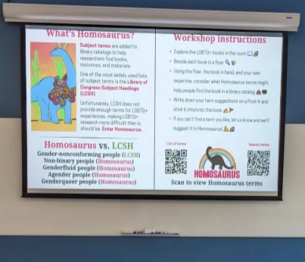
Education through belonging (continued)
Lessons learned from outreach
  Space matters
  Perfect the elevator pitch (especially with complex topics)
  Don’t underestimate student interest
  Zines, handouts, and takeable things

Slide 11
Additional resources
Homosaurus
  About Homosaurus
  Documentation and implementation guide
  Contact and term suggestion page
  Homosaurus Google group
Automation and bibliographic enhancement at Emory
  Research and presentations
Contact: jude.romines@emory.edu

