Slide 1

“Leveling Up Your
Libraries’ Defenders”
Dr. Stacy Creel
Dr. Sarah Mangrum
MAY 27, 2026

Slide 2

Slide title

Slide 3

What is Advocacy?
“At its core, advocacy is about educating and equipping people with resources to support a cause—and librarians do this every day, hundreds of times a day, across thousands of organizations.”

Slide 4
“Advocacy that happens through daily library interactions often focuses on raising awareness about resources and services”
The point is to GROW SUPPORT for our libraries.
Notes:
True advocacy is when stakeholders stand up and speak out for you on behalf of a cause, idea, program, or organization…. As librarians, we need to plan ahead and focus our efforts on building support from stakeholder groups.​
​
Public library advocacy is defined as: The actions individuals or organizations undertake to influence decision-making at the local, regional, state, national, and international level that help create a desired funding or policy change in support of public libraries. ​

Slide 5
What does that look like???
Mini ’Mercials!
Notes:
Sarah ask a question:​
Mini commercial answer:

Slide 6
Who Can Be An Advocate? (or who should be)
The Library Workers
Community Groups/Partners
Regular Library Users
The Library Board
Friends of the Library
State Organizations
Notes:
“Anyone can be an advocate for their public library. First, you need to know “who” you want to advocate to. Ask yourself “what” messages, facts, and library stories will be most effective to capture their attention and get them to focus on the library. Successful advocacy efforts by public libraries usually begin with the development of an advocacy plan and are a team effort. Ideally, all public library staff should feel comfortable advocating for their library.”​

Slide 7
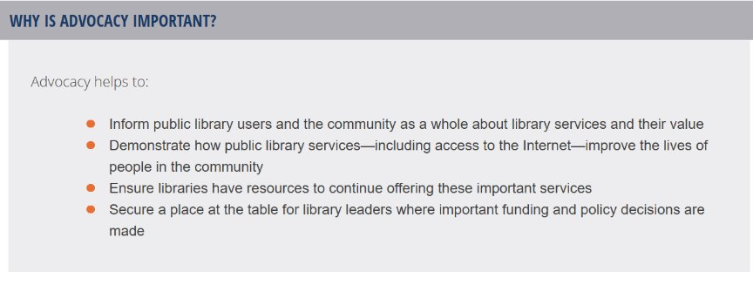

Slide 8
Discussion
General
Special
Unique
What value does your library bring to the table?
What needs are you meeting?
Notes:
Think of anything special, unique, general…

Slide 9
Examples
Free materials
Programs
Literacy activities
Technology
Job resources
Test guides

Slide 10
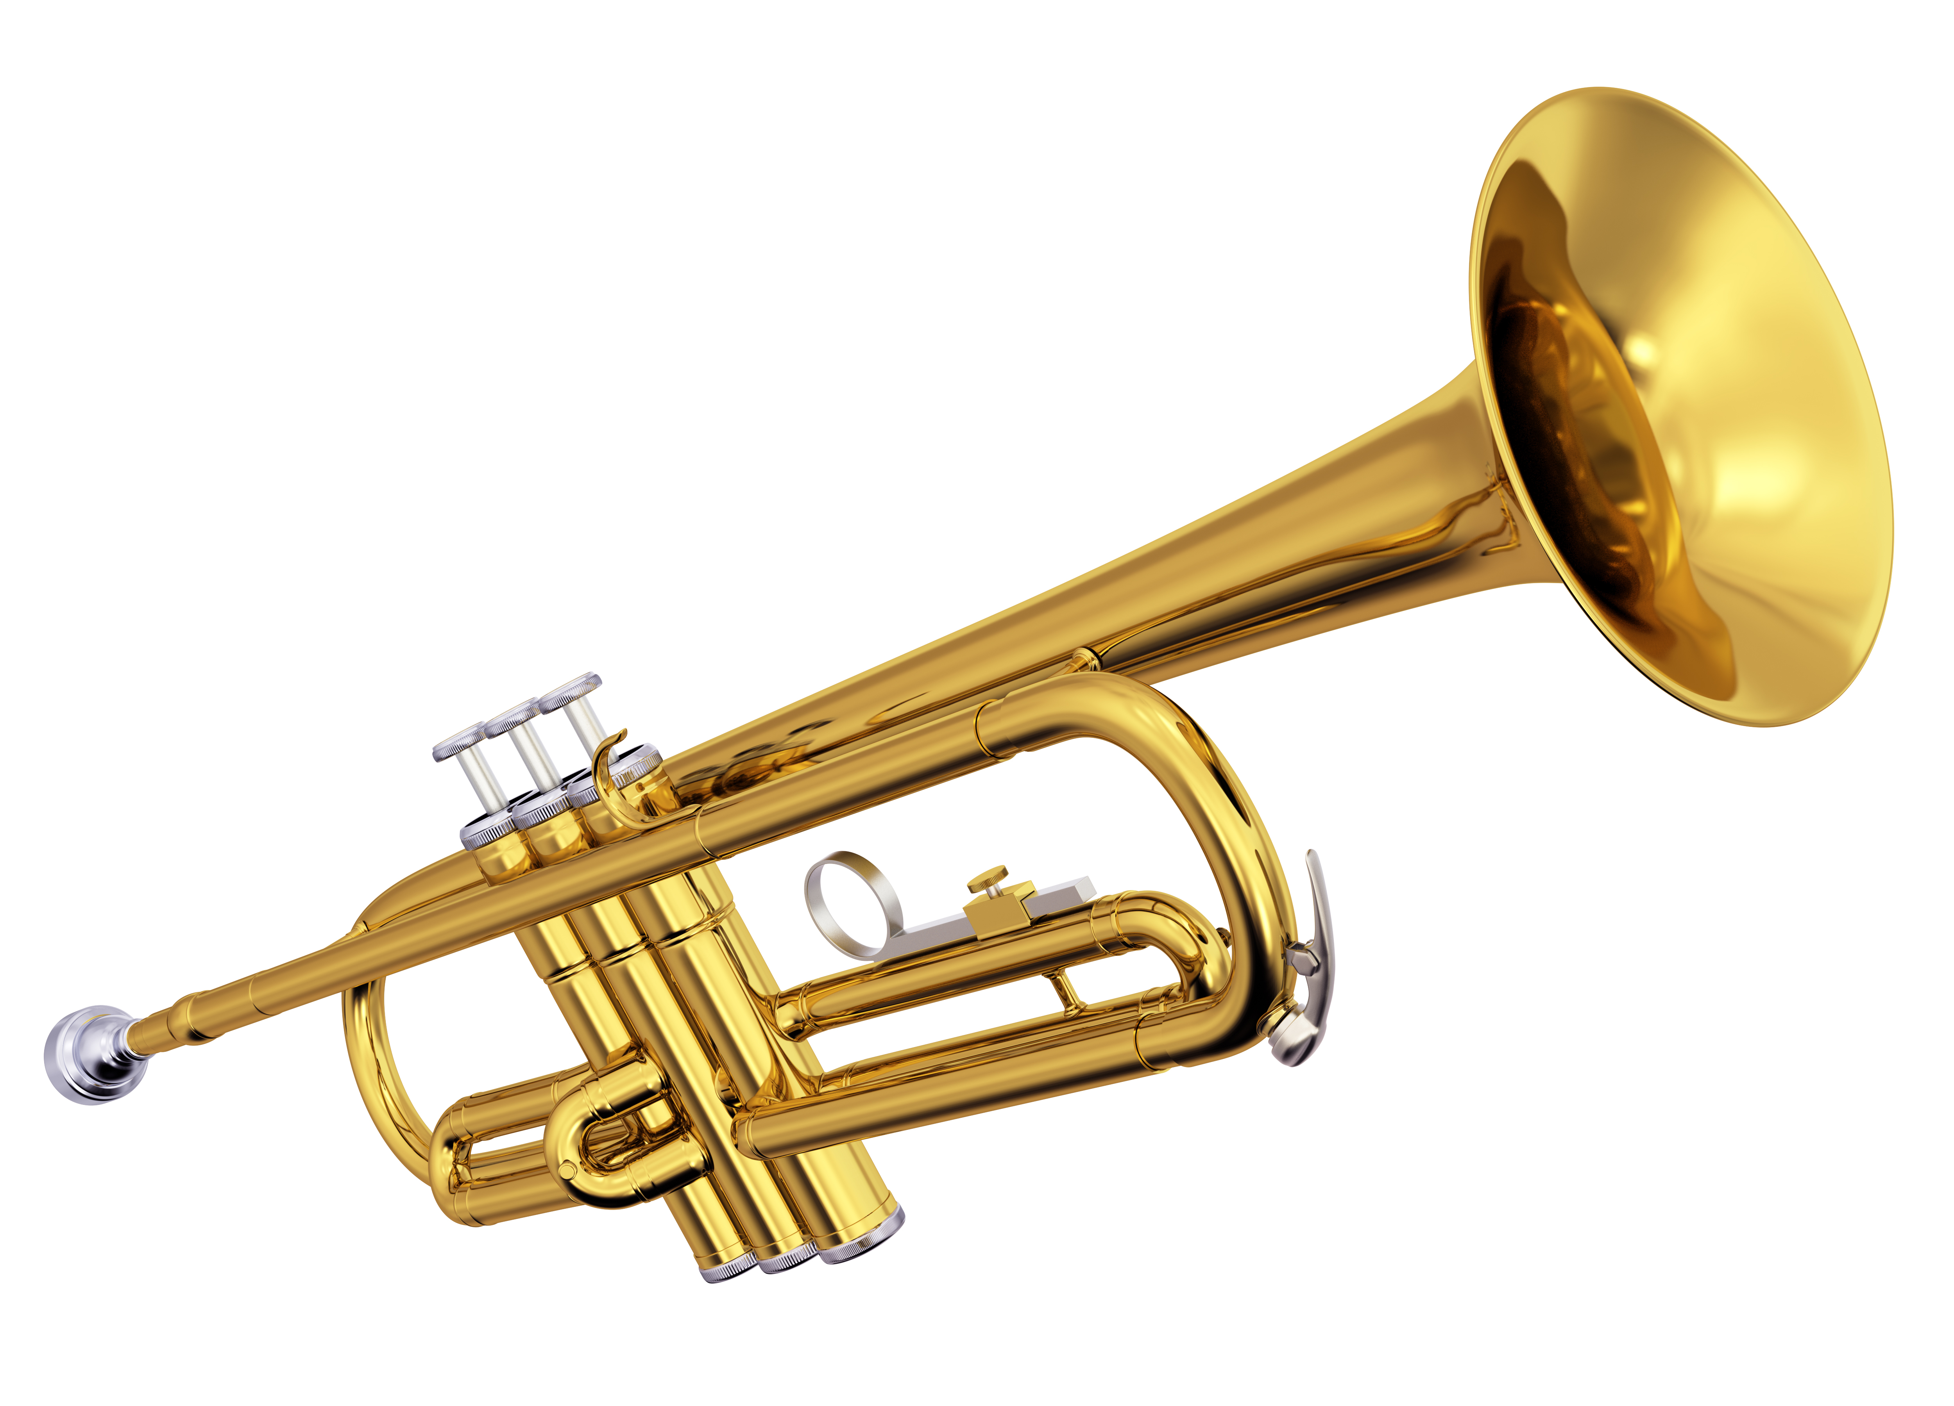
Build from your existing success
TOOT, TOOT, TOOT
Notes:
Build from your existing successes​
Be prepared to talk about the success of your libraries whenever you are given the opportunity. Let people know how libraries can do even more for them, if facilities were improved, if budgets were improved, if staffing were improved….. ​

Slide 11
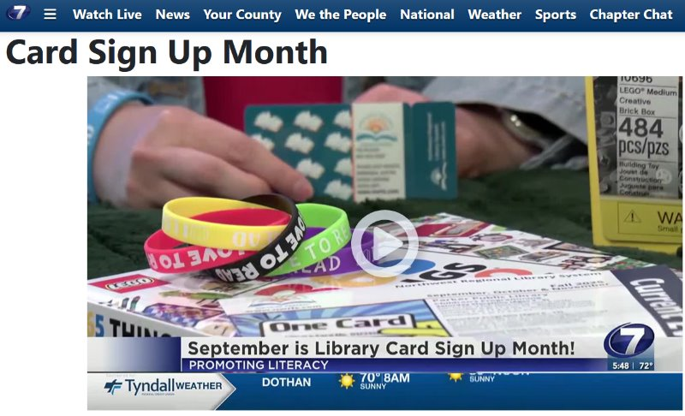
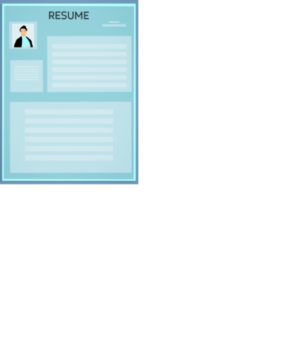

Couch your success in economic and personal terms
Notes:
Detail out the economic impact of your library. Are you highlighting your workforce development resources? Are you hosting resume workshops? Workshops that promote skills?​
​
Personal stories about the new libraries make great anecdotes for informal conversations and for presentations. Letting officials and legislators know how much the senior citizens in their communities enjoy the new libraries is important. Stories about how a resident benefited personally from using the library to find a job, learn a skill, take a computer class, or attend a program are stories that can be used for advocacy.

Slide 12
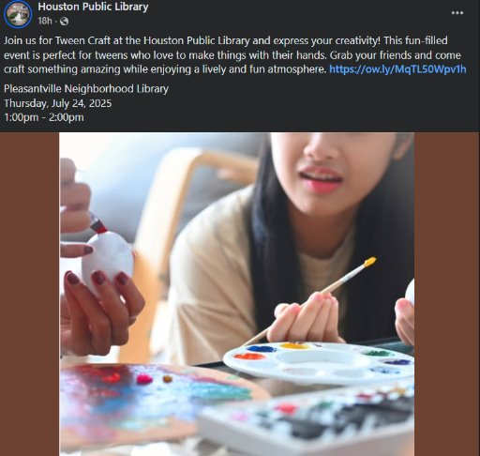
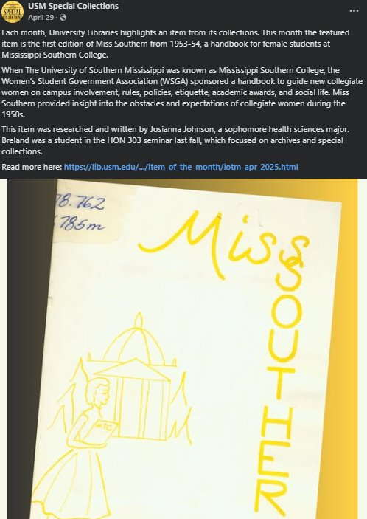
Social Media
Notes:
​
Speak their language ​
Be personable​
Use visuals ​
Keep it short ​
Ask yourself: Would I share this? ​
Determine what audience you are targeting—be specific.​
Have a plan and provide a call to action ​
Make a commitment​
​

Slide 13
Forge partnerships wherever possible. Build relationships.
Local Universities & Community Colleges​
Parks & Recs​
Museums​
Community/Civic Organizations/Clubs—League of Women’s Voters, Junior Auxiliary Clubs, Garden Clubs​
Schools ​
Churches​
Shelters ​
Incarcerated ​
Chamber of Commerce
Notes:
What are your officials’ priorities? How can you partner with other agencies that are beloved?​
​
Libraries can offer the meeting space for literacy tutors, programs, and labs. Libraries can promote computer literacy by offering computer‐training classes in new computer labs for job seekers, adults, and senior citizens. ​
​
Partnerships can provide endorsements, testimony, and opportunities to enlist the support of others to become advocates for your cause. The relationships that you build at conferences and other venues help you find advocates.​

Slide 14
Use testimony from public officials and residents in support of the library whenever you can.​
City council members​
Local leaders​
Caregivers from storytimes​
Program participants​
Heads of local organizations
Notes:
Your library story should focus on the impact your library has on your community and the lives of the people who live there.​
​
The more you know about your target audiences and what they know, think, and feel about the library, the easier it will be to create library stories that will appeal to and connect with them.​
​

Slide 15
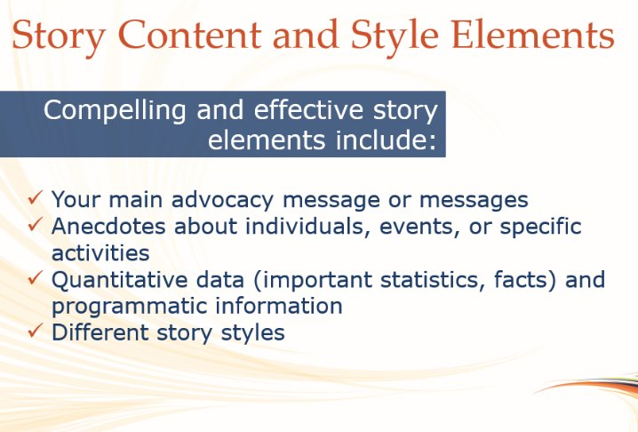

Slide 16
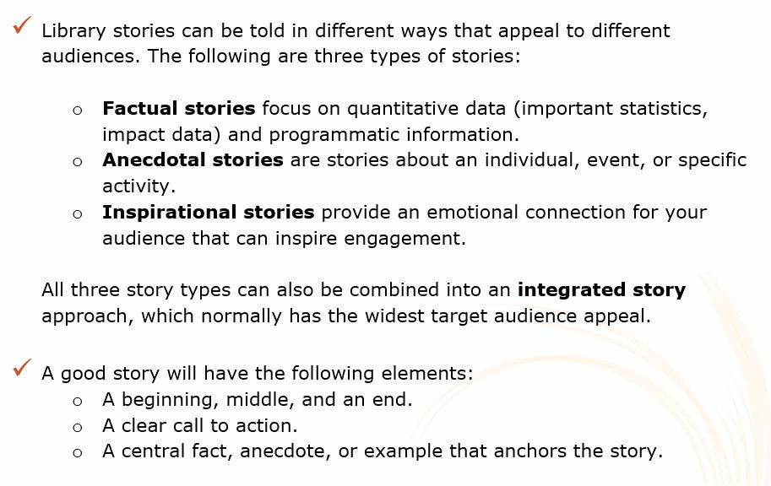

Slide 17
A picture is worth a thousand words … and PowerPoint presentations, calendars, and other marketing and public relations tools are worth even more.​

Slide 18
Create Toolkits.
Speaking points everyone should know.​
Grab bags of flyers/swag/etc.​
Public-facing annual reports

Slide 19
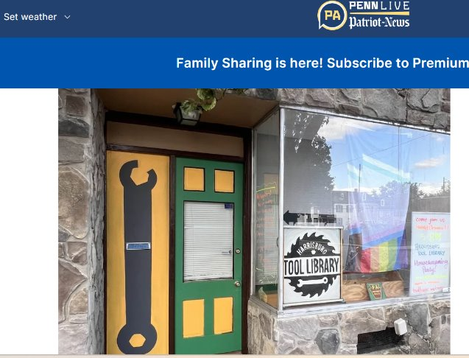
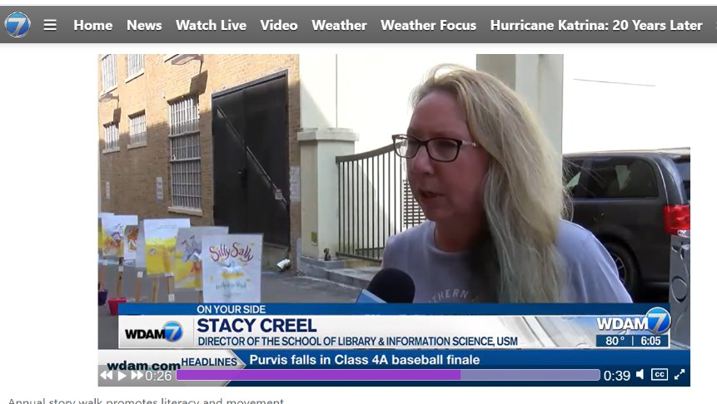
Know your local media and share with them FREQUENTLY!

Slide 20
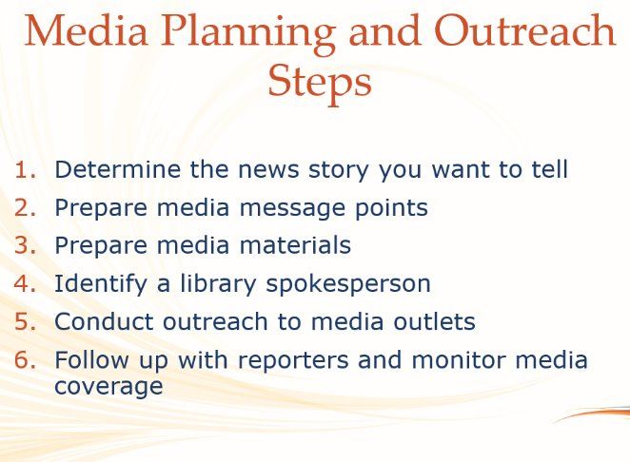

Slide 21
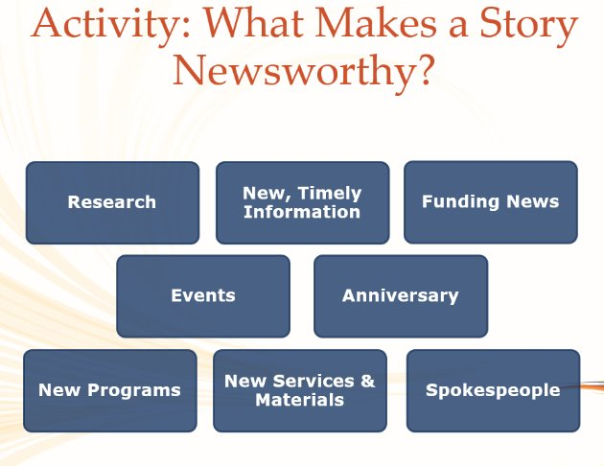

Slide 22
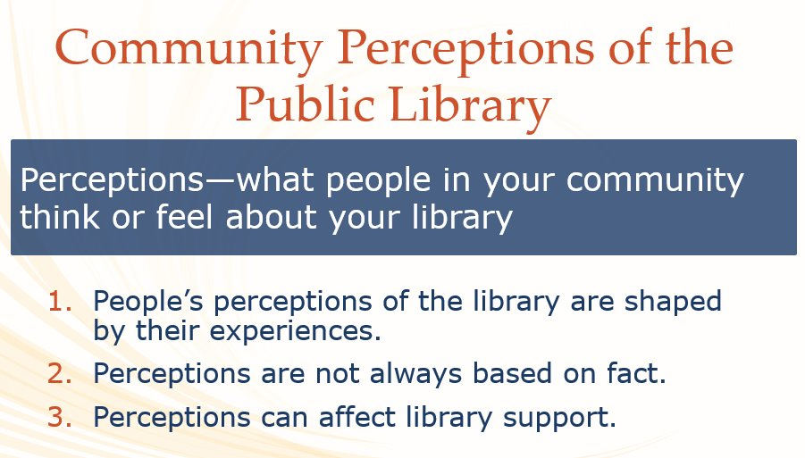

Slide 23
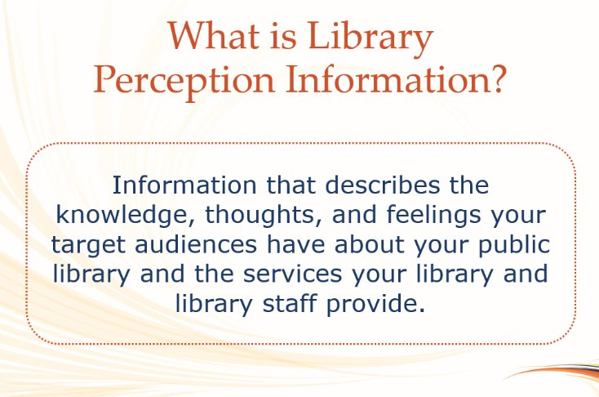

Slide 24
Train your staff. Prepare your staff.
Notes:
Library staff is extremely valuable: You are a professional serving the needs of your community. Your knowledge, experience, and skills are valuable inside and outside the library.

Slide 25

https://ncac.org/resources-for-librarians​

Slide 26
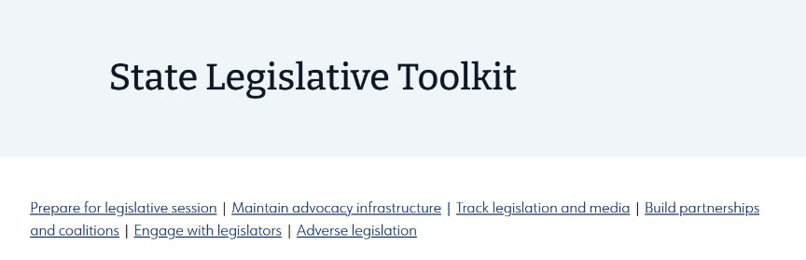

https://www.ala.org/advocacy/state-legislative-toolkit​
https://www.everylibrary.org/billtracking​

Slide 27
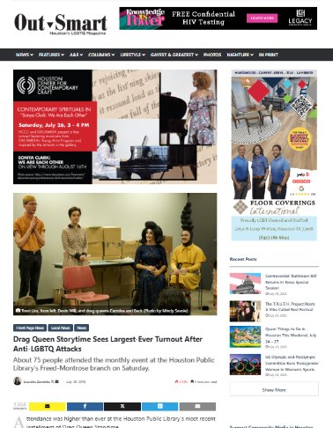
Articles

Slide 28
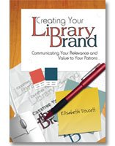
MARKETING!
Identify the audience
Develop the story
How do you attract/intrigue users
https://about.ebsco.com/blogs/ebscopost/library-branding-moving-beyond-physical-space​
Notes:
marketing is the process of (1) identifying the potential audience that you want to hear your library’s story, (2) developing that story so that those potential users understand what makes your library unique and why they will find it interesting, and (3) developing ways of telling the story that will intrigue those users and attract their attention ​

Slide 29
BRANDING!
Exercise #1: Explore Brands You Like​
Exercise #2: Establish Your Identity & Outline your library brand in the following areas:​
  Logo​
  Vision​
  Mission​
  Culture​
  Design​
  Communication​
Exercise #3: Evaluate the Current State of Your Library Brand​
  The physical library environment ​
  The physical community ​
  Social media ​
  The website and digital tools
Notes:
Technically, a brand is a mark, or logo, combined with specific colors and fonts that identifies a particular product or service to potential users. More generally, a brand is shorthand for the story that an organization wants to tell potential users about how it can meet a need in their lives. ​
​
When it comes to library branding, you are more than just a logo. Libraries play a vital role in the community and the lives of your students or patrons, and as a library brand you need to consistently express your mission, value and offerings.” Create consistent brand for physical/digital spaces​
​
Exercise #1: Explore Brands You Like​
Pick a favorite brand or brands​
Examine their marketing, advertising, website, social media, brand story and overall look and feel and voice​
Jot down what you like about their branding and note if it is consistent across channels​
Exercise #2: Establish Your Identity & Outline your library brand in the following areas:​
Logo​
Vision​
Mission​
Culture​
Design​
Communication​
Exercise #3: Evaluate the Current State of Your Library Brand​
The physical library environment – inside library, entrances, shelves, rooms, circulation desk, etc.​
The physical community – print advertising, signage, in-person events, etc.​
Social media – imagery, tone, types of content you post on your own and repost from others​
The website and digital tools – color schemes, imagery, fonts, mobile display vs. desktop​
Evaluate whether your library brand is consistent across these channels and where you need to improve.​
​
Your brand is your story in an image.​
​

Slide 30
Develop your clear, concise, unique story:
If you are a public library, what percentage of your community has library cards? Who uses your virtual library and for what purposes?​
If you are an academic library, what percentage of students use the library, either virtually or by taking books out? ​
Does your community support your library? How do you know—through financial support, through feedback you get from community surveys, or through some other mechanism?​
Is your community aware of the services offered by your library? Again, how do you obtain that information?

Slide 31
Be quick to praise and thank people for any help they give you!​

Slide 32
Share:
What are some local groups that would be a good partnership for your library?
Name three people that would support your library on the news. What would they say?​

Slide 33
Resource List
Ames H. Walther, Tina Keresztury; Ten tips for advocacy: a look at cash for buildings. The Bottom Line 1 September 2005; 18 (3): 119–125. https://doi.org/10.1108/08880450510613588​
​
Everhart, Nancy, and Marcia A. Mardis. “Building Advocacy before a Crisis.” American Libraries, 2014, pp. 26–29. JSTOR, http://www.jstor.org/stable/26197778. Accessed 3 Sept. 2025.​
​
Doucett, Elisabeth. Creating your library brand: Communicating your relevance and value to your patrons, 2008, American Library Association.​
​
Arthur W. Hafner & Susan G. Akers. “Building the Library’s Brand: Using Taglines or Logos.” Public Libraries Online, April 26, 2013 ​.
https://publiclibrariesonline.org/2013/04/building-the-librarys-brand-using-taglines-or-logos/​
​
https://www.everylibraryinstitute.org/fundamentals​
​
https://www.publiclibraryadvocacy.org/session/session-1-introduction/

