Slide 1
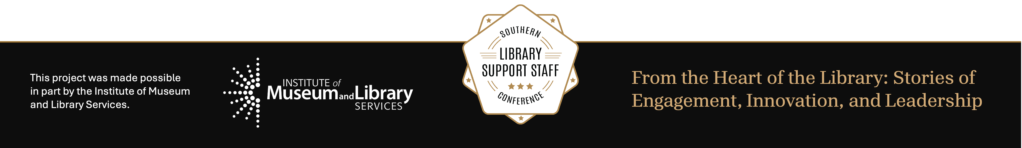
Algorithms, Influence, and the Library’s New Role in the Age of AI
Exploring truth, bias, and the evolving role of information professionals
Charisse Brent, MLIS, MARA, CRA (she/her)
MAY 27, 2026
Notes:
For my lightening talk I will briefly be shining a light on “Algorithms, Influence, and the Library’s New Role in the Age of AI– with emphasis placed on the people who keep libraries running every day: circulation staff, front desk teams, student workers, shelving teams, and everyone who is often the first person a patron asks. Algorithms are already shaping what patrons see, what they trust, and what they bring to us. My goal is to connect that reality to our daily work.

Slide 2
Slide title
The Invisible Feed: When Algorithms Think for Us
What if the information we see every day isn’t random—but engineered?
Personalization = persuasion
The average person sees 6,000-10,000 ads per day, most chosen by algorithms.
Every scroll is a story someone—or something—wants you to believe
AI curates your reality—what you see, feel, and believe.
Notes:
Imagine waking up, checking your phone, and scrolling through your feed.
Every post, every video, every “trending” story feels like it’s speaking directly to you—your beliefs, your fears, your hopes—but what we see is no accident.
When patrons walk in after scrolling online, they often carry assumptions shaped by feeds that are ranked, personalized, and optimized for attention. At the desk, we see the results: confusion, urgency, strong emotions, and sometimes misinformation.
Feeds are not neutral—what shows up first is often what the system thinks will keep people engaged, not what is most accurate. Algorithms track what we click, like, and linger on, silently curating a world that feels tailored individually just for us.
However, personalization can be manipulation—deciding what emotions we feel and what truths we accept. This is propaganda reimagined— It’s not just posters on walls or headlines in newspapers anymore—it’s quiet, predictive, and invisible.
And in an age where AI controls the flow of information, we must ask: how do we learn to think freely in systems designed to think for us?

Slide 3
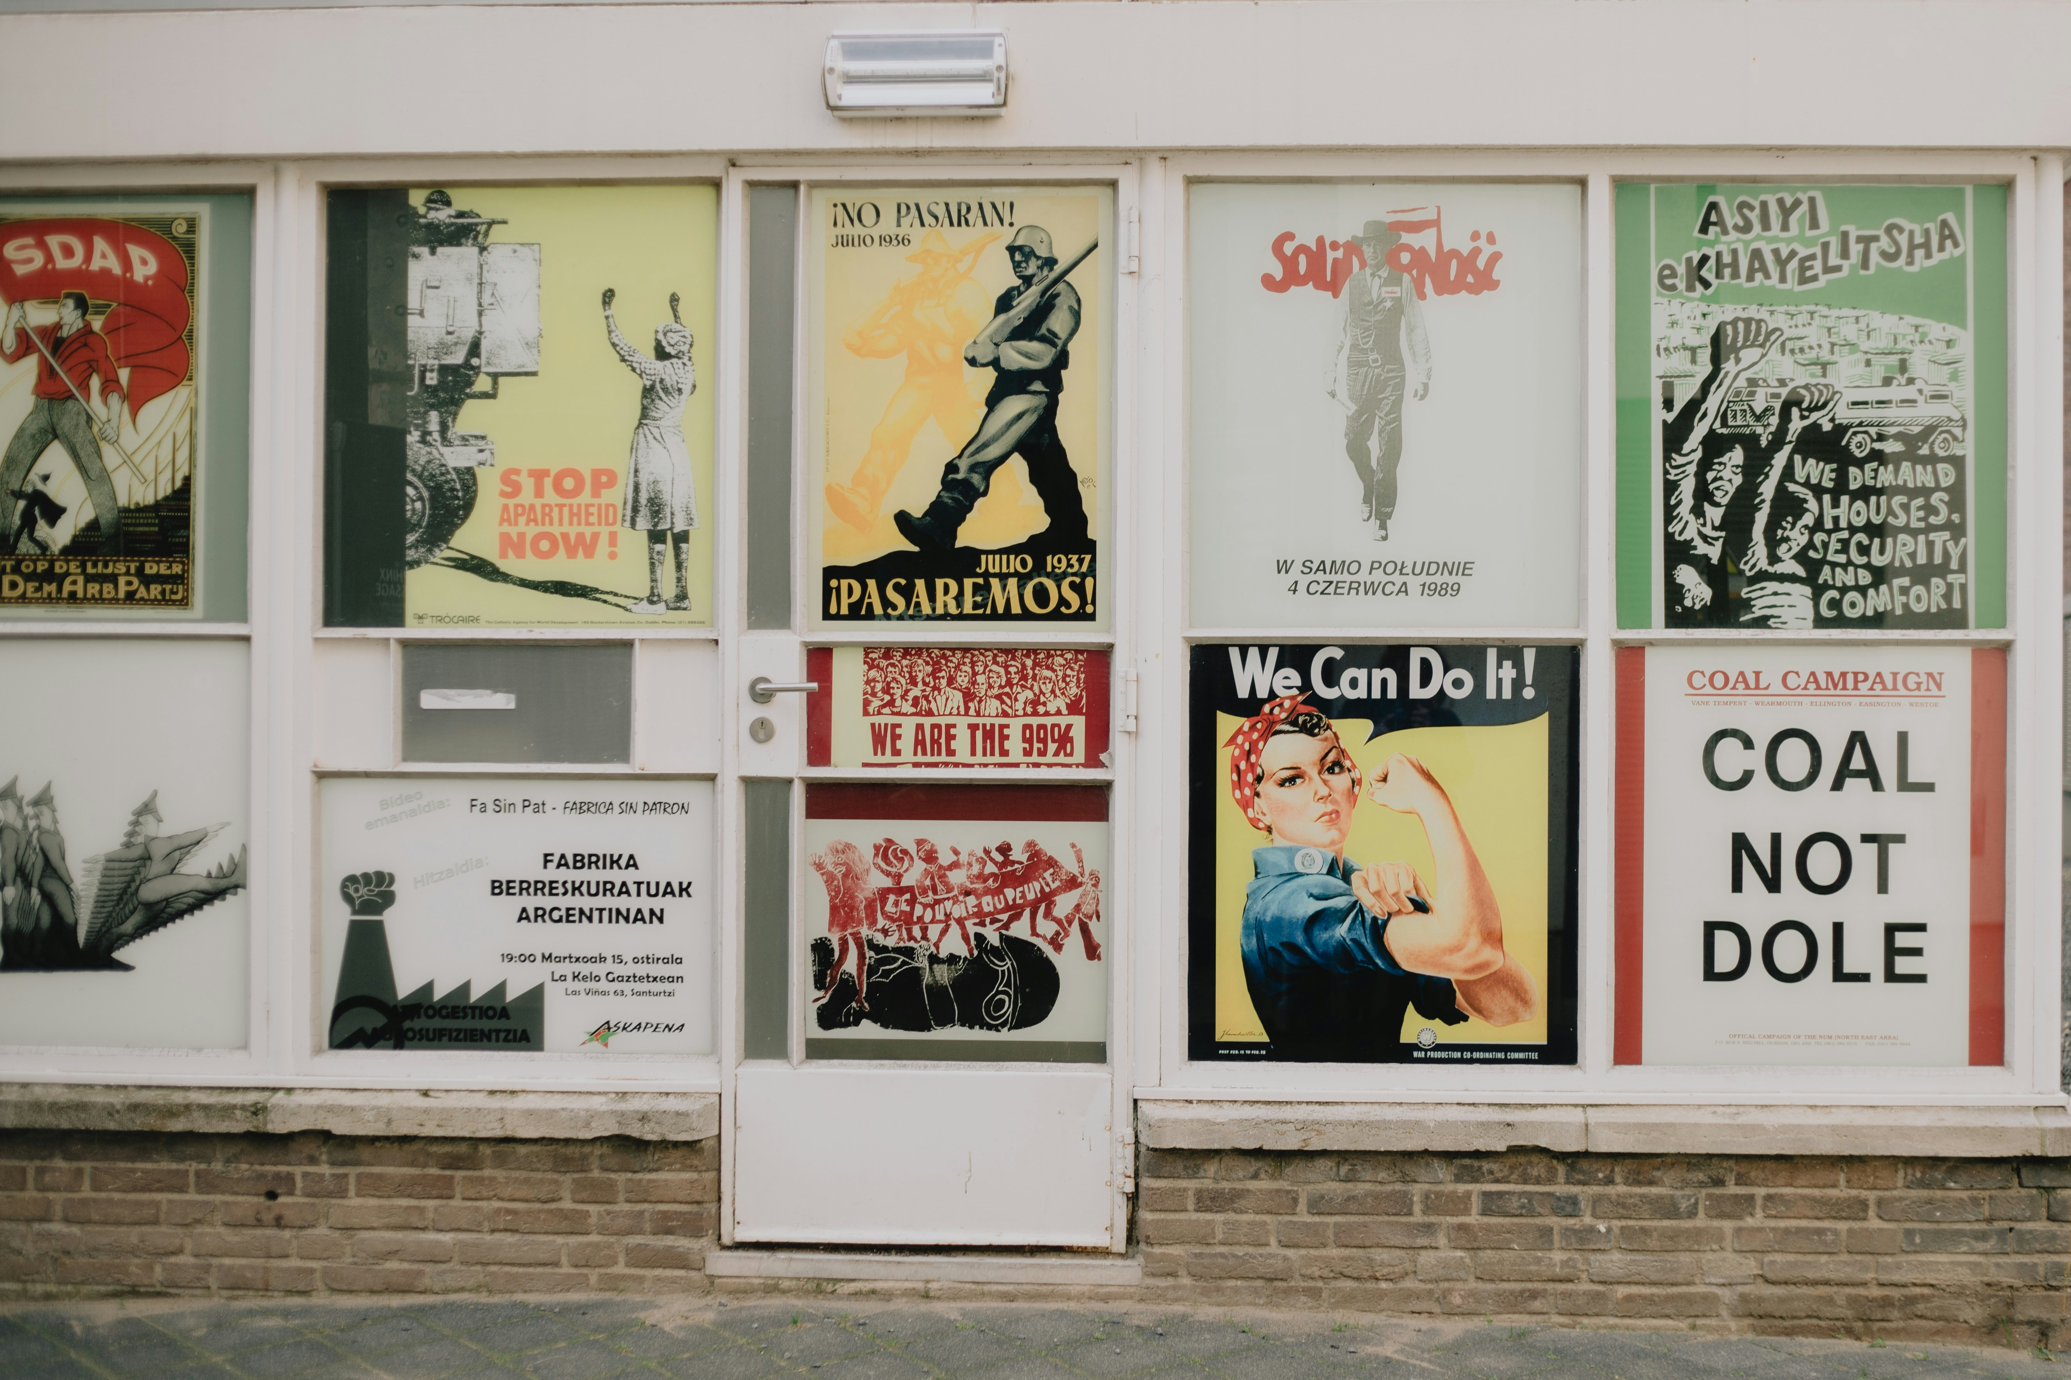
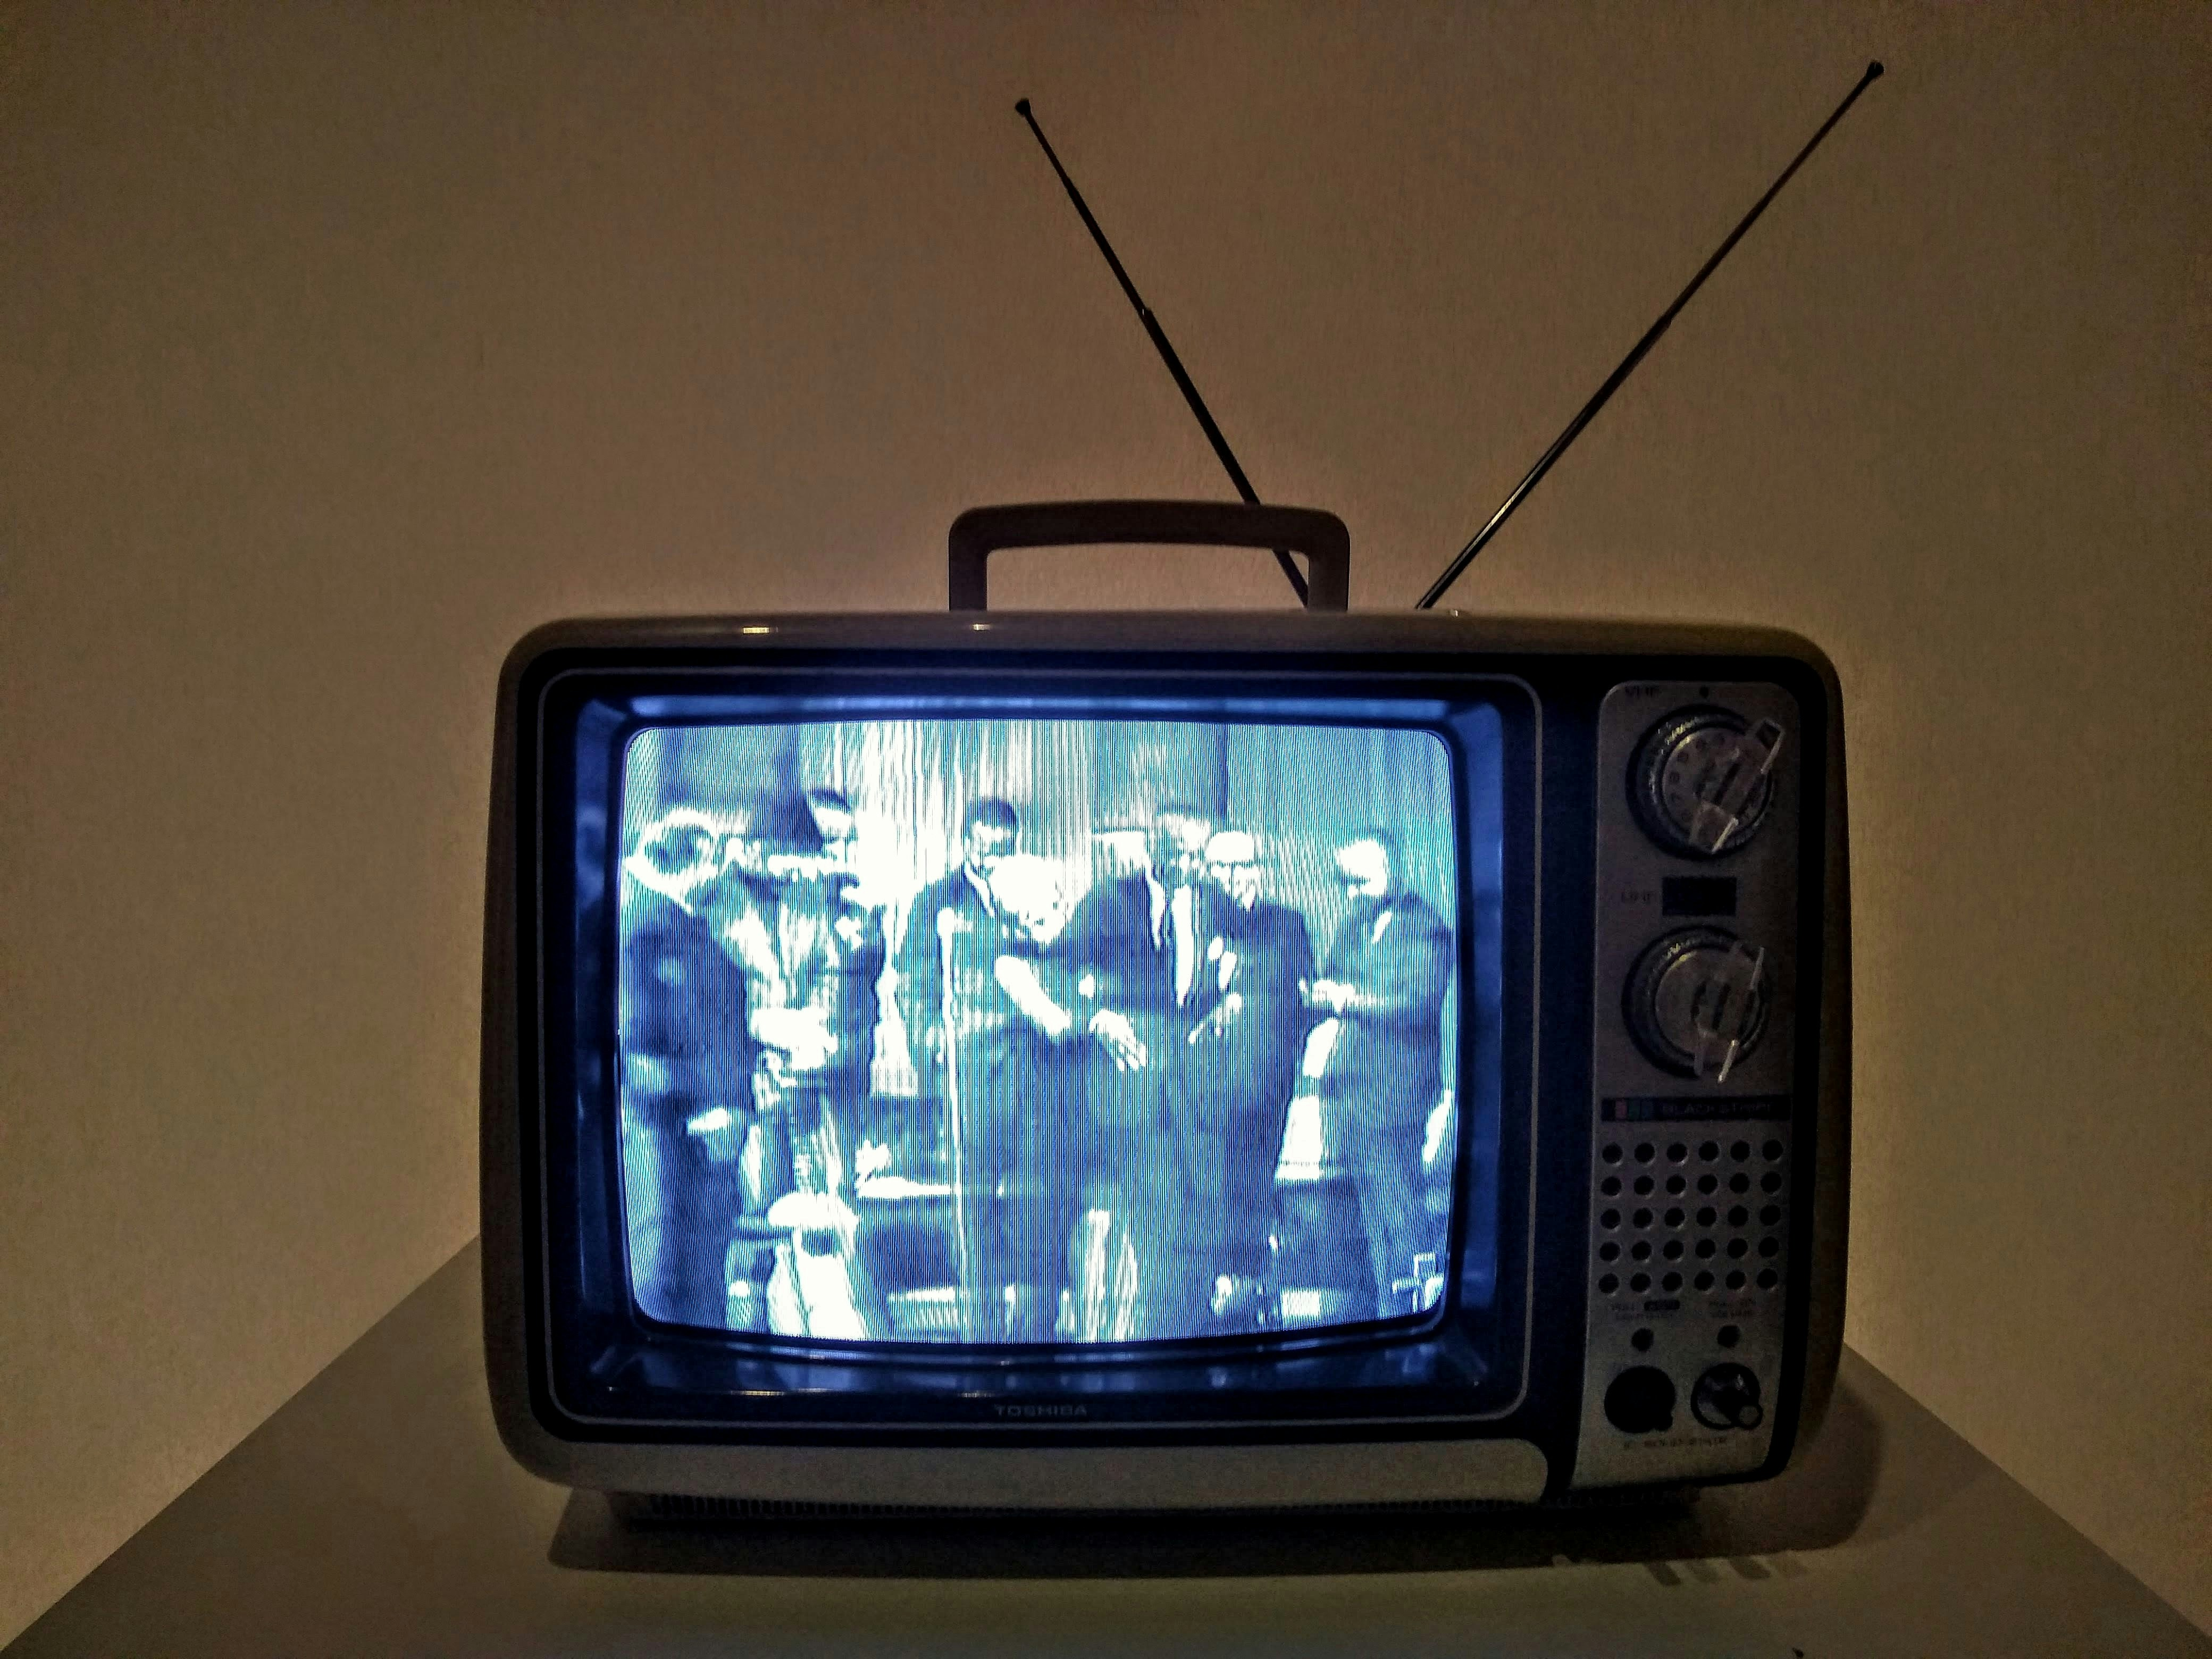
Propaganda adapts to every era
1940s: Radio waves → 2020s: Algorithmic waves
Libraries evolved too: from shelves → servers → search
The Evolution of Propaganda
Propaganda adapts to every medium. So do libraries.
Notes:
Propaganda has never stayed still—it has always adapted to the medium of the time. In the 1940s, it was wartime posters and radio broadcasts. In the 1980s, it was nightly news and political ads. Today, it’s algorithms deciding which TikToks or news headlines ride to the top. Each shift makes propaganda feel more personal, more emotional, and harder to detect.
Likewise, libraries have evolved too. From quiet archives of books to interactive digital environment where we confront misinformation every day. Our challenge now isn’t access to information—it’s awareness of how that information reaches us.
When propaganda meets machine learning, the manipulation multiplies. What matters for library support staff is that misinformation now arrives through texts, videos, search results, and even shared screenshots.
However, Libraries adapt too. We are often the first stop when someone wants help figuring out what is real, what is reliable, and what to trust.

Slide 4
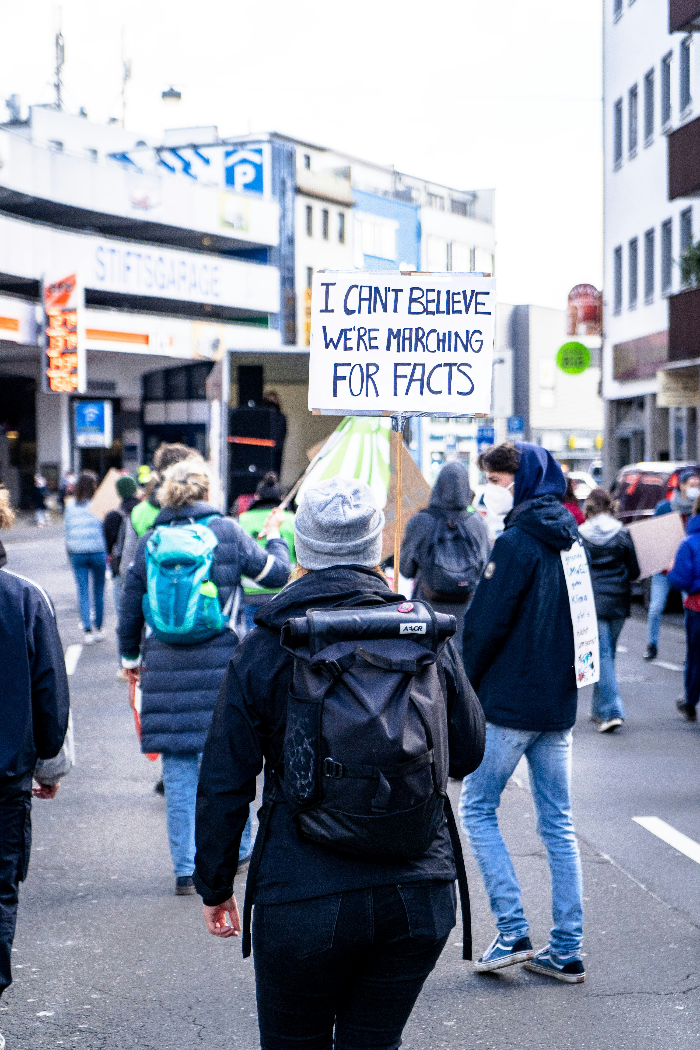
How AI Drives Modern Propaganda
Deepfakes → 90% of online videos could be synthetic by 2030
AI learns your emotions. Then it plays them
Emotional engagement > factual accuracy
Feedback loop: anger → engagement → more content
When propaganda becomes personalized, it becomes invisible.
Notes:
Artificial intelligence doesn't just predict what we'll watch—it shapes what we believe. Deep fakes can make politicians appear to say things they never said, bots can flood comment sections to sway public opinion, and AI written “news” outlets can publish convincing stories entirely without human editors.
AI systems today can generate text, images, and videos so realistic that truth and fiction blur at the edges. Let’s say for example (a current president in a crown on the front of TIMES magazine or Former President Obama getting arrested by ICE during an oval office meeting or even fighter jets dumping sewage on protesters marching for their constitutional rights with a current president in the cockpit).
These aren't distant hypotheticals they're happening now, in our feeds and timelines. The real danger isn't just falsehood, its emotional engineering. AI learns that outrage and fear keep us engaged, so it feeds us more. For students and researchers, this means our digital environment can quietly bias what we read, share, and even see. Support staff do not need to be experts to help; we can model simple habits like pausing before sharing, checking the source, and asking whether a post is trying to provoke emotion more than provide evidence. That small pause can interrupt the spread of false information.

Slide 5
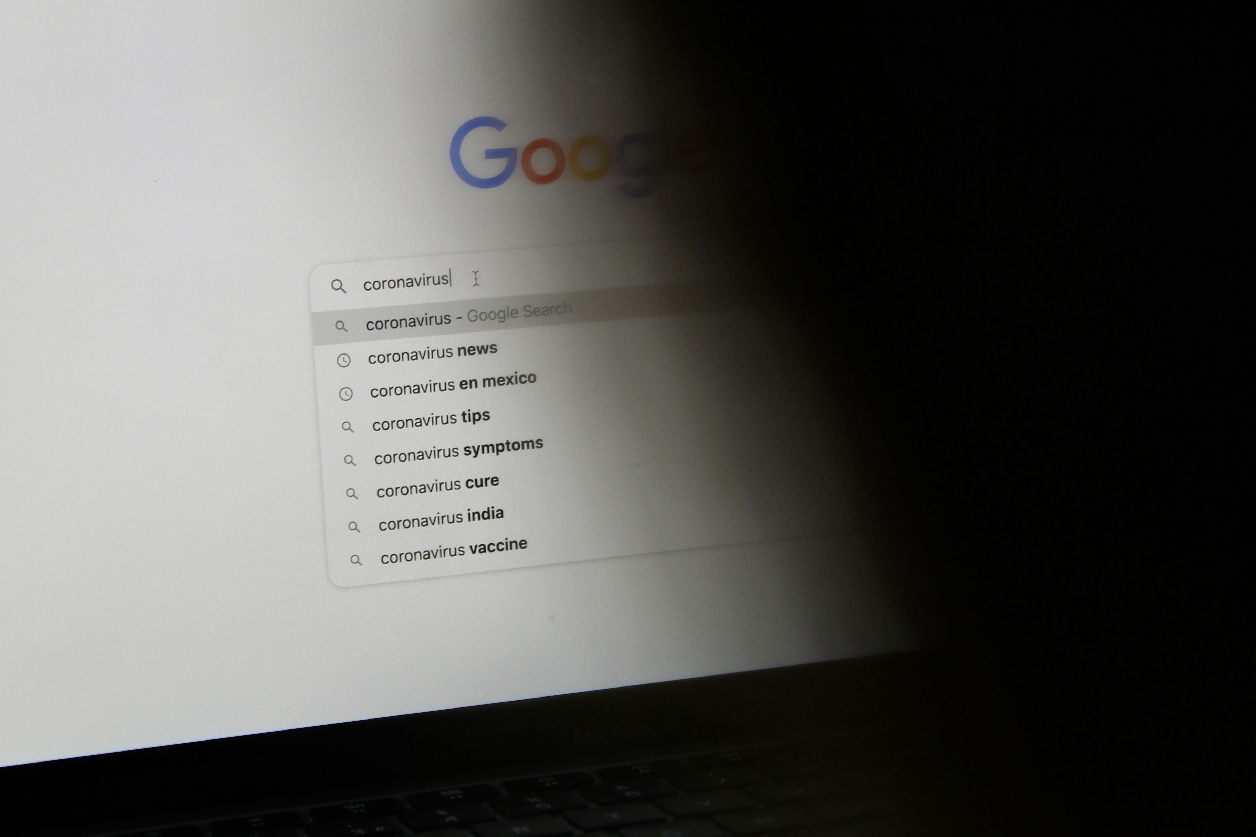

Digital Gatekeepers or Guardians?
Search results aren’t neutral
Metadata = visibility
If it’s not tagged, it’s invisible
Libraries: the original curators of context
Over 90% of students never look past the first page of search results.”
Libraries mediate between people and powerful unseen systems.
Notes:
Now here’s where libraries come in.
Libraries have always stood for access, equity, and informed choice.
But in an age of algorithmic control, we’re no longer just curators of books—we’re mediators between people and powerful, unseen systems.
Think about it: AI already affects how we search library catalogs.
Discovery tools rank what we see first.
Metadata influences what surfaces—or what disappears.
If our systems reproduce commercial algorithms, or if our metadata reflects bias, we risk perpetuating the same inequities we’re supposed to challenge.
Libraries have a new responsibility: not just to teach information literacy, but algorithmic literacy—helping communities understand why they see what they see, and how invisible forces shape what they believe.
For support staff, this means our work matters in everyday moments: helping patrons search, explaining why results look the way they do, and pointing them toward databases, filters, and human help when automated tools fall short. When communities learn how library algorithms work, they gain the power to question digital hierarchies and to use information, not be used by it.

Slide 6
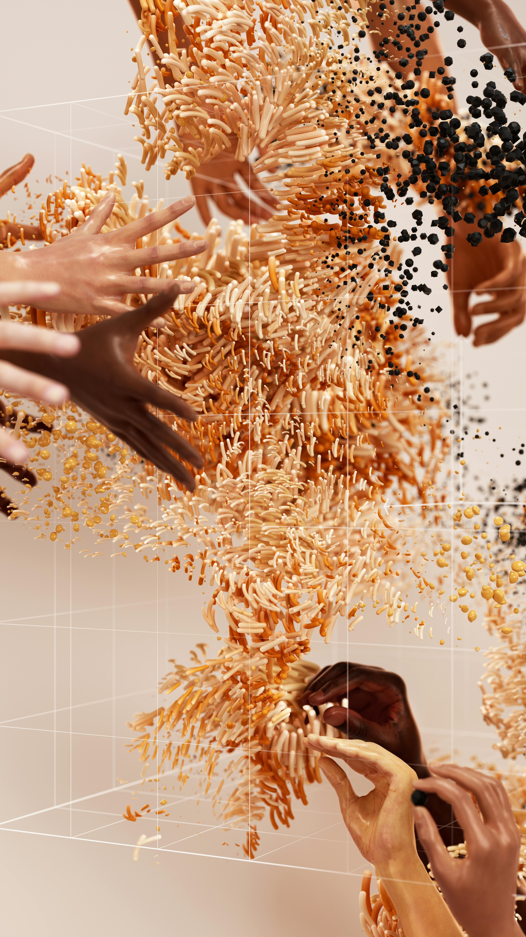

The Bias Problem: When Data Learns Our Inequality
AI reproduces social bias
Word cloud: bias, representation, silencing
AI learns from society’s inequities
AI reflects the world’s biases—unless we intervene.
Notes:
AI systems learn from the world as it is, not as it should be—and the internet is full of human bias. Studies have shown that AI image generators reproduce stereotypes, while language models reflect racial and gender prejudices embedded in data.
When these biases feed into search algorithms or academic tools, marginalized voices risk being underrepresented or misrepresented. They’re stereotyped in data, silenced in algorithms, and erased in digital histories. Bias is not only a technical problem; it is a collection, metadata, and access problem. If records are incomplete or language is outdated, whole communities can become harder to find.
Libraries and Support staff can help by intentionally curating inclusive collections and metadata that highlight diverse perspectives, noticing missing or inaccurate terms, using respectful language, and flagging issues so the library’s systems better reflect the people we serve. Without this, AI systems will keep amplifying the loudest voices, not the most truthful or authentic ones.

Slide 7


Libraries at the Crossroads
Promoting Algorithmic Awareness
Transparent Tool Use
Human-Centered Guidance
Notes:
As we think about where Academic Libraries fit in this moment of rapid AI development, our call to action is simple: We align our use of AI with the ACRL Information Literacy framework— using AI as a supplement, not a shortcut. Let’s lean into algorithmic literacy, choose transparency, and stay connected to the human expertise that keeps our research grounded and ethical.
First, we can strengthen algorithmic literacy through the Framework by keeping in mind that not all information is equal — and with AI, we also need to ask who trained the model, what data shaped it, and why it generates certain outputs. Academic Libraries, as well as public libraries can integrate these questions into “First-Year Student” workshops, “AI Lab Workshops”, in-class sessions, and one-on-one consultations so students and patrons alike learn not just to fact-check, but to systems-check.
Second, for support staff of both public and academic libraries, algorithmic literacy can be practical and small-scale. We don’t have to teach everything at once. We can ask patrons what they are trying to do, show one search strategy, compare a generated answer with a library database, and be transparent when a tool is automated. That kind of guidance builds trust and helps patrons use technology more critically. Because AI searching is iterative and nonlinear—we can ultimately teach students how to interact with AI tools. Support staff can help students and patrons refine prompts, try multiple pathways, compare AI results to database search results, and reflect on what each method reveals or obscures. Patrons can practice reading model documentation, questioning an output’s reliability, and recognizing when they need to pull in librarian expertise for deeper context. Support staff should keep in mind that AI supports research, but human judgment guides it.
Let’s use AI in alignment with the values Libraries already uphold.
Let’s teach students to question systems, explore strategically, and engage ethically. Let’s position AI as a supplemental tool — powerful, but always grounded in human expertise, cultural context, and critical thinking. If we do that, our Academic and Public Libraries won’t just keep pace with technological change. We’ll lead — with intention, with transparency, and with our students and patrons at the center of the conversation.

Slide 8



“Truth Has a Human Voice”
"The future of truth belongs to those who dare to question.”
Libraries = sanctuaries for critical thinking.
Technology shapes us. Libraries teach us to shape it back.
“Reclaim curiosity. Reclaim truth.”
Libraries are where we learn to question, not just to search.
Notes:
My closing message is that libraries remain one of the few places where people can slow down, ask questions, and think together. They’re not just places to find books—they’re spaces for critical thinking—spaces where communities learn to navigate not just books and databases, but algorithms and bias itself.
In the age of AI, that matters deeply. Support staff are central to that mission because you are often the first human voice a patron meets. You help turn a library from a system into a conversation.
The future of truth doesn’t belong to AI. The future of truth won’t be decided by machines; it’ll be defined by the people who dare to question them. And libraries—our libraries as support staff—can lead that revolution by keeping humanity at the heart of knowledge.

Slide 9

Speaker Contact Information
Charisse Brent, MLIS, MARA, CRA
Archivist Intern
Email:
cbrent@usc.edu
brentcharisse@gmail.com
LinkedIn: Charisse Brent, MLIS
Notes:
Contact Information

Slide 10

Use of AI Statement
I knowingly used ChatGPT to revise and refine my original drafts and outlines and check for grammar and spelling errors. I reviewed, verified, and revised all AI-generated content and the final product represents my own work and ideas.
Notes:
Use of AI Statement:
I knowingly used ChatGPT to revise and refine my original drafts and outlines and check for grammar and spelling errors. I reviewed, verified, and revised all AI-generated content and the final product represents my own work and ideas.

Slide 11
References
Alvarez, B. (2017, January 11). Public libraries in the age of fake news. Public Libraries, 55(6), 24–27. https://publiclibrariesonline.org/2017/01/feature-public-libraries-in-the-age-of-fake-news/
American Library Association. (2015). Framework for information literacy for higher education. http://www.ala.org/acrl/standards/ilframework
American Library Association. (2016). Framework for information literacy for higher education. Association of College & Research Libraries. https://www.ala.org/acrl/standards/ilframework
Benjamin, R. (2019). Race after technology: Abolitionist tools for the new Jim code. Polity Press.
De Paor, S., & Heravi, B. (2020). Information literacy and fake news: How the field of librarianship can help combat the epidemic of fake news. The Journal of Academic Librarianship, 46(5), 1–8. https://doi.org/10.1016/j.acalib.2020.102218
Eubanks, V. (2018). Automating inequality: How high-tech tools profile, police, and punish the poor. St. Martin’s Press.
Gillespie, T. (2018). Custodians of the internet: Platforms, content moderation, and the hidden decisions that shape social media. Yale University Press.
Jowett, G. S., & O’Donnell, V. (2019). Propaganda & persuasion (7th ed.). SAGE.
Marwick, A., & Lewis, R. (2017). Media manipulation and disinformation online. Data & Society Research Institute.
Noble, S. U. (2018). Algorithms of oppression: How search engines reinforce racism. New York University Press.
O’Neil, C. (2016). Weapons of math destruction: How big data increases inequality and threatens democracy. Crown.
PressReader Team. (2023, August 7). Libraries can fight AI-generated misinformation with media literacy education. PressReader. https://blog.pressreader.com/libraries-institutions/libraries-can-fight-ai-generated-misinformation-with-media-literacy-education
Rainie, L., & Anderson, J. (2017). Code-dependent: Pros and cons of the algorithm age. Pew Research Center. https://www.pewresearch.org
USC Libraries. (n.d.). Research guides and digital resources. https://libraries.usc.edu/
van Dijck, J., Poell, T., & de Waal, M. (2018). The platform society: Public values in a connective world. Oxford University Press.
Notes:
References

