Slide 1
One Island. One Vision.
Building State Capacity for PK–1 Literacy Through Coherent Systems
Puerto Rico Department of Education + Islands Comprehensive Center
Dr. Eneida Padró, Islands CC
Dr. Kevin S. Carroll, Islands CC
Prof. Indhira Castro Rivera, Puerto Rico DE

Slide 2
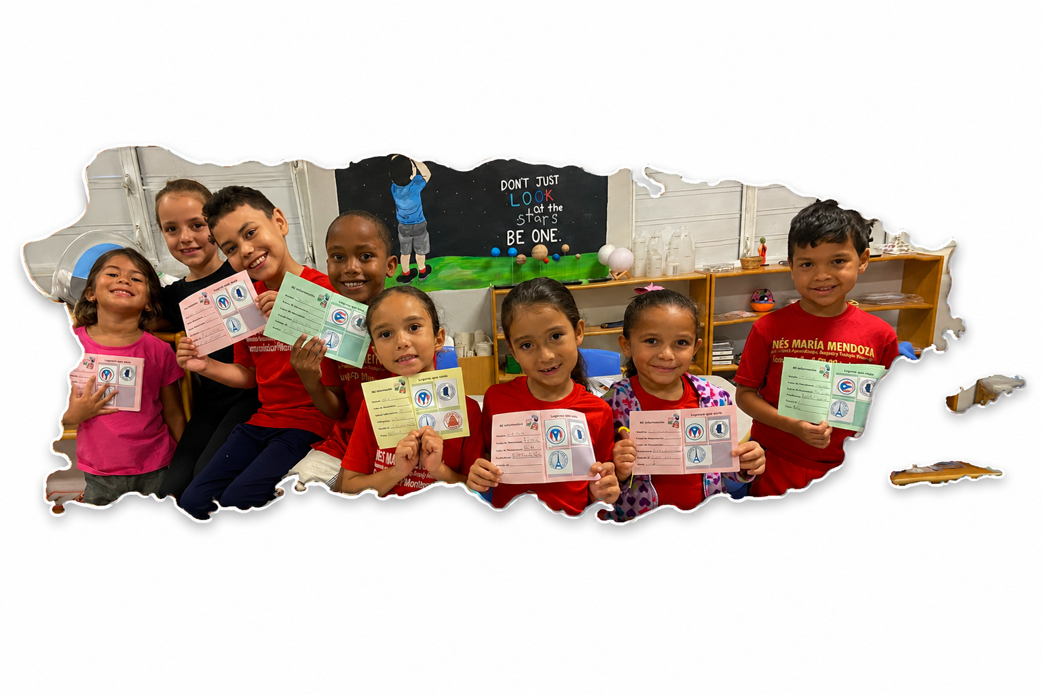

Notes:
From good to great narrative – supporting prde to maximize potential (systemic project to reach regional offices but also the sytem as a whole) - intentionally demistify the pobrecitos
Our challenge wasn't a lack of effort or expertise.
It was a lack of coherence and implementation supports.
This is the experience of PRDE's and ICC working together to strengthen the state's capacity for early literacy—not by launching another initiative, but by creating coherence.

Slide 3
Agenda
Theory of Action
Project Phases
Lessons Learned

Slide 4
If
Then
DEPR strengthens literacy structures and resources in order to:
We will be able to influence long-term academic achievement in literacy because teachers, principals, facilitators, and support teams:
clarify student learning expectations and key instructional practices in PK-1 literacy, supporting transition and creating coherence;
will share a common understanding of which literacy practices are essential and how they appear in implementation;
define existing roles through
a clear instructional lens in
order to identify and
strengthen coaching structures;
will use existing roles and structures to observe, support, and strengthen instruction in a more coherent way;
develop practical tools that allow observation and measurement of implementation of the practices.
will be better prepared to measure implementation quality and participate in continuous improvement cycles.
.
.

Slide 5
Phase 1: CLARIFY
Creating one shared vision of high-quality PK–1 literacy instruction
We asked ourselves:
What does great literacy instruction look like?
What does every educator implement?
What does every child practice?
We asked the system:
How does PRDE define effective early literacy instruction?
What resources are available?
What does support look like?
Notes:
Presenters will
Before we could improve practice, we had to define practice.

Slide 6
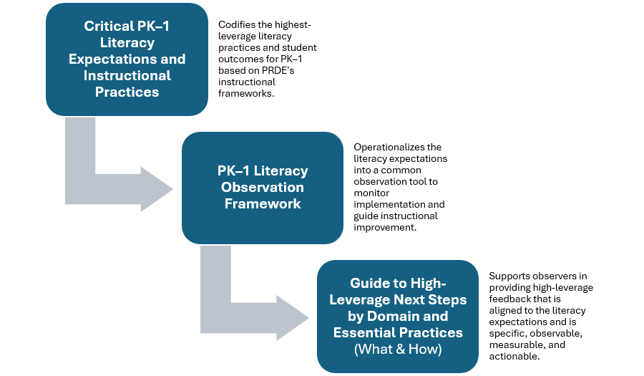
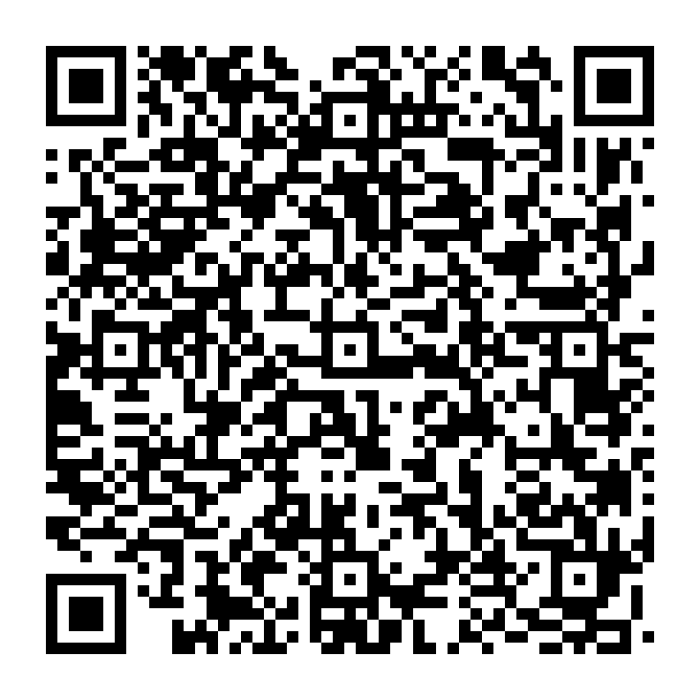
Phase 2: DESIGN
Making Practice Visible
Notes:
Before we could improve practice, we had to define practice.
Didn't just stay in the hands of teachers but also signed off by partners and cao – add two columns table for audience that it intended to reach

Slide 7
Phase 3: PILOT
What we thought vs what we learned.
We thought... | We learned...
The observation tool was the innovation | The coaching conversation was the innovation
More indicators are necessary | Fewer priorities increases usability
Training principals | Building facilitator capacity to support principals first
Roll out the toolkit | Pilot the implementation and pressure test the coaching

Slide 8
Uplifting the Voices of the SEA​
Simplified observation priorities
Shifted emphasis toward coaching conversations
Different entry points for Principals
Added implementation guidance and professional learning supports
Doubled down on scaling up the pilot to further test implementation and coaching
Facilitator Surveys
Professional Learning Sessions
Classroom Observations & Debriefs
Principal Focus Group -
Notes:
Will discuss the more than 50% participation in the facilitator surveys + Terrific feedback and satisfaction from school principals in the pilot + Principal focus group participants shared that the instrument had a lot of potential with the right training

Slide 9
Beyond the Toolkit
The project resulted in:
A shared instructional vision
Common observation language
Coaching supports
Facilitator capacity-building model
Principal implementation model
Statewide scaling recommendations
Notes:
The real value is not the observation itself but the coaching conversation that results.

Slide 10
5 Lessons for State Agencies
Codify before you coach.
Use existing structures before creating new ones.
Pilot implementation—not just products.
Coaching changes practice more than compliance.
Capacity grows through continuous improvement.

Slide 11
Looking Ahead
Our goal was never to build a better observation tool.
Next steps:
Facilitator Academy
Volunteer principal cohort
Regional implementation (instructional rounds)
Strengthen implementation for the transition tool Mi Pasaporte
Our goal was to help the system build a shared understanding of high-quality early literacy instruction that facilitated follow up and job-embedded supports.
Notes:
Make sure to mention the children

Slide 12
Roundtable preview
Provide more details on the research pedagogical rationale behind the toolkit
Unpack the importance of instructional leadership in fostering biliteracy
Share best practices related to toolkit design and steps required to ensure alignment with the SEA
Notes:
Make sure to mention the children

Slide 13

Questions

Slide 14
Thank You
Prof. Indhira Castro Rivera,
Puerto Rico Department of Education – castrori@de.pr.gov
Dr. Eneida Padró, Islands CC – Eneida@concentri.co
Dr. Kevin S. Carroll, Islands CC – kevin@empowered-pr.com
Notes:
Add QR CODE HERE TOO

Slide 15
Appendix

Slide 16
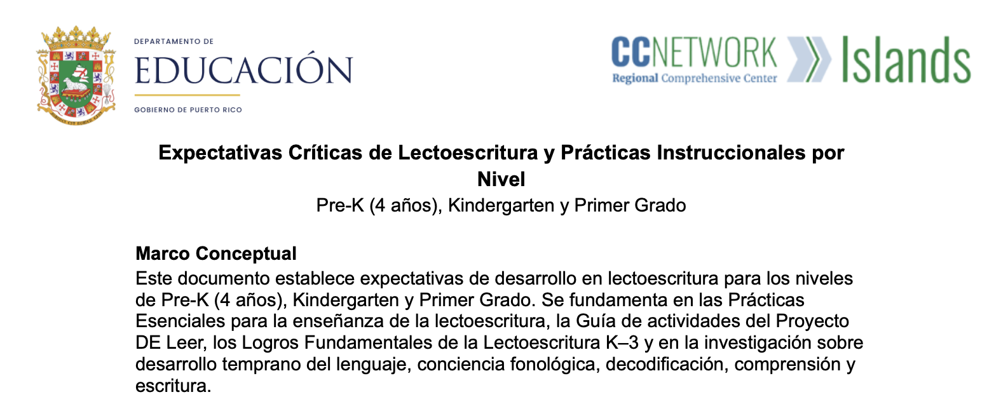
Critical PK–1 Literacy Expectations and Instructional Practices Document

Slide 17
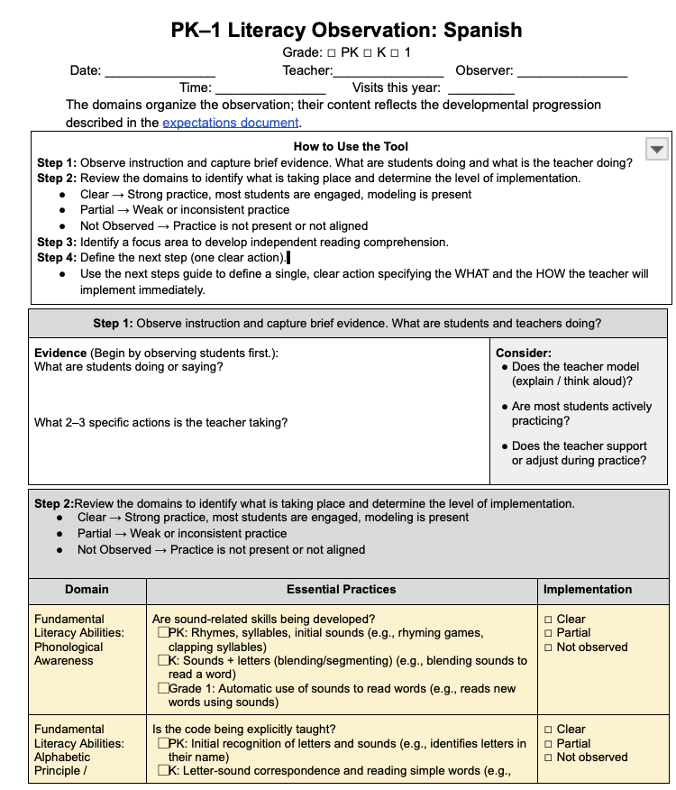
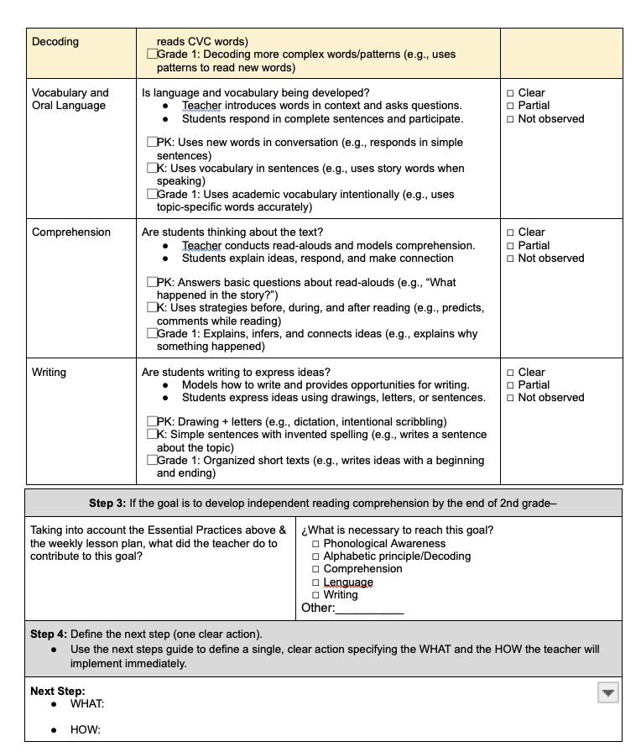

Slide 18
