Slide 1
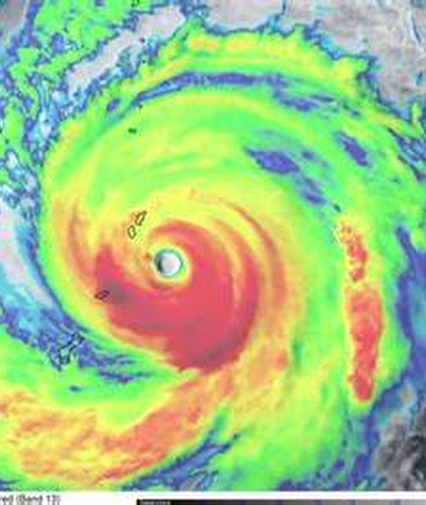
EXAMINE FEDERAL FLEXIBILITIES IN PRACTICE
CAPACITY LEVER: STRATEGY + RESOURCE ALIGNMENT
Weathering the Storm
Using Federal Flexibilities to Build Fiscal and Organizational Resilience in the CNMI Public School System
A replicable operating-model strategy from a small island school system
Jacqueline Che
Acting Commissioner of Education • CNMI Public School System
National Comprehensive Center • Stronger States, Stronger Outcomes • Washington, DC

Slide 2
THE CENTRAL MESSAGE
Resilience is an operating model
Resilience is not simply having more resources. It is having an operating model that can realign people, funding, and administrative capacity when conditions change.
Question 1
Question 2
Question 3
What problem forced us to change?
Super typhoon damage, school closures, declining local appropriations, and the expiration of approximately $160 million in ARP funding created simultaneous fiscal and operational pressure.
What did we actually change?
CNMI PSS cross-mapped Title programs, FEMA Public Assistance, and other grants; built shared infrastructure; and reorganized staff around cross-functional capacity.
What can another SEA take home?
Treat funding streams as part of one strategic operating model while protecting allowability, accountability, and documentation.
Through-line: from funding silos to one strategic operating model
CNMI PSS • STRONGER STATES, STRONGER OUTCOMES
2

Slide 3
WHY THIS STORY MATTERS IN CNMI
Island context shapes the operating challenge
Island system
A small island education system has less slack. Physical disruption, staffing constraints, and funding volatility are felt quickly across operations.
Geographic reality
Disruption affects facilities, transportation, utilities, scheduling, and access across communities and islands—not just one program office.
Resource reality
The question is not whether needs are real. The question is how to align limited funds and staff capacity to protect core instructional functions.
Replicable lesson
This logic can help any SEA facing fiscal cliffs or compound pressure.
For CNMI PSS, resilience meant protecting a shared operating backbone:
groups
cached
payments
description
People
cross-functional staffing
Processes
shared workflows
Funding
portfolio alignment
Documentation
audit-ready decisions
CNMI PSS • STRONGER STATES, STRONGER OUTCOMES
3

Slide 4
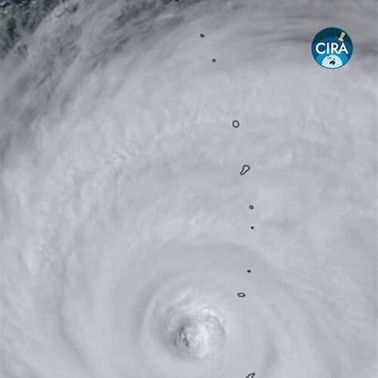
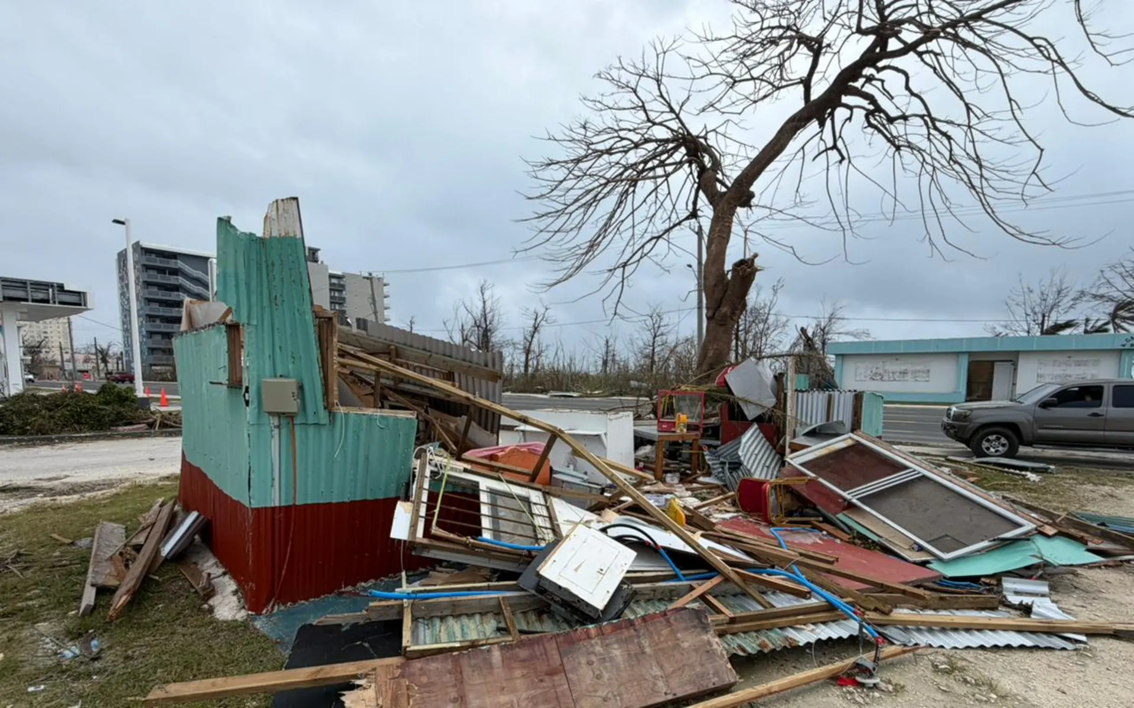
WHAT FORCED US TO CHANGE
A compound shock—not a single funding problem
Storm damage + school closures
Physical damage, interrupted operations, and changing facility use patterns competed directly for leadership time, staff capacity, and recovery management.
Declining local appropriations
Recurring local support tightened while core instructional and operational demands remained. The system had less unrestricted room to absorb disruption.
Expiration of approximately $160M in ARP funds
Temporary federal relief supported important work, but it also created a looming funding cliff. CNMI PSS had to decide what capacity could be preserved after the cliff.
Why this mattered
The challenge was simultaneous: fiscal, operational, and organizational.
CNMI PSS • STRONGER STATES, STRONGER OUTCOMES
4

Slide 5
THE FISCAL SHOCK REACHED THE CALENDAR
Budget pressure showed up in instructional time
SY 2025–26 Calendar
Selected 2025–26 Proof Points
129
Instructional Days
19
Austerity Days
38
Typhoon Days
726
graduates
59
graduates with disabilities
⚠️ 57 days (about 31% of the calendar)
were not standard instructional days.
186
calendar days
129
instructional days
What this meant operationally
The operating question became:
"How do we preserve instructional capacity when both time and money are constrained?"
This is where flexibility and resource alignment became essential.
Data point: 2025–26 graduates remained substantial despite disruption
CNMI PSS • STRONGER STATES, STRONGER OUTCOMES
5

Slide 6
FEDERAL FLEXIBILITY IN PRACTICE
How CNMI PSS operationalized resource alignment
01
Start with outcomes
Name the instructional and operational capacity that must be protected.
02
Cross-map authorities
Map purposes, deadlines, and award-specific constraints across Title, FEMA, local, and other sources.
03
Assign relative benefit
Identify who benefits from the work, then select a reasonable basis for cost assignment.
04
Build shared infrastructure
Use common planning, procurement, finance, and documentation processes wherever appropriate.
05
Document relentlessly
Keep rationale, approvals, and evidence clear enough to withstand monitoring and audit.
Flexibility did not mean fewer rules; it meant coordinated use of allowable options.
CNMI PSS • STRONGER STATES, STRONGER OUTCOMES
6

Slide 7
THE STRUCTURAL WEAKNESS
The default model was built for stability
Before the shift, funding streams often brought their own staff lanes, workflows, and reporting cycles.
Title programs
FEMA PA
Other grants + local
Result under stress
Staff
Staff
Staff
Duplicate processes and fragmented ownership
Workflow
Workflow
Workflow
Slow cross-program decision-making
Calendar
Calendar
Calendar
Administrative burden rose as demands intensified
Reporting
Reporting
Reporting
Capacity could not be redirected fast enough toward classrooms
CNMI PSS • STRONGER STATES, STRONGER OUTCOMES
7

Slide 8
ONE STRATEGIC OPERATING MODEL
Align the portfolio around protected capacity
Title programs
Outcome:
Protected instructional capacity
IDEA + other formula funds
ARP / ESSER
students • teachers • school operations
FEMA PA + local funds
Instead of asking “Which grant owns this?” first, CNMI PSS asked: “What outcome or shared capability are we trying to protect…and which sources can support it within their rules?”
CNMI PSS • STRONGER STATES, STRONGER OUTCOMES
8

Slide 9
ORGANIZATIONAL RESTRUCTURING
We reorganized around capacity, not grant labels
The change was organizational as well as financial.
BEFORE
AFTER
Key Outcome
The reorganization preserved program expertise while reducing silos.
By sharing planning, finance, procurement, and compliance work across the entire portfolio.
Title program team
Fiscal workflow
FEMA recovery team
Procurement / reporting
Operating-model shift
Shared administrative infrastructure
Cross-functional staffing
Coordinated decision-making
More overhead redirected to classrooms
≈15% overhead capacity redirected
CNMI PSS • STRONGER STATES, STRONGER OUTCOMES
9

Slide 10
ACCOUNTABILITY BY DESIGN
Guardrails made flexibility credible
Allowable
Permitted by statute, regulation, award terms, and applicable guidance.
Reasonable
Prudent and appropriate for the circumstances and scale of benefit.
Allocable
Charged in proportion to relative benefit—or assigned using a documented, reasonable basis.
Documented
Supported by rationale, approvals, records, and evidence adequate for monitoring or audit.
Compliance guardrails made it possible to move quickly with confidence.
This is what turned flexibility into a system capability rather than a one-time workaround.
CNMI PSS • STRONGER STATES, STRONGER OUTCOMES
10

Slide 11
PROOF POINT: STUDENT OPPORTUNITY WAS PROTECTED
AP results show resilience in action
Despite Super Typhoon Sinlaku, CNMI PSS achieved its highest AP qualifying rate in six years.
24%
2021 AP exams scoring 3+
55%
2025–26 AP exams scoring 3+
276 / 501
exams earned a 3 or higher
Typhoon disruption
Power and water interruptions occurred immediately before the scheduled testing window.
Rapid realignment
PSS shifted to the College Board exception-testing window and realigned locations, schedules, technology, staffing, and transportation.
Partnership execution
Schools, AP coordinators, teachers, families, and the College Board coordinated to preserve student access.
Student outcome
Students retained the opportunity to test and posted the strongest six-year result.
The AP program is supported through federal funding under the Consolidated Grant’s College, Career, Life Readiness Project.
CNMI PSS • STRONGER STATES, STRONGER OUTCOMES
11

Slide 12
SUPPORTING THEMES
Partnerships, organizational capacity, and technical assistance
SEA leadership
Set direction and made tradeoffs visible.
Leadership reinforced that fiscal strategy was in service of instructional capacity, not the other way around.
Program + fiscal teams
Designed and executed the model.
Teams crosswalked requirements, aligned workflows, and turned strategy into implementable staffing, budgeting, and documentation.
Federal + TA partners
Added clarity and surge expertise.
External partners helped CNMI PSS work through cross-program questions with more confidence and speed.
CNMI PSS • STRONGER STATES, STRONGER OUTCOMES
12

Slide 13
WHAT CHANGED — AND WHAT WE LEARNED
From reactive management to operating discipline
FROM
TO
WHAT WE LEARNED
Separate funding plans
A portfolio view of priorities
Define outcomes first
Start with the outcome and capability, then map the resources.
Single-program ownership
Cross-functional capacity
Share decisions & infrastructure
Keep program expertise, but share the infrastructure and decisions.
Reactive problem-solving
Operating discipline
Repeatable processes
Use a repeatable decision process for shared costs, staffing, and documentation.
Temporary relief mindset
Post-cliff sustainability
Strengthen the core model
Use temporary funds to strengthen the model that remains after they expire.
CNMI PSS • STRONGER STATES, STRONGER OUTCOMES
13

Slide 14
WHAT OTHER SEAs CAN ADAPT
A practical 90-day starting point
Days 1–30
Map the portfolio + risk
Name 3–5 priority outcomes
Inventory funding cliffs and constraints
Identify shared people, processes, and costs
Days 31–60
Design the operating model
Choose common workflows and decision rights
Draft allocation logic and documentation expectations
Clarify where technical assistance is needed
Days 61–90
Test + implement
Pilot on a small set of cross-program decisions
Refine based on issues found
Train teams and standardize templates
CNMI PSS • STRONGER STATES, STRONGER OUTCOMES
14

Slide 15

FOUR TAKE-HOME QUESTIONS
01
Where is your SEA still organized around funding streams rather than outcomes?
02
What compound pressure is forcing your operating model to change?
03
Which people, costs, and capabilities benefit more than one program—and how are they assigned?
04
What capacity must remain after temporary funds expire?
Resilience is an operating model. Realign people. Align resources. Preserve student opportunity.
CNMI PSS • STRONGER STATES, STRONGER OUTCOMES
15

Slide 16

CONCLUDING SESSION
CNMI Public School System
Questions
Si Yu'us Ma'ase
CNMI PSS • STRONGER STATES, STRONGER OUTCOMES

