Slide 1
Mississippi LEADS the Way!
Stronger States, Stronger Outcomes
September 9-10, 2026
Lance Evans, Ed.D., State Superintendent of Education
Paula Vanderford, Ph.D., Chief Accountability Officer
Courtney Van Cleve, Ed.L.D., Executive Director
Robin Jarvis, Ph.D., Gulf Comprehensive Center Director
Notes:
- Greetings and introductions

Slide 2
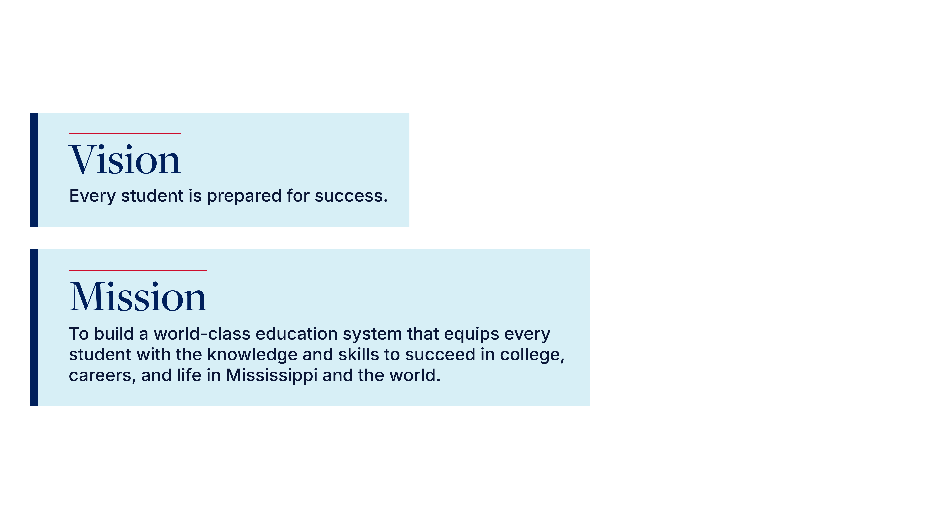
Mississippi Department of Education
Notes:
Within the Mississippi Department of Education, we always ground in our vision, which is to READ SLIDE
To implement this vision, our mission is to READ SLIDE

Slide 3
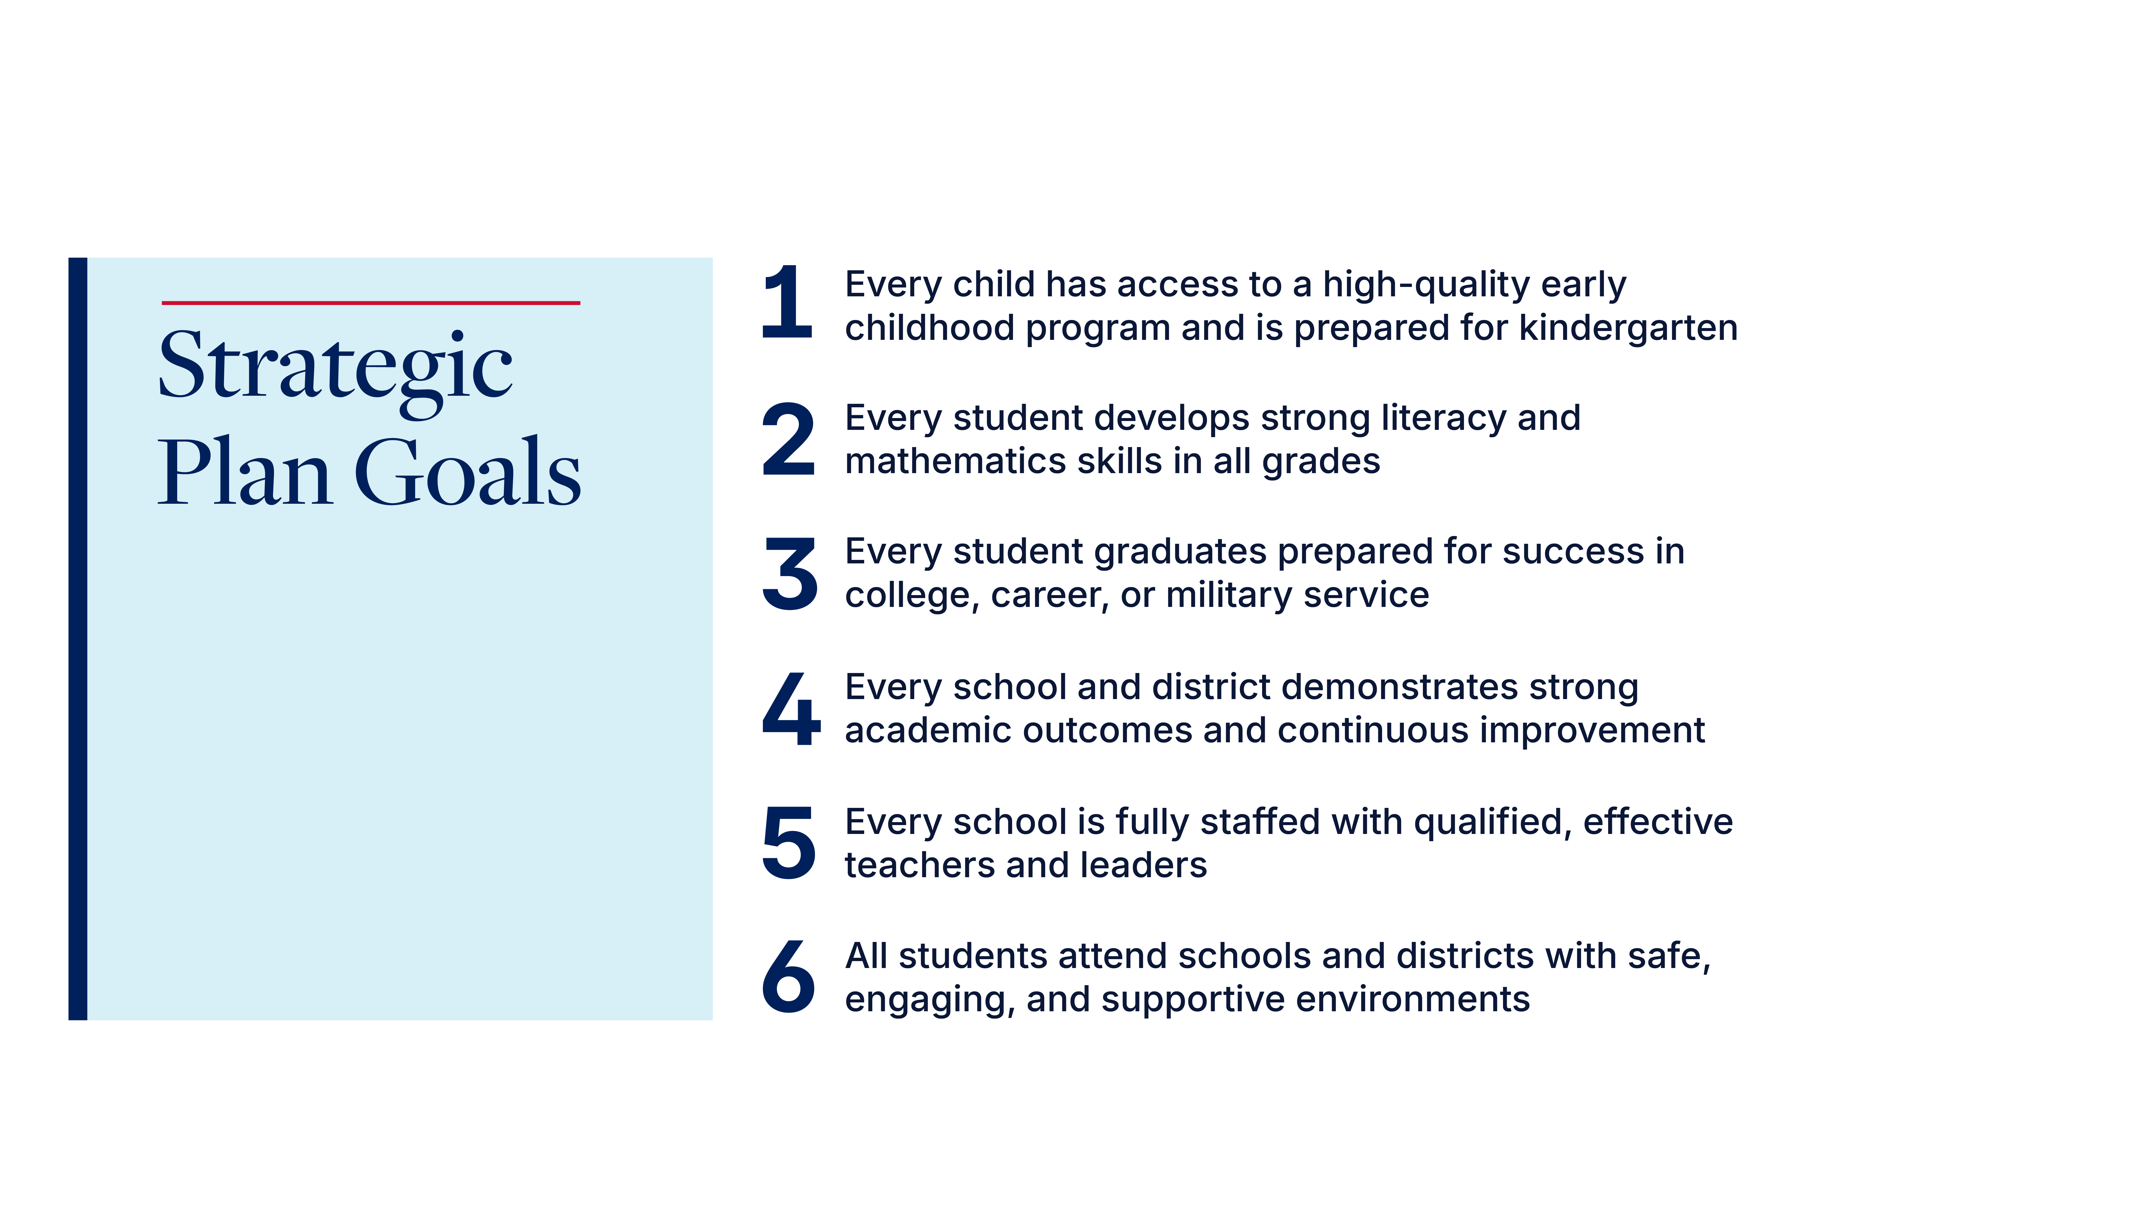
Mississippi Department of Education
Notes:
And we aim to achieve both through our Strategic Plan Goals, as crafted by Mississippi education stakeholders and outlined here.
To accomplish these goals…NEXT SLIDE

Slide 4
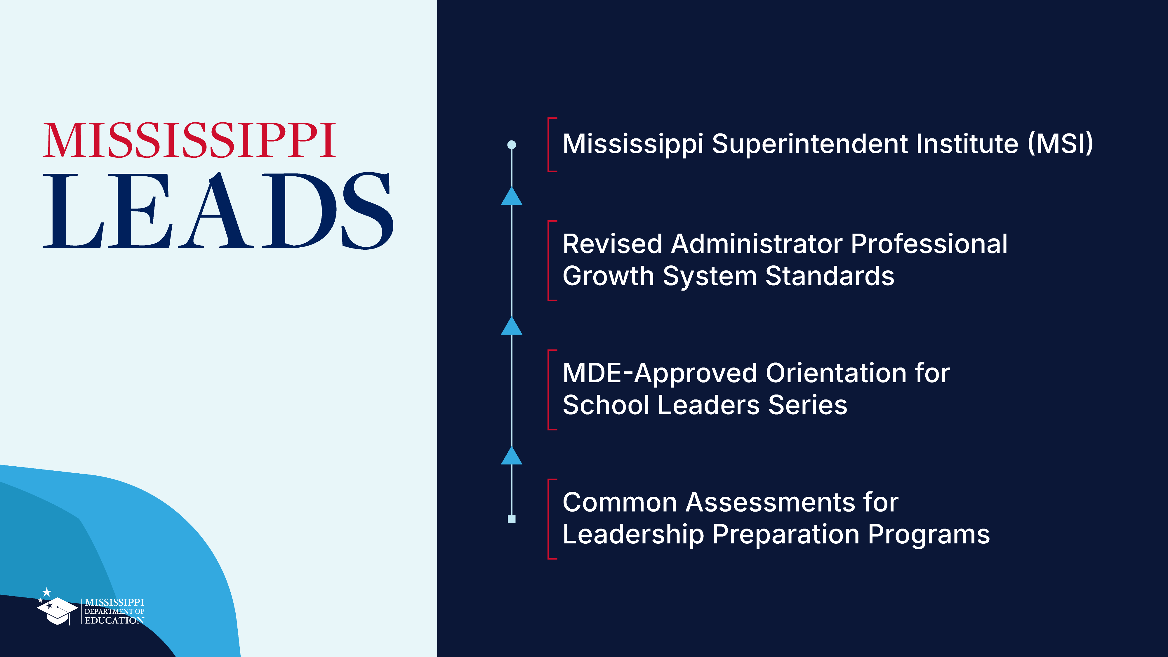
Leadership Development
Leadership Development
Notes:
As of the 2024-2025 school year, Mississippi teachers cited school leadership as the second-biggest factor in their decision to leave teaching.
Therefore in an effort to increase teacher retention and leadership effectiveness, State Superintendent, Dr. Lance Evans, charged the MDE with developing a structured focus on leadership, which subsequently became the Leading Education Achievement in Districts and Schools initiative, or Mississippi LEADS for short.
This effort focuses on the leadership development continuum from teacher leaders to principals and superintendents.
Mississippi LEADS includes READ SLIDE, wherein we will share a brief overview and outcomes from each today….

Slide 5
Mississippi Superintendent Institute (MSI)
Notes:
…starting with the Mississippi Superintendent Institute.

Slide 6

Mississippi Superintendent Institute (MSI)
Phase II: Thriving
NCEE NISL Next Series
Phase I: Surviving
MASS Network Training
Sept. 2026
Feb. 2027
Mar. 2027
May 2028
District Superintendent License
MSI Features for New and Career Superintendents
Continuum of support through MASS, NCEE, and MDE partnership
Mentorship opportunities through MASS Network Training
Cohort-based professional learning
Eligibility for a Standard Career-Level District Superintendent License*
*Not required to serve as a district superintendent.
Notes:
The Mississippi Superintendent Institute (MSI) now functions as a two-year continuum of support for Superintendents through the Mississippi Association of School Superintendents and the National Center for Education and the Economy.
Through MASS’ Network Training, the first phase focuses on the practical realities of what new Superintendents need to survive their first six months on the job.
From there, the second phase shifts gears into how Superintendents can benchmark to the best and develop future-ready districts, while thriving themselves as leaders through NCEE’s NISL Next series.
Completion of MSI then offers eligibility as one criterion for the new Standard-Career Level District Superintendent License.

Slide 7
Of MSI participants agree/strongly agree they are prepared to design innovative learning pathways that prepare future-ready graduates.
100%
“This has been one of the most relevant and impactful professional learning opportunities of my 24-year career in education.”
“This shifted my thinking from managing programs to designing a system that actually works for kids.”
Notes:
We piloted MSI this year and were pleased to recommend it for state appropriations based on the outcomes and participant comments from our ongoing evaluations, which you can see here.

Slide 8
Revised Administrator Professional Growth System (PGS) Standards
Notes:
But in order to develop strong Superintendents, we know we need effective Principals which pushed us to revise our Professional Growth System standards for Administrator observation, feedback, and professional learning.

Slide 9
Administrator PGS Revision Journey
Mississippi Educational Leadership Faculty Association
PGS Pilot School Districts
Gulf Comprehensive Center
2024-2025 SY
Summer 2025
Fall 2025
Spring 2026
Mississippi Principal Advisory Council
Mississippi Principal Advisory Council (Continued)
PGS Pilot School Districts (Continued)
Notes:
Through extensive partnership and engagements with the comprehensive center, advisory councils, university faculty, and districts over the last 18 months…NEXT SLIDE

Slide 10
Revised Administrator PGS Standards
Streamlined Standards, Retained Rigor
5
4
Domains
Domains
19
9
Standards
Standards
5
Standard optional exemption for Assistant Principals
ALL
Standards designed to apply to Assistant Principals
Notes:
...we were able to streamline the standards within the Administrator PGS from 5 domains and 19 standards to 4 domains and 9 standards while retaining rigor by ensuring alignment with the national PSEL standards and the applicability of all 9 standards to Assistant Principals.
The 4 domain, 9 standard rubric now also reflects the structure embedded across all educator rubrics to advance instructional coherence across Mississippi’s educator workforce
(If asked: PSEL=Professional Standards for Educational Leaders)

Slide 11
LEADERS REGISTERED for and/or attended training on the revised Administrator Professional Growth System (PGS) Standards in one month.
350+
AVERAGE SCORE on post-training assessments of the state requirements, rubric structure, responsibilities, and evidence-based practice for the Administrator PGS.
92.6
Notes:
To ensure Mississippi district and school leaders are prepared to implement the revised standards this year, MDE is hosting a series of regional sessions and are excited by early outcomes, some of which you can see here READ SLIDE

Slide 12
MDE-Approved Orientation for School Leaders (OSL) Series
Notes:
But as we know, effective outcomes are often the result of effective practice.
Therefore, we offer the MDE-Approved OSL Series…

Slide 13
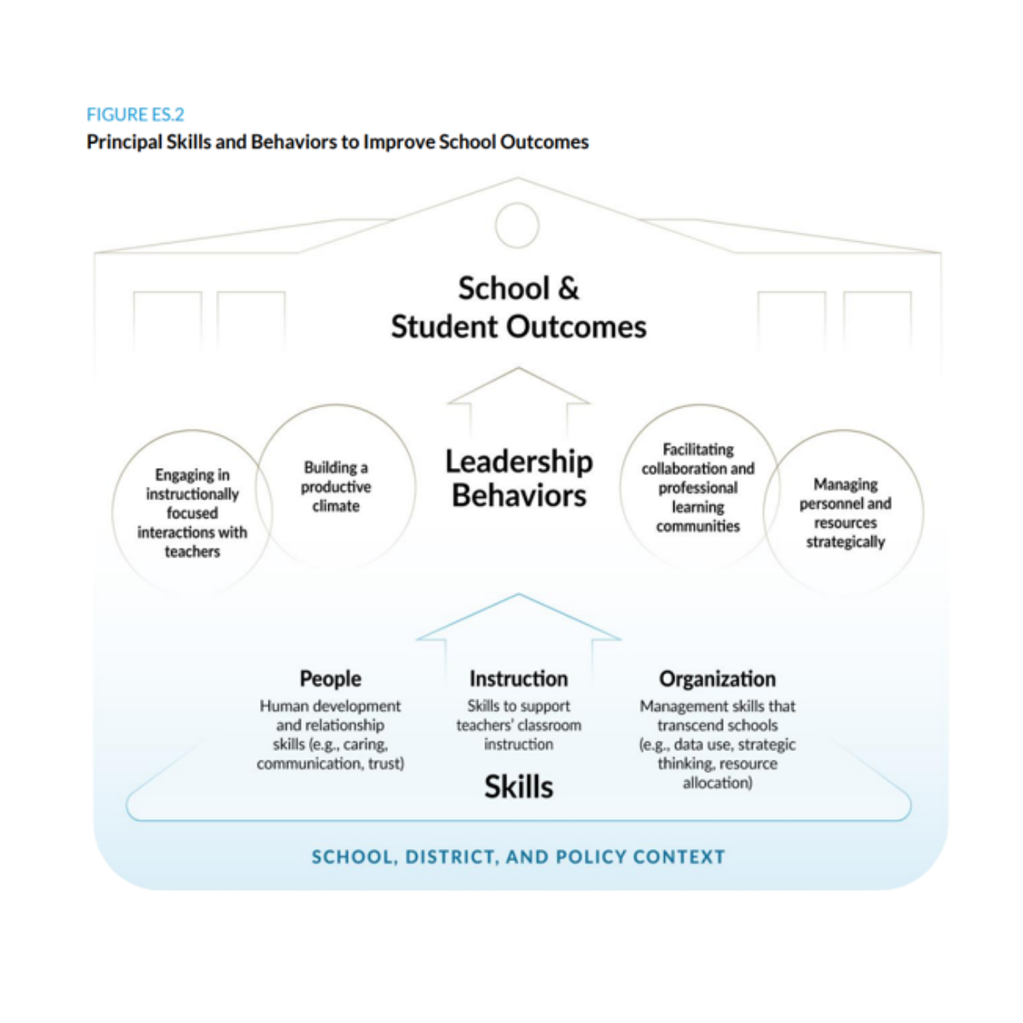
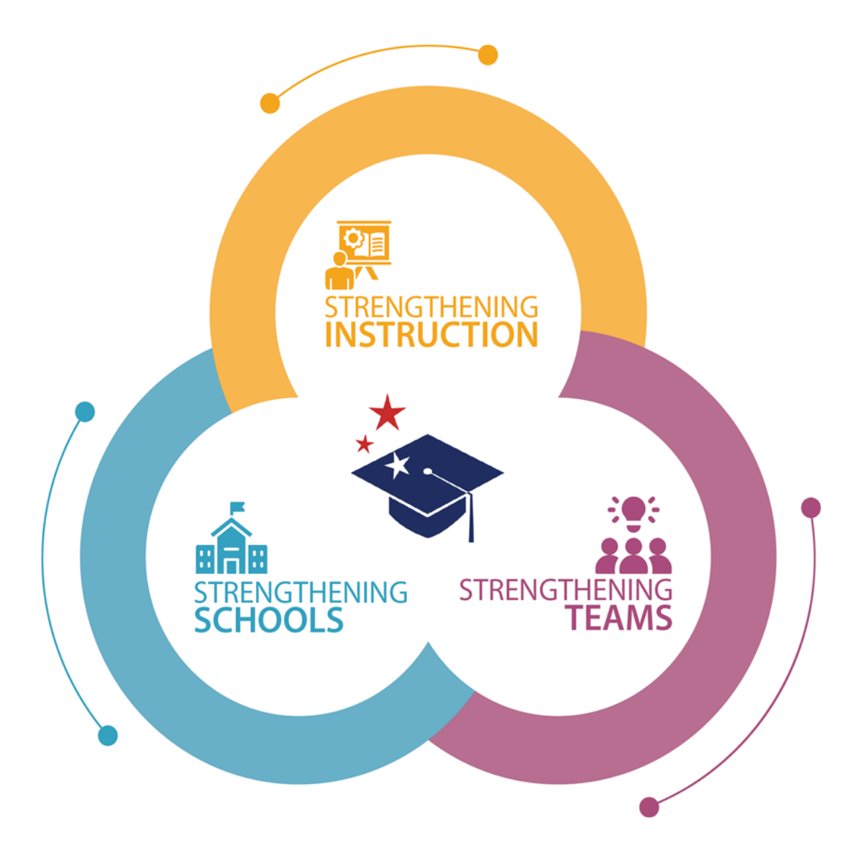

How Principals Affect Students and Schools: A Systematic Synthesis of Two Decades of Research (Grissom et al, 2021)
Notes:
The MDE’s Orientation for School Leaders series is intended to address the needs of what all Mississippi administrators need to know and be able to do
Module topics were advised by Mississippi administrators, grounded in the Wallace Foundation’s study on effective principal leadership, and implemented as a regional delivery model through technical assistance from our regional comprehensive center…

Slide 14
MDE-Approved Orientation for School Leaders (OSL) Series Topics
Strengthening Schools
Apply accreditation standards
Calculate accountability ratings under the current model
Understand the current criteria for school improvement entry and exit
Strengthening Teams
Complete the required PGS training
Apply strategies for improving school culture
Develop coaching skills for Professional Learning Communities
Practice social media scenarios
Strengthening Instruction
Understand high-quality instructional materials implementation
Engage the components of a multi-tiered system of support
Improve access to learning for all students
Notes:
…and are as outlined here.

Slide 15
LEADERS ATTENDED
OSL modules in six months.
700+
POST-TEST AVERAGE SCORE GROWTH across 5 regional education service agencies, 30 trainers, and 102 public school districts:
22%
Notes:
Within six months of the series launch READ SLIDE

Slide 16
Common Assessments for
Leadership Preparation Programs
Notes:
And as the final step in backwards mapping our leadership development continuum, the state of Mississippi is unique in their use of statewide common assessments in their educational leadership preparation programs.
The common assessments are intended to evaluate candidates’ application of leadership practices, particularly regarding school safety, community relationships, school improvement, and the PGS.

Slide 17

Mississippi Educational Leadership Faculty Association (MELFA), Mississippi Department of Education, and Gulf CC Collaboration
The purpose of our collaborative effort is to impact leadership practices across the state/region through refining common assessments and guidance materials, resulting in increased validity and reliability, thereby ensuring implementation consistency.
Notes:
The Gulf CC and the Mississippi Educational Leadership Faculty Association with the support of the MDE collaborated on the revisions of the state common assessments for education leadership programs.
The first session defined the purpose of the collaborative effort as to READ SLIDE

Slide 18

MELFA Common Assessment Revisions
Data Collection: Surveys, Focus Groups
Gulf Comprehensive Center
Common Assessment Revisions
Jan-Feb 26
Mar
26
Apr-Jun
26
Jul-Sep 26
Mississippi Educational Leadership Faculty Association
Training on Revised Common Assessment and Scoring
Common Assessment Pilot
Notes:
Based on in-person feedback from education leadership faculty on their use of the common assessments, the Gulf CC began revising the common assessments in April and shared the final drafts with MELFA leadership in June for review and feedback.
We are now preparing for the development of the training on the revised assessments and piloting the assessments beginning this summer and look forward to sharing additional outcomes at that point.

Slide 19
Panel Discussion

Slide 20

Panel Discussion
Dr. Evans, why is focusing on district leaders a top priority? Were there any lessons learned from the first cohort of Mississippi Superintendent Institute participants?
Dr. Vanderford, how have the Orientation for School Leadership series and the Professional Growth System improved over time?
Dr. Jarvis, what motivated multiple leadership preparation programs to collaborate and redesign a set of common assessments?
Dr. Evans or Dr. Vanderford, how is Mississippi leveraging the Gulf Comprehensive Center and other Comprehensive Center Network resources to advance state education initiatives and innovations such as Mississippi LEADS?
Notes:
Dr. Evans, why is focusing on district leaders a top priority? Were there any lessons learned from the first cohort of MSI participants?
Dr. Vanderford, I understand you worked with the original Orientation for School Leaders training model and led implementation of the Professional Growth System. How have you seen the OSL series and the PGS improve over time to support agency priorities?
Dr. Jarvis, can you share a bit more about the Common Leadership assessments? Specifically, what motivated multiple leadership preparation programs to collaborate and redesign a set of common assessments?
Dr. Evans or Dr. Vanderford, How is Mississippi leveraging the Gulf Comprehensive Center and other Comprehensive Center Network resources to advance Mississippi LEADS as well as other agency priorities?

Slide 21
Questions?

Slide 22
Administrator Growth Rubric Domains and Standards
DOMAIN I: Vision and Strategy
​Implements a shared vision.
​ Monitors progress toward goals and aligns the school’s resources based on the school and/or district strategic plan.
DOMAIN II: Teaching and Learning
3.​​ Supports the development and/or implementation of Mississippi standards-based instructional materials.
4. ​ Uses data to drive continuous improvement and inform academic intervention.
5.​ Provides leadership opportunities and develops a highly-effective leadership team.
Notes:
Share if asked about revised Admin PGS Domains and Standards.

Slide 23
Administrator Growth Rubric Domains and Standards
DOMAIN III: School Culture
6. Maintains a safe, supportive, secure, and respectful learning environment.
7. Welcomes families and community members into the school and communicates with stakeholders.
DOMAIN IV: Professional Responsibilities
8. Provides actionable feedback and implements learning structures.
9. Demonstrates self-awareness, reflection, and ongoing learning.
Notes:
Share if asked about revised Admin PGS Domains and Standards.

Slide 24
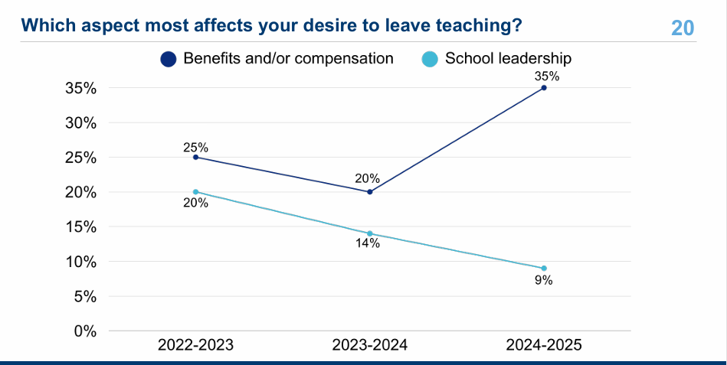
Notes:
Share if asked about key factors for teacher attrition/shortages, noting reduction in school leadership as a factor.

Slide 25
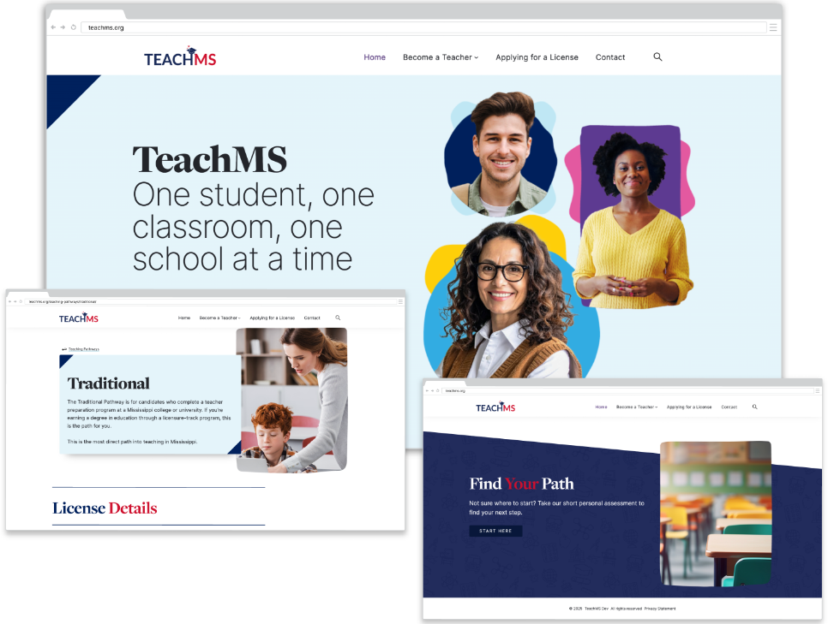
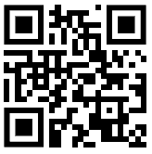
Teacher Recruitment and Retention Resources
TeachMS.org
Interactive Tools for Teacher Recruitment
TeachMS.org is an unprecedented tool for prospective educators to find their path to the classroom using an interactive licensure tool and salary schedule.
https://teachms.org/
TeachMS.org
Notes:
Share if provided the opportunity to offer additional resources.

