Slide 1
Redesigning Mentorship
Strengthening Early-Career Teacher Retention and Working Conditions
September 9, 2026
Dr. Derrick Jordan, NCDPI Chief Operations Officer
Dr. Fredrica Nash, SSEW Center Director
Dr. Meghan S. Doyle, Capacity Building Lead

Slide 2
Session Roadmap
Guiding Question: What would a coherent mentoring system look like across North Carolina’s educator pathways?
The Challenge
The compliance-based, fragmented mentoring landscape that limited SEA capacity.
The Innovation
Using federal capacity-building resources to design a coherent, cross-pathway system.
The Result
Early outcomes, new organizational capabilities, and emerging data points.
The Learning
Lessons in process, policy, and practice to share with other states.

Slide 3
NC’s Teacher Workforce | 2024-2025 Attrition

Slide 4
Early-Career Effectiveness & Licensure Pathway
±<0.05 Very Small Impact
±0.05-0.20 Moderate*
±≥ 0.20
Large**
Effect Size Interpretations
*typical meaningful impact​
**unusual, high impact intervention​

Slide 5
Traditional vs. Residency Licensed Teachers
Post-Program Completion
±<0.05 Very Small Impact
±0.05-0.20 Moderate*
±≥ 0.20
Large**
Effect Size Interpretations
*typical meaningful impact​
**unusual, high impact intervention​

Slide 6
The Challenge
A fragmented, legacy mentoring landscape
Compliance over Coherence
The Systemic Hurdle
Four Mentoring Systems
The Result:
Varying expectations
Uneven training
Inconsistent compensation and release time, and
No common measure of what “high-quality mentoring” means.
Limited SEA Visibility
Aging Standards
Emerging Demand Fueled by Innovative Pathways
Notes:
A fragmented, legacy mentoring landscape | Mentoring has long been central to North Carolina’s education pipeline – yet as new pathways to the profession have emerged, with differing expectations, structures, and levels of specificity.
Compliance over Coherence - Beginning teacher support and clinical preparation were shaped by policy requirements (e.g., TCED-016) rather than a shared vision of quality mentoring.
Limited SEA Visibility - NCDPI monitors beginning teacher support programs systems. The quality of mentoring programs, role clarity, and support structures across public school units vary.
Aging Standards - The current NC Mentor Standards were written in 2010; the accompanying rubric is rarely used and difficult to apply to today’s school realities and demands.
Emerging Demand Fueled by Innovative Pathways - A statewide strategic staffing model coupled with proposed teacher apprenticeship pathway requires more structured, competency-based supervision than current models were built to provide.

Slide 7
Mentoring Across NCs Educator Pathways
A fragmented, legacy mentoring landscape
Pre-Service Teachers
MENTOR ROLE
Cooperating Teacher
DESIRED IMPACT
Prepare classroom-ready candidates and smooth entry into the profession
Beginning Teachers
MENTOR ROLE
Mentor Teacher
(TCED-016)
DESIRED IMPACT
Accelerate early effectiveness and improve retention of new teachers.
Teacher Leadership Models
MENTOR ROLE
ATR Roles & Instructional Coaches
DESIRED IMPACT
Extend expert practice and distribute leadership across schools.
Emerging Teacher Apprenticeships
MENTOR ROLE
Apprentice Supervisors
DESIRED IMPACT
Build local “grow-your-own” pipelines with structured on-the-job training.
Notes:
Pre-Service Teachers – Why They Exist - Supervise student teachers in clinical placements through University & Community College partnerships
Beginning Teachers – Why They Exist - Support induction & onboarding under the Beginning Teacher Support Program
Emerging Teacher Apprenticeships – Why They Exist - Mentor/supervisor roles being developed through TeachReadyNC & registered apprenticeship.
Teacher Leadership Models – Why They Exist - Advanced Teaching Roles, department chairs & instructional coaches serving mentoring functions.

Slide 8
What the Evidence Says
Grounding our Redesign | Characteristics of effective mentoring and induction
Comprehensive,
Multi-year Induction
Rigorous Mentor
Selection & Training
Protected Time & Frequent Contact
Non-evaluative, Trusting Relationships
Sustained Duration
(2+ years)
Leadership & Culture of Shared Responsibility
Notes:
Comprehensive, Multi-Year Induction | Support that combines a trained mentor with orientation, collaboration, and structured learning has positive effects on retention, instruction, and student achievement (Ingersoll & Strong, 2011).
Protected Time & Frequent Contact | Regular, protected mentor–mentee interaction and classroom observation are among the strongest enablers of quality (New Teacher Center, 2023).
Sustained Duration (2+ Years) | Two years of mentoring is generally more effective than one, especially when paired with cohort collaboration (Ingersoll & Strong, 2011).
Rigorous Mentor Selection & Training | Mentors should be experienced, effective teachers, selected against clear criteria and trained in observation, feedback, and coaching (New Teacher Center, 2023).
Non-evaluative, Trusting Relationships | Keeping mentoring separate from formal evaluation builds the trust novices need to take risks and grow (Strong, 2009).
Leadership & Culture of Shared Responsibility | Programs thrive where leaders prioritize mentoring and teacher success is a team responsibility, not one mentor's load (New Teacher Center, 2023).

Slide 9
Why It Matters: The Evidence Base
High-quality mentoring pays off in retention, effectiveness, and cost
2 X
more likely to stay
Teachers in comprehensive induction were about twice as likely to remain after five years (Ingersoll & Strong, 2011).
93% vs. 73%
first-year retention
Districts with comprehensive induction saw 93% first-year retention vs. 73% without (Learning Policy Institute, 2017).
+ 2-3 months
student learning gains
Students of mentored first-year teachers gained an additional 2–3 months of learning (New Teacher Center, 2018).
$1 : $1.50
return on investment
Every $1 invested in comprehensive mentoring yielded ~$1.50 in reduced turnover costs (RAND, 2019).

Slide 10


The Innovation
Using federal capacity-building resources differently
Map the Statewide Landscape
A shift in strategy
Rather than retrofitting a new apprenticeship model into existing programs, NCDPI is using SSEW technical assistance to redesign mentoring as one coherent, statewide system that serves current programs and emerging workforce strategies at once.
Center Practitioner Voice
Braid Federal Flexibility
“Move beyond compliance toward intentional system design.”
Design Role-differentiated Structures
Notes:
Map the Statewide Landscape | Inventory mentor roles across pre-service, induction, ATR, and apprenticeship — documenting definitions, selection, compensation, and training.
Center Practitioner Voice | Bring beginning teachers, mentors, cooperating teachers, and coordinators into the design through surveys, focus groups, and interviews.
Braid Federal Flexibility | Leverage capacity-building resources to work across program silos toward shared workforce outcomes rather than one-off requirements.
Design Role-Differentiated Structures | Build clear, role-specific frameworks that anticipate apprenticeship supervision without assuming it is already in place.

Slide 11
Our Approach: Statewide Scan
A phased, mixed-methods design centering those closest to the work
Phase I
Phase II
Phase III
Document & Policy Review
Statewide Scan (Survey)
Focus Groups & Interviews
Policy
Beginning Teacher Support
Cooperating Teachers
Advanced Roles Frameworks
TeachReadyNC
District Programs
PSU Questionnaire
Beginning Teachers
Mentors
Cooperating Teachers
ATR Leaders
TeachReadyNC
June - July
July
August
September
Landscape Scan & Standards Review
Focus Groups & Interviews
Co-Design Differentiated Roles
Quality Mentor Standards

Slide 12
What the Data Show
A statewide view of mentoring practices, structures, and readiness

Slide 13

The Scale of the Statewide Scan
164
Unique Public School Units
89
Counties Represented
12,920
Beginning Teachers Represented
261
Teacher Apprentices Represented
3,868
Residency Teachers Represented
3,341
Student Teachers/ Interns Represented

Slide 14
North Carolina’s Mentoring Landscape
Respondent Local Education Agencies (LEAs)
Mt. Airy City
Mooresville Graded
Chapel-Hill Carrboro City
Weldon
City
Elkin City
Newton- Conover City
Asheville
Asheboro City
Clinton
City
68 LEAs Completed Questionnaire
58 County School Systems
9 City-School Systems

Slide 15
North Carolina’s Mentoring Landscape
Respondent Charter and Regional Schools
73 Charter or Regional Schools Completed Questionnaire
72 Charter Schools
1 Regional School

Slide 16
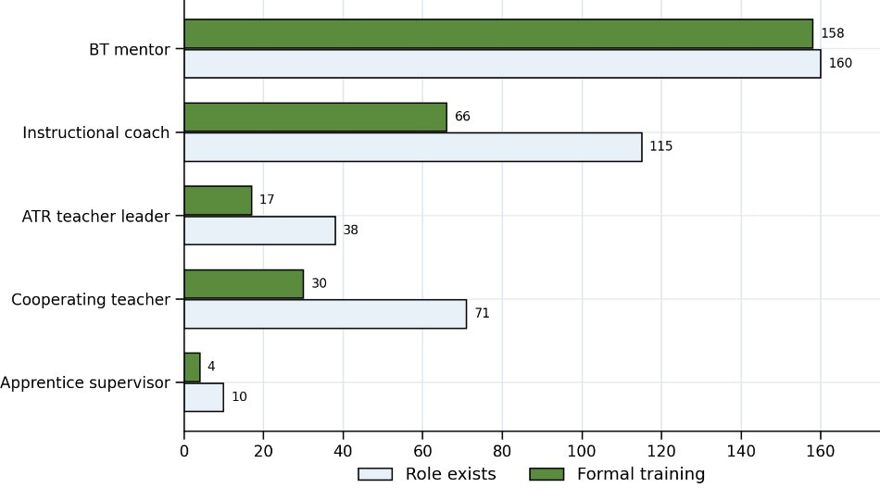
Mentor Training is Built Around the Mandated Role
Reflection: Where is training for mentors in your SEAs or LEAs already strong—and how could you build on that to reach more roles?​
Training Reach Among PSUs where the Role Exists
99% - Beginning Teacher Mentors
57% - Instructional Coaches
45% - Advanced Teaching Roles Leaders
42% - Cooperating Teachers
40% - Apprentice Supervisors

Slide 17
Districts Are Asking for Conditions and Tools
Barriers describe capacity constraints; requested supports point to system design​
TOP BARRIERS
MOST REQUESTED SUPPORTS

Slide 18
Compliance is Stronger than Coherence
Common Beginning Teacher requirements coexist with uneven infrastructure
Turn and Talk: What challenges with mentoring (assignment, training, compensation, recruitment, etc.) are occurring in your state? How are you addressing them?​
91.5%
Require Documentation of Mentoring Support
73.8%
Require Completion of NCDPI Mentor Training
31.7%
Report Board Policy Supporting Mentoring
41.5%
Guarantee Workday Time to Support Mentoring
North Carolina has strong process compliance for beginning-teacher mentoring, but no equally consistent architecture for policy, protected time, or cross-pathway roles.​

Slide 19
Apprenticeship Readiness is Emerging
Current participation and role infrastructure remain limited​
13.4%
29.3%
6.1%
13.4%
Currently Participate in Apprenticeship Pathway
Are Not Sure
Name an Apprentice Supervisor Role
Currently Participate in Apprenticeship Pathway
Table Reflection: Where in your pipeline is mentoring assumed rather than designed?​

Slide 20
Focus Groups - What We’ve Learned to Date
Early insights (July 2026)
Local models vary widely
Mentors, buddies, full-release, retired educators — driven by staffing, not design
Recruiting quality mentors is difficult
Stipends boost volume, not quality; willing, qualified mentors are scarce
Time is the binding constraint
Protected time, scheduling, and proximity — top enabler and top barrier
Leadership and coordinators matter
Dedicated Beginning Teacher Coordinators = stronger programs
Roles differ based on context
EPPs support student teachers; BT mentoring skews to curriculum over management/family engagement
Standards feel dated
2010 standards/rubric hard to apply and rarely used for evaluation

Slide 21

The Result
Early outcomes and new organizational capabilities (project in progress)
STATEWIDE REACH
4 PATHWAYS ALIGNED
New organizational capabilities
Distributed to all NC public school units
Four mentoring pathways examined together
Clearer, role-specific mentorship expectations across beginning-teacher support and clinical preparation.
A repeatable, mixed-methods process for gathering statewide practitioner data (survey + focus groups + interviews).
Stronger alignment between current mentoring practice and anticipated apprenticeship supervision requirements.
Greater readiness across the SEA and partners to operationalize an aligned mentoring infrastructure.
LEAs, charters & lab schools, via Regional Education Facilitators
First shared, cross-pathway view of mentoring in NC
From Findings to Design
Emerging evidence to support differentiated mentor roles, updated quality standards, and a future modular training framework.​
Data points shown are projected/early-stage; final results reported at conference.

Slide 22
The Learning
Lessons in process, policy, and practice to share with other states
PROCESS
POLICY
PRACTICE
Use continuous improvement to design roles for future needs, not just today's compliance.
Center practitioner voice early to drive relevance and adoption with fidelity.
Build a repeatable data engine (survey + focus groups) you can reuse as the system evolves.
Federal funding flexibility can support integrated, cross-program system design.
Aging standards (e.g., 2010 rubric) need refresh to remain usable and credible.
Design for emerging pathways (apprenticeship) without assuming they are already in place.
Role clarity is the precondition for scalability
Implementation conditions such as protected time, scheduling, caseloads, leadership matter as much as training.
A team culture of shared responsibility outperforms mentoring that rests on one person.

Slide 23
Looking Ahead
Where the redesign goes next — as resources (human, financial, time, capacity) allow
Completed in Current Phase (Project Objectives 1-6)
Completed in Current Phase (Project Objectives 1-6)
Develop scalable, modular mentor training
Establish fidelity, quality, and continuous improvement standards
Map the current landscape of mentor roles
Assess mentor standards, training & certification
Center the voices of those being supported
Engage practitioners across mentor roles
Identify gaps vs. apprenticeship supervision needs
Design role-differentiated mentorship structures
Notes:
Scalable, modular training - Tiered framework with shared foundations plus role-specific modules for beginning-teacher, clinical, and apprenticeship contexts — including administrator/HR training on structuring mentor time.
Fidelity, Quality, and CI - Observation and feedback tools, mentor self-assessment, monitoring protocols, and recommendations for updating statewide standards across all mentoring contexts.

Slide 24
References
Preliminary selected evidence base
Ingersoll, R. M., & Strong, M. (2011). The impact of induction and mentoring programs for beginning teachers: A critical review of the research. Review of Educational Research, 81(2), 201–233.
Strong, M. (2009). Effective teacher induction and mentoring: Assessing the evidence. Teachers College Press.
New Teacher Center. (2023). High-quality mentoring and instructional coaching practices [Reports and tools].
Regional Educational Laboratory Pacific. (2025). What are components of new teacher mentor programs that support building an effective teacher workforce? Institute of Education Sciences.
North Carolina Department of Public Instruction. (n.d.). Mentor training. NCDPI.

Slide 25
The contents of this presentation were developed under a grant from the U.S. Department of Education (Department). The Department does not mandate or prescribe the practices, models, or other activities described or discussed in this document. The contents of this presentation may contain examples of, adaptations of, and links to resources created and maintained by other public or private organizations. All external links cited in this resource were reviewed for compliance with all federal regulations in effect at the time of publication; however, the Comprehensive Center Network is not responsible for subsequent changes to those external sites or for any content beyond the specific material referenced. External links are provided solely to support the research, examples, analysis, and conclusions presented in this resource and do not constitute endorsement of any broader site content. The content of this presentation does not necessarily represent the policy of the Department. This presentation is not intended to represent the views or policies of, or be an endorsement of, any views expressed or materials provided by any federal agency. © 2026 Westat.

Slide 26
Questions?

Slide 27
Thank you!
Derrick.Jordan@dpi.nc.gov
fnash@rti.org
msweeneydoyle@rti.org

