Slide 1

Accelerating Outcomes:
A Conversation on Systemwide Improvements in the Bureau of Indian Education
Thursday, September 9, 2026

Slide 2
Turn and Talk to Your Neighbor
Every community holds deep knowledge, experience, and expertise.
What is one change you can make in your work to ensure those voices help shape decisions and solutions?

Slide 3
Moderators
Rob Salley
Director, BIE CC
April Kateri Chavez
(Kewa Pueblo/ Diné Nation)
Associate Director, BIE CC

Slide 4

Mission
In partnership with tribal nations, the BIE promotes a culturally based, comprehensive education that prepares and empowers students to be healthy and successful.
Vision
Excellence in Student-Centered, Indian Education.
  BIE is the government’s lead agency charged with providing educational opportunities for Indigenous youth in accordance with a Tribe’s needs.
Notes:
The BIE is a sub agency of the U.S. Department of the Interior and operates as a federal agency under the Bureau of Indian Affairs.
As an Executive Branch agency, BIE receives their policy directives from the President, Congress, and most directly from the Assistant Secretary of Indian Affairs.

Slide 6
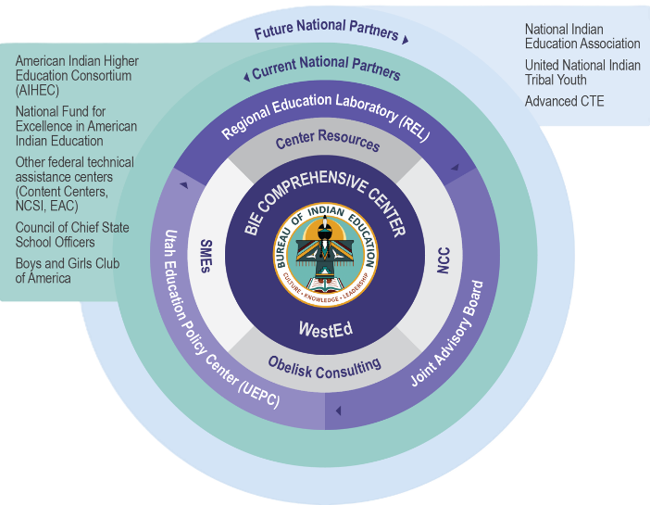

Technical Assitance Ecosystem
Evaluator
External
Supports
Notes:
Key players
How support flows
Why coordination matters

Slide 7
Special Guests
Juanita Mendoza
Special Assistant (Central Office) Bureau of Indian Education
Ventura Lovato
Chief Performance Officer
Bureau of Indian Education
Brooke Ratliff
Program Analyst
Bureau of Indian Education
(Turtle Mountain Band of Chippewa)
(Kewa Pueblo)
Pascua Yaqui Tribe

Slide 8
Panelists Question
BIE serves more than 183 schools across 23 states, representing diverse Tribal nations, communities, and educational contexts.
What makes the BIE system unique, and what are the opportunities and challenges that come with supporting Native students across such a vast and geographically diverse landscape?

Slide 9
Panelists Question
The BIE is at a pivotal moment in its 105-year history, having recently exited corrective action after nearly 20 years.
What did it take to achieve this milestone, and how is it changing the way BIE approaches support, accountability, and student success moving forward?

Slide 10
Panelists Question
The Comprehensive Center Network has been a parter with BIE for nearly 10 years.
How has the partnership with the Region 14 BIE Comprehensive Center strengthened BIE's ability to pursue its strategic goals, build long-term organizational capacity, and/or support continuous improvement across the BIE?

Slide 11
Panelists Question
As BIE continues this transformation, what does success look like over the next five years, and what will it take to continue accelerating outcomes for Native students while honoring Tribal sovereignty, culture, and community aspirations?
OR
If you could leave this audience of educators, education leaders, and technical assistance providers with one key takeaway about advancing educational excellence in Tribal and rural communities, what would it be?

Slide 12
Audience Question
Every community holds deep knowledge, experience, and expertise.
What is one change you can make in your work to ensure those voices help shape decisions and solutions?

Slide 14
Stay in Touch
Bureau of Indian Education
Juanita Mendoza: juanita.mendoza@bie.edu
Ventura Lovato- ventura.lovato@bie.edu
Brooke Ratliff- brooke.ratliff@bie.edu
BIE Comprehensive Center
Rob Salley: rsalley@wested.org
April K. Chavez: achavez2@wested.org

