Slide 1
From Coaching to Impact
Introducing Alabama’s Evidence-Based Coaching Accountability System
September 9, 2026
Dr. Karen Anderson
Jennifer Towles
Notes:
1 minute (1 minute)

Slide 2
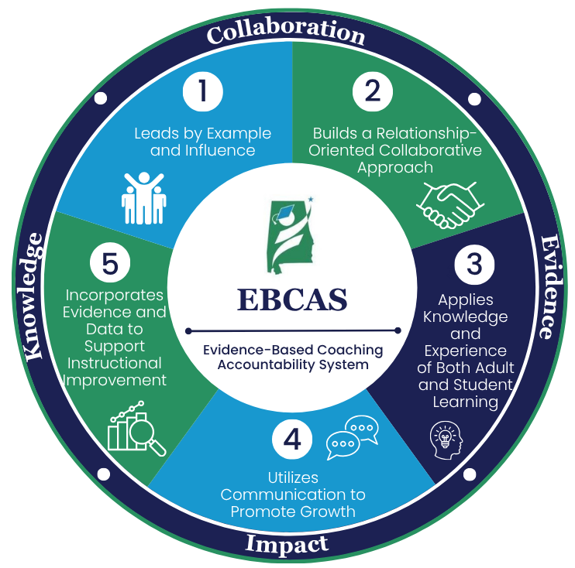
Most states can describe what coaches do.
Few states can demonstrate how coaching improves teaching and student learning.
Alabama set out to change that!
Notes:
1 minute (2 minutes)

Slide 3
Which coaching challenge is your state currently facing?
Defining effective coaching
Evaluating coaches fairly
Collecting meaningful evidence of coaching impact
Connecting coaching to student outcomes
Poll
Mentimeter QR Code
Those are the challenges Alabama addressed through the Evidence-Based Coaching Accountability System (EBCAS).
Notes:
3 minutes (5 minutes)
After people vote, click for the following to appear, "Those are exactly the problems Alabama set out to solve."

Slide 4
Today's Topics
Explain how Alabama implemented legislative policy through stakeholder collaboration to develop the EBCAS.
1
Describe Alabama’s phased plan for piloting, refining, and implementing EBCAS statewide.
3
Reflect on 3 lessons learned that could inform coaching systems in your state.
4
Identify the design features that make EBCAS a growth-focused, evidence-based approach to strengthening coaching practice.
2
Notes:
2 minutes (7 minutes)

Slide 5
Getting Started
Legislative Requirement | Problem | Question
Develop an evidence-based accountability system for measuring the effectiveness of mathematics coaches for: ​ Improving teacher professional learning Increasing student growth and proficiency​ | An evaluation system did not exist for instructional coaches in Alabama. | How do we measure coaching in a way that promotes growth instead of compliance?
Notes:
2 minutes (9 minutes)
The Alabama Numeracy Act required the development of an evidence-based accountability system for math coaches. The Office of Mathematics Improvement is required to submit a report to the legislature detailing how coaches are improving teacher professional learning and increasing student growth and proficiency. The problem was that Alabama did not have an evaluation system in place for any instructional coaches. Administrators either did not evaluate coaches or used the teacher evaluation system, which did not align with the work of coaches. As we started this process, we asked ourselves, “How do we measure coaching in a way that promotes growth instead of compliance?”

Slide 6
The Design Features
Growth over Compliance
Evidence over Opinion
Consistency through Content-Neutral Standards
Collaboration through Co-design
Implementation through Continuous Refinement
Notes:
2 minutes (11 minutes)
When creating EBCAS, these 5 principles guided the work:
Growth over Compliance – The system is designed to improve coaching practice through continuous learning.
Evidence over Opinion – Multiple sources of evidence reduce bias and increase consistency.
Consistency through Content-Neutral Standards – A common framework can support coaches across disciplines and grade levels.
Collaboration through Co-Design – Practitioners, state leaders, and external partners built the system together.
Implementation through Continuous Refinement – Select selected and administrators will pilot the self-reflection and the PLP. They will provide feedback to inform revisions and drive ongoing improvements and calibration before statewide implementation.
​

Slide 7
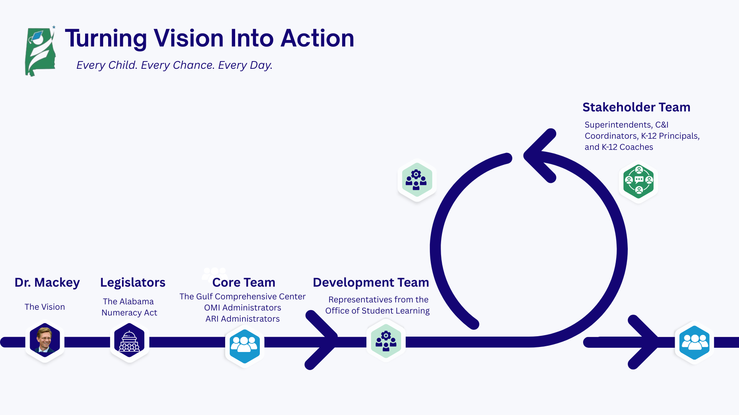

Notes:
3 minutes (14 minutes)
Dr. Eric Mackey established the motto of "Every Child. Every Chance. Every Day." This motto guides how we work at the ALSDE because we want every Alabama child to graduate high school either college or career ready. To support that work, the Alabama Legislature passed the Alabama Numeracy Act, placing a mathematics coach in every K–5 school and requiring the development of an evidence-based coaching accountability system.
Because no existing model met the intent of the legislation, Alabama developed EBCAS through a highly collaborative design process. The Gulf Comprehensive Center facilitated the work, while the Core Team provided oversight, the Development Team drafted the system, and a Statewide Stakeholder Team of educators and leaders reviewed and refined each draft. The document moved through multiple rounds of feedback before receiving final approval.
The greatest innovation was not just the framework itself—it was the collaborative process used to create it. By bringing together policymakers, state leaders, and practitioners, Alabama built a system with educators rather than for educators, creating strong ownership and a solid foundation for statewide implementation.

Slide 8

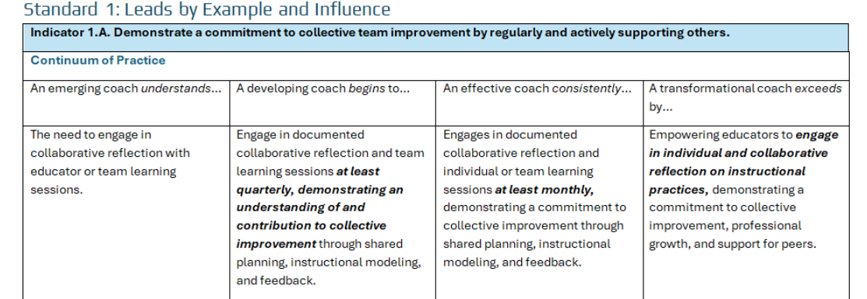
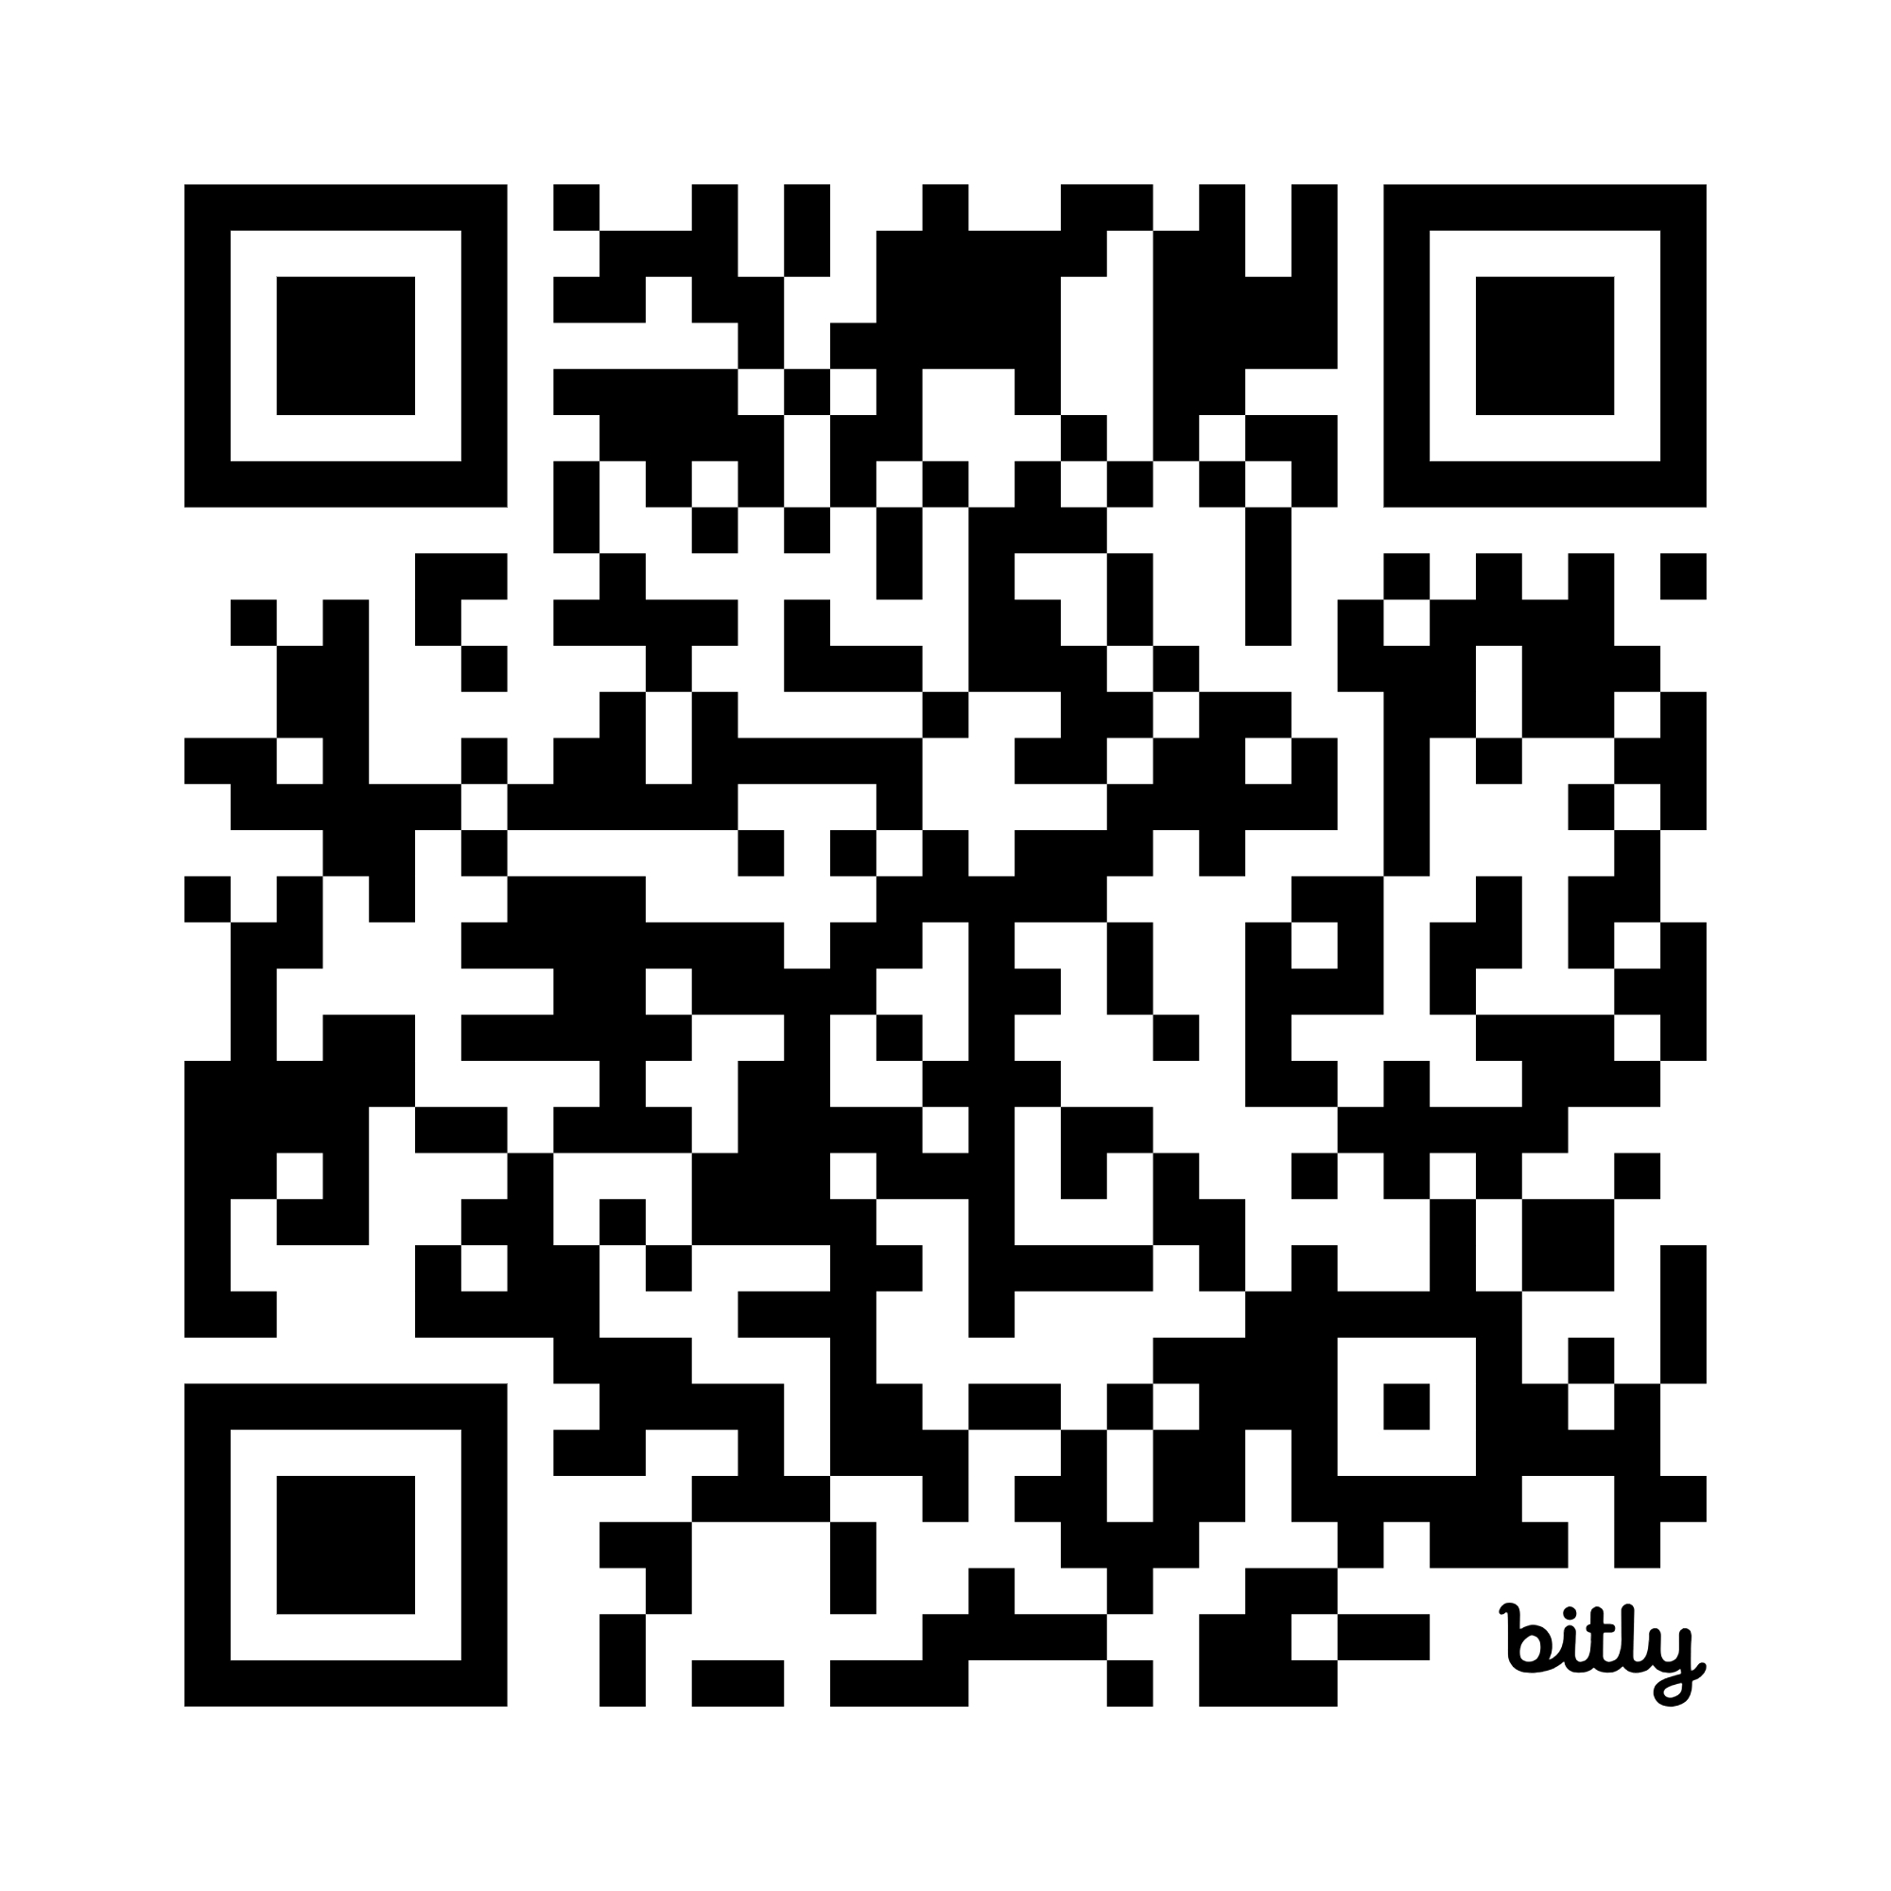
bit.ly/46m8w3S
Standard - The desired goal for coaches to reach
Indicator - The guide to assess progress toward the goal
Continuum of Practice – Developmental framework outlining
a progression toward the indicator
Notes:
3 minutes (17 minutes)
Alabama's Coaching Framework, developed in 2020, defined what effective coaches do, but it did not provide a roadmap for how coaches grow from an emerging coach to a transformational coach. EBCAS fills that gap by adding a developmental continuum aligned to each coaching indicator.
Coaches begin by self-reflecting on each indicator and collecting evidence to support their placement on the continuum. They then engage in a collaborative conversation with their administrator to review the evidence, calibrate their ratings, and identify areas for growth.
Using the AIM Portal, coaches document evidence and create an individualized Professional Learning Plan. Statewide evidence also helps Alabama identify common growth areas, allowing us to develop a Coaching Menu of Services aligned to the standards and indicators. Together, the continuum, evidence, professional learning plan, and targeted supports create a clear pathway for continuous coach development.

Slide 9


Implementation
Phase 1 | Phase 2 Pilot | Phase 3 Scale
Framework Standards Stakeholders | Professional Learning Plans Calibration Feedback Loop | Aim Portal Training Statewide Implementation
Notes:
1 minute (18 minutes)

Slide 10
3 Lessons Learned
Co-design builds ownership.
Evidence reduces evaluator bias.
Growth models create trust.
Notes:
1 minute (19 minutes)
The lessons learned came from feedback on the implementation of coaching from a 600 participant coach and administrator survey conducted in January. We will continue to send survey throughout the pilot to gain feedback, measure completion data, and calibration data.

Slide 11
Systems don't transform schools.
People do.
When we invest in the growth of coaches, we strengthen teachers.
When we strengthen teachers, we change student outcomes.
And when students succeed, we fulfill our promise of
Every Child. Every Chance. Every Day
Notes:
1 minute (20 minutes)

Slide 12
Questions?

