Slide 1


Aligned for Achievement:
How South Carolina Reorganized Our SEA Around Foundational Skills
September 9, 2026
Ellen E. Weaver | State Superintendent of Education
Dr. Rebecca M. Gunnlaugsson | Chief of Staff
Dr. Abbey S. Duggins | Chief Academic Officer

Slide 2
The Challenge
How do you align an SEA to improve student outcomes?

Slide 3
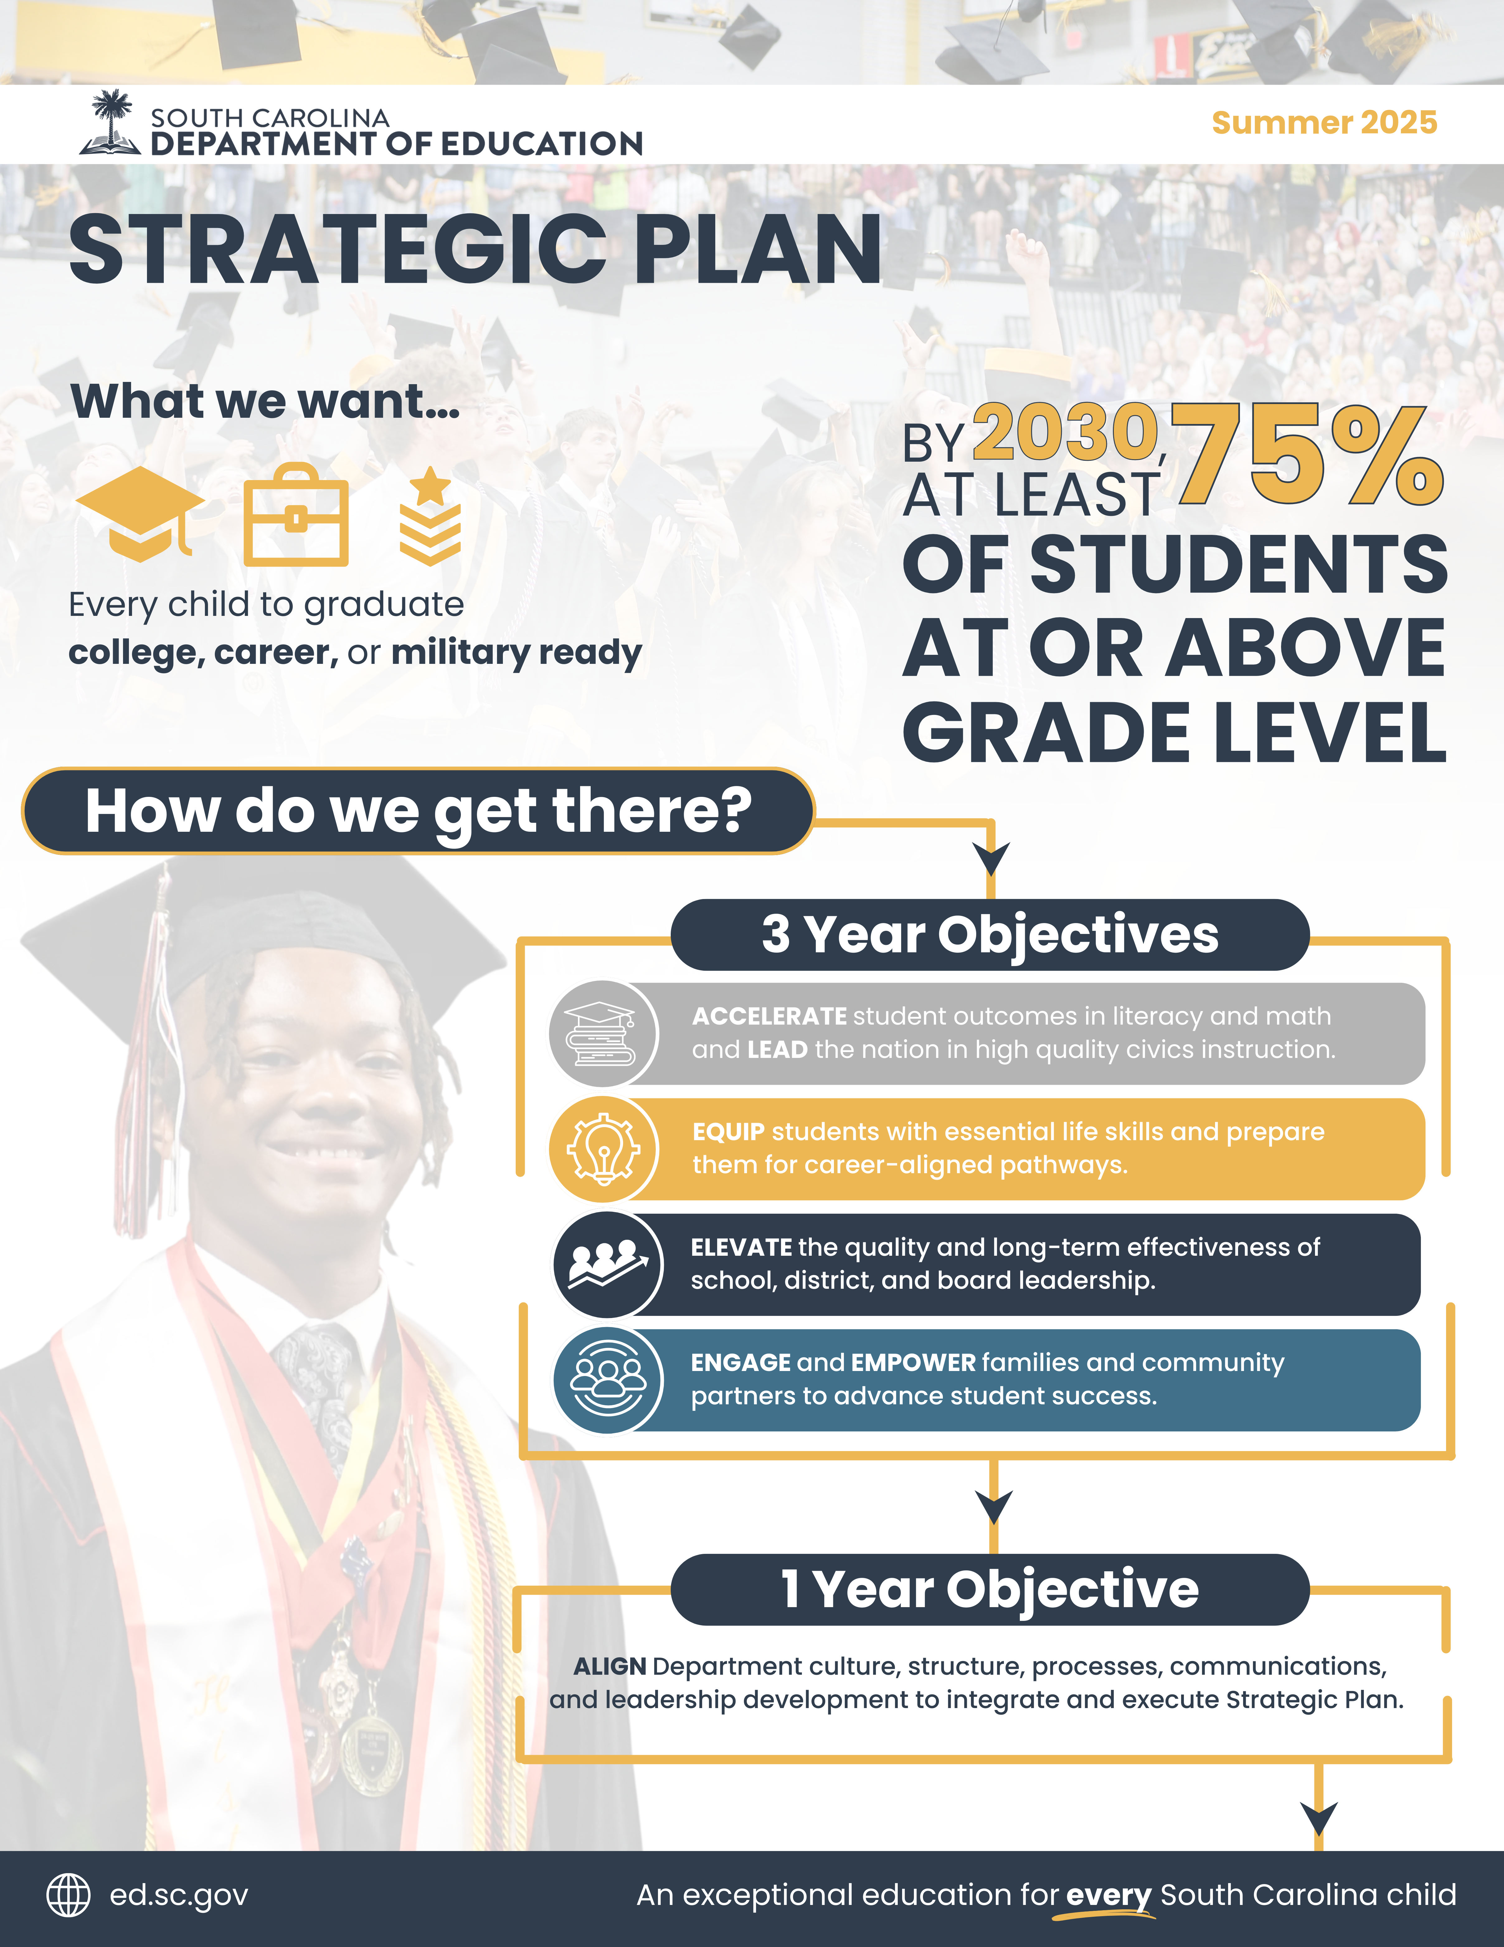

Our Strategic Plan

Slide 4
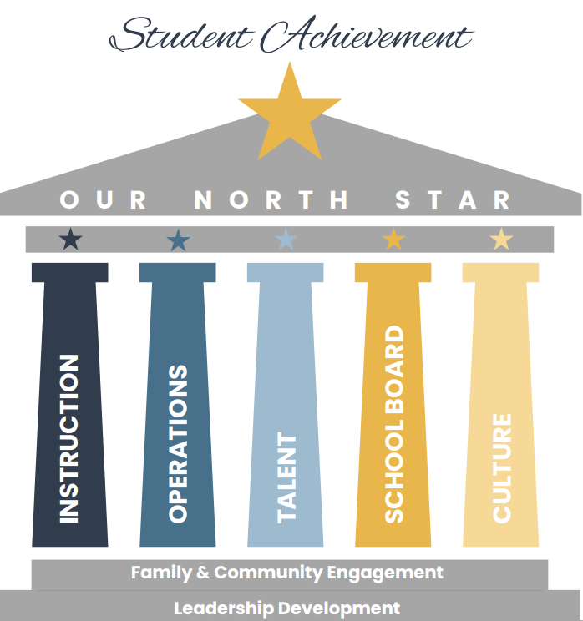
The HOPE Framework
Helping Our Pupils Excel

Slide 5
Pillar #1
Instructional Coherence

Slide 6

SC Reading Instruction Over Time
A Scientific Shift
Phonemic Awareness | Phonics | Vocabulary | Fluency | Comprehension
2014
2018
2019-2022
2022-23
2024
2023-24
2026
Read to Succeed 1.0 (Act 284)
Statewide
MTSS Framework (Act 213)
Palmetto Literacy Project (2019)
New ELA Standards Approved
Read to Succeed 2.0
(Act 114)
Statewide LETRS (all K-3 teachers) and HQIM- adoption funded
R2S 2.0 Accountability Frame
Stronger 3rd
Grade Retention
New Teacher Cert Requirements
LETRS Training Launch (2021)
New HQIM for PLP Schools (2022)

Slide 7
SC Math Instruction Over Time
A Scientific Shift
Concrete | Representational | Abstract
2023
2024
Fall 2024
Spring 2025
2025-2026
2025-2030
2030
Launched Palmetto Math Project in 10 pilot schools
2025 SC College & Career Ready Math Standards approved by State Board of Education
Funding allocated for the Palmetto Math Project (PMP)
Initial PMP schools identified
Reviewed Math HQIM
Partnership with Modern Classrooms Project
New Math Standards
Adoption of Math HQIM
Zearn Math Partnership
On-going professional development (OGAP)
Regional Support
North Star:
At least 75% of students at or above grade level by 2030

Slide 8
Scaling High-Quality Instruction in South Carolina by 2028
To reach 75% of students on grade level by 2030, South Carolina is prioritizing skillful HQIM implementation in reading and math. Over the next three years, SCDE will build leadership capacity, align state systems, and clear out the noise, so educators can focus on delivering high-quality, grade-level instruction at scale.
 | Year 1 (2025-2026): Building the Foundation | Year 2 (2026-2027): Deepening Practice and Expanding Reach | Year 3 (2027-2028): Begin Achieving Scale and Sustainability
Field | All CAOs and state-based coaches participate in baseline HQIM implementation training; 32 schools in 24 districts participate in deeper learning via the HQIM Leadership Academy. | Cohort I schools deepen practice and start building replicable implementation models; teams representing an additional 27 districts participate in deeper learning via the HQIM Leadership Academy. | First cohort reaches sustained practice of HQIM implementation; exemplary models expand statewide; all remaining districts participate in deeper learning via the HQIM Leadership Academy.
SEA | All state-level coaches effectively use implementation tools; Internal agency systems begin to orient towards HQIM priorities; Leadership team collects and responds to implementation data to plan for Year 2. | Leadership team aligns training, funding, guidance, and communications to HQIM strategy and expands use of implementation data to refine state supports. | Key state systems are fully operationalized to reinforce behaviors at scale, including a communications strategy, a unified funding application, aligned training and supports, and guidance and regulations.

Slide 9
Many Budgets, Plans, and Timelines
A unified application addresses common challenges in grants administration by elevating priority-aligned actions in a single plan and enabling districts to budget all resources behind that plan for each school year.
Common Challenges in Grants Administration
Opportunities to Streamline
Siloed Decision Making — Decisions on spending are based on grant requirements rather than student learning goals.​
Inefficient Processes — LEAs develop separate plans for each requirement, which is duplicative and makes it harder to focus.​
Multiple Timelines — Plans and grants do not operate on the same timeline which can lead to incomplete financial pictures.​
Priority Spending — A single plan allows LEAs to braid funding sources behind investments in the state’s priority areas.
Streamlined Planning — LEAs engage in one, consolidated cycle of planning with more targeted application questions.
Complete Forecasts — Leaders have complete funding information, resulting in less underspending and rollover.

Slide 10
Pillar #2
Operational Coherence

Slide 11
Office of Implementation & Support
Turning strategic priorities into consistent, accountable execution at scale.
01
02
03
04
05
Translate
Remove silos
Govern
Refocus
Build capacity
Convert the SCDE Strategic Plan into clear, executable, agencywide initiatives.
Bring teams together around shared goals and responsibilities.
Establish consistent project governance, tracking, and communication across offices.
Shift staff effort from compliance-driven activity to purpose-driven, outcome-focused work.
Strengthen operational capability, upskill teams, and give leadership visibility into outcomes.

Slide 12
Cross-functional X-Teams
THE WHY
When critical initiatives span multiple offices and systems without a clear, consistent structure for collaboration and
leadership, they risk becoming fragmented and inconsistent and not delivering desired results.
CROSS-FUNCTIONAL X-TEAMS BRING
ACTIVE X-TEAMS
Collaboration. Cross-office engagement replaces silos.
Career Pathways
Special Education
Clarity. Defined roles, timelines, and deliverables keep focus on recurring initiatives.
Civics
Finance
Alignment. Strategy, operations, and communication match SCDE goals.
GPS Data Platform
Transportation
Accountability
AI & EdTech Strategy
Agility. Scalable structure enables recurring yet changing work.
Educator Pipeline
Education Scholarship Trust Fund
Continuous Improvement. Built-in learning cycle ensures improvement after each phase.
...and more, as priorities emerge.

Slide 13
District Accounting & Best Practices Committee
A statutory committee of legislators, district CFOs, and business leaders, collaboratively defining the financial infrastructure districts, SCDE, and policymakers need.
Statewide Finance Platform
Consistent Chart of Accounts
Best-Practice Toolkits
Public
Transparency
A single, standard system replacing manual district-by-district reporting, launching FY 2027-28.
Standardized coding and validation so district financials can be compared, aggregated, and trusted.
Governance, CFO and board-level decision tools, and financial toolkits, templates, reports, ready for districts to adopt.
Standardized reporting for districts, plus real-time dashboards and early-warning fiscal indicators.

Slide 14
Office of Research
A research agenda aligned to SCDE's strategic priorities, linking what we implement, how we implement it, and what actually works.
ANALYZE
SELECT
Rapid analyses of what is and isn't working across South Carolina classrooms and districts.
Use results to inform decisions about interventions, curriculum, and professional development.
e.g., Student outcomes across programs, districts, and geographies.
e.g., Which HQIM adoptions produce the strongest early-literacy gains.
REPORT
PARTNER
Publish findings transparently for districts, families, policymakers, and the public.
Work with nationally renowned researchers and build qualitative capacity for the questions numbers alone cannot answer.
e.g., Public-facing research agenda and outcomes aligned to the 1-4-1-4.
e.g., Partners include University of South Carolina, Clemson, Accelerate, Boston Univ., RAND, Stanford, UPenn

Slide 15
Promising Outcomes
Early Indicators of Success

Slide 16
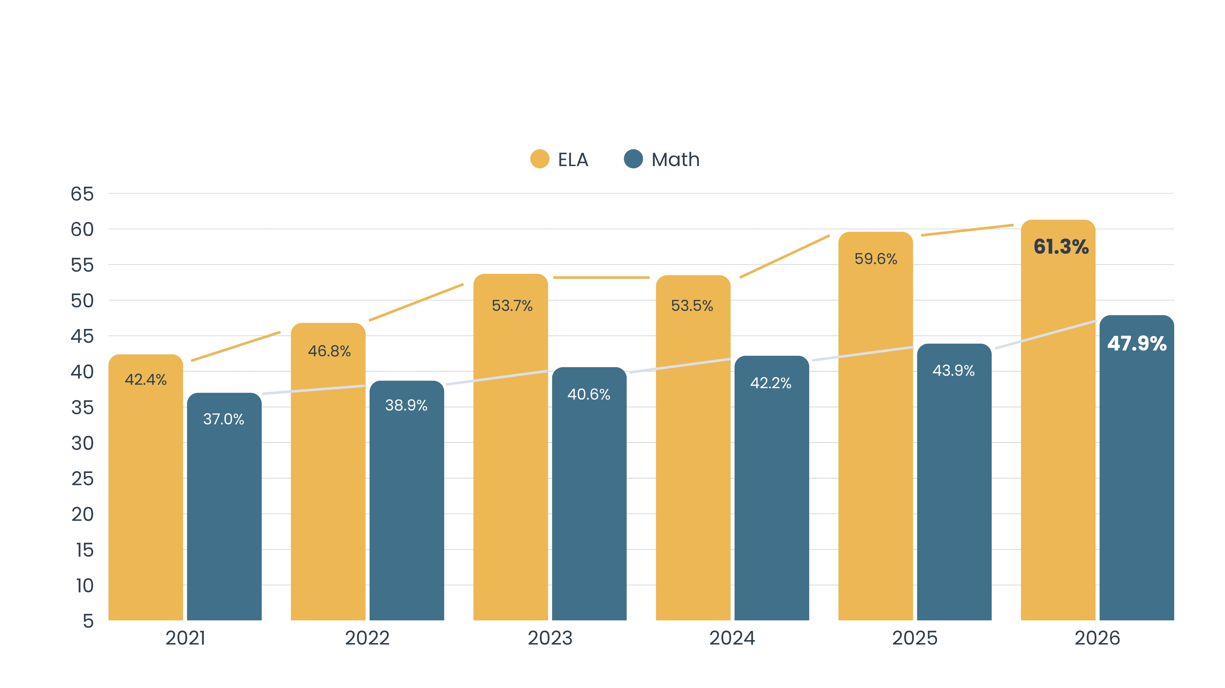
Students "Meeting" or "Exceeding" on SC READY
Grades 3-8

Slide 17
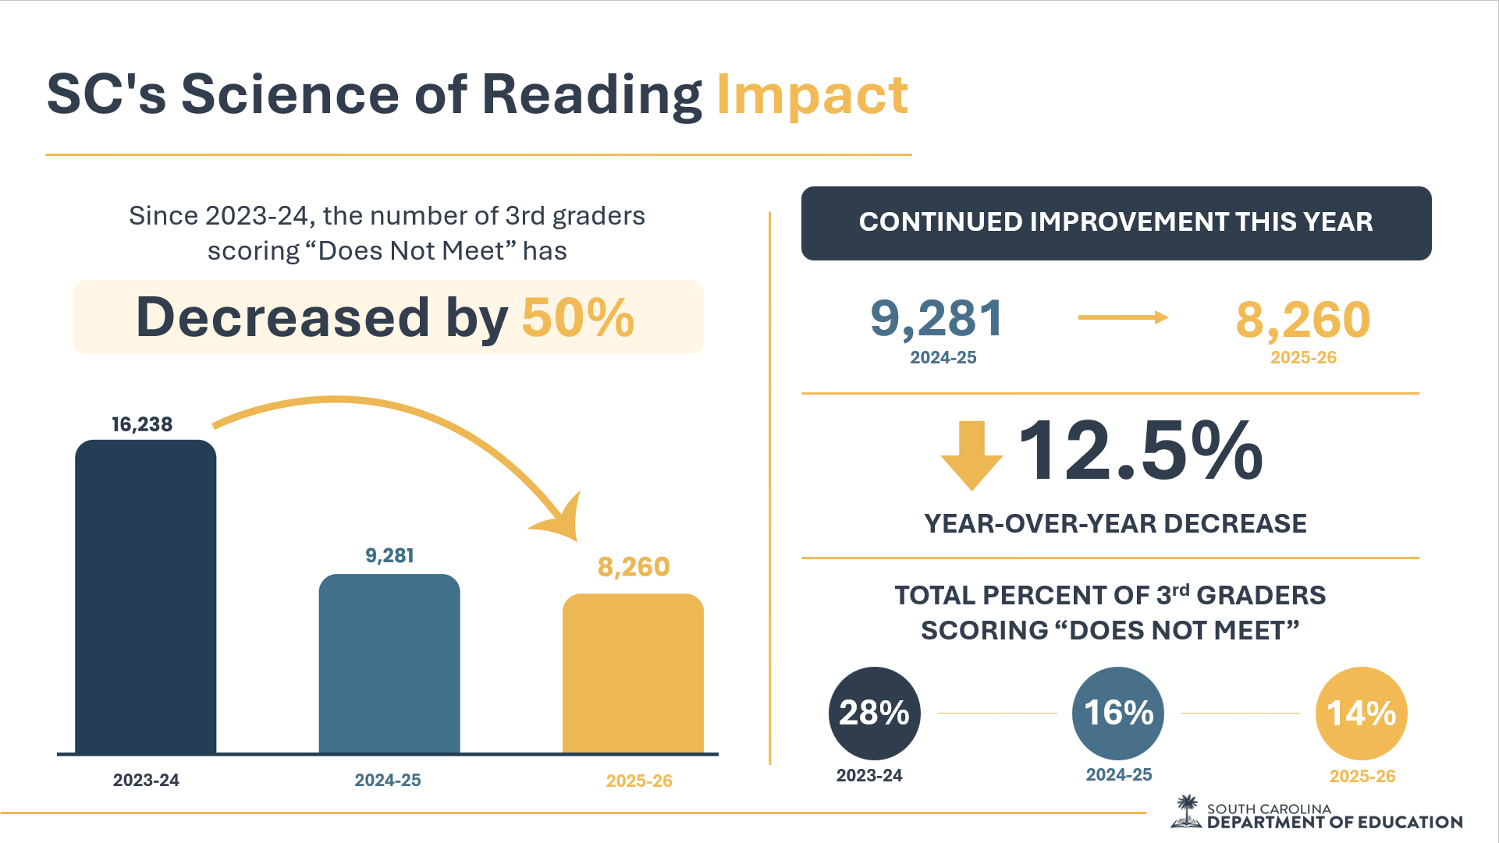

Slide 18



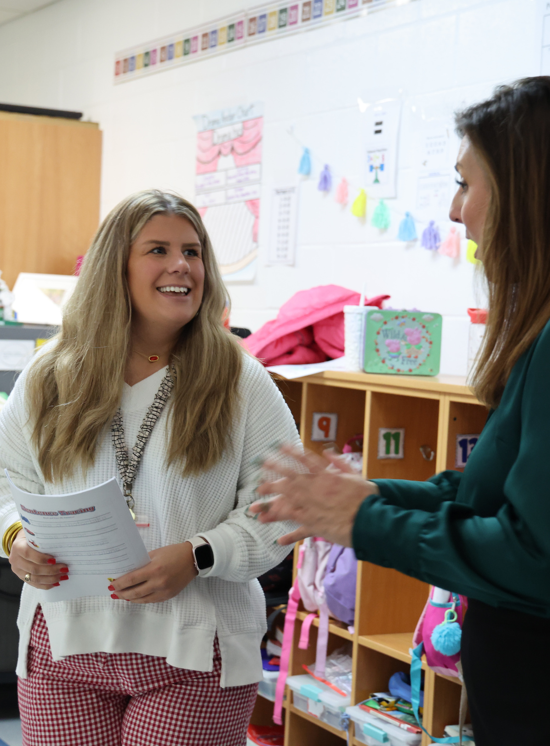
Teacher vacancies are down
Starting pay is up
56%
52%*
Teacher Key Stats
since 2019 and is now regionally competitive.
(*FY 2025-26)
since 2023, even as positions increased.

Slide 19
Key Takeaways
Begin with CLARITY – What is our timebound, measurable goal? What levers must we pull to achieve it?
Follow with ALIGNMENT – How do we organize resources (money, time, people power, communication) for impact?
Be PATIENT and PERSISTENT – It always takes longer than you think it will, be ready to relentlessly repeat the message!
Build a STRONG FOUNDATION – Sustainable scale begins with strong systems and a commitment to deepening practice.
Design systems to ENABLE people – People drive achievement. Strong systems give talented people the clarity, authority, information, and support to turn vision into action.
Cultivate an agency that LEARNS – Treat everything as an iteration, using research to identify what works and how to continuously improve.

