Slide 1

Beyond Compliance: Building Literacy Capacity Through Data Insights and Evidence-Based Supports
Ann Ellefson, North Dakota Department of Public Instruction
Brenda Ehrmantraut, North Dakota Department of Public Instruction
Lea Kugel, North Dakota Department of Public Instruction
Lacy Wood, Regional Educational Laboratory (REL) Central
September 9, 2026
Notes:
Lacy – 1 minute
Welcome and introduce topic – 2 minutes

Slide 2

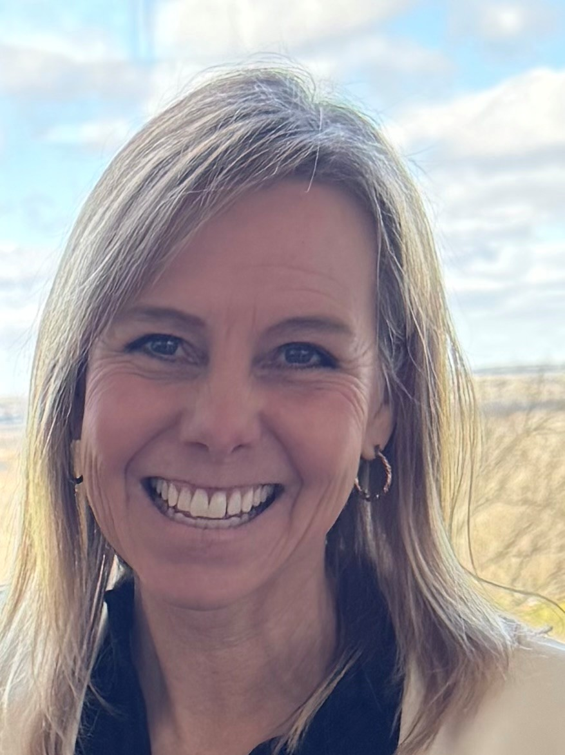




Beyond Compliance: Building Literacy Capacity Through Data Insights and Evidence-Based Supports
Who are we?
REL Central
Ann Ellefson
Assistant Superintendent for Academic Support
North Dakota Department of Public Instruction
Brenda Ehrmantraut
Assistant Director of Academic Support
North Dakota Department of Public Instruction
Lea Kugel
Special Education Coordinator, Office of Specially Designed Services
North Dakota Department of Public Instruction
Lacy Wood
REL Central Researcher, ND Literacy Partnership
REL Central
Notes:
Panel Introductions (3 minutes)
Name
Role (at org and on project)

Slide 3

Stand up if…
Beyond Compliance: Building Literacy Capacity Through Data Insights and Evidence-Based Supports
We’ll read a few statements.
Stand up if the statement applies to you.
Stay seated if it doesn’t.
Take a quick look around the room.
Then reset for the next statement.
Notes:
LACY
Before we begin let’s start with a quick sit-stand poll. If you’re unable to stand at the moment you may raise your hand.
We’ll read a few statements.
Stand up if the statement applies to you.
Stay seated if it doesn’t.
Take a quick look around the room.
Then reset for the next statement

Slide 4
Stand up if…
Beyond Compliance: Building Literacy Capacity Through Data Insights and Evidence-Based Supports
…you’ve ever collected data and later wondered, “What are we actually going to do with this?”
…you’ve ever had data showing whether something was implemented, but not how it was implemented.
…if you WANT better/more information, but are concerned about the burden of collecting and analyzing it.
Notes:
LACY (note statements appear on click)
Statement 1: Stand up if …you’ve ever collected data and later wondered, “What are we actually going to do with this?”
Statement 2: Stand up if……you’ve ever had data showing whether something was implemented, but not how it was implemented.
Statement 3: Stand up if…if you WANT better/more information, but are concerned about the burden of collecting and analyzing it
[Lacy narrate key takeaways and connect to the presentation]

Slide 5
North Dakota context
Beyond Compliance: Building Literacy Capacity Through Data Insights and Evidence-Based Supports
Our state’s Science of Reading Journey
4 in 10 students score proficient or higher in ELA
State legislation (July 2022)
Literacy curricula, assessments, and professional development
Professional development coordinated through NDREAs
Curriculum guidance
Statewide supports
Dyslexia screening and supports
Centralized resources
Source: 2024/25 achievement data for North Dakota students in grades 3-11 (https://insights.nd.gov)
Notes:
BRENDA
Start by telling you a bit about the context of literacy in North Dakota.
This is a state where increasing literacy is a key strategic priority and, as of spring 2025, about 4 in 10 students scored proficient or higher in English language arts across grades 3-11.
In July 2022, ND passed legislation that:
Requires schools to adopt literacy curricula, assessments, and PD aligned with the SoR (NDCC 15.1-21-12.1)
Established statewide requirements for dyslexia screening and supports (NDCC 15.1-32-26)
ND’s DPI then began collecting data on schools’ implementation of the legislated requirements. And they also implemented literacy supports statewide, including PD offerings coordinated through its regional education associations, curriculum guidance and other resources aligned with the Science of Reading, and everything made available in a centralized resource hub.

Slide 6
What are the goals of our partnership?
Deeper insights into current Science of Reading implementation data
Actionable evidence about implementation and outcomes
Evidence-based guidance to address specific instructional challenges
Beyond Compliance: Building Literacy Capacity Through Data Insights and Evidence-Based Supports
Notes:
LACY
NDDPI is partnering with REL Central to tackle 3 goals:
Surface deeper insights into the SoR implementation data they currently have
Develop actionable evidence about SoR implementation and outcomes
Co-develop evidence-based guidance to help their educators address specific literacy instructional challenges

Slide 7
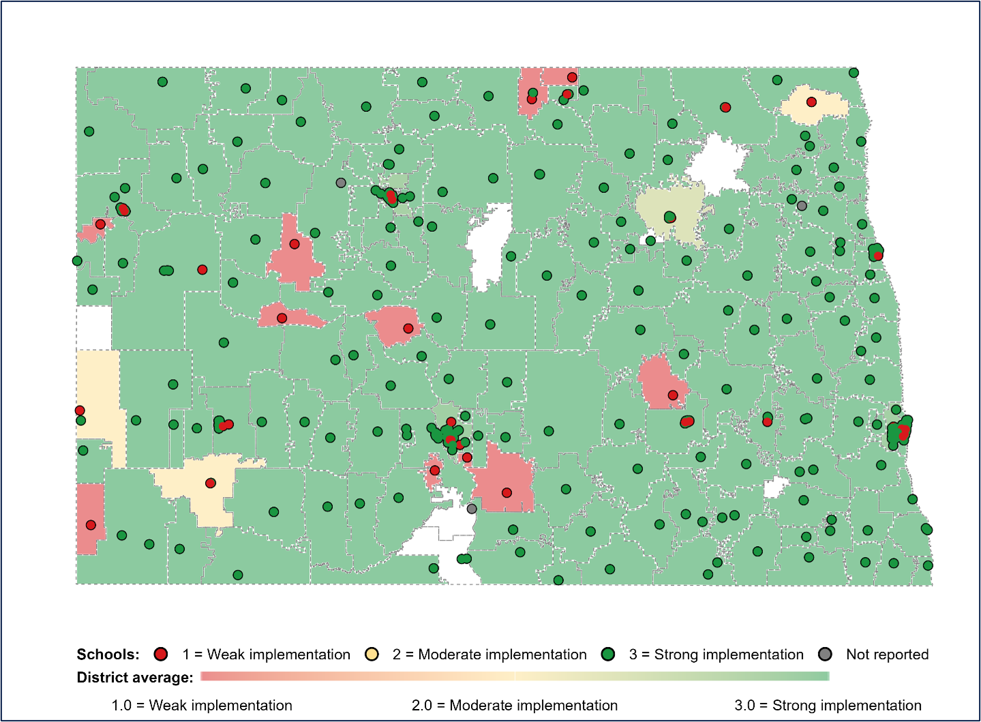
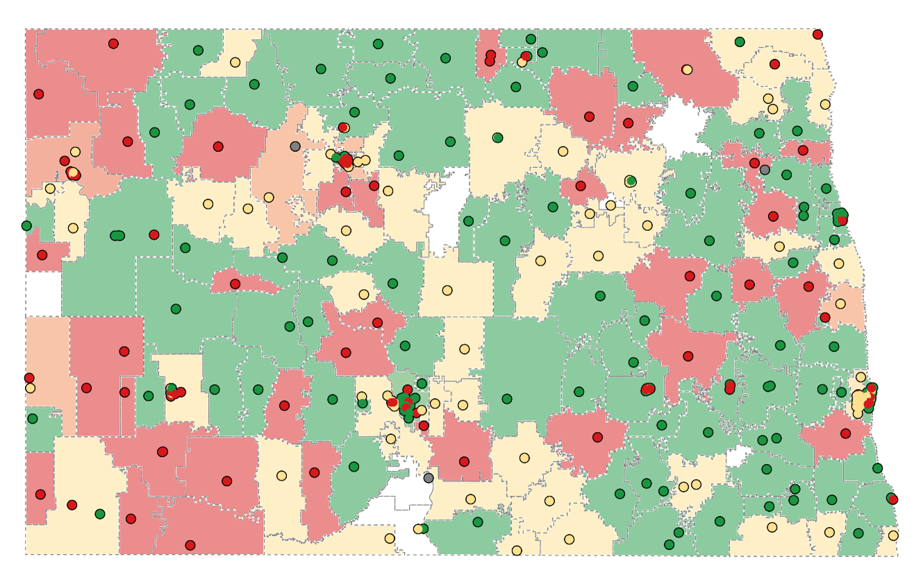
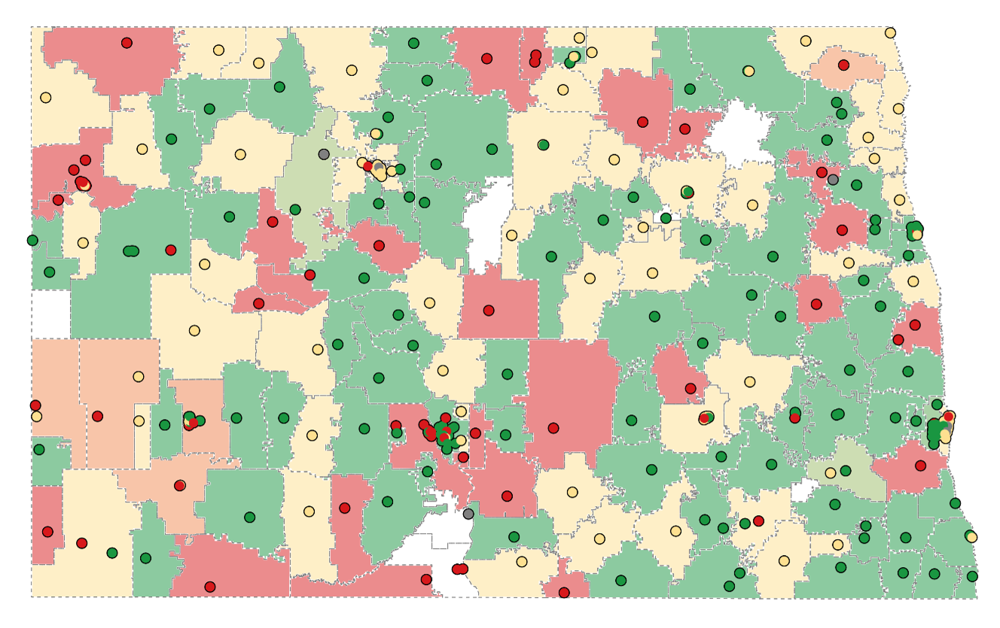
Deeper insights
Beyond Compliance: Building Literacy Capacity Through Data Insights and Evidence-Based Supports
Data on Science of Reading implementation
Most schools were rated strong for assessment implementation, but there were more differences in curricula and professional development ratings across schools.
Assessment implementation ratings
Curricula implementation ratings
Professional development implementation ratings
Notes:
LACY
A couple examples of our work together so far.
We started w/the first goal: Creating deeper insights into current Science of Reading implementation. We co-interpreted the state’s data that schools are required to report every 1, 2, or 3 years (depending on the school’s ratings).
This is one example of what we found:
-Most schools (87%) were rated strong for implementation of the required literacy assessments (all that green in the L-most chart), but there were more differences in ratings for literacy curricula (middle) and PD requirements (right).
-Just under half of schools were rated strong in each of these other two areas.
From here, we also looked at more detailed patterns in schools’ implementation of these requirements as well as patterns in schools’ performance on the ELA state test.

Slide 8
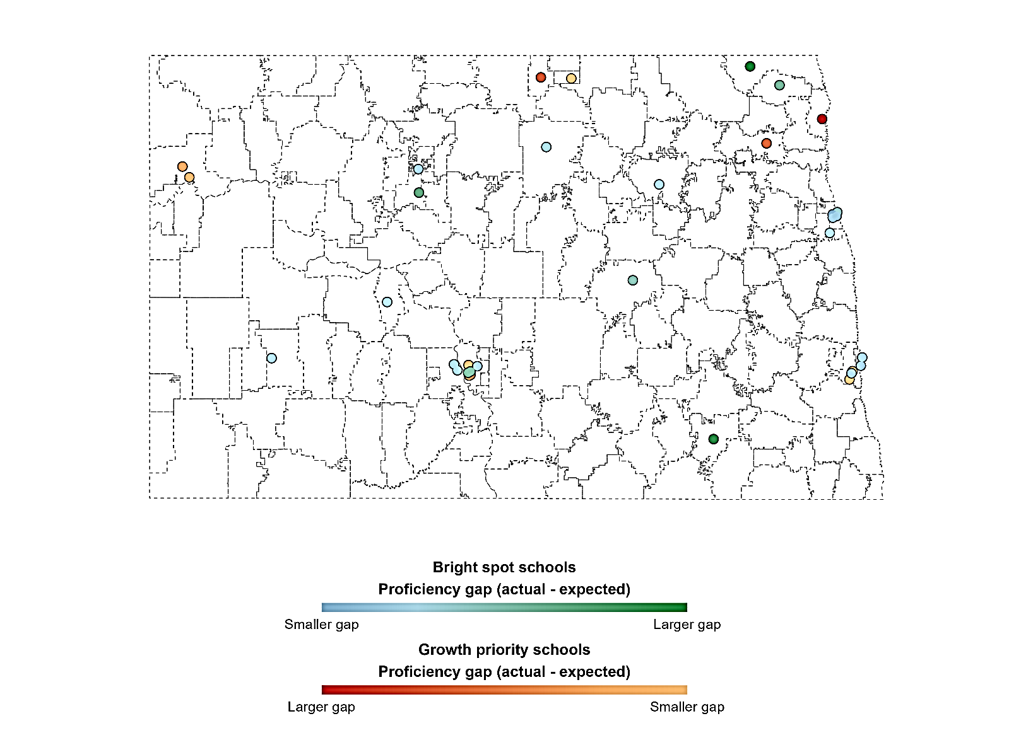
Deeper insights
Beyond Compliance: Building Literacy Capacity Through Data Insights and Evidence-Based Supports
Insights from Grade 3 ELA
While student demographics and economic resources play a role, they do not fully determine outcomes.
Schools that are similar in some ways produce different results, suggesting that additional factors are shaping early literacy success.
Outperforming Schools
Growth Opportunity Schools
Notes:
LACY
We also examined ELA grade 3 data from SY 2024/2025 year, by looking at where actual achievement differed statistically from an expected achievement measure that considered all sorts of observable factors about students and schools. We were interested in those schools because the difference between actual and expected achievement suggests something else may be going on to get to those actual outcomes. We were interested to see if there was any correlation with the implementation ratings.
We found that Schools outperforming expectations were geographically dispersed, sometimes near schools performing below expectations.
Outperforming schools served fewer low-income students and English learners, but were similar to growth-opportunity schools on special education and K–3 retention
Thie indicates that although demographics and resources matter, but do not fully explain outcomes. Similar schools can produce different results, suggesting other factors may shape early literacy success.

Slide 9
In progress: Actionable evidence
Beyond Compliance: Building Literacy Capacity Through Data Insights and Evidence-Based Supports
Using Our Learning to Guide Feasible change and future research
  The goals
    Remain mindful of reporting and analysis burden
    Collect useful data that answers key questions we have about professional development, curriculum, and assessment
    Inspire schools to reflect on how they are implementing
  The challenge: we can only collect things that are specifically noted within the law
Identify strategic data collection opportunities and potential changes to NDDPI’s data collection processes and tools.
Develop learning questions to guide future investigation
Notes:
LACY + BRENDA
Lacy
We’re using what we’ve learned to identify potential changes and sharpen our learning questions.
While there may be opportunities to strengthen curriculum and PD implementation, our findings suggest there is no single lever for improving outcomes.
Brenda
We’re identifying opportunities to streamline data collection and focus on information that is most useful for decision-making and learning.
As we refine questions about areas such as classroom implementation, we want data collection to be purposeful and, where possible, help schools reflect on their own implementation.
We also need to work within clear statutory boundaries, ensuring a direct connection between what districts and schools are asked to report and what the law allows us to collect.

Slide 10
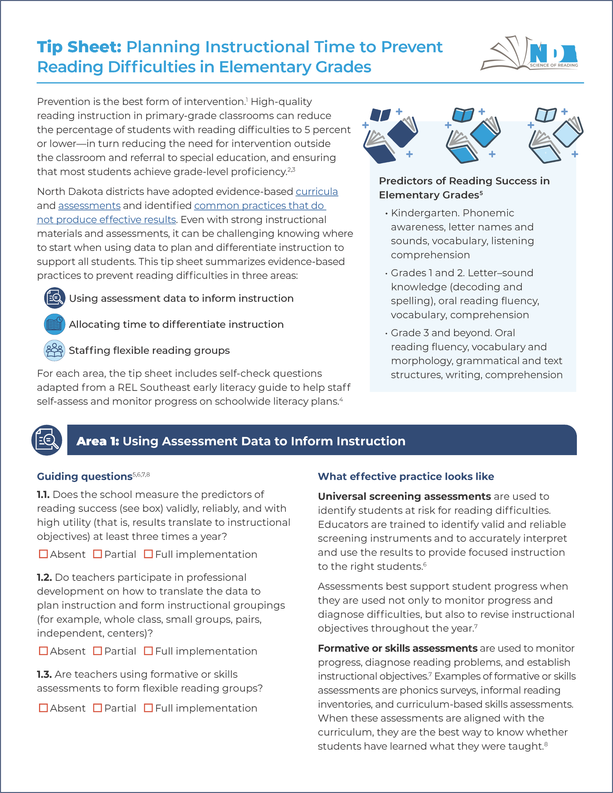
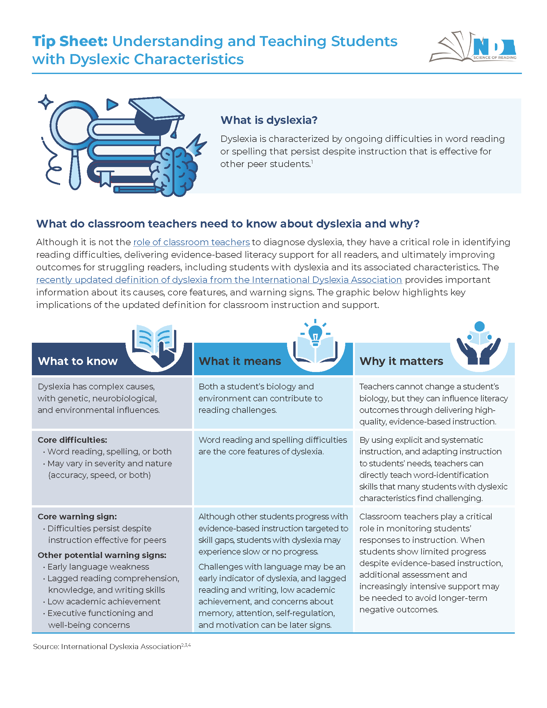
Evidence-based guidance
Beyond Compliance: Building Literacy Capacity Through Data Insights and Evidence-Based Supports
Educator tip sheets on literacy-based Instructional Challenges
Tips sheets now available on our website!
Notes:
LACY
Finally, we collaborated with NDDPI and the REAs to develop two tip sheets addressing instructional challenges where educators across the state have asked for more guidance. These are now available on the NDDPI and REL websites.
Planning instructional time to prevent reading difficulties. This self-check helps elementary school and instructional leaders identify opportunities to strengthen assessment use, instructional time, and staffing to ensure all readers get the support they need.
Supporting students with dyslexic characteristics in general education classrooms. This resource clarifies what dyslexia is, what teachers should look for, and how they can respond with evidence-based supports—while reinforcing that teachers identify and address reading difficulties rather than diagnose dyslexia.

Slide 11
Reflections from the team
Beyond Compliance: Building Literacy Capacity Through Data Insights and Evidence-Based Supports
How can SEAs best support literacy improvements, particularly in a local control environment?
What successes and challenges have you seen so far with improving reading outcomes in ND schools?
What are the most important supports or conditions needed to do this work successfully?
What role do you see for data and evidence insights to inform statewide literacy efforts in ND?
Notes:
Reflections from NDDPI team on these questions, moderated by Lacy (10 minutes)
How can SEAs best support literacy improvements, particularly in a local control environment?
What successes and challenges have you seen so far with improving reading outcomes in ND schools?
What are the most important supports or conditions needed to do this work successfully?
What role do you see for data and evidence insights to inform statewide literacy efforts in ND?

Slide 12

Q&A
Beyond Compliance: Building Literacy Capacity Through Data Insights and Evidence-Based Supports

