Slide 1
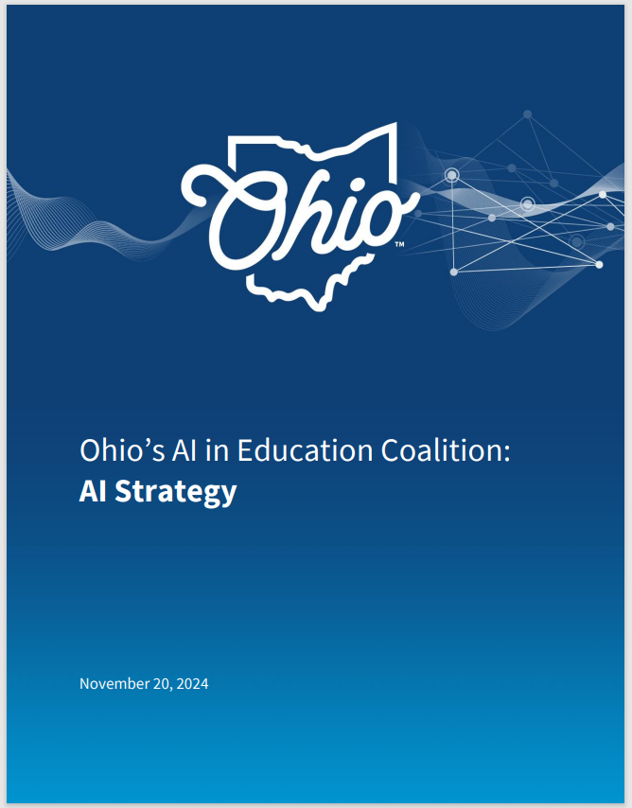
AI in Ohio: Supporting districts' implementation of required local AI Policy
Chris
Woolard
Chief Performance and Innovation Officer
Christopher.Woolard@education.ohio.gov
Tori
Cirks
Director, Midwest Comprehensive Center
vcirks@air.org

Slide 2
Problem Statement
As innovation emerges and accelerates, Ohio must be strategic and forward thinking in supporting schools with a focus on preparing students for success.

Slide 3
Timeline
AI K-12 Toolkit
February 2024
AI in Education Coalition:
AI Strategy
November 2024
State Model Policy
December 2025
Supports and Implementation
LEA Policy Adoption
July 1, 2026
Notes:
AI Toolkit
Spearheaded by then Lt. Governor Jon Husted
Released in Feb. 2024
Was designed to equip stakeholders in Ohio’s schools (district superintendents, school principals, educators, parents, and more) with the resources to advance AI literacy among their students.
AI in Education Coalition: AI Strategy
Coalition launched in May 2024, under the leadership of Lt. Governor Jon Husted
Released strategy report in November 2024
This comprehensive strategy was designed to ensure that the state's K-12 education system is prepared for and can help lead the AI revolution.
AI in Education Model Policy
House Bill 96 required the Ohio Department of Education and Workforce to develop a model policy on the use of artificial intelligence in schools no later than Dec. 31, 2025.
The model policy addresses appropriate use of artificial intelligence by students and staff for educational purposes.
HB 96 requires each school district, community school, and STEM school to adopt a policy on the use of artificial intelligence no later than July 1, 2026. Under this provision, the district or school may adopt the Department's model policy.
Supports and Implementation
Department has released several resources related to AI. Including:
Guidance on the responsible use of AI in the development, implementation, and documentation of special education services.
Guidance on using federal formula grant funds to support several aspects of Ohio’s AI Strategy.
Resources for integration AI into content-area instruction.
And a student AI usage model to provide clear guidelines for responsible classroom use, covering tasks like brainstorming, editing, and group projects with a focus on honesty and transparency while using AI.

Slide 4
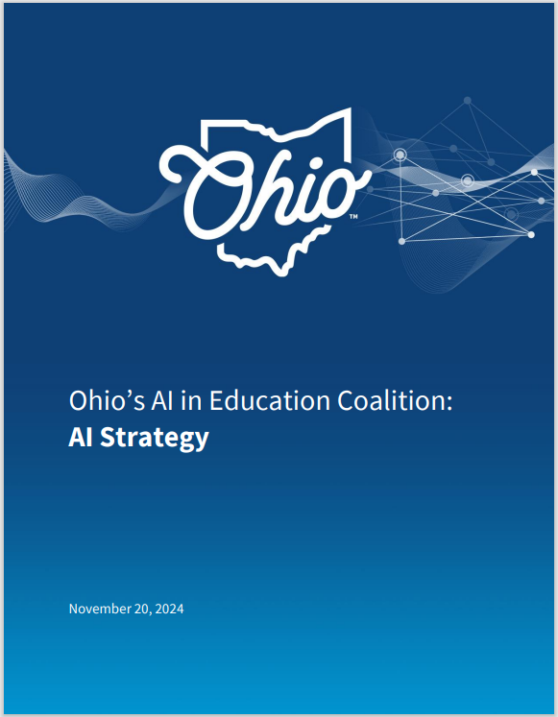
Ohio’s AI In Education Coalition
AI is a transformative force in education, with a large impact on Ohio’s Workforce.
Ohio's students must be prepared with the knowledge and skills necessary to thrive in an AI-enhanced world.
Ohio's AI In Education Strategy Report
Notes:
In May 2024, under the leadership of then Lt. Governor Jon Husted, Ohio’s AI in Education Coalition convened to develop a comprehensive strategy to ensure that the state's K-12 education system is prepared for and can help lead the AI revolution.
The coalition, composed of representatives from industry, school districts, educators, and other stakeholders, was divided into three workgroups—Industry, Operations, and Instructional—each tasked with addressing specific aspects of AI's impact on education.
The recommendations of these workgroups form the core of this strategy.
The coalition outlined several recommendations for schools and districts, institutions of higher education institutions, and the State of Ohio – specifically the Department of Education and Workforce.

Slide 5
Ohio’s AI Strategy Guiding Principles
Provide
Provide All Students with Responsible AI Experiences
Reflect
Reflect on Methods to Teach AI While Maintaining a Balanced Curriculum
Provide
Provide AI Learning Opportunities to All Ohio Educators
Inform
Inform Parents on How AI Supports Learning
Connect
Connect with Local Employers on AI Workforce Needs

Slide 6
Coalition Recommendations
Districts
  Comprehensive AI Workgroup
  Establish a Policy
  Offer AI Professional Development and Support for District Personnel
Higher Ed
  Incorporate AI Literacy into Education Preparation Programs
State
  Resources and Best Practices
  Academic Standards and Model Curriculum
  Review Existing Policies
  Cooperative Purchasing Program
  Learning PathWays for Students
  Maintain Coalition

Slide 7

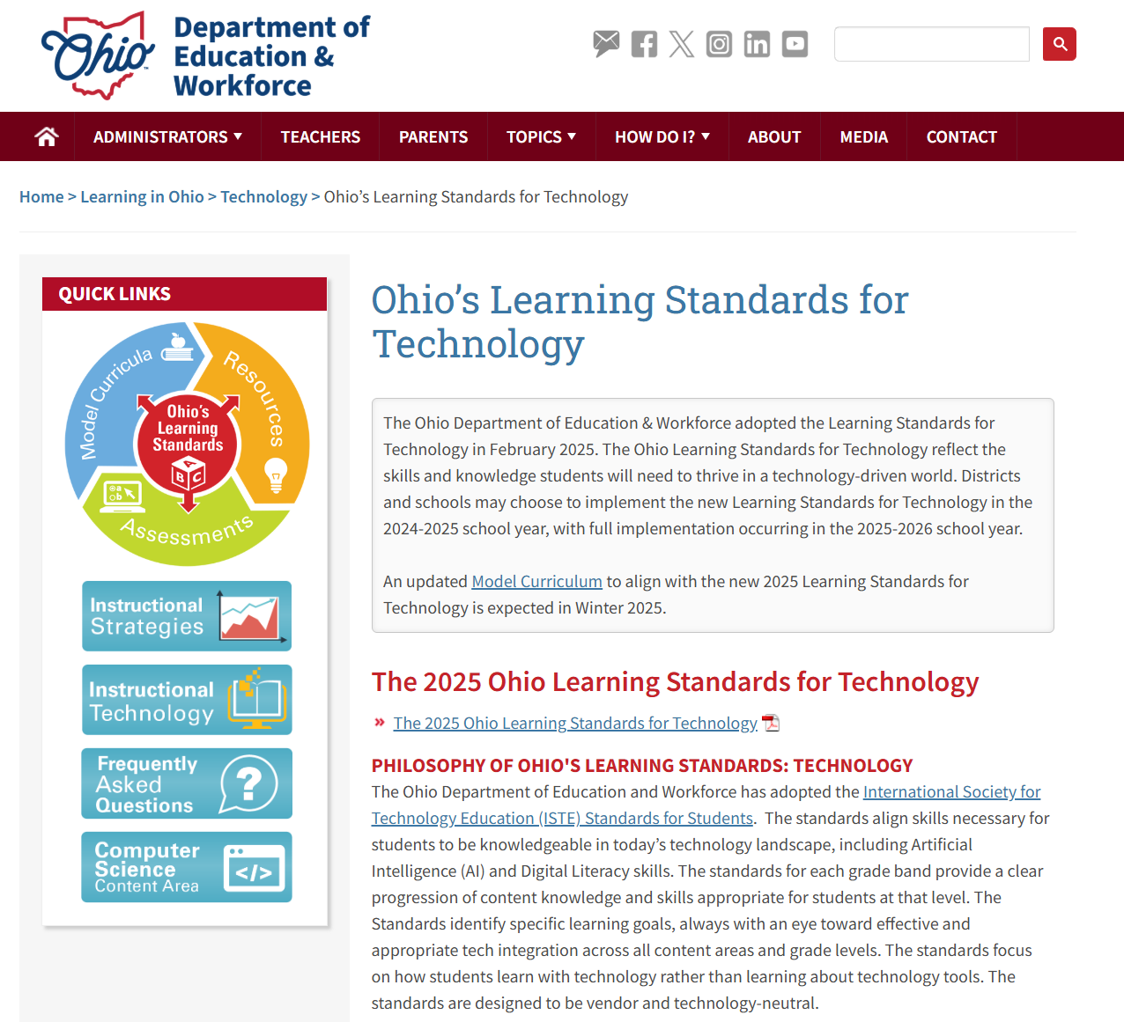

OHIO’S LEARNING STANDARDS
Ohio’s Learning Standards for Computer Science
Ohio’s Learning Standards for Technology
Scan the QR code to view the standards
Notes:
Talking Points
Schools and districts can connect AI to the content learning standards. Ohio’s Learning Standards for Computer Science include specific standards for AI that can help support student AI literacy and fluency development.
Ohio’s Learning Standards for Technology provide clear expectations for digital literacy and responsible technology use, which can guide schools and districts in aligning their practices with the AI Model Policy. By leveraging these standards, educators can ensure that AI integration supports ethical, safe, and effective learning experiences for all students.

Slide 8
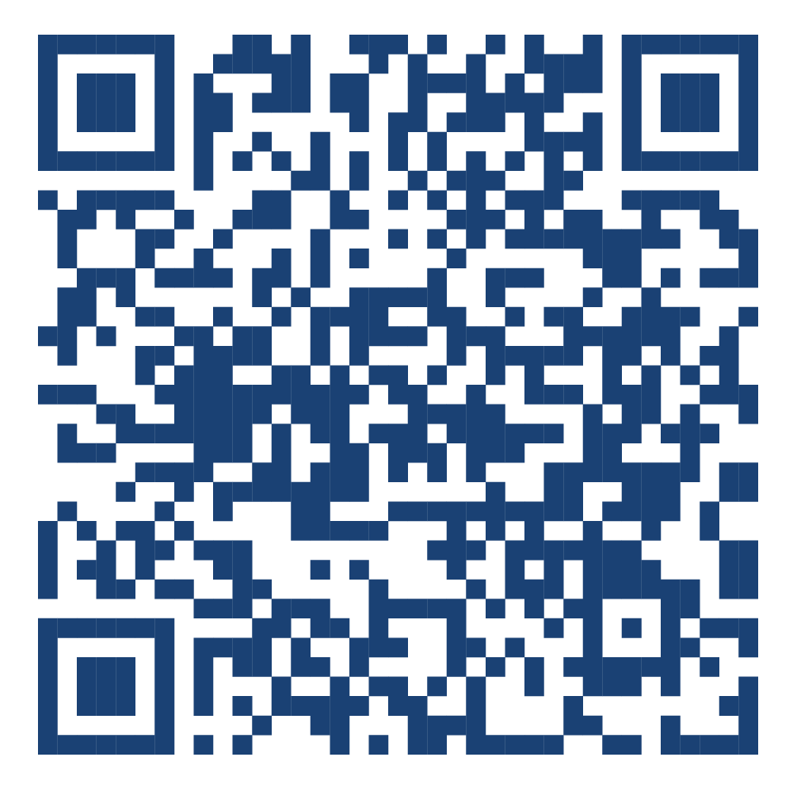
AI MODEL Policy
DEW AI Model Policy released in December, 2025.
Under House Bill 96, all Ohio districts were required to adopt a formal AI policy by July 1, 2026.
Scan QR code to review model policy.
Notes:
The Department released its model policy on artificial intelligence (AI) in education in December 2025.
DEW’s model policy provides a template that districts may adopt as written or customize to meet local needs, and is designed to guide traditional public school districts, community schools, and STEM schools in the responsible and effective use of AI in education.
Developed in collaboration with Ohio's AI in Education Coalition, the model policy reflects extensive feedback from educators, businesses, nonprofits, and government leaders.
You can scan the QR code to review the full model policy.
It addresses appropriate use of AI by students and staff, promotes ethical practices and academic integrity, and sets standards for data privacy and security.
The policy also provides guidance for integrating AI into curriculum, evaluating third-party tools, and aligning with existing policies on bullying, academic integrity, and procurement.
As a reminder, under HB96, all Ohio districts are required to adopt a formal AI policy by July 1, 2026.

Slide 9
AI Model Policy
PURPOSE STATEMENT
DEFINITIONS
AI LITERACY
STAKEHOLDER ENGAGEMENT
DATA PRIVACY AND SECURITY
PROCUREMENT AND EVALUATION OF AI TOOLS
ETHICAL USE OF AI
ACCEPTABLE USE
ACADEMIC INTEGRITY
IMPLEMENTATION AND REVIEW
OTHER CONSIDERATIONS
Notes:
Model Policy
The model policy is an important step and sends an important message to our education system, that we need to responsibly implement and integrate AI in Ohio
This is a workforce issue, we must prepare Ohio’s students for success
Humans must be at the Center of related work and decisions, keeping people – educators, students, communities – at the heart of every AI-related decision.
Prepare students for success, encourage innovation for classroom instruction, and embrace opportunities for operational efficiency, while providing for consistent expectations, standards, and approval processes for safe and responsible implementation and integration of AI
The Department’s model policy represents extensive feedback from our stakeholders and reinforces the urgency of preparing students for success in an AI-infused world.
Key components include:
Stakeholder Engagement
Examples include representative of grade levels, departments, including students with disabilities, board members, students, local business, higher education
Inform parents on importance AI, skills needed, potential risks
Data Privacy
Student and staff data, PII, FERPA, state and Federal laws
Ethical Use and Academic Integrity
Tool to support learning and teaching, not a substitute for student effort or the role of the educator.
Users should critically analyze AI output, respect safeguards and rules, and be transparent about its use (citation)
Integration with other school policies such as bullying and student wellness
Appropriate use of AI by students and staff for educational purposes.

Slide 10
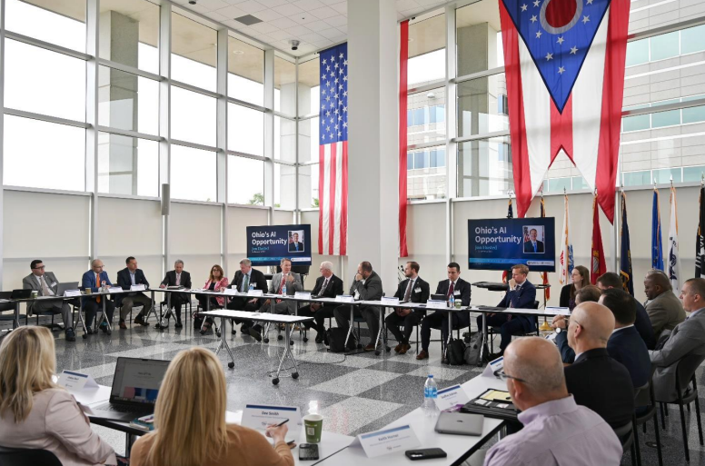
Additional Considerations
Non-consensual intimate imagery (NCII)
  NCII-related issues, digital wellness, and cyberbullying
Policy implementation and review
  Planning for success and sustainability
Ohio’s AI in Education Coalition Kick-off Meeting in May of 2024
Image courtesy of the AI in Education Strategy report
Notes:
Talking Points
The model policy concludes with additional local considerations.
As schools and districts implement a local AI policy, review and selection processes may need to be established or updated to include AI tools. These policies can include criteria such as privacy, security, instructional value, and school or district alignment.
Ohio’s AI model policy encourages schools and districts to consider issues related to non‑consensual intimate imagery, cyberbullying, and student well‑being in policy and incident responses- particularly in alignment with existing policies
Schools and districts should also plan policy rollout, training, and scheduled reviews. It can be helpful to view AI implementation and governance as a continuous improvement cycle built within school operations.
Consider the alignment, conflicts, and opportunities for your school or district when adopting and implementing a local AI policy.

Slide 11

AI Model Policy: Supporting Resources
Special Education
Federal Funding
Integration with content areas
Student AI Usage Model
Intel Partnership
Scan QR code to access additional resources.
Notes:
ISTE and aiEDU partnerships in the works

Slide 12
Federal Supports
Waiver (funding flexibilities)
Title II state activities
Midwest Comprehensive Center support

Slide 13
Midwest Comprehensive Center Support
Research Briefs
Produce research briefs and syntheses examining emerging uses of artificial intelligence in K–12 education.
Promising Practice Briefs
Highlight and disseminate promising district practices related to the responsible and effective use of artificial intelligence.
Implementation Tools
Develop practical implementation tools aligned with the state’s model AI policy to support district adoption and use.
Notes:
..
..
.

Slide 14
Key topics and early learnings
Research Briefs
Using AI for district/school operational purposes
Promising Practices Briefs
Literacy in Teaching and Learning
Using AI for teaching and educator practice
Using AI for student learning and assessment
Stakeholder Engagement
Procurement, Evaluation, Privacy, and Security
Ethical Use, Acceptable Use, and Academic Integrity
Implementation, Review, and Leadership

