Slide 1
Building Mentor Supports for Delaware’s Educator Apprenticeship Program
September 9, 2026
Katherine Burns, Delaware Department of Education
Elizabeth Eaton, Mid-Atlantic Comprehensive Center

Slide 2
Before we talk about mentor supports…
Think of a mentor in your life: a teacher, coach, or colleague who helped you grow.
Share: What did they do that made their support useful?

Slide 3
Building Mentor Supports for Delaware’s Educator Apprenticeship Program
Core Challenge: Increasing the pipeline of qualified educators
Creates affordable pathways into teaching through the Delaware Educator Apprenticeship Program
Utilizes a partnership between the Delaware Departments of Education and Labor
Offers aspiring teachers paid, school-based positions while they complete the coursework required for certification
Complements additional strategies underway through Delaware’s Grow Your Own Educator Program and teacher residency programs

Slide 4
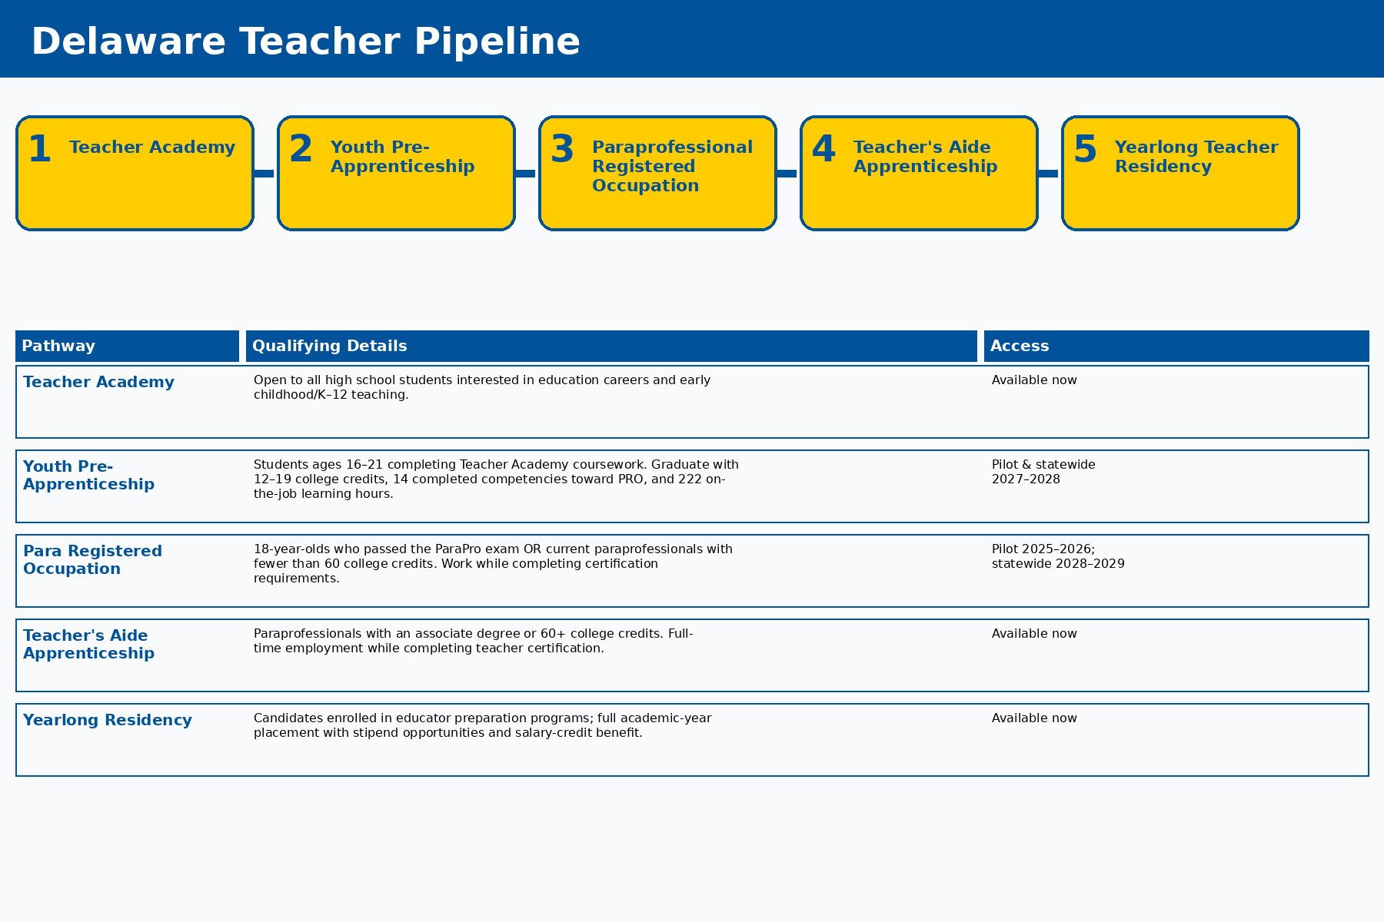
Delaware’s Teacher Pipeline

Slide 5
Delaware’s Teacher Pipeline: Where Mentors Fit
Classroom Experience
Teacher Education Programs
Constructive Feedback
Mentors translate work-based learning into instructional skill growth.
Apprentices need structured, school-based opportunities to practice and receive feedback.
Mentors coach apprentices toward skill acquisition, document competency completion, and provide day-to-day support.
State sponsorship helps align the pathway across education, labor, school districts, and educator preparation programs.

Slide 6
Building Mentor Supports for the Delaware Educator Apprenticeship Program
Objective: Develop a coherent system of supports for mentor teachers to help strengthen the apprenticeship model, enhance apprentice success, and promote statewide scalability.
Training for mentor teachers on key concepts
Community of practice to strengthen mentor capacity
Tools and resources to support mentoring practice
Capacity building moves from shared concepts → applied practice → reusable tools.

Slide 7
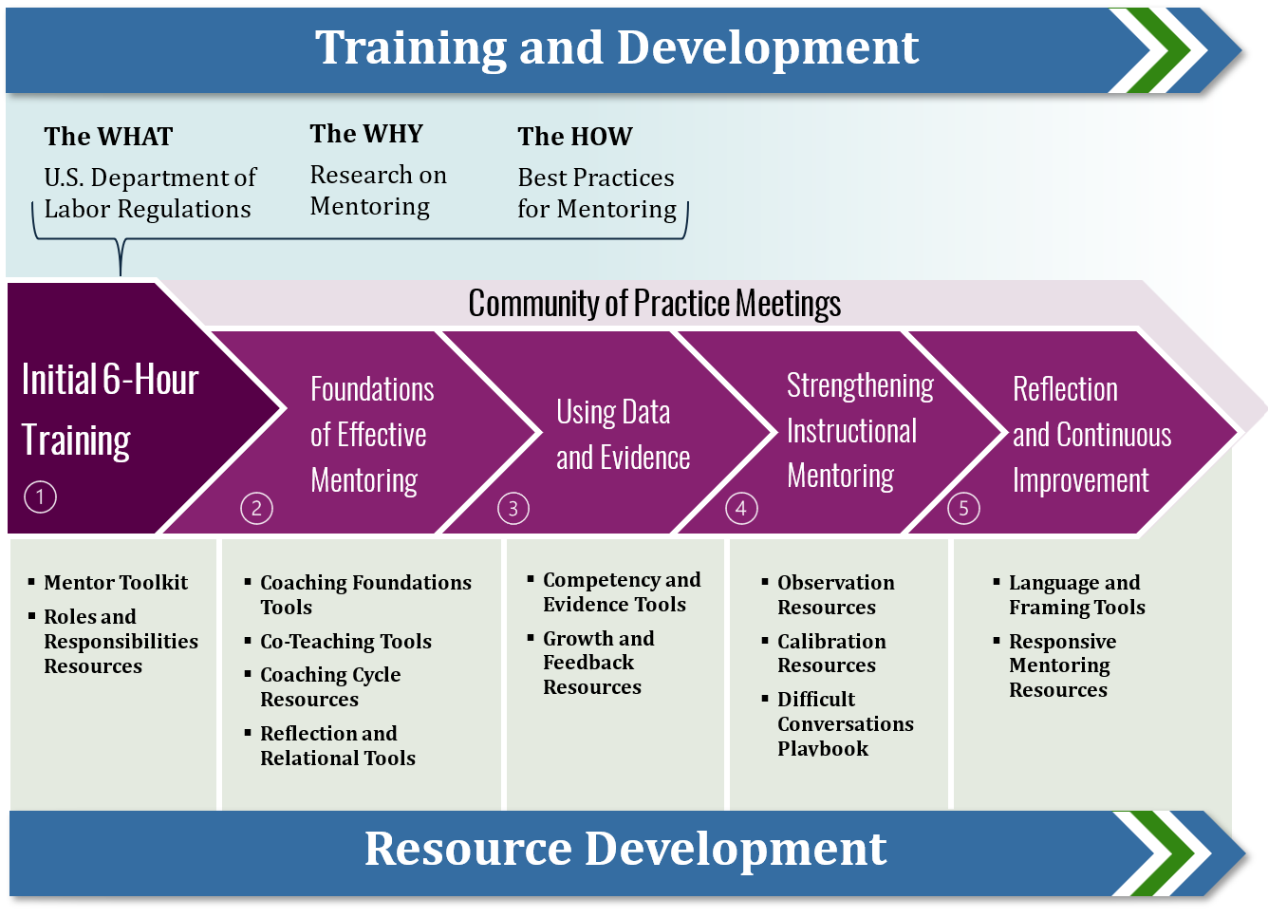
Arc of Support for Mentor Teachers

Slide 8

Intended Outcomes of Capacity Building Support
Greater understanding of evidence-based mentoring practices.
Increased access to resources for mentor teachers.
Increased awareness and understanding of the priorities, needs, and challenges related to mentoring educator apprentices.

Slide 9
Key Takeaways: Factors for Success
Success Factor | What This Looks Like in Delaware
Clearly define the role and expectations of mentor teachers. | Clarify mentor responsibilities, time commitments, and requirements in at-a-glance overview shared with local districts. Provide an overview of expectations during mentor orientation and training.
Support alignment and implementation through state sponsorship. | Leverage state leadership to align education, labor, local districts, educator preparation providers, and other partners around common expectations and a coherent pathway.
Engage partners in developing tools, resources, and supports. | Establish a Teacher Apprenticeship Governance Team comprised of representatives from all partner agencies and organizations. Meet regularly to ensure resources address mentor needs and are practical for use in school settings.
Design for scale from the beginning. | Facilitate statewide community of practice for mentor teachers during the 2026-27 school year to support consistent implementation, with an intentional transition over time to regional/countywide facilitation.

Slide 10

Questions?

Slide 11
Thank you!

