Slide 1
Leading Literacy Together:
Developing Georgia’s Adolescent
Literacy Playbook
Notes:
This session will showcase how the Georgia Department of Education (GaDOE) is working to strengthen internal collaboration and leverage external partnerships to enhance its organizational capacity to support improvements in literacy achievement. In 2025, staff from GaDOE's Office of Teaching and Learning and Office of Whole Child Supports thought-partnered on the need for the state to provide guidance and resources on adolescent literacy to school administrators of grades 4 and up. To expand GaDOE’s capacity, the state requested assistance from the federally-funded Southeast Region 5 Comprehensive Center in the development of an Adolescent Literacy Playbook for school leaders.
This playbook will enhance GaDOE's capacity to provide support to LEAs and schools in the area of adolescent literacy. Importantly, it is designed to first build leadership capacity by equipping system and school leaders with the knowledge and tools to establish conditions for effective adolescent literacy instruction. The playbook will also serve as a foundation for the future development of professional learning modules and other resources for LEAs and schools.
The collaboration required between multiple SEA offices to develop the Adolescent Literacy Playbook is strengthening interoffice connections and GaDOE staff's ability to use shared language in the areas of ELA, literacy, and MTSS. The process of developing the playbook will also help GaDOE staff identify policy gaps that may need to be addressed in the future and strengthen the SEA's knowledge of evidence-based practices to share with the field.

Slide 2
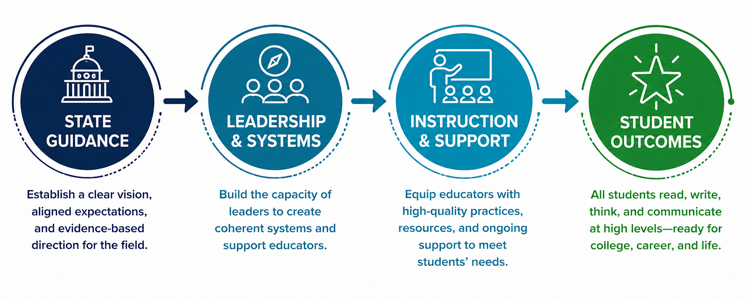
Why Adolescent Literacy – Why Now?
Strengthening Literacy Systems to Improve Student Outcomes

Slide 3
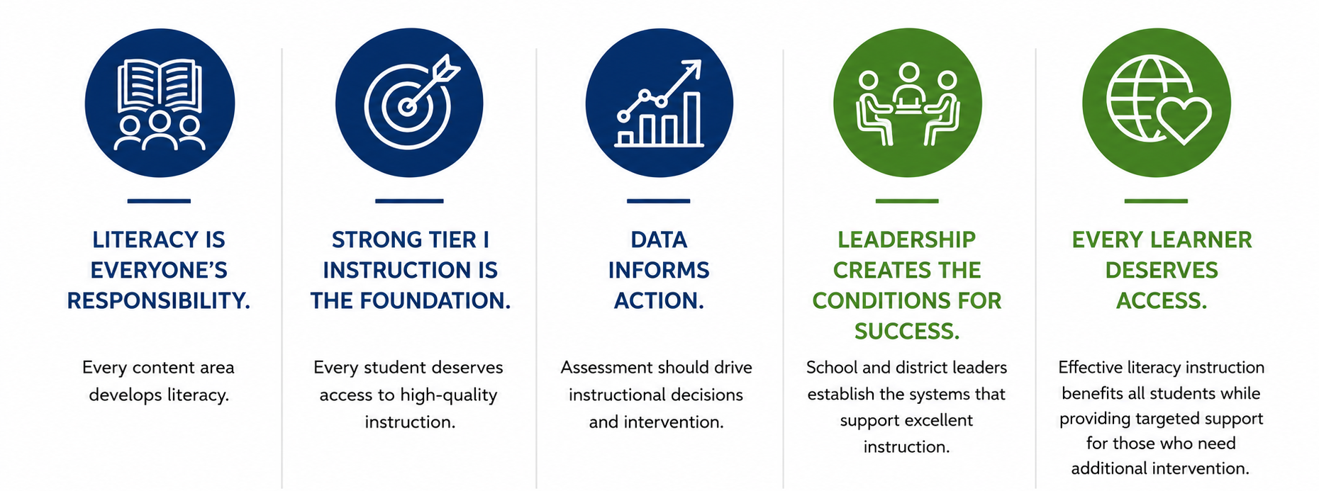
Our Beliefs
Notes:
📖 Literacy is everyone's responsibility. Every content area develops literacy. 🎯 Strong Tier I instruction is the foundation. Every student deserves access to high-quality instruction. 📈 Data informs action. Assessment should drive instructional decisions and intervention. 🤝 Leadership creates the conditions for success. School and district leaders establish the systems that support excellent instruction. 🌎 Every learner deserves access. Effective literacy instruction benefits all students while providing targeted support for those who need additional intervention.

Slide 4
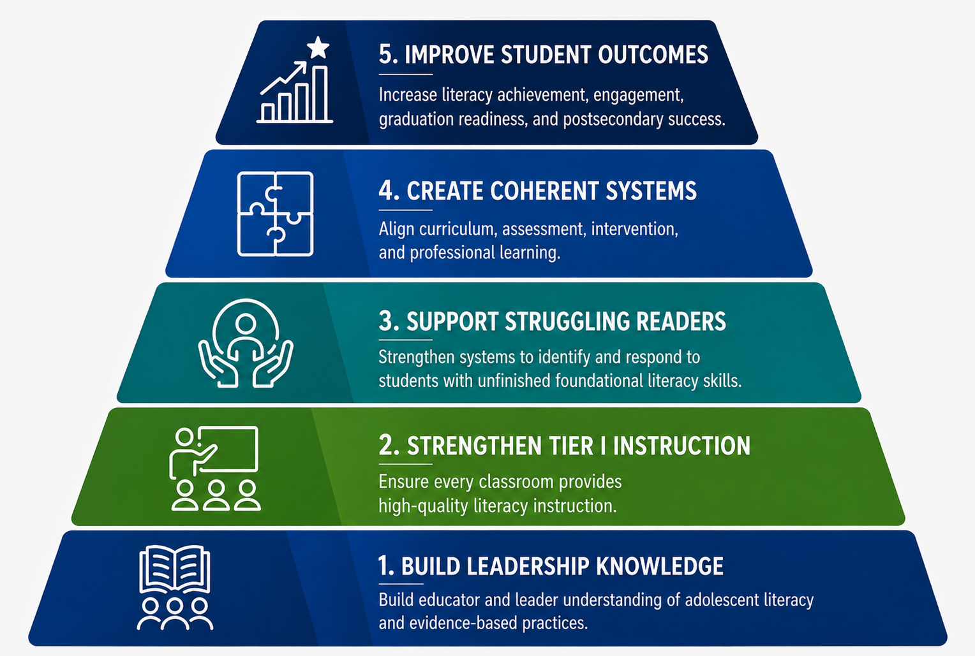
Leadership Priorities
Notes:
Rather than beginning with programs or resources, we started by establishing five priorities that would shape every aspect of our work. As we launched Georgia's adolescent literacy work, these priorities guided every decision we made.

Slide 5
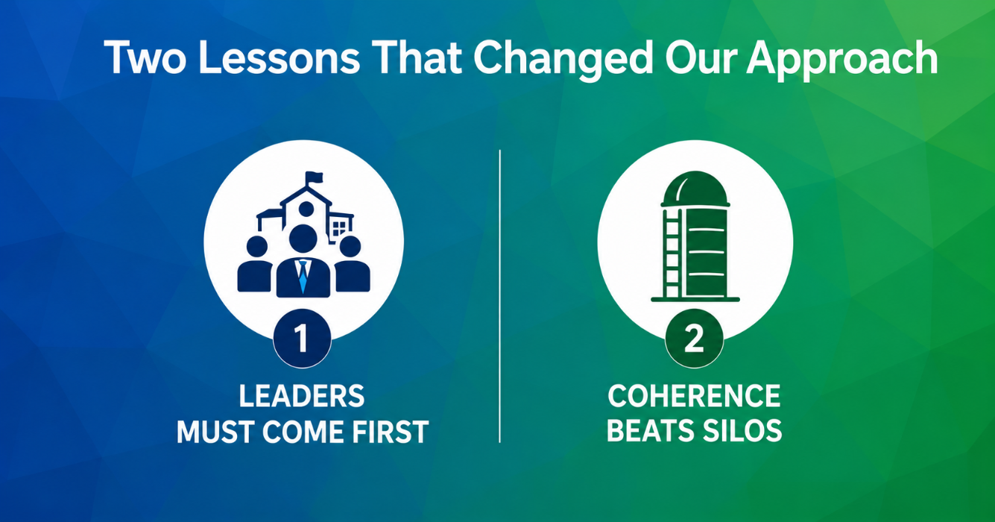

Slide 6
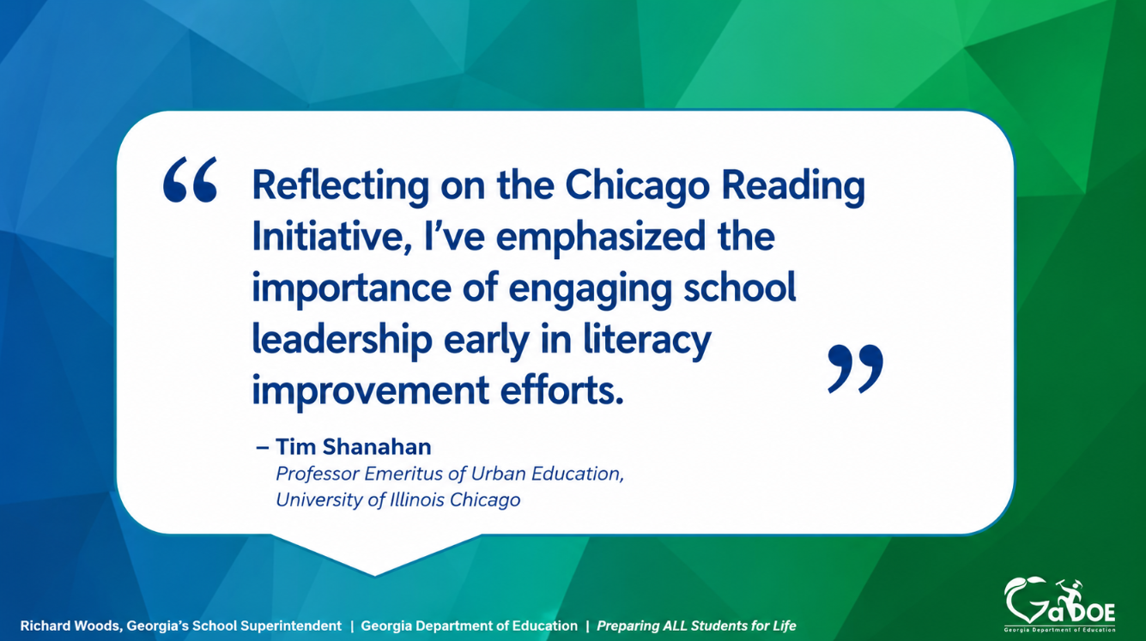
Notes:
April
We know that effective implementation doesn’t happen overnight—moving through the phases typically takes 2–4 years, and often 3–5 in real-world settings.
(Adapted from the National Implementation Research Network, NIRN AI Hub)

Slide 7
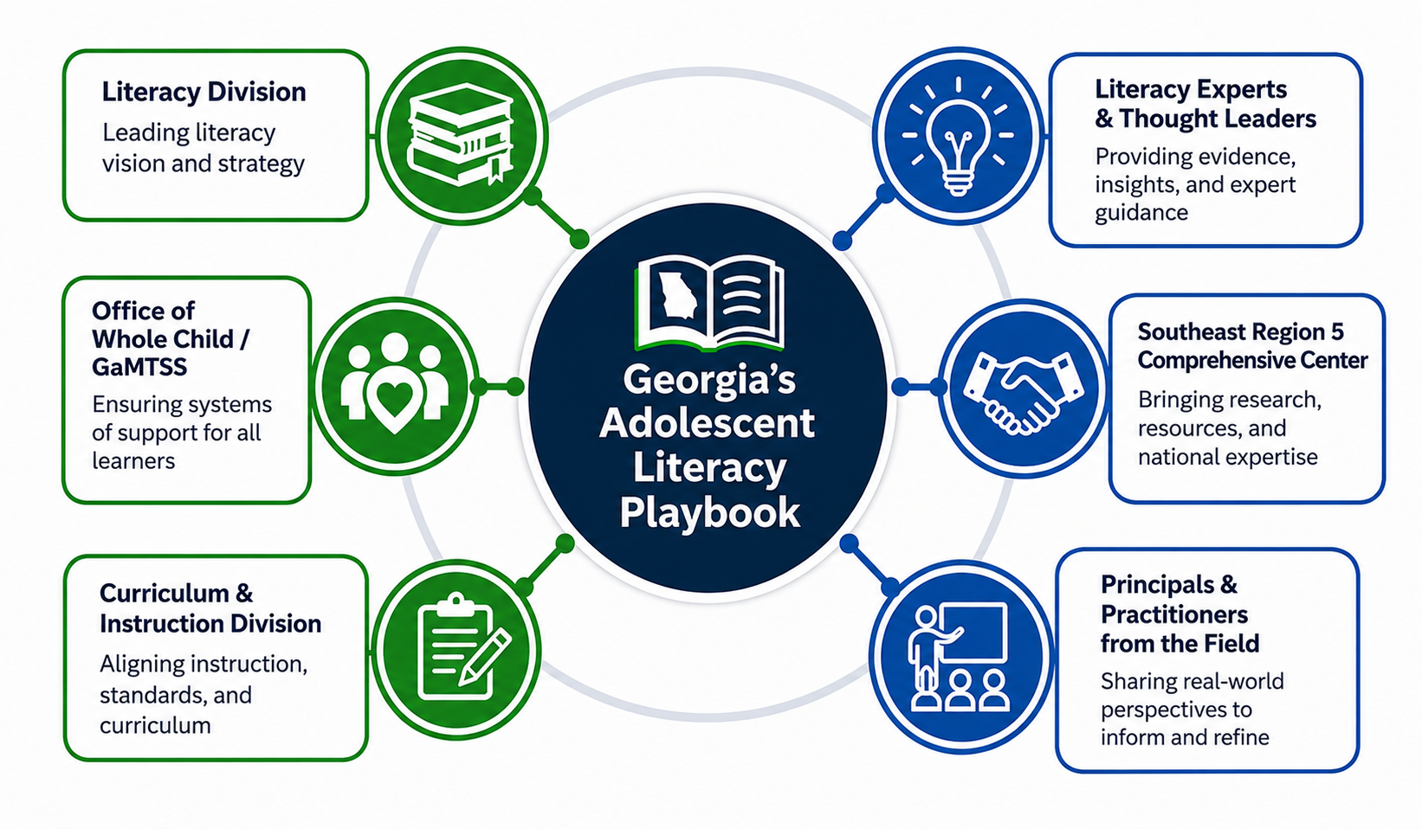
Notes:
Green = internal collaborators
Blue = external collaborators

Slide 8
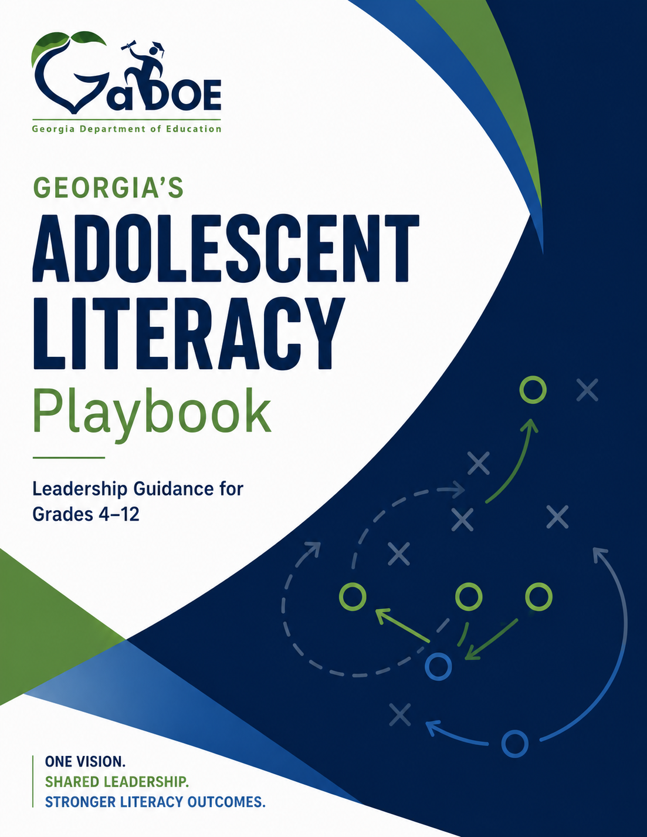
Georgia’s Adolescent Literacy Playbook
A leadership playbook for building coherent adolescent literacy systems.
Notes:
WHAT IT IS
A leadership playbook for building coherent adolescent literacy systems.
WHO IT SERVES
District leaders • School leaders
HOW IT BUILDS CAPACITY
• Shared vision
• Practical leadership tools
• Evidence-based implementation

Slide 9
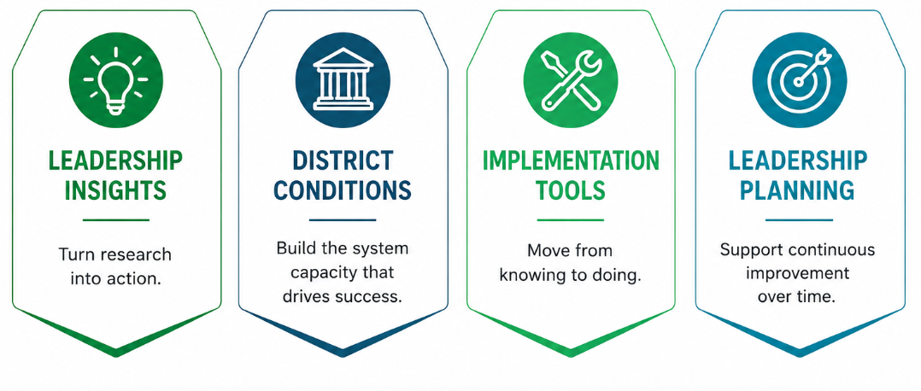
Signature Features of the Playbook
Four design features to support leaders.
Notes:
Rather than walk through 90+ pages, we want to highlight four design features we intentionally built for leaders.

Slide 10
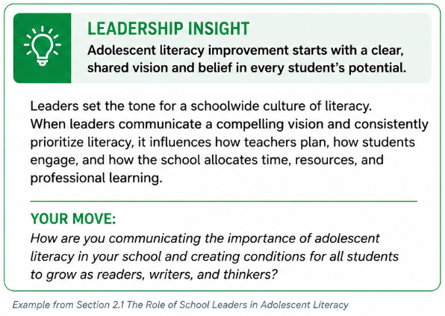

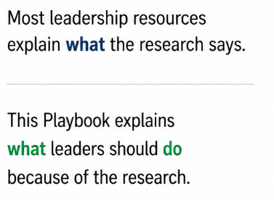
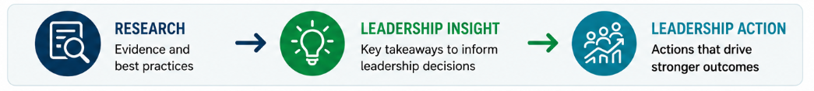
Leadership Insights
Turning research into leadership action.
WHY WE INCLUDED IT
Notes:
Amy

Slide 11
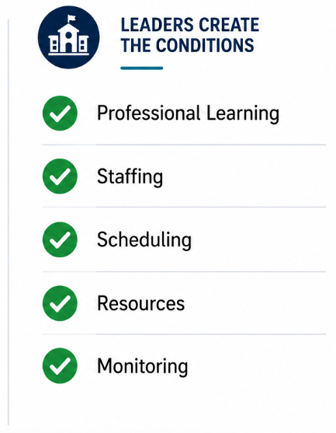
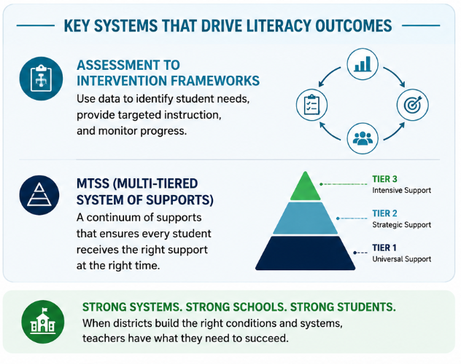
District Conditions for Success
Building the system supports that drive literacy outcomes.
Notes:
Amy

Slide 12
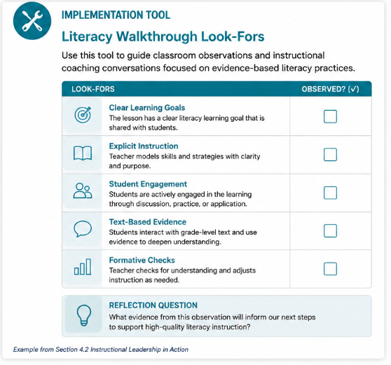
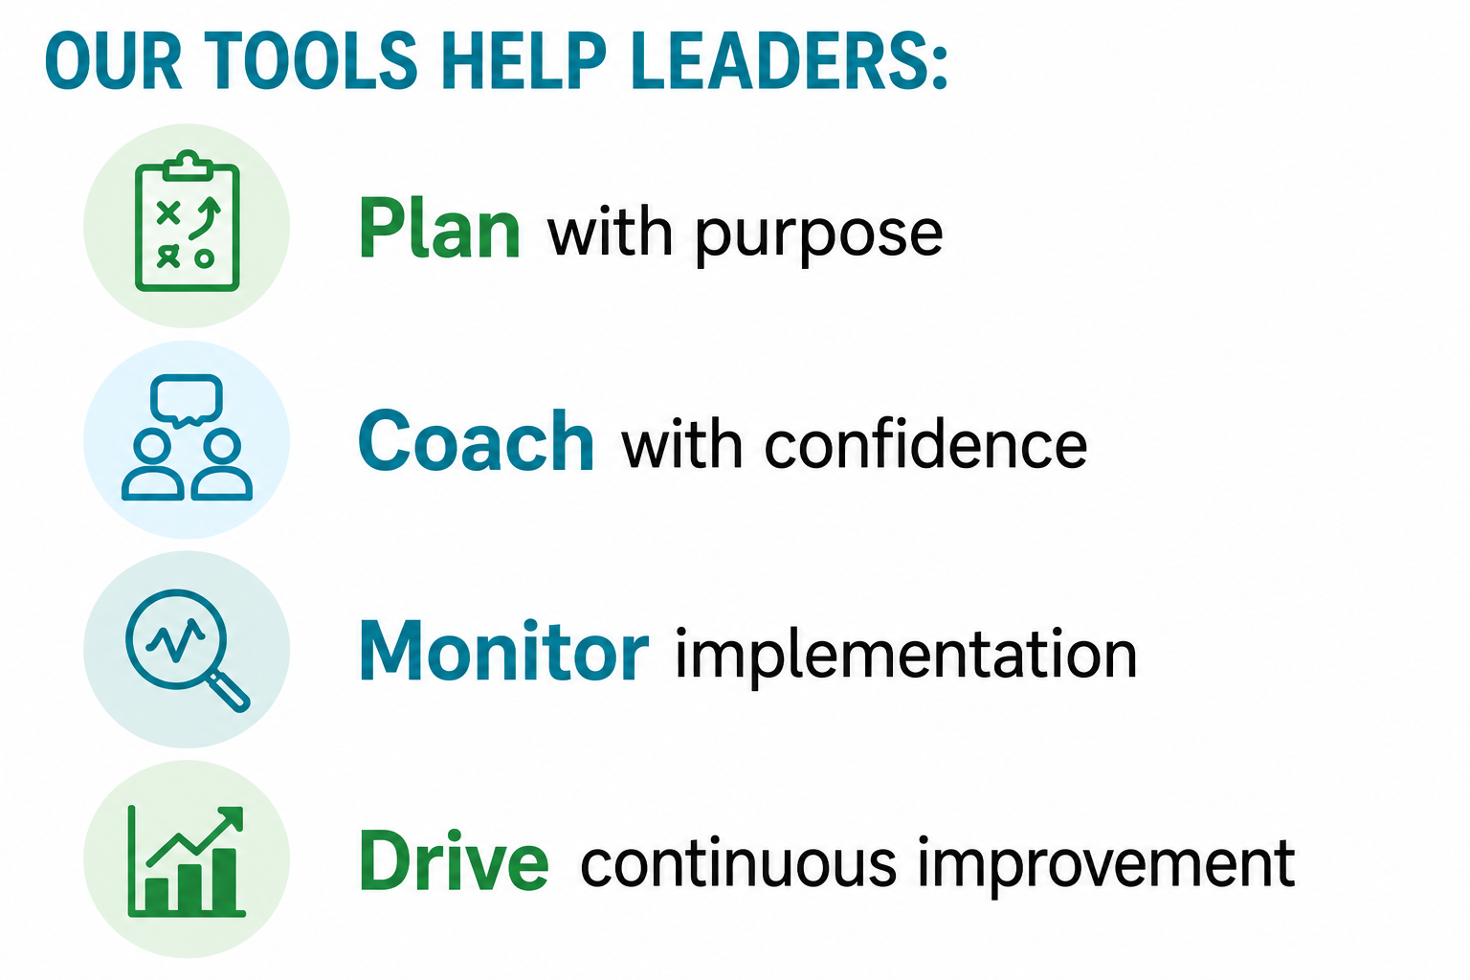
Practical Implementation Tools
Tools to help leaders turn ideas into action.
Notes:
Amy

Slide 13
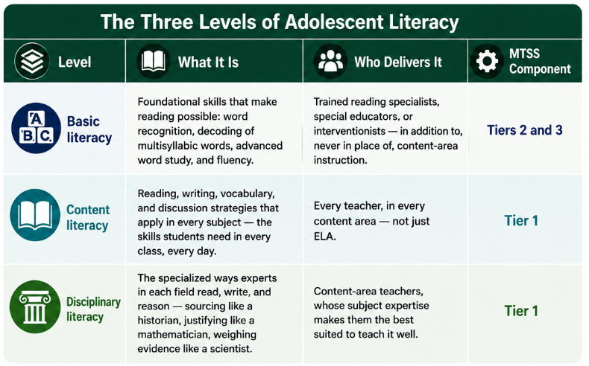
A Shared Framework
Creating a common language for adolescent literacy leaders and educators.
Why a Shared Framework?
Build a shared understanding of adolescent literacy.
Clarify the unique purpose of each level.
Align instruction, intervention, and professional learning.
Make informed decisions about student support.
Strengthen collaboration across schools and content areas.
Notes:
Amy

Slide 14
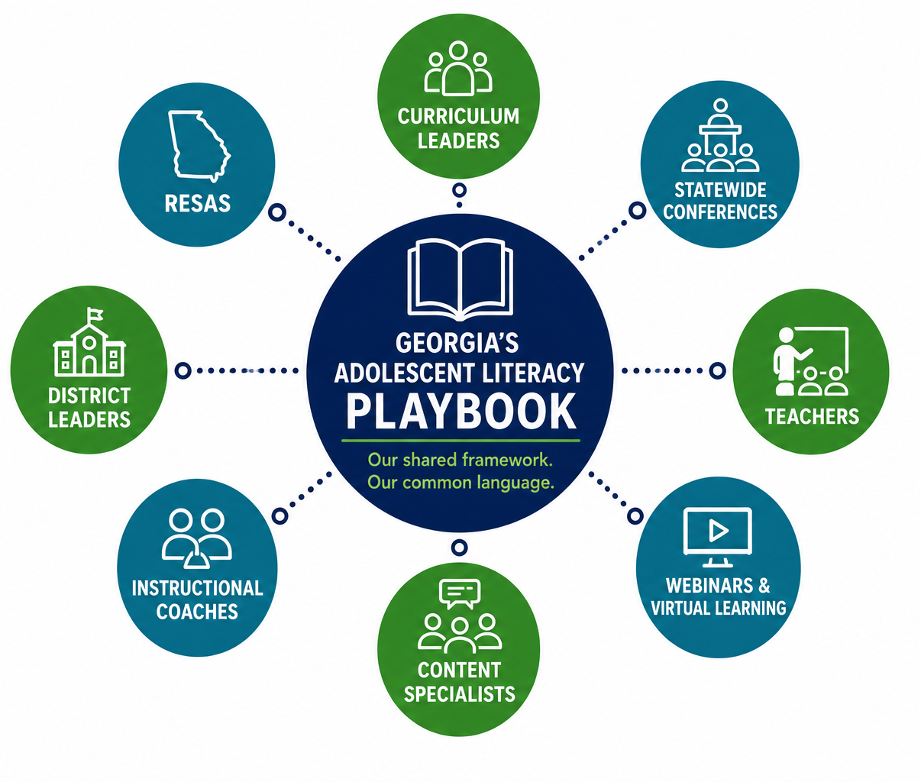
More Than a Resource
An anchor for statewide professional learning and leadership development.
We will use it to:
✓ Build a common language across Georgia
✓ Develop leaders and teachers together
✓ Connect professional learning across divisions
✓ Support coherent implementation statewide
Notes:
Amy

Slide 15
THANK YOU
Social Media: @GeorgiaDeptofEd
YouTube: @GeorgiaDepartmentofEducation
Web: gadoe.org
Notes:
Amy

Slide 16
Early Results & Emerging Capacity
Playbook
Shared language
Stronger interoffice connections
Future PL/resource foundation
Notes:
Amy

Slide 17
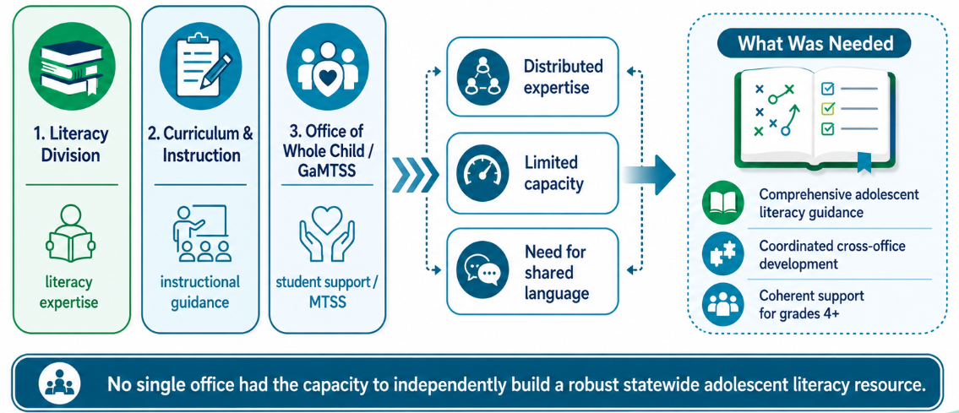
The Challenge: From Silos to Shared Work
Strong expertise. Limited collective capacity.
Notes:
Amy

Slide 18
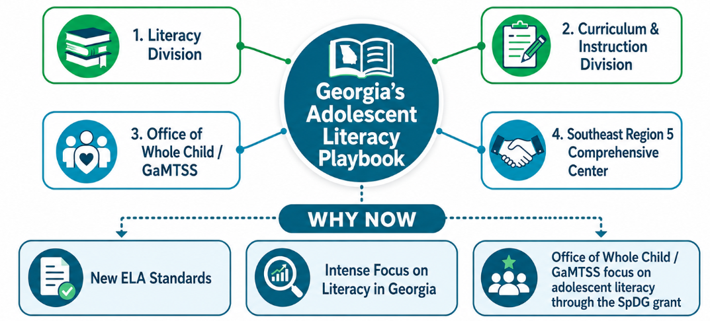
Why Adolescent Literacy – Why Now?
A collaborative effort to build Georgia’s Adolescent Literacy Playbook
Notes:
Amy

Slide 19
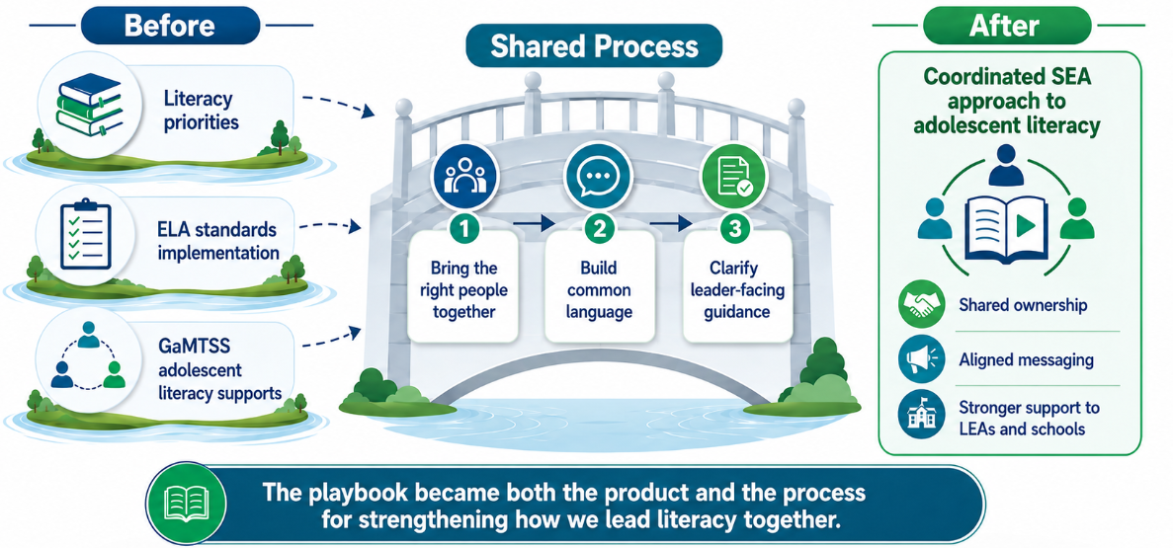
The Shift: Building Collective Capacity First
We did not start by writing a resource. We started by aligning the work.
Notes:
Amy

Slide 20
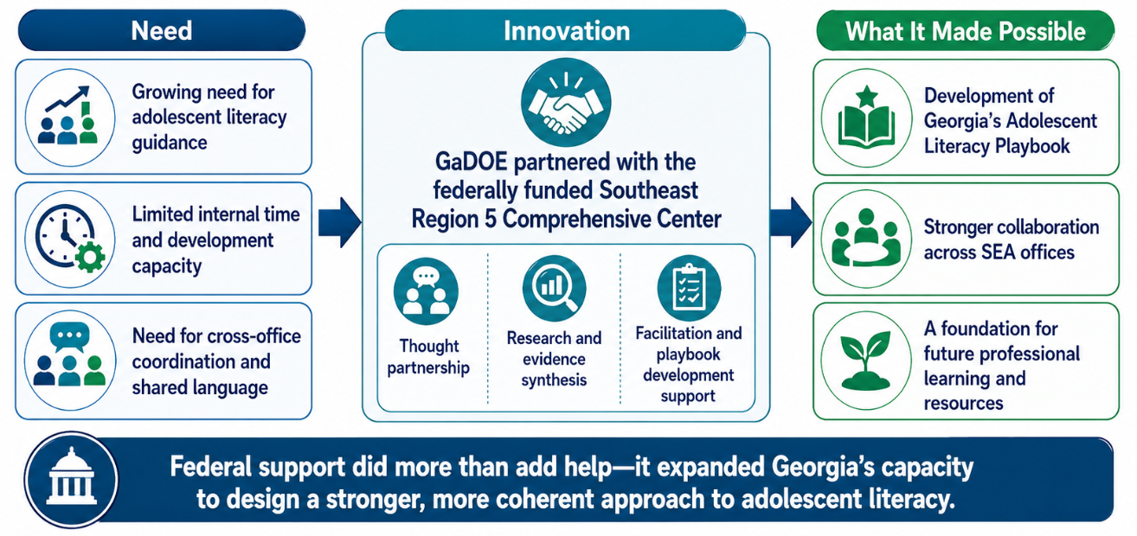
The Innovation: Expanding Capacity Through Partnership
Notes:
Amy

Slide 21
Challenges

Slide 22
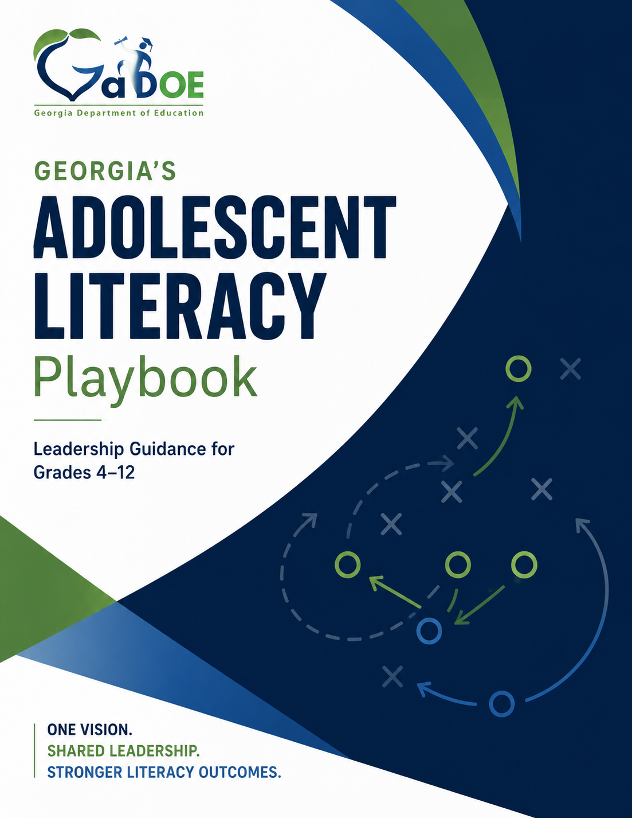
Georgia’s Adolescent Literacy Playbook
WHAT IT IS
A leadership playbook for building coherent adolescent literacy systems.
WHO IT SERVES
District leaders • School leaders
HOW IT BUILDS CAPACITY
• Shared vision
• Practical leadership tools
• Evidence-based implementation
Notes:
Amy

Slide 23
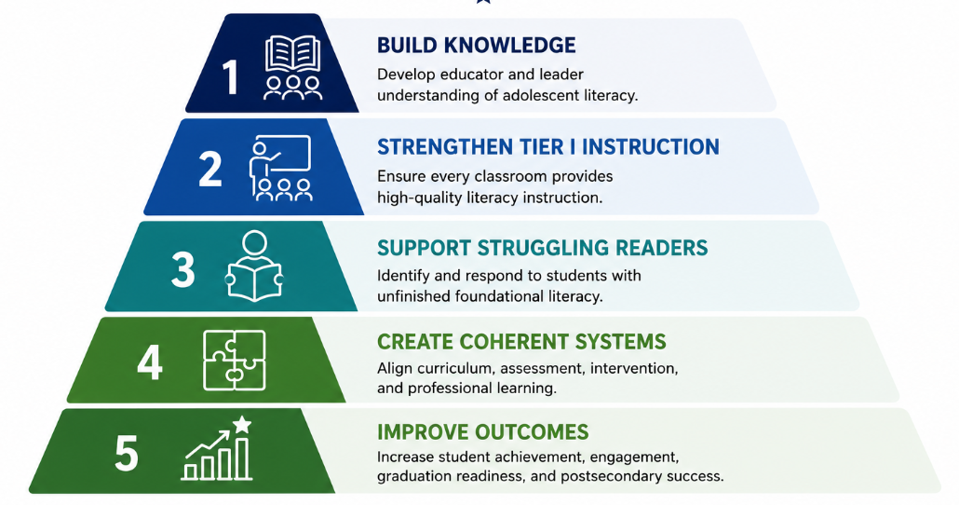
Leadership Priorities
Notes:
Rather than beginning with programs or resources, we started by establishing five priorities that would shape every aspect of our work. As we launched Georgia's adolescent literacy work, these priorities guided every decision we made.

Slide 24
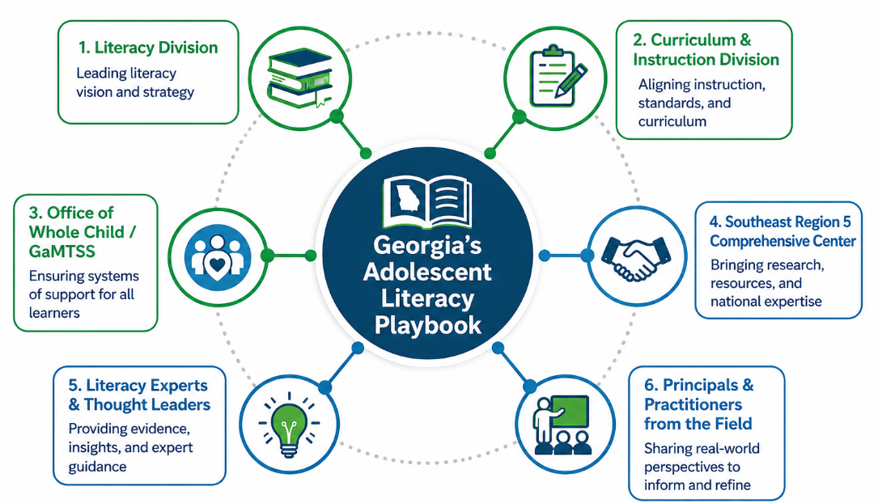
Notes:
Green = internal collaborators
Blue = external collaborators

Slide 25
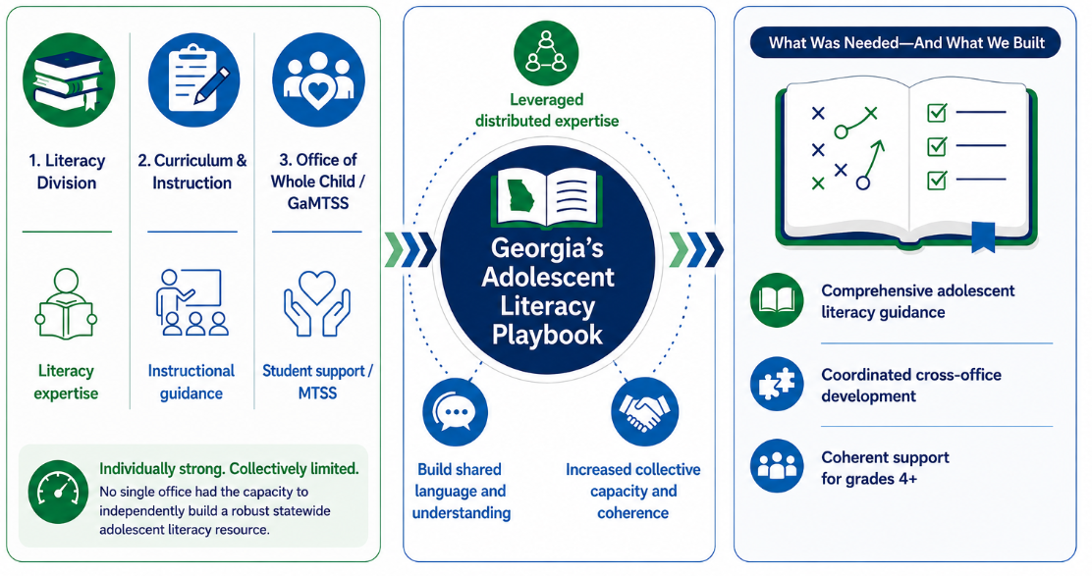
From Silos to Coherence
Strong expertise. Limited collective capacity.
Notes:
Amy

