Slide 1



From Compliance to Capacity in
Rural Atoll Schools
Co-Creating Multi-Age Integrated Thematic Units (ITU) in the RMI
Sandy Dismas-Konelios Associate Commissioner
Yshiwata Lomae District Supervisor
Rodrigues "Junior" Nakamura Language Arts Specialist
September 9, 2026
Comprehensive Center Region 12 (CCR12)
& The Pacific American Foundation (PAF)

Slide 2





Agenda & Session Learning Map
01. The Challenge
02. The Innovation
03. Results & Lessons
Analyzing outer-atoll geographical dispersion and the mismatch of standard single-grade resources in multigrade environments.
Collaborative May/June "Write-Shops" designed to co-create place-based, bilingual thematic units with technical assistance.
Unveiling "Unit 1: Oceans (Lometo)", the self-sustaining Training-of-Trainers model, and scalable capacity-building takeaways.
20-Minute Strategic Session Focus • SEA Capacity Building

Slide 3
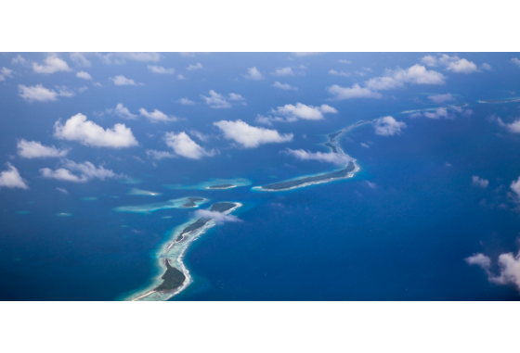
The Rural Atoll Reality
Multi-Age Reliance: Outer-atoll educators must adapt materials designed exclusively for single-grade setups into multi-age classrooms.
Geographical Dispersion: Fragmented island geography creates operational barriers for supporting or monitoring curriculum delivery.
Beyond Compliance: True progress requires replacing static checklist compliance with functional, locally relevant tools for outer-island teachers.
Notes:
many of whom are not trained teachers,

Slide 4
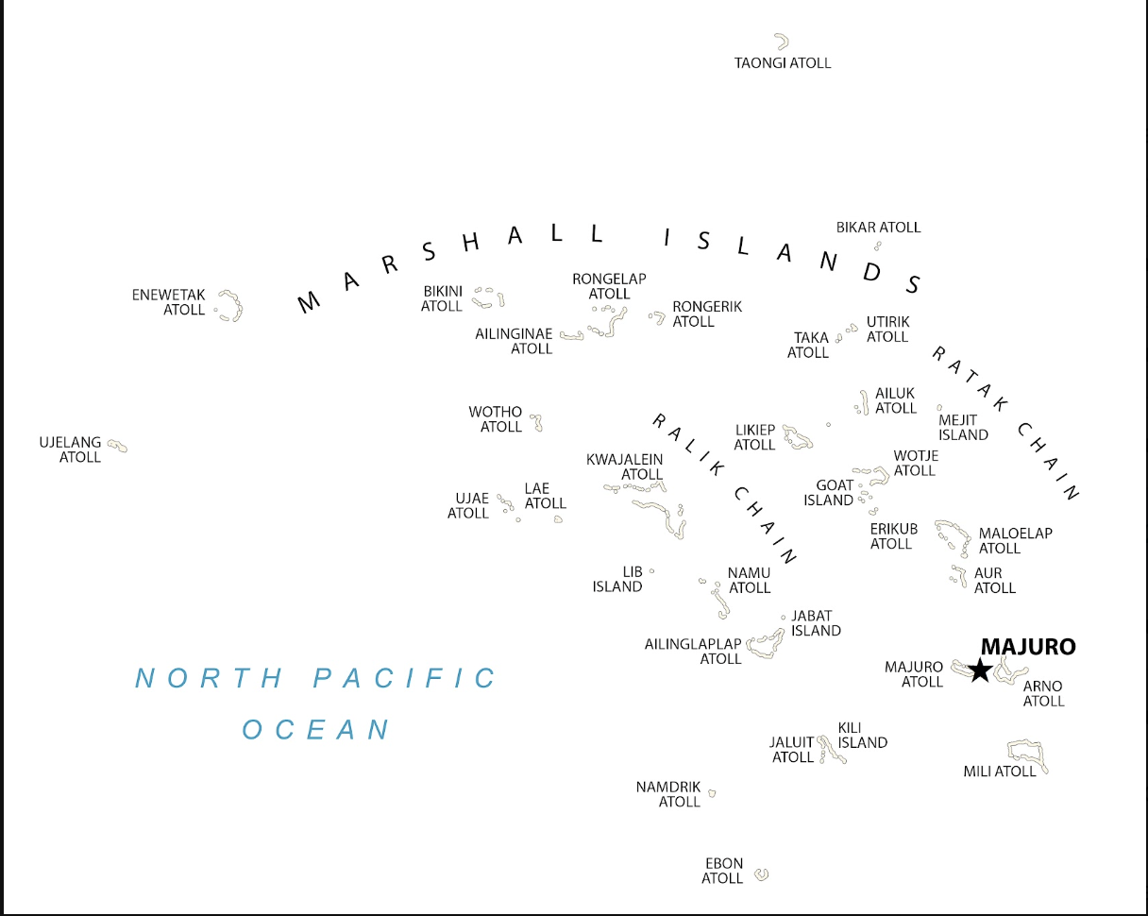
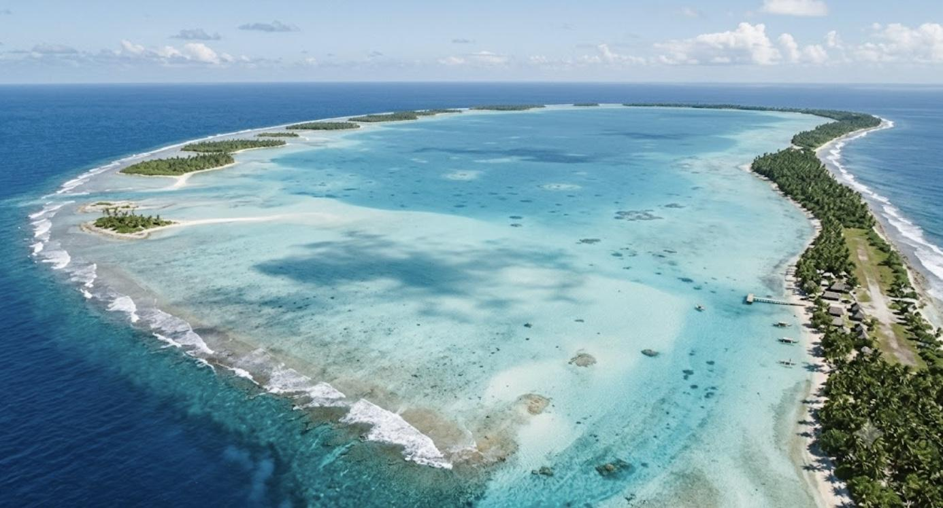
Islands and Atolls
Notes:
Explain this geography, difference between an atoll and an island. how children often boat across huge lagoons to attend school. EXPLAIN that there are 73 schools (check my number) currently operating with multi grade children in one classroom. you want to keep children on their home islands but sometimes you have 15 students across 6 grades and only one teacher

Slide 5


Pedagogical & Cultural Gaps
Pedagogical Mismatch
Local Context Deficit
Outer-atoll teachers are expected to meet national standards, but all core text materials and PD modules are built for single-grade structures. This forces educators to invent complex multi-tier lessons daily without structured programmatic support.
Imported textbooks carry cultural assumptions alien to remote coral atolls. To foster deep engagement, instruction must integrate home-language proficiency and traditional maritime knowledge directly alongside core competencies.
Notes:
Many teachers (find the statistIc) do not have formal teacher training, they struggle to teach multiple lessons in each subject block to multiple grade levels

Slide 6
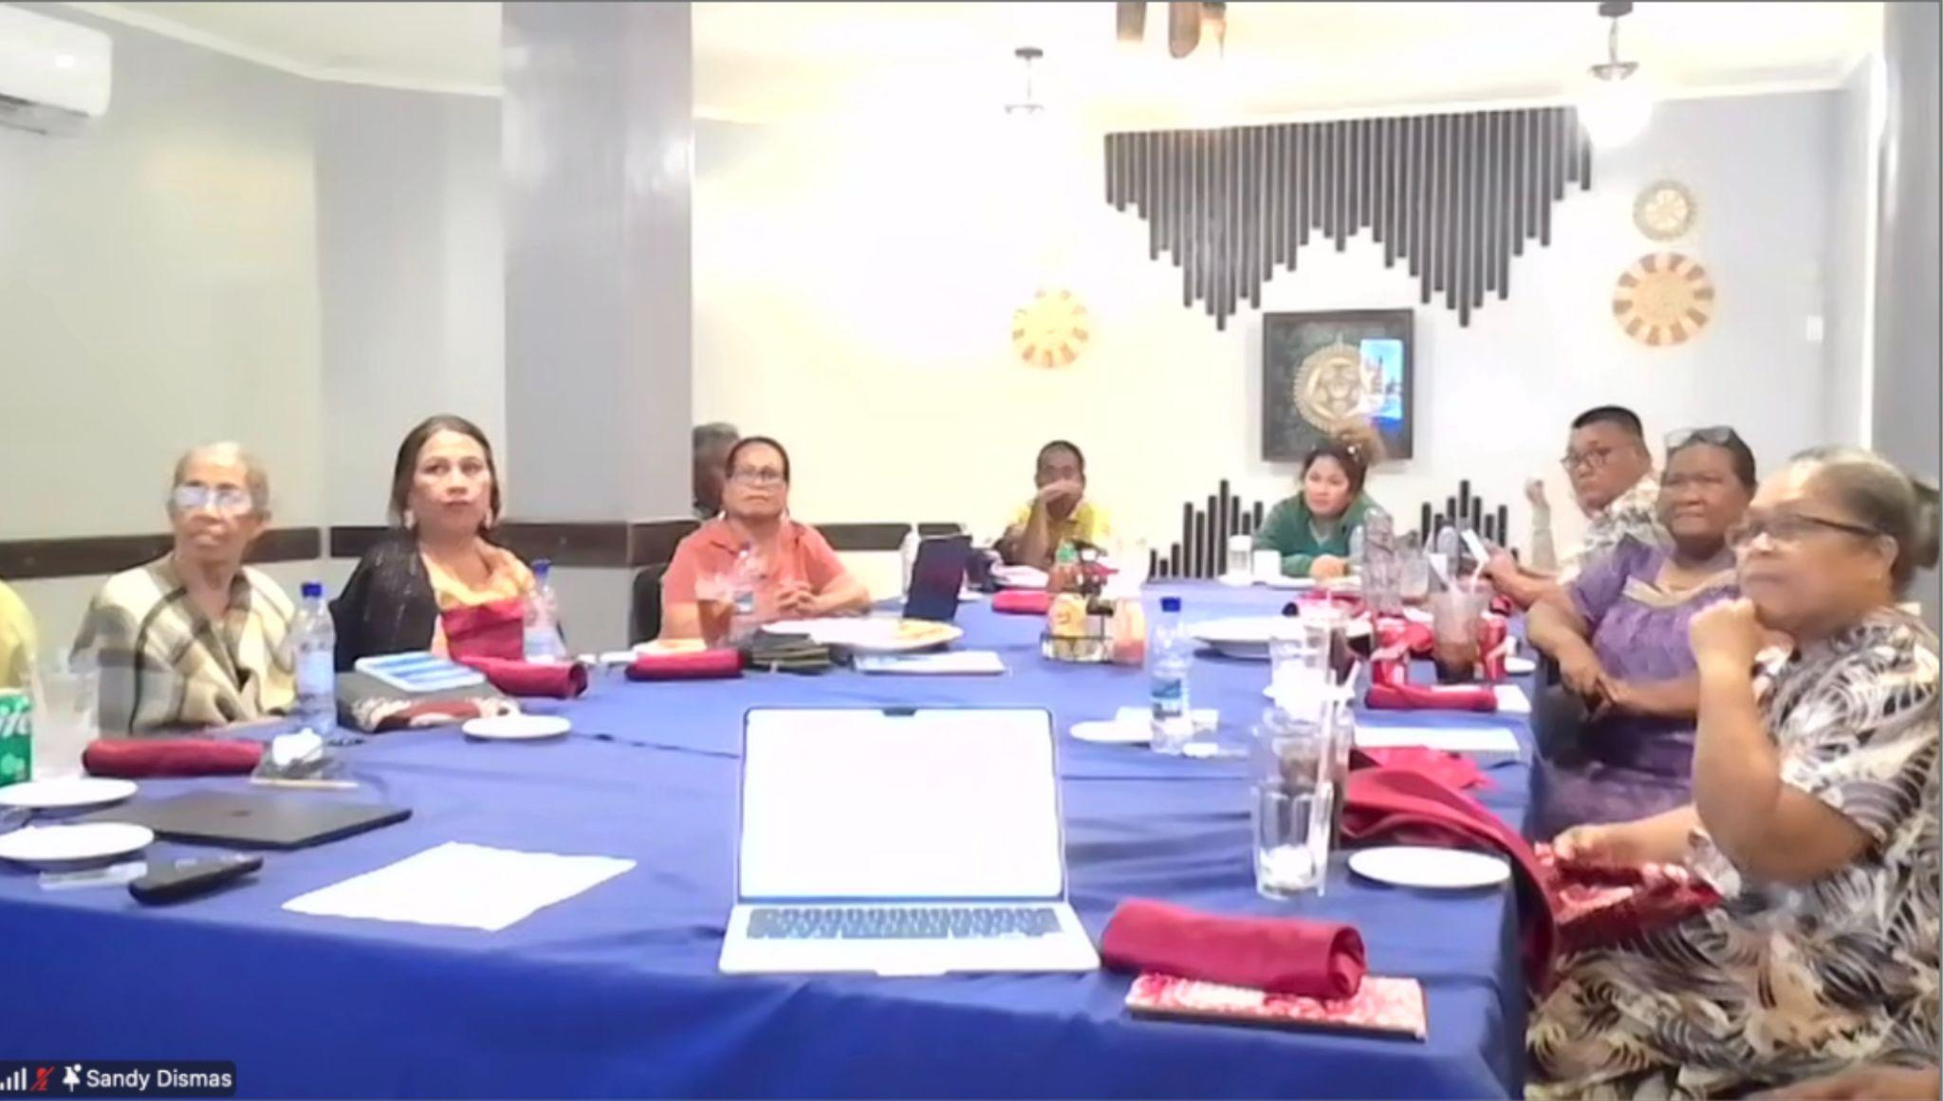
The "Write-Shop" Model
Technical Assistance in Action
In May and June 2026, RMI PSS joined forces with bilingual curriculum experts from CCR12 for 30 intensive work hours across one month.
Moving away from passive seminars, local teams actively co-created complete multi-age thematic units that integrate Social Studies and Science —including standards mapping, developmental strands, daily tasks, and rubrics grounded in Marshallese values. Most importantly it is “place-based” meaning a curriculum for the local context.

Slide 7

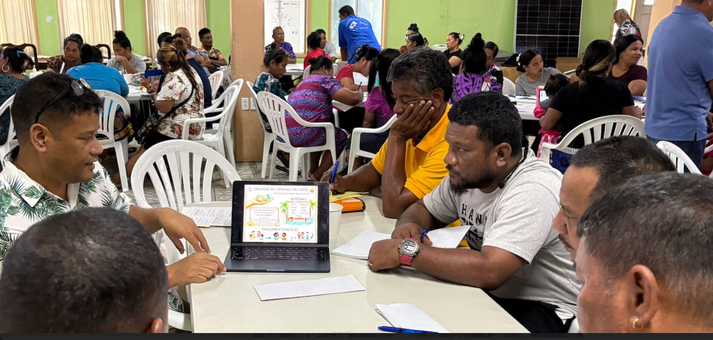
Spotlight: Unit 1 - Oceans (Lometo)
Integrated Disciplines: Rather than isolating math, reading, and science into silos, Unit 1 connects these subjects around ocean exploration and marine ecosystems.
Place-Based Learning: Aligns academic standards to sustainable fishing techniques, ocean navigation, and traditional outrigger lore.
Bilingual Framework: Bridges Marshallese language structures with core literacy skills for authentic student engagement.
Notes:
It weaves together Culture, history, geography, economics with many Science s like environmental science, Life Science, physical Science because there are many ways of knowing and has links to language arts in both languages and math.

Slide 8
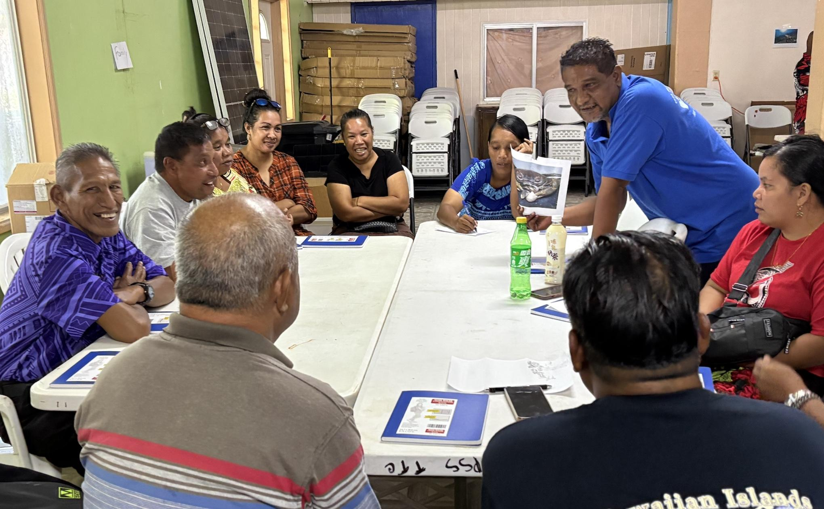
Delivered Outcomes & Capacity
Self-Sustaining ToT Structure
Offline-First Design: Packaged in digital and offline formats built to operate seamlessly in remote outer atolls with constrained internet connectivity.
Building Internal Capacity: The Training-of-Trainers (ToT) model equips PSS supervisors and specialists to write, refine, and deploy and provide professional development on curriculum independently—ending reliance on external consultants.
Pilot Multigrade Units
Notes:
Why does this slide have #2, there is no slide with #1 Maybe replace the number with pics of the trainers working with teachers? you could have four small pics showing different supervisors leading?

Slide 9
Strategic Milestones & Timeline
Phase & Timeline | Work Allocation | Direct Deliverables | Strategic Value
Write-Shops (May - June 2026) | 30 Hours | Bilingual Curriculum Maps | Built core multigrade design capacity
ToT Training (Early July 2026) | Core Sessions | Active ToT Modules | Prepared regional supervisors to lead
Cohort Onboarding (July 13 - 24, 2026) | Two Cohorts | Deployment Training | Onboarded incoming outer-island teachers
Pilot Rollout (August 2026+) | Classrooms | Live Classroom Units | Active multigrade deployment in rural schools
Notes:
Teachers will have reflective tools to track their progress in the unit and give feedback on content/strategies

Slide 10
Strategic Reflections & Takeaways
Move From Isolation to Co-Creation: True capacity is created when local educators and technical assistance specialists sit side-by-side to write materials.
Target Real Classroom Realities: Designing explicitly for actual multigrade environments avoids paper compliance and yields real classroom results.
Treat Cultural Knowledge as an Asset: Anchoring units in home-language structures and traditional wisdom enhances academic rigor.
TA as Capacity Catalyst: Technical assistance must build pipelines that empower SEAs to adapt and scale resources independently.

Slide 11
Integrated Thematic Unit
Multi-Week Instructional Unit
- Lōmeto (Ocean) - Āne (Land/Islands)
- Wōt (Garden/Food) - Wa (Canoe)
Organized around a Central Concept
- How does the ocean provide for our community?
Drawn from the intersection of
- Science - Social Studies
- Cultural Knowledge - Community Life

Slide 12

Questions & Discussion
From Compliance to Capacity in Rural Atoll Schools
RMI Public School System
Comprehensive Center Region 12

