Slide 1
From Mandate to Meaning: Wyoming’s Resource Allocation Review Process
September 9, 2026
Karen Bierhaus, Wyoming Department of Education
Mark Bowers, Wyoming Department of Education
Stephanie Levin, Strategic Funding and Finance Center
Joe Simpson, Central Comprehensive Center
Notes:
Danielle - introductions

Slide 2
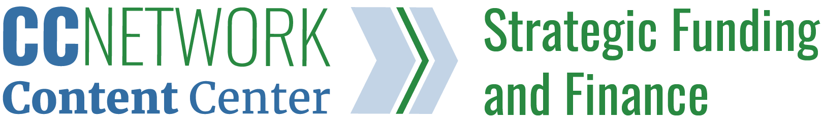

Today’s Story:
Challenge
Design
Process
Learning
Notes:
Stephanie - Wyoming’s RAR work is not primarily a story about compliance. It is a story about system design: how a state can use a federal requirement as an opportunity to build a clearer, more useful, and more sustainable process for aligning resources to student needs.
Add strategic finance: This work is grounded in strategic finance and resource allocation. Why is it important for districts to examine funding, staffing, time, and programs together rather than separately?

Slide 3

The Challenge:
From disconnected compliance to coherent decision-making
How can WDE meet the federal requirement while helping districts make better, more transparent decisions about resources?
If RAR is treated as compliance only
Wyoming’s intended approach
One-time activity
Checklist or monitoring protocol
Resource data reviewed in isolation
State requirement experienced as burden
Ongoing improvement cycle
Structured inquiry
Resources connected to student needs, root causes, and goals
State-supported, district-engaged process
Notes:
Ask question one first - Let's start at the beginning. Why did Wyoming decide to undertake this work? What challenge was WDE trying to solve, why did WDE reach out to the Central Comprehensive Center, and how did the partnership help clarify a path forward?

Slide 4
Moderator Questions
Topic | Target | Questions
1. Why this project? | MARK (Joe) | Let's start at the beginning. Why did Wyoming decide to undertake this work? What challenge was WDE trying to solve, why did WDE reach out to the Central Comprehensive Center, and how did the partnership help clarify a path forward? [ strategic finance,
2. Principals guiding the design | Stephanie, Karen and Mark | Before developing tools or processes, you had to decide what a good Resource Allocation Review should actually look like. What design principles guided your thinking?
3. Moving beyond compliance | Karen and Mark | A theme throughout the presentation is moving beyond compliance. What does that mean in practical terms for Wyoming?
4. Designing for rural Wyoming | MARK (Joe, Stephanie) | Wyoming's context requires a continuum of and differentiated supports (rural, local control, limited capacity in the agency). How did you design this process for small and rural districts where capacity is often limited and people wear multiple hats? [Design has to be do-able]
5. Learning from the field | Karen, Mark, and Stephanie | As you talked with districts and gathered input from LEAs across the state, what stood out? What did districts tell you they needed from a process like this?
6. The pilot | Stephanie (Joe & Mark ) | This fall, a small set of districts will pilot the process. What will those districts actually experience, and what are you hoping to learn? [Cross agency/department, peer working group, center needs of districts], opportunity for extended capacity building – connecting districts to each other]
7. Strategic finance | Stephanie and Joe | This work is grounded in strategic finance and resource allocation. Why is it important for districts to examine funding, staffing, time, and programs together rather than separately?
8. Lessons for other SEAs | All panelists | Many people in this room are thinking about similar challenges. Based on what you've learned so far, what advice would you offer another SEA that wants to transform a federal requirement into an opportunity for capacity building and improvement?
Notes:
If time is tight, cover these four questions: 3, 4, 6, 7
Just one moment…JS
Why this project? Why did WDE engage CC? (5 min)
Important process – foundation to school improvement and improve student outcomes – slide 3
What principles guided the design?
What does moving beyond compliance mean in practice?
How did Wyoming's rural context shape the approach? – WY is a large state geographically with multiple considerations and limited capacity. (5 min)
How do you design TA for districts to be effective? As well as making it unique to each district?
Requires a continuum of supports
How do you design for these different aspects which includes various levels of capacity (one person vs team)
How change mindset based on implementation process?
Local control – tools and evidence made accessible
What did you learn from conversations with LEAs across the state?
What will the pilot test and what are you hoping to learn?
We are designing a working group of districts. Working a peers is attractive to districts vs just hearing from WDE and following some step by step process. This has to be for them.
Describe pilot in one sentence – inviting districts to work through the process in the course of a year. The five step process – slide 7
What will be hardest part? Finance and program collaboration – with similar goal of supporting student outcomes and aligned with evidence
SEA wants districts input into the process – not top down approach. Hearing from the client/customer
Pilot – cross-agency collaboration and client centered needs
How is the SEA working differently based on this work? Internally? With CCNetwork?
Shifting mindsets, process is important –
Host will ask question before starting
If trying to move from compliance what does it mean? Context is unique – rural connections

Slide 5
Wyoming’s RAR Design Principles
Fair: Provides resources based on the needs of students and schools
Transparent: Provides resources through a simple, well-defined, and clearly documented process
Engage educators and community members: Allows for input from school site leaders and staff, parents, and community members.
Align with district priorities and goals: Integrates and aligns school goals and student needs

Slide 6

RAR in Wyoming: Moving from Checklist to Structured Inquiry
Audit
Compliance Checklist
Monitoring Protocol
Structured Inquiry
Collaborative Problem-Solving
Continuous Improvement
Student Needs
Root Causes
Resources
Strategies
Outcomes
Continuous Improvement
The goal was not to create a better checklist. The goal was to create better decisions.

Slide 7
The Five Phase Wyoming RAR Process
Preparation & Team Formation
Data Collection & Resource Inventory
Analysis & Alignment
Recommend-ations & Planning
Monitoring
Monitoring & Continuous Improvement
Recommendations & Planning Wyoming

Slide 8
Building the Conditions for Useful Resource Allocation Review
Process
Five phases of inquiry and action.
Tools
Guidebook, companion worksheet, templates, and supports.
Shared Understanding
Common language across WDE, districts, and school teams.
The goal: make RAR clear enough to implement and useful enough to sustain.

Slide 9
Integrating RAR into Existing District Processes
District Planning | Budget Development | Continuous Improvement
Identify needs | Align resources | Monitor results
Analyze root causes | Prioritize investments | Adjust strategies
Set priorities | Finalize plans | Learn and improve
RAR connects needs, resources, and results through one coherent process.

Slide 10
What We Hope to Learn
(through the piloting process)
District Experience
Is the process practical?
Does it fit district workflows?
Tools & Guidance
Are resources clear and usable?
What additional supports are needed?
State Supports
What training and coaching will districts need?
Continuous improvement applies to the RAR process.

Slide 11
What’s Next: Action
Strategic Finance
⚙️ Act
🔍 Review
💡 Discover
🏕 Base Camp
🎯 Align
Continuous Improvement

Slide 12
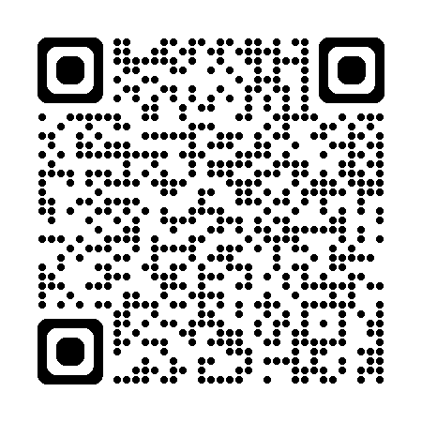
Support for you
🧩 Federal Flexibility Tool
Identify opportunities across funding sources
🎛 District Decision Modeling Tool
Model tradeoffs and financial implications
🗺 Funding and Finance Data Map
Shows state and district funding and finance policies
🧰 Strategic Finance Resources
Guidance, templates, and implementation supports
Website: sffcenter@air.org

Slide 13
Questions?

Slide 14
Thank you!
Karen Bierhaus
karen.bierhaus@wyo.gov
Mark Bowers
karen.bierhaus@wyo.gov
Stephanie Levin
slevin@air.org
Joe Simpson
jsimpson1@live.com

Slide 15
The contents of this presentation were developed under a grant from the U.S. Department of Education (Department). The Department does not mandate or prescribe the practices, models, or other activities described or discussed in this document. The contents of this presentation may contain examples of, adaptations of, and links to resources created and maintained by other public or private organizations. All external links cited in this resource were reviewed for compliance with all federal regulations in effect at the time of publication; however, the Comprehensive Center Network is not responsible for subsequent changes to those external sites or for any content beyond the specific material referenced. External links are provided solely to support the research, examples, analysis, and conclusions presented in this resource and do not constitute endorsement of any broader site content. The content of this presentation does not necessarily represent the policy of the Department. This presentation is not intended to represent the views or policies of, or be an endorsement of, any views expressed or materials provided by any federal agency. © 2026 Westat.

