Slide 1

Strengthening Literacy Through Family Partnerships in Arkansas
CCNetwork National Center | Stronger States, Stronger Outcomes
September 9, 2026
Amy Counts, Arkansas Department of Education
Windy Lopez, Learning Heroes
Notes:
This session explores how Arkansas is prioritizing families as key partners in improving literacy outcomes through implementation of the state’s new third-grade promotion policy. While literacy policies often focus on instruction and intervention, Arkansas recognized that student success also depends on strong family–school partnerships grounded in trust and a shared understanding of student progress. The challenge was not only implementing a new policy, but ensuring educators and families had support to navigate conversations about reading progress in ways that were clear and actionable, connecting classroom and at-home learning.
Leveraging resources, cross-agency collaboration and TA partners, Arkansas is embedding family engagement into existing efforts from the state to school level. The model focuses on three interconnected strategies informed by national and Arkansas parent research: (1) Improving family communication related to literacy and third-grade promotion, (2) Increasing family awareness about the importance of understanding their child’s reading progress through an awareness campaign, and (3) Building educator capacity to strengthen home–school partnerships focused on reading achievement. This work requires shifts in both mindset and practice—positioning family engagement as a core instructional strategy and creating stronger conditions for trust-based partnerships focused on literacy.

Slide 2
Supporting Every Student’s Right to Read
The intent of the 3rd Grade Promotion Law is to identify and support struggling readers early and ensure every student receives the support they need to become a successful reader.
Students will… | Families will… | Teachers will… | Principals will… | Districts will… | Co-Ops will… | ADE will…
Achieve success as learners by improving their academic skills through dedicated intervention, better preparing them for future grades and beyond. | Be engaged partners on their child’s progress, and feel confident their child is being supported to become a strong reader. | Use screeners to identify students who need support, implement effective, evidence-based reading instruction and interventions, develop and monitor IRPs, and communicate with families about student growth. | Assign students to well-equipped teachers, support intervention planning, and lead family communication efforts. | Support schools to provide interventions and staffing to meet the requirements of the law, offer professional development, and track screener data to ensure early, consistent intervention. | Train districts on policy details and best practices, and support implementation of high-quality literacy instruction within an MTSS system. | Set a statewide vision that prioritizes early reading success, provide technical assistance and implementation guidance, develop family- and educator-facing tools, and monitor progress toward full implementation of the promotion policy.
Notes:
Amy
Reminder of how we are supporting students and promotion and retention in 3rd grade.l
Present from right to left, beginning with ADE
ADE will provide technical assistance around Tier 1 instruction through PD opportunities. Districts are responsible for having a literacy plan, based on the needs of the district and SoR, that outlines how they will provide core instruction for students. HQ Professional Learning can be brought in to support district Tier 1 instruction needs.
Pause at this slide and collect any questions about the background, the responsibility, or the law.

Slide 3
By show of hands…
Think about your pre-service training and/or the teachers in your state…
Are educators effectively trained on effective family engagement?
Notes:
Windy

Slide 4
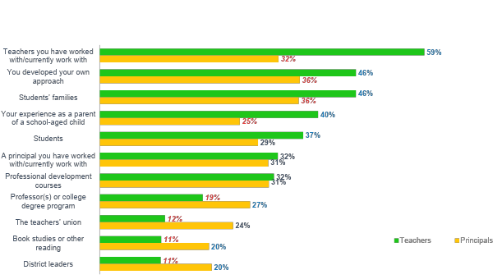
Reliance on Informal Sources
Which of these has influenced your approach to family engagement?
Notes:
Windy

Slide 5
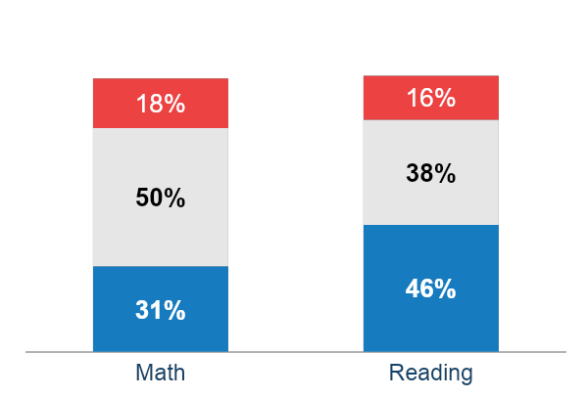
Most parents believe their child is at or above grade level
AR Parents of elementary students are less likely to feel this way about reading than parents of older students
84%
At/Above
88%
81%
At/Above
of parents nationally, regardless of race, income, and education level, believe their child is at or above grade level in reading and math.
Below
At
National data from March 2023
Above
Notes:
Windy

Slide 6
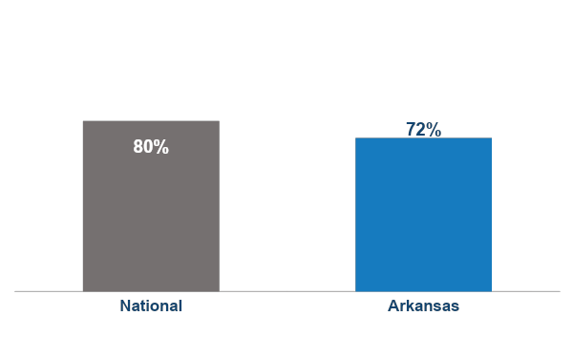
7 in 10 parents report their child gets mostly B's or better
When you think about your child’s report cards, does he/she typically get…
Mostly B’s or Better
National data from March 2023
Notes:
Windy

Slide 7

With multiple measures, parents’ mindsets shift
88%
of parents think their child is at or above grade level in math.
44%
of parents think their child is at or above grade level in math when told...
Their child received a B in math
Their child’s state test results indicated below grade level in math
Their child’s results on benchmark tests indicated child below grade level in math
*National Data
Notes:
Windy

Slide 8
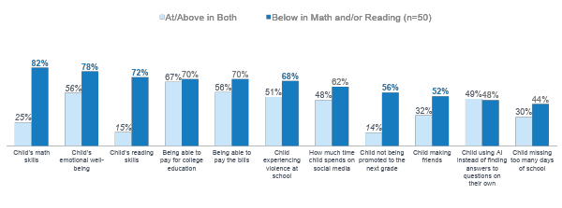
When parents know their child is behind, worries flip
As a parent, to what extent do you worry about each of the following?
Ranked by % Worried among parents with a child below grade level
Notes:
Windy

Slide 9
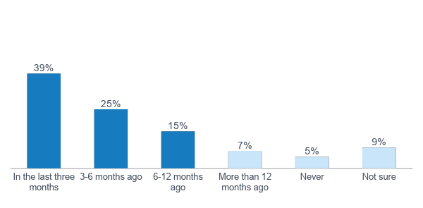
Parents pay attention to ATLAS results
Last time looked at child’s state test (ATLAS) scores
Most (79%) have looked in last year.
Notes:
Windy
Q18: When was the last time you looked at your child’s state test (ATLAS) scores?

Slide 10

Improving Student Outcomes in Arkansas |
A Comprehensive Approach
Research: Listen to parents and educators’ perceptions and experiences
Create comprehensive communications tools for families
State Level Capacity-Building
Shift educator mindsets, foster the conditions and skills for building trust
with families to advance outcomes
Families & Educators Take Aligned Actions to Support Student Outcomes
Educator
Capacity-
Building
Family
Capacity-
Building
Raise awareness & provide actionable resources for parents to make informed decisions
Notes:
Windy
Three interconnected levers
Clearer communication about reading progress and third-grade promotion
Family awareness and activation around understanding reading progress
Educator capacity to build strong partnerships around literacy

Slide 11
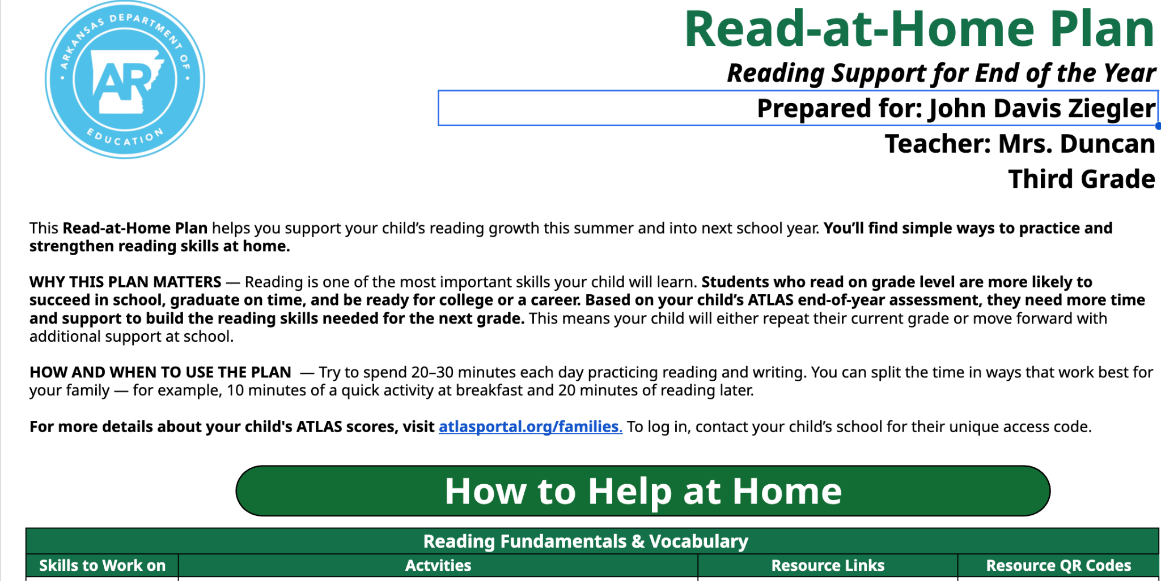
Arkansas | What It Looks Like in Practice
Make literacy data clear & make the resources available actionable | Improve the information families receive—not just increase the amount communication.
Clearer explanations of assessment data
Helping families know if their child is meeting grade-level expectations
Concrete support for how to support reading at home aligned to Individualized Reading Plans
Notes:
Windy/Amy

Slide 12
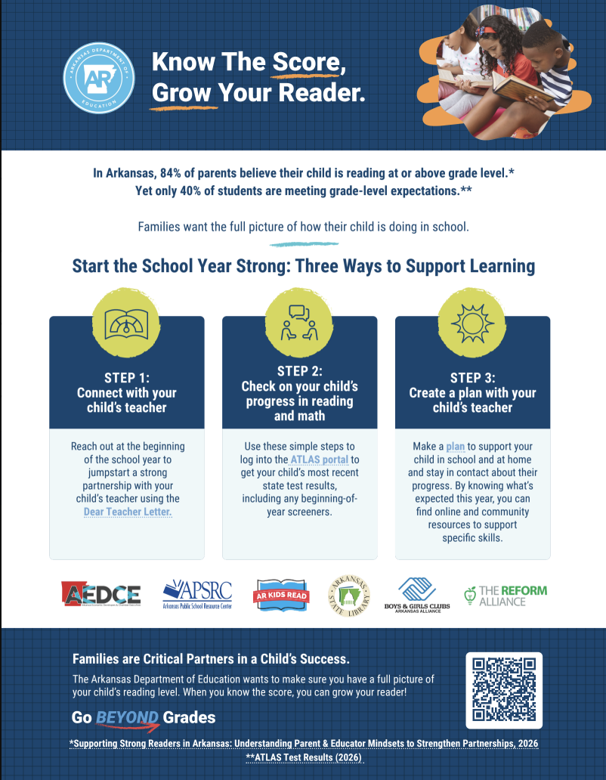
Arkansas | What It Looks Like in Practice
2. Build public awareness to support parent and educator action around a shared understanding of student progress — not just policy awareness.
3 concrete call to actions for families & educators
Website and key resources
Partner resources including the AR Library interactive map to find local libraries
Social Media Kit for sharing
Notes:
Windy/Amy

Slide 13
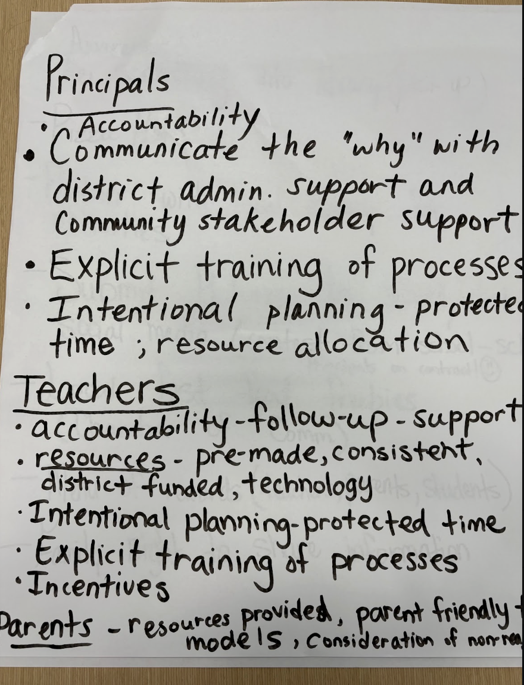
Arkansas | What It Looks Like in Practice
3. Build state, district and school level capacity for stronger literacy partnerships
Start with existing systems, not a new family engagement initiative
Position family partnership as part of an instructional strategy – at every level
Mindset and practice have to move together.
Notes:
Windy/Amy

Slide 14
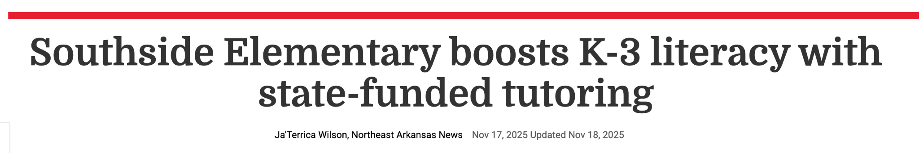
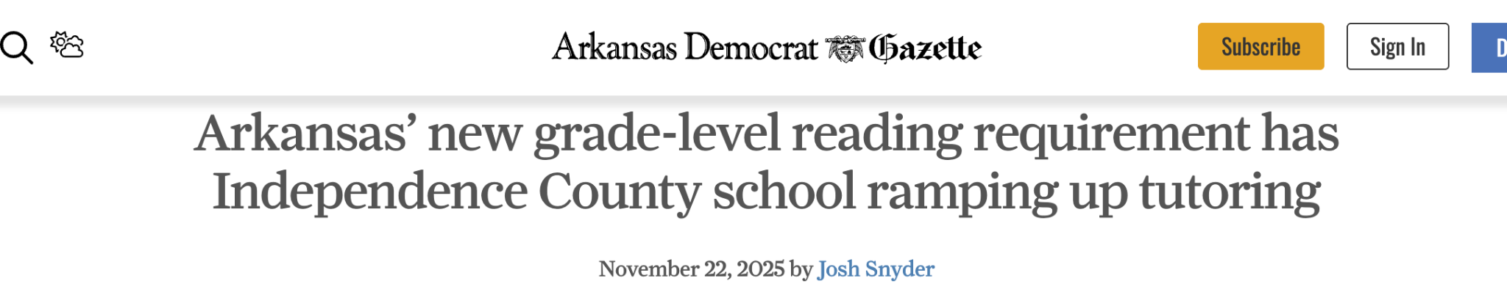
Early Outcomes |
Increase in tutoring enrollment
Notes:
Amy

Slide 15



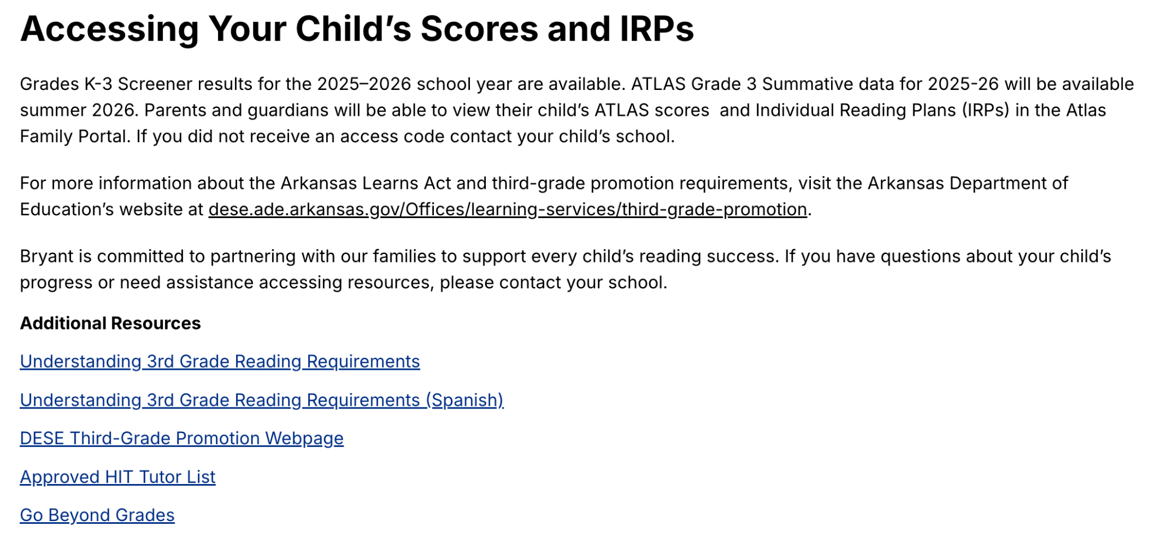
Early Outcomes |
Increase in families accessing ATLAS scores
Districts integrating family communication about literacy data and supports
Notes:
Amy

Slide 16

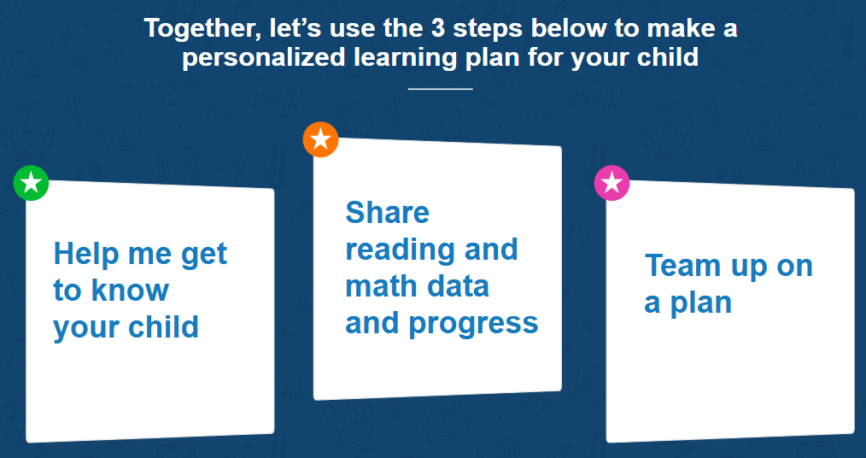
Early Outcomes |
Improving Literacy Infrastructures (ISRs and IRPs; parent-teacher conferences)
Shifting critical mindsets that enable systemic change
“I used to think getting parents involved in their child’s education is a vital but almost impossible task. Now I think we have the tools needed to get parents involved (with additional training).”
“I used to think family engagement just included parent nights or family literacy nights. Now I think it could be included in all core systems and strategies.”
“I used to think parents had a higher level of awareness regarding their students’ performance. Now I think we need clearer communication and structures to ensure and monitor their understanding of student performance.”
Notes:
Amy/Windy

Slide 17
Closing | Reflection Questions
Thinking about your state’s reading policy and implementation…
Communication | Do families have a clear and actionable picture of how their child is progressing? What and how are we communicating with them about their child’s progress?
Capacity | Are educators prepared and supported to partner with families in ways that are grounded in trust and anchored in student learning?
Coherence | Are family partnership strategies embedded into our instructional priorities—or operating alongside them?
Notes:
Windy
The Opportunity for State Leaders
Three Cs: Key questions for state leaders to consider:
Communication: Do families have a clear and actionable picture of how their child is progressing? What and how are we communicating with them about their child’s progress?
Capacity: Are educators prepared and supported to partner with families in ways that are grounded in trust and anchored in student learning?
Coherence: Are family partnership strategies embedded into our instructional priorities—or operating alongside them?

Slide 18




Thank You!
Windy Lopez-Aflitto
SVP, Professional Learning
wlopez@learningheroes.org
Amy Counts
Education Professional Supervisor/ Expert
amy.counts@ade.arkansas.gov
Follow us on Instagram: @learning.heroes
Follow us on LinkedIn: @learning-heroes-us
Like us on Facebook: /Bealearninghero
Follow us on Twitter:
@bealearninghero

