Slide 1
Beyond Compliance: Using Improvement Science to Transform School Turnaround Support

Slide 2


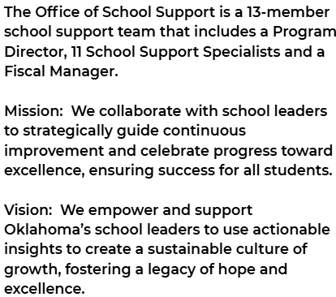
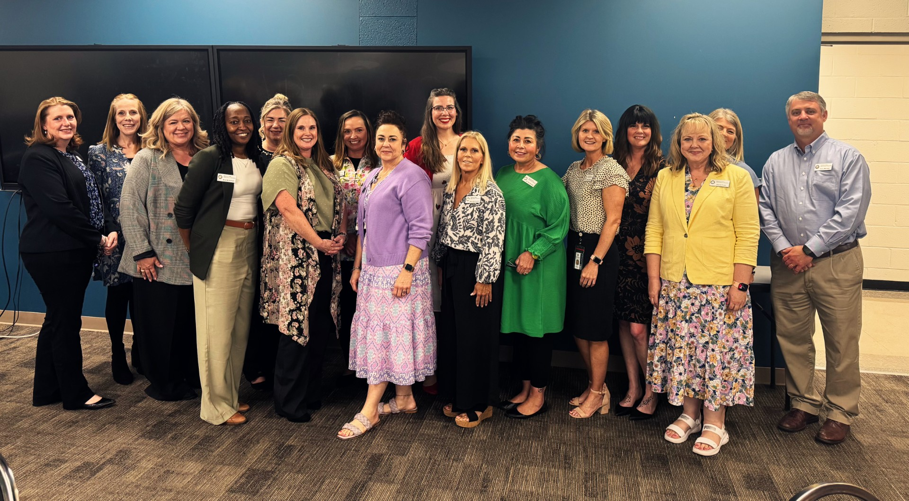
2

Slide 3
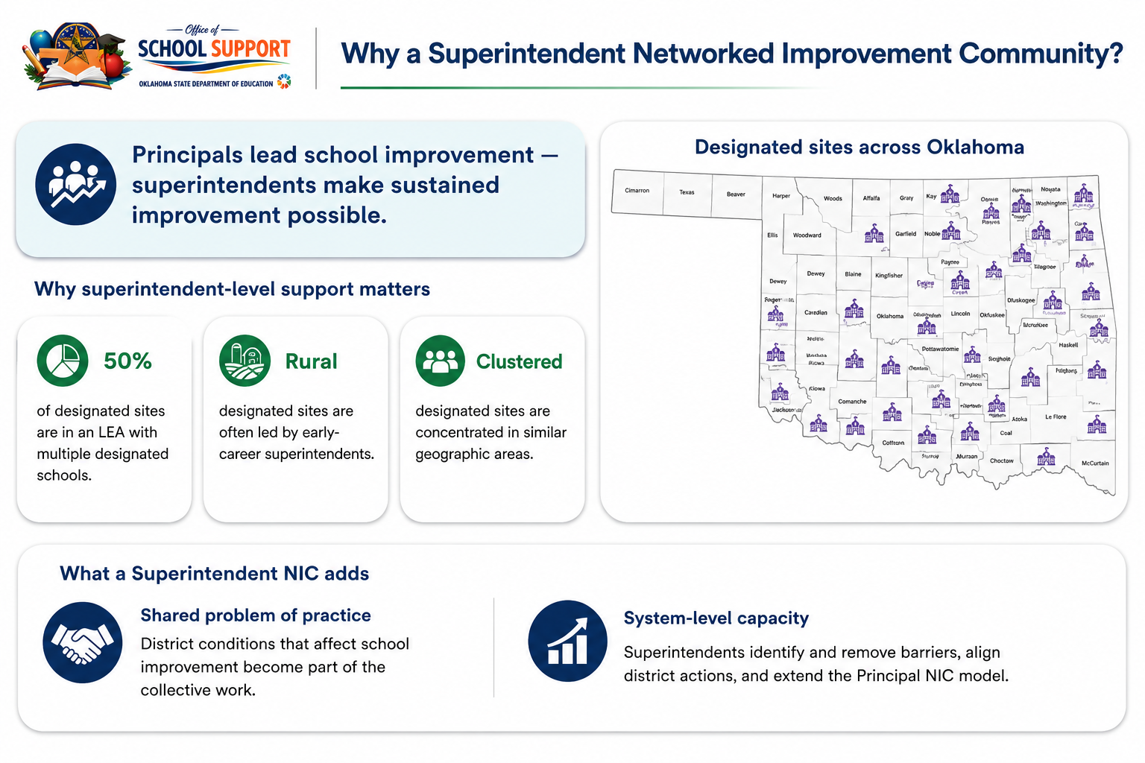

Slide 4
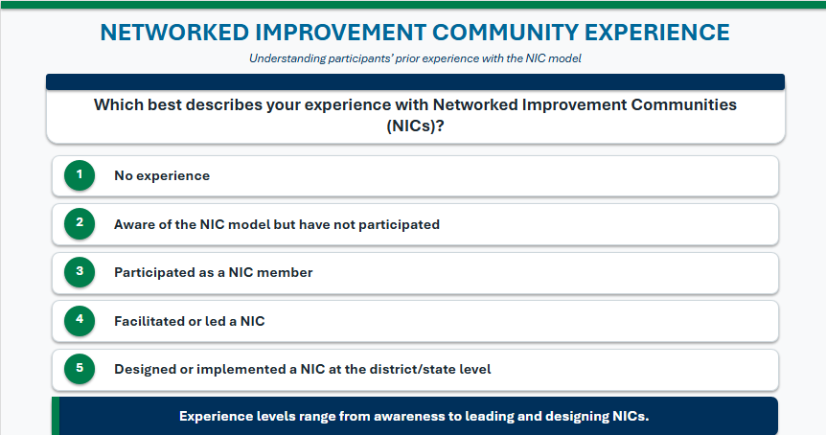


Slide 5
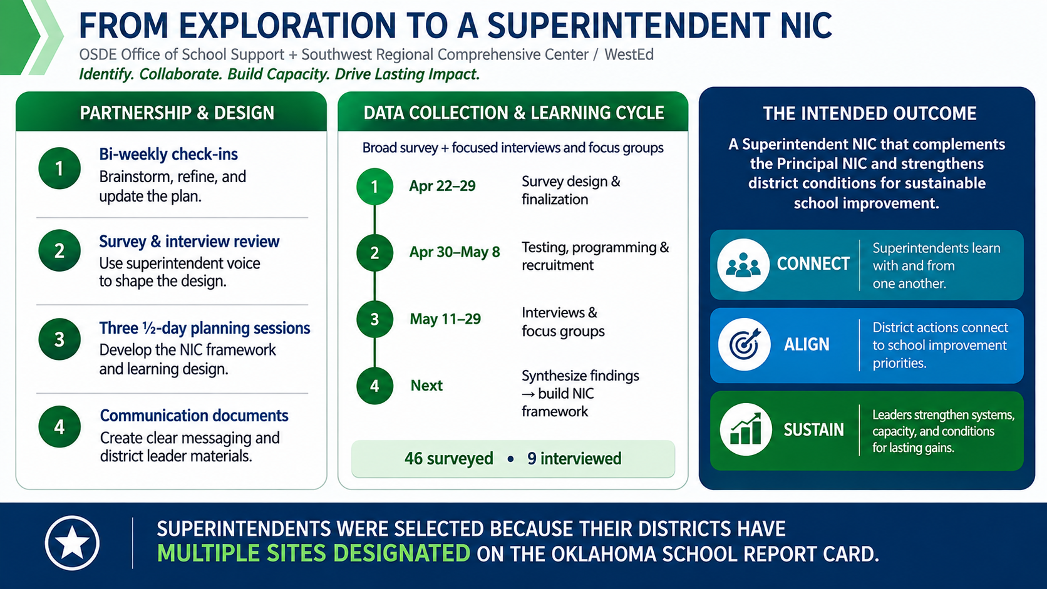
5

Slide 6
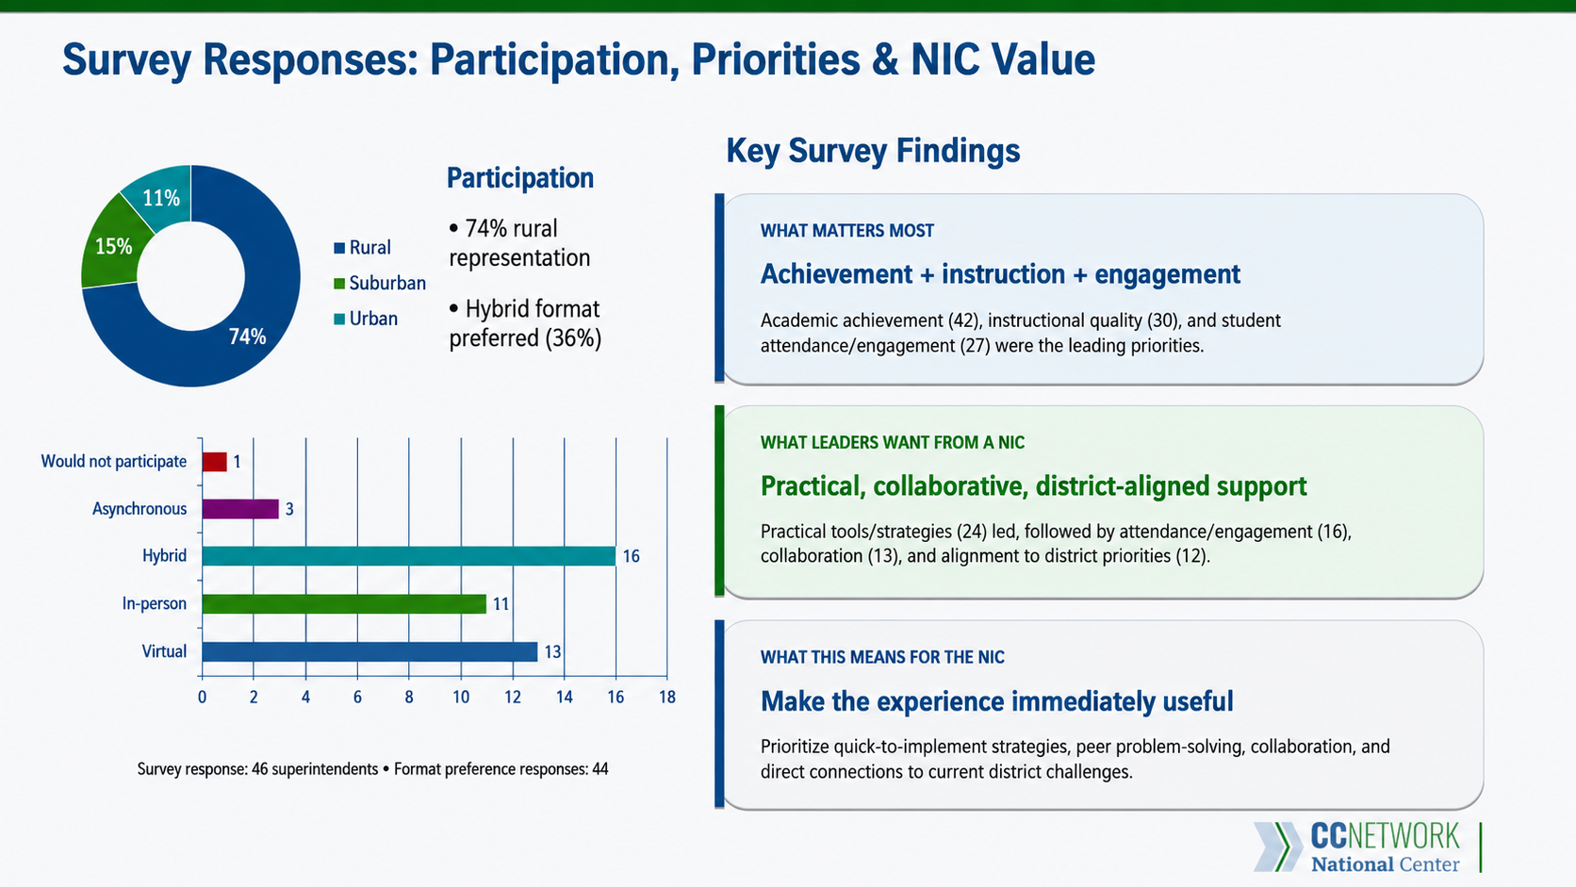

Slide 7
Interview Responses: What Superintendents Need
Themes from superintendent interviews
1
Top Priorities
2
NIC Design
3
Barriers
WHAT IS COMPETING FOR ATTENTION
WHAT WOULD MAKE THE NIC USEFUL
WHAT COULD LIMIT ENGAGEMENT
• Managing every-day "fires"
• Small groups that allow vulnerability & learning
• Competition for leaders’ time
• Budgeting & staffing
• Practical strategies with quick implementation
• Stigma may limit authentic engagement
• Instruction & student performance
• Education on designations & the school report card
• Recognize the political side of education
• Strategic planning
• Alignment to district priorities
• Competing priorities can limit sustained participation
Implication: Make the NIC practical, relevant, collaborative, and connected to superintendents’ daily realities.

Slide 8
AUDIENCE REFLECTION
From superintendent voice to NIC design
WHY THIS MATTERS
TURN & TALK REFLECTION QUESTION
CONSIDER
1
?
VALUE
Is the experience worth the time?
Superintendents have told us what competes for their time, what they value, and what could limit engagement.
Based on what superintendents told us, what must a Superintendent NIC provide to make participation valuable enough to prioritize?
RELEVANCE
Does it connect to district priorities?
PRACTICAL IMPACT
Can leaders use what they learn?
★
THE GOAL: DESIGN A NIC EXPERIENCE SUPERINTENDENTS WILL SEE AS WORTH THEIR TIME.

Slide 9
Planning the Superintendent NIC
9

Slide 10
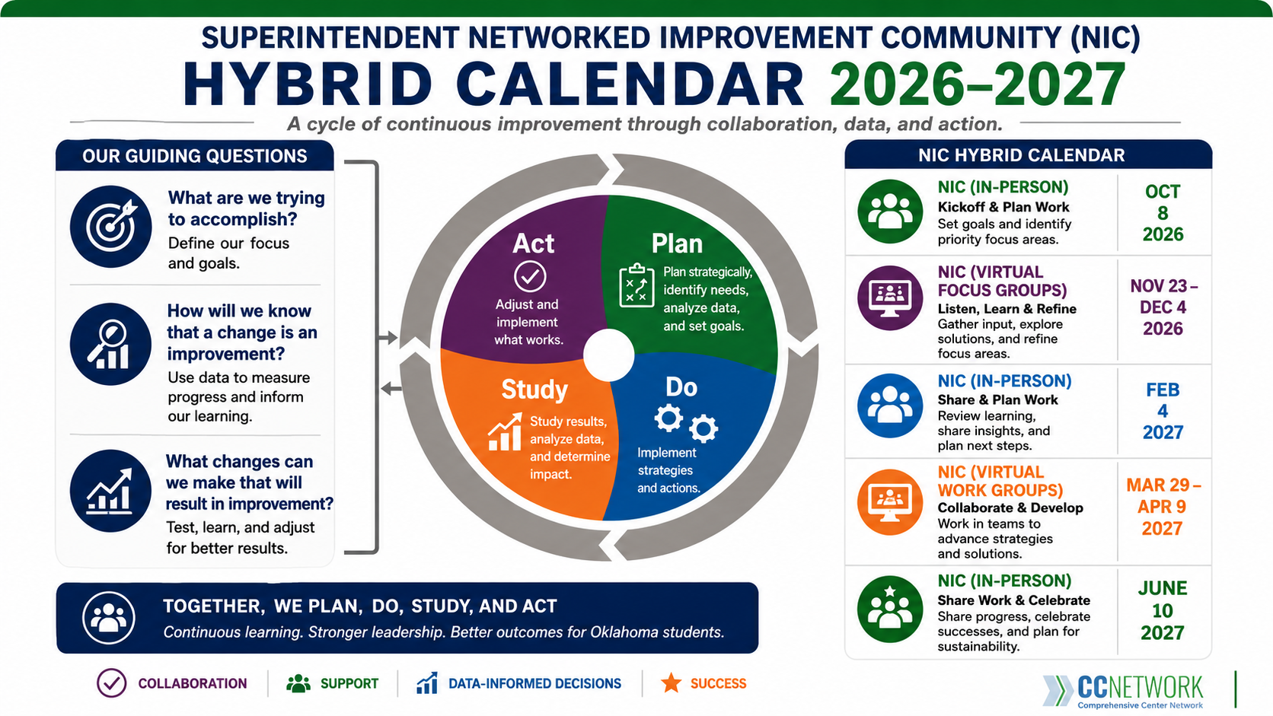

Slide 11
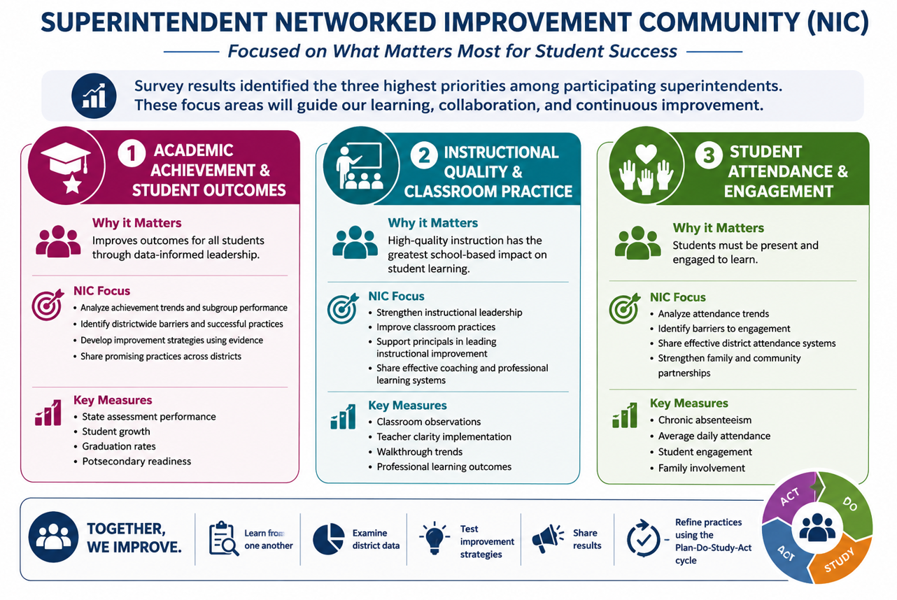
11

Slide 12
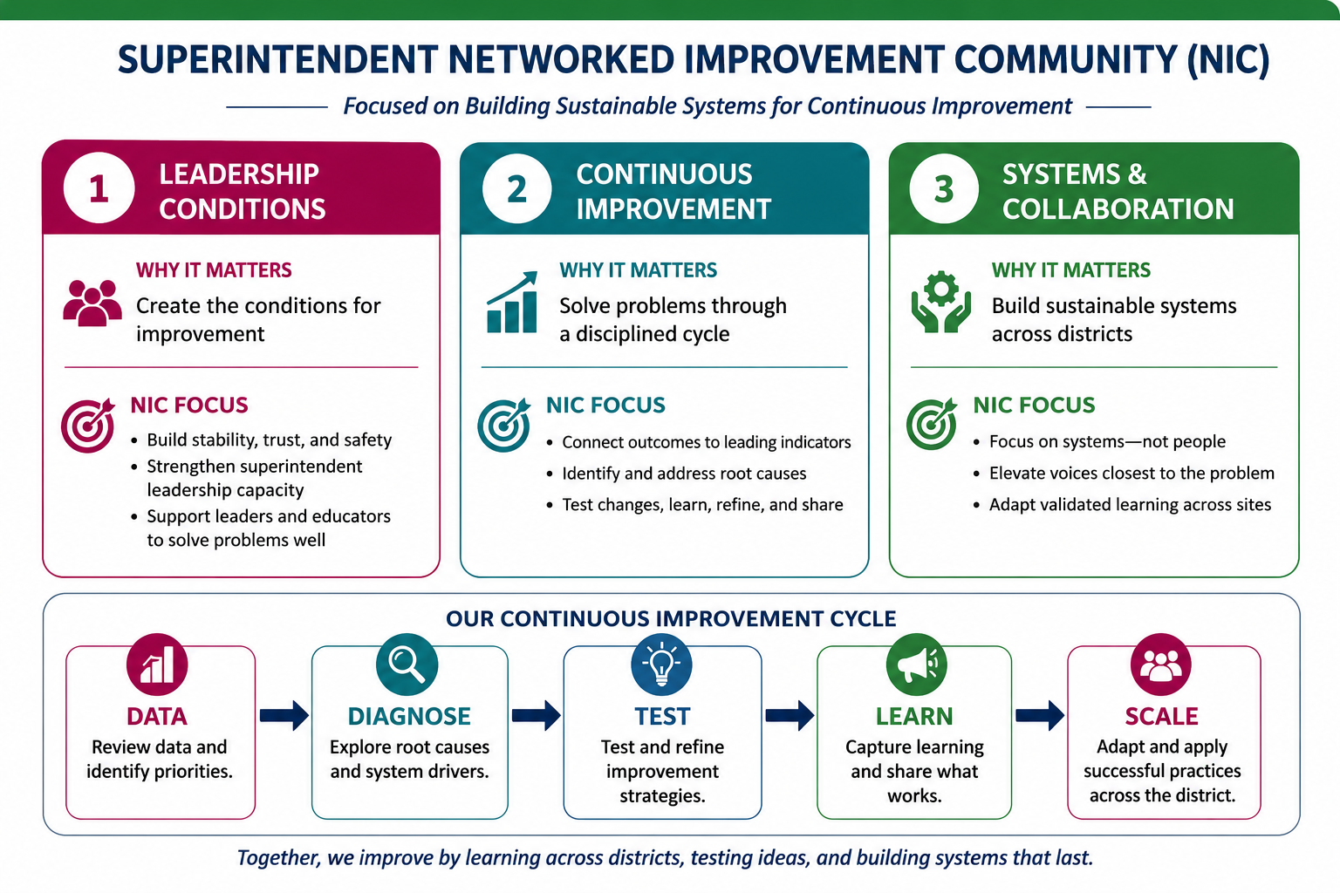

Slide 13
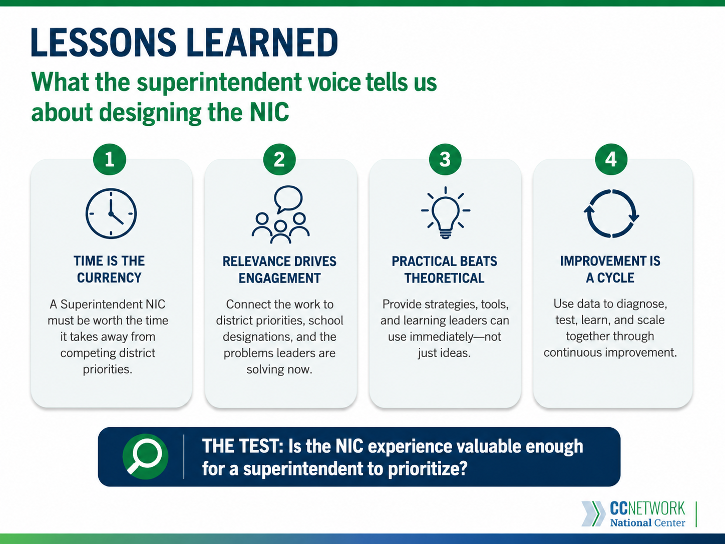

Slide 14
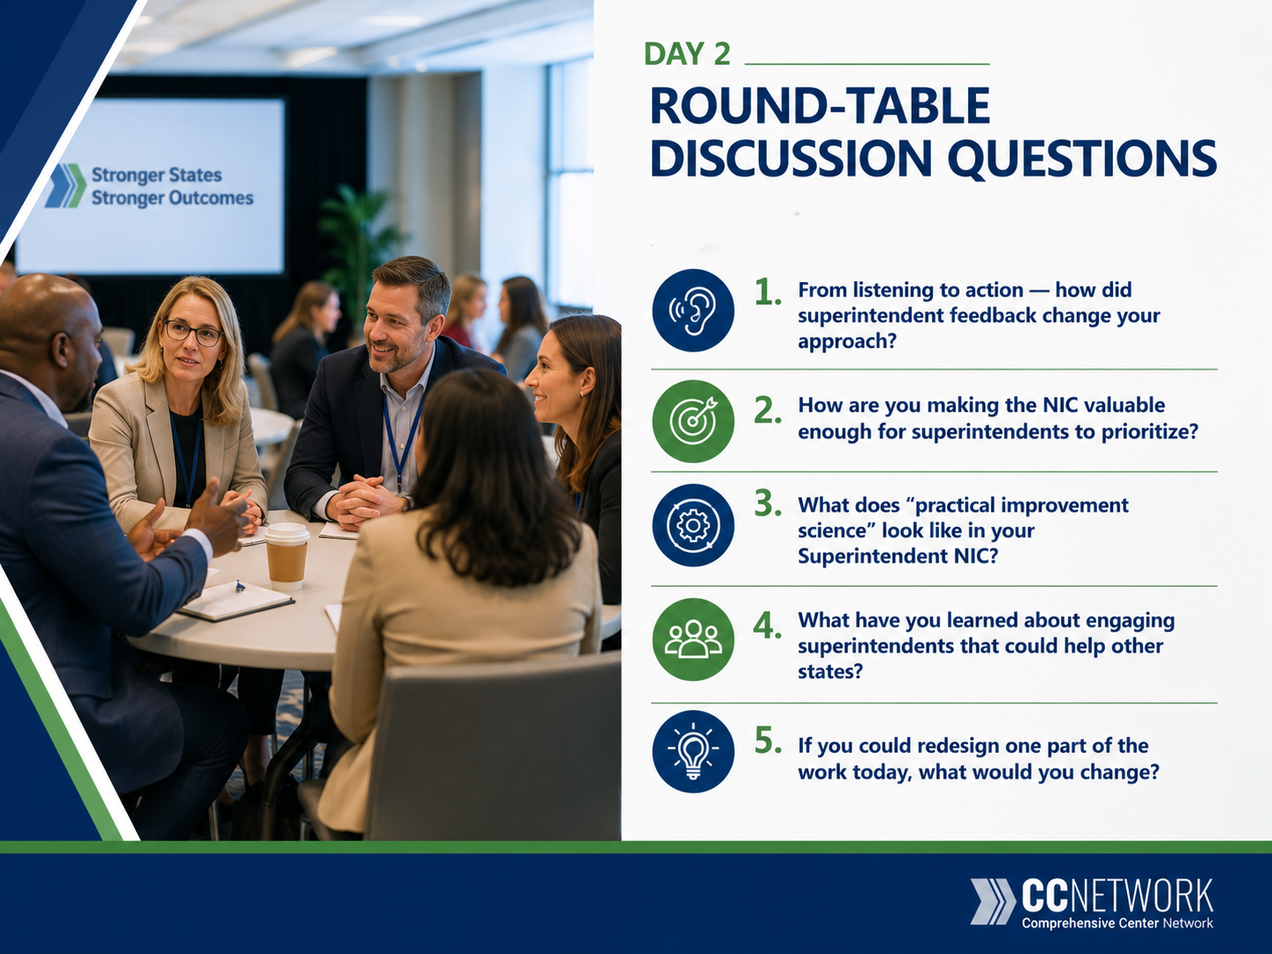
14

Slide 15


15

