Slide 1
Virginia and Ohio Scale Evidence-Based Literacy for Adolescent Learners
Stronger States Stronger Outcomes
September 2026

Slide 2
Virginia Literacy Act for Grades 4-8
Jill Nogueras
Associate Director K-12 English and Literacy
Virginia Department of Education

Slide 3
Virginia Literacy Act in Grades 4-8
September 2026

Slide 4
Timeline of Virginia Literacy Act Implementation
Year | Key Milestones
2022 | • VLA passed by General Assembly • Advisory Workgroup established • Initial Superintendent’s memos released
2023 | • Early implementation begins • Statewide Literacy screener updates • Approval of K–3 core curriculum
2024 | •VLA expands to include Grades 4-8 VLA Implementation Playbook released • Division Literacy Plan guidance issued • Literacy Network Series launched
2025 | • VALLSS rollout statewide • Biennial Division Literacy Plan guidance • Reading Specialist training and office hours
2026 | • Executive Order 4 reconstitutes Workgroup • Expanded duties and partnerships • April convening and updated guidance

Slide 5
VLA Seeks to Improve K–12 Literacy Outcomes
Defines key terms, such as evidence- based literacy instruction & science-based reading research
Aligns core curricula, screening, and intervention methods
Requires continuing professional development and training for principals, teachers, and reading specialists
Notes:
The key components of the VLA include defining evidence-based literacy instruction and science-based reading research for all educators across the Commonwealth. The VLA aligned core curricula (K-5), screening model (K-8) and intervention methods (K-8) while adding a reading specialist staffing ratio.
Defines Key Terms
Establishes the definition of evidence-based literacy instruction and science-based reading research.
Provides a structured framework for instruction, assessment, and intervention.
Aligns Core Curricula, Screening and Intervention Methods
Requires alignment of core (K-5) instructional, supplemental (K-8) and intervention (K-8) programs with science-based reading research, as established in a division-wide literacy plan.
Uses a screening model to identify students in need of intervention and requires the development of reading plans for students designated in the high-risk band.
Adds a division-wide staffing ratio of one reading specialist per 550 students in K-5 and one reading specialist per 1,100 students in Grades 6-8.
Requires Continuing Professional Development and Training
Requires principals, teachers and reading specialists be provided with professional development in science-based reading research and evidence-based literacy instruction. (Provided by VLP.)

Slide 6
VLA Requirements for Communication and Educator Supports
Partners with Families
Aligns Educator Preparation and Licensure
VLA Information Website: Virginia Literacy Act | Virginia Department of Education
Notes:
With the implementation of a screener and intervention materials, the VLA ensures that families are engaged in the development of student reading plans and have access to a variety of resources to support literacy development at home. Additionally, the VLA aligned the work occurring in Virginia's educator preparation programs with coursework rooted in science-based reading research and evidence-based literacy instruction.
Partners with Families
Ensures parents are engaged in the development of student reading plans and have access to resources to support literacy development at home.
Aligns Educator Preparation and Licensure
Requires certain educator preparation programs to ensure candidates have a program of coursework and demonstrate mastery in science-based reading research and evidence-based literacy instruction.
Stipulates that the literacy assessment for licensure or alternate route to licensure with certain endorsements include a test of science-based reading research and evidence-based literacy instruction.
Requires every person seeking initial licensure with certain endorsements complete study in science-based reading research and evidence-based literacy instruction.
Establishes a microcredential program for earning an add-on reading specialist endorsement (when needed).
VLA Information Website: Virginia Literacy Act | Virginia Department of Education

Slide 7
Table Talk
What literacy practices are currently driving success in your state?
Where do you see alignment or gaps with the VLA requirements?

Slide 8
Grade 4–8 Reading Specialists
Virginia’s Grade 4 through Grade 8 reading specialists:
  May be employed by a division if they are certified reading specialists or educators who have successfully completed the Reading Specialist microcredential course and received the add-on endorsement
  Any add-on endorsement that results from completion of such microcredential program shall be provisional for a period of five years

Slide 9
Reading Specialist Microcredential
The VDOE has established a:
Microcredential program—Reading Specialist Microcredential
To ensure participants will have a strong understanding of the cognitive science and reading research that supports an evidenced-based approach to literacy instruction
Total # enrolled: 1,385
Total # completed: 406
Total # provisional licenses issued: 307
Notes:
The VDOE has established a microcredential program through Canvas for the purpose of permitting any teacher who holds a renewable or provisional license to earn a provisional reading specialist endorsement to be employed in this role at a school. Upon completion of the Reading Specialist Microcredential, participants will have a strong understanding of the cognitive science and reading research that supports an evidenced-based approach to literacy instruction, what strong literacy instruction consists of, and the alignment between the research and the Virginia Literacy Act.
Total # enrolled: 1,385
Total # completed: 406
Total # provisional licenses issued: 307

Slide 10
Supporting Improvement in 4–8
Virginia’s Grade 4 through Grade 8 educators, reading specialists, and administrators:
  Delivered supplemental and intervention literacy instruction for Grade 4 through Grade 8
  Utilized reading specialists, in collaboration with the teacher of any student who receives reading intervention services
  Literacy leaders collaborated with division finance personnel to determine how many reading specialists are allocated at the secondary level
Notes:
Virginia’s Grade 4 through Grade 8 educators, reading specialists, and administrators:
Delivered supplemental and intervention literacy instruction for Grade 4 through Grade 8 based on reading research and the lists approved by the Board of Education.
Utilized reading specialist(s), in collaboration with the teacher of any student who receives reading intervention services, to develop, oversee implementation of, and monitor student progress on a student reading plan.
Literacy leaders collaborated with division finance personnel to determine how many reading specialists are allocated at the secondary level to meet the 1:1,100 requirement of the Virginia Literacy Act.

Slide 11
Intervention
Virginia’s Grade 4 through Grade 8 educators, reading specialists, and administrators planned for intervention with flexibility and combination of interventions.
Intervention materials for grades K–8 must be selected from the Board Approved Intervention List for K–5 and the Board Approved Intervention List for Grades 6–8.
Notes:
Virginia’s Grade 4 through Grade 8 educators, reading specialists, and administrators planned for intervention
School divisions have flexibility and can use a combination of any of the options included below to ensure that students receive literacy intervention. This is an opportunity for middle school grade level teams to collaborate and determine the best interventions and supports for students. Intervention may include the following services for the student:
instruction from a reading specialist, trained aide, computer-based reading tutorial program, or classroom teacher with support from an aide
extended instructional time in the school day or school year
an additional literacy course, outside of the required SOL English course, that provides the specific evidence-based literacy instruction identified in the student's reading plan (optional for grades 6-8).
Intervention materials for grades K-8 must be selected from the Board Approved Intervention List for K-5 and the Board Approved Intervention List for Grades 6-8.
§ 22.1-253.13:1. (Effective July 1, 2026) Standard 1. Instructional programs supporting the Standards of Learning and other educational objectives

Slide 12
Student Reading Plans for 4–8
Virginia’s Grade 4 through Grade 8 educators, reading specialists, and administrators created Student Reading Plans:
  Student Reading Plans are intended for students who fail the SOL with a Fail/Basic or Fail/Below Basic, outlining appropriate interventions.
  Students who pass the English SOL with an accommodation may receive a Student Reading Plan based on a body of evidence.
  Additional students who participate in VALLSS: 4-8 who were not required to participate may also receive a Student Reading Plan based on a body of evidence.
  Teachers will use SOL assessment reports, VALLSS reports, and other pieces of data to create the Student Reading Plans.
Notes:
Virginia’s Grade 4 through Grade 8 educators, reading specialists, and administrators created Student Reading Plans:
Student Reading Plans: Students who fail the SOL with a Fail/Basic or Fail/Below Basic score will be required to have a Student Reading Plan outlining appropriate interventions. Students who pass the English SOL with an audio or read-aloud accommodation may receive a Student Reading Plan based on a body of evidence, including data from VALLSS: 4-8.
Additional students who participate in VALLSS: 4-8 who were not required to participate may also receive a student reading plan based on a body of evidence, including data from VALLSS: 4-8.
Teachers will use SOL assessment reports, VALLSS reports, and other pieces of data to create the Student Reading Plans.

Slide 13

Statewide Partnership between VLP at UVA & VDOE

Slide 14
Virginia Literacy Partnerships (VLP) at UVA and VLA
Partners with VDOE to support VLA through:
Professional Learning
Virginia Language and Literacy Screening System (VALLSS)
VAConnects
Student Reading Plan Template and Supporting Materials
Implementation of the Core, Supplemental and Intervention program reviews
Literacy coaching, as requested
Notes:
With the implementation of a screener and intervention materials, the VLA ensures that families are engaged in the development of student reading plans and have access to a variety of resources to support literacy development at home. Additionally, the VLA aligned the work occurring in Virginia's educator preparation programs with coursework rooted in science-based reading research and evidence-based literacy instruction.
Development of Science of Reading Research and Evidence Based Literacy Instruction Professional Learning for Educators
Development of the Virginia Language and Literacy Screening System (VALLSS) for Pre-K, K-3, and 4-8 and maintenance of such system through VAConnects
Development of the Student Reading Plan Template and Supporting Materials
Implementation of the Core, Supplemental and Intervention program reviews for recommendations to the Board of Education for approval
Provide literacy coaching to local school divisions, if requested

Slide 15
VLP at UVA Supports Data Collection and Reporting
Collect validity information for the development of VALLSS
Provides VDOE with results of statewide data analysis for inclusion in briefing documents that VDOE prepares for the General Assembly.
Maintain a website to provide scoring and instructions for VALLSS
Develop reports to support data use and instruction
Notes:
With the implementation of a screener and intervention materials, the VLA ensures that families are engaged in the development of student reading plans and have access to a variety of resources to support literacy development at home. Additionally, the VLA aligned the work occurring in Virginia's educator preparation programs with coursework rooted in science-based reading research and evidence-based literacy instruction.
Collect validity information for the development of VALLSS
Within 30 days of the final scores due date for the term for each testing window for the beginning of year, middle of year, and end of year, provides VDOE with results of statewide data analysis and any other pertinent data or information that VLP collects for inclusion in briefing documents that VDOE prepares for the General Assembly.
Maintain a website to provide scoring and instructions for VALLSS, develop reports to support data use and instruction
To the extent possible, the data entry screen will have STI prepopulated to minimize data entry errors
Improve overall user interface with the website used for VALLSS

Slide 16
Table Reflection
One insight I’ll take back to my state…
One question I still have…

Slide 17
Virginia Literacy Act: Year-by-Year Highlights (2022-2026)
2022 VLA Established | 2023 Early Implementation | 2024 Expansion and Resources | 2025 Data and Professional Learning | 2026 Stakeholder Input and Continued Support
VLA passed by the General Assembly, establishing statewide literacy requirements. Advisory Workgroup formed to guide implementation. Communication released outlining division expectations. | Initial rollout of literacy initiatives to divisions. Updates to statewide Virginia Early Literacy Screener (VALLSS) introduced. First cycle approval of K-3 core curriculum materials. Advisory Workgroup convened in June to review progress and next steps. | VLA expands to include grades 4-8. Release of the VLA Implementation Playbook to guide division planning. Approval cycle for supplemental and intervention materials for grades 4-8. Division Literacy Plan guidance issued. Statewide Literacy Network Implementation Series launched. Continued development of VLA resources and support. | VALLSS rollout and technical assistance to support new screener. Biennial Division Literacy Plan guidance released. Statewide Reading Specialist training and office hours for grades 4-8. Continued focus on data-informed instruction and literacy leadership statewide. | Executive Order 4 calls for a new VLA Advisory Workgroup to consider improvements to the Student Reading Plans and alignment to interventions. Continued updates and collaboration across divisions.

Slide 18
Resources to Support Educators
Division Literacy Plans
Approved Core Instructional Programs for Grades K-5
Intervention Instructional Program Guide & Supplemental Instructional Program Guide
Curriculum Review Process Update for the Virginia Literacy Act
Homepage | Virginia Literacy Partnerships
VALLSS: Grades 4-8 Overview
Virginia Language & Literacy Screening System (VALLSS): Grades 4-8 | Virginia Literacy Partnerships
Virginia Literacy Act
  Virginia Literacy Updates
  VALLSS Assessment Calendar
  Student Reading Plans
  Division Literacy Plans
  Approved Instructional Programs
  Curriculum Review Resources
  Literacy Implementation Network Sessions
  Virginia Literacy Act Advisory Work Group
  Resources and Explainers
  Webinars and Presentations
  Superintendent's Memos

Slide 19
Next Steps
Jot one concrete action they’ll take to strengthen literacy outcomes and/or implementation practices in your own state.
Share out!

Slide 20
English and Literacy Team Contact Info
​
Amanda Hassell​
Early Literacy Specialist​
Amanda.Hassell@doe.virginia.gov​
​
Ciara Stamper​
Secondary Intervention Specialist
Ciara.Stamper@doe.virginia.gov​
​
Emily McMillen​
Division Support Specialist​
Emily.McMillen@doe.virginia.gov
Jill Nogueras
Associate Director of K-12 English & Literacy
Jill.Nogueras@doe.virginia.gov
Ellen Frackelton
Coordinator of Elementary Reading & Literacy
Ellen.Frackelton@doe.virginia.gov
Colleen Cassada
Coordinator of Secondary English & Literacy
Colleen.Cassada@doe.virginia.gov
English Program
VDOE.English@doe.virginia.gov
Reference within this document to any specific commercial or non-commercial product, process, or service by trade name, trademark, manufacturer or otherwise does not constitute or imply an endorsement, recommendation, or favoring by the Virginia Department of Education.

Slide 21
Adolescent Literacy, The ReadOhio Network
&
Policy Implementation
Rachel Ealy, Adolescent Literacy Specialist,
Ohio Department of Education & Workforce (ODEW)
Notes:
Chris to introduce Ohio and transition to them for their presentation

Slide 22

Mission
The Ohio Department of Education and Workforce supports Ohio’s students, families, and educators to ensure every student gains the knowledge and life skills needed for the future.
Notes:
The Department is dedicated to preparing students today for the challenges and opportunities of tomorrow.
This begins with equipping every Ohioan with the skills and tools necessary to thrive in a rapidly changing world
Our vision and mission bring this into focus.
Our vision: Ohio students are prepared for success in the real world.
Our mission: The Ohio Department of Education and Workforce supports Ohio’s students, families, and educators to ensure every student gains the knowledge and life skills needed for the future.
This encompasses many areas and speaks to how we all approach our work. This includes:
Academic knowledge and practical, real-world skills
Supporting families and educators
Focus on core values to help Ohioans live up to their full potential and thrive.

Slide 23

Literacy
Building a foundation for lifelong success by ensuring every student is reading at or above grade level
Notes:
Rachel
Literacy is the foundation to all other educational endeavors and initiatives.
Ohio is committed to supporting an education system that prioritizes the language and literacy development of all learners.
In 2023, Ohio Governor Mike DeWine announced the ReadOhio initiative, a statewide effort to improve literacy skills for all ages that includes the implementation of curriculum aligned with the Science of Reading in Ohio’s schools.
Ensuring educators have the training, resources, and instructional materials aligned to the Science of Reading is an important part of this priority.
Ohio students are counting on us, and our work remains urgent.

Slide 24
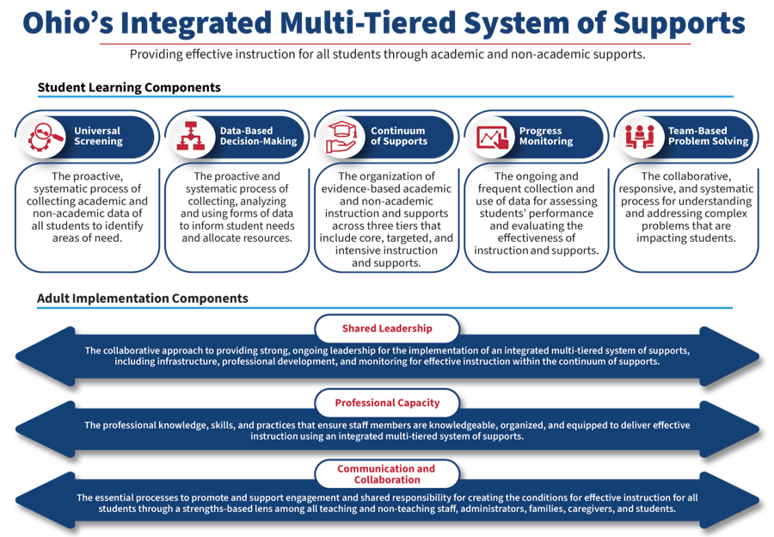

Slide 25
Collective Responsibility
District and School Leaders
How do district and school leaders provide supports to buildings to improve outcomes?
Building Leaders
How do building leaders provide supports to teachers to improve outcomes?
Building-Level Staff
How do building-level staff provide student-level supports to improve outcomes?
Ohio Department of Education and Workforce
How does the Department provide guidance and supports across the state of Ohio to improve outcomes?
Regional Systems of Support
How do regional support systems provide supports across regions to improve outcomes?
Increased Student Outcomes
Families/Caregivers
How do families and caregivers provide student-level supports to improve outcomes?
Guidance and supports are grounded in research and inclusive of federal & state policy.
Notes:
We share a collective responsibility – from the state level to the classroom – to ensure the successful implementation of Ohio's Integrated MTSS framework. This unified effort is essential to building a coherent, sustainable system that truly impacts every student. ​
The Department plays a role in this implementation and impacts the rest of the educational system. ​
​
The regional system of supports includes our SSTs, as well as our ESCs, tech centers, etc. These regional partners serve as the bridge between state guidance and local implementation. They take the policies and priorities from the Department and work alongside district and school leaders to translate them into daily practice. Our partners in the regional system play a critical role in turning policy into practice.
​
District and school leaders are essential in translating the framework into daily practice, through aligning systems, empowering teams and fostering a culture of contentious improvement. ​
​
Building leaders are critical – implementing the practices and processes in their buildings – keeping focus on needs of their students and staff. - Building leaders create conditions necessary to improve outcomes for all leaners. ​
​
Building level staff also have a collective responsibility – using data for implementation for effective instruction and make necessary adjustments. ​
​
Family and caregivers are also critical - ensuring they are informed about supports available to their student.

Slide 26
Ohio’s Timeline of Adolescent Literacy Policy, Implementation & Initiatives

Slide 27

2018-2020
2018: Ohio published its 1st Plan to Raise Literacy Achievement
Ohio’s vision is for all learners to acquire the knowledge and skills to read at grade level. The Department begins to promote the implementation of evidence-based systems and instructional practices to increase learner achievement across all content areas and age levels.
2019: “Adolescent Literacy Roadshow”
3 regional adolescent literacy consultants created professional learning and traveled throughout the state to present on evidence-based strategies for adolescent literacy.
Early 2020: CLSD Grant awarded
CLSD grants awarded to 22 subgrants supporting middle and high schools showed urgent needs to provide regionally based support in adolescent literacy.
Mid 2020: Online Adolescent Literacy Network begins
Consultants and ODEW began working with researchers, including Dr. Dan Reynolds and Dr. Josh Lawrence, to create an adolescent literacy network held online quarterly. The goal of the network was to “remove the veil” and bring research to the classroom.
2017: Ohio Awarded the Striving Readers Grant
Ohio awarded 35 million from the US Department of Education with a little over 13 million of those dollars supporting secondary schools.
Notes:
Highlights/Talking Points:
Striving Readers Grant
2019 beginning of the adolescent literacy statewide professional learning
2020- CLSD even more urgent needs

Slide 28

2022-2026
2022: SPDG Grant awarded focusing on adolescent literacy
The Department was awarded the State Personnel Development Grant (SPDG). Adolescent literacy specialist position shifted to support regional entities and districts involved in the SPDG in building capacity and knowledge around adolescent literacy.
2023: House Bill 33 Passes and the ReadOhio Network is created
House Bill 33 passed. Governor Mike DeWine launched the ReadOhio initiative. Under this initiative, ODEW creates the ReadOhio Network, hiring 33 coaches (12 were in adolescent spaces) and requiring Reading Improvement and Monitoring Plans (RIMPs) for K-4 Students; expanding each year by one grade level.
2024: Adolescent Literacy Specialists increase to 6
The Department increased the number of Adolescent Literacy Specialists to 6. ALSs begin to work as coaches twice a week in ReadOhio schools and provide direct support to SPDG and regional schools.
2025: RIMPS continue through 6th grade
Adolescent Literacy Specialists reduce to 5. ALSs continue to work as coaches in ReadOhio schools twice a week and provide direct support to SPDG and regional schools. RIMPs effective into 6th grade.
2026: Senate Bill 19 passes
SB19 requires each school district to provide evidence based academic intervention services, free of cost, to each qualifying student.
A “qualifying student” means a student K-12 who demonstrates a limited level of skill in the subject area of mathematics, English language arts or both.
Notes:
Highlights/Talking Points:
Governor Dewine launches the ReadOhio Initiative and provides funding for coaching in K-12 settings.
2024 increasing to 6 and starting to coach in ReadOhio Schools
2025- Reading Improvement Monitoring Plans move to middle school levels- this also addresses the need for more professional learning in providing approved interventions in middle schools.
2026- Over the summer SB 19 passed- data suggests that 50% of students scoring Limited (not on IEPS) in grades 7 and up (non RIMP levels) could not be receiving any intervention and are now required to receive intervention.

Slide 29
Adolescent Literacy Policy

Slide 30
Legislation Impacting Adolescent Literacy Intervention
Senate Bill 19
Third Grade Reading Guarantee (TGRG)
Individuals with Disabilities Education Act (IDEA)
Notes:
While we have Senate Bill 19, this does not change our other polices that impact adolescent literacy intervention.
With 3 different policies, we need to begin to think of students not by policy, but by what is it that each student specifically needs to be successful? While one intervention may work for one student, it may not be effective for another. This is due to a students’ reading profile.
Schedule students in intervention classes not by their legislation but by need. To determine each student’s need, it’s best to use a gated diagnostic approach to determine their reader profile.

Slide 31
Implementation Supports

Slide 32
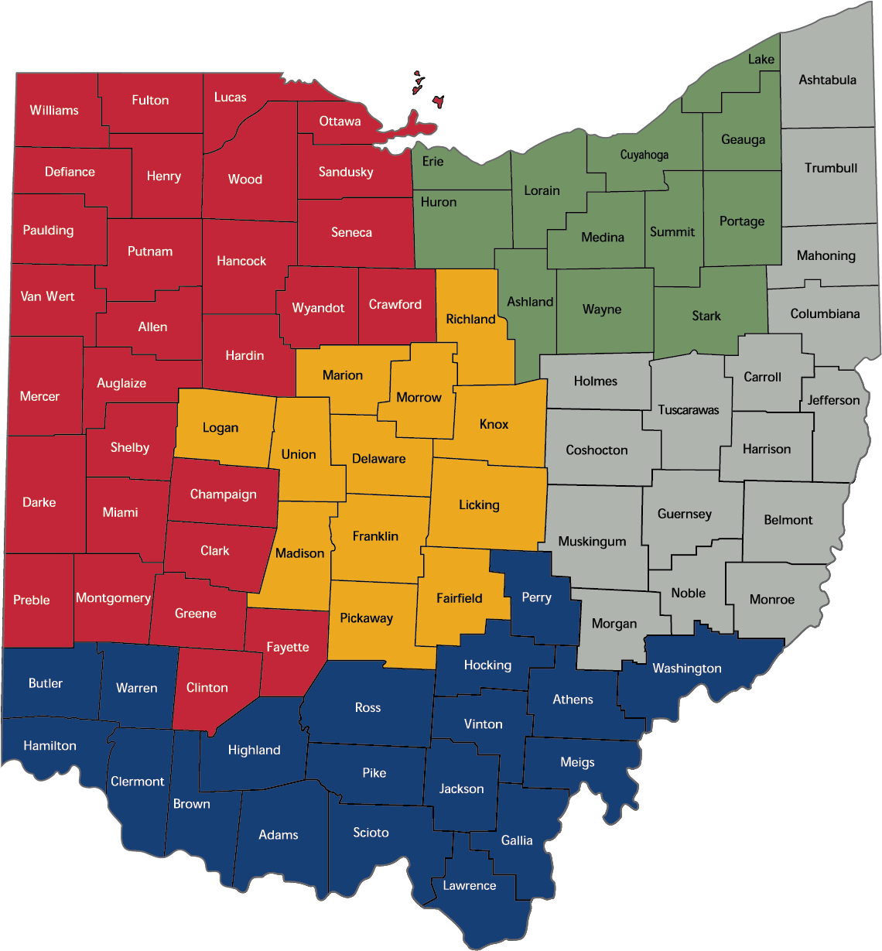
The ReadOhio Network
Professional Capacity
Ohio has 16 Educational Regions with:
  16 Regional Literacy Specialists (RLSs)
  11 Urban Literacy Specialists (ULSs)
  2 Adolescent Literacy Specialists (ALSs)
  118 ReadOhio Coaches
  5 Regional Coaching Coordinators
  131 New Coaching Credential Candidates
  200+ District and community schools
Notes:
2026- due to turnover and shifting regional roles, we will be a small but mighty team.

Slide 33
Current ALS Specialist Role
Professional Capacity
  Intensive support for Identified ReadOhio District and Building
  Technical assistance for schools and districts involved in SPDG
  Adolescent Literacy coaching and technical assistance to support the implementation of an integrated multi-tiered system of supports for literacy.
  Participate on Literacy Implementation Teams
  Support Ohio’s Plan to Raise Literacy Achievement through the ReadOhio Network.
  Develop as a literacy content expert.
  Communicate with regional system leaders and colleagues (ESCs & SSTs) on progress of adolescent literacy in the region.
Notes:
Highlight #4 as new this year. Another new initiative will be working with REL Midwest to facilitate the use of the PRISMS toolkit in middle schools throughout the state this will support their ability to provide intensive support to districts, provide technical assistance and develop as a content expert

Slide 34
Additional Resources for Implementation
Professional Capacity
Current Resources Include:
  RIMP videos
    Supporting Older Students on RIMPS
    How to Create a RIMP for Grades 4-9
  Guides
    2025 Ohio’s Plan to Raise Literacy Achievement
    A Guide for School Leaders, Grades 6-12
  Approved List of Evidence-Based Reading Intervention Programs PK-12
  Literacy Assessment Audit Tool, Grades 6-12
  6-12 Literacy Academy On Demand
  Science of Reading Refresher Course Module 1: Grades 6-12

Slide 35
Implementation Initiatives for 2026-2027

Slide 36

PRISMS Toolkit
Professional Capacity
This Fall, we are partnering with REL Midwest to provide a professional learning series on using the IES Providing Reading Interventions to Students in Middle School (PRISMS) Toolkit.
This will include 1 session overview
and 6 spot workshops covering
each module of the toolkit.
Notes:
Rachel presents

Slide 37
New Federal Grant
Ohio was recently awarded an EIR Midphase Grant to support adolescent literacy, Accelerating Literacy Outcomes in High-Needs Ohio Middle Schools through PACT.
In collaboration with the Meadows Center and University of Cincinnati, the project will serve approximately 36,000 6th–8th grade students and 360 teachers, with a focus on schools with the lowest reading proficiency rates, including rural and under-resourced districts.
Impact analyses will estimate PACT’s effects on middle school students’ reading comprehension and subject-area knowledge.
Notes:
What steps has your state done to get put policy and research into practice?

Slide 38
Next Steps
Offer Adolescent literacy office hour sessions throughout the 2026-2027 school year
Develop Module 2 SOR Refresher courses for content area teachers
Revise Implementation Guide for School Leaders, Grades 6-12 to align to new Ohio's Integrated MTSS framework
Promote our 6-8 HQIM ELA Rubric
Provide technical support on Ohio’s revised ELA standards
Develop model curriculum based on revised standards, including the new reading foundations and writing foundation standards
Notes:
What steps has your state done to get put policy and research into practice?

Slide 39
Lessons Learned
Principal involvement is key
Must continue building assessment and intervention knowledge
Support discipline-specific professional learning for content area teachers
Strategic communication is an ongoing process
Accessible, aligned secondary resources are needed
There is room for more Adolescent Literacy Specialists
Encourage use of HQIM in secondary grades
Secondary schools don’t always have the capacity to involve families
Notes:
Principal involvement is key for successful coaching and district culture and systems change.
Secondary schools need schedules that allow time for collaboration and intervention class periods. This is even more challenging for high schools to adapt.
More training is needed across content specialists; not just working with ELA teachers. We need content area teachers to deliver High Quality intervention to implement our policies. It can’t all be given to the ELA or IS teachers.
While we have HQIM for interventions, there is no policy for beyond 5th grade for schools to adopt HQIM. Therefore, coaching in tier 1 is geared towards high leverage practices, which without materials, don’t always transfer into the classrooms.
While district leaders often get the resources, it does not always trickle down to get in the hands of the correct audience. We need more strategic communication.
School leaders need more information on assessment and diagnostic assessment to identify interventions based on student needs and learning profile.
We need to simplify resources, align them to IMTSS and create specific resources for secondary schools
Funding adolescent literacy specialists on yearly contracts has increased turnover.
It’s more challenging finding adolescent specialists who have structured literacy certifications.
With younger kids, there is more family involvement; it is not always recognized in secondary schools the necessity to continue involving families nor how it looks different in secondary settings.

Slide 40
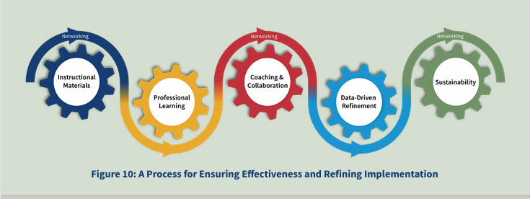
Building professional capacity takes time
Ohio’s Plan to Raise Literacy Achievement
Notes:
Lastly, we have learned that this graphic is ever so true- building capacity takes time. Just like we ask our schools to learn, collaborate, and refine, we, too, are part of the wheels; still working to strengthen adolescent literacy, so all students can graduate able to read and successfully be college and career ready. Thank you.

Slide 41
Ohio Literacy Achievement Team Contacts
Name | Title | Email
Rachel Ealy | Adolescent Literacy Specialist | Rachel.Ealy@education.ohio.gov
Sherine Tambyraja | Administrator, Literacy Achievement | Sherine.Tambyraja@education.ohio.gov
Kelsi Edrington | Adolescent Literacy Administrator & MTSS Literacy Coordinator | Kelsi.Edrington@education.ohio.gov
LM Clinton | Associate Administrator, Policy | LM.Clinton@education.ohio.gov
Liesl Huenemann | Associate Administrator, HQIM and CLSD | Liesl.Huenemann@education.ohio.gov
Stephanie VanDyke | Coaching Administrator | Stephanie.VanDyke@education.ohio.gov
https://education.ohio.gov/Topics/Learning-in-Ohio/Literacy
ReadOhio@education.ohio.gov

