Slide 1
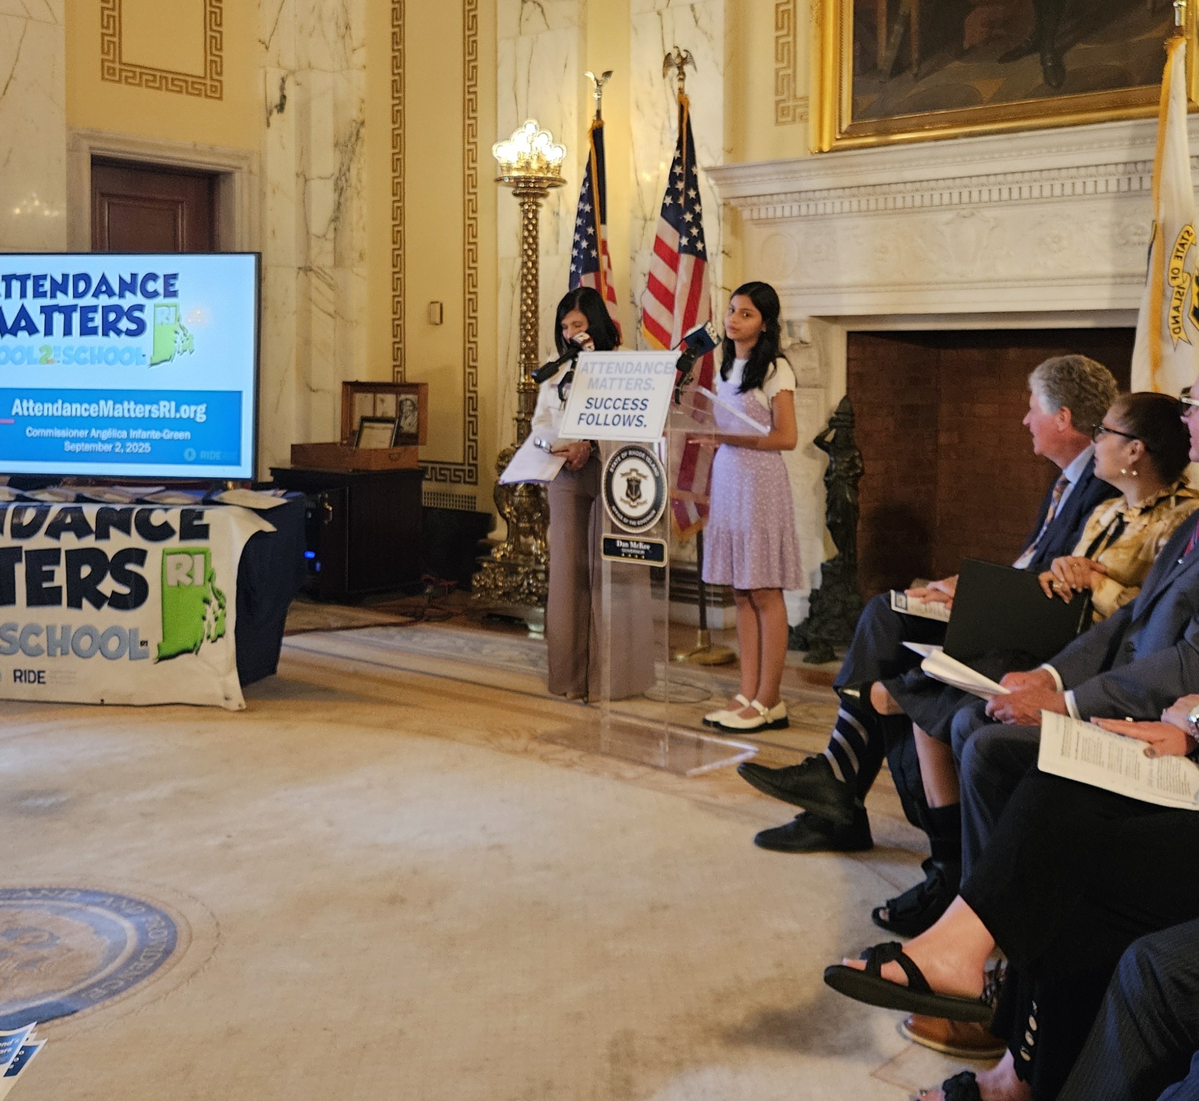

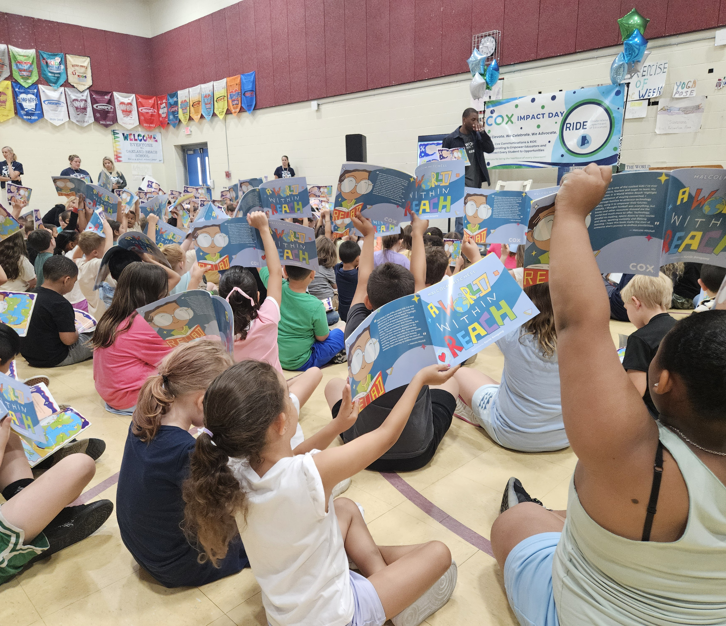
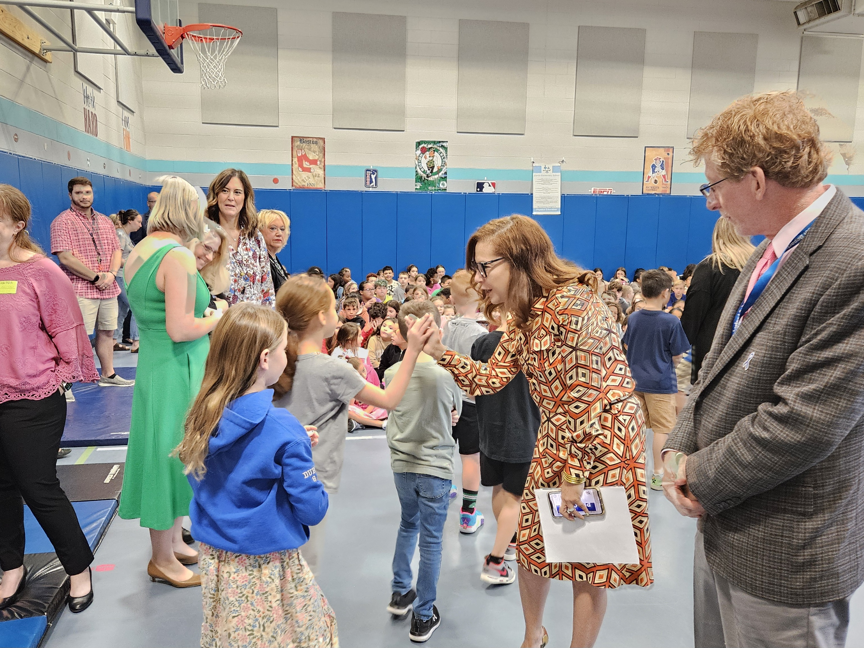


Rhode Island’s Attendance Matters Strategy
Stronger States, Stronger Outcomes Presentation
Brian Darrow – RIDE Chief of Innovation, Improvement, and Data
September 9, 2026
Notes:
Good Afternoon,
We’re pleased you could join us for a briefing of the 2025 assessment results.

Slide 2
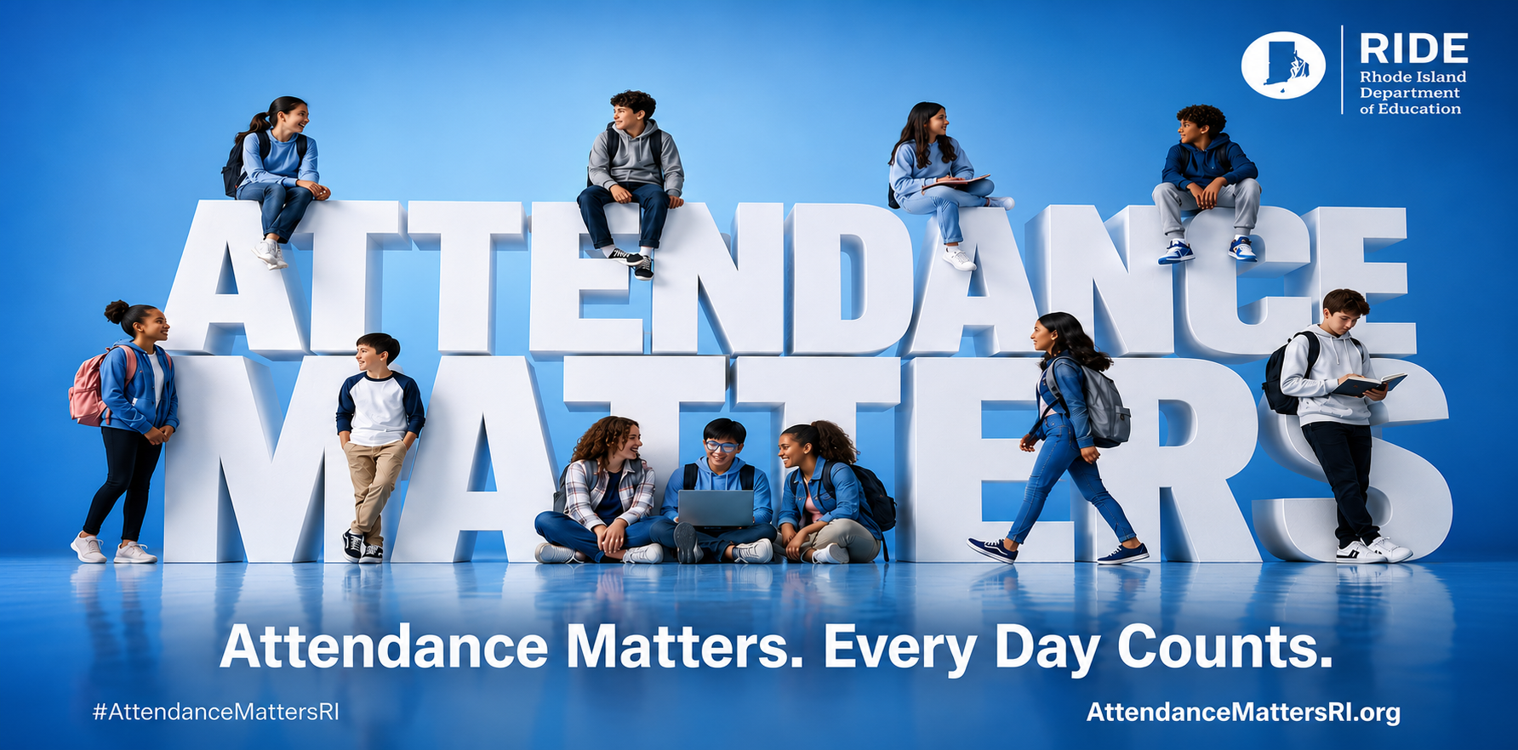
Looking Ahead

Slide 3
The Number of Chronically Absent Students in Rhode Island Has Dropped Significantly
34.1%
Chronically Absent
28.9%
Chronically Absent
SY20-21
SY21-22
24.7%
Chronically Absent
SY22-23
SY18-19
SY19-20*
27.6%*
Chronically Absent
SY23-24
SY24-25
SY25-26
19.1%
Chronically Absent
18.5%*
Chronically Absent
Reduced chronic absenteeism by 2.4%pts since last year and 14.4%pts since the height of the pandemic
Reduced absences equates recovering over 4.4M instructional hours since the pandemic

Slide 4
Student Subgroups Beating Pre-Pandemic Levels
Rhode Island’s most vulnerable student subgroups not only have made progress since the pandemic,
but have now actually improved beyond their pre-pandemic levels.
Student Subgroup | 2019-20 (Pre-Pandemic) | SY21-22 (Pandemic Height) | 2025-26 (Recent Year) | Improvement (vs. Pandemic High) | Improvement (vs. Pre-Pandemic)
Low-Income | 28.4% | 49.2% | 27.0% | -22.2% | -1.4%
Multilingual Learners | 27.8% | 48.2% | 23.3% | -24.9% | -4.5%
Differently-Abled Students | 25.5% | 39.7% | 24.6% | -15.1% | -0.9%
Notes:
1) Reduce Chronic Absenteeism
EOY Target: Reduce from 22.1% → 19.1% (-3.0 pts)
Year-to-Date: 23.8% → 19.4% (as of March 11, Day 120)
This reflects a 4.4 percentage point improvement year over year at this point in time, exceeding the pace needed to meet the full-year goal.
This is a significant and encouraging reduction, signaling strong impact from statewide efforts.
2) Improve Daily Attendance Rates
EOY Target: 93.0% (up from 92.1%, +0.9 pts)
Year-to-Date: 92.8%, a +0.6 point increase compared to the same time last year
This represents meaningful year-over-year improvement, continuing a positive upward trend in daily attendance.
If sustained, this would represent one of the largest gains in recent years, with continued opportunity to build on this progress through the remainder of the year.
3) Increase Recovered Instructional Hours
Through Day 120, Rhode Island has 130,892 fewer absences compared to last year
Adjusted for enrollment changes (~98% of prior year), this equates to over 708,500 hours recovered
This reflects substantial reclaimed learning time for students statewide and already surpasses the annual goal.

Slide 5
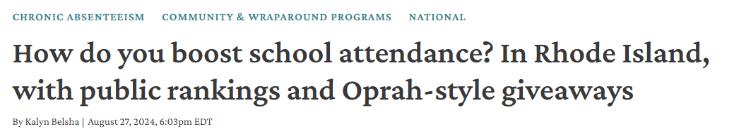

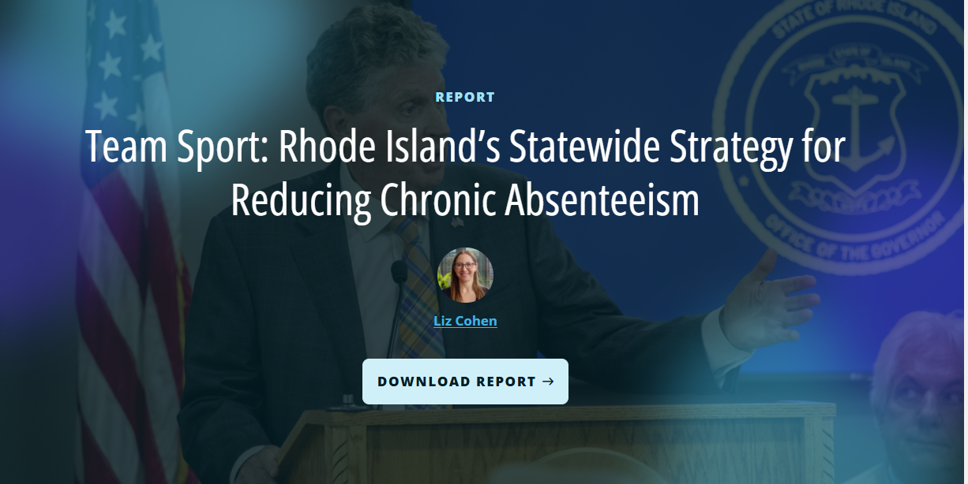

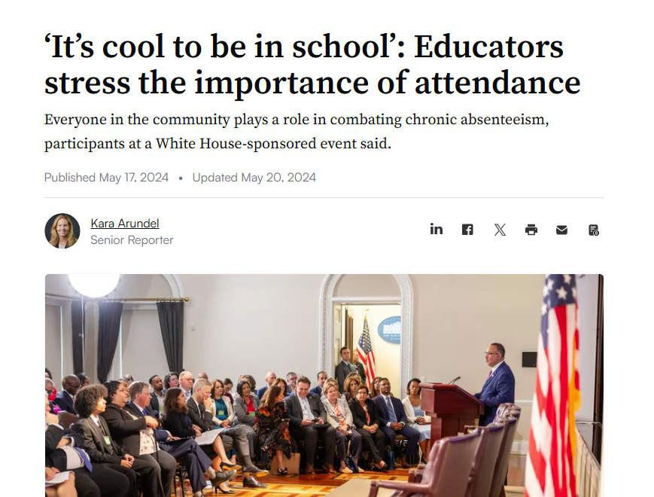

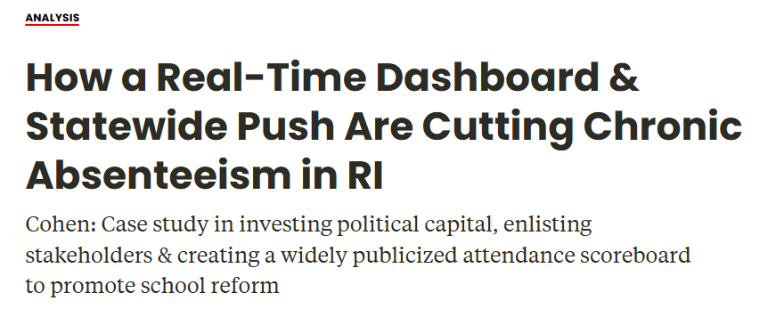
How Rhode Island is Improving Student Attendance
Rhode Island’s #AttendanceMattersRI strategy catalyzed a whole-of-state effort to improve student attendance focused on the following key elements:
Statewide, All-In
Communications Campaign and Partnerships
Real-time, Innovative Data
Dynamic Student & School Supports

Slide 6


Statewide Communications Campaign
Dynamic, aligned statewide messaging reinforcing that #AttendanceMatters.
Statewide messaging, driven by Governor McKee and Education Commissioner Infante-Green
Multimedia “AttendanceMattersRI” campaign, with social media and AttendanceMatters videos
Active statewide coalition - business, community, and city leaders all engaged through a statewide Chronic Absenteeism Working Group
Weekly press releases recognizing attendance leaders
AttendanceMattersRI.org website
Student video contest to uplift student voice

Slide 7

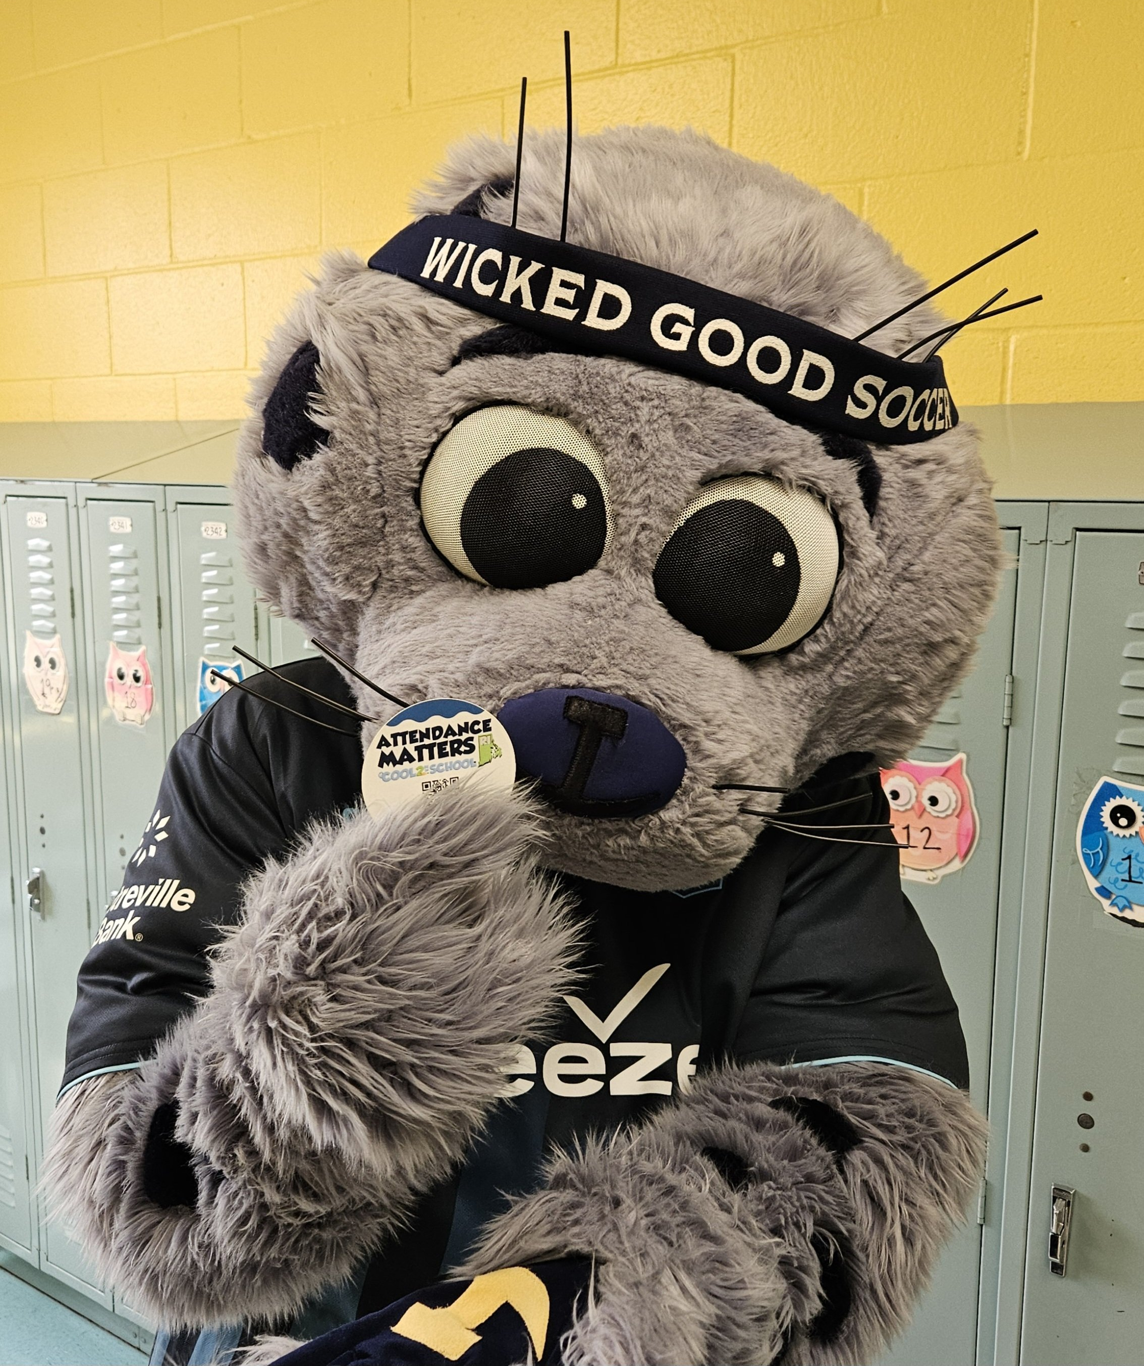
Campaign Spotlight: The RIFC Attendance Challenge
RIDE partnered with Rhode Island FC to launch the RIFC Attendance Matters Challenge, a weekly attendance challenge that awarded Rhode Island FC tickets to schools with high or improved attendance
Lasted April 27 and ends May 22 (4 weeks between April Vacation and Memorial Day)
Top 3 schools with the highest and most improved weekly attendance won free tickets to RIFC’s June 6 Kids Night game
  Over 700+ free tickets awarded to 24 winning schools across the 4-week challenge
  Winning schools also awarded buy-one, get-one-free student tickets
Recognized RIFC as an “Attendance Champion” – inspired by the CAWG and replicable model for future partnerships
Joint messaging – whether it’s showing up for school or RI’s favorite soccer team, Attendance Matters

Slide 8
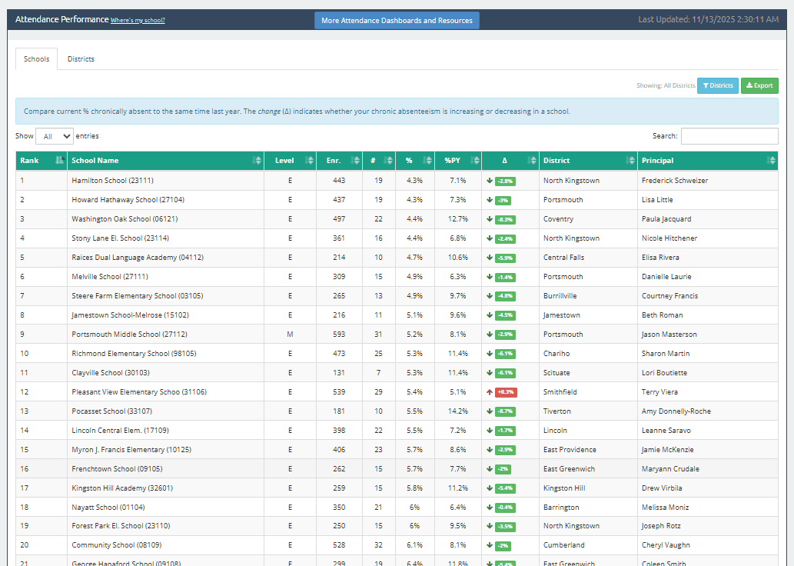
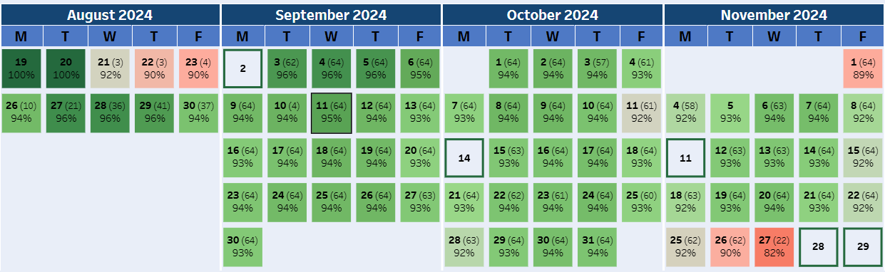
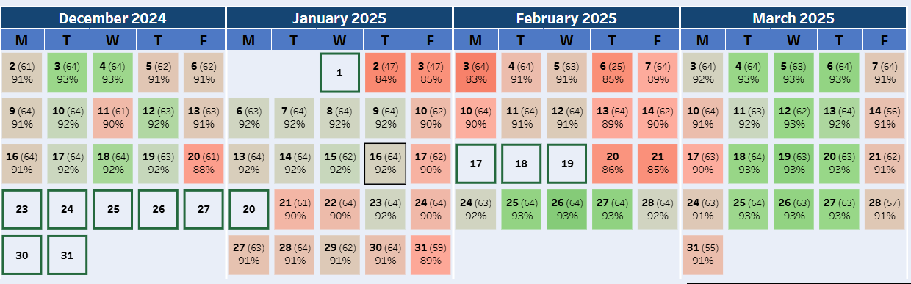
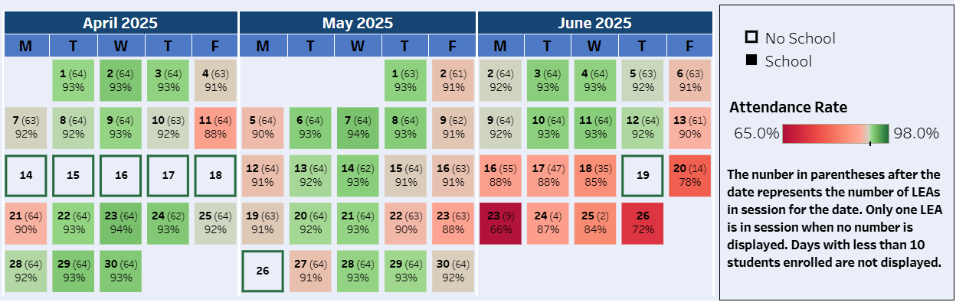
Real-Time, Innovative Data: Data Tools
Real-Time School Chronic Absenteeism Leaderboard
School Calendar Attendance Heat Map

Slide 9
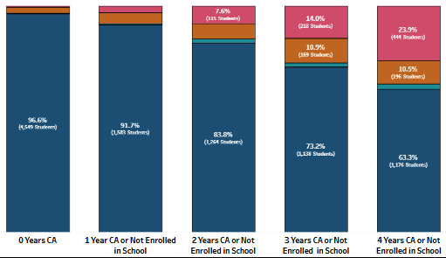
Real-Time, Innovative Data: Student Impact
Connecting chronic absenteeism to student outcomes is critical. Rhode Island was the first state to publish performance results, broken out
by chronic absenteeism:
Assessment results: students who were not chronically absent performed at rates 2x higher
Graduation rates: less than 60% of students
who were chronically absent throughout high school graduated in four years
The impact of chronic absenteeism starts in kindergarten
Improving attendance improves assessment results by 7-10% points year over year
4-Year Graduation Rates vs. Student Chronic Absenteeism

Slide 10

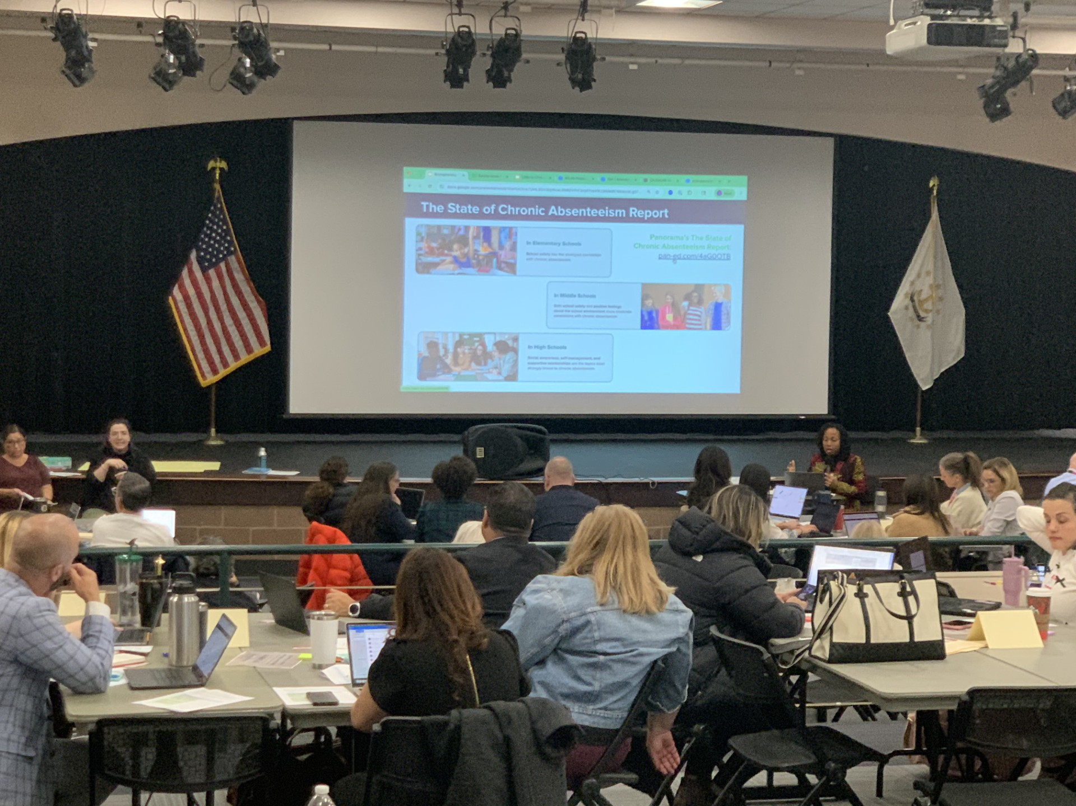
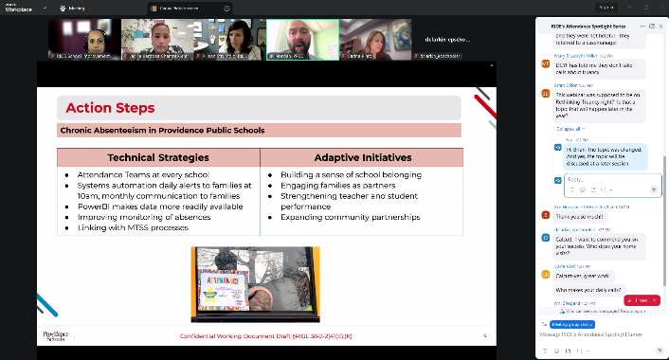
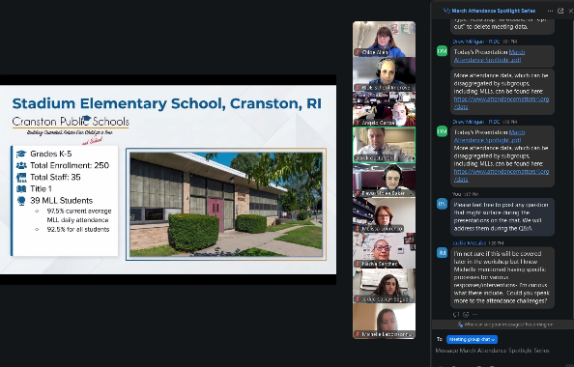
Dynamic Supports for Schools
Over 1000 educators statewide have engaged in RIDE professional learning this year, focused on building capacity at the school and district level to improve student attendance.
Clear attendance goals for the state, districts, and schools
Building data-driven attendance teams through a year-long professional learning cohort
Attendance “Spotlight Series” – uplifting best practices directly from the field
Professional learning series connecting mental health to student attendance
Focused, intensive supports for RI’s lowest-performing schools
Notes:
Spotlight: 140+
Panorama: 68
Bradley: Around 640 (40 per session, 16 sessions so far)
1:1 visits/technical assistance from fellow: 36 (16 LEAs, 20 schools)
143 enrollees, 67 completers - Bridge

Slide 11

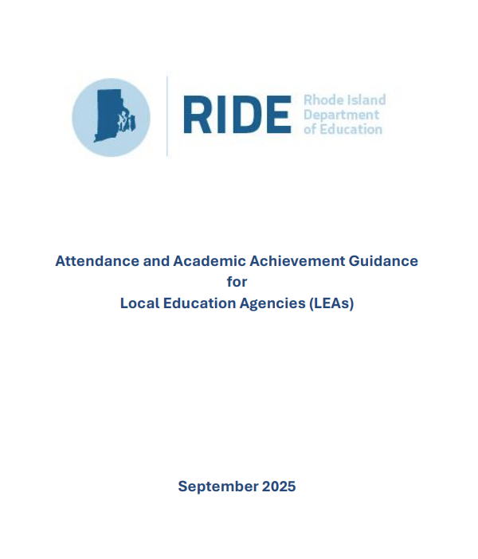

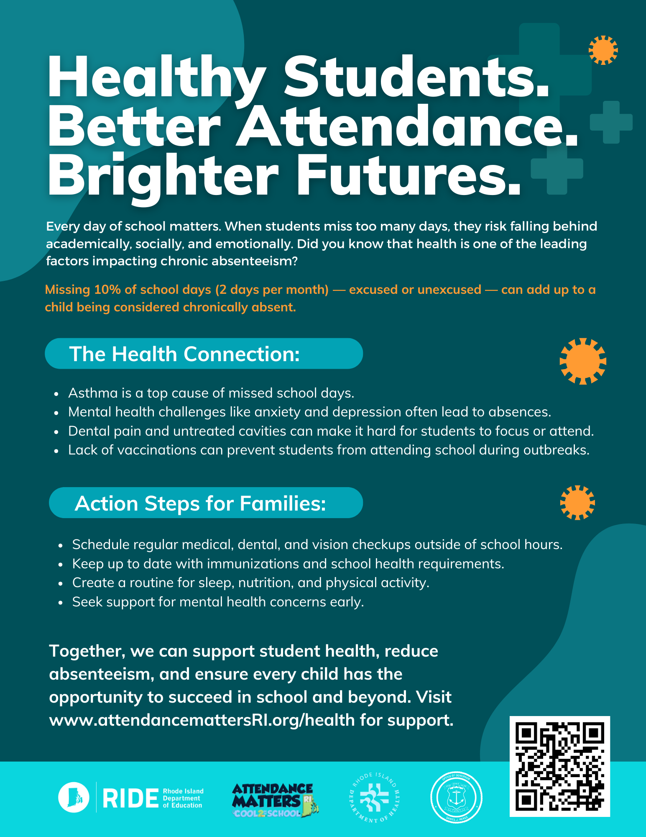
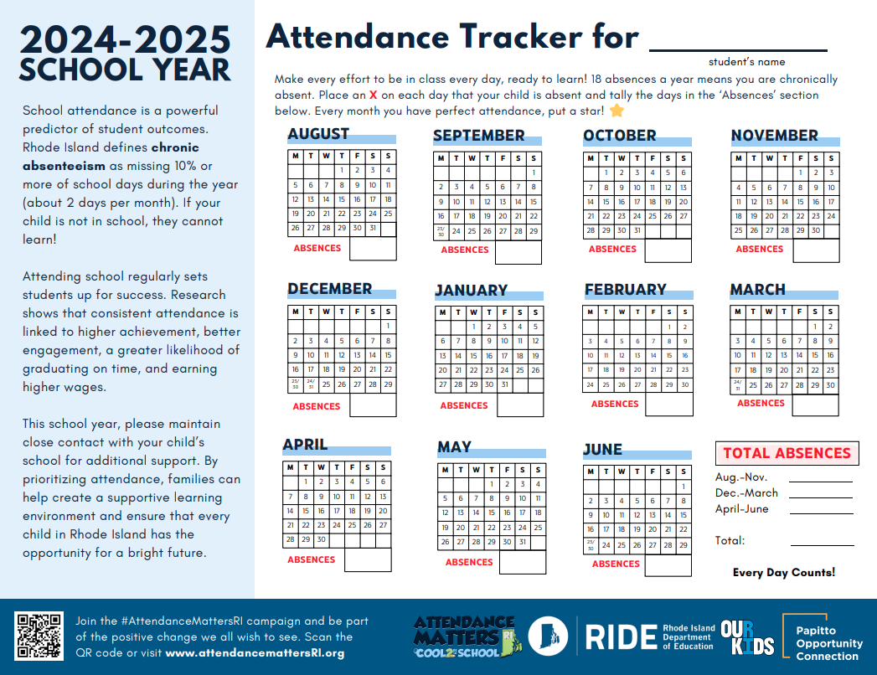
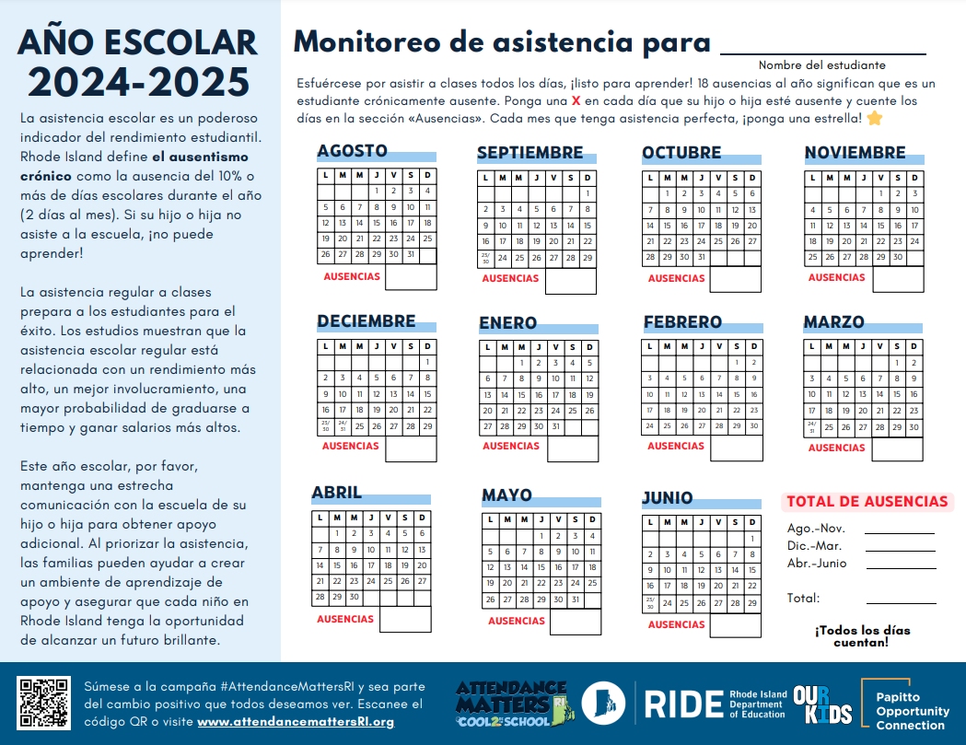
Dynamic Supports for Students
Mental Health Supports for Every Student
Multi-tiered student supports, connecting attendance and academic achievement
School Calendars for Every Family
Connecting chronic absenteeism with pediatric health and school nurses

Slide 12
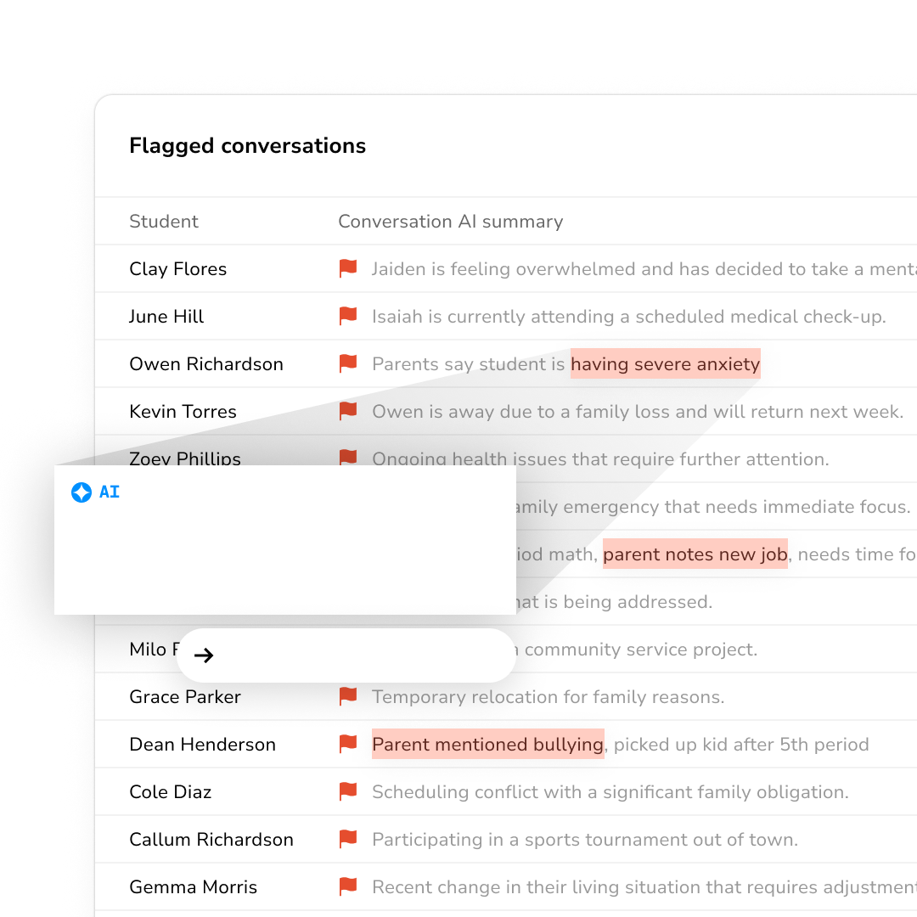
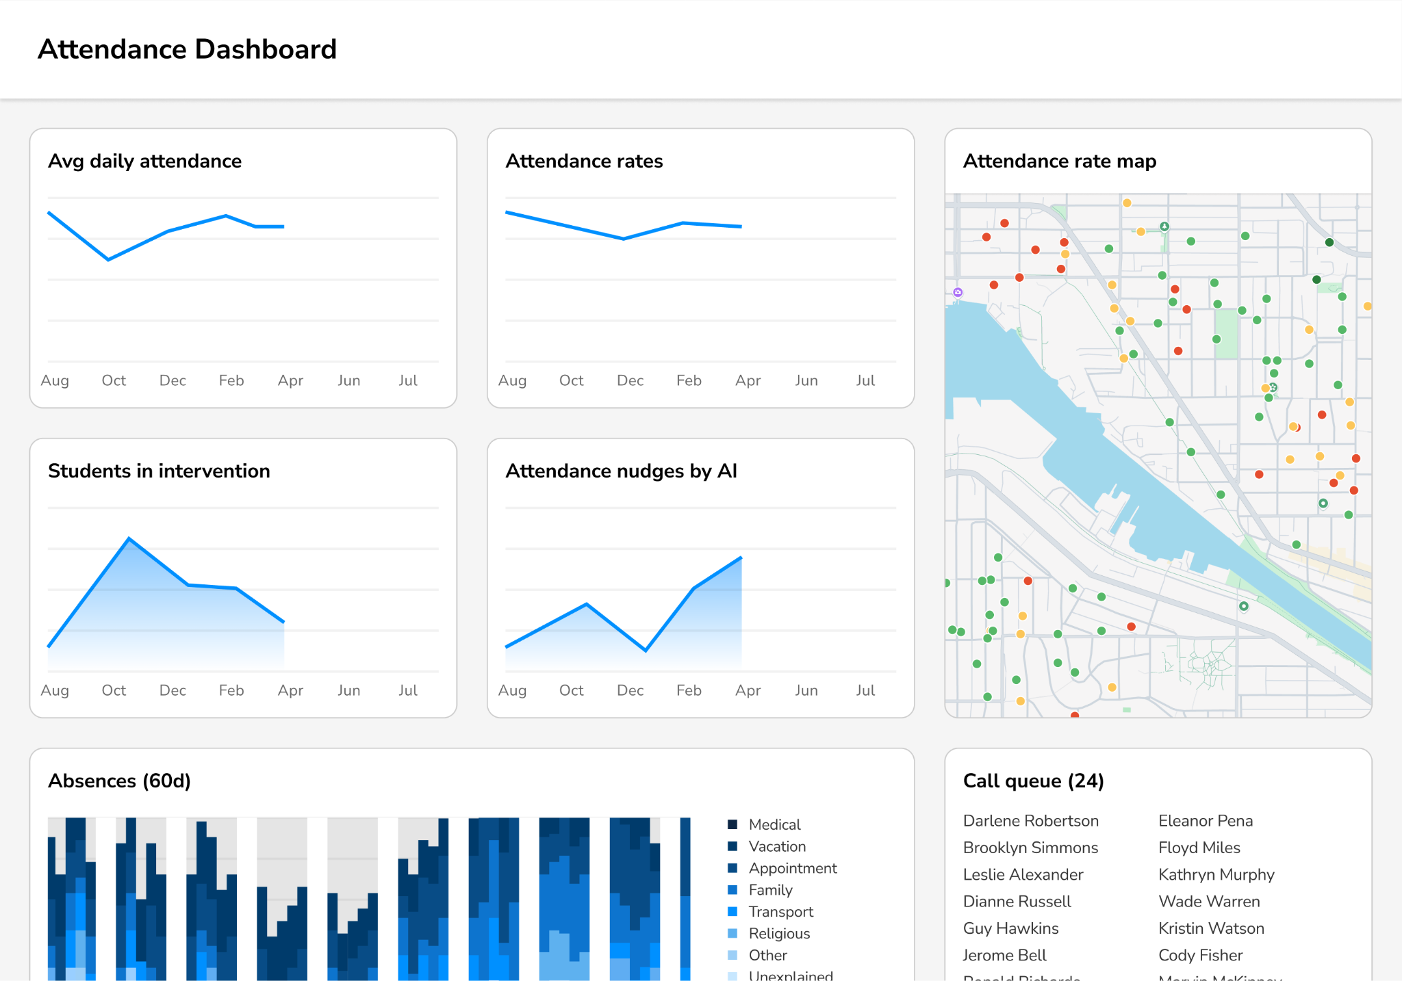
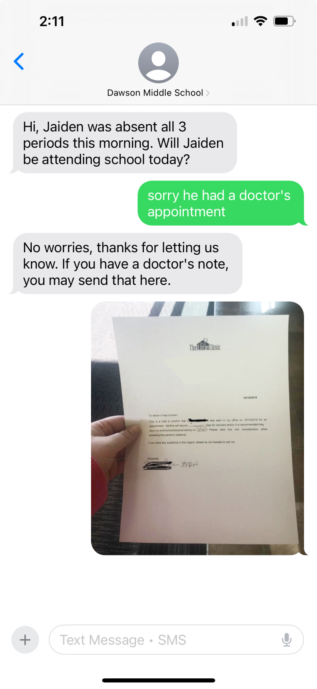
New: Statewide AI Partnership to Improve Attendance
RIDE is launching a first-of-its-kind statewide AI initiative to help schools better engage families more effectively and reduce chronic absenteeism.
Through this partnership, schools will now be able to leverage AI to:
Engage families within minutes of unexplained absences, in over 100+ languages
Create personalized attendance intervention plans using evidence-based strategies, based on each student’s needs
Provide real-time attendance insights to identify and address trends at the school and district level
Three-year partnership at no cost to RIDE or participating schools. Formal announcement planned for late August.
Student is having severe anxiety after moving to new school
Mental health counseling

Slide 13

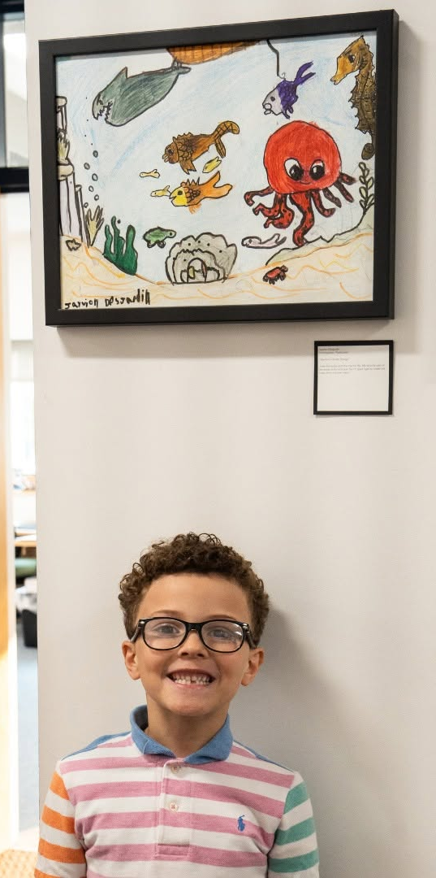
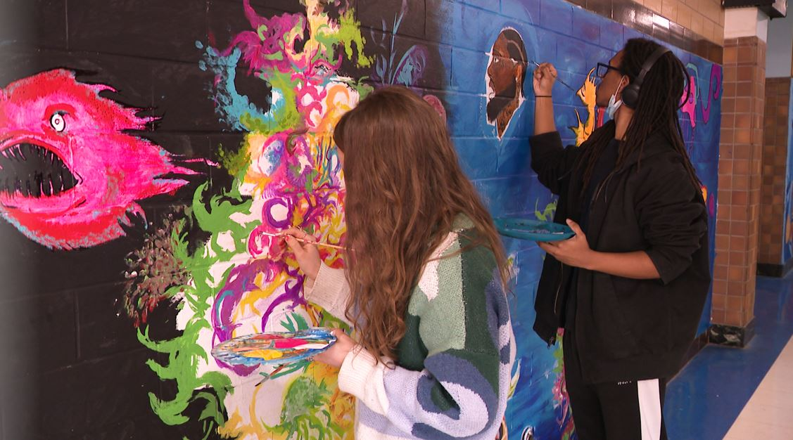
New: Statewide Student Attendance Arts Competition
RIDE is partnering with the Rhode Island State Council on the Arts on a statewide student arts competition to elevate student voice and reinforce the importance of showing up every day.
Recent research found that students meaningfully engaged in the arts experience lower rates of chronic absenteeism.
Building on these findings, RIDE and RISCA are launching a statewide student arts competition inviting students in every grade to share, through original artwork, what inspires them to show up to school each day.
Engaging art educators across the state in this challenge. Winners will be showcased at the state house in Spring 2027.

Slide 14
Recap: RIDE’s #AttendanceMattersRI Strategy
Rhode Island’s #AttendanceMattersRI strategy catalyzed a whole-of-state effort to improve student attendance focused on the following key elements:
Statewide, All-In
Communications Campaign and Partnerships
Real-time, Innovative Data
Dynamic Student & School Supports

Slide 15

Questions?
For more information, please visit:
AttendanceMattersRI.org or e-mail Brian.Darrow@ride.ri.gov

