Slide 1



Building a Unified Statewide Framework for Family and Community Engagement in Alabama
National Comprehensive Center Convening |
Stronger States, Stronger Outcomes
Text
Notes:
Time: 2 minutes
Primary Speaker: Dr. Mackey
Speaker Notes:
Good morning, and thank you for the opportunity to share Alabama’s work around Family and Community Engagement. Today’s overview is really about a shift in how we think about this work at the state level.
For many years, family and community engagement has existed in many places across the agency. Different sections have supported families, communities, schools, and districts in important ways. That work matters, and it has created strong examples across Alabama. But as our needs have grown, especially around attendance, student belonging, academic recovery, and school improvement, we recognized that effort alone is not enough. We also need coherence.
The purpose of this work is not to replace local innovation or the strong work already happening in districts. The purpose is to create a clearer statewide structure so local innovation can connect to common language, aligned guidance, consistent supports, and shared expectations.
Today, we will briefly walk through how Alabama is moving from fragmented efforts to a more unified framework for Family and Community Engagement, or FACES, and how this work is being designed to support stronger outcomes for students, families, schools, and communities.
Transition:
To begin, let’s ground this in why engagement matters as part of the larger improvement system.

Slide 2
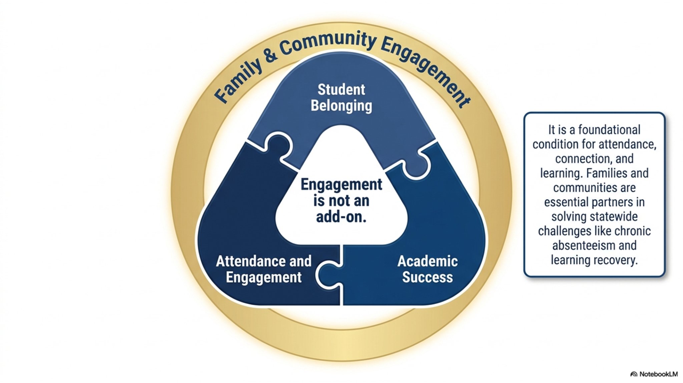
Text
Notes:
ime: 2 minutes
Primary Speaker: Dr. Mackey
Speaker Notes:
This slide captures one of the central messages of the work: engagement is not an add-on. Family and community engagement is a foundational condition for student success.
When students feel connected, when families understand how to support learning, and when communities are engaged as partners, we create stronger conditions for attendance, belonging, and academic growth. That is why Alabama is connecting family and community engagement directly to the larger goals of student learning and school improvement.
This is especially important as we think about chronic absenteeism and learning recovery. These are not challenges schools can solve in isolation. They require relationships, trust, communication, and shared ownership with families and community partners.
So, the message is simple but important: FACES is not separate from school improvement. It is part of the infrastructure that helps school improvement actually take hold.
Transition:
And that leads us directly to the challenge we identified: the issue is not a lack of effort. The issue is alignment and coherence.

Slide 3
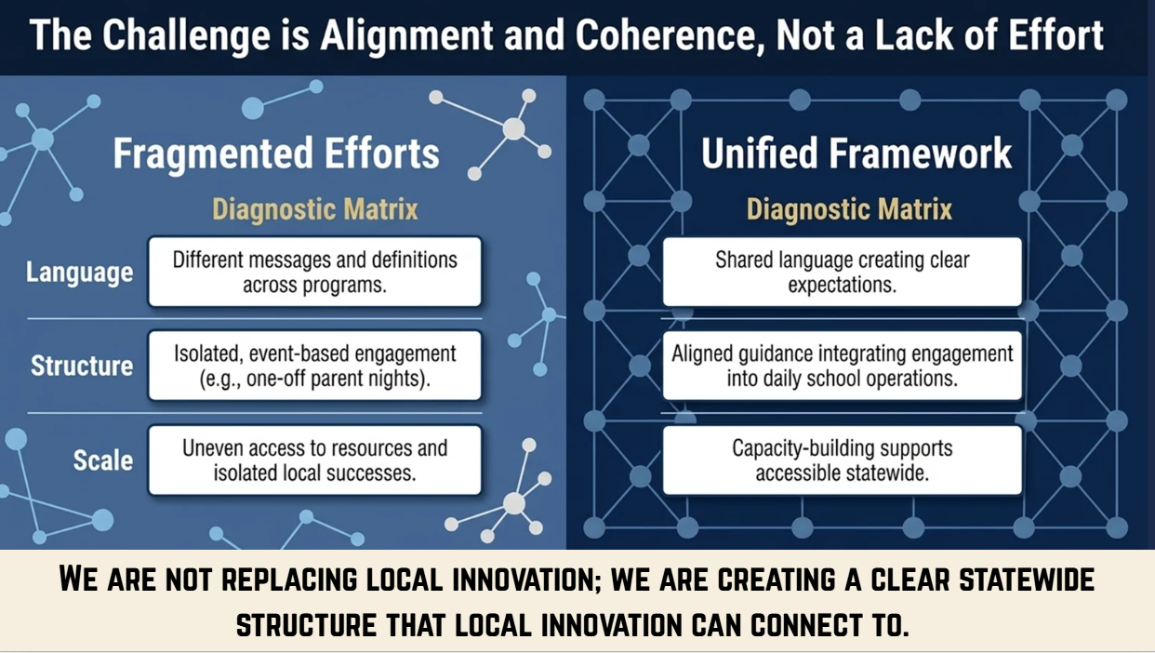
Text
Notes:
Time: 2.5 minutes
Primary Speaker: Dr. Shields
Speaker Notes:
This slide names the problem we are trying to solve. Alabama has not been lacking effort in family and community engagement. In fact, many teams across the agency have been supporting this work in different ways.
The challenge is that when different sections are using different messages, definitions, tools, and resources, districts can experience that support as fragmented. One section may emphasize compliance. Another may emphasize parent communication. Another may focus on attendance. Another may focus on community partnerships. All of those pieces are important, but without a shared structure, they can feel disconnected at the local level.
Our goal is to move toward a unified framework that provides shared language, aligned guidance, and capacity-building supports that can be accessed statewide. This does not mean every district does the same thing in the same way. It means districts have a common structure they can adapt to their local context.
That distinction is important. We are not replacing local innovation. We are creating a statewide structure that local innovation can connect to.
Add This Work Update:
This is also why the agency has been working to bring the pieces together across sections. Instead of multiple sections having separate FACES-related efforts, we are moving toward one more coherent message, one set of aligned supports, and one clearer pathway for districts to understand how the work connects to student outcomes.
Transition:
So, what does that unified framework look like? The next slide shows the foundational pillars.

Slide 4
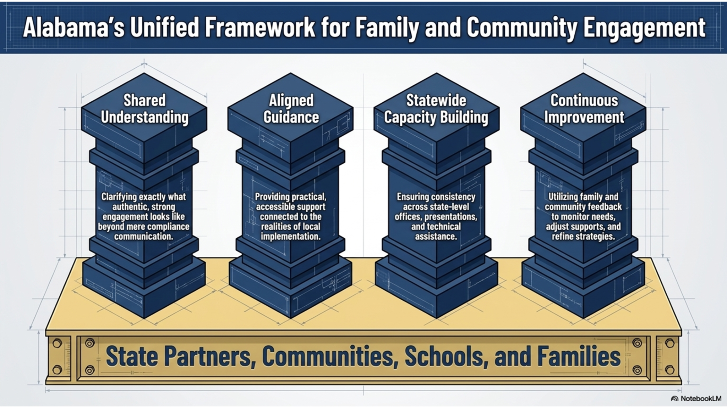
Notes:
Time: 3 minutes
Primary Speaker: Dr. Shields, with handoff to Kristie Shankles
Speaker Notes:
This framework is organized around four big ideas: shared understanding, aligned guidance, statewide capacity building, and continuous improvement.
First, shared understanding means we are clarifying what authentic, strong engagement looks like. This moves us beyond thinking of engagement only as communication, events, or compliance documentation.
Second, aligned guidance means we are updating and expanding resources so they are practical, accessible, and connected to the realities of local implementation. Districts need guidance they can actually use, not just guidance that sits on a shelf.
Third, statewide capacity building means we are working toward consistency across state-level offices, presentations, and technical assistance. When districts hear from ALSDE, they should hear a coherent message about what engagement is and why it matters.
Fourth, continuous improvement means we will continue to listen to families, communities, schools, and districts. Feedback should inform how we refine resources, adjust supports, and strengthen implementation over time. [FACES thoughts | PDF]
Suggested Handoff to Kristie Shankles:
At this point, I want to ask Kristie Shankles to speak briefly about how this work is being operationalized through guidance development, modules, and statewide communication structures.
Kristie Shankles Add-On Notes:
Thank you. One of the concrete pieces of this work has been updating the guidance so that it reflects implementation, not just compliance. We are also creating slide deck modules that can be rolled out in the fall. These modules are being designed so they can be used together as part of a broader professional learning sequence, but also as standalone resources when districts or regional teams need targeted support.
Another important step has been creating a listserv through the Education Directory to identify LEA points of contact for family and community engagement. That has not existed before in this way. Having a clear point of contact gives us a more reliable communication structure and helps us build a statewide network for sharing resources, guidance, updates, and opportunities.
Transition:
The next slide shows how we are thinking about the work as an ongoing cycle, not a one-time product.

Slide 5
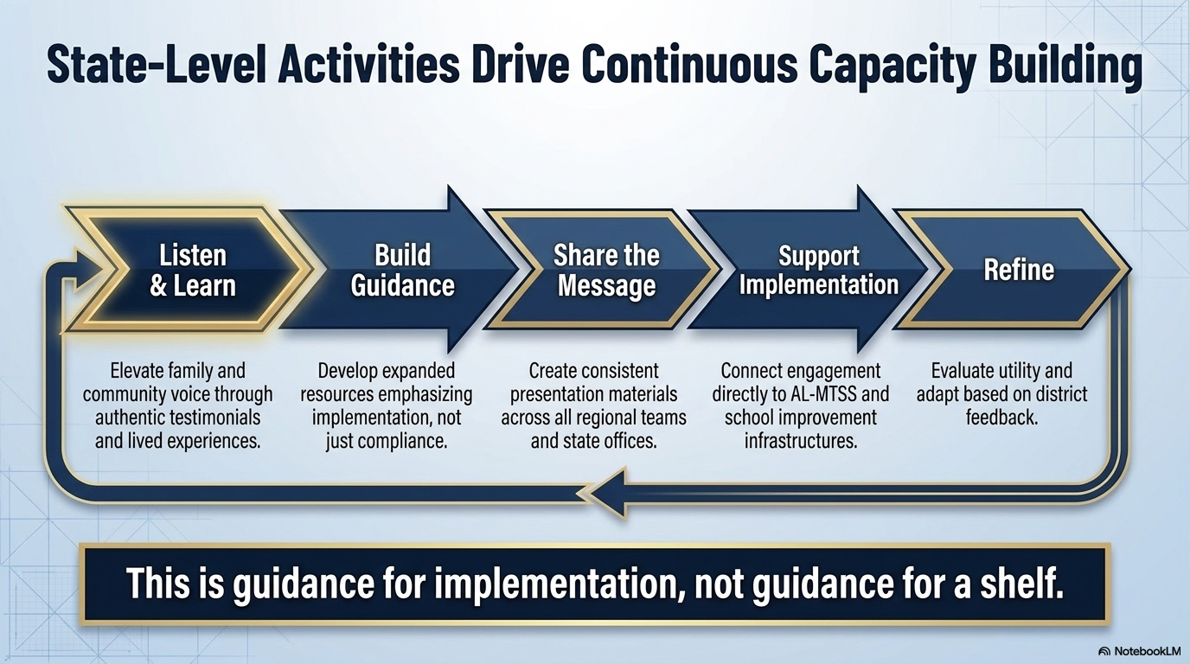
Text
Notes:
Time: 2.5 minutes
Primary Speaker: Kristie Shankles
Speaker Notes:
This slide shows the cycle we are using to guide the state-level work: listen and learn, build guidance, share the message, support implementation, and refine.
We began by listening and learning. That includes elevating family and community voice through authentic testimonials and lived experiences. This matters because family engagement cannot be designed only from a state-office perspective. It has to be grounded in how families and communities experience schools.
From there, we are building guidance that emphasizes implementation. The goal is to provide practical tools, examples, and language that help districts understand what strong engagement looks like in daily practice.
The next step is sharing the message consistently. That means using common language across presentations, state offices, regional teams, and technical assistance settings. This is also where the fall slide deck modules become important. They give us a consistent set of materials that can be used across multiple settings.
Then we support implementation by connecting engagement directly to AL-MTSS and school improvement infrastructure. Engagement should not be a separate initiative. It should help strengthen the systems districts are already using.
Finally, we refine. We will continue to evaluate whether the guidance and resources are useful and adapt based on district feedback.
Transition:
One of the strongest examples of why this work matters right now is attendance.

Slide 6
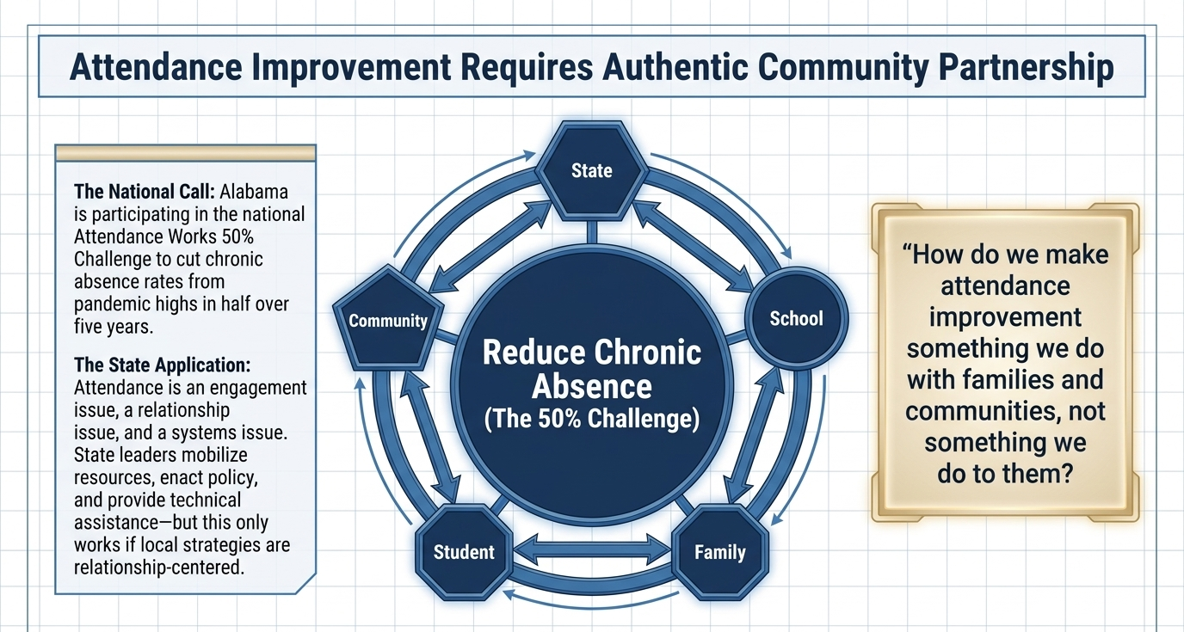
Text
Notes:
Time: 2.5 minutes
Primary Speaker: Dr. Mackey or Dr. Shields
Speaker Notes:
Attendance is one of the clearest examples of why family and community engagement must be part of the improvement system.
Alabama is participating in the national Attendance Works 50% Challenge, which focuses on cutting chronic absence rates from pandemic highs in half over five years. But attendance improvement is not only about sending letters or tracking numbers. Attendance is an engagement issue, a relationship issue, and a systems issue.
The state role is to mobilize resources, enact policy, and provide technical assistance. But the implementation has to be relationship-centered at the local level. Schools must be able to work with families and communities in ways that are proactive, respectful, and supportive.
A key question on this slide is: How do we make attendance improvement something we do with families and communities, not something we do to them?
That question should guide our work. If families experience attendance efforts only as compliance or blame, we will miss the opportunity to understand barriers and build solutions. If they experience attendance efforts as partnership, we are much more likely to create sustainable change.
Transition:
And that is why partnership has been so important in designing the work itself.

Slide 7
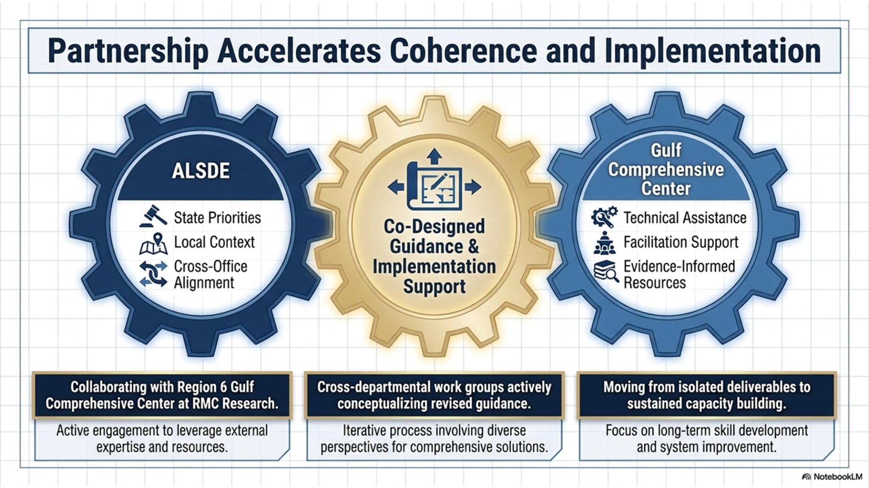
Text
Notes:
Time: 2.5 minutes
Primary Speaker: Lacy Wood
Speaker Notes for Lacy Wood:
From the Gulf Comprehensive Center perspective, this work has been about co-designing guidance and implementation support with ALSDE, not simply developing a product and handing it off.
The partnership allows us to bring technical assistance, facilitation support, and evidence-informed resources to the table, while ALSDE brings the state priorities, local context, and cross-office alignment needed for the work to be meaningful and sustainable.
This is important because statewide change requires both structure and relationships. The revised guidance, modules, and implementation supports are being conceptualized through an iterative process. The goal is not isolated deliverables. The goal is sustained capacity building.
The recurring Gulf Center-ALSDE Family and Community Engagement Planning Meetings also show that this is active, ongoing planning work with ALSDE and Gulf partners
Transition:
As we think about statewide coherence, the next slide names the design principles that are guiding the work.

Slide 8
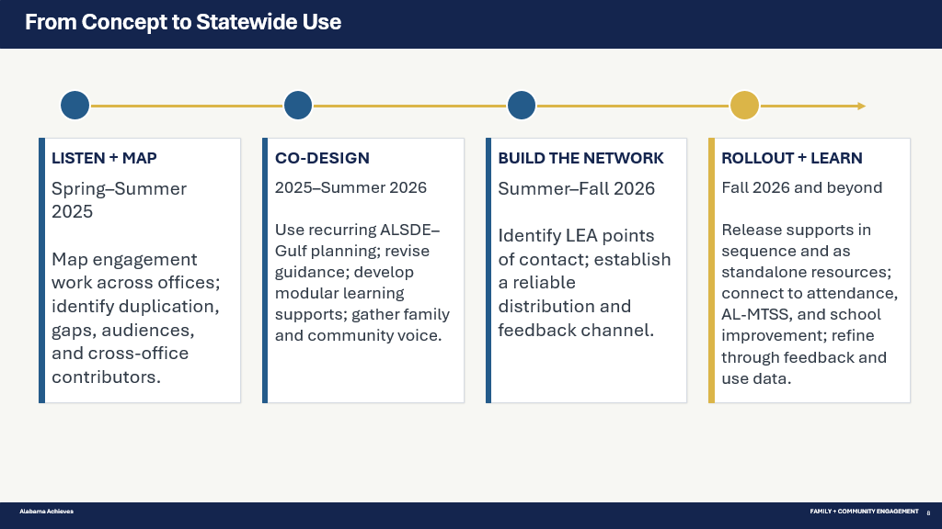


Slide 9
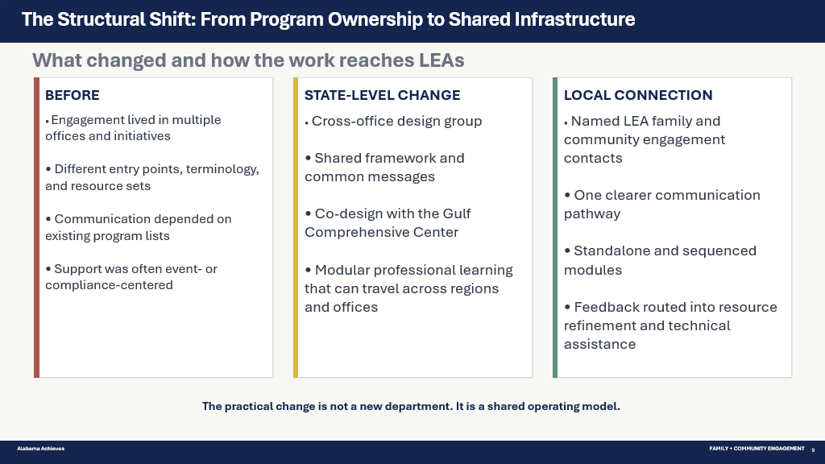

Slide 10
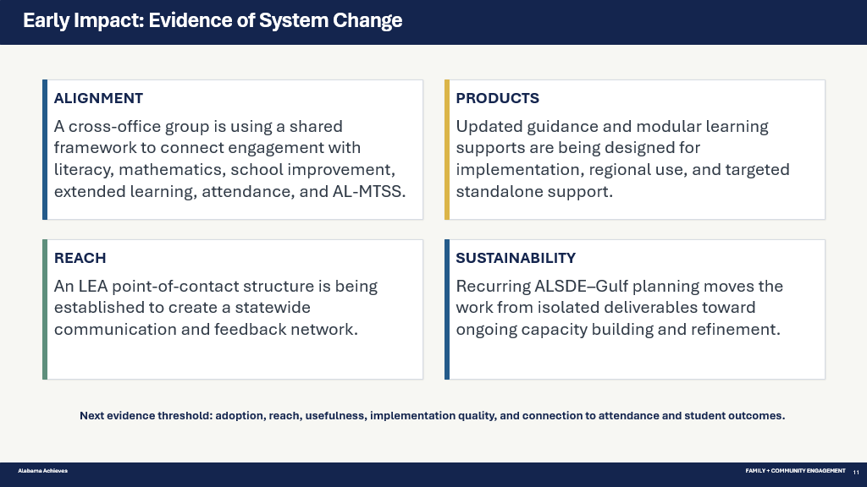

Slide 11
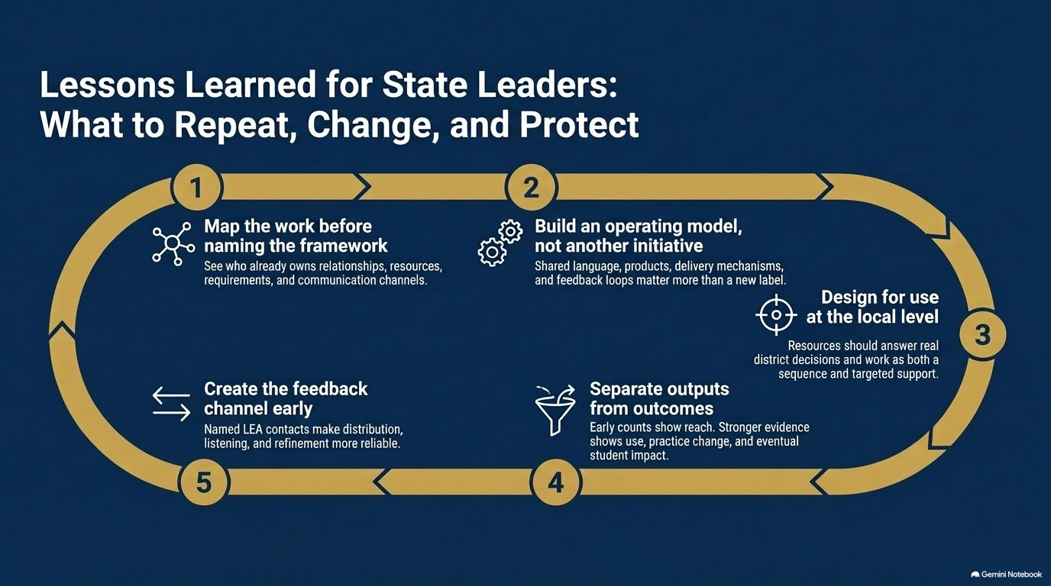


Slide 12
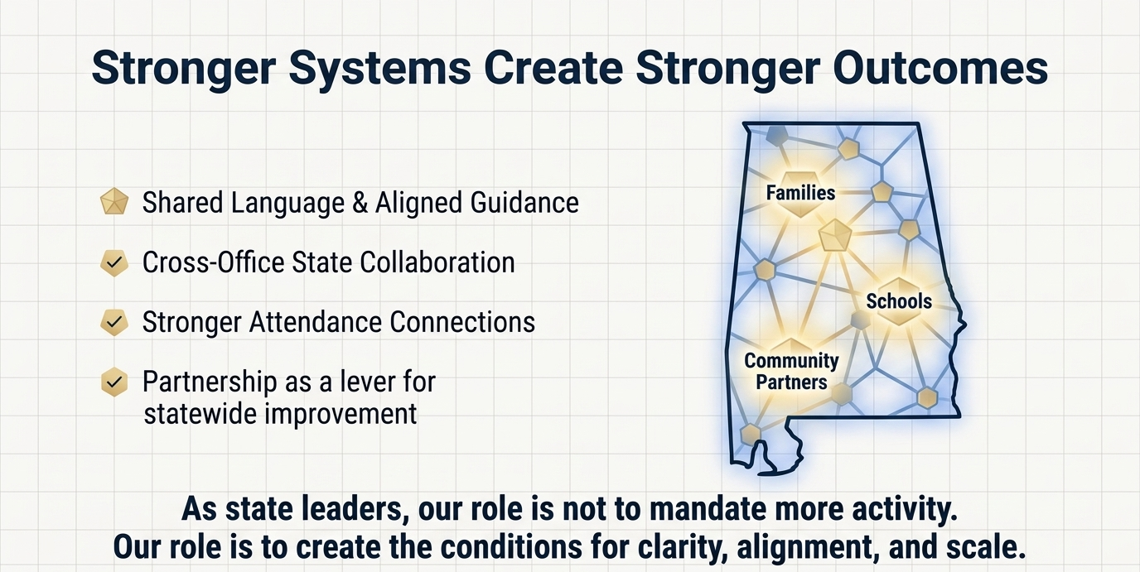
Text
Notes:
Time: 1 minute
Primary Speaker: Dr. Mackey
Speaker Notes:
As we close, this slide summarizes the direction of the work.
We are building shared language and aligned guidance. We are strengthening cross-office state collaboration. We are connecting family and community engagement more intentionally to attendance. And we are using partnership as a lever for statewide improvement.
The role of state leadership is not simply to mandate more activity. Our role is to create the conditions for clarity, alignment, and scale.
That is what this unified FACES framework is designed to do. It honors the good work already happening locally, while creating a stronger statewide structure to support it. It helps us move from isolated efforts to connected systems. And ultimately, it keeps the focus where it belongs: stronger outcomes for Alabama students, families, schools, and communities.
Closing Line:
Thank you for the opportunity to share this work. We are excited about the direction, the partnership, and the opportunity to support districts more coherently as this guidance and the fall modules are rolled out.

