Slide 1
Rural Innovation in Action
Aligning Education, Workforce, and Housing Systems for Community Impact
September 9, 2026
Keith Perrigan, Vickie Ratliff,
Mayana Rice, and Lori Vandeborne

Slide 2
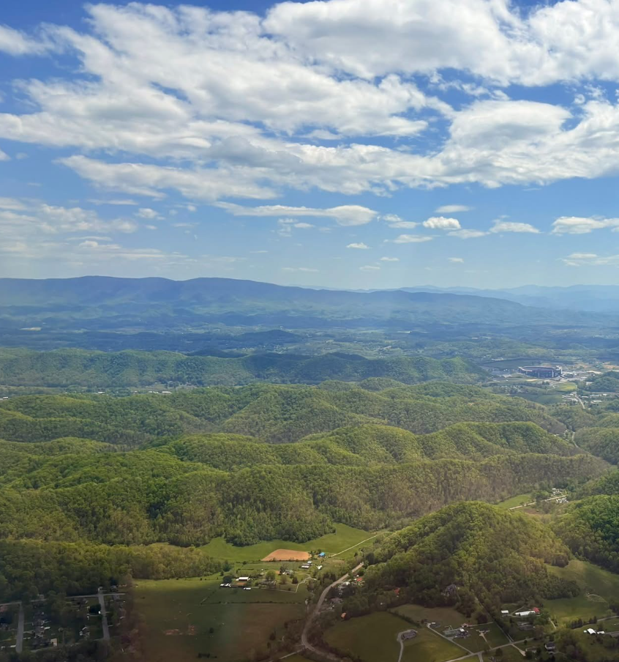
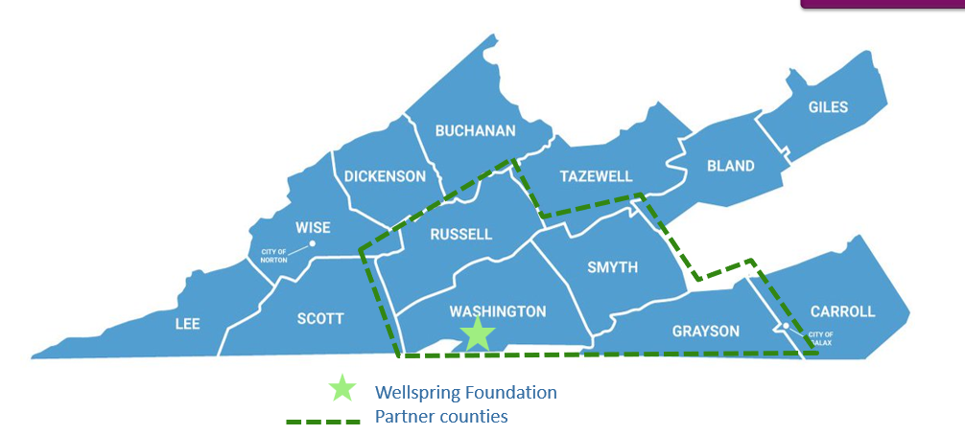
A Local Problem
Requires a Local Solution

Slide 3



Working Together
Southwestern Virginia faces an affordable workforce housing challenge for medical professionals
AHHP and the Wellspring Foundation identified an opportunity to design a local solution with the community
Their significant investment in the community is a critical piece to the success of this project
Notes:
Non-Profit wholly owned subsidiary of Wellspring Foundation of Southwest Virginia
Developed from the Wellspring Foundation board’s understanding of a need for workforce housing
501c3 status obtained to “lessen the burden of Government”
Service Counties: Washington, Grayson, Russell & Smyth

Slide 4

Find a Champion: Washington County Public Schools

Slide 5

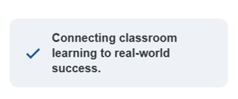
The Virginia Department of Education Three “E” Readiness Framework:
Enrollment, Employment, AND Enlistment
The 3E
Framework
High Demand Credentials
Six Approved High-Quality Work-based Learning (HQWBL) Experiences
Increased earning potential
Validate skills employers’ value
Strengthen career readiness
Open doors to opportunities
Registered apprenticeship
Internship
Supervised agriculture experiences
Entrepreneurship
Clinical experiences
School –based enterprise
Notes:
Lori
3E Readiness High School | Virginia Department of Education

Slide 6
People + Process = Success
People
AHHP
WCPS
VDOE
Appalachia CC
Process
Organizing frameworks
Partnership for logistics
Thought partnership
Focus on students
Expertise & resources
Nurturing trust
Success
Improved opportunities for students
Ongoing partnerships
Serving the needs of communities
+
=

Slide 7
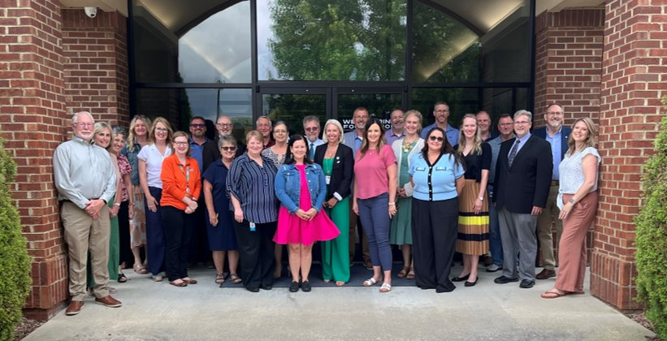
HOMEWorks Workgroup Meetings
People
Objective: To convene educational leaders, educators, community, industry, and local government partners to develop a strong, community‑based construction technology pathway that supports students, meets employer demand, and helps address regional workforce housing needs.
HOMEWorks connects education, workforce, community, and industry partners into one coordinated regional system guiding learners from career awareness to credentials, work-based learning, and employment in the trades.

Slide 8
HOMEWorks Workgroup
People
Career & Technology Instructors
Students
Superintendents
District-Leaders
CTE Directors
Higher Education
Education
Workforce
Community
Economic Organizations
Workforce Development Organizations
Employers
Industry Partners
Community Partners
Community Services Providers
Local or State Government Agency Representative
Philanthropic Partners

Slide 9

Process
Working Together:
Closing the SW Virginia Workforce Housing Gap
Construction Technology Education
Leveraging skills training across the continuum
High School Programs
CTE & trades pathways
Early career exposure
Community College
Certificates & degrees
Technical credentials
Adult Learning Programs
Apprenticeships
Upskilling & retraining
Dual Enrollment
Credentials
Student and Community Benefits
Skilled Pipeline
Affordable Housing
Career & Wages
Economic Impact
9

Slide 10
Level Setting, Program Review, Support Plans, and Implementation
Process
Gathering Data
Synthesis of Findings
Planning Supports
Implementation
Sustainability
Needs Sensing
Observation Overviews
Program Support Plans
Regional Design Plan
Individual Program Supports
Ongoing Partnership for Improvements
Regional Overview
Site Visit
2026–27
School Year
April–June 2026
June 2026
July - August 2026
Ongoing
10
10

Slide 11
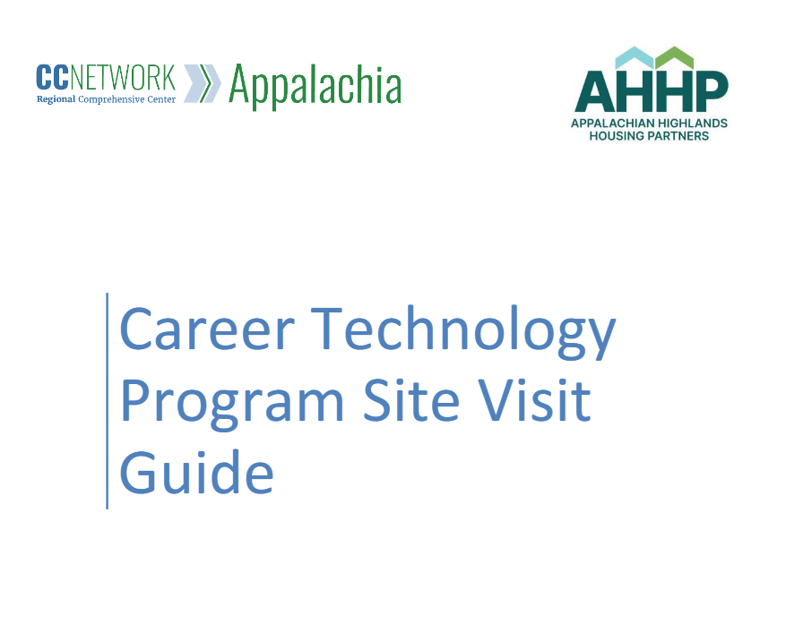
Gathering Data and Synthesis of Findings
4 Needs Sensing Visits
4 districts
3 Workgroup Meetings
Average 36 attendees
7 observers
# Programs
Notes:
4 Needs Sensing Visits (4 districts, 7 observers, # Programs)
Curriculum and instruction is occurring in the classrooms and aligned to industry recognized credentials. There is opportunities to make connections and establish access to high-demand credentials with the help of AHHP and the build site location.
Workgroup Meetings
There is no lack of quality assets and opportunities in the region. There is an opportunity to establish AHHP as a coordination hub for partnerships and pathways from career exposure to employment opportunities.

Slide 12
Successes and Lessons Learned
Success
Practical Advice:
Identify a Champion to move the work forward
Create roles and responsibilities for different levels of involvement
Establish regularly scheduled meetings
Map assets and opportunities with key stakeholders (present and not present)
Build a united approach
Successes:
Stronger partnerships
Better understanding of community needs
New ideas and approaches
Improved opportunities for students
Breaking down barriers to succeed
More and stronger relationships
Notes:
Lessons Learned:
It takes commitment and coordination
People want to be involved and help
Establishing a process to collaborate is imperative
We have the assets and opportunities
Building a united approach will be key to success

Slide 13
Questions?

Slide 14
Thank you!
kperrigan@wcs.k12.va.us
lvandeborne@aemcorp.com
AHHPConsultant@ahhpva.org

Slide 15
The contents of this presentation were developed under a grant from the U.S. Department of Education (Department). The Department does not mandate or prescribe the practices, models, or other activities described or discussed in this document. The contents of this presentation may contain examples of, adaptations of, and links to resources created and maintained by other public or private organizations. All external links cited in this resource were reviewed for compliance with all federal regulations in effect at the time of publication; however, the Comprehensive Center Network is not responsible for subsequent changes to those external sites or for any content beyond the specific material referenced. External links are provided solely to support the research, examples, analysis, and conclusions presented in this resource and do not constitute endorsement of any broader site content. The content of this presentation does not necessarily represent the policy of the Department. This presentation is not intended to represent the views or policies of, or be an endorsement of, any views expressed or materials provided by any federal agency. © 2026 Westat.

