Slide 1
Prevention and De-escalation of Challenging Behaviors
Christine Manning M.Ed/Spe., BCBA, LBA
Autism Conference 2026

Slide 2
Objectives
In our time together, we will:
Understand behavior
Learn a variety of prevention strategies
Learn de-escalation strategies

Slide 3


What We Thought!

Slide 4


What We Realize!

Slide 5


What We Thought!

Slide 6
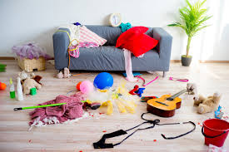

What We Realize!

Slide 7


We Need Tools!
The best predictor of future behavior is past, relevant behavior.
If we do things the same way and expect a different result, that is the definition of INSANITY!

Slide 8
Challenging behavior
Patterns of behavior that interfere with learning, engagement, social interactions, and independence.
Behaviors like…

Slide 9
Challenging behavior
Higher rates for people with autism
Deficits in communication
Skill deficits- social, academic, emotional, behavioral
Perceptions
Illness/discomfort
Technology
Difficulties at home and/or school….
Patterns and functions

Slide 10
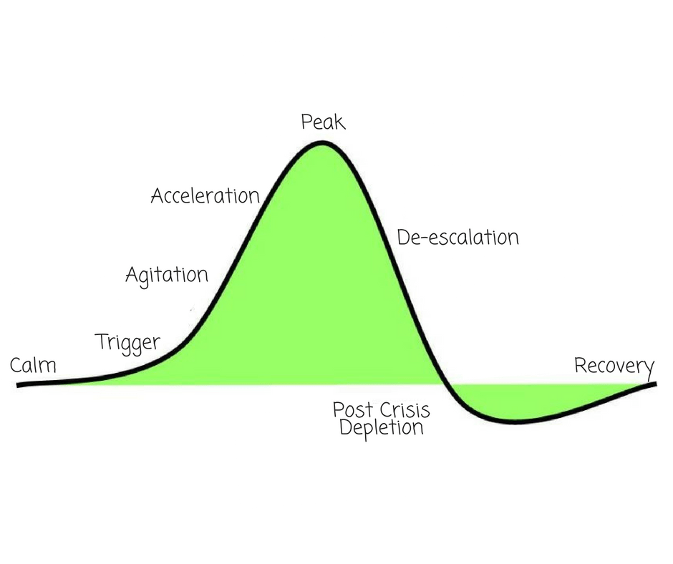
Challenging behavior

Slide 11

Prevention vs. De-escalation

Slide 12
Prevention and de-escalation
Prevention occurs prior to the occurrence of challenging behavior
  When? All day, every day
  Manage the environment
  Foresee needs
De-escalation occurs after challenging behavior has already begun
  This takes more effort, time, and resources
  Be the early worm!
  Know the triggers AND the strategies

Slide 13
Escalation Cycle

Slide 14
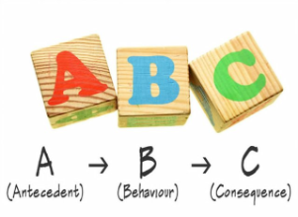
The ABC’s of Behavior
Antecedent-
What happens right before the behavior that may set the occasion for the behavior to occur?
Behavior-
What the person does
Consequence-
What happens AFTER the behavior occurs?

Slide 15
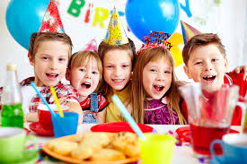
Common Home Antecedents
Bored, under stimulated
Overstimulated by noise, commotion, t.v., unknown
Nonpreferred activities
Being told “No”
Chores/expectations
Busy, late, rushing
Gaming time over
Dinner time!

Slide 16

Common School Antecedents
Transitions
Social times
Down time- Free choice
Work that is too difficult, too much
Boredom
Being told “No”
Unexpected events
Change in schedule/routine

Slide 17

Think it Through
What consequences occur after the behavior?
Consequences occur because of the behavior.
What happens after a behavior will either:
  Increase behavior
  Decrease behavior
  Maintain behavior

Slide 18
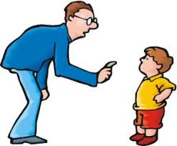
Common Home Consequences
Gets help
Gets out of doing something
Attention- good or bad
Back tickle
Sits on parent’s lap (comfort)
Snack
Reprimand
Falls asleep

Slide 19
Common School Consequences
Get out of work/class
Reprimand
Reminders/prompts
Praise
Attention- bad or good
Ipad
Ignored

Slide 20
A-B-C Diagram
Environmental Variables
Antecedent
Behavior
Consequence
Sets the Stage- may cause irritation
Sets occasion for behavior to occur
What does it look like/sound like?
Increase, decrease or maintain behavior

Slide 21
Environmental Variables
Basic Needs- water, food, safety, sleep
Lights
Noise level or certain sounds
Discomfort/pain
Emotional events/perceived emotional events
Home/school events
Medications
Classroom Instruction
Significant changes
Clutter/disorganization

Slide 22
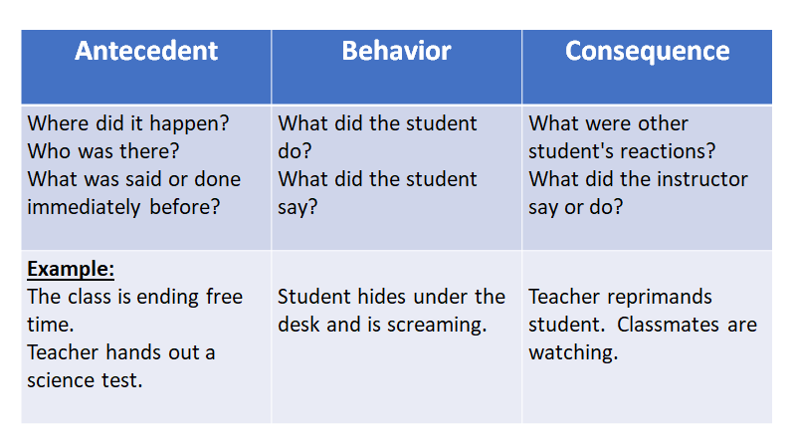

Slide 23

Home Scenario
Environment: Chaotic, kids excited, running, talking
Antecedent: Getting in the car to go to grandma’s house
Behavior: Screaming, running
Consequence: Mom yells, sibling try to help
Why is the child screaming?

Slide 24
Think it Through
When is the challenging behavior occurring?
  Time of day, subject in school, activity, transitions, mealtime
Who is present?
    Parents, friends, teachers, siblings
  What is the environment like?
  What are antecedent(s) may set the occasion for the behavior to occur?
  What consequences occur after the behavior?

Slide 25
School
  Root cause
  Look for patterns
  Hypothesize why behavior is occurring- what is the child trying to get or get out of?
  Reflect
    What can I do to prevent this behavior from happening again?

Slide 26
Home
Behavior: Josh is crying and refusing to go to school.
Antecedent(s): Dad says, “Time to wake up and get ready for school.”
Environmental variable(s):
  Mom just had a new baby
  Sleep is disrupted
  Change in routine, dad is taking kids to school
  Josh has difficulty with transitions
  Disorganization in the home

Slide 27
Home
Consequence: Josh gets to stay home from school today
Root cause of the problem
  Look for patterns
  When does the challenging behavior occur?
  Who is present?
  Hypothesize why the behavior is occurring
    Escape something, get access to something, attention, sensory

Slide 28

Prevention is proactive
Mindful prevention- be observant
Intervene early- BEFORE challenging behavior
Be consistent with implementation

Slide 29
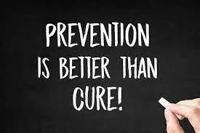
Prevention
Engineer the environment
Basic needs
Structure and predictability
Appropriate expectations
Provide “transition” supports
Teach skills that foster independence
Use pre teaching and prompting strategies

Slide 30
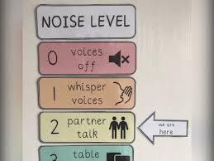
Environmental Engineering
School
Control noise level, lighting, and temperature
Provide transition warning
Provide structured transition
Visual supports
Avoid 4-letter words- like “test”
Use Behavior Momentum
Build reinforcing activities into the schedule

Slide 31
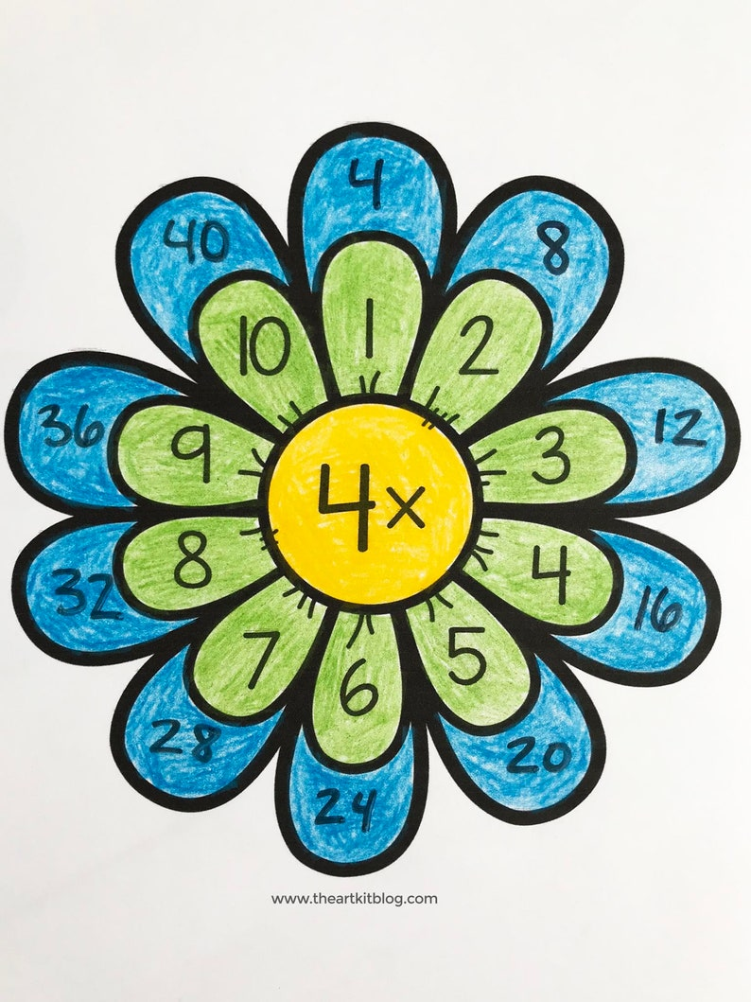
Environmental Engineering
Behavior Momentum Example: Math class
Come in and get your workbook vs. Come in and let’s sing math songs
Chillax time
Math songs
Math vocabulary and movement activities
Math lesson- I do, We do, You do
Math art- reinforcing activity

Slide 32
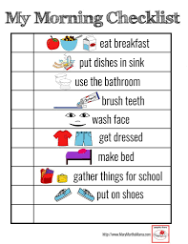
Environmental Engineering
Home
Ensure enough sleep
Use a visual schedule
Allow ample time for activities
Give praise
Structure transitions
Provide reinforcement for completed tasks
Alternate activities- up time/down time

Slide 33
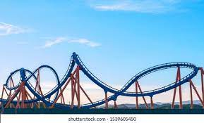
Environmental Engineering
Alternate activities example: Home
Wake up
Snuggle time
Get dressed
Breakfast
Brush teeth
Color
Go on a walk
Snack and movie

Slide 34

Basic needs
Healthy food, drinks, and snacks
Ensure access
Ample time
Preferences
Be aware of medications that may affect appetite
Sleep- good conditions at home, bedtime, nap
Safety- Inclusion, antibullying
Attention

Slide 35
Structure and predictability
School
Follow a schedule (daily and class) and review often
Have rules with consequences for following AND not following
Provide reminders prior to changing activities
Communicate changes in the schedule
Provide structured transitions
Enriched environment- what do students do when they are “done”?

Slide 36
Structure and predictability
Home
Follow a schedule
Have routines for morning, bedtime, meals, etc.
Keep mealtimes, bedtimes consistent (even on weekends)
Communicate and prepare for changes early

Slide 37
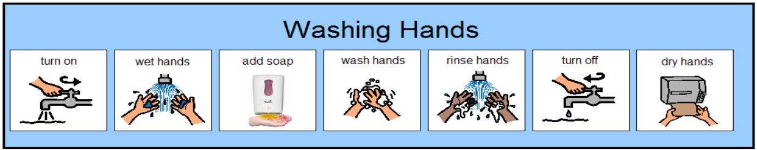
Set appropriate expectations
Set clear expectations
Know what each person can do
Provide support (visual schedules, partners, differentiate)
Teach and reinforce

Slide 38
Transition supports
School
Give preferred job/task
Teacher helper
Peer buddy
Visual supports- First- Then, Task analysis
Change up the warning signal (earlier, later, touch shoulder)
Explicitly teach new skills

Slide 39
Transition supports
Home
Give ample time
Provide visual supports as needed- Task analysis for routines
Be prepared with food, water, activities, etc.
Frequent reinforcement
Simplify expectations temporarily
Work with teacher upon arrival to school

Slide 40
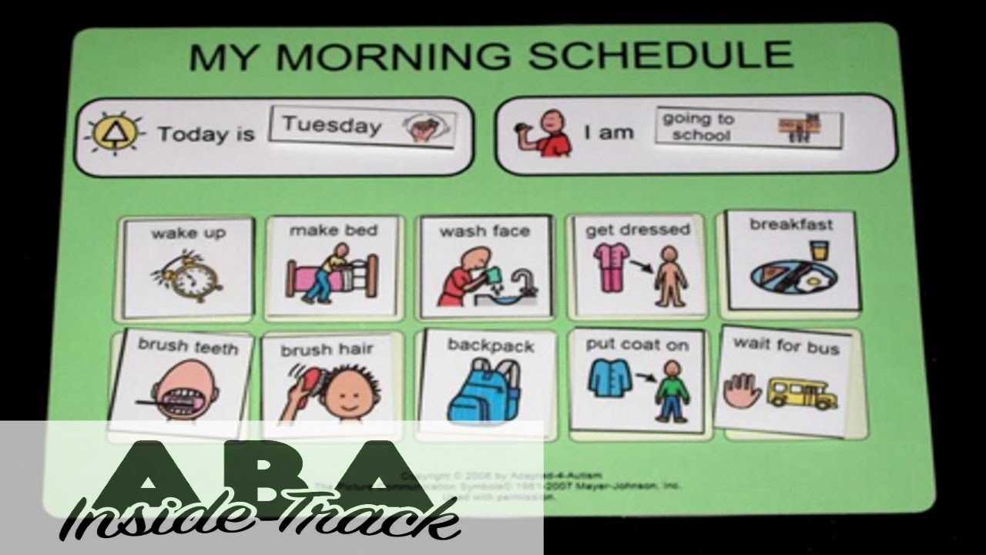

Slide 41


Teach skills to promote independence
Ask for help
Clean up toys
Transition appropriately
Ask for a break
Get dressed
Wash hands
Sit and eat a meal
Brush teeth

Slide 42
Pre teaching and prompting
Pre teach and provide reminders prior to periods of difficulty
Use a timer when/if appropriate
Teach and practice learning the skills, then prompt as needed
Provide visual support
Reinforce

Slide 43
More prevention strategies
Provide choice
Break bigger tasks into smaller chunks
Give breaks
Create and maintain good relationships
Be aware of sensory needs
Be consistent
Reinforce desired (good) behavior- praise and attention
Avoid coercion, threatening, and nagging
Be compassionate

Slide 44
Behavior escalation

Slide 45

Early warning signs
Not following instructions/off task
Whining, crying, sighing
“This is too hard; I can’t do it.”
Intervene early

Slide 46

Early-stage de-escalation
Remove or modify expectation temporarily
Assist in getting started or do with
Redirect
Increase opportunities for success
Reinforce basic compliance
Be sympathetic and understanding
  What does the person need?
Provide higher rates of reinforcement

Slide 47

Unfocused- change it up
Make environmental adaptations
Be near to provide support
Give choices
Change the activity or the way something is being done. Independent vs. partner
Show empathy
Change to a preferred activity or run an errand
Shift what is happening

Slide 48

Defuse the situation
Diffuse
Disengage, avoid escalation
Not a time to give choices and process their behavior
Remove triggers
Allow time and space
Reinforce good behaviors or partial compliance
Avoid power struggles

Slide 49
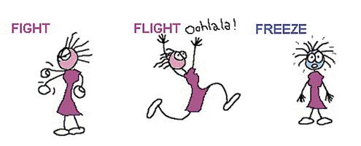
De-escalation
Thinking brain vs. Emotional brain

Slide 50

Manage your own emotions
Stay calm
Don’t engage in the power struggle- emotional brain is not the time for teaching, reasoning, negotiating
Don’t assume- think about what is driving the behavior
Maintain safety for all
What is the behavior communicating
Address the problem

Slide 51

Problem Solving
How do we solve problems with behavior?
Think of a sick child
Why do they have a fever?
What is causing the fever?

Slide 52

Get to the root of the problem
If the fever does not go away despite the “interventions”…
Medication and a cool bath may help reduce the fever, but it does not solve the underlying problem.
We need to treat the cause, not just the symptoms.
Problem behavior is a symptom of a larger problem.

Slide 53

Look for clues
What to look for:
Can/does the person meet the expectation?
Do they meet it within the time allotted?
Are they successful socially/emotionally?
Do they communicate their needs and wants appropriately?
Are there skill deficits?
Do certain subjects/activities increase problem behaviors?
Look at antecedents and consequences.

Slide 54

De-escalation
Think of de-escalation as the beginning, not the end
What happened and “WHY”
Reflect- What strategies worked? What skills need to be taught? What can I change to prevent this behavior?
If we don’t change something, nothing will change
The definition of insanity is doing the same thing over and over again and expecting a different result. - Einstein

Slide 55
Remember
Focus on:
Prevention- proactive
Build lasting relationships
Resolve problems, teach skills
Provide additional support
You’ve got this!

Slide 56

More questions?

Slide 57
Contact me
Christinemanningconsulting@gmail.com
Christine@manningbehaviorservices.com

