Slide 1
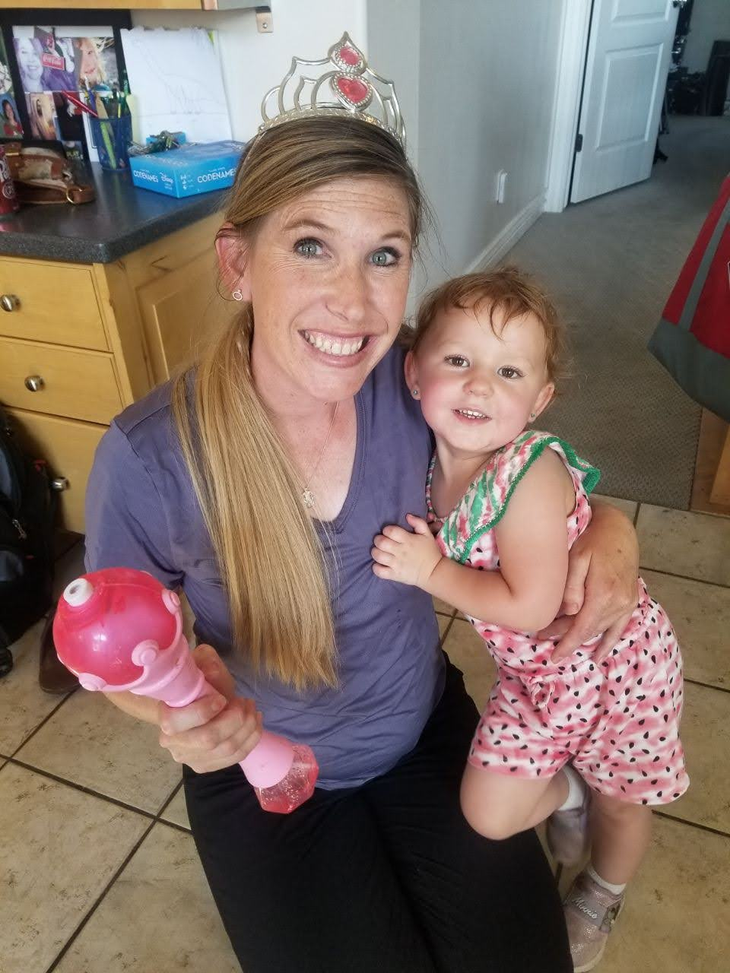
From Traits to Trust: Navigating Temperament for Early Learning Success
Summer Gunn M.Ed. BCBA LBA
Professional Practice Assistant Professor
Department of Special Education and Rehabilitation Counseling
Southern Utah Autism Conference April 18, 2026

Slide 2
Who is here?

Slide 3
Objectives:
Define temperament
Explain why it matters
Explore traits, types, and Goodness of Fit
Share practical strategies for understanding temperament

Slide 4
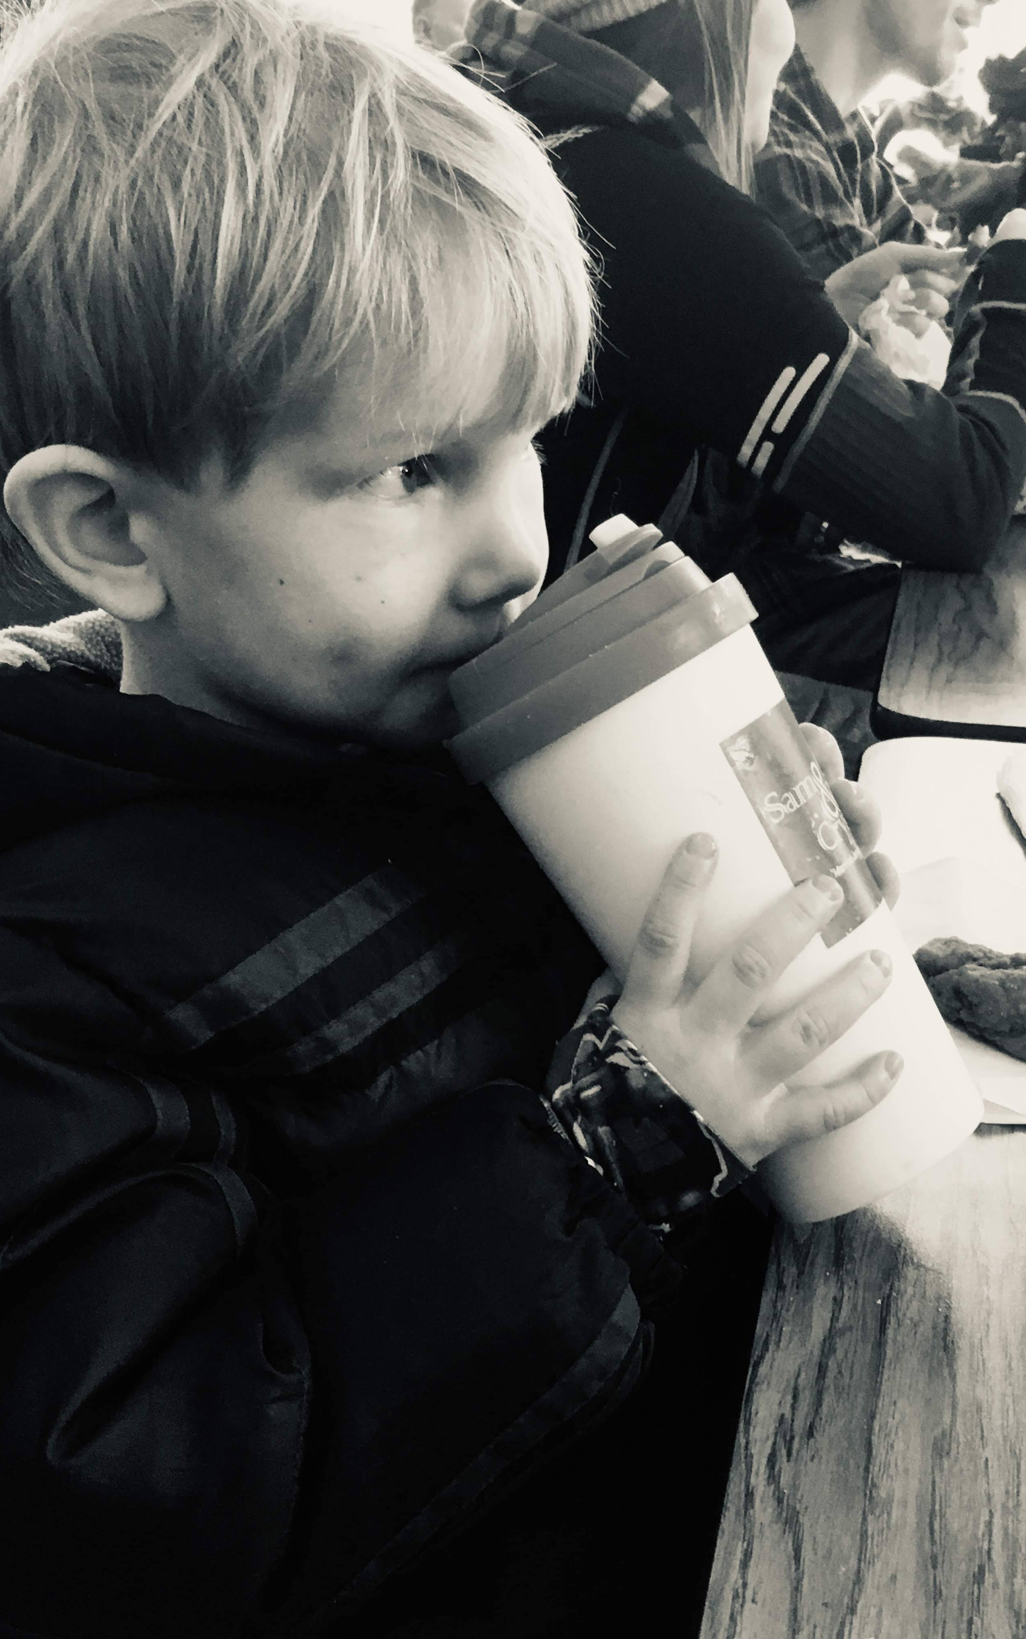
DEC Recommended Practices
INS1. Practitioners, with the family, identify each child's strengths, preferences, and interests to engage the child in active learning.
F5. Practitioners support family functioning, promote family confidence and competence, and strengthen family-child relationships by acting in ways that recognize and build on family strengths and capacities.

Slide 5
Standards
NAEYC
1b: Understand and value each child as an individual with unique developmental variations, experiences, strengths, interests, abilities, challenges, approaches to learning, and with the capacity to make choices.
2b: Collaborate as partners with families in young children’s development and learning through respectful, reciprocal relationships and engagement.
CEC EI/ECSE
1.3 Candidates apply knowledge of biological and environmental factors that may support or constrain children’s early development and learning as they plan and implement early intervention and instruction.
6.2 Candidates engage in reciprocal partnerships with families and other professionals to facilitate responsive adult-child interactions, interventions, and instruction in support of child learning and development.

Slide 6
What is Temperament

Slide 7
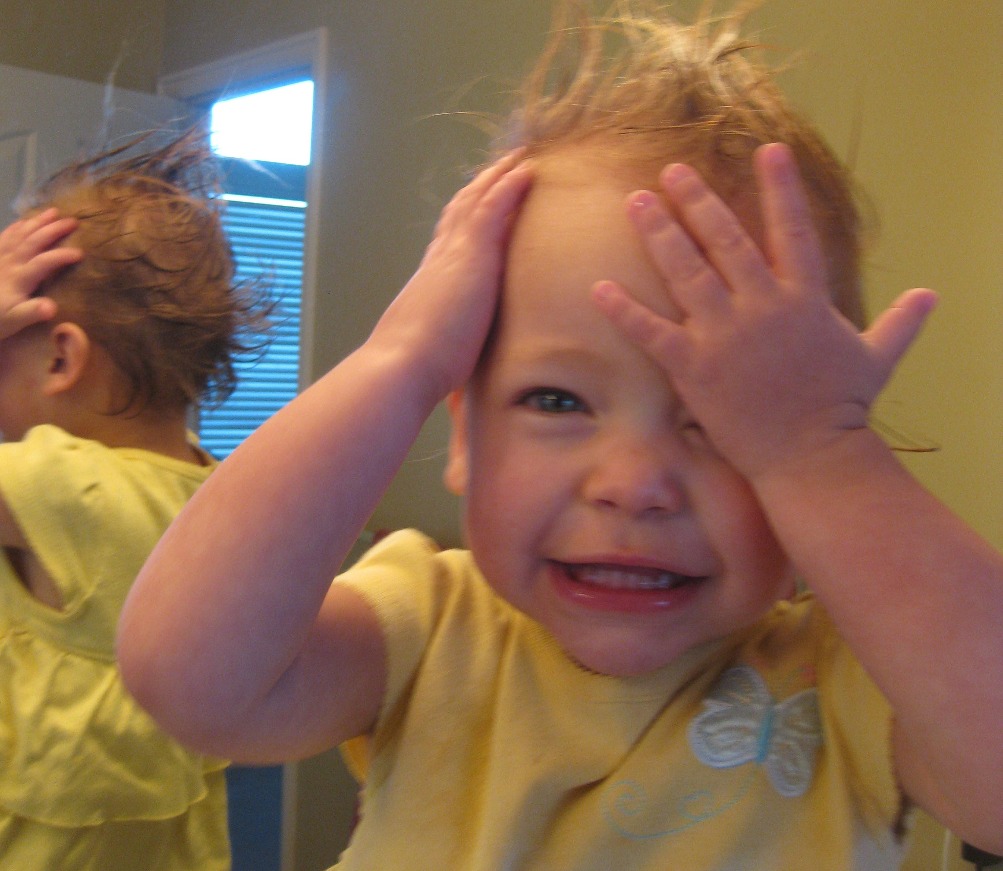
What is Temperament
A child's innate behavioral style influences how they react to the world, manage emotions, and adapt to new situations.
Notes:
Temperament is like your natural style of reacting to the world. It’s the way you usually feel and behave without even thinking about it.

Slide 8
Why Understand Temperament?
Notes:
As you watch the video, think about how children's varied temperaments have impacted your interactions with them.

Slide 9
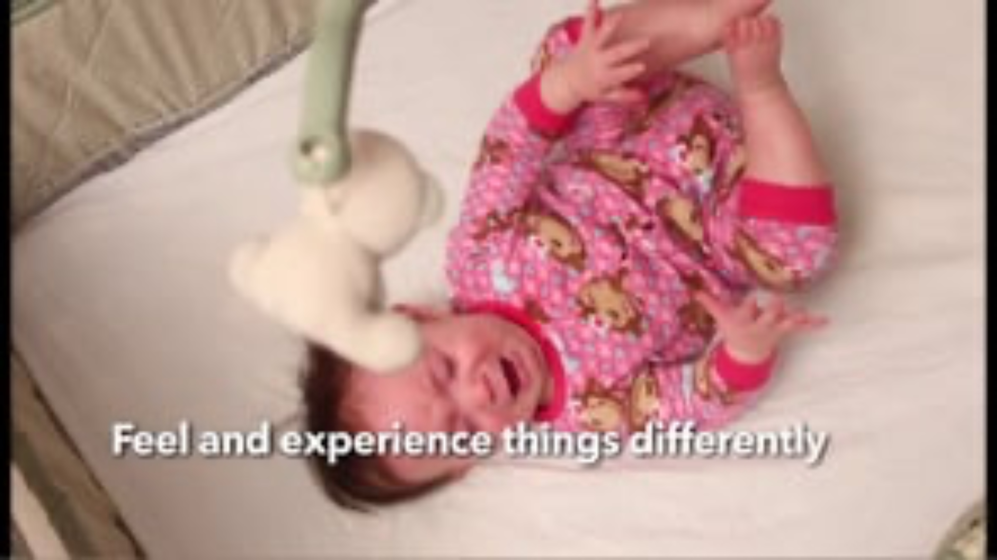
Notes:
Start at :48

Slide 10
Think of a child you know well. Which temperament traits were most noticeable?

Slide 11
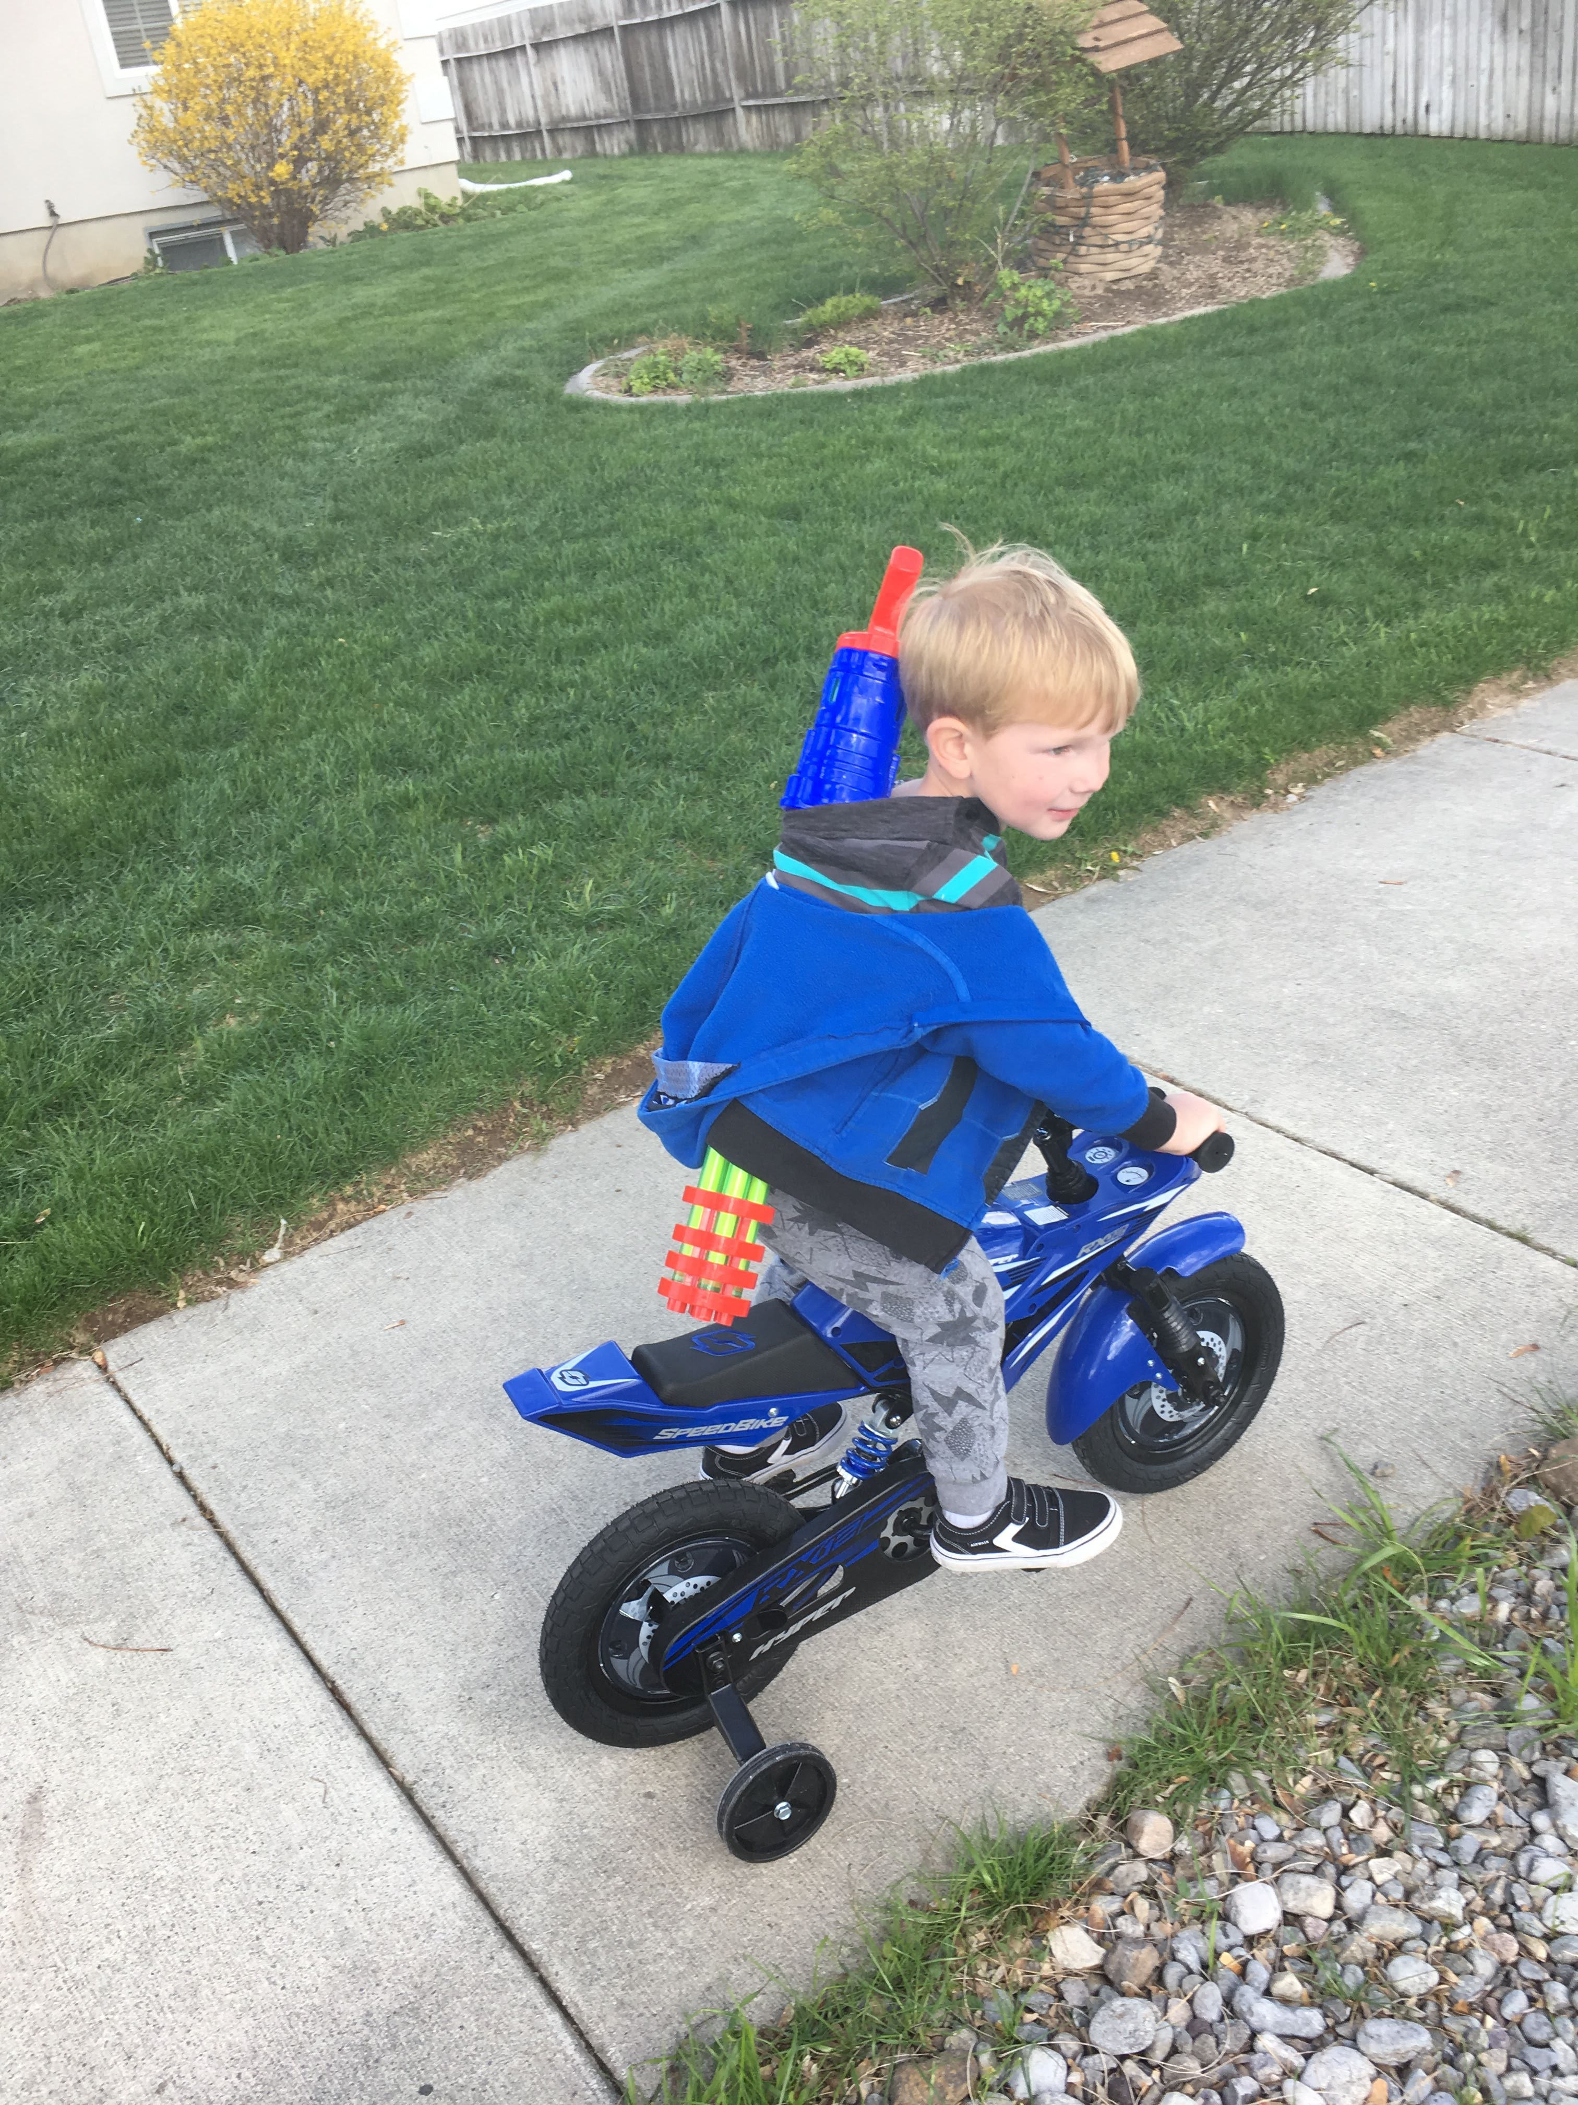
Why Understand Temperament?
Understand the child’s reactions
Understand preferences
Identify strengths and needs for support
Improve attunement
Allard & Hunter (2023)

Slide 12
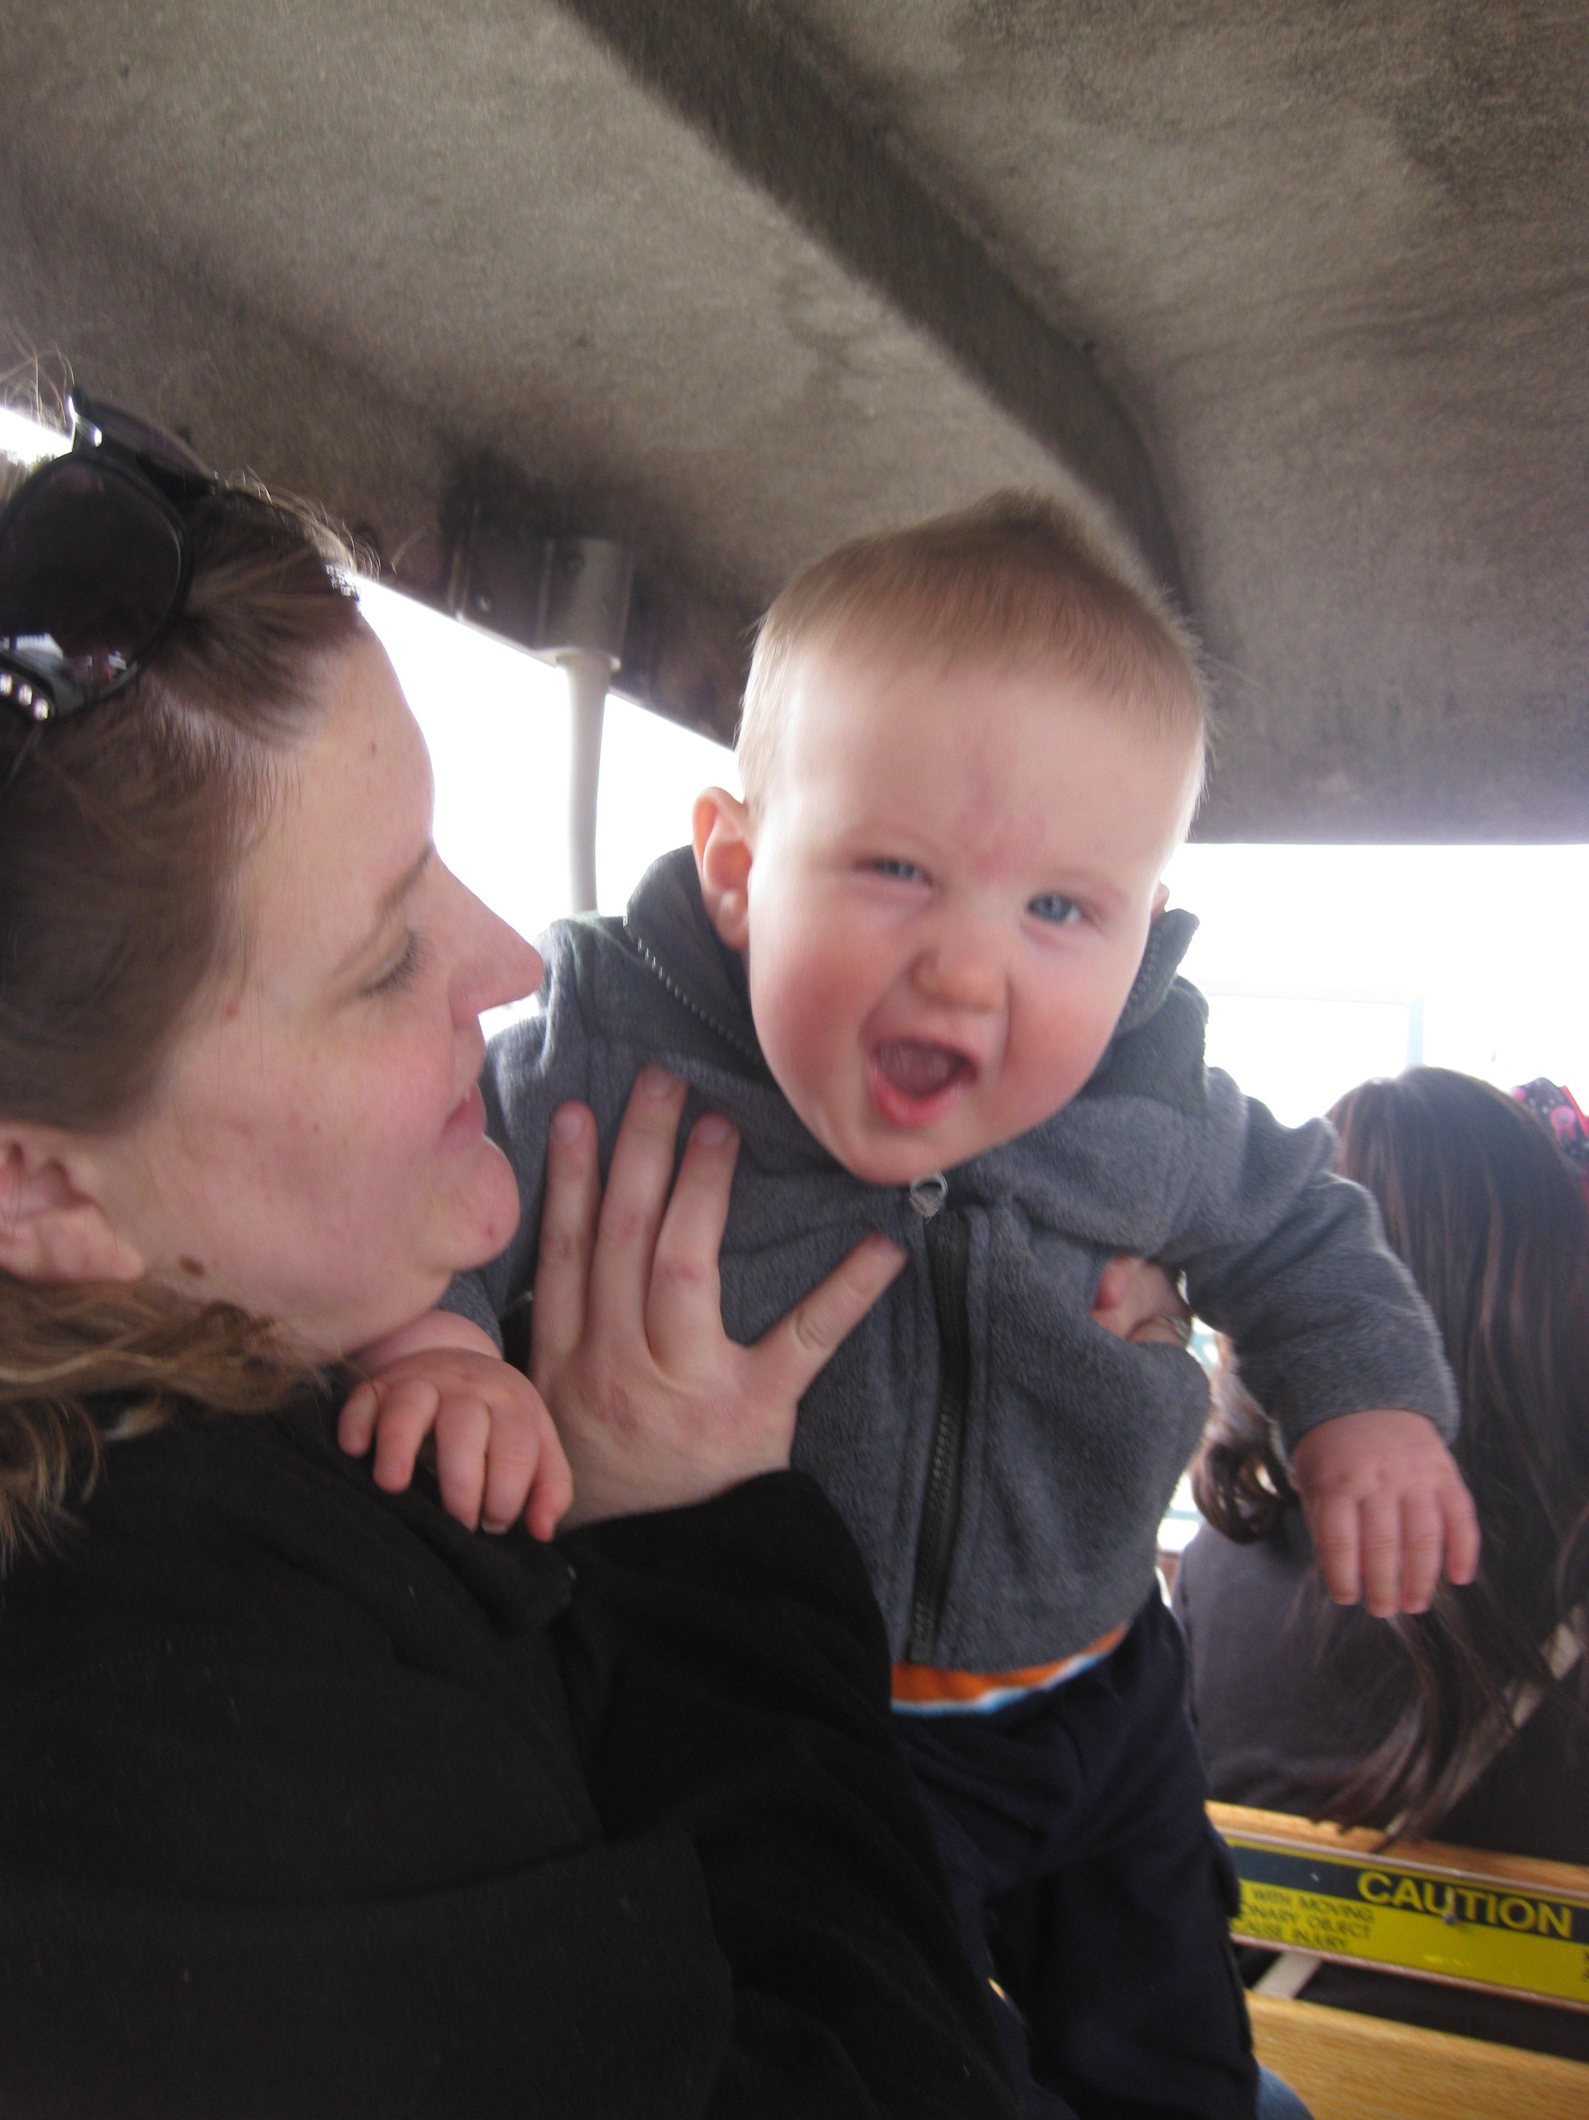
Attunement
The process of a caregiver being fully present and in tune with a child's emotional and physical needs, responding to their cues like facial expressions and body language

Slide 13
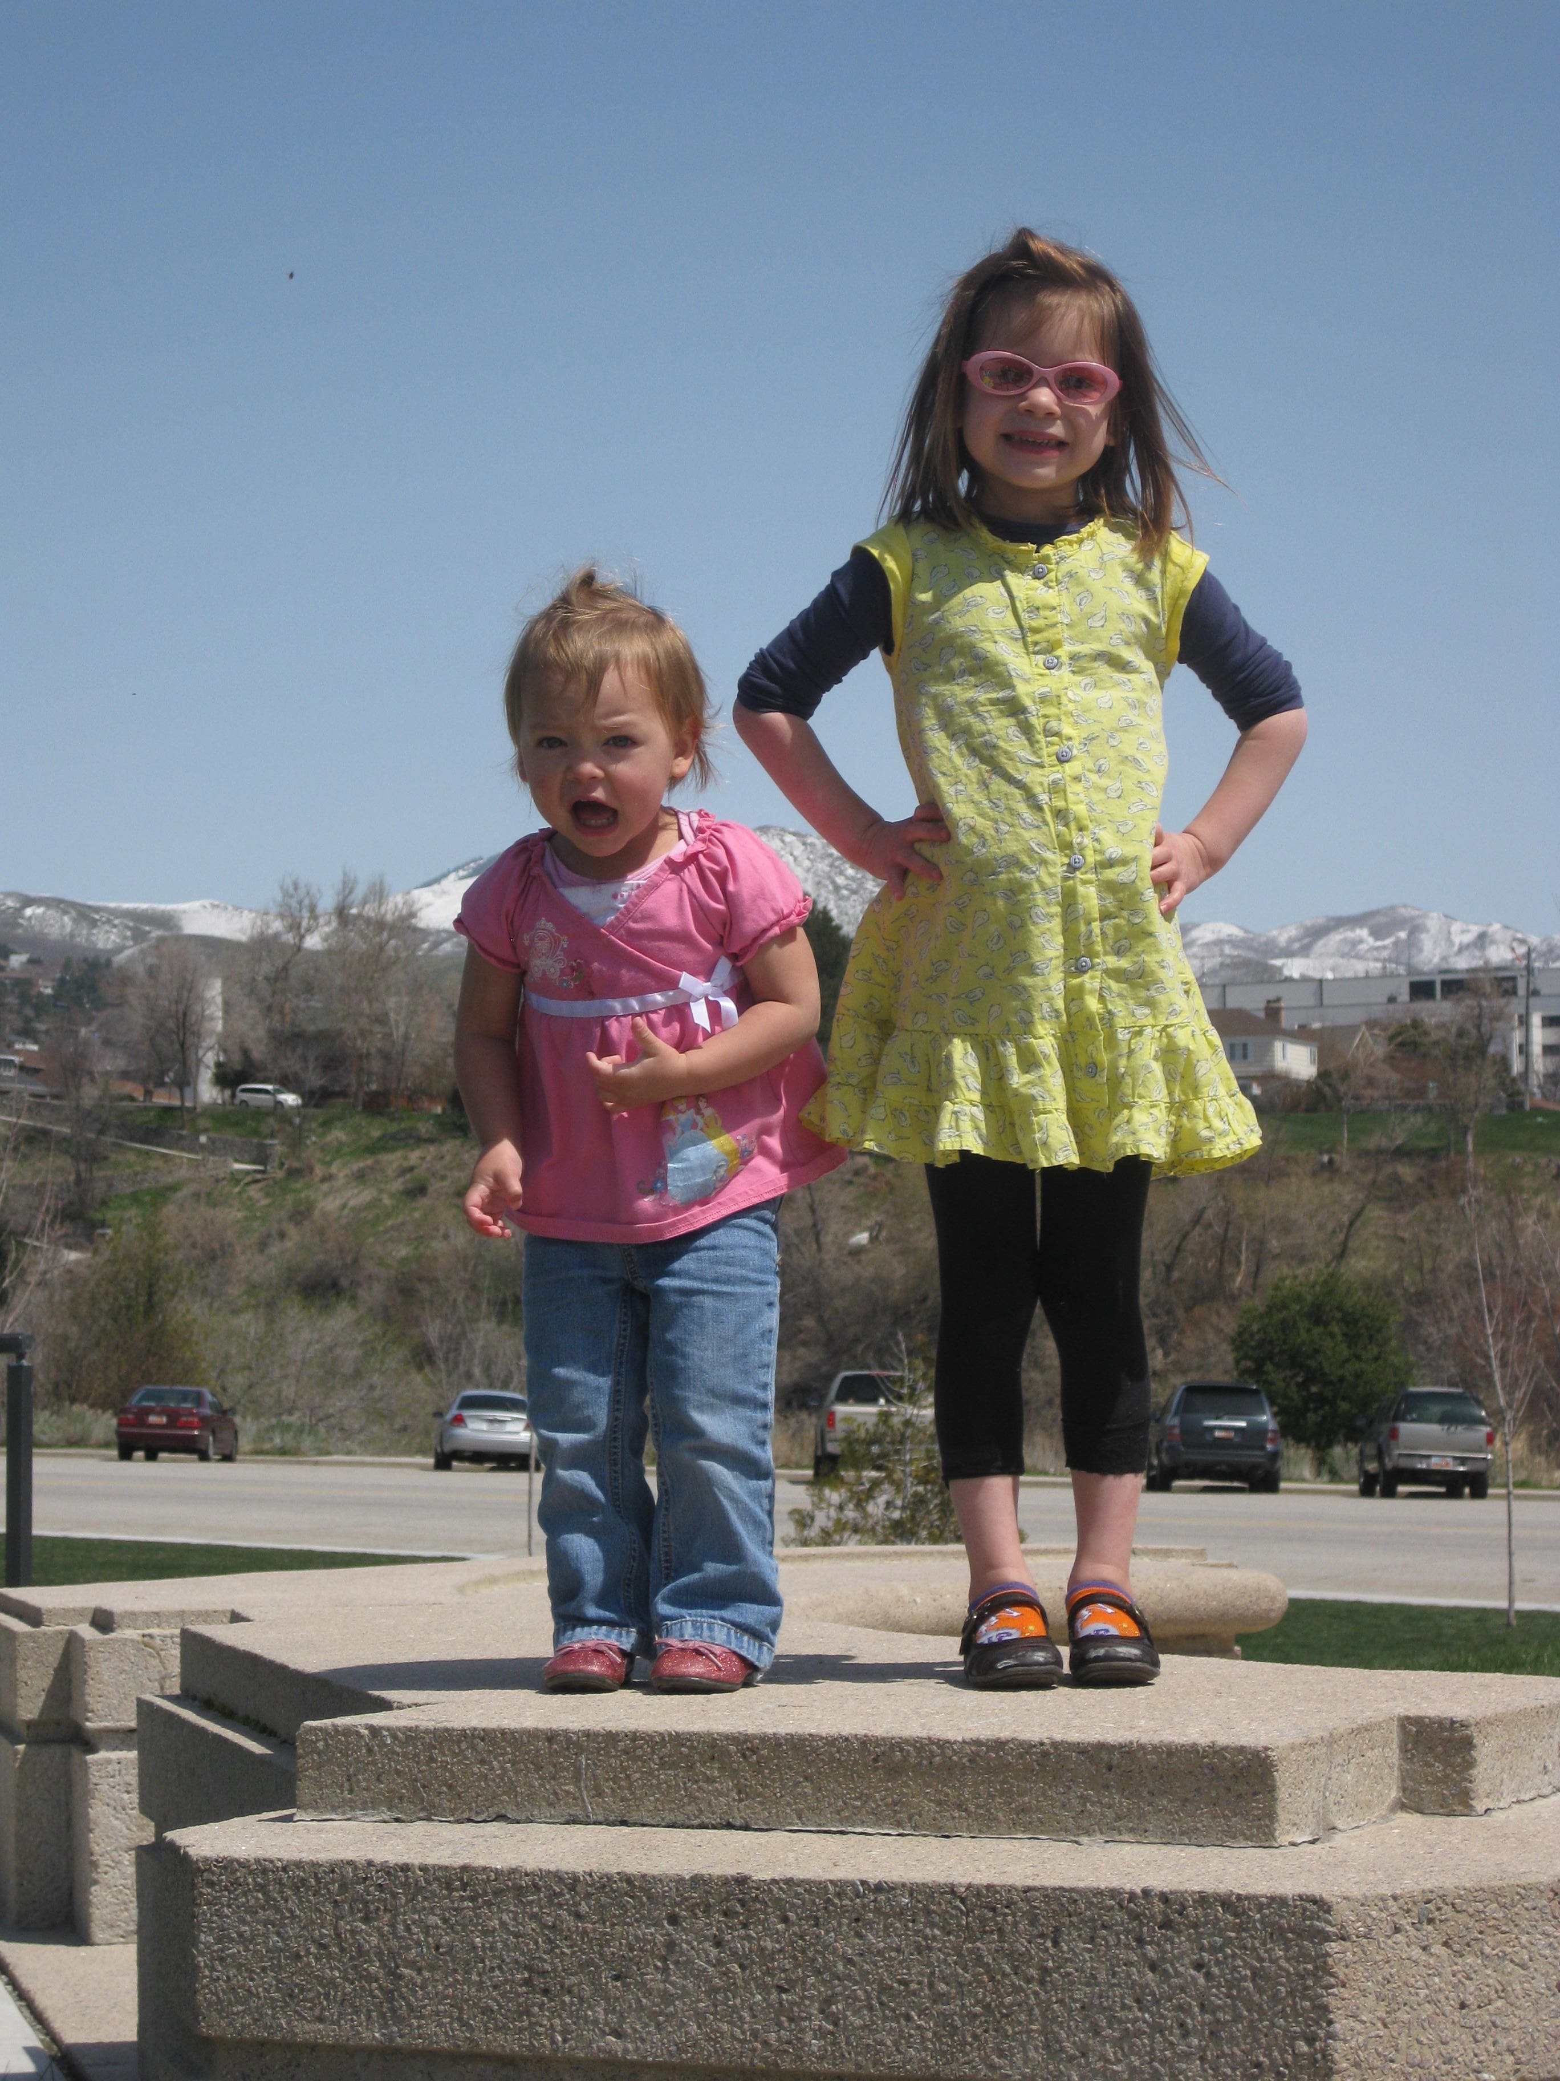
What influences temperament?
Genetics
Family Environment
Culture
Medical Conditions/ Disability
Toxic Substances
Trauma
Nutrition
Allard & Hunter (2023)

Slide 14
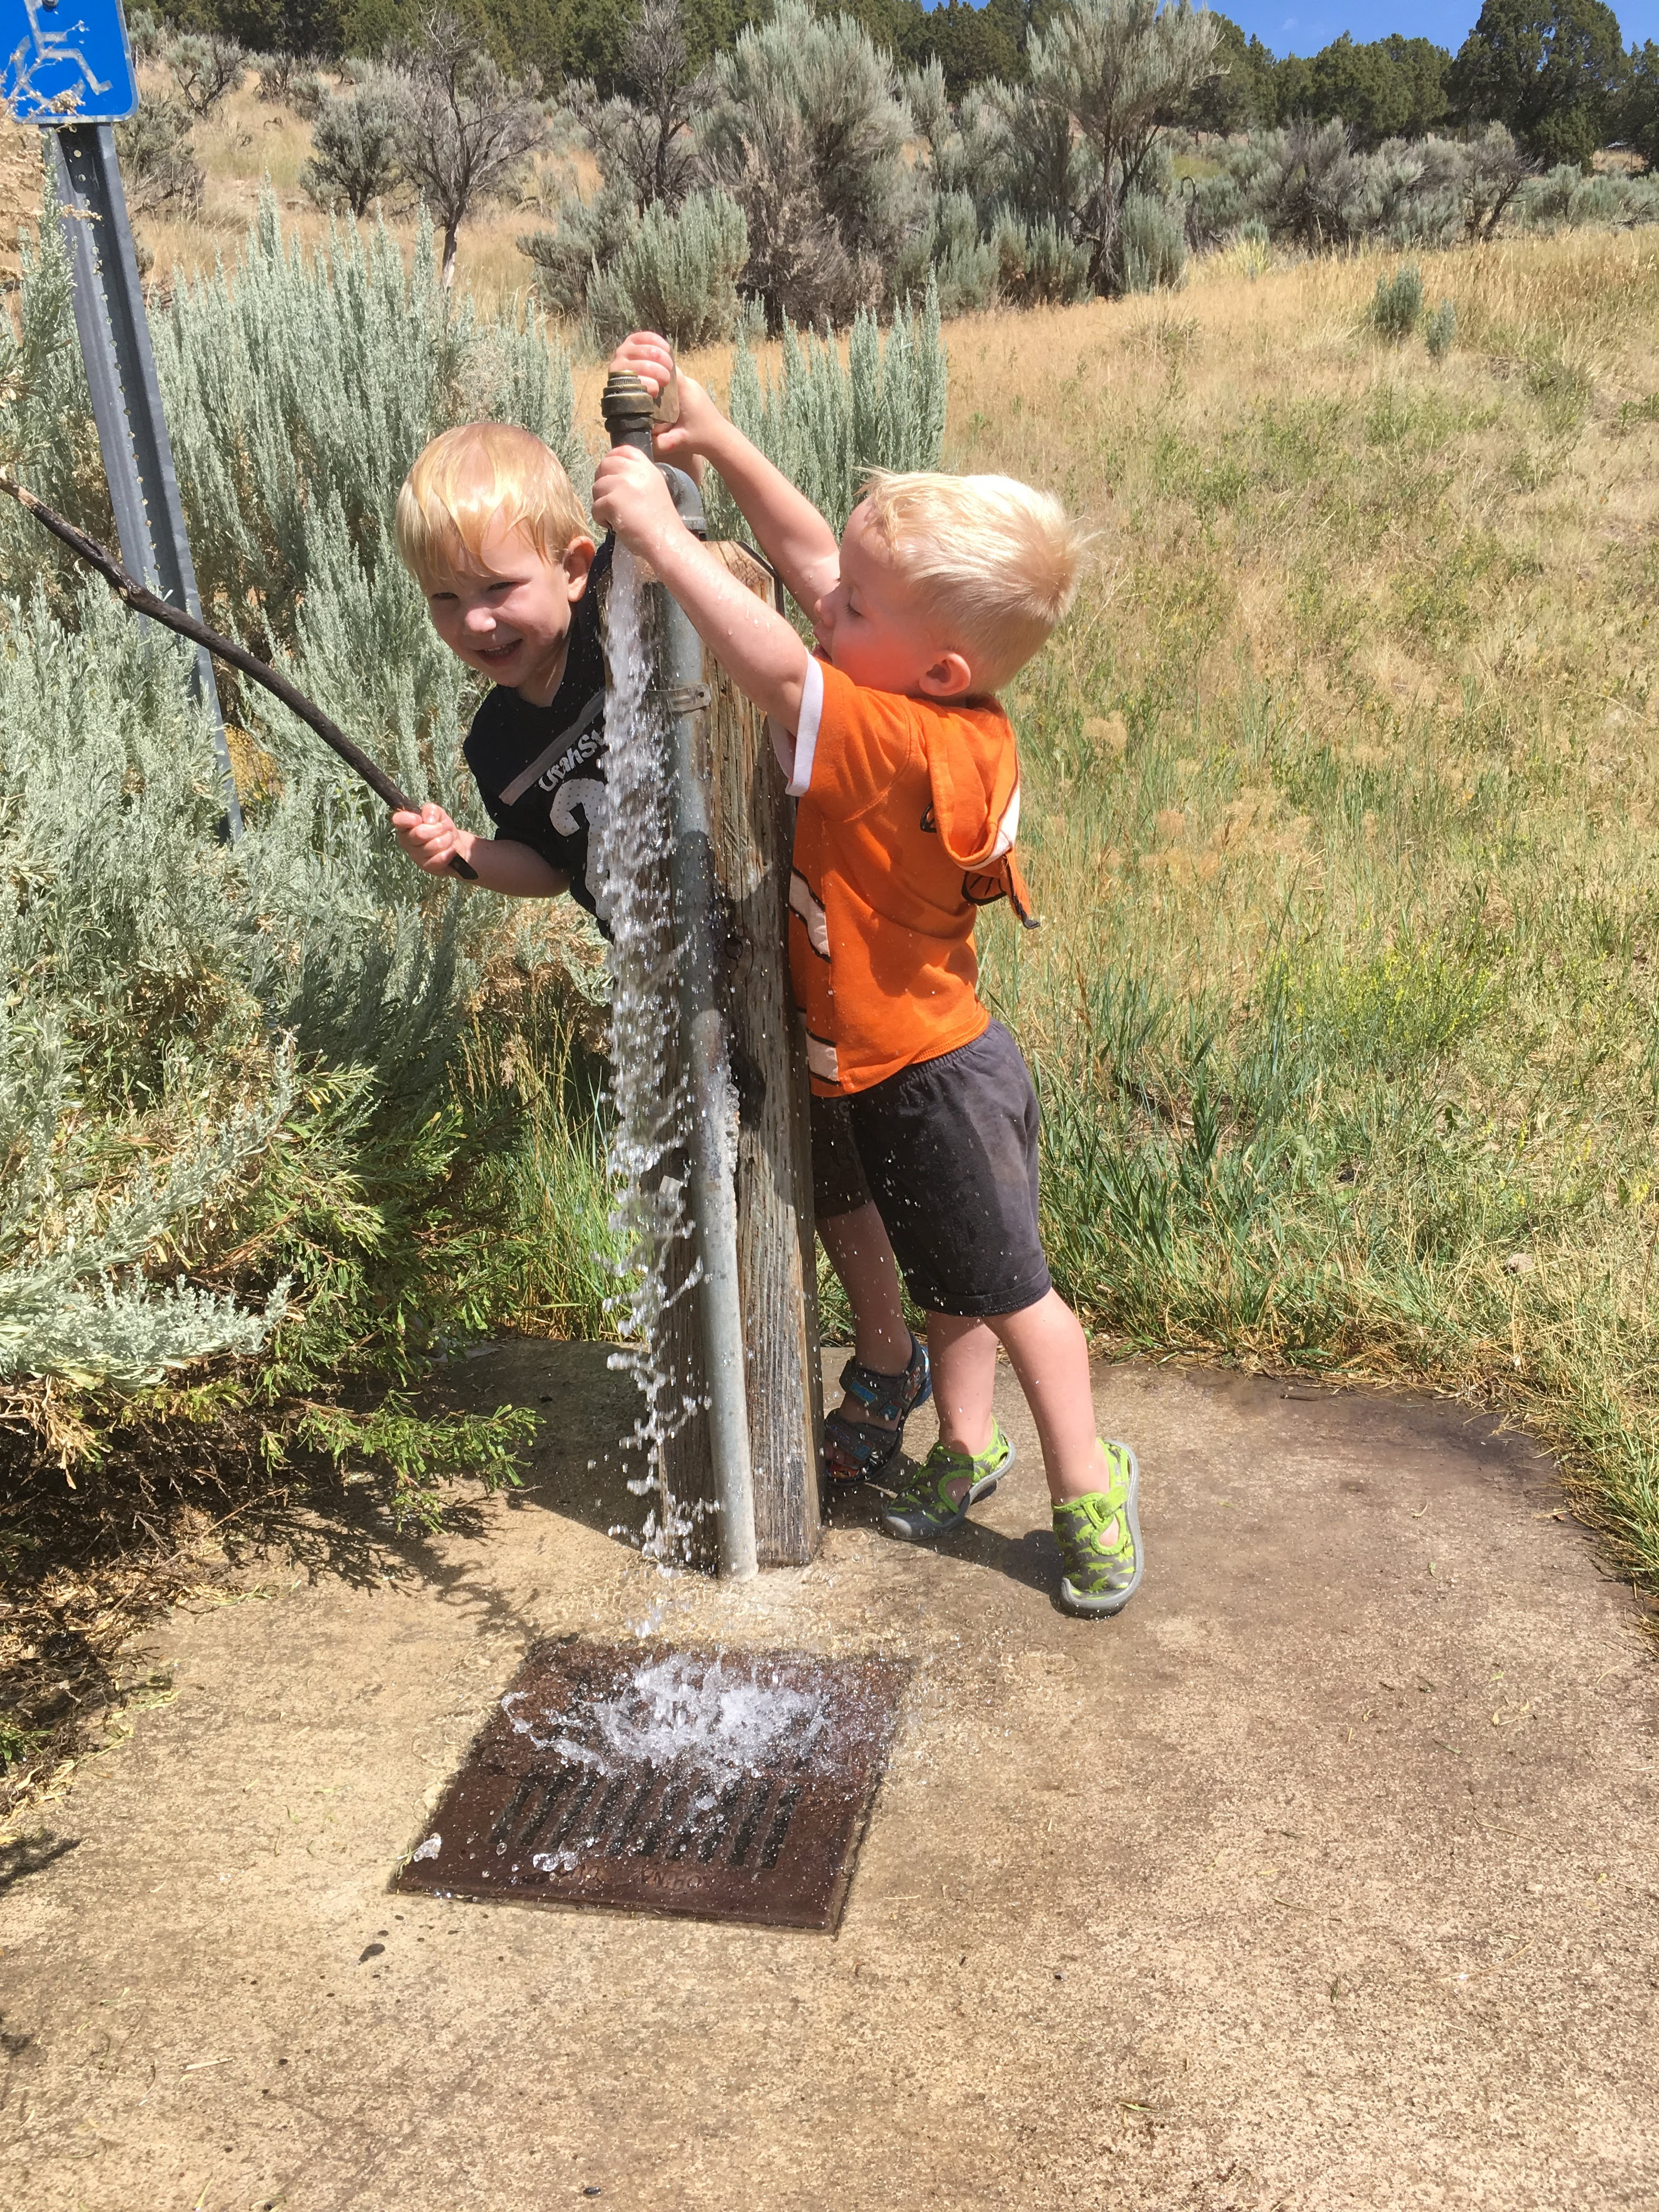
Temperament is unlikely to change over time; however, family cultural values and parenting style can impact the intensity of the temperament traits
Allard & Hunter (2023)
Notes:
What caregivers attend to over time is reinforced. It will not force a new temperament, but intensify or decrease priority for certain traits.

Slide 15
Temperament Traits
Activity
Regularity (Rhythmicity)
Approach/
Withdrawal
Adaptability
Intensity of reaction
Distractibility
Persistence
Sensory threshold
child’s overall energy and movement
predictability of routines (e.g., sleep, eating)
response to new people/situations
ease of responding to changes/transitions
strength of emotional display
susceptibility to external distraction
sensitivity to stimuli like noise, lights, textures
staying power when facing challenges

Slide 16
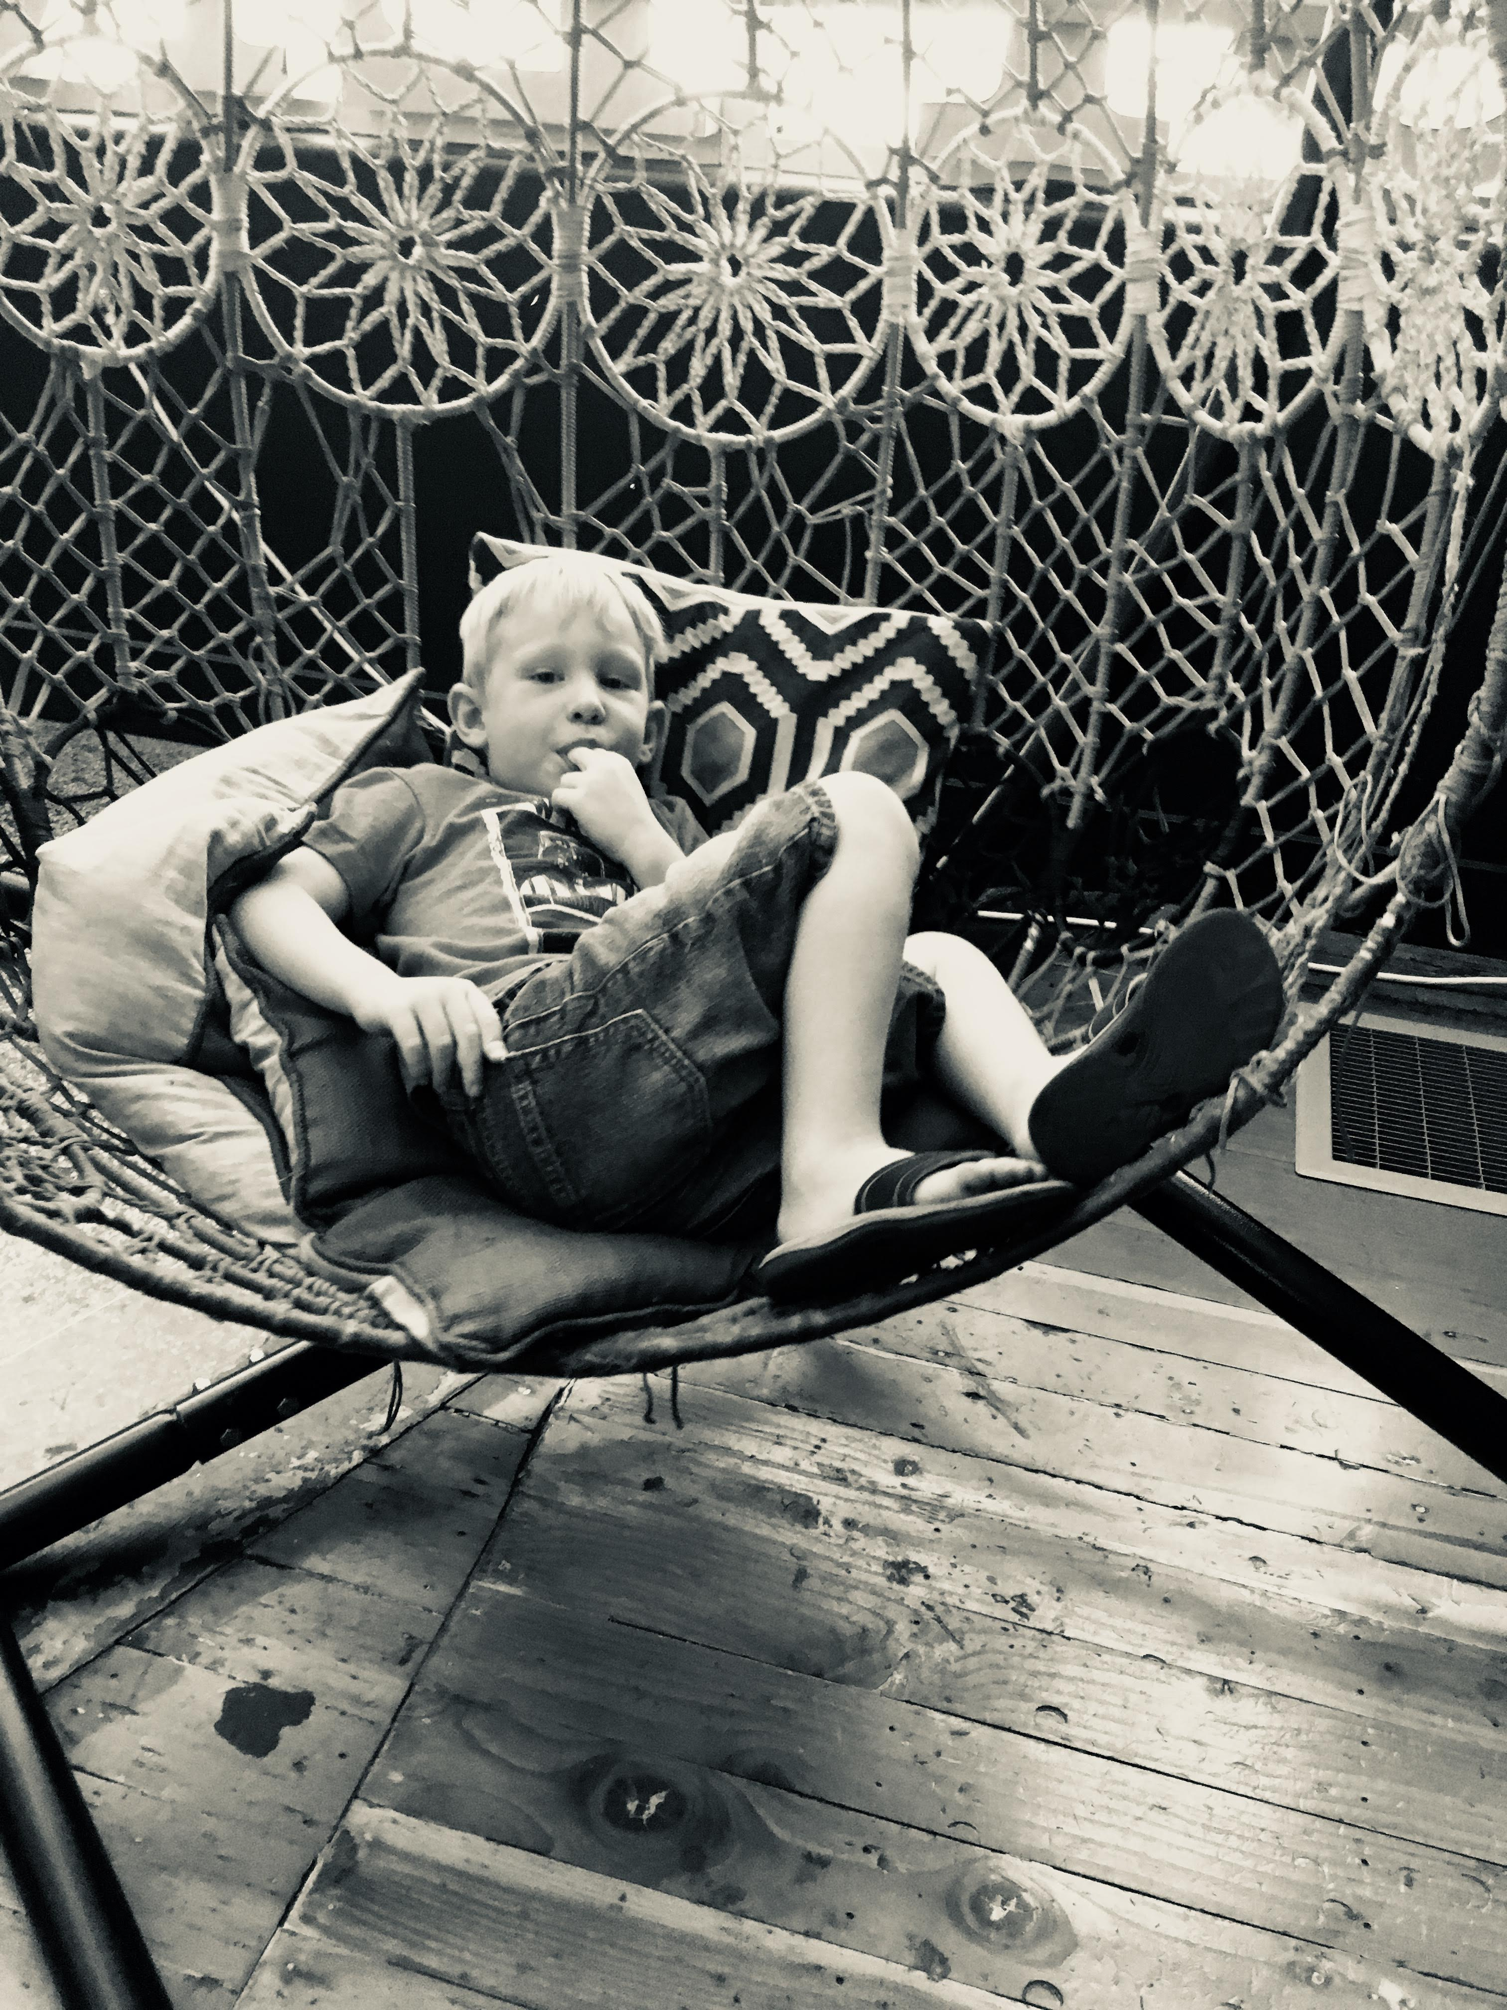
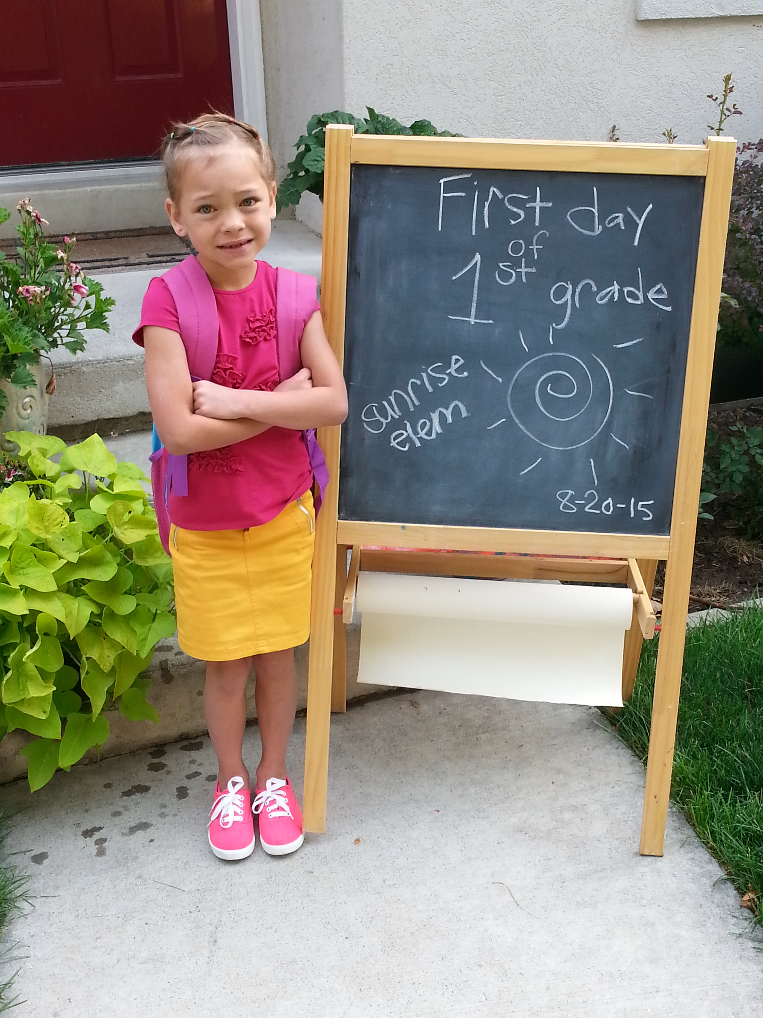

Easy Going Slow to Warm Active

Slide 17
Easy Going
Trait | Easy Going
Activity Level | Moderate – enjoys play but not overly energetic
Distractibility | Low – stays focused even with distractions
Intensity | Mild – reactions are calm and balanced
Regularity | Predictable – consistent sleep and eating
Sensitivity | Low – tolerates noise, textures, and changes
Approachability | High – eagerly engages with new people/situations
Adaptability | High – adjusts easily to changes
Persistence | Moderate – keeps trying but not overly stubborn

Slide 18
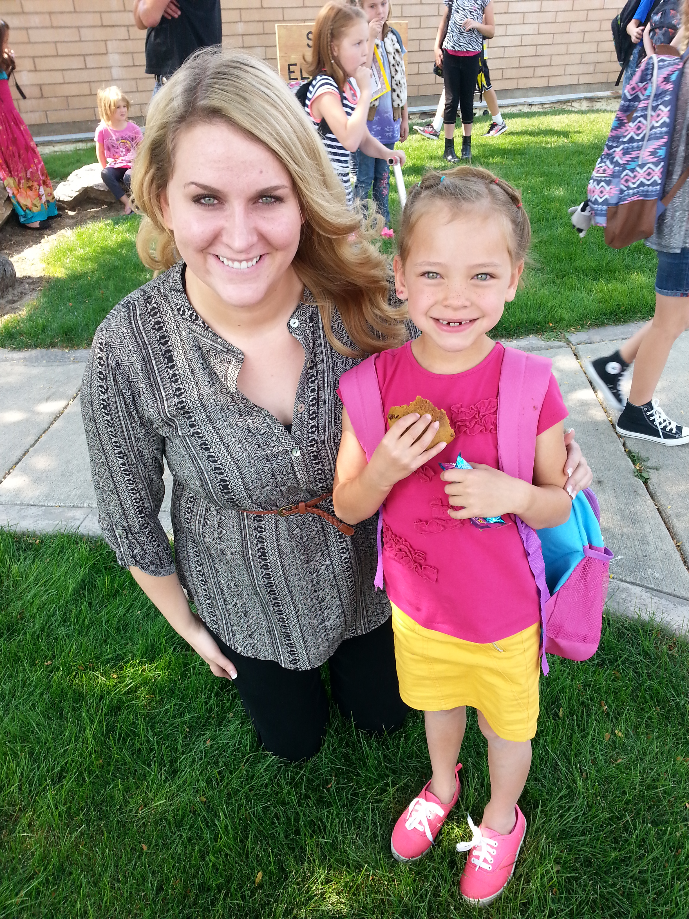
Slow to Warm Up
Trait | Slow to Warm Up
Activity Level | Low – prefers calm activities, less movement
Distractibility | Moderate – may lose focus in new settings
Intensity | Low – responses are subdued
Regularity | Fairly regular but slower to adjust
Sensitivity | High – easily bothered by sensory input
Approachability | Low – hesitant, needs time to warm up
Adaptability | Low – resists transitions, needs preparation
Persistence | High – sticks with tasks quietly and patiently

Slide 19
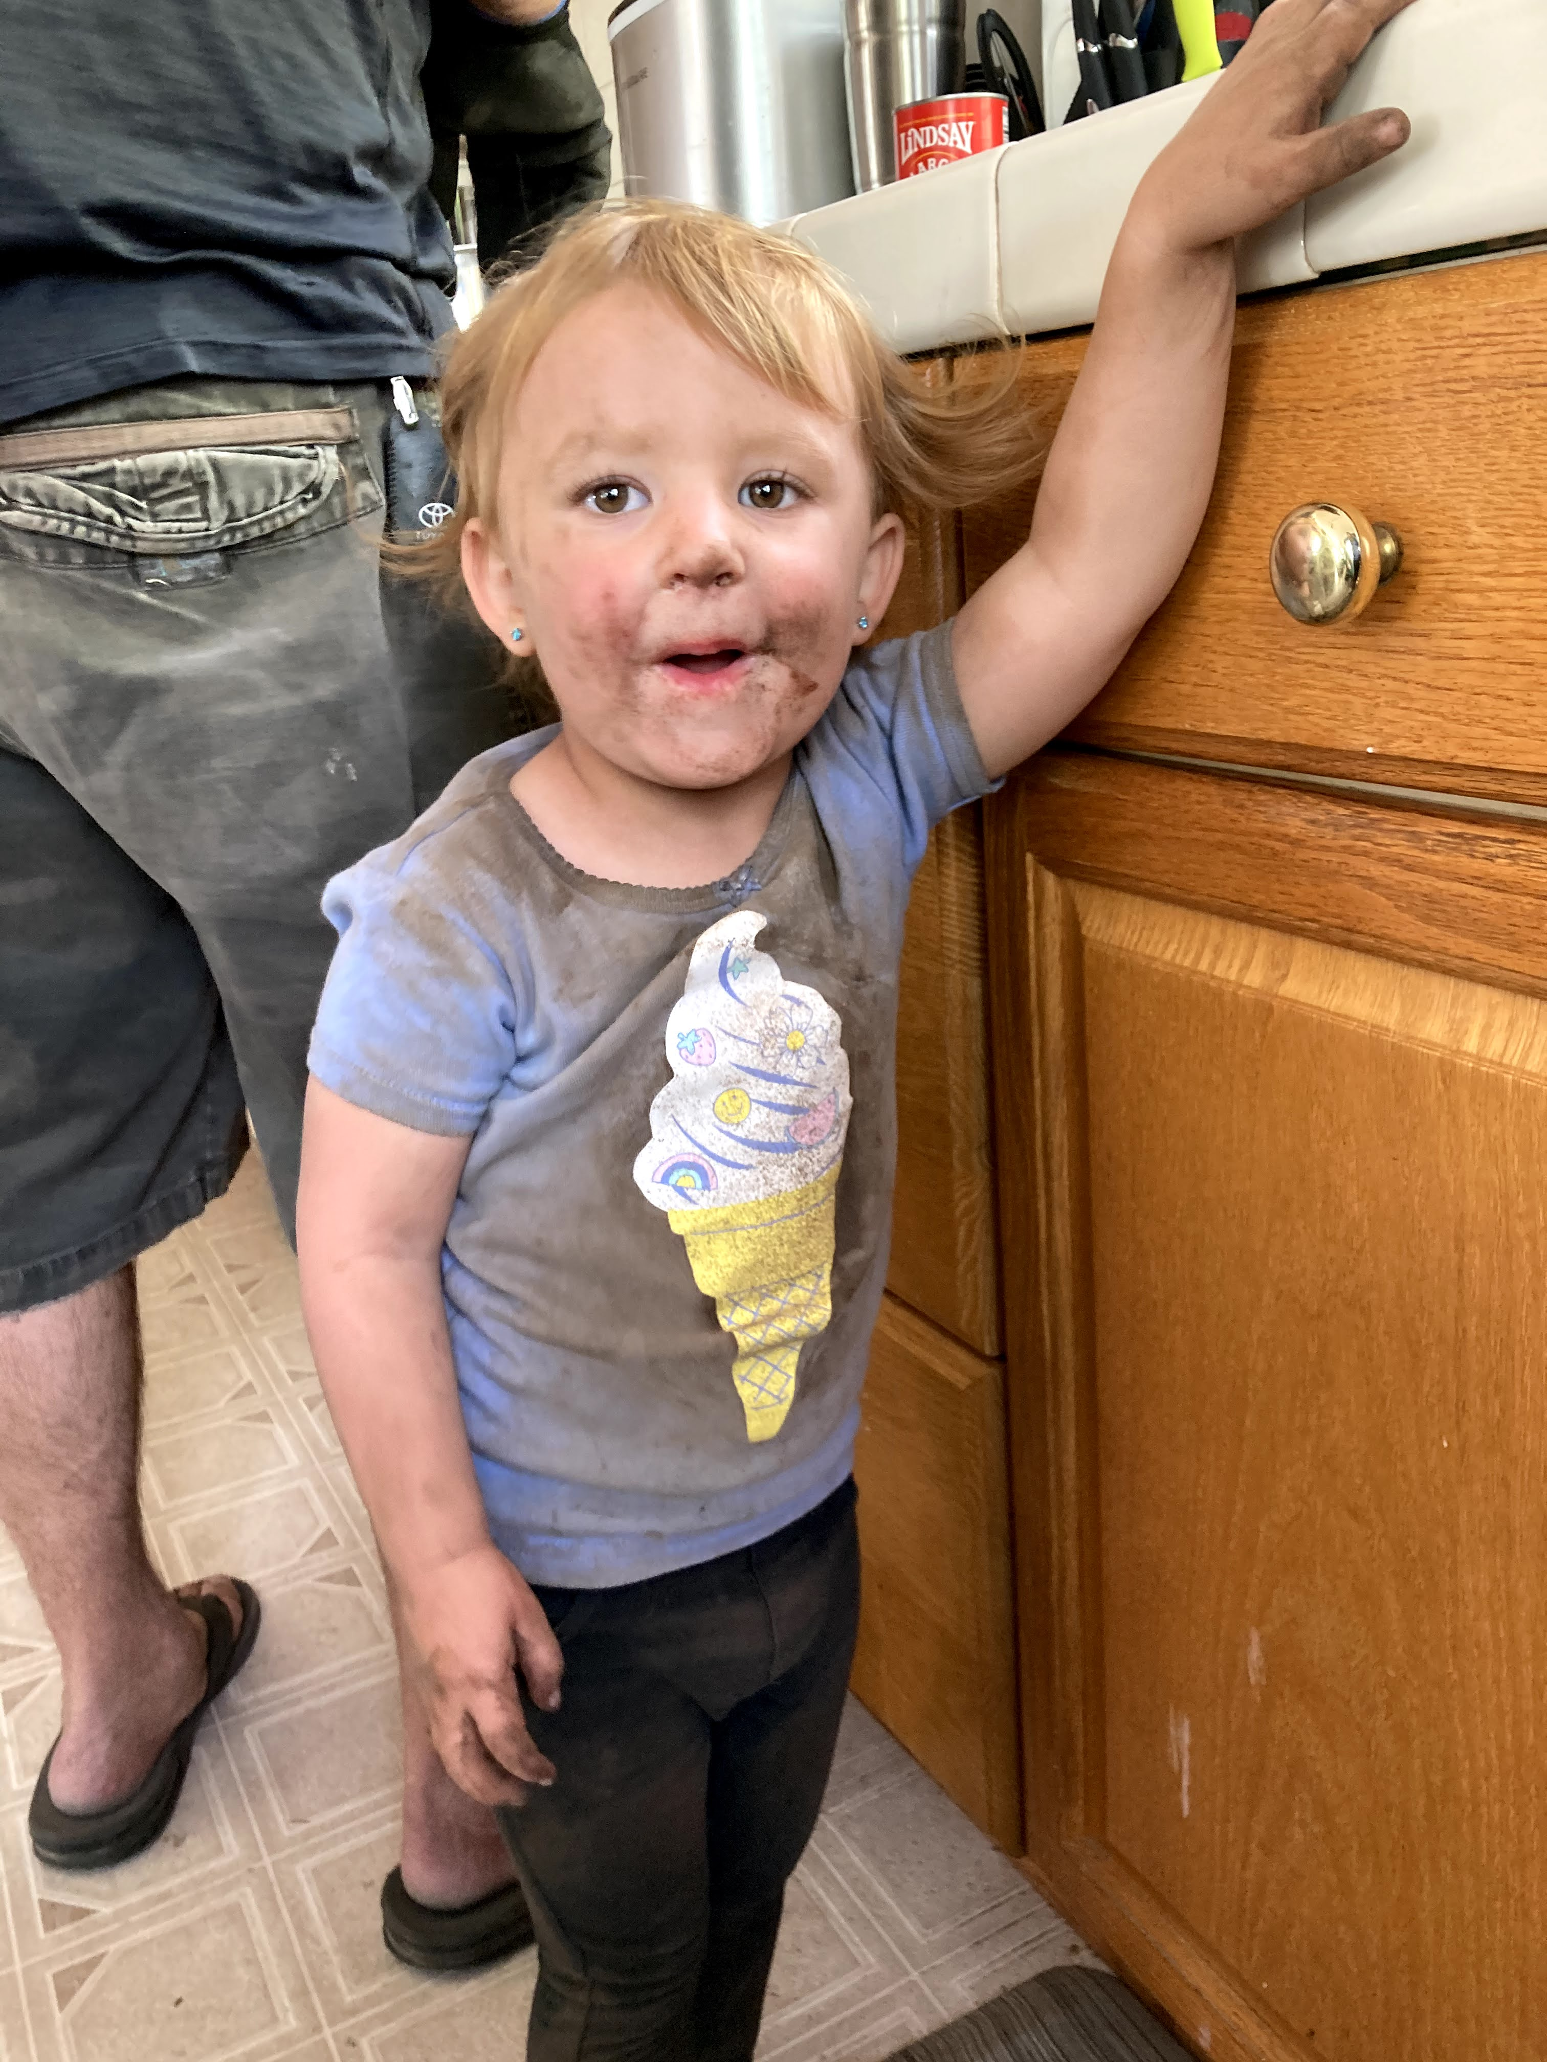
Active (Feisty)
Trait | Active
Activity Level | High – constantly moving, loves physical play
Distractibility | High – easily sidetracked by sights and sounds
Intensity | High – strong emotional reactions (positive or negative)
Regularity | Irregular – routines vary day to day
Sensitivity | Moderate – notices stimuli but adapts quickly
Approachability | High – jumps into new experiences enthusiastically
Adaptability | Moderate – adapts but may protest initially
Persistence | Low – gives up quickly if frustrated

Slide 20
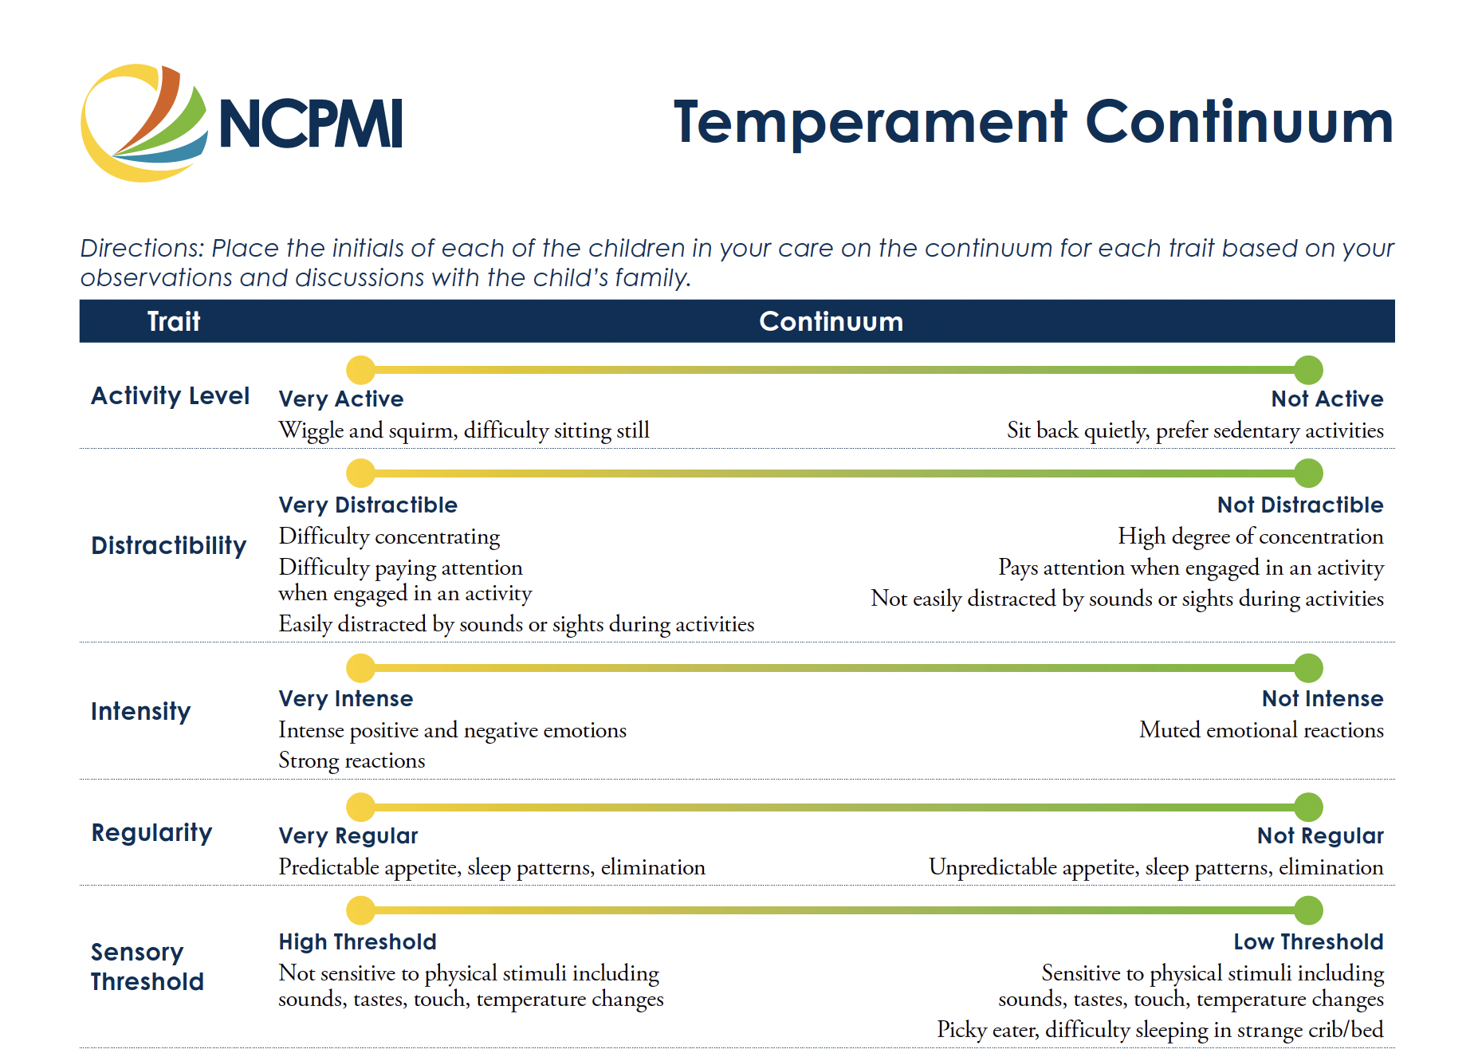
Think of a child you care for…

Slide 21
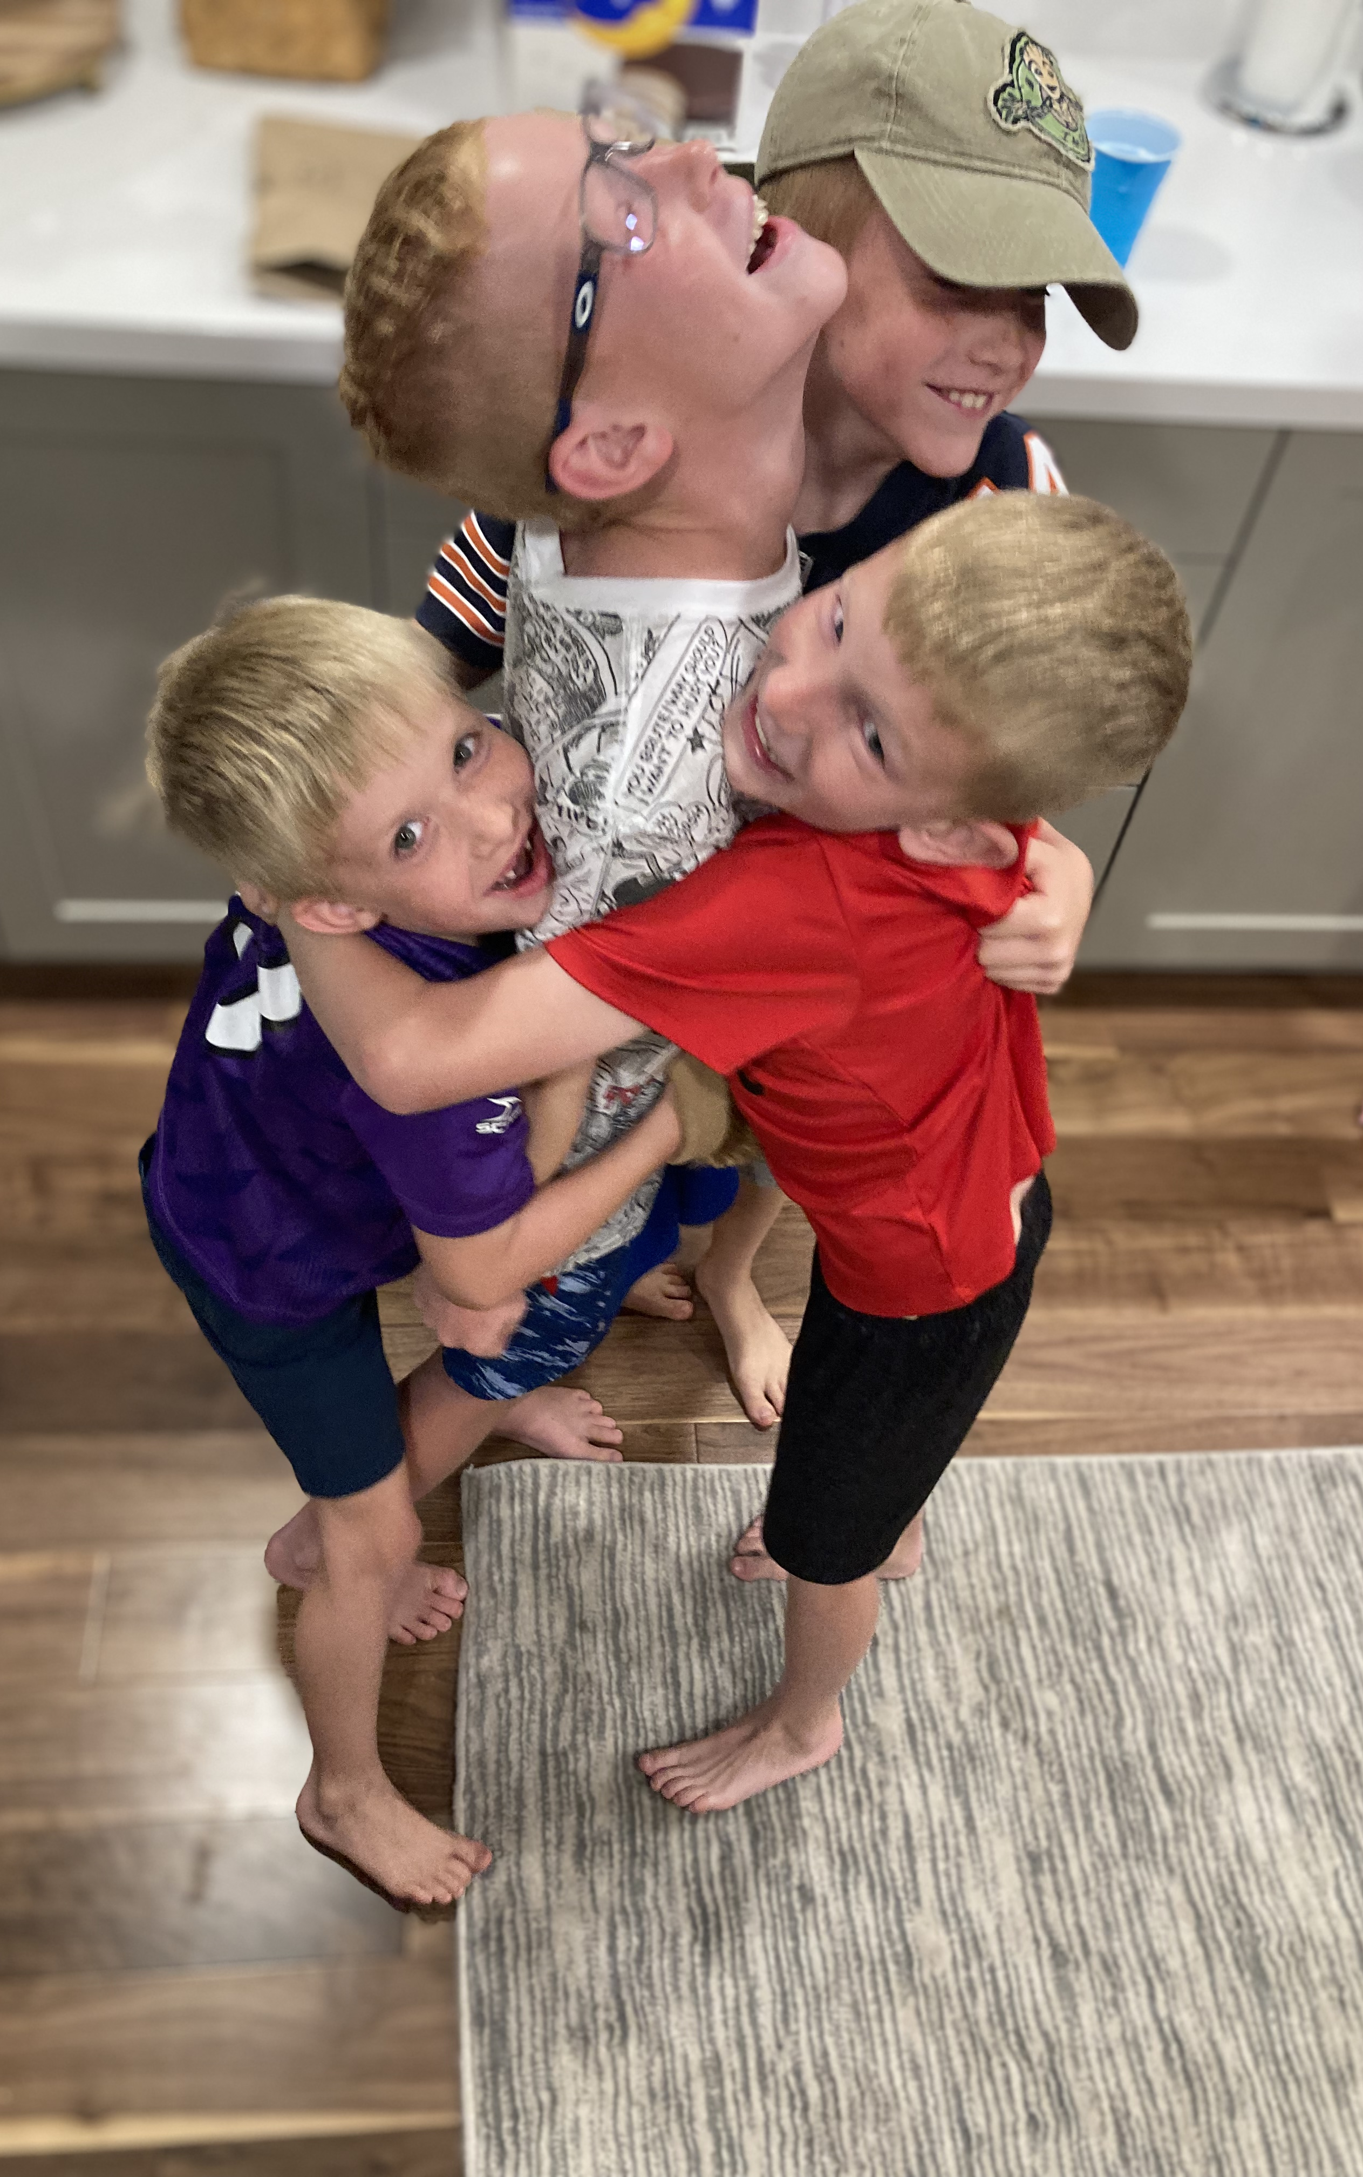
Goodness of Fit
Creating harmony between a child’s temperament and their caregiving environment through flexibility, understanding, and collaboration.
Allard & Hunter (2023)

Slide 22

Reflect on your own temperament.
Understanding your own temperament can help you to identify the “goodness of fit” for each child in your care.
Notes:
For example, a caregiver who enjoys movement, loud music playing, and constant bustle might try to imagine what it would feel like to spend all day in a setting that was calm, hushed, and quiet. This reflective process can help you become more attuned to the experience of each child within your care. You can then determine what adjustments might be needed to create a better fit for each child.

Slide 23
How would you rate your temperament…

Slide 24
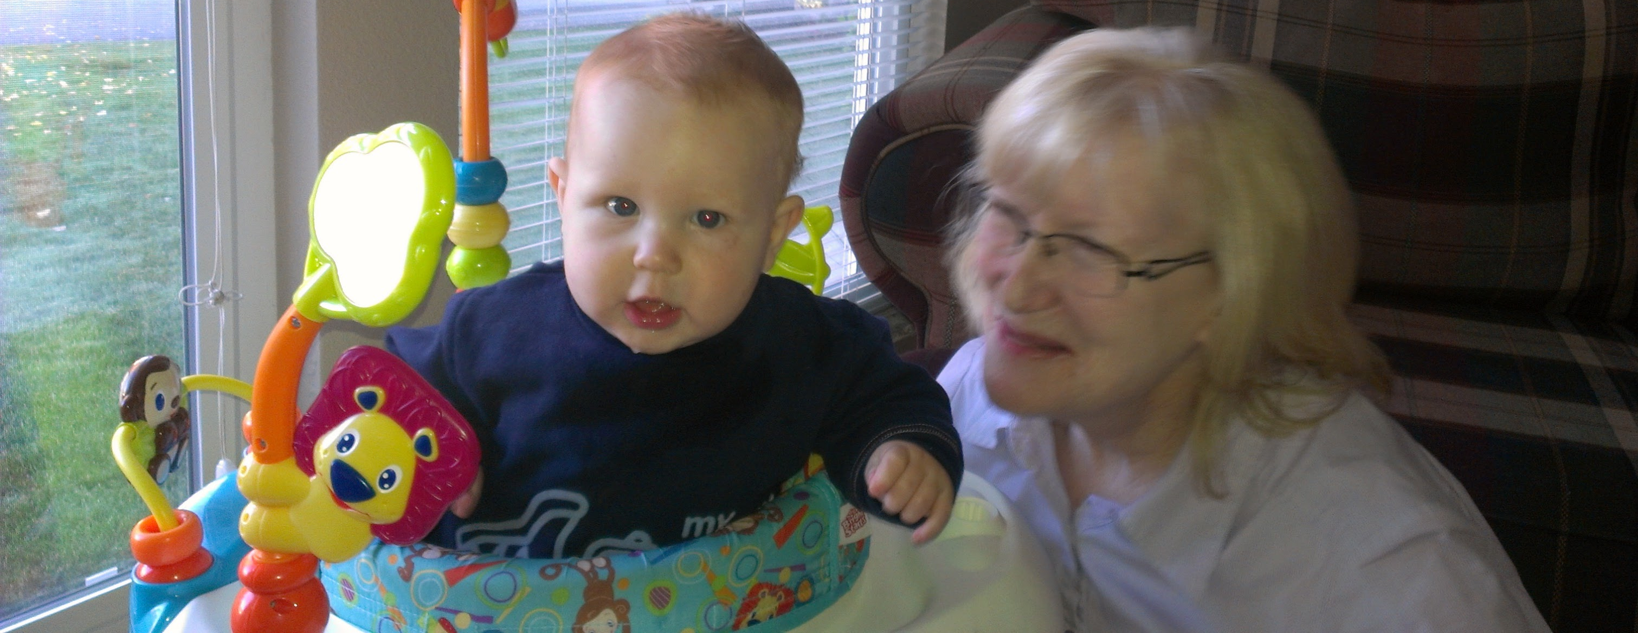
Create partnerships with families to understand a child’s temperament.
Allard & Hunter (2023)
Notes:
Refrain from judging a child’s temperamental traits as “good” or “bad” behavior, and work with parents to see each child’s approach to the world through a positive lens. Without understanding how temperament fits into the child’s behavior, families and caregivers may face frustration when a child’s temperament does not align with their family routines and values. Helping caregivers understand flexibility can improve attunement and attachment.

Slide 25

Value each child’s temperament in your curriculum.
Allard & Hunter (2023)

Slide 26
How would you feel if you were someone who likes movement, music, and staying busy, but was expected to spend all day in a quiet, calm, hushed classroom?

Slide 27
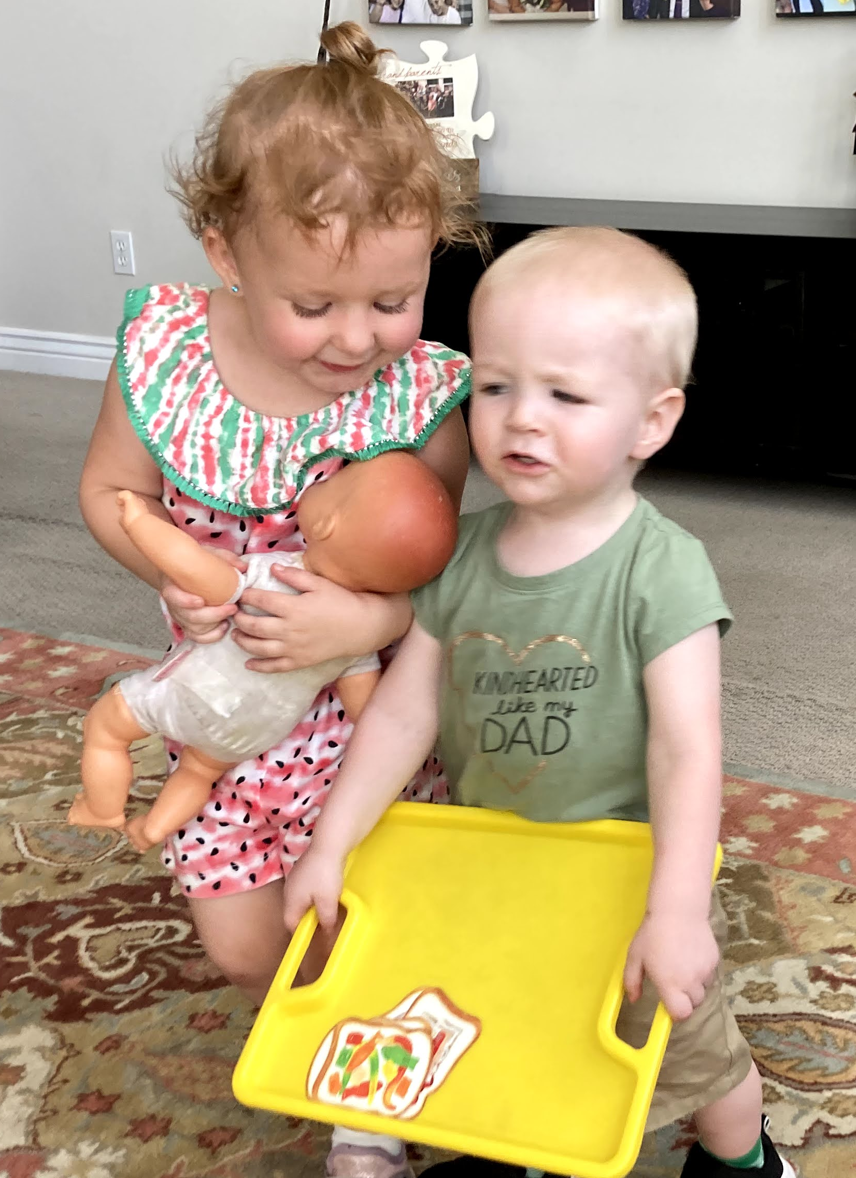
Easy Going
Less likely to demand attention and make their needs known.
Check in with them often
Communicate about emotions
Teach them how to seek help when needed
Allard & Hunter (2023)

Slide 28

Slow to Warm Up
Allard & Hunter (2023)
Prepare them for new situations and people with extra support.
Maintain a predictable environment and clear routines; visual schedules!
Allow extra time for drop-off and pick-up to ease transitions.
Offer encouragement for exploration and independence.

Slide 29

Active (Feisty)
Allard & Hunter (2023)
Be prepared to be flexible and patient in your interactions.
They can experience intense emotions and reactions.
Offer choices and provide plenty of active, gross-motor play
Create calm spaces to transition from play to rest.
Give individualized transition reminders to ensure understanding.
Label emotions clearly (e.g., “You are so angry. You really wanted that toy.”).
Stay calm during intense emotions and acknowledge feelings.
Point out when the child is calm to help them learn emotional self-awareness.

Slide 30
Caregiver: Ms. Mitchell Child: Micah, 22 mo.
It is 2:50 p.m. and Micah is sitting on Ms. Mitchell’s lap in the comfy corner watching another caregiver say goodbye to a little girl and his parent as they leave. Micah has his hand resting on Ms. Mitchell's leg. Ms. Mitchell is singing a hello song to each child as they arrive and is bouncing her legs to the beat. Micah sees the parent give the child a teddy bear and a hug. Micah gets up from Ms. Mitchell’s lap and moves towards his cubby. He finds and reaches inside his diaper bag and pulls out his own teddy bear from home. Micah walks over to Ms. Mitchell and sits down on the floor next to her with his bear. He holds the bear up and smiles at Ms. Mitchell and says, “Bear.” Ms. Mitchell, smiles back and says, “Yes, Micah that is your bear.” Ms. Mitchell gets up and walks quickly over to the snack area and says, “I will be right back and she resumes her singing.” Micah looks up at her and smiles. He puts the bear down and begins to play with some blocks that another caregiver puts down in front of him. Another child sits down next to Micah and starts to place one block on top of another. Micah looks over and smiles. He says, "Block." Micah scoots closer to his peer and puts his hand on her arm and says, "Sara." Sara scoots away and says, "Mine." Micah leans over and hugs Sara. Sara says, "No, hug." Micah frowns and looks up toward Ms. Mitchell.
(Center of Excellence for Infant & Early Childhood Mental Health Consultation, n.d.)

Slide 31
Rate Micah’s Temperament

Slide 32
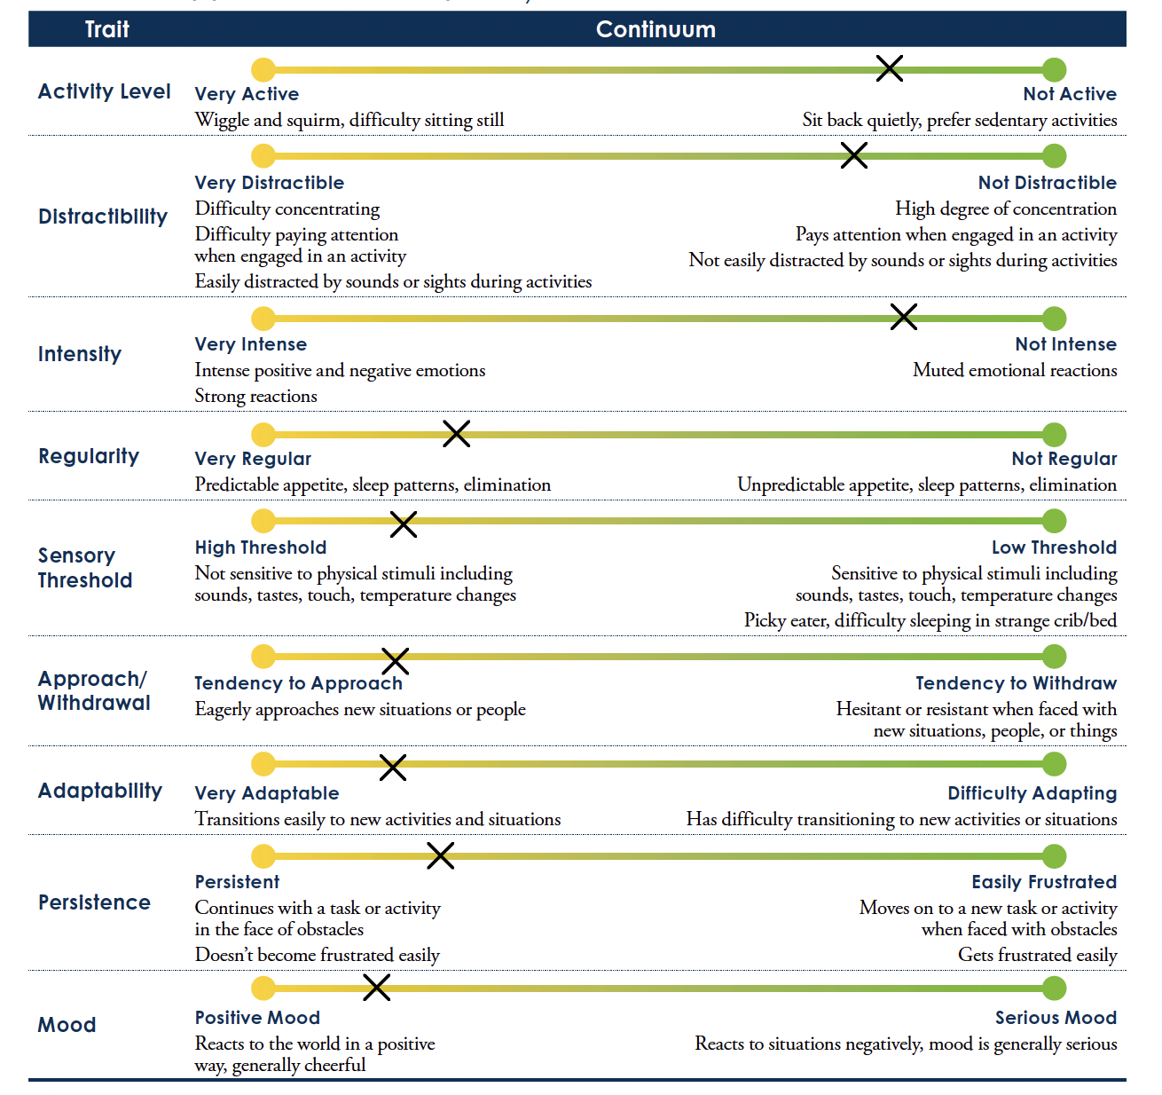
Micah’s Temperament

Slide 33
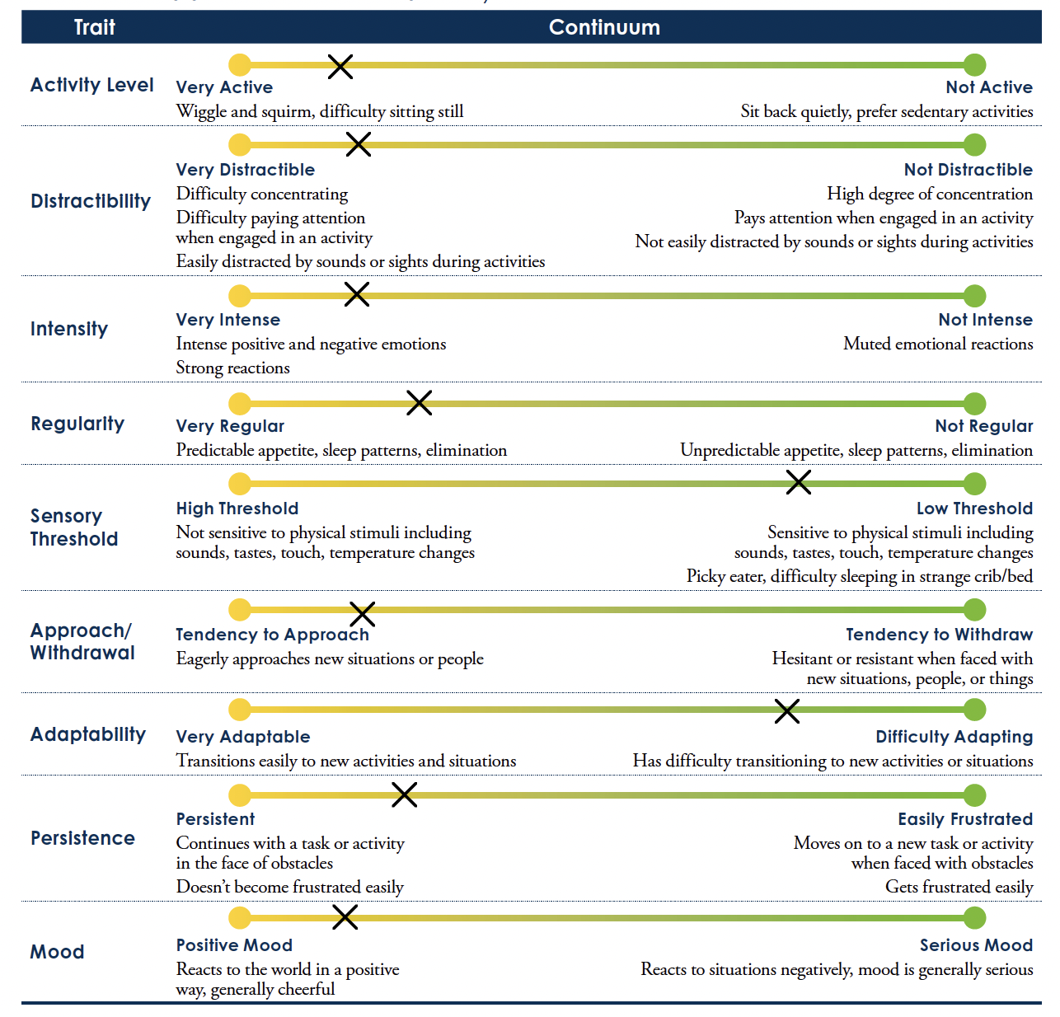
Ms. Mitchell’s Temperament

Slide 34
Which areas should Ms. Mitchell consider when thinking about Goodness of Fit?
Ms. Mitchell’s Temperament
Micah’s Temperament

Slide 35
Shared Traits
High Persistence:
Provide a range of activities and new objects
Delight in watching all of the ways the child explores.
Describe feelings for your child and consider praising his/her efforts.
High Approachability:
Take time to be around other children and families.
Be close by to help them as they learn to interact with others.
Sometimes highly approachable children need help interacting with those who are less approachable.
(Center of Excellence for Infant & Early Childhood Mental Health Consultation, n.d.)

Slide 36
Suggestions for a goodness-of-fit Low Distractibility
Allow extra time for activities Micah enjoys (e.g., “Would you like to look at a few more stories?”).
Offer choices at the end of activities (e.g., “Go down the slide again or ride bikes?”).
Give frequent transition reminders and use multiple cues (pictures, songs, gentle touch).
Encourage interaction with peers by noticing and describing play (e.g., “Can you roll the ball to Adam?”).
Spend regular one-on-one time with Micah each day.
(Center of Excellence for Infant & Early Childhood Mental Health Consultation, n.d.)

Slide 37
Suggestions for a goodness-of-fit High Sensitivity
Offer quiet alternatives during stimulating activities (e.g., reading or observing nearby).
Allow indoor play when outdoor conditions are uncomfortable (e.g., gym time).
Respond calmly when the child feels overwhelmed; suggest a quiet activity.
Respect eating patterns; introduce new foods slowly.
Warn before physical contact (e.g., “I’m going to pick you up now”).
Provide sensory experiences safely (e.g., sealed bags with sand or water).
Offer tools for exploring textures at the child’s pace (e.g., tongs, brushes, gloves).
(Center of Excellence for Infant & Early Childhood Mental Health Consultation, n.d.)

Slide 38
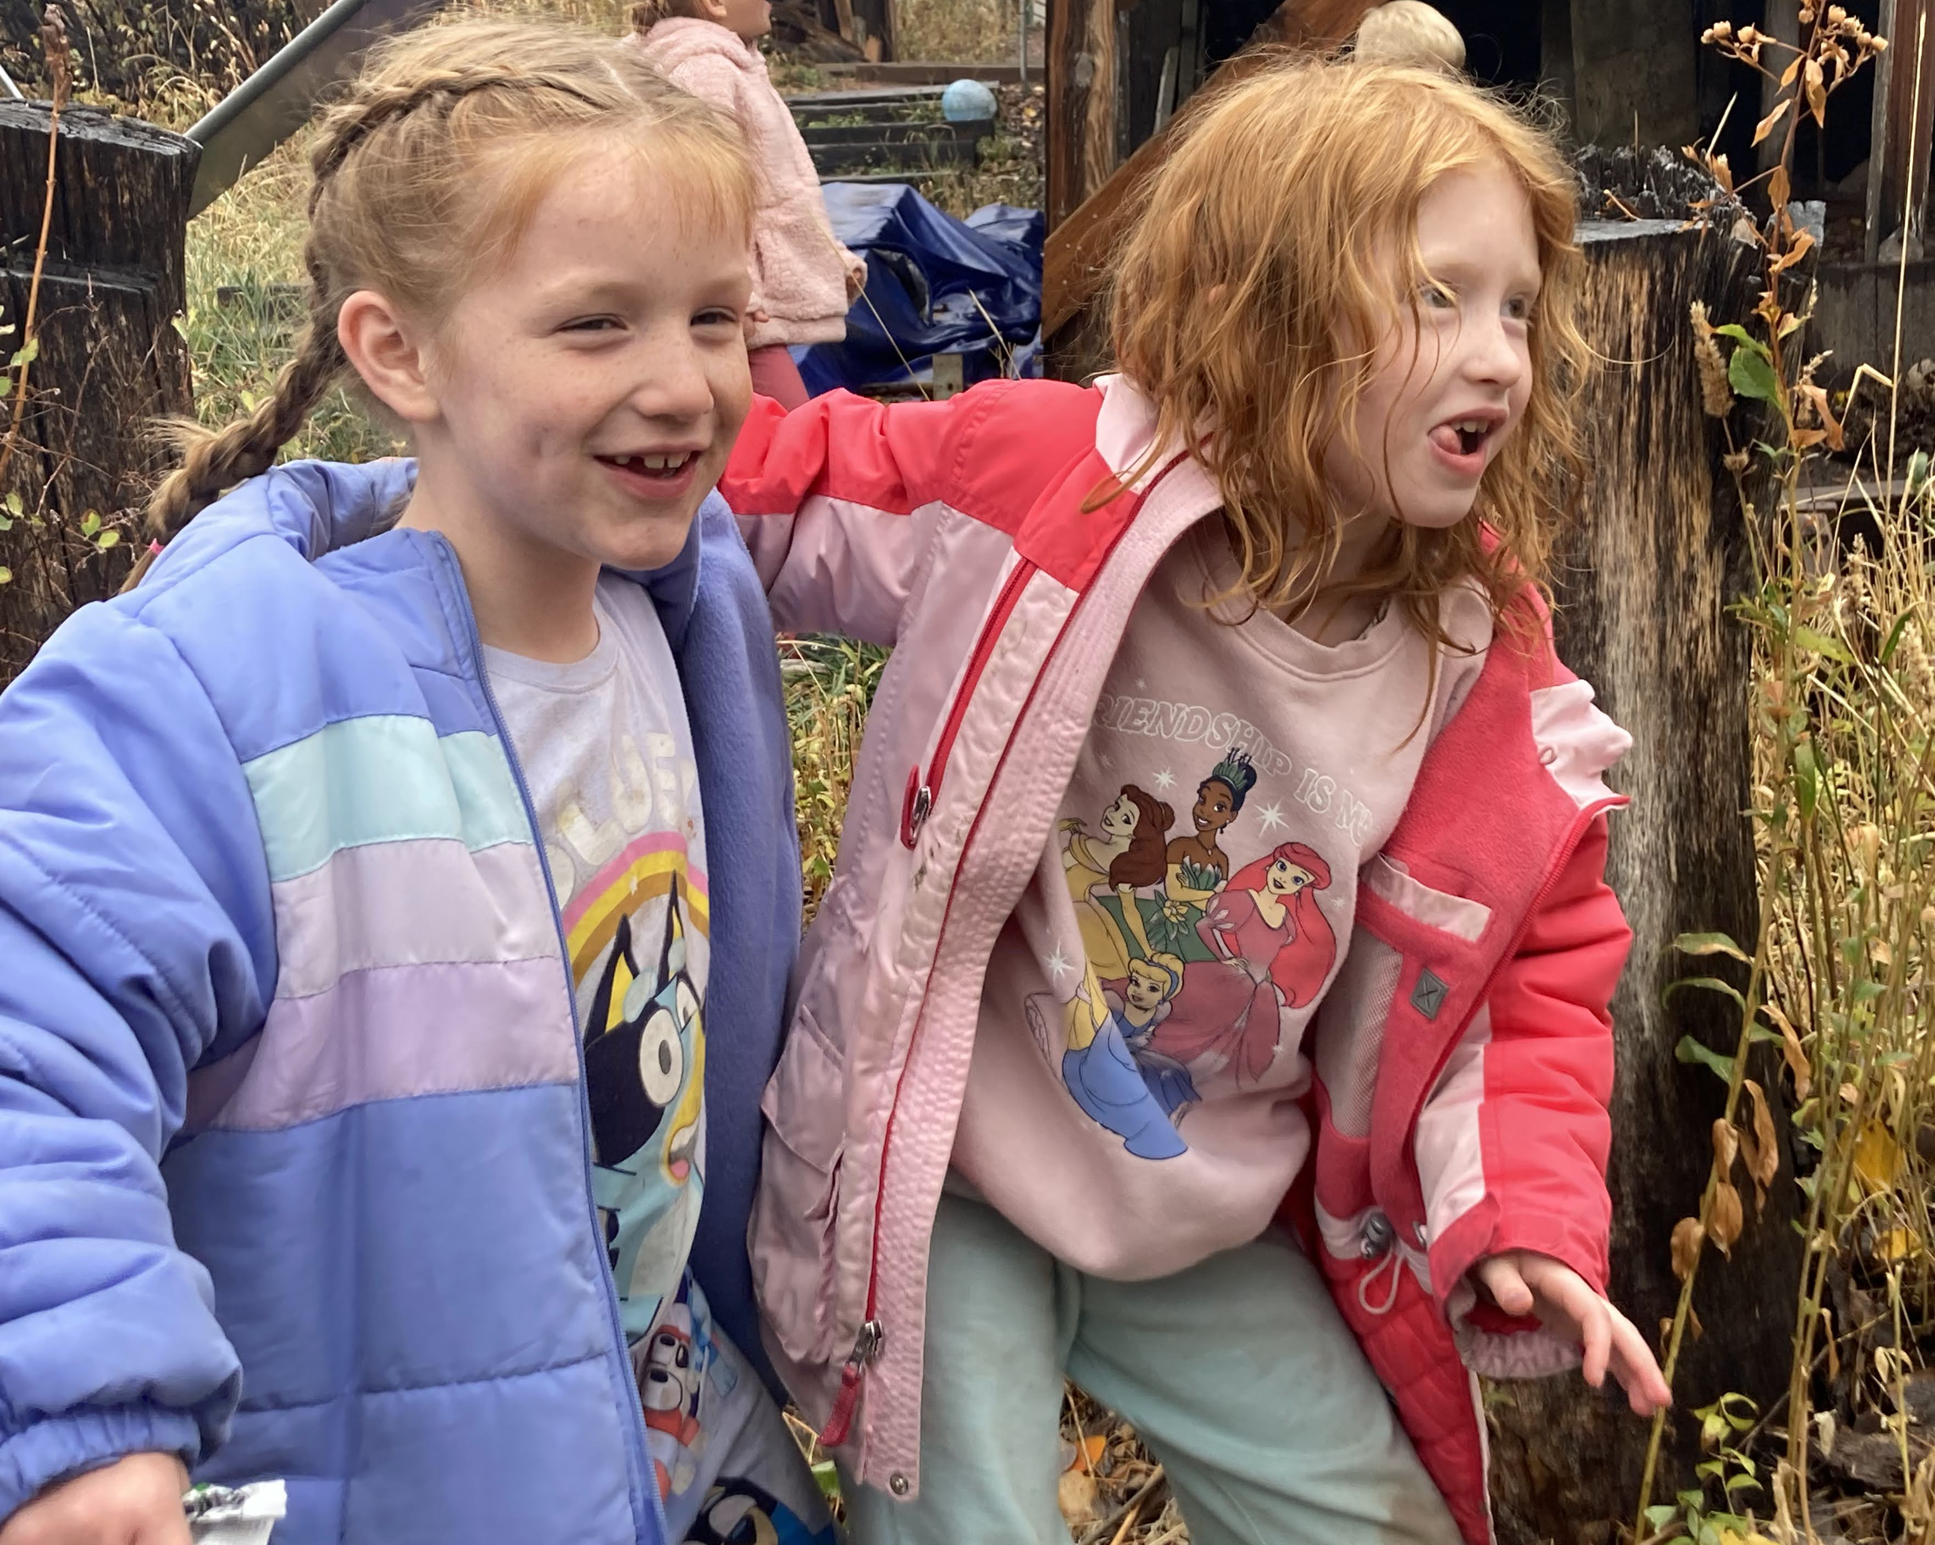

Temperament Tool and Suggestions
https://www.ecmhc.org/temperament/index.html
(Center of Excellence for Infant & Early Childhood Mental Health Consultation, n.d.)

Slide 39
The role of understanding temperament and its influence on learning self-regulation

Slide 40
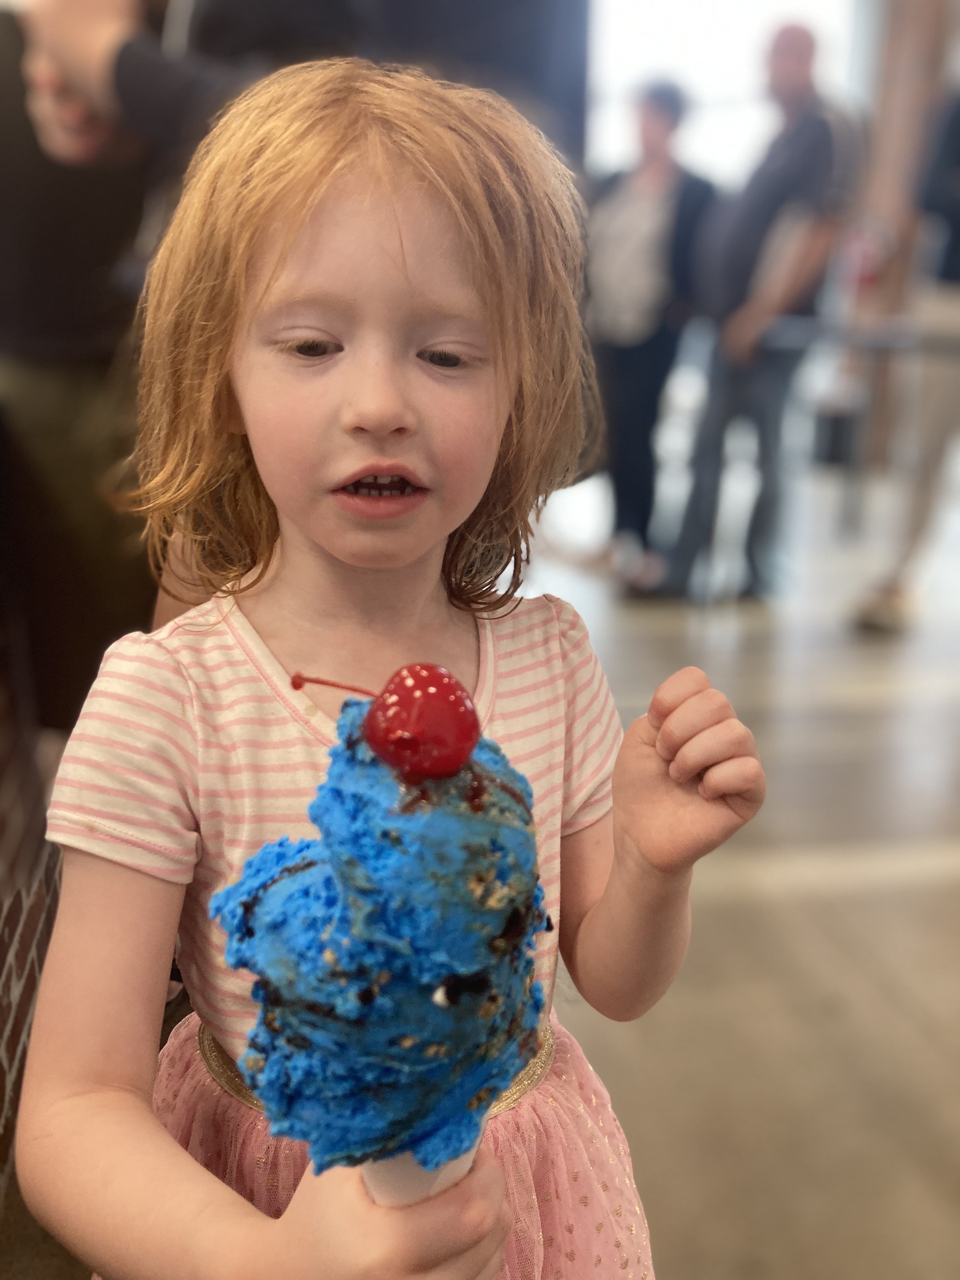
Self-Regulation
Easier time making friends
Handle disappointment better
Relate more successfully with peers and adults
Less impulsive
NPMI, 2022

Slide 41
Thank You

Slide 42
References
Allard, L. T., & Hunter, A. (2023). Understanding temperament in infants & toddlers (What Works Brief Series). National Center for Pyramid Model Innovations. https://challengingbehavior.cbcs.usf.edu/Chess, S., & Thomas, A. (1977). Temperament and development. Brunner/Mazel.
Center of Excellence for Infant & Early Childhood Mental Health Consultation. (n.d.). Temperament case study for use in training: Micah, 22 months old. https://www.ecmhc.org/temperament/case-study.html
Chess S, Thomas A. (1984). Origins and evolution of behavior disorders. Cambridge, MA: Harvard University Press.
Zero to Three. (2014). Temperament case study: Micah [Video]. Vimeo. https://vimeo.com/103169734

