Slide 1
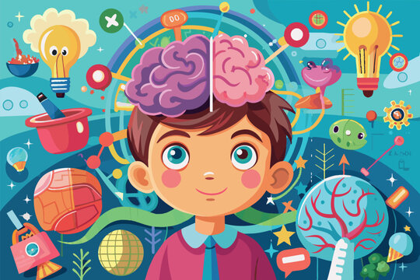

TRAUMA’S IMPACT ON THE BRAIN
HOW IT IMPACTS BEHAVIOR

Slide 2
What is Childhood Trauma?
Childhood trauma refers to distressing or harmful experiences that overwhelm a child’s ability to cope. These experiences may include:
Abuse (physical, emotional, sexual)
Neglect
Household dysfunction (substance use, domestic violence)
Loss of a caregiver
Chronic stress (poverty, instability)
A commonly referenced framework is Adverse Childhood Experiences (ACEs), which links early trauma to long-term health and behavioral outcomes.

Slide 3

TRAUMA AND THE BRAIN

Slide 4
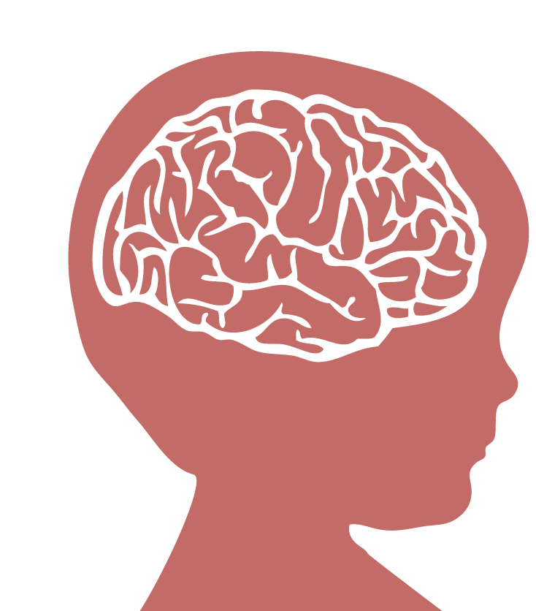
TRAUMA’S IMPACT ON THE BRAIN
Children’s experiences with trauma can negatively affect brain development.
Trauma has been found to …
Change the structure and chemical activity of the brain.
Decrease the size /connectivity in some parts of the brain.
Impair the emotional / behavioral functioning of the child.

Slide 5
How Trauma Impacts the Brain & Development
Trauma affects the developing brain in significant ways:
Heightened stress response: The brain becomes wired to detect danger quickly (fight, flight, or freeze)
Reduced executive functioning: Difficulty with attention, planning, and impulse control
Emotional regulation challenges: Strong reactions to seemingly small triggers
Memory and learning impacts: Difficulty retaining and processing information

Slide 6
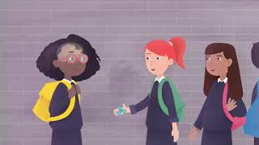
TRAUMA AND THE BRAIN
Notes:
Harvard Center on the Developing Child. (2013). The Science of Neglect. Retrieved August 28, 2016, from https://www.youtube.com/watch?v=bF3j5UVCSCA

Slide 7
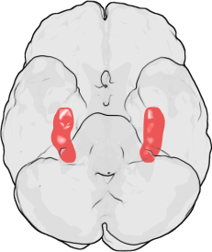
TRAUMA AND THE HIPPOCAMPUS
Maltreatment can affect the volume of the hippocampus, which is central to learning & memory.
The Hippocampus is involved in…
Declarative memory
purposefully recalling facts or events
Notes:
Child Welfare Information Gateway. (2015). Understanding the Effects of Maltreatment on Brain Development. Retrieved August 28, 2016, from https://www.childwelfare.gov/pubs/issue-briefs/brain-development.
Hippocampus: Function, Anatomy & Definition. (2015, April). Retrieved August 28, 2016, from http://www.healthline.com/human-body-maps/hippocampus

Slide 8
TRAUMA AND THE HIPPOCAMPUS
If trauma has affected a child’s hippocampus, they may have trouble with…
Vocab words or new terms
New facts
Recalling details from
recent events
Notes:
Byrne, J. (n.d.). Learning and Memory. Retrieved August 28, 2016, from http://neuroscience.uth.tmc.edu/s4/chapter07.html
DIGITALE, E. (2014, August). New research sheds light on how children's brains memorize facts. Retrieved August 28, 2016, from https://med.stanford.edu/news/all-news/2014/08/new-research-sheds-light-on-how-childrens-brains-memorize-facts.html

Slide 9
TRAUMA AND THE HIPPOCAMPUS
Studies show that the stronger the connection between a child’s hippocampus and other regions of their brain, the greater was each individual child’s ability to retrieve math facts from memory.
+
-
x
÷
Notes:
Byrne, J. (n.d.). Learning and Memory. Retrieved August 28, 2016, from http://neuroscience.uth.tmc.edu/s4/chapter07.html
DIGITALE, E. (2014, August). New research sheds light on how children's brains memorize facts. Retrieved August 28, 2016, from https://med.stanford.edu/news/all-news/2014/08/new-research-sheds-light-on-how-childrens-brains-memorize-facts.html

Slide 10
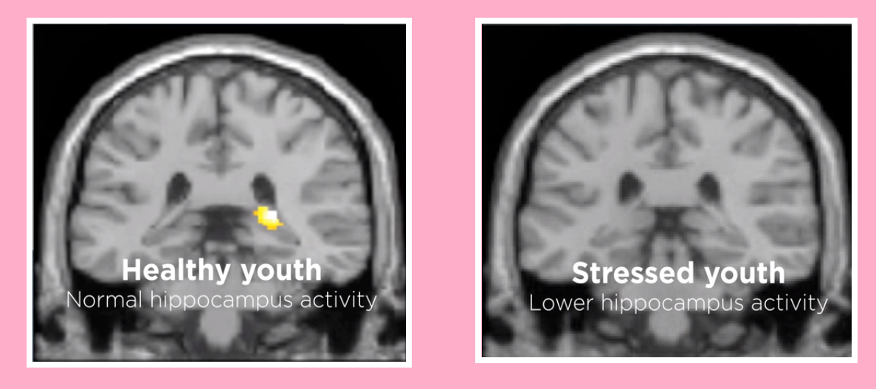
TRAUMA AND THE HIPPOCAMPUS
Maltreated youth have lower hippocampal activity than their non-abused cohort.
Notes:
Carrion, V. G., Haas, B. W., Garrett, A., Song, S., & Reiss, A. L. (2009). Reduced Hippocampal Activity in Youth with Posttraumatic Stress Symptoms: An fMRI Study. Journal of Pediatric Psychology, 35(5), 559-569.
Brains Change with Trauma. (2011, July). Retrieved August 28, 2016, from http://www.amnh.org/explore/science-bulletins/(watch)/human/news/brains-change-with-trauma/

Slide 11
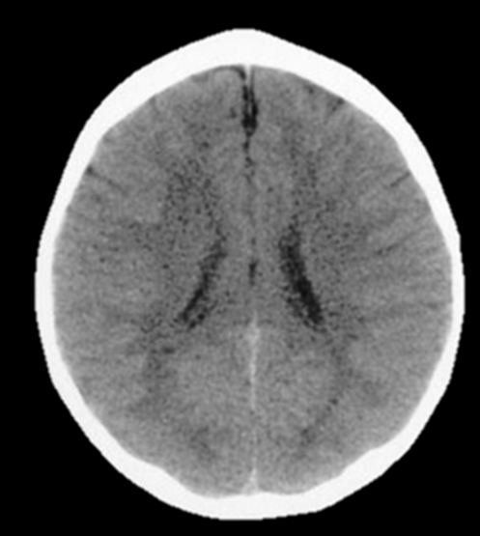
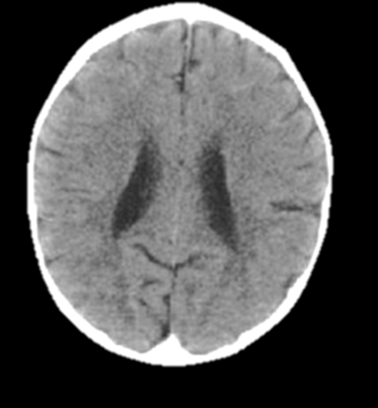
NEGLECT AND THE BRAIN
CARED FOR 3 YEAR OLD
NEGLECTED 3 YEAR OLD
The neglected brain is smaller, has enlarged ventricle holes in the center of the brain and a shrunken cortex (outer layer).
Notes:
Harvard Center on the Developing Child. (2013). The Science of Neglect. Retrieved August 28, 2016, from https://www.youtube.com/watch?v=bF3j5UVCSCA

Slide 12
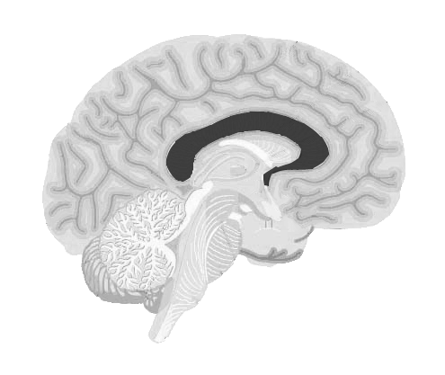
TRAUMA AND THE CORPUS CALLOSUM
Maltreated youth tend to have decreased volume in the corpus callosum.
This area of the brain is
responsible for connecting the
left & right brain & is involved in processes such as arousal, emotion, & higher cognitive abilities.
Notes:
Child Welfare Information Gateway. (2015). Understanding the Effects of Maltreatment on Brain Development. Retrieved August 28, 2016, from https://www.childwelfare.gov/pubs/issue-briefs/brain-development.

Slide 13

TRAUMA AND THE CORPUS CALLOSUM
The overall size of the corpus callosum correlates positively with verbal memory capacity and semantic coding.
If a youth’s corpus callosum has been affected by trauma they could struggle with recalling vocabulary words or new terminology.
Notes:
Kozlovskiy, S., Vartanov, A., Pyasik, M., & Nikonova, E. (2012). Functional role of corpus callosum regions in human memory functioning. International Journal of Psychophysiology, 85(3), 396-397.

Slide 14
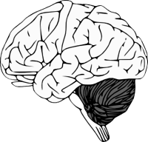
TRAUMA AND THE CEREBELLUM
Maltreated children and adolescents tend to have decreased volume in their cerebellum.
The cerebellum helps coordinate motor behavior and executive functioning.
Notes:
Child Welfare Information Gateway. (2015). Understanding the Effects of Maltreatment on Brain Development. Retrieved August 28, 2016, from https://www.childwelfare.gov/pubs/issue-briefs/brain-development.

Slide 15
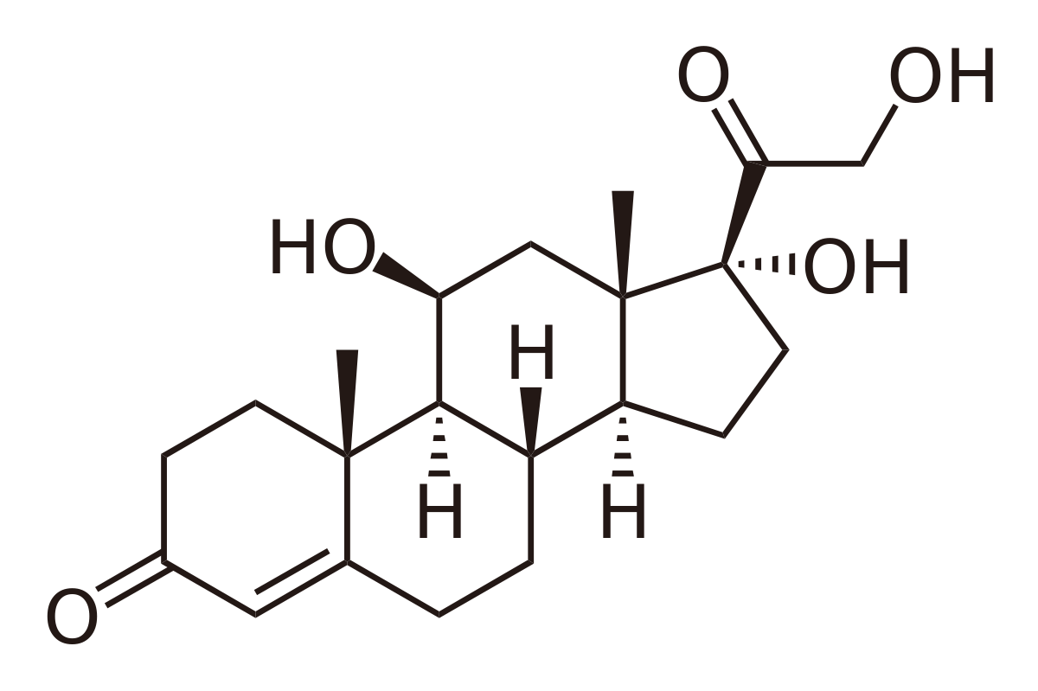
TRAUMA AND CORTISOL
Many traumatized youth have irregular cortisol levels This can affect their emotional and physical wellbeing.
LOWER THAN NORMAL CORTISOL LEVELS CAN CAUSE…
decreased energy resources
vulnerability to autoimmune disease
HIGHER THAN NORMAL CORTISOL CAN…
harm cognitive processes
subdue immune reactions
heighten the risk for anxiety and depression
Notes:
Child Welfare Information Gateway. (2015). Understanding the Effects of Maltreatment on Brain Development. Retrieved August 28, 2016, from https://www.childwelfare.gov/pubs/issue-briefs/brain-development.

Slide 16
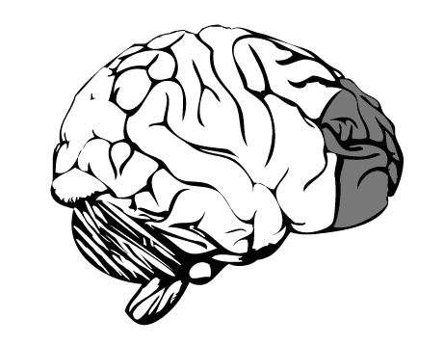
TRAUMA AND THE PREFRONTAL CORTEX
Studies show that individuals neglected as children have a smaller prefrontal cortex.
This prefrontal cortex is critical to:
  behavior
  cognition
  emotion regulation
Notes:
Child Welfare Information Gateway. (2015). Understanding the Effects of Maltreatment on Brain Development. Retrieved August 28, 2016, from https://www.childwelfare.gov/pubs/issue-briefs/brain-development.

Slide 17

TRAUMA AND THE PREFRONTAL CORTEX
When trauma affects a child’s prefrontal cortex, they may struggle with…
  Planning
  Emotional regulation
  Impulse control
  Decision making
  Judgment
  Problem-solving
  Memory
Notes:
Wake Forest Baptist Medical Center. (2012, March). Scientists gain new insight into prefrontal cortex activity. Retrieved August 28, 2016, from https://www.sciencedaily.com/releases/2012/03/120305160656.htm

Slide 18

TRAUMA AND THE AMYGDALA
Abuse and neglect can cause over activity in the Amygdala, the area of the brain which helps determine whether a stimulus is threatening and trigger emotional responses.
  Overstimulation of the amygdala can produce anxiety, hyperarousal and hypervigilance, resulting in …
Meltdowns
Overreactions
Difficulty calming down
Notes:
Child Welfare Information Gateway. (2015). Understanding the Effects of Maltreatment on Brain Development. Retrieved August 28, 2016, from https://www.childwelfare.gov/pubs/issue-briefs/brain-development.
Trauma-related behaviors are often adaptive responses, not intentional misbehavior. For example:
A child who refuses tasks may be avoiding perceived failure or stress
Aggression may be a learned survival response
Withdrawal may be a way to feel safe
Understanding this shift—from “What’s wrong with this child?” to “What happened to this child?”—is central to trauma-informed care.

Slide 19
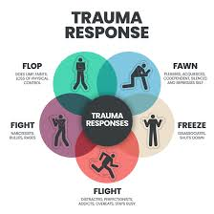
Trauma + Diagnosis
Trauma can have a stronger and more complex impact on children who already have diagnoses. Trauma interacts with existing vulnerabilities in ways that can intensify challenges.

Slide 20
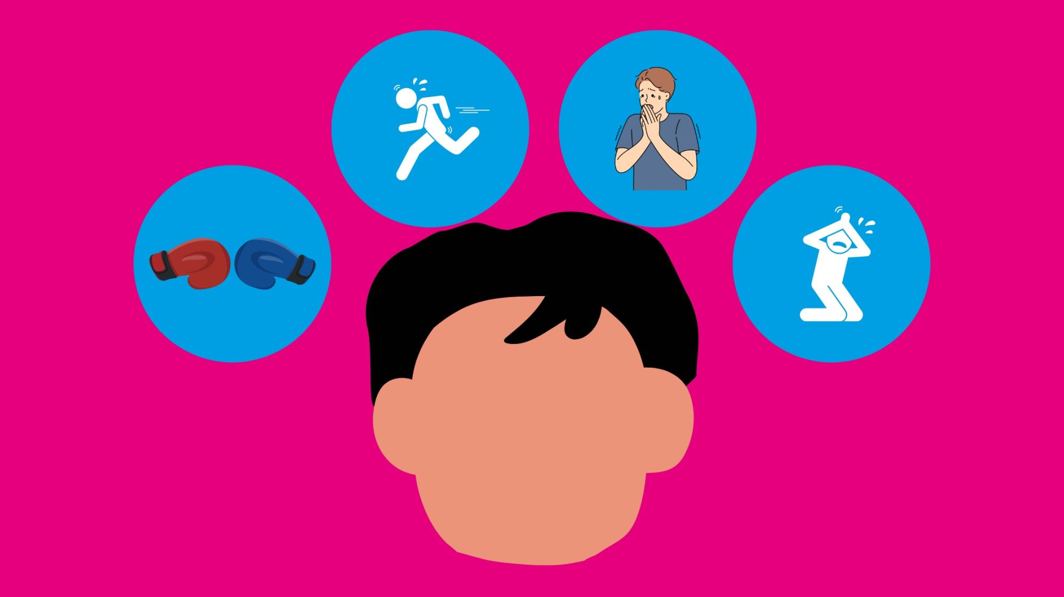
Trauma + Diagnosis
Here’s how it tends to show up:
Lower threshold for stress
Notes:
Many children with autism or ADHD already have differences in sensory processing, emotional regulation, or executive functioning. When trauma is added, their system may become overwhelmed more quickly.
Smaller triggers → bigger reactions
Longer recovery time after stress
Increased fight/flight/freeze responses

Slide 21

Trauma + Diagnosis
Behavior can escalate or look different
Notes:
Trauma responses can blend with or amplify existing behaviors, making it harder to tell what’s driving what.
For example:
A child with ADHD may show more impulsivity or aggression
A child with autism may have increased rigidity, shutdowns, or meltdowns
Avoidance, elopement, or refusal may increase
Sometimes what looks like “noncompliance” is actually a trauma response.

Slide 22

Trauma + Diagnosis
Communication barriers can mask trauma
Notes:
Children with communication challenges (common in autism) may not be able to express fear, confusion, or distress verbally.
Instead, you might see:
Sudden behavior changes
Regression in skills
Increased self-stimulatory or self-injurious behavior
This can delay recognition of trauma.

Slide 23

Trauma + Diagnosis
Difficulty generalizing safety
Notes:
Children with developmental differences may have a harder time understanding:
“That event is over”
“This place/person is safe”
So the trauma response may persist across settings (school, home, community).

Slide 24
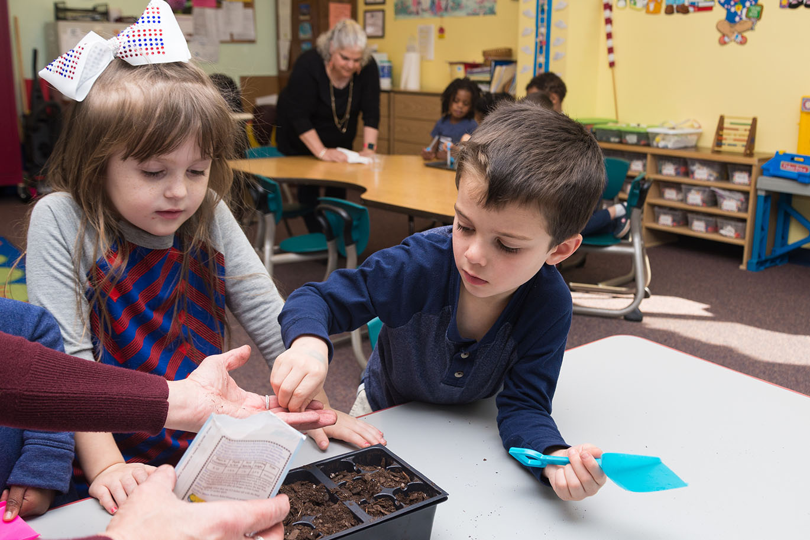
Trauma + Diagnosis
Higher risk for repeated stress and impact on skill development
Notes:
Unfortunately, kids with disabilities are statistically at higher risk for adverse experiences (e.g., misunderstanding by adults, social isolation, bullying), which can compound trauma over time.
Trauma can interfere with:
Learning
Social development
Emotional regulation
For kids already working on these skills, progress may slow or regress.

Slide 25
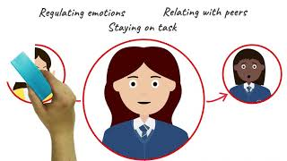
TRAUMA INFORMED SCHOOLS
Notes:
Harvard Center on the Developing Child. (2013). The Science of Neglect. Retrieved August 28, 2016, from https://www.youtube.com/watch?v=bF3j5UVCSCA

Slide 26

TRAUMA INFORMED STRATEGIES
1. Build Relationships
Prioritize connection before correction
Use consistent, supportive language
Establish trust over time
2. Create Predictable Environments
Maintain clear routines
Prepare students for transitions
Use visual schedules and structured expectations
3. Teach Replacement Skills
Coping strategies (deep breathing, breaks)
Emotional identification and expression
Problem-solving and communication skills
Notes:
Trauma can affect:
Academic performance
Peer relationships
Trust in adults
Ability to follow routines and expectations
Students may appear unmotivated or oppositional when they are actually overwhelmed or dysregulated.

Slide 27
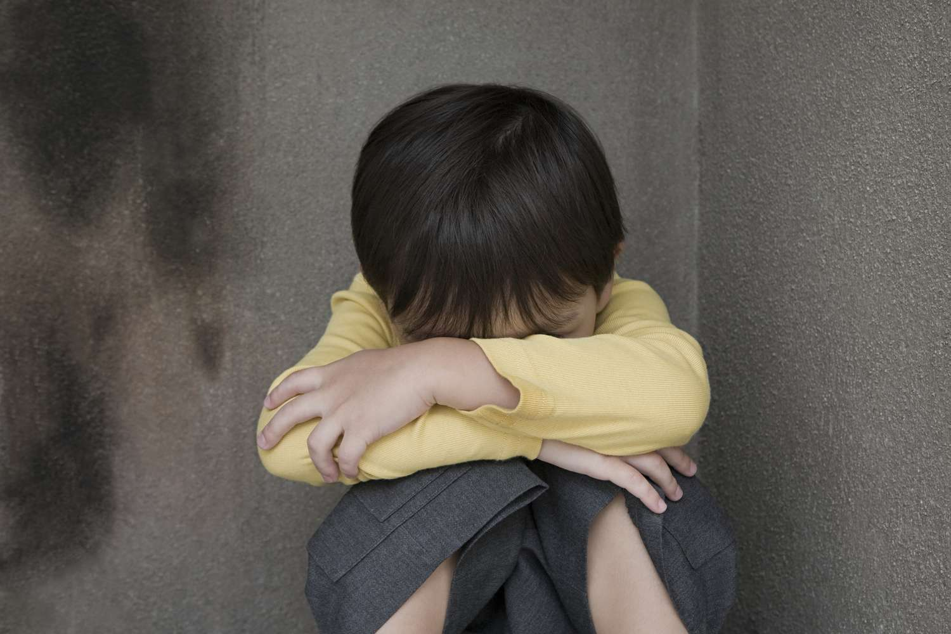
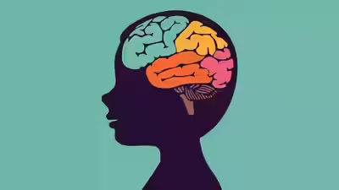
TRAUMA INFORMED STRATEGIES
4. Respond, Don’t React
Stay calm and regulated as the adult
Avoid punitive responses that may escalate behavior
Use de-escalation techniques
5. Provide Regulation Supports
Calm-down spaces (e.g., classroom break areas)
Sensory tools or movement breaks
Opportunities for choice and control
Behavior is often a form of communication. When children have experienced trauma, their behavior reflects underlying needs for safety, connection, and regulation. With consistent, trauma-informed support, students can build the skills needed to succeed socially, emotionally, and academically.

Slide 28

What this means
Behavior should be viewed through a DUAL LENS
What does effective
support include?
Notes:
The key takeaway is that behavior should be viewed through a dual lens:
Skill deficits (e.g., regulation, communication)
Trauma response (e.g., fear, hypervigilance, avoidance)
Effective support often includes:
Predictability and structure
Explicit teaching of regulation skills
Trauma-informed approaches (safety, trust, choice)
Careful interpretation before implementing intensive behavior plans

Slide 29
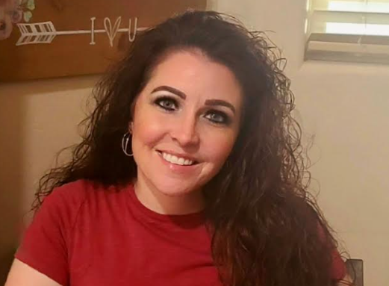

Thank you for coming!
Emily Sagendorf, M.Ed, BCBA, SSW
Southwest Educational Development Center
emilys@sedck12.org

