Slide 1
Function-Matched Behavior Strategies
Autism Conference 2026
Christine Manning M.Ed/Spe., BCBA
christinemanningconsulting@gmail.com

Slide 2
Session Objectives
Learn how to examine antecedent and consequence events to determine the function of a behavior
Discuss how to match appropriate evidence-based interventions to the function to increase desired behaviors.
Problem-solve a variety of function-matched interventions

Slide 3

Behavior Is Communication
Problem behavior has an underlying cause.
Behavior has cycles and patterns.
Behavior has a function.
Children will behave if they have the skills and know the expectations.

Slide 4


What are some behaviors you are dealing with?
We need to ask “WHY” a behavior is occurring.

Slide 5
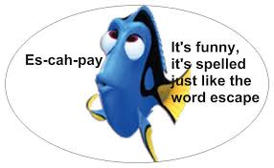
Functions of Behavior
Escape/Avoid: Gets out of or delays
Attention: Good or bad
Tangible or Activity
Sensory
All living organisms choose the path of least resistance:
Quickest resolution
Least amount of effort
Best reinforcers

Slide 6
ABC’s of Behavior
Antecedent- What happens right before the behavior that sets the occasion for the behavior to occur?
Behavior- What the student does- observable and measurable
Consequence- Something that happens AFTER the behavior that is in direct relation to the behavior happening. IT HAPPENS BECAUSE OF THE BEHAVIOR.
WHY is the student doing what they are doing?
Why=Function

Slide 7

Function-Matched Interventions
Try to match the function of behavior to an appropriate intervention.
If not, results are short-lived.
Let’s practice our A-B-C’s!

Slide 8

Look at the Context Clues
Where?
When?
Who?
Activity?
Unstructured time?
Take data to show times of day, frequency, and duration of behaviors. Subjective data tends to reflect problem child behavior as much worse than it is.

Slide 9

What’s the Function?
Why do we do what we do?
Work
Gym
Watch t.v.
Scroll
Grocery shop
Escape/Avoid
Attention – good or bad
Tangible/Activity
Sensory

Slide 10
Escape Interventions
What things do we want to escape or avoid?
1.Shorten activity
even #s
fold paper
choose 5
file folder
2. Modify/simplify expectation
Morning routine- hang coat, turn in homework, put backpack away, get bellringer, desk
3. Eliminate or postpone the antecedent – math worksheet

Slide 11
Escape Interventions
4. Modify Instruction, Change HOW content is presented (SDI)
5. Modify the task to make more functional, relevant, interesting
6. Shorten work sessions
7. Use behavioral momentum- easy gradually transition to more difficult
8. Provide alternate means to show mastery – discussion, project, presentation, etc.

Slide 12
Escape Interventions
9. Ensure classroom instruction is appropriate (pacing, differentiation, ect.)
10. Enriched Environment/learning modes – music, movement, art, chants, songs, visuals, kinesthetic activities
11. Non-Contingent Reinforcement for Escape (NCR-Escape)
12. Teach how to ask for a break or a change in activity
13. Increase OTR’s
14. HQ Instruction using High Leverage Practices (HLP’s)
15. Higher rates of reinforcement for more difficult tasks

Slide 13
Attention Interventions
1. Non-Contingent Reinforcement for Attention (NCR-Attention)
2. Class helper, job
3. Times to receive attention: line up, take roll, tell appropriate jokes, hand-outs, door holder
4. Peer tutoring/Dyad reading
5. Collaboration/partners

Slide 14
Attention Interventions
6. Opportunities to Respond
7. Differential Reinforcement for attention
8. Teach HOW to appropriately solicit attention “Look teacher (mom), I just finished my math!”
9. Earn reinforcers/prizes, etc. for class (class clap)
10. Scheduled time (talk ticket)

Slide 15
Tangible or Activity Interventions
1. First/then visual
2. Token economy to purchase tangible or activities or TIME with
3. Transitions times using tangibles/fidget tools
4. Visual schedule with time for tangibles/activities
5. Increased opportunities for tangibles/activities – decrease deprivation

Slide 16
Tangible or Activity Interventions
6. Tangible or activity schedule (Scheduled times)
7. Enriched environment with hands-on activities for learning
8. Noncontingent access to tangibles

Slide 17
Sensory Interventions-Basic
1. Sensory breaks- music, dance, stretching
2. Downtime (no demand)
3. Sensory box
4. Enriched environment
5. Hands-on activities

Slide 18
Sensory Interventions-Basic
6. Teach strategies to fill the need (socially appropriate and independent)
7. Work with the child to find out what the needs are: Headphones, weighted blankets or vests, fidgets, velcro, seating options, chewing options, music,...
8. Teach calming and/or self-regulation strategies
Work with an Occupational Therapist

Slide 19
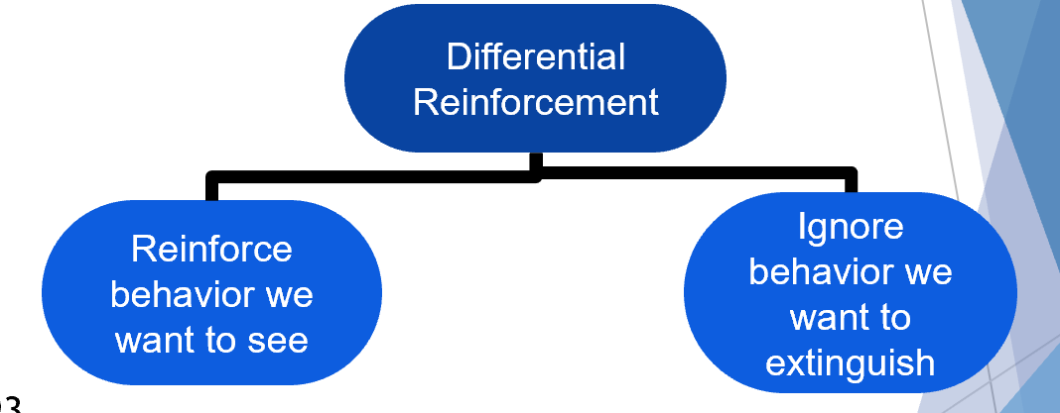
Differential Reinforcement
A procedure where you are reinforcing the behaviors you want to see and giving little or no attention to the problem behavior.

Slide 20

We will experience greater success
When we match the function of the behavior to the appropriate intervention.
If at first you don’t succeed, try try again.

Slide 21
Christine Manning M.Ed/Spe., BCBA, LBA
christinemanningconsulting@gmail.com
christine@manningbehaviorservices.com

