Slide 1
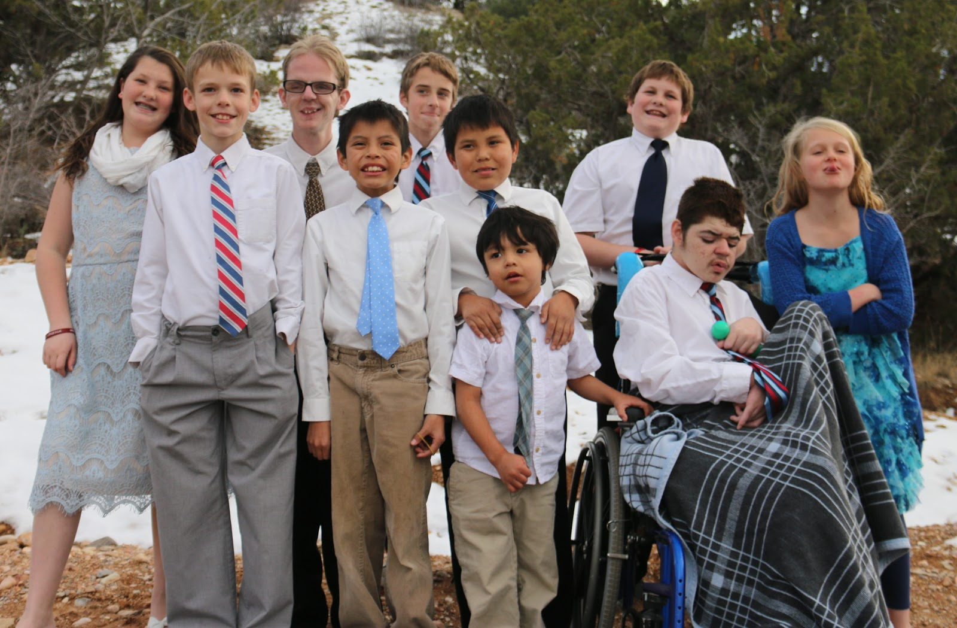
You Matter Too! Caring for the Caregiver Presented by Amy Arnold M.S.Ed
Notes:
“Raise your hand if you’re tired.” (pause… let them laugh)
“Raise your hand if you love your child more than anything.”
“Both can be true. That’s what today is about.” Its about YOU

Slide 2
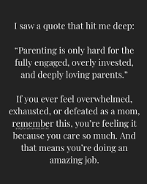
The hardest part of parenting my child is…

Slide 3
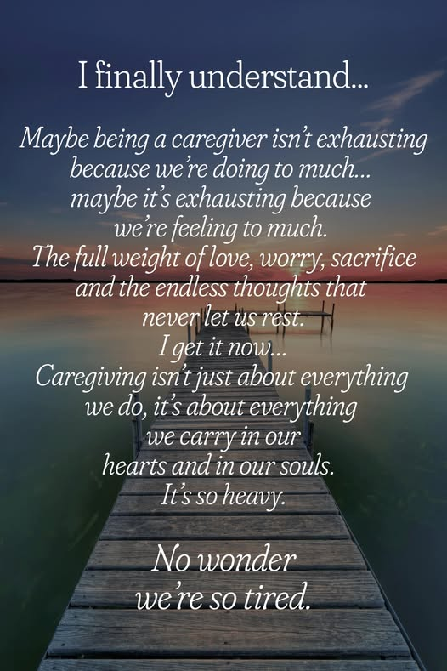
Caregiver Reality
Doctor Appointments
Therapy Appointments
School Meetings
Med Management
Laundry
Dinner
Cleaning the house
Friends
Exercise
Marriage
Other kids
Self Care

Slide 4

Put a Finger Down
Parent Edition

Slide 5
Red Flags of Burnout
Loss of motivation
Irritability
Numbness
Headaches
Too much sleep
Not eating enough
Isolation
Physical symptoms
Exhaustion
Eating too much
anxiety
Loss of sleep
Resentment

Slide 6
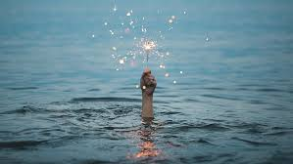
Glimmers
As each one of us finds a glimmer, the glimmer moments begin to accumulate in our system. We begin to see more, and we begin to have more capacity to be in that place of regulation. And from that place of regulation, you then can show up for others in a different way.
It's almost as if this
micro-moment
— this glimmer —
is the beginning of what
can become a really big change.”
-Deb Dana LCSW

Slide 7
Green Light Behavior
Green Light Behavior | Yellow Light Behavior | Red Light Behavior
Step 1: In the green column list behaviors that happened when everything is at its best
Step 2: In red light column list behaviors you see when secondary trauma is negatively effecting your life
Step 3: In yellow light column list behaviors that start you in a negative direction

Slide 8
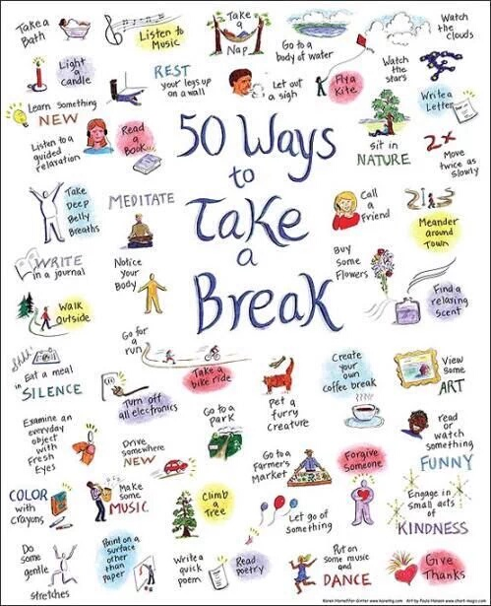
Micro Self-Care

Slide 9
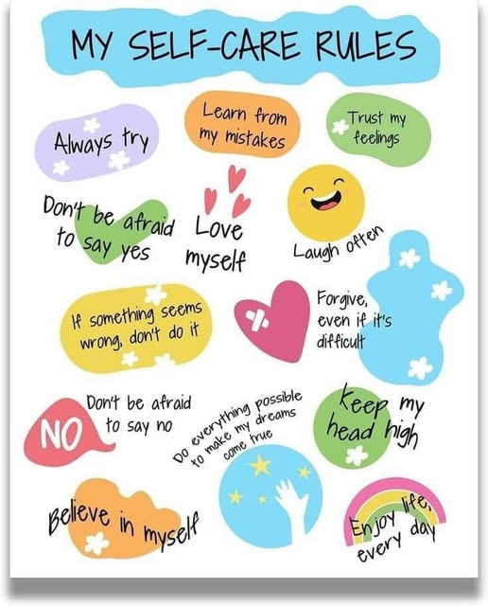
The 10-Minute Rule
What can you do
for yourself in
10 minutes today?
Do that!

Slide 10
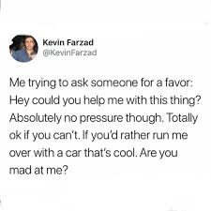
Ways to Ask for Help (Without the Guilt)
Be specific
(what, when, how long)
Start small
Ask someone safe
Practice saying it
out loud
Notes:
Common barriers:
- “I should be able to handle this.”
- “I don’t want to be a burden.”
- “It’s just easier to do it myself.”
Shift your mindset:
- Help is not charity—it’s connection.
- People often WANT to help, they just don’t know how.
Specific asks make it easier for others to say yes.
Why it matters:
Asking for help is not a weakness—it is a strategy for sustainability. You were never meant to do this alone.

Slide 11
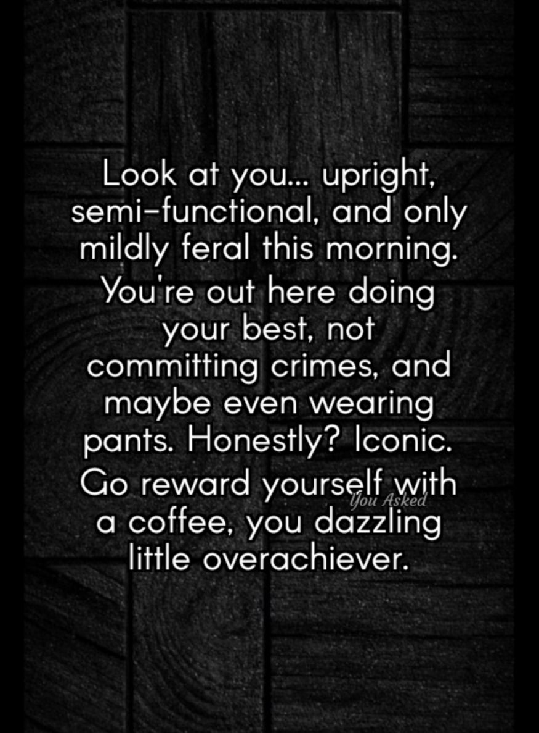
Real-Life Strategy
Lower the bar.
Then lower it again.
Survival days count.

Slide 12
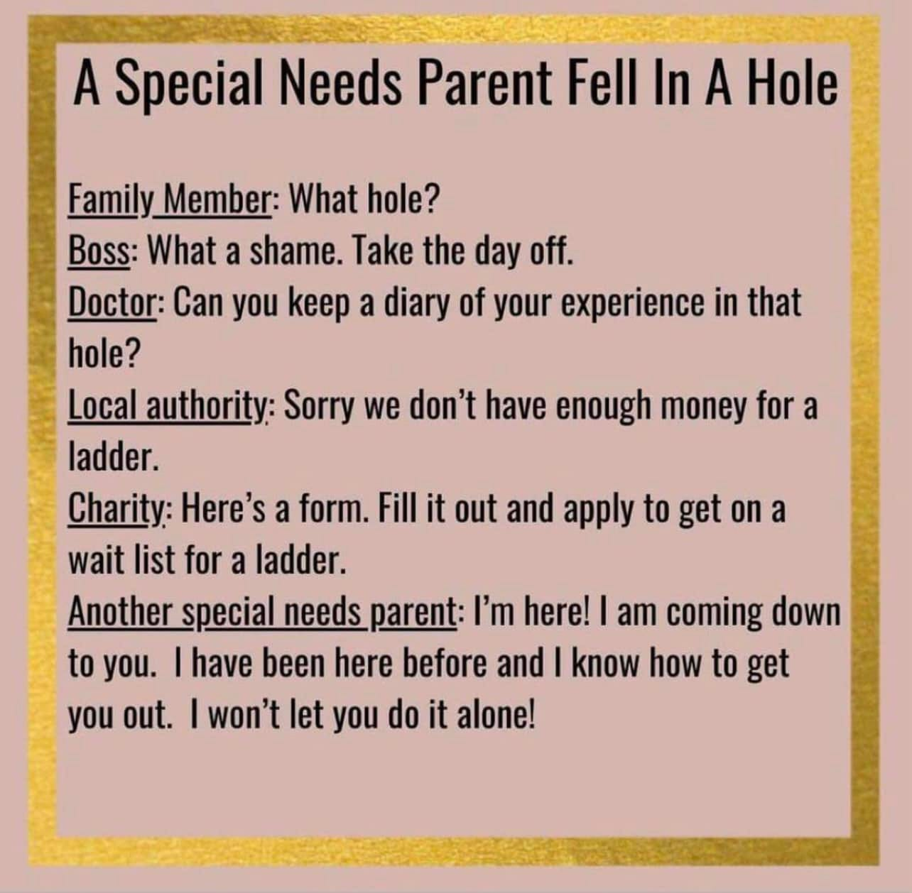
Support Systems
You were never meant to do this alone.
Find your people.

Slide 13
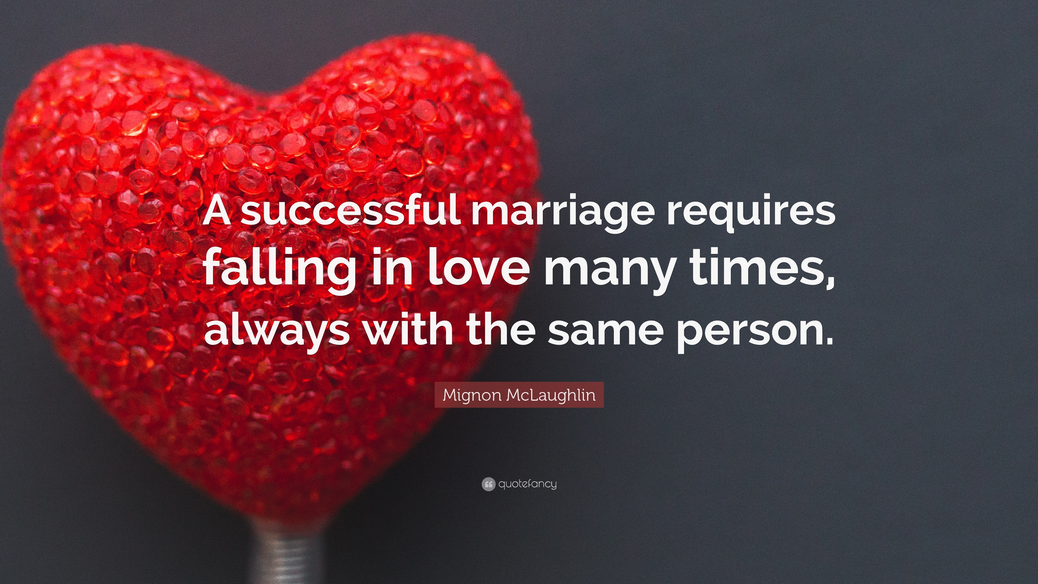
Marriage & Relationships
You’re on the same team.
Even when you’re tired and snappy.

Slide 14
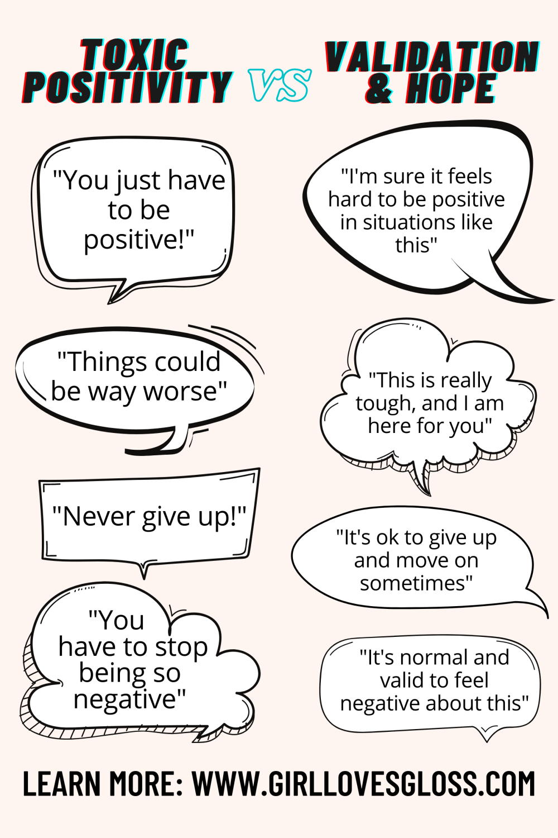
Reframing Strength
Notes:
Strength isn’t doing it all.
It’s knowing when to rest.

Slide 15
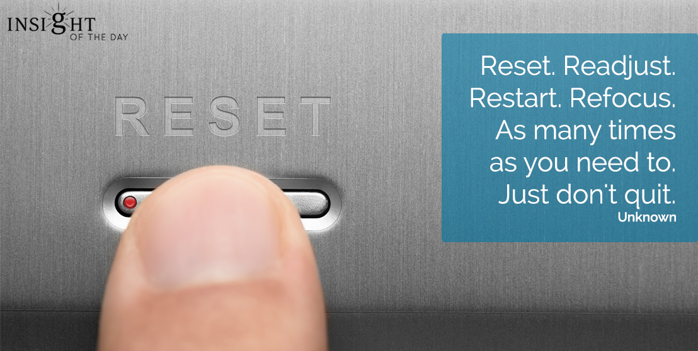
Daily Reset
Ask: What do I need today?
Not forever—just today.

Slide 16
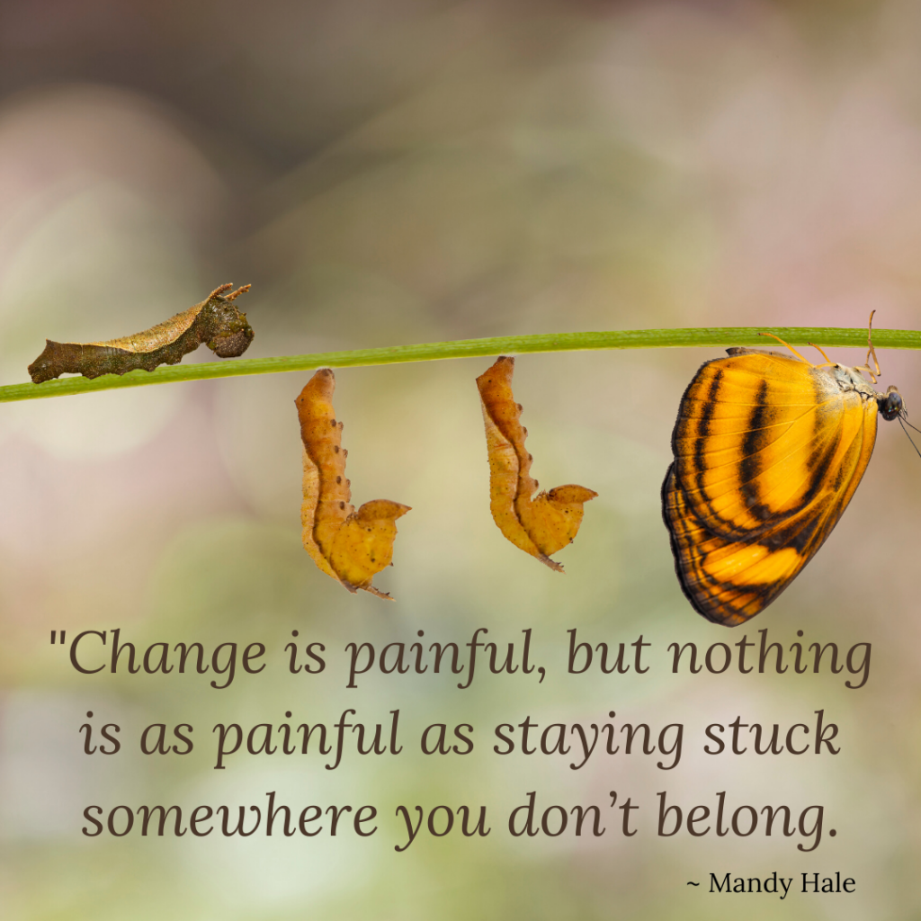
Cultivating Changes
Deal with one issue at a time
Start small
Go slow
Practicing and tracking
Fact check your values

Slide 17
Fact Check your Values
Social Creative
Physical Emotional
Intellectual Spiritual
Low 1 2 3 4 5 High
Never 1 2 3 4 5 Always

Slide 18

Your Emotions
Releasing Anger
Opposite to Emotion Action
ACT: Acceptance and Commitment Therapy
Regenerate Empathy

Slide 19
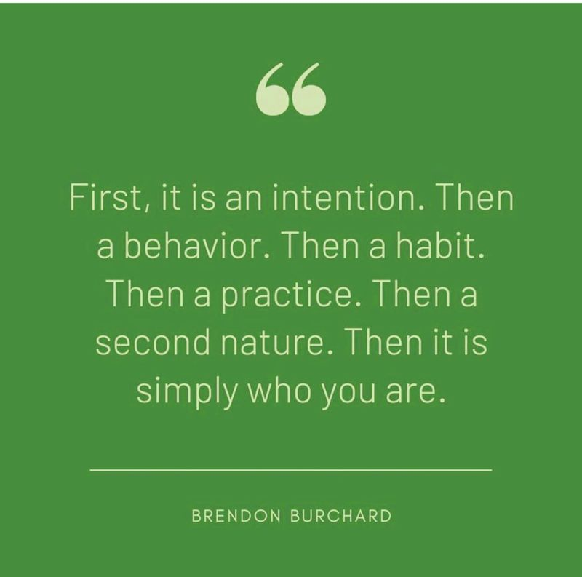
“What is ONE thing you are taking from today?”

Slide 20
