Slide 1
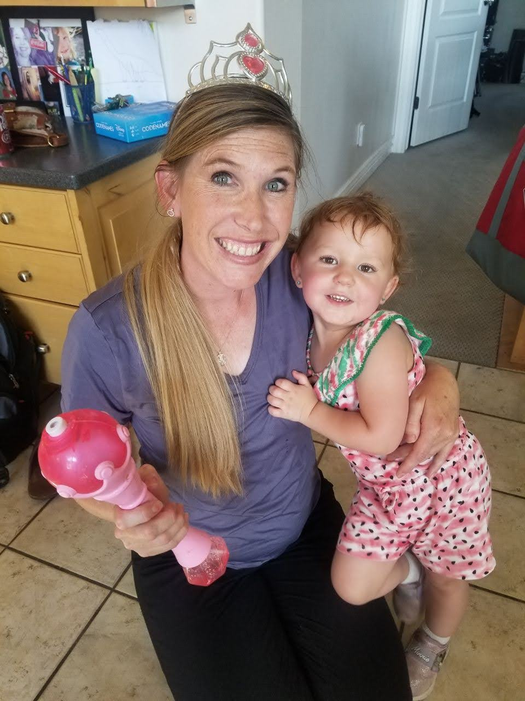
Bridging Trust and Expectations: Gaining Assent from Children with Disabilities During Intervention
Summer Gunn M.Ed. BCBA LBA
Professional Practice Assistant Professor
Department of Special Education and Rehabilitation Counseling
Southern Utah Autism Conference April 18, 2026

Slide 2
Who is here?

Slide 3
Objectives:
Understand the ethical importance of assent in interventions.
Learn to recognize vocal and nonverbal assent/dissent cues.
Explore strategies to balance behavioral expectations with autonomy.
Apply evidence-based recommendations for fostering trust and collaboration.

Slide 4
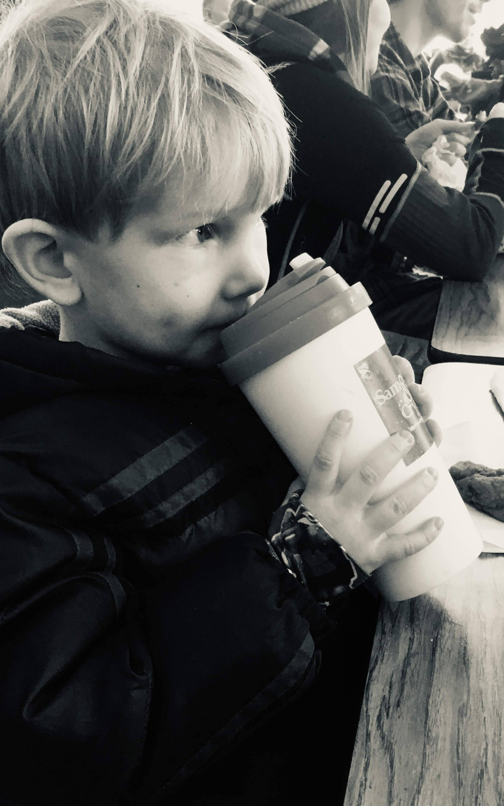
DEC Recommended Practices
INT1. Practitioners promote the child’s social-emotional development by observing, interpreting, and responding contingently to the range of the child’s emotional expressions.
INT5. Practitioners promote the child’s problem-solving behavior by observing, interpreting, and scaffolding in response to the child’s growing level of autonomy and self-regulation.

Slide 5
Standards
NAEYC
1b: Understand and value each child as an individual with unique developmental variations, experiences, strengths, interests, abilities, challenges, approaches to learning, and with the capacity to make choices.
4a: Understand and demonstrate positive, caring, supportive relationships and interactions as the foundation of early childhood educators’ work with young children.
CEC EI/ECSE
1.1: Candidates demonstrate an understanding of the impact that different theories and philosophies of early learning and development have on assessment, curriculum, intervention, and instruction decisions.
6.2 Candidates engage in reciprocal partnerships with families and other professionals to facilitate responsive adult-child interactions, interventions, and instruction in support of child learning and development.

Slide 6
What is Assent? What words do you associate with assent?

Slide 7
Assent
Vocal or nonvocal verbal behavior that can be taken to indicate willingness to participate in services (BACB, 2020).
Notes:
Consent
Definition: A person gives informed permission for something to happen, such as a medical procedure or participation in a study.
Requirements:
The person must have the legal capacity and cognitive ability to understand the information.
They must be given adequate information about risks, benefits, and alternatives.
Consent must be voluntary and documented.
Example: An adult signs a form agreeing to participate in a research study after being fully informed.
Assent
Definition: A person agrees to something, but may not have the legal or cognitive capacity to give full consent.
Used When:
The individual is a minor or has a disability that affects decision-making capacity.
They can still understand the situation in a developmentally appropriate way.
Example: A child says “yes” to participating in a study after it’s explained in simple terms, even though their parent gives formal consent.

Slide 8
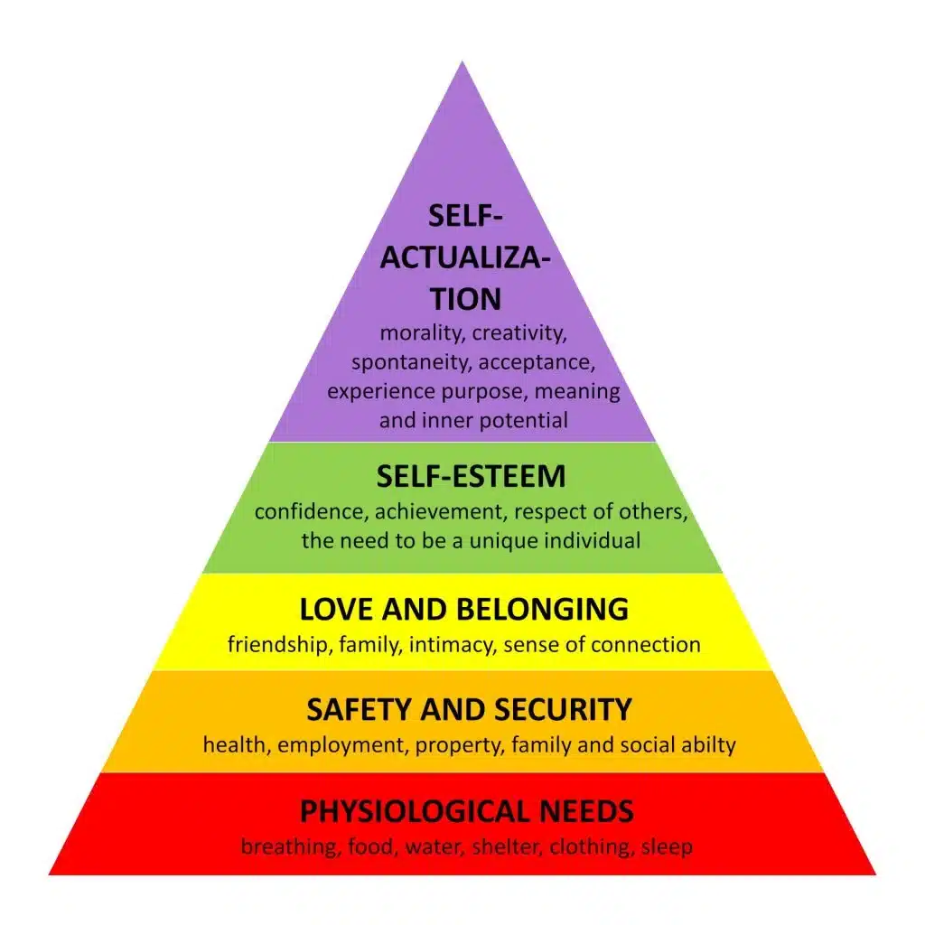
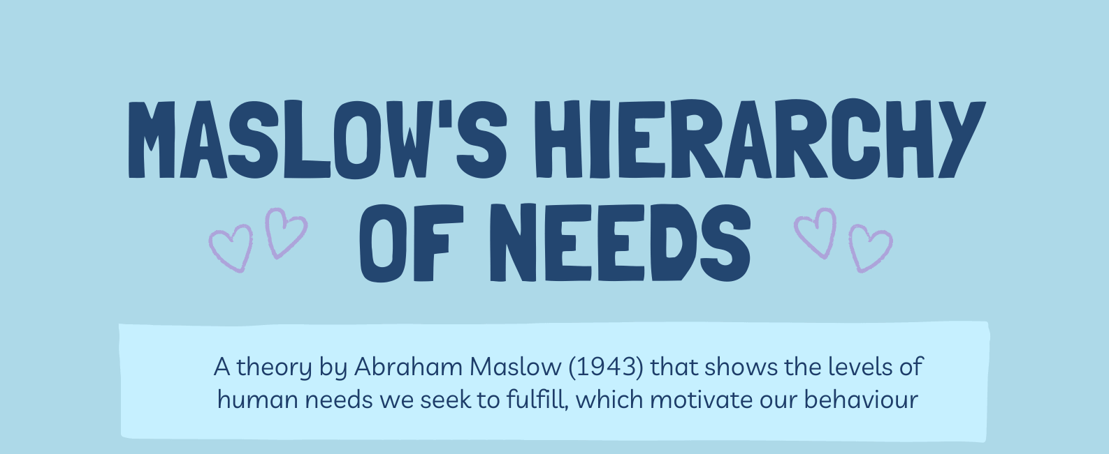
(Maslow, 1943)

Slide 9
USBE LRBI
RISK FACTORS AND PROTECTIVE FACTORS
Each student may experience different risk factors that can increase the likelihood of poor outcomes. These risk factors might include experiencing unsafe situations in the home, school, or community; lacking food, safe shelter, or supportive social relationships; and/or experiencing bullying, discrimination, or abuse. Actively building specific protective factors can prevent or reduce the negative impact of risk factors and improve health outcomes. To do this, teams can highlight the existing strengths and skills of a student, then note where support can be provided to build the student’s connection to these protective factors
Utah LRBI (2023)

Slide 10
Self-
Actualization
Esteem
Love/Belonging
Physiological
Safety Needs
A child who is hungry, tired, or unwell will struggle to engage in learning. Meeting these needs is foundational for readiness.
Predictable routines, emotional security, and physical safety create the conditions for attention and exploration.
Positive relationships with caregivers and peers foster trust, which is essential for participation and risk-taking in learning.
Encouragement and recognition build confidence, making children more willing to attempt new tasks.
When all prior needs are met, children can fully engage in creative, problem-solving, and higher-order learning.
Fluency
Acquisition
(Omrod, 2020)
Notes:
Foundational needs (bottom tiers) create readiness for learning. Skill acquisition begins once safety and belonging are stable, and it accelerates at esteem and self-actualization levels.

Slide 11

When we prioritize…
Sense of Safety
Dignity (honoring choice, inclusion)
Participation
Engagement
…we prioritize relationships as a vehicle for learning
(Barr & Bateman, 2025)

Slide 12
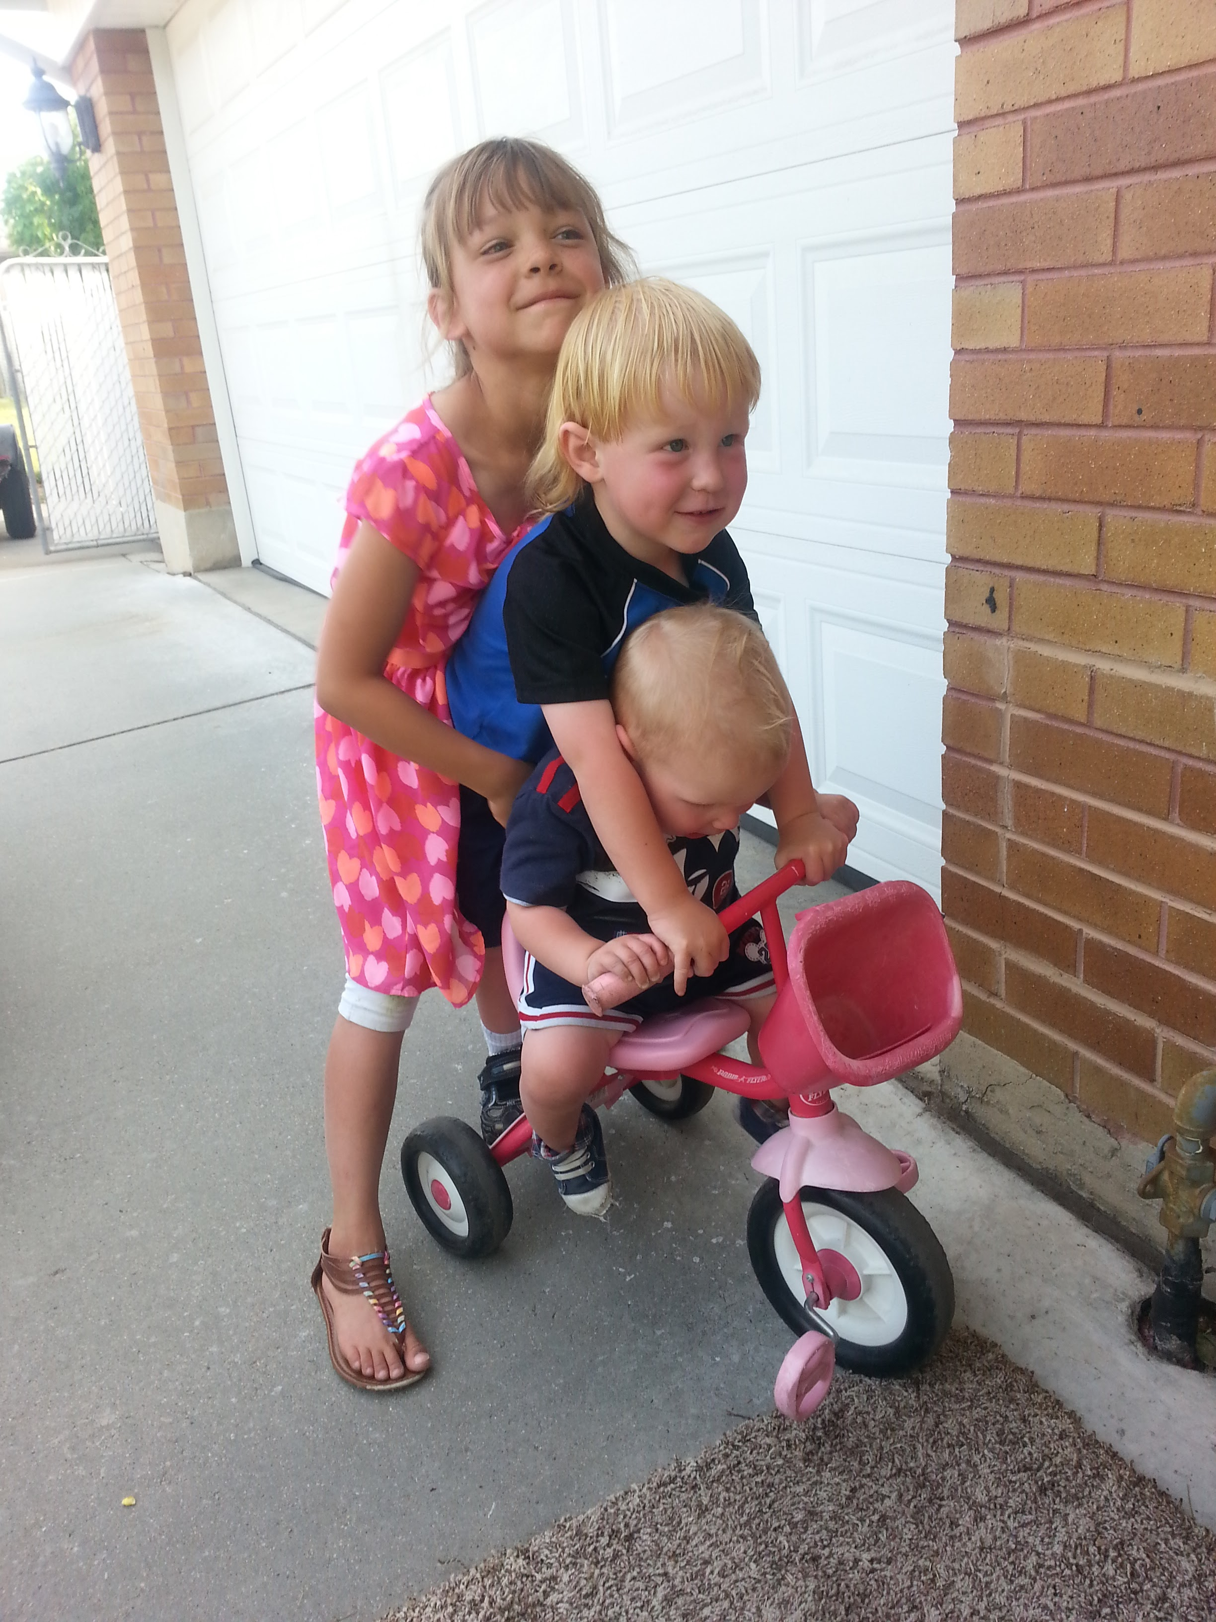
“Children’s motivation to learn is increased when their learning environment fosters a sense of belonging, purpose, and agency.”
(Source: National Association for the Education of Young Children [NAEYC], 2020, Developmentally Appropriate Practice: A Position Statement, p. 10)

Slide 13
Honoring assent is not…
Honoring assent is …
Children can do whatever they want
Giving up the provider's authority
We do not need rules or boundaries
Assent and boundaries/ rules can coexist.
Children having a way to communicate choice and agency.
(Barr & Bateman, 2025)
Notes:
Children don’t need
rules or boundaries
> Learners can do
whatever they want,
when they want
> Giving up teacher
authority
We are NOT saying
But, first...
We ARE saying
• Boundaries and
structure can coexist
with learner autonomy
• Children deserve voice
and agency in the
learning process
• Active participation
supports engagement,
trust, and ethical
practice

Slide 14
Reframing Narratives
Deficit-Based
Strength-Based
The student has behavior problem
The student benefits from support in building self-regulation strategies
Notes:
The student benefits from support in building self-regulation strategies

Slide 15
Category | Deficit-Based Approach | Strength-Based Approach
Perspective on Individuals | Sees individuals as needing to overcome flaws or deficiencies | Sees individuals as capable, resourceful, and resilient
Problem Approach | Identifies problems and seeks to fix them | Identifies strengths and seeks to build on them
Intervention Strategy | Interventions aim to correct deficiencies or reduce problems | Interventions aim to enhance existing strengths and abilities
Role of the Professional | The professional is seen as the expert who fixes the problem | The professional collaborates with the individual, guiding them to discover and use their strengths
Outcome Focus | Aims for elimination of the problem or weakness | Aims for empowerment, growth, and success through leveraging strengths
Language Used | Problem-oriented (e.g., “fix,” “overcome,” “deficiency”) | Strength-oriented (e.g., “empower,” “build,” “resources”)
Motivation | May create dependency and focus on what’s wrong | Encourages self-efficacy and emphasizes what is already working well
(Barr & Bateman, 2025)

Slide 16

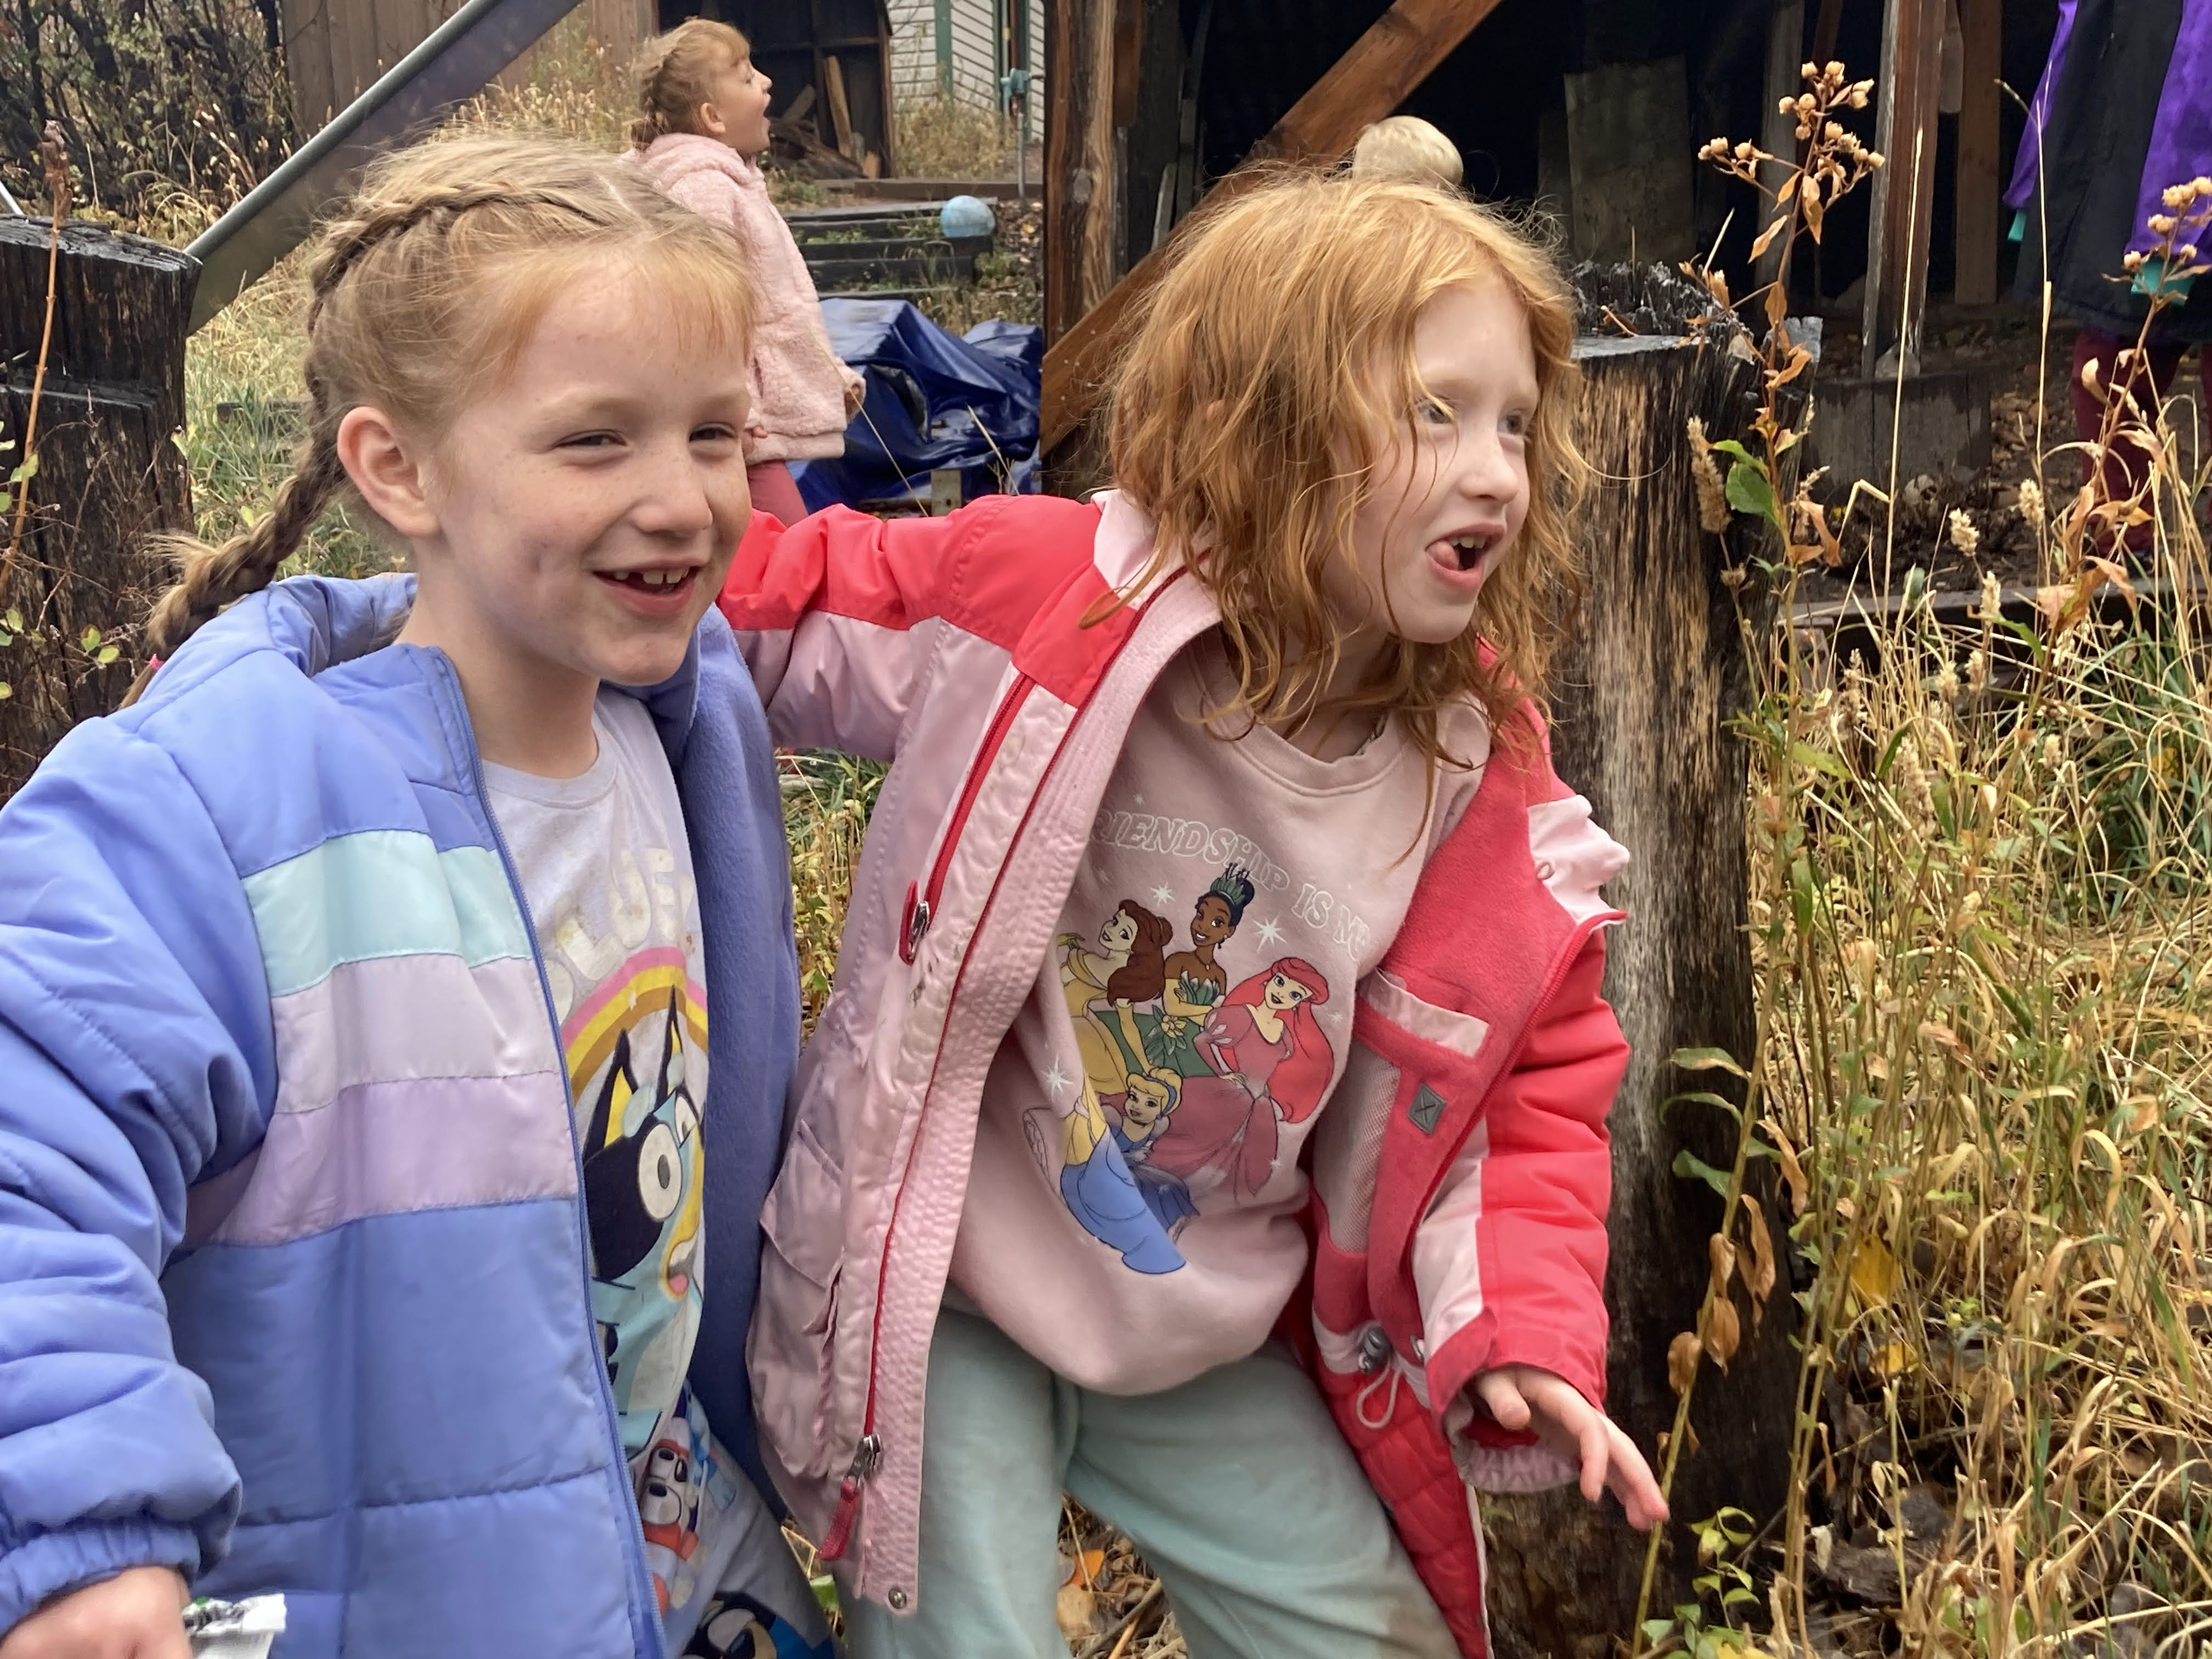
What does assent look like?

Slide 17
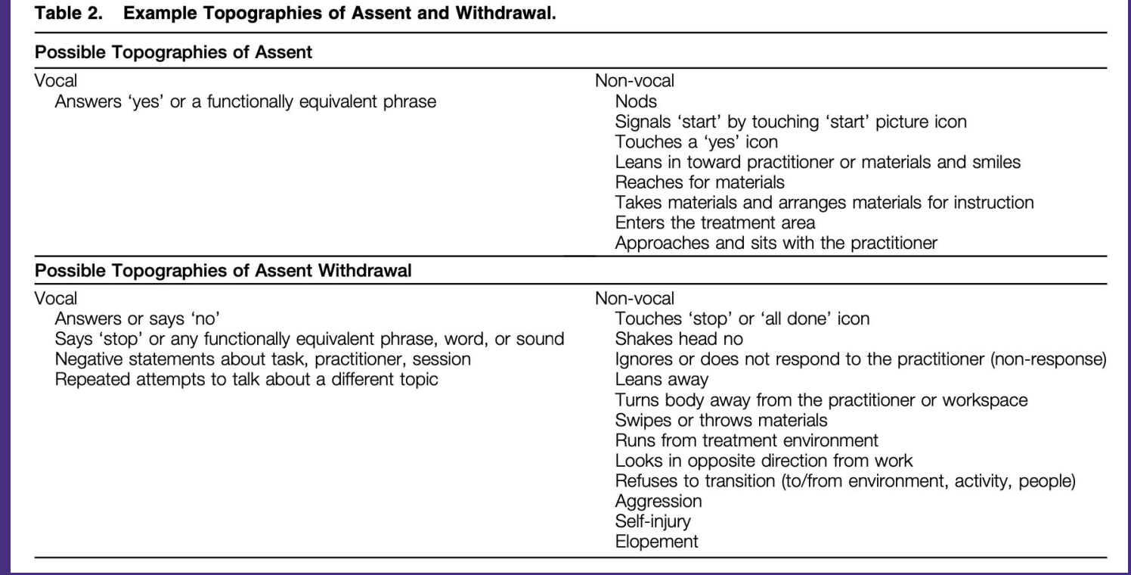
(Breaux & Smith, 2023)

Slide 18
What ways do you show assent (willingness to participate in an activity)?

Slide 19
What ways do you show your withdrawal of assent (objection to participating in activities)?

Slide 20

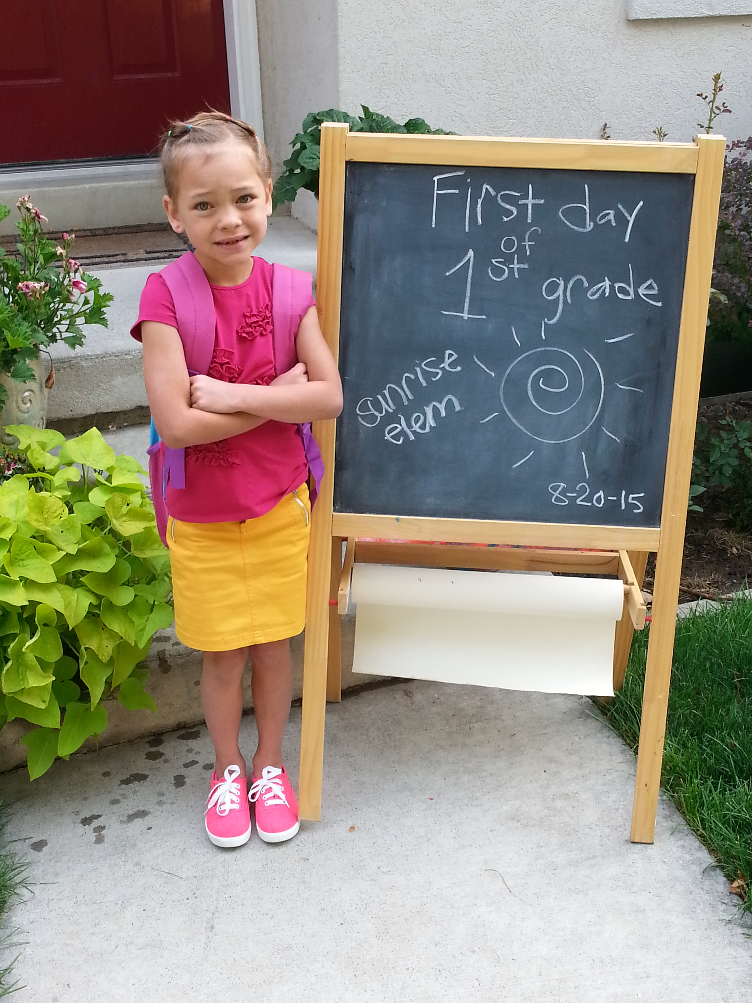
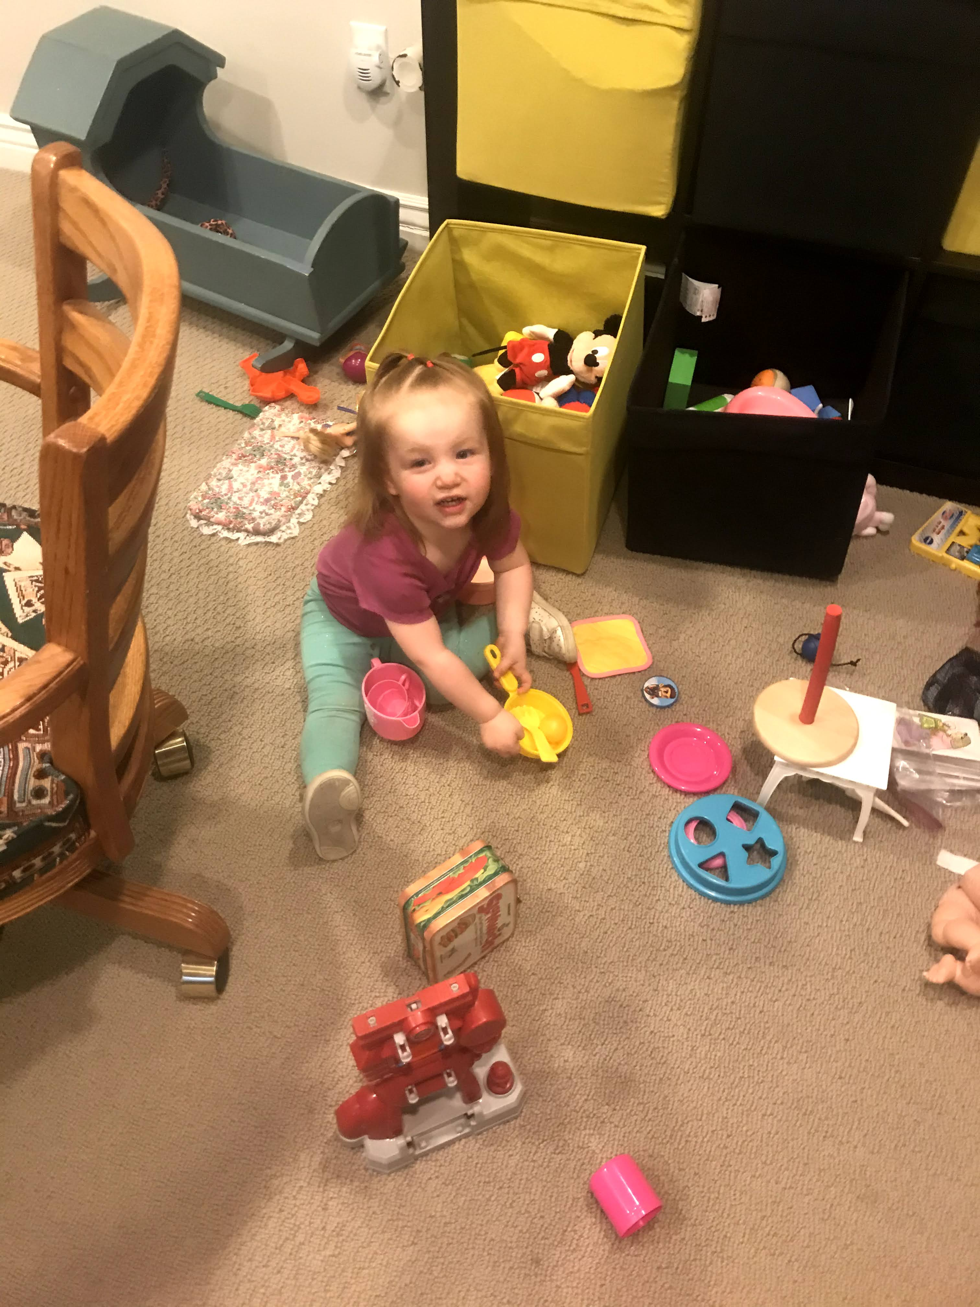
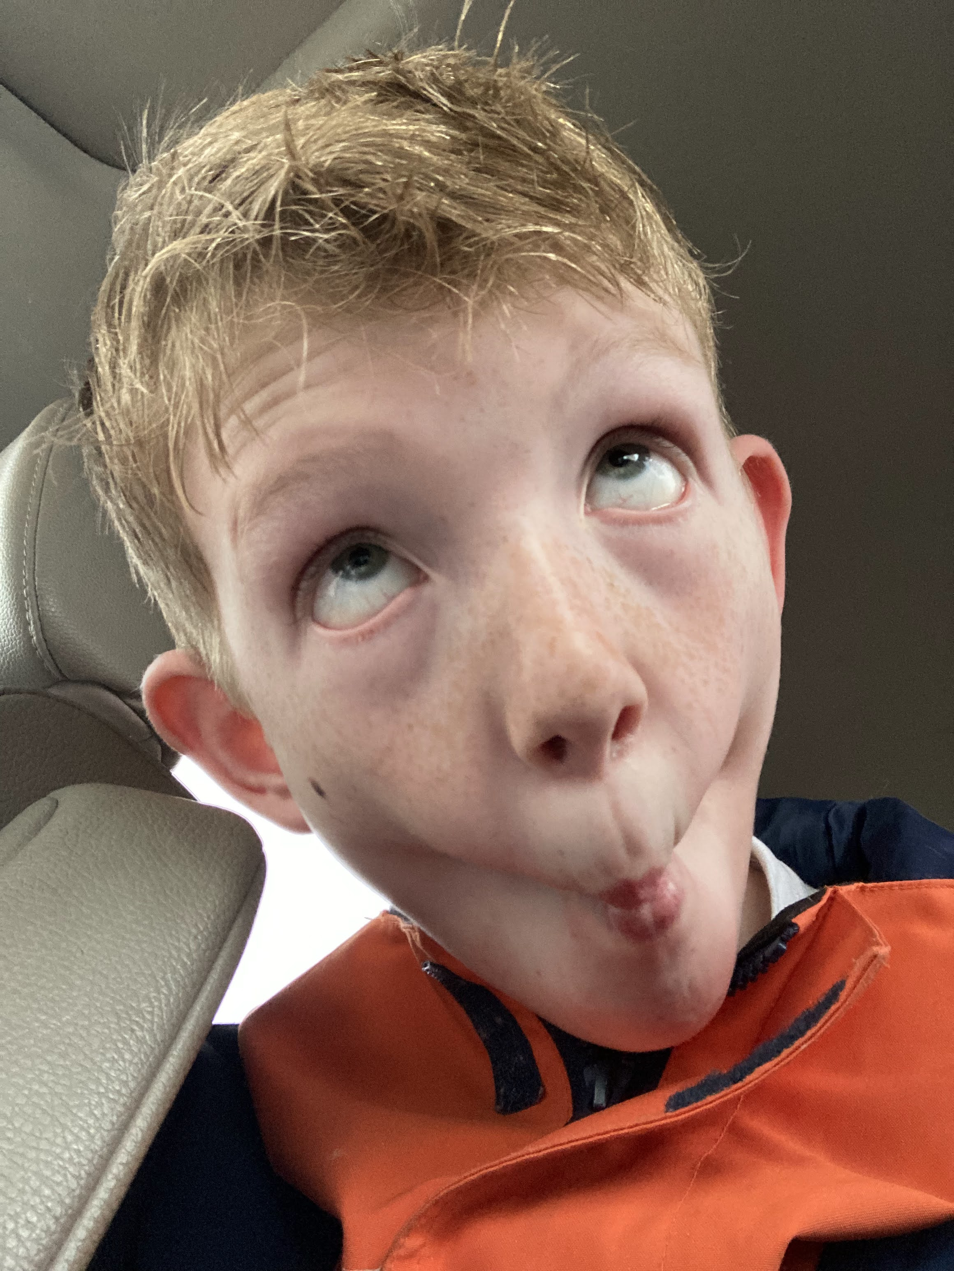
Each Child is Unique
Get to Know Individual Temperaments
Notes:
Follows the afore-listed topographies
Will show expressions of anxiety but persist
Will get ‘silly’ when they wish to withdraw
Does not use typical facial expressions or communication signals, but will signal withdrawal by a loud screech.

Slide 21
Teaching Assent and Withdrawal
Self-advocacy skills
Appropriate refusal or removal :
Socially-mediated (no, all done, stop, I need a break)
Self-mediated (walk away, put head down)
Asking for support
Asking for help
Asking for modifications or accommodations
Choice-making and problem-solving
Choice selection
Expressing preferences
Persisting at challenging tasks
Using varied behavior
(Barr & Bateman, 2025)

Slide 22
When to Teach Assent & Withdrawal
Before challenging activities
Using explicit instruction
Embed opportunities for success
As part of the curriculum
Collaborate with caregivers
Supported in functional activities
Do not wait to teach solely when withdrawal behaviors occur that are disruptive or dangerous

Slide 23
Making Data-Based Decisions
Data on assent and assent-withdrawal
Data across all intervention components
interaction
skill building instruction
prompting levels
environmental arrangement
Data on the skills relevant to assent
Using the data to adjust within and across intervention sessions
(Barr & Bateman, 2025)

Slide 24

Teaching Assent & Withdrawal

Slide 25
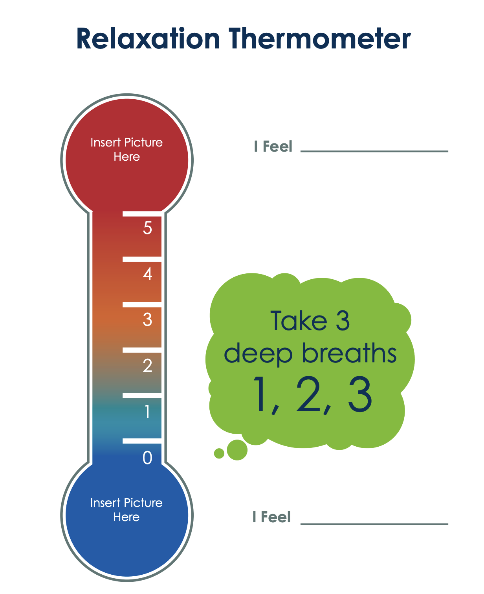
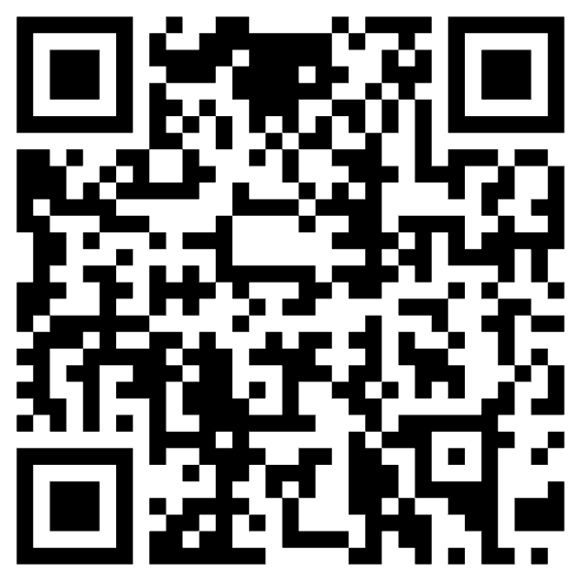

Slide 26
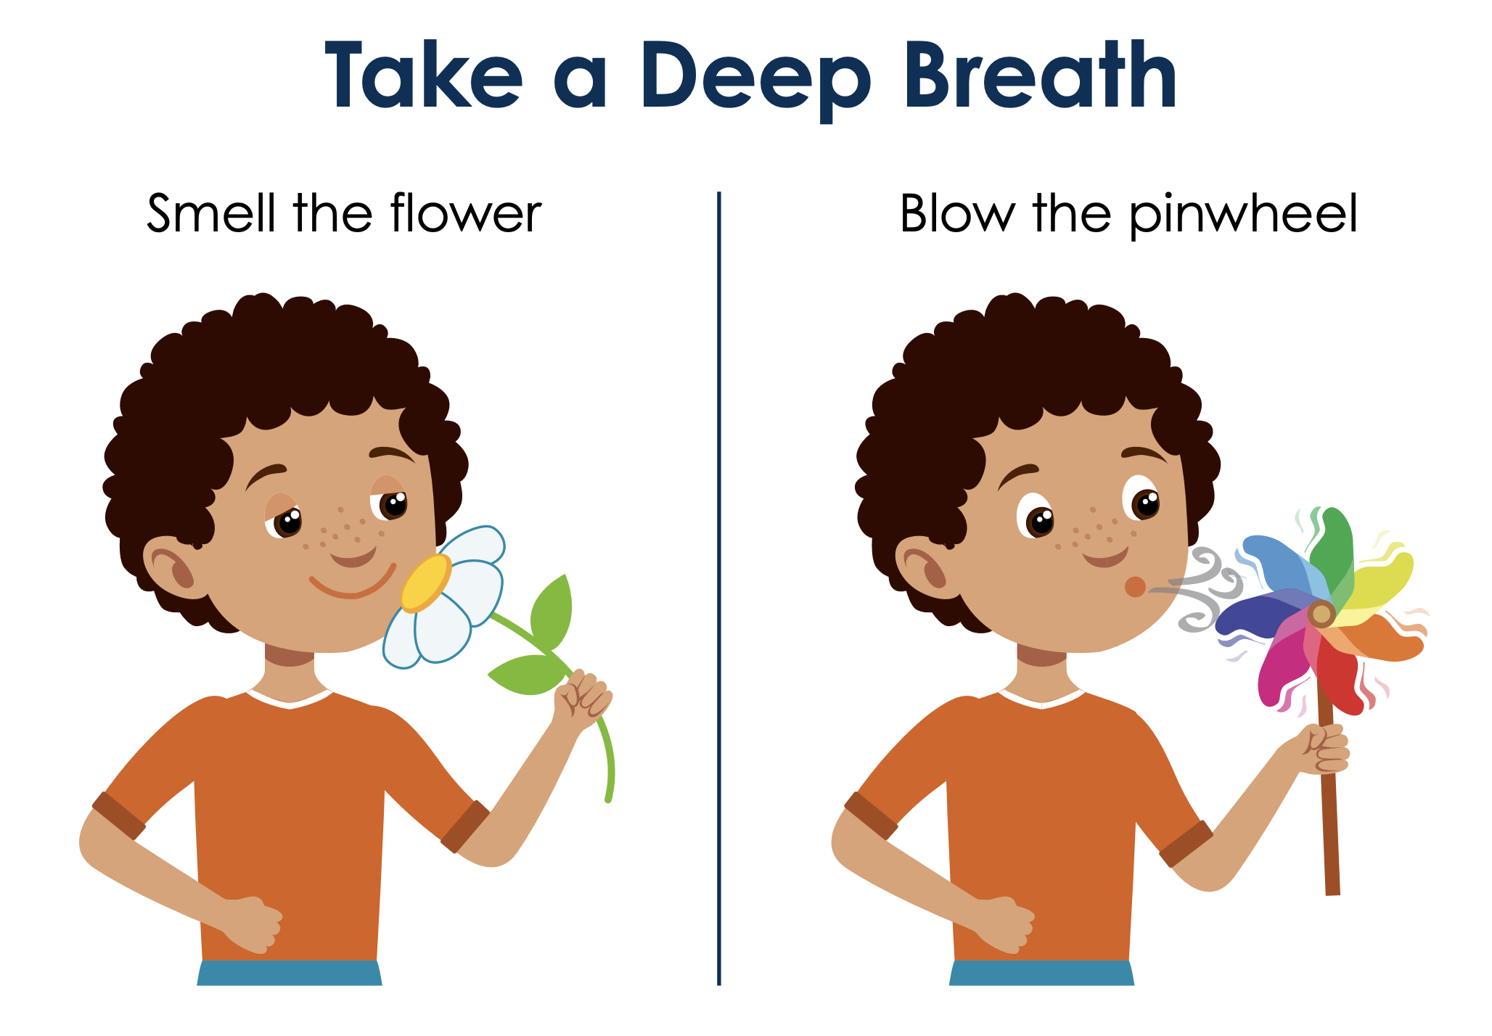
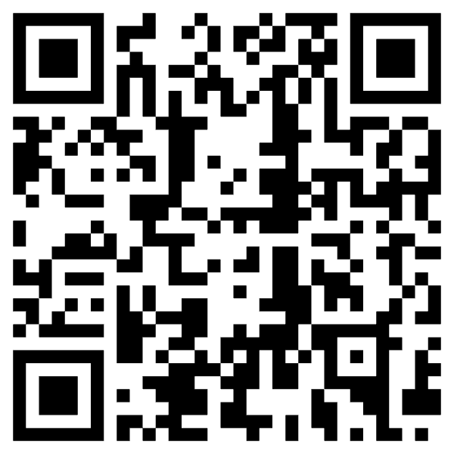

Slide 27
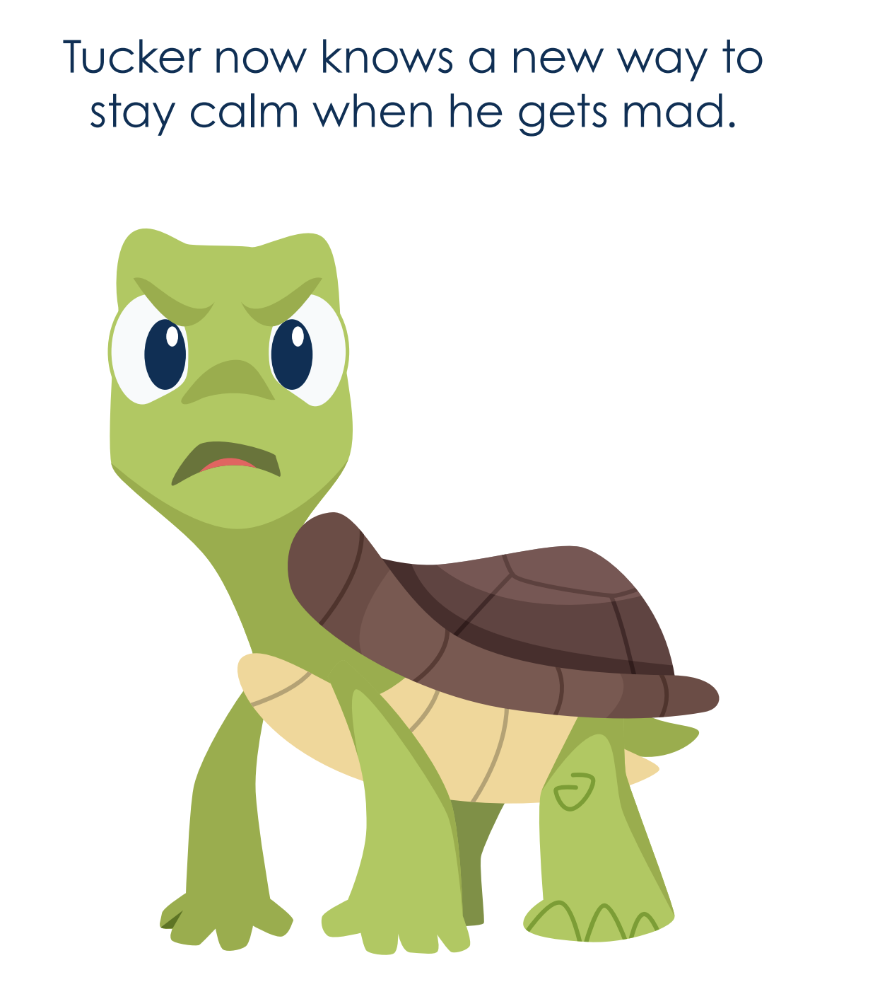
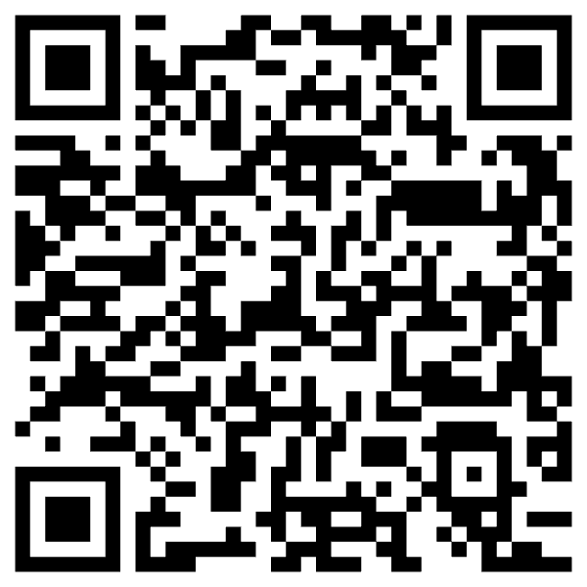
Notes:
Tucker the Turtle

Slide 28
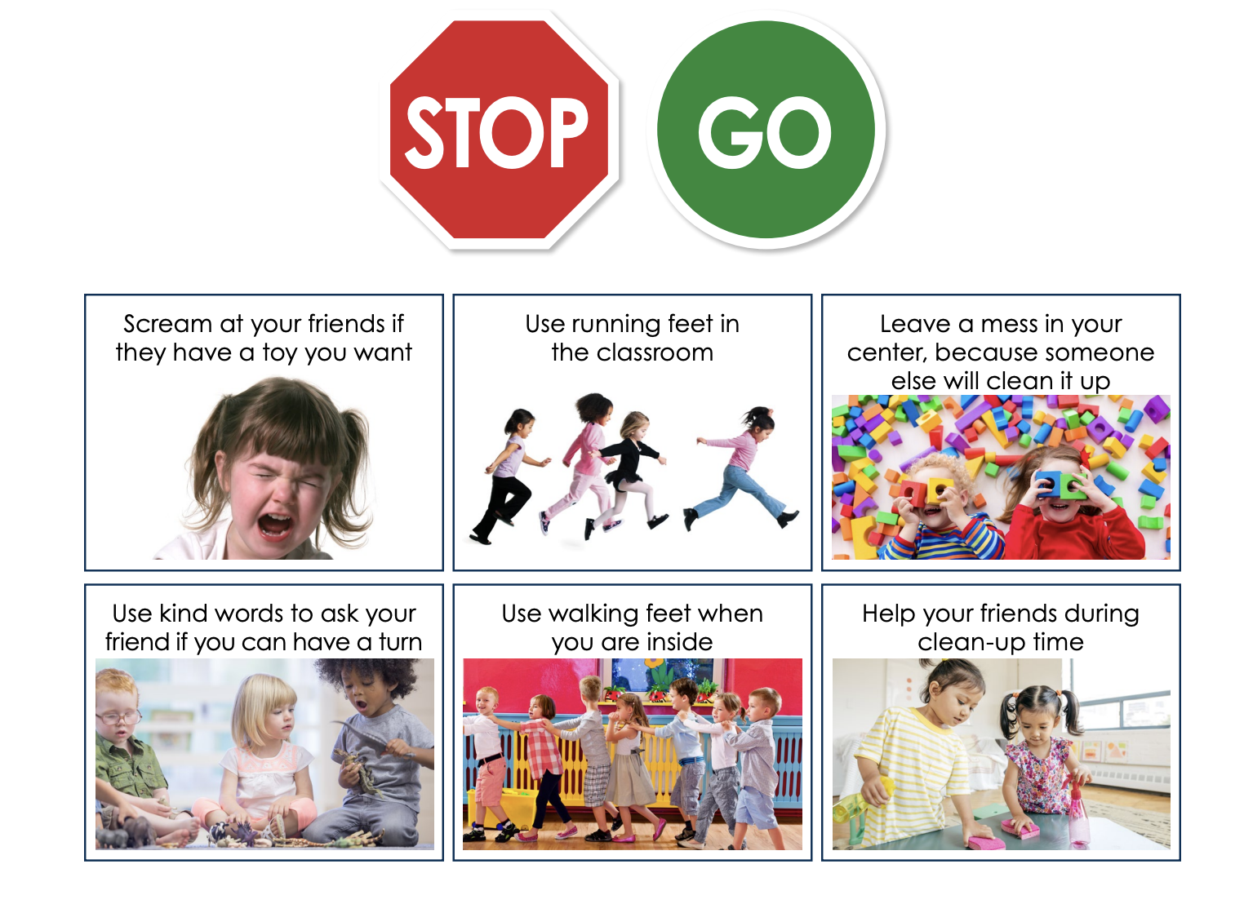
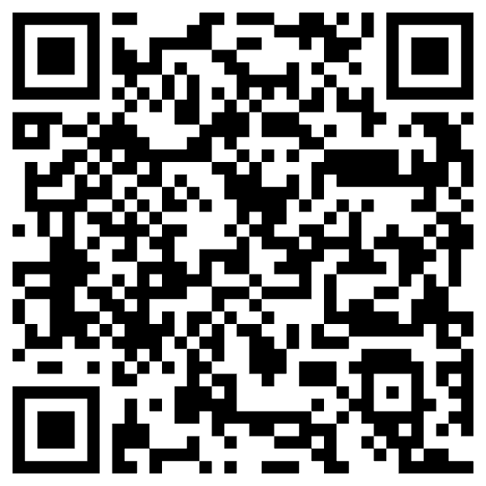
Notes:
Stop and Go activity

Slide 29
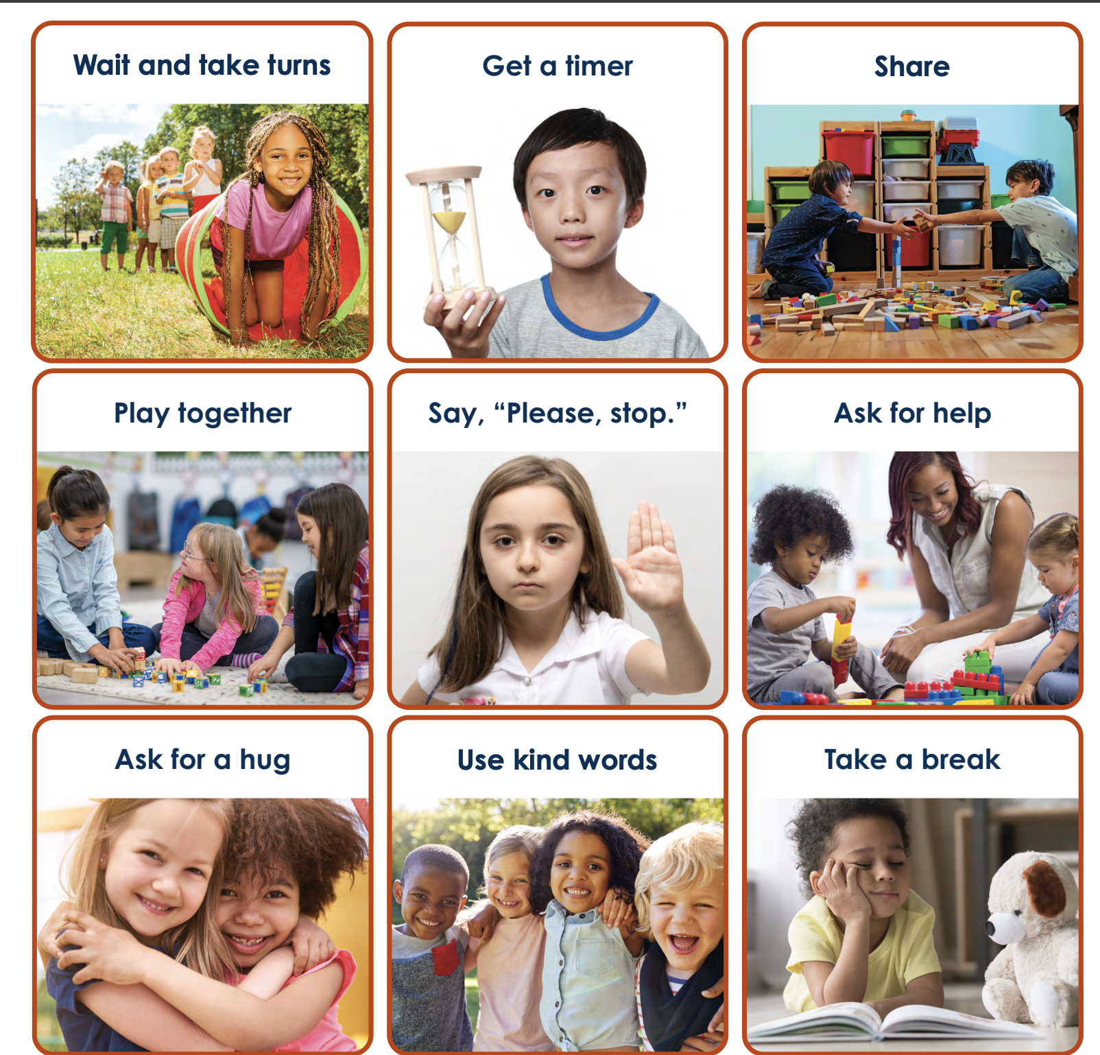
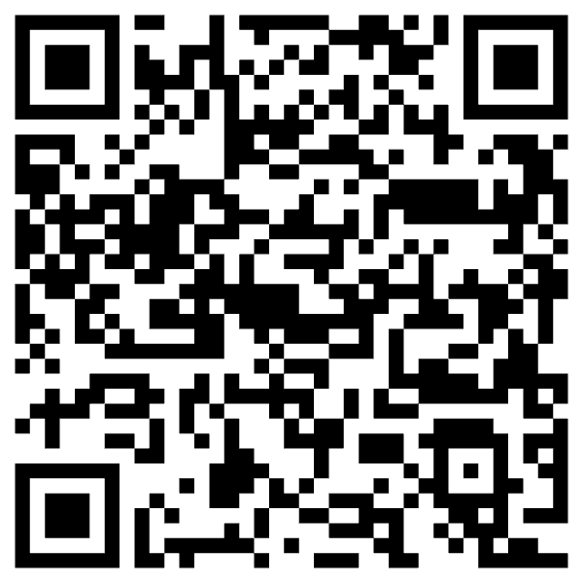
Notes:
Solution Tool Kit

Slide 30
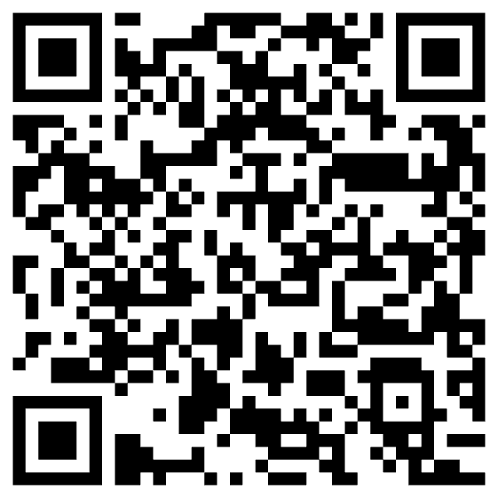
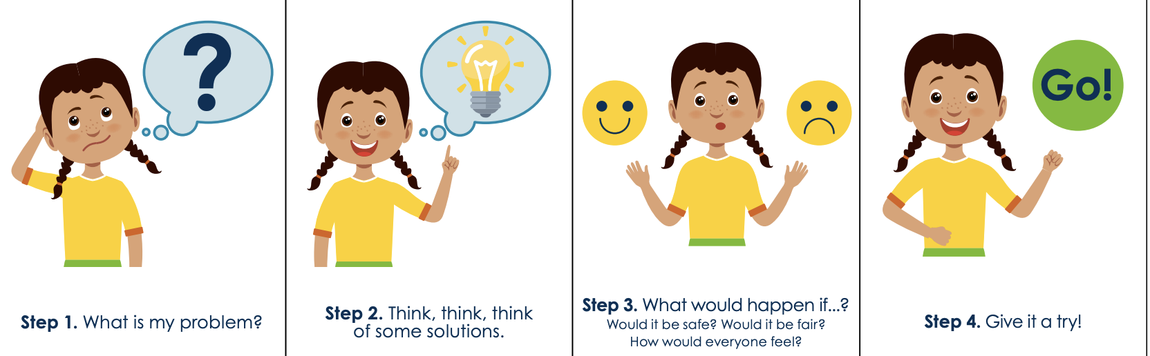

Slide 31
Thank You

Slide 32
References
Barr, S., & Bateman, K. (2025, October 8). Empowered participation: Assent in behavioral interventions [Conference presentation]. Division for Early Childhood (DEC) Annual Conference, Portland, OR.
Behavior Analyst Certification Board. (2020). Ethics code for behavior analysts (Glossary). https://www.bacb.com/wp-content/uploads/2022/01/Ethics-Code-for-Behavior-Analysts-240830-a.pdf
Breaux, C. A., & Smith, K. (2023). Assent in applied behaviour analysis and positive behaviour support: ethical considerations and practical recommendations. International Journal of Developmental Disabilities, 69(1), 111-121.
Maslow, A. H. (1943). A theory of human motivation. Psychological Review, 50(4), 370–396. https://doi.org/10.1037/h0054346
National Center for Pyramid Model Innovations. (2025). *National Center for Pyramid Model Innovations*. https://challengingbehavior.org/
Ormrod, J. E. (2020). Human learning (8th ed.). Pearson.
Utah State Board of Education. (2023). *Least Restrictive Behavioral Interventions (LRBI) technical assistance manual* [PDF]. Utah State Board of Education. https://www.schools.utah.gov/schoolsafetyandstudentservices/pdfs/LRBITEchnicalManual2023.pdf

