Slide 1

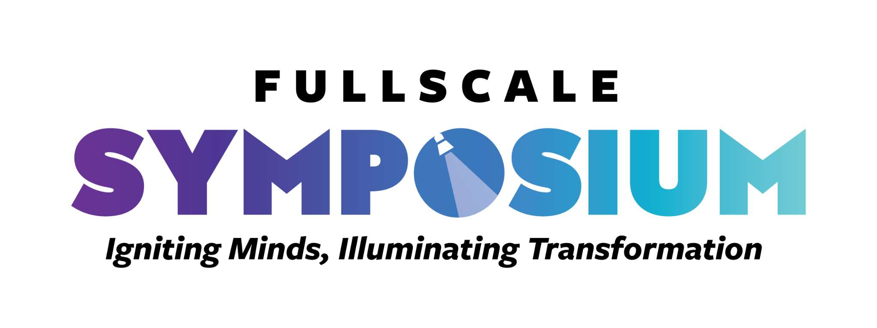
Embracing Mastery Based Learning to Transform a School and Evolve a District!
FULL SCALE
Sem Yeto High School: Fairfield California
2025-26
Igniting Minds, Illuminating Transformation

Slide 2
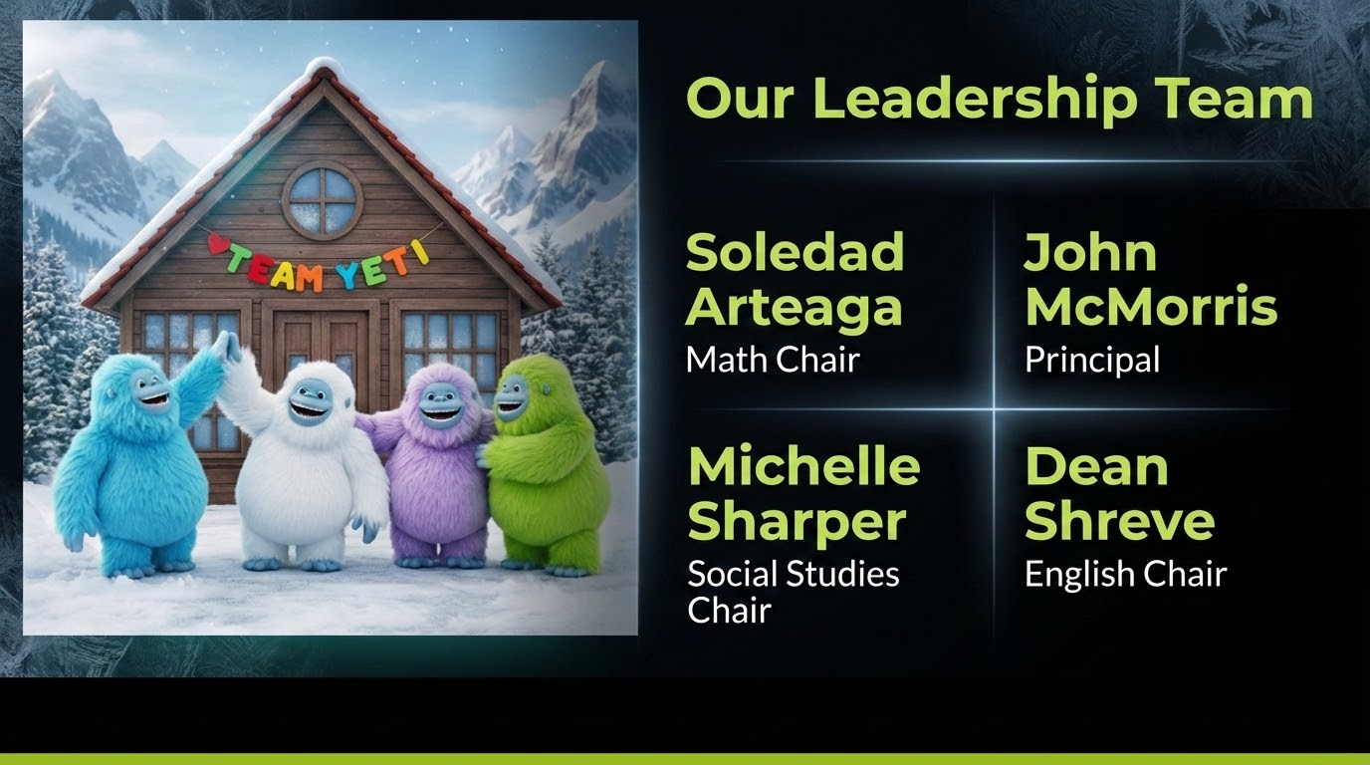

Slide 3

Sem Yeto H.S.
Questions We Asked Ourselves
Who are we?
Making the change:
Steps taken
Mistakes made
Mindsets changed
What does Competency Based Education (CBE) look like at Sem Yeto?

Slide 4
The Big Question
How can we transform Sem Yeto from a focus on credits to a focus on learning?

Slide 5
The Big Question
What it was like
Before we changed our approach to credit recovery and proficiency levels, we were required to mirror traditional high school courses—for example, offering English 9 through 12. But we realized something important: what’s the benefit of assigning 12th-grade material to a senior who reads below an 8th-grade level?
Making the Switch
As a staff we realized we needed to find a way to match what we offer to the very specific needs of our student population. We also needed to make sure our instructional material and methods were flexible to accommodate the wide range of proficiency levels found at Sem Yeto. This does not mean less rigor. Our goal is to build student proficiency based on their levels.

Slide 6
Who Are We ?
Demographics
Our students represent a wide range of backgrounds and needs. Some arrive credit deficient due to circumstances beyond their control and simply need an opportunity to recover credits. Others come to Sem Yeto because they have struggled in traditional school settings, performing below proficiency and lacking foundational learning skills. Still others once disengaged from school, fell far behind in credits, and would be unable to graduate without additional support.
Purpose
Sem Yeto is a continuation school designed to get our students back on track to graduate and transform them from reluctant learners to lifelong learners.
Specific Challenges
Because students come to Sem Yeto for many different reasons, our population reflects a wide range of learning abilities, proficiency levels, and credit needs—ranging from freshman requirements through senior-level courses.

Slide 7
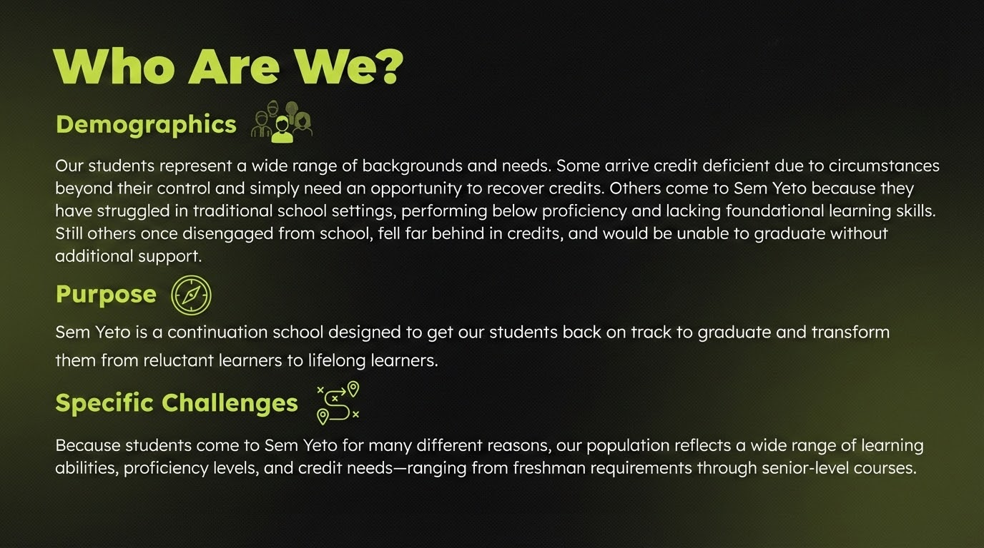

Slide 8
Why Did We Embrace The Humanized Education Model?
We embraced the Humanized Education Model because it places literacy, equity, student agency ,relationships, and brain health (neurophysiology) at the center of learning. Rather than focusing only on content delivery, this approach values the whole person—their backgrounds, cultures, and unique learning needs.
By fostering connection, trust, and belonging, students feel safe to take intellectual risks, ask questions, and engage more deeply. It also encourages active participation and collaboration, helping learners develop critical thinking, creativity, and self-motivation—skills essential beyond the classroom, while supporting learning at every Depth of Knowledge (DOK) level.
Ultimately, we chose this model because learning is most powerful when students feel seen, respected, supported, yet held to high academic standards… The Humanized Education Model provides a framework to make that happen.

Slide 9
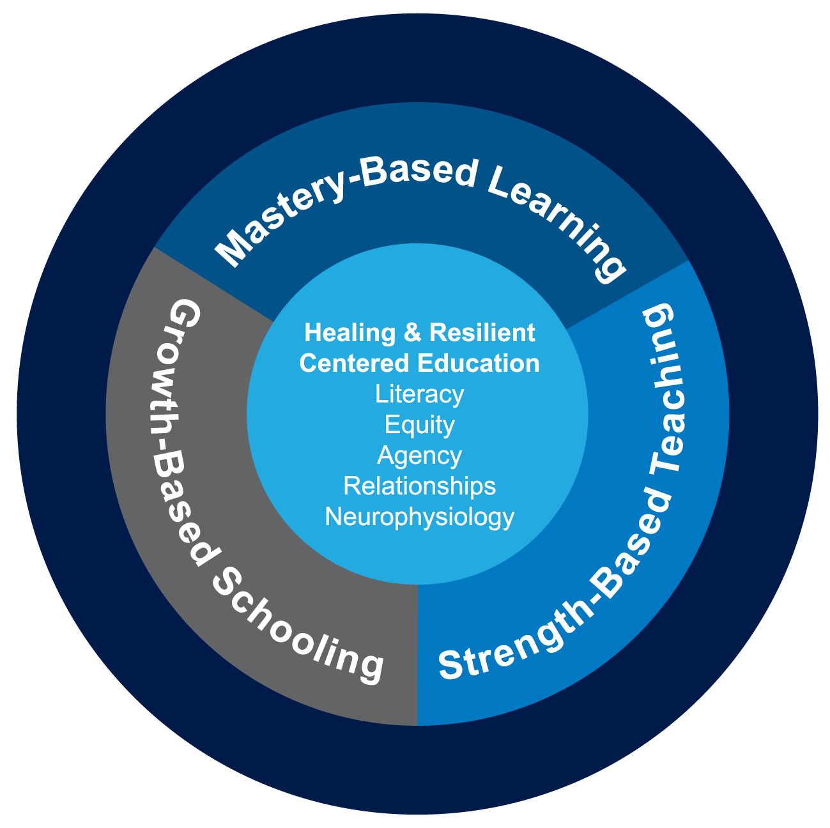
HUMANIZED EDUCATION 15 INDICATORS
Mastery-Based Learning
Goals/Scales
Assessment
Personalized Instruction
Teacher Optimism
Student Engagement/ Efficacy
Growth-Based Schooling
Positive-Safe Environment
Consistency & Transparency
Collaboration & Voice
Well-Being
Self-Regulation
Strength-Based Teaching
Access
Academic Press
Meaning & Motivation
Teacher as Facilitator
Culture & Community

Slide 10
HUMANIZED EDUCATION 15 INDICATORS
Mastery-Based Learning
Goals/Scales
Assessment
Personalized Instruction
Teacher Optimism
Student Engagement/ Efficacy
Growth-Based Schooling
Positive-Safe Environment
Consistency & Transparency
Collaboration & Voice
Well-Being
Self-Regulation
Strength-Based Teaching
Access
Academic Press
Meaning & Motivation
Teacher as Facilitator
Culture & Community

Slide 11
HUMANIZED EDUCATION 15 INDICATORS
Mastery-Based Learning
Goals/Scales
Assessment
Personalized Instruction
Teacher Optimism
Student Engagement/ Efficacy
Growth-Based Schooling
Positive-Safe Environment
Consistency & Transparency
Collaboration & Voice
Well-Being
Self-Regulation
Strength-Based Teaching
Access
Academic Press
Meaning & Motivation
Teacher as Facilitator
Culture & Community

Slide 12

Translating Theory into Practice
How does humanized education look in the classroom?
We understand Trauma. We understand how it affects student performance.
We need to build bridges with our students.
Start with getting to know your students (Empathy)
Make connections
Establish Academic Press via High Expectations and help them to meet these expectations
Using Personalized Competency Based Education to get your students ready for the next level and society in general.

Slide 13

Mastery-Based Learning
Benefits
Learning is Competency-Focused: Students progress when they master clearly defined learning targets, not just when a unit ends.
Pacing is Flexible: Students can move faster if they demonstrate mastery early, or spend extra time on challenging skills.
Assessment is for Learning: Frequent, low-stakes assessments help students see what they know and what they still need to work on.
Feedback is Actionable: Students receive meaningful feedback and have chances to revise and improve their work.
Transparency: Learning targets and success criteria are clearly communicated, so students know exactly what “mastery” looks like.

Slide 14
Mastery-Based Learning
Benefits
Promotes Equity – All students have the opportunity to achieve mastery of vital skills and knowledge, not just those who “get it” on the first try.
Builds Confidence – Students see progress through growth and persistence.
Prepares for Real Life – Reflects real-world expectations where competence matters more than time spent.
Encourages Deeper Learning – Emphasizes understanding, not memorization or rushing through material.

Slide 15

Growth-Based Schooling
Benefits
Motivates All Learners – Students who start below grade level still earn recognition for improvement.
Reduces Stress – Emphasizes progress rather than perfection.
Promotes Equity – Gives credit to students making significant gains, even if they haven’t reached the “finish line.”
Builds Lifelong Skills – Encourages resilience and persistence in learning.

Slide 16

Strength-Based Teaching
Benefits
Boosts Motivation: Students are more engaged when their strengths are recognized and used as a foundation for learning.
Improves Self-Efficacy: Helps students believe they are capable of growth and success.
Fosters Resilience: Encourages students to use their strengths to overcome obstacles.
Builds Relationships: Teachers get to know students deeply, which increases trust and respect in the classroom.

Slide 17
Healing leads to better Fitness
Mastery Based Learning = Academic Fitness
Growth Based Schooling = Mental Fitness
Strength Based Teaching = Psychological Fitness
If you feel good, you will do good…

Slide 18
We Need All Three!
Simply stated, mastery-based learning, growth-based schooling, and strength-based teaching are solid initiatives that are insufficient by themselves to shift the existing educational paradigm.
But their combined force in a comprehensive system can form a new model of schooling that is ultimately transformational.

Slide 19
We need all Three
Until we create schools that actively focus on the overall health of the brains, bodies, and psyches of the humans in the building, the quality of the curriculum, instruction, and assessments is irrelevant.
Thus, there is a critical responsibility for the adults in the educational system to adjust their professional orientation away from simply delivering curriculum, providing instruction, and maintaining traditional grading systems, to adopting and growing within a humanized educational model that recognizes the individuality of the students before them and helping them grow to the greatest capacity possible.

Slide 20
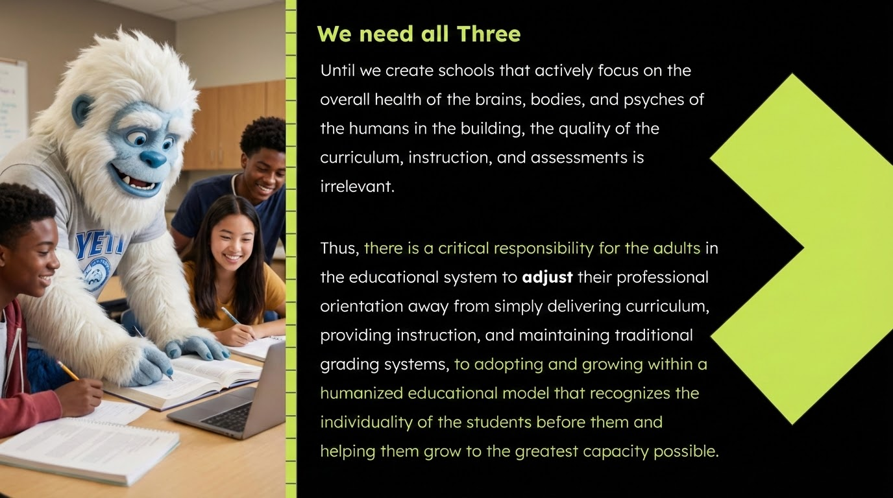

Slide 21
Why Proficiency Scales?
The why…
Transforming classrooms into dynamic, student centered, learning Environments
What we are using scales for
Clear Learning Targets
Differentiation
Progress Monitoring
Goal Setting
Student/Parent Engagement
Aligned Assessment and Instruction
Formative Feedback
Circular Development

Slide 22
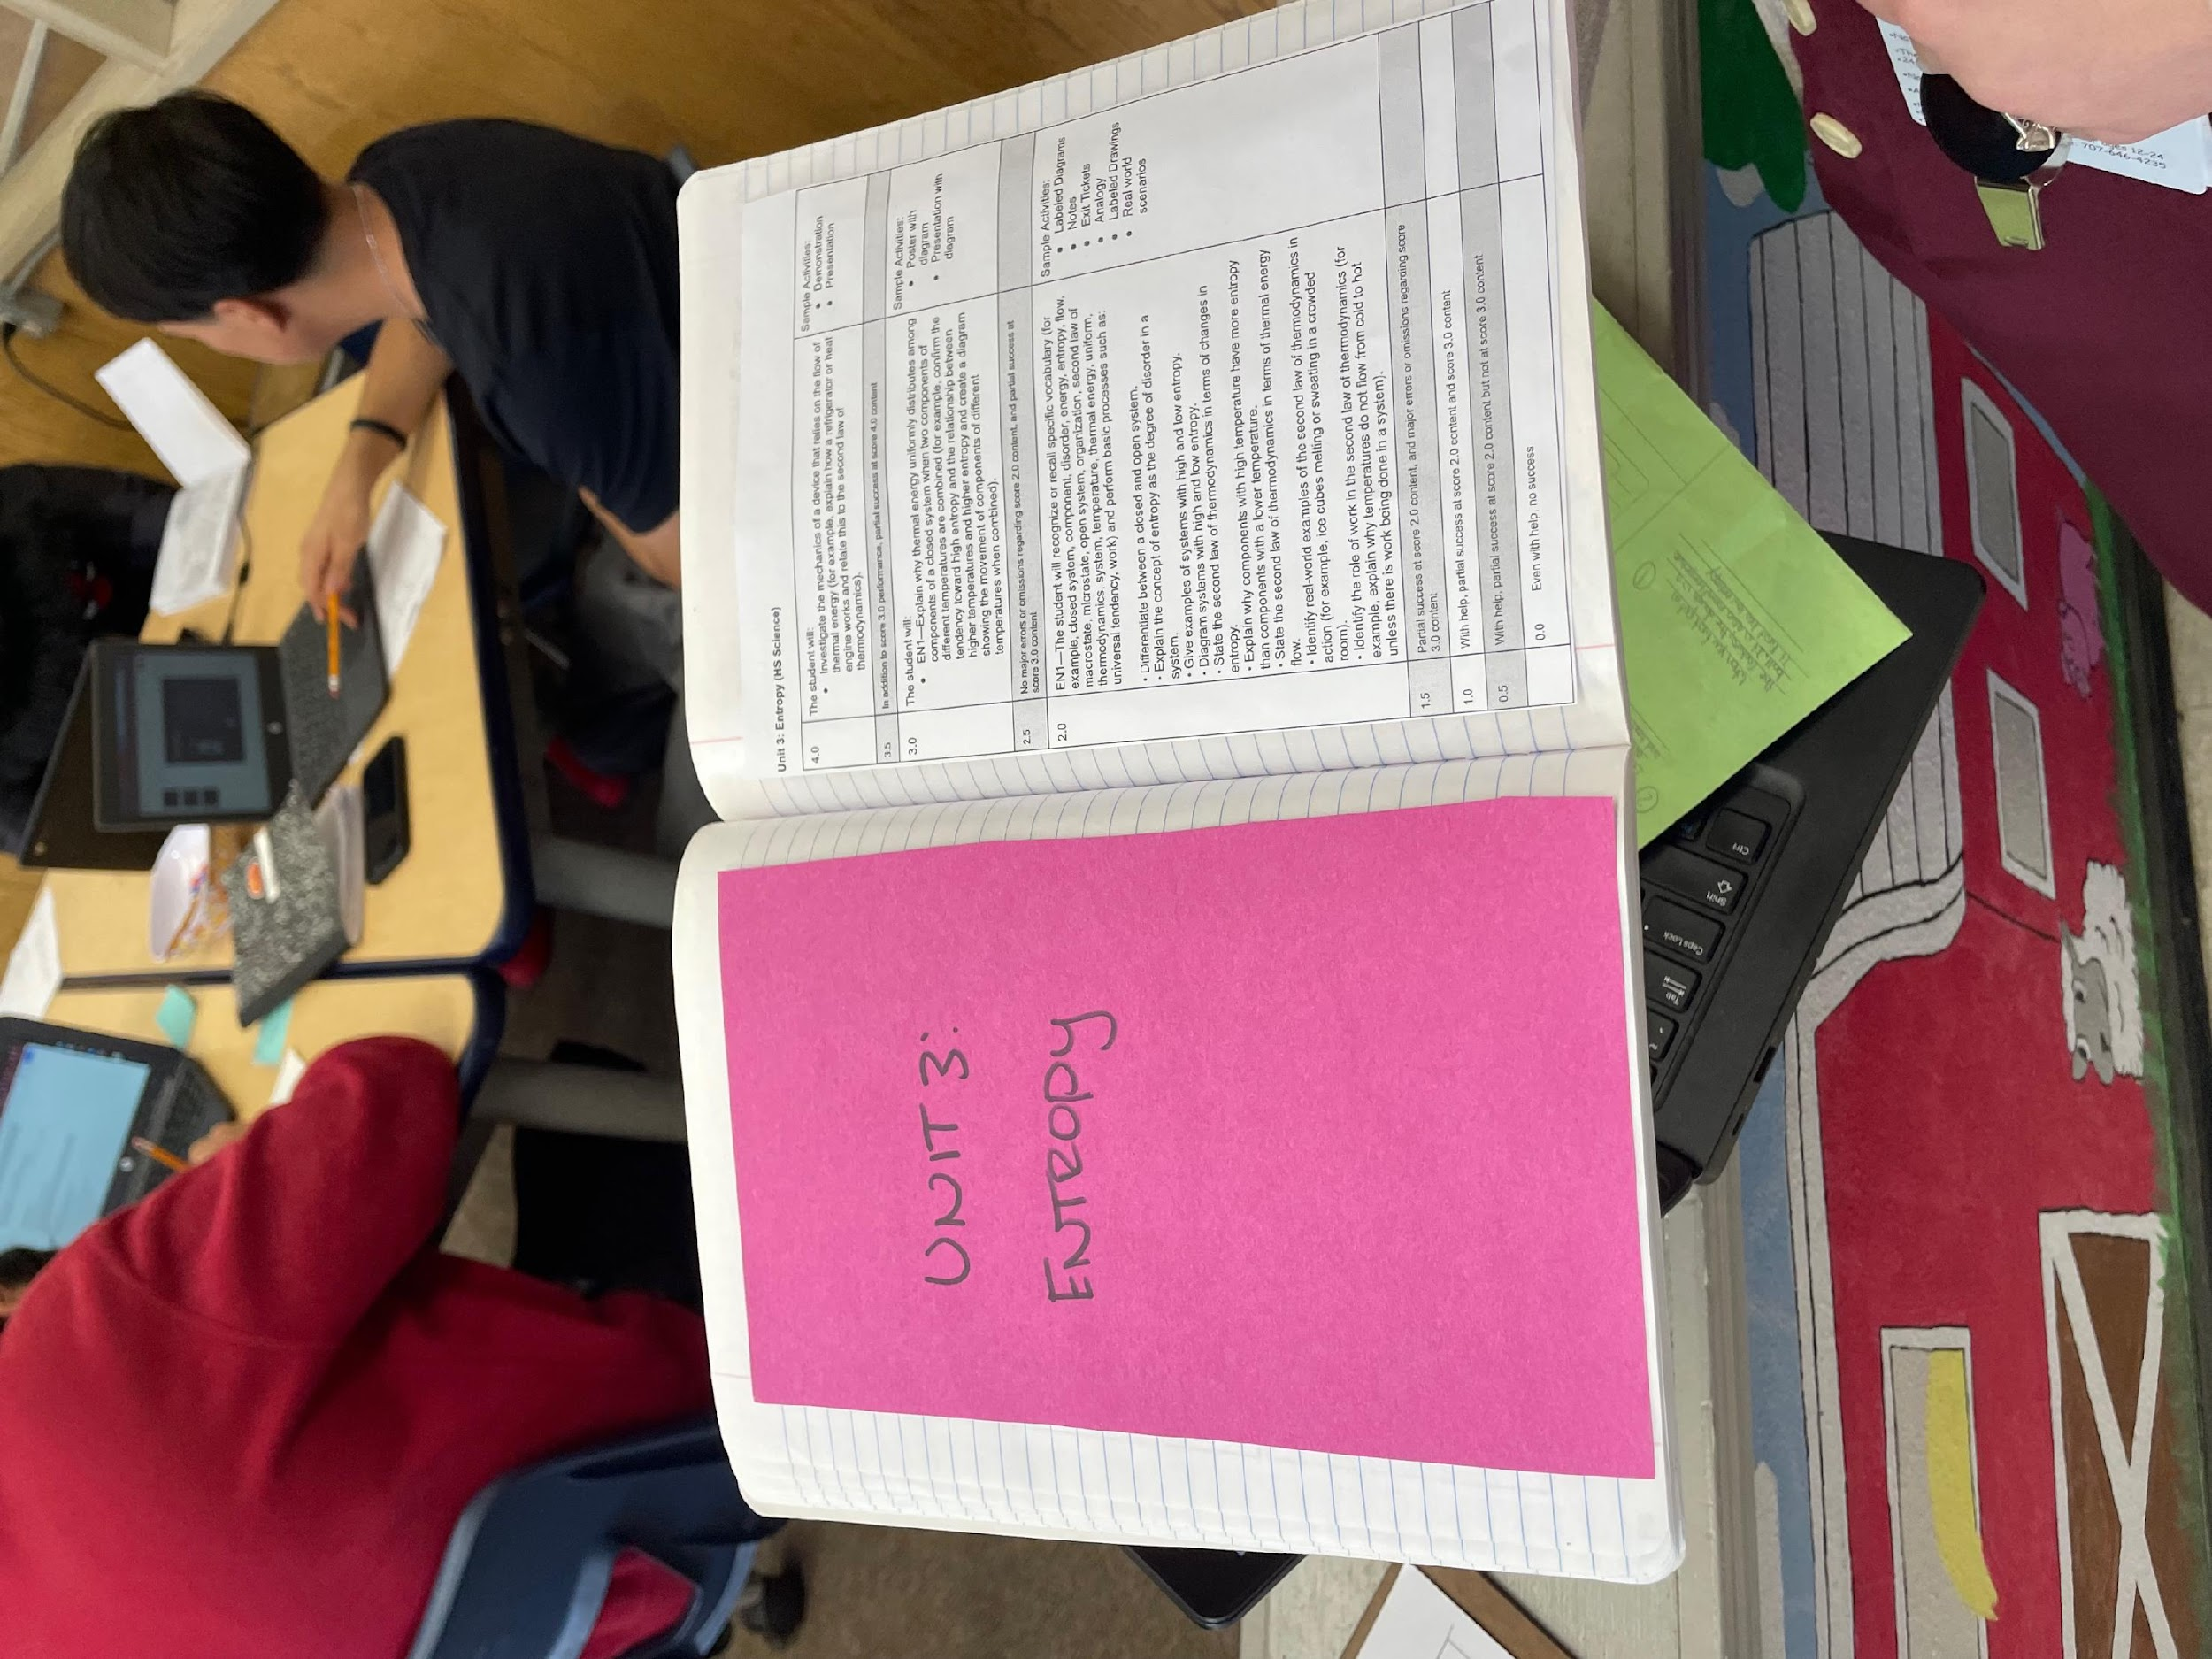
This Year’s Focus
Proficiency Scales drive all teaching and learning…
Increasing Access by focusing on high level vocabulary instruction.
Mindfulness practices daily to facilitate healing and resilience

Slide 23

Understanding Key Concepts
Proficiency Scales focus on Key Concepts that students will be able to clearly define and communicate understanding.
1. Clear Learning Targets
Break standards or objectives into specific, measurable skills or knowledge.
Define exactly what students should know or be able to do.
2. Levels of Proficiency
Typically a 4-point scale (though 3- or 5-point models exist):
Level 4 – Exceeds expectations (transfer or extension of learning)
Level 3 – Proficient (meets grade-level expectations independently)
Level 2 – Approaching (basic understanding with some support)
Level 1 – Beginning (limited understanding, needs significant support)

Slide 24
Understanding Key Concepts
3. Progressive Skill Development
Each level describes a continuum of mastery, not just a grade.
Students see what growth looks like and what’s needed to move forward.
4. Student-Friendly Language
Descriptors should be written so students can understand what each level means.
Encourages self-assessment and goal setting.
5. Consistency in Assessment
Teachers use the same scale across tasks, ensuring fair and clear evaluation.
Focuses on evidence of learning rather than completion or effort.

Slide 25
Understanding Key Concepts
6. Feedback and Reflection
Proficiency scales guide feedback: instead of “right/wrong,” feedback shows where students are on the scale and how to improve.
Students can reflect: “I’m at Level 2 because I can identify symbols but not yet explain their meaning.”
7. Instructional Alignment
Teachers design lessons and assessments that target movement along the scale.
Differentiation becomes clearer—supporting those at Level 1–2 while extending learning for Level 4.

Slide 26

Proficiency Scales drive all teaching and learning
Using Proficiency Scales to drive our instruction and reflect on how effective was our instruction.
Are students gaining mastery
Are students taking ownership of their education (Agency)
Easier to monitor growth
Provides clarity: Where I am and Where I need to be!

Slide 27
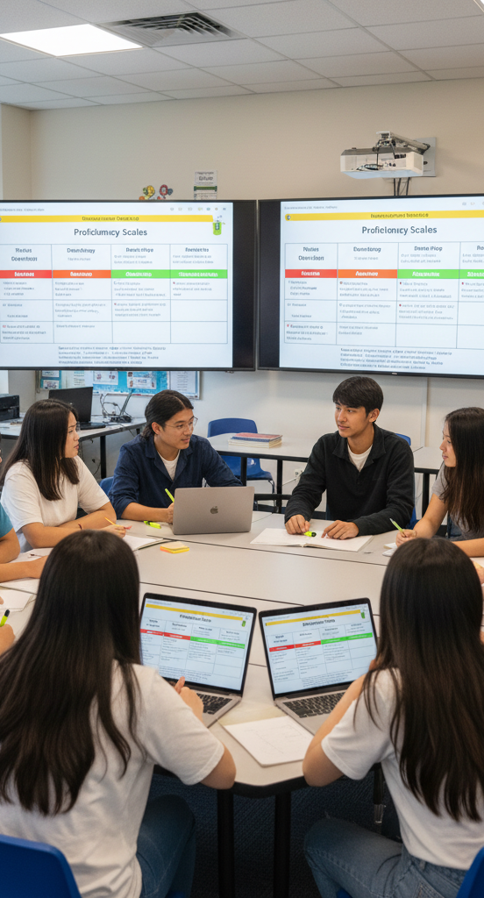
The Starting point
Making Changes with the English Department
Looking at what Sacramento St was doing.
E.R.W.C.: Expository Reading & Writing Course
The English department took the strategies and applied them to our high school students at their proficiency levels
Created classes that were adaptable to various proficiency levels.
It’s Lit - Ethics & Morality - Mythology & Modernity
Applied courses with texts (books) that students enjoyed reading
Students Vote on Reading Materials. What to keep and what to change

Slide 28
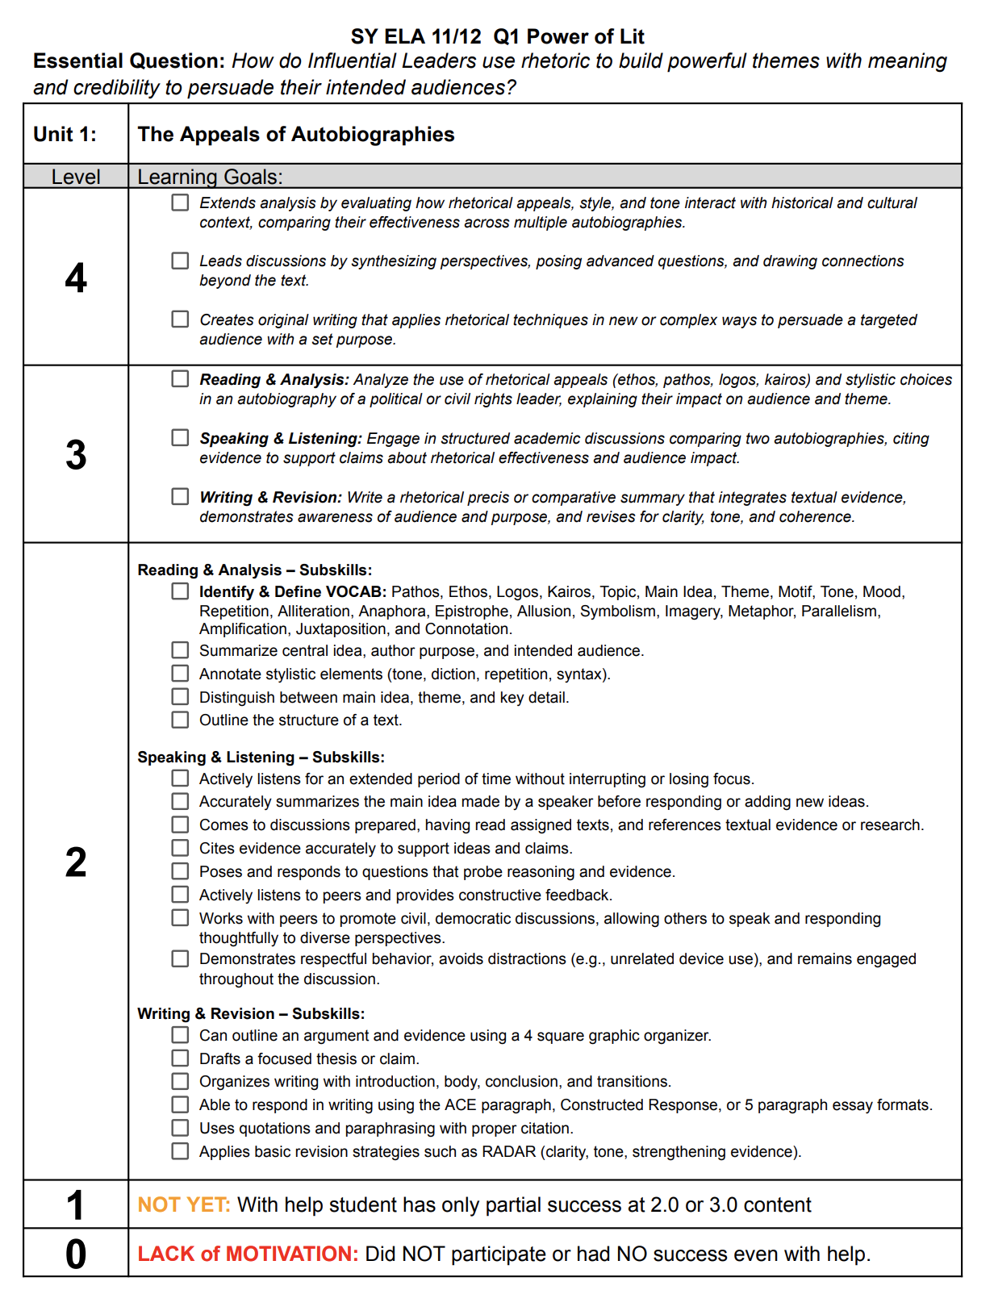
English : Proficiency Scales
Provide the structure needed to unify feedback systems and clearly communicate expectations across all content areas:
Clarity of Learning Goals Each unit includes a Level 3 target aligned to rigorous content standards. Students know exactly what they must demonstrate to be considered “proficient.”
Pathways to Growth Level 2 subskills break down the foundational steps required to reach Level 3, offering both students and teachers a roadmap for practice and intervention.
Extension and Excellence Level 4 encourages creative, independent application of skills—an opportunity to move beyond compliance into mastery and innovation.
Accountability and Feedback These scales transform vague comments like “try harder” into concrete learning targets. Teachers and students both know what success looks like—and how to get there.
Every Unit has a scale
Link to Example ELA Scales

Slide 29
The Turning Point: Reflection, Stamps, and Self-Efficacy
To address Self Efficacy, we introduced two critical systems:
The Stamp System Assignments turned in only once they’ve earned a stamp, which signifies proficiency—not just completion. If an assignment doesn’t meet the standard, the teacher responds immediately with corrective feedback, guiding students in real-time toward revision and growth. This system actually motivated students to seek feedback.
Daily Reflections These guided prompts fostered metacognitive habits in students. By reflecting each day on what they learned, how they grew, and what they still needed, students began to take ownership of their learning process and became much more accurate in their self assessment.
Students stopped asking,
“Did I get my Credit?”
they began asking for feedback:
“Is this good enough?”
They started taking ownership of outcomes, but something was still missing.

Slide 30
English Matriculation in a Quarter System
Quarter | Q1 | Q2 | Q3 | Q4
Students Needing English 1, 2, or Elective credits | Ethics & Morality in Lit U1 Defining Morality & Ethics U2 The Road to Hell | Its Lit U1 Defining Terms of Character U2 Going Crazy | Let’s be Frank, Tech & Me U1 Tech & Me U2 Let’s Be Frank | Mythology & Modernity U1 Myth to Modern Reality U2 The Eternal Odyssey
Students Needing English 3, 4, or Elective credits | Power of Lit U1 Appeal of Autobiographies U2 Rhetorical Statistics | Building Character U1 Mindset U2 Grit | Creative Writing U1 Story vs Plot U2 Metaphorical | Writing Workshop U1 LTGs & Resumes U2 Talking to the Pros

Slide 31
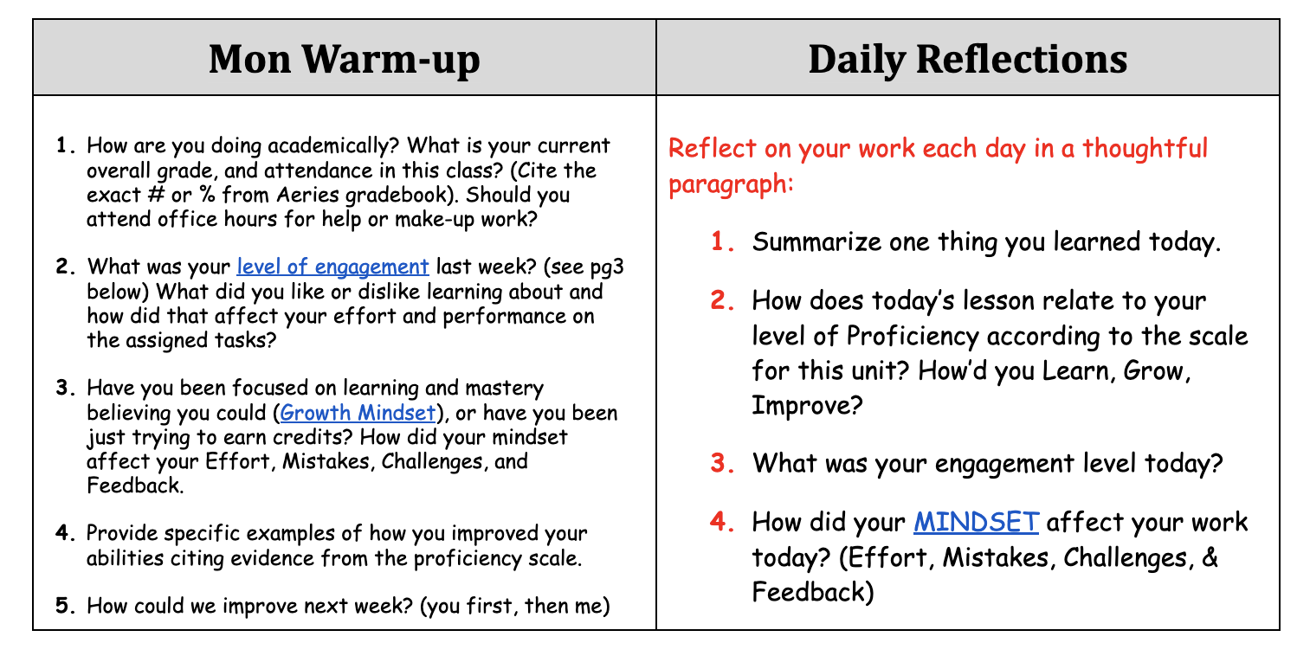
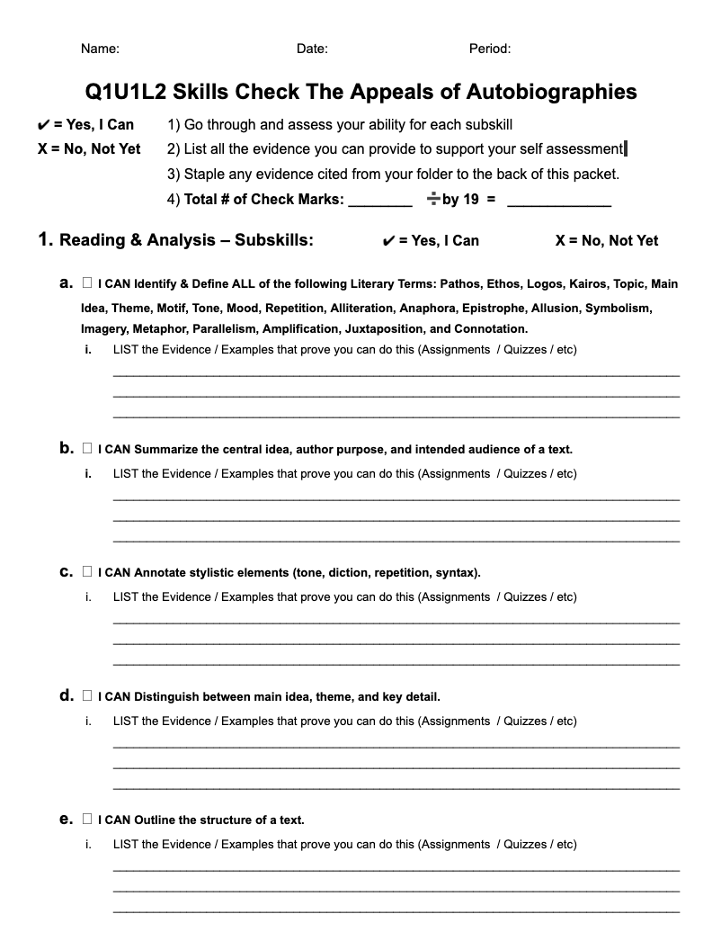
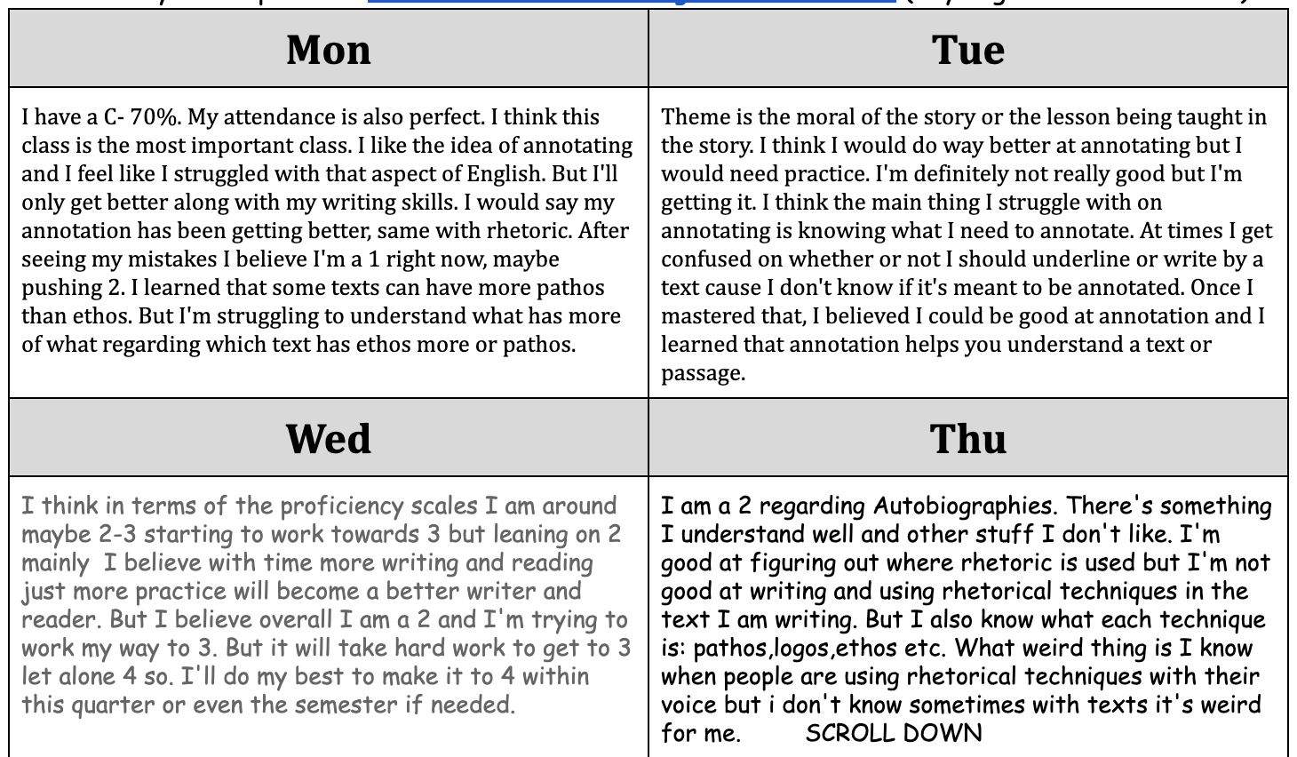
Students complete a Pre & Post Skills self assessment
Students now have clear set goals and assess their own growth daily.

Slide 32
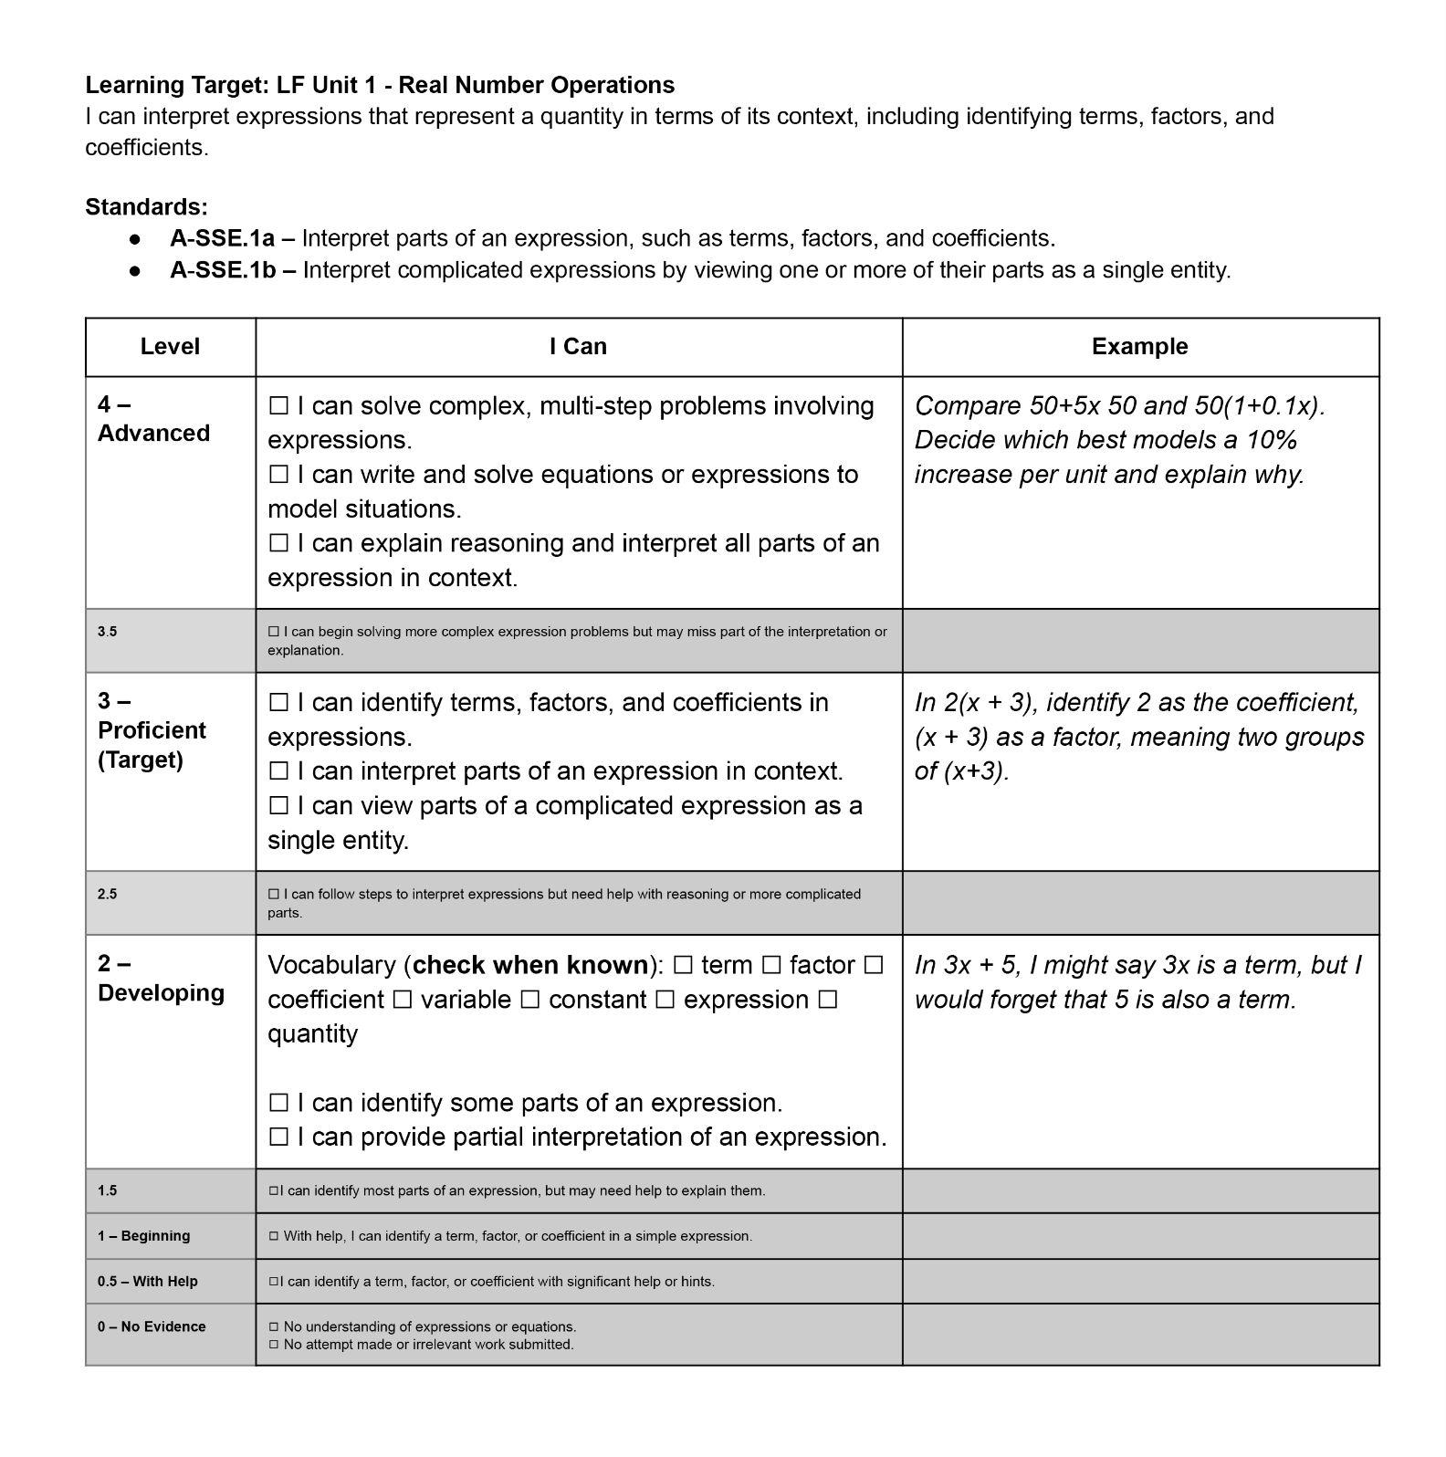
Math Scales
A math scale is a Road Map for students learning. It breaks down a learning goal into levels four levels, from beginner to advanced.
Teacher can use it to guide and differentiate instruction.
Students use it to answer questions such as Where am I know? What is my goal? How do I get there?
The scales contain concrete examples so students can answer these questions.
Link to revised scale PDF
Link to Progression example of scales

Slide 33
Math Scales
In addition to answering content-specific questions, students are explicitly taught high-utility academic vocabulary used across core subjects, helping them transition more easily between disciplines like from Math to Social Science.

Slide 34
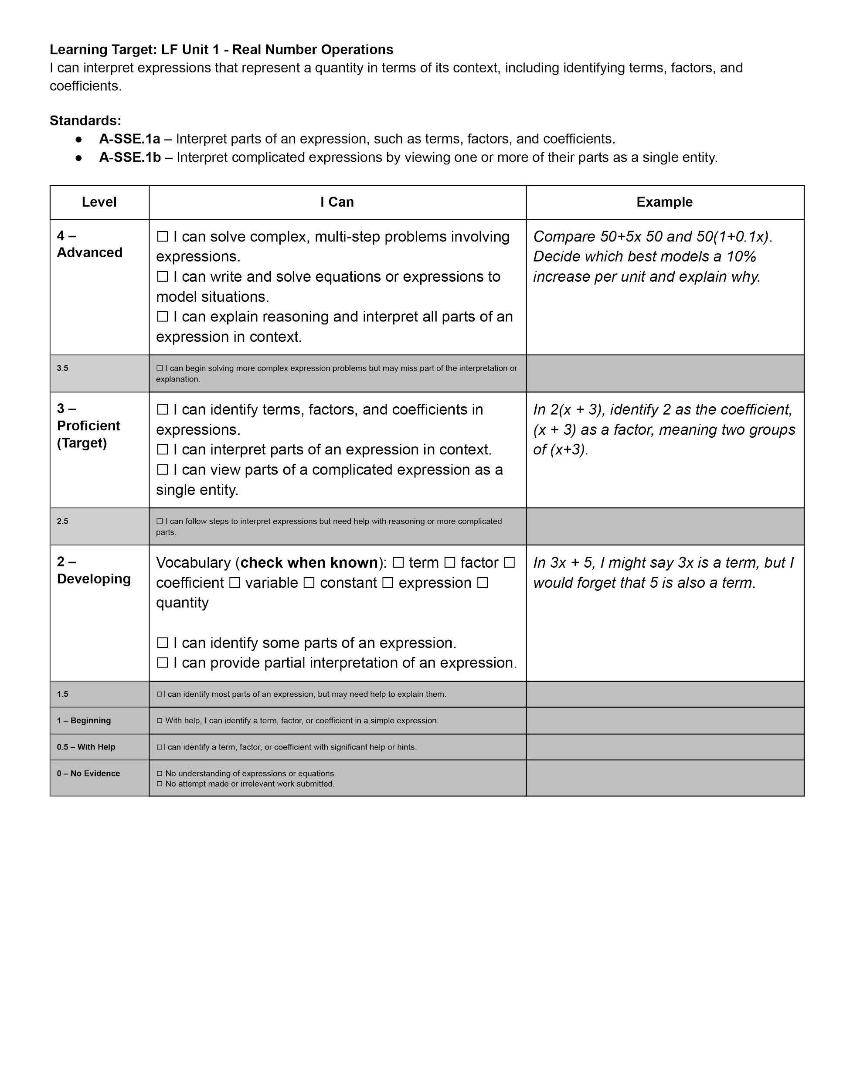
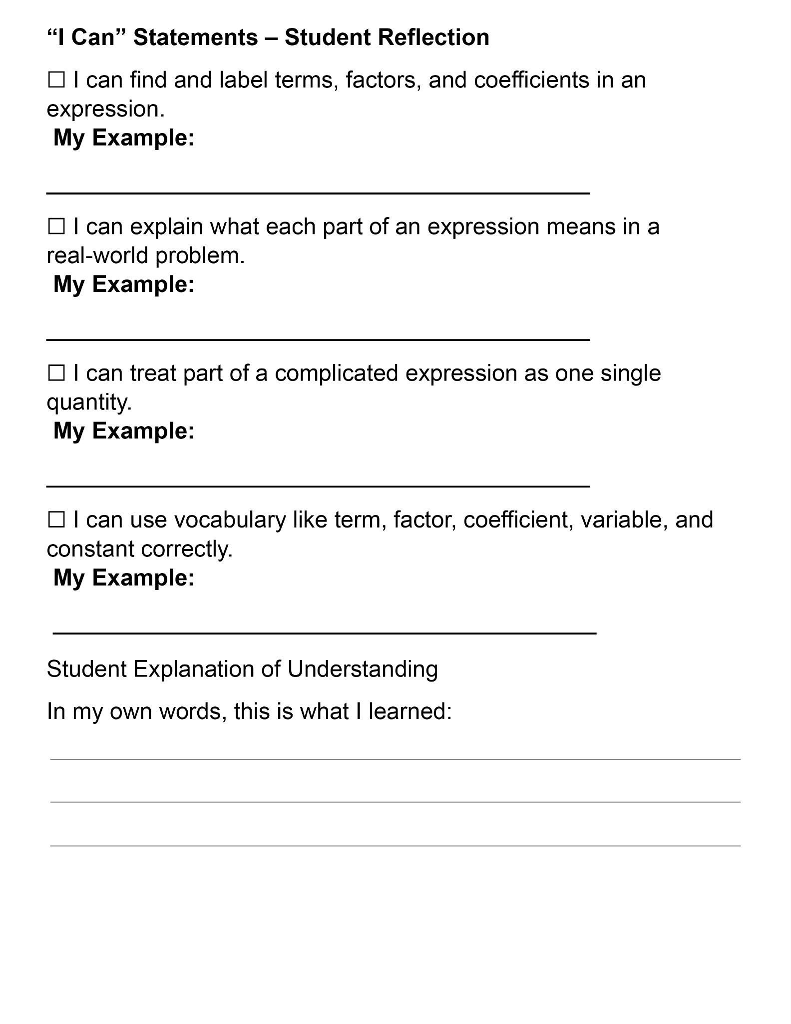

Slide 35
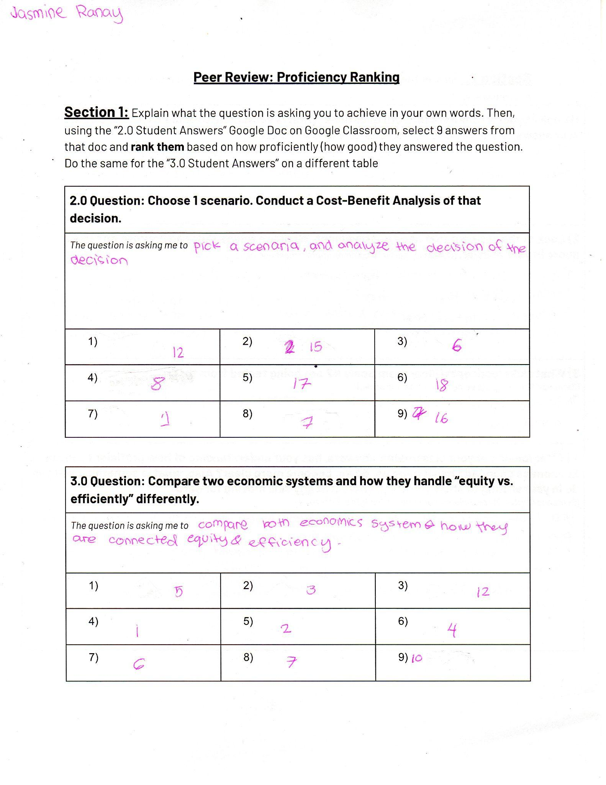
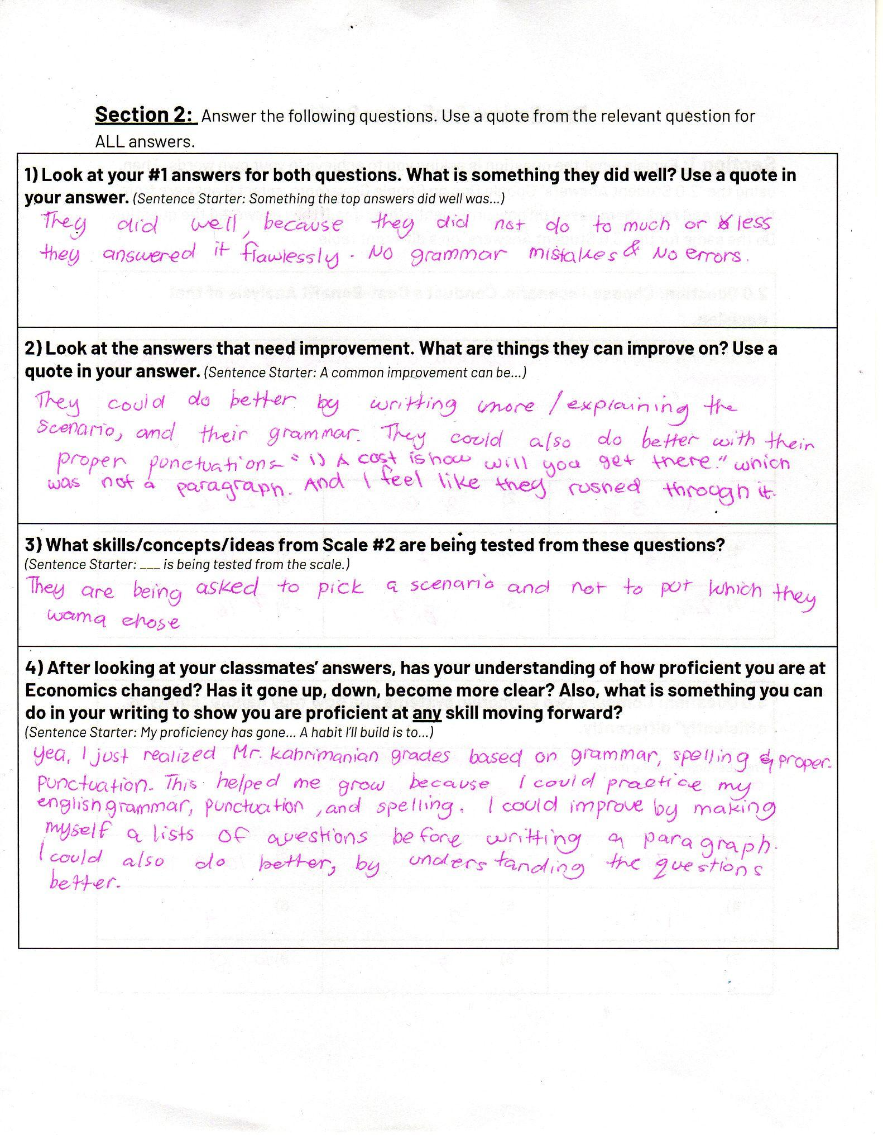
Economics: Using proficiency scales for students to evaluate themselves.
Students reviewed each others answers to a writing prompt which was “Describe the basic features of different Economic Systems”.
They ranked the best answers and categorized what areas of improvement the class needed.
Link
Link
The purpose of this was to show students an array of mixed skill answers and to reflect on their own level.

Slide 36
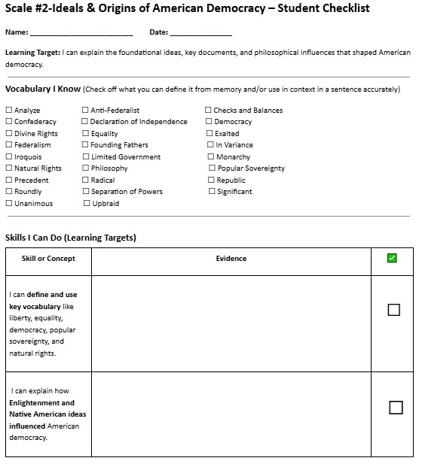
Social Science Scales
Link to PDF
The purpose of this checklist is for students to assess what they have learned in class and whether or not they have mastered the specific skill or concept.
Students will write down evidence such as documents, quizzes and projects to show they are proficient in the skill. They will gather all their physical evidence and staple it together. Once they are done writing and gathering their evidence they will complete final reflective questions for the proficiency scale.

Slide 37
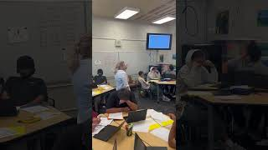
Mastery Learning in Action
Purpose: This check-in was designed to help students monitor their own learning, practice self-assessment, and make connections between their work, the proficiency scale, and their personal growth. The clip you’ll see focuses on Step 3, where students engaged in reflective writing about their progress.
Direct Link to video

Slide 38

Vocabulary Instruction
What is the point of teaching Vocabulary if students don’t understand the definition? Our goal is teaching Mastery!
Look for any words in the definition that students might struggle with
Have students explain the definition in their own words
Provide visual examples for the vocabulary words when possible
Give context for the vocabulary words
Link to Line Vocabulary

Slide 39

Mindfulness practices daily to facilitate healing and resilience
As teachers and school sites we need to accept the reality that many of our students lack Social Emotional Skills and we have to fill in the gaps!
Fostering a positive environment
Addressing emotional needs
Tying in healthy minds and positive outlooks to increase performance and success
Growth in proficiency leads into “buying in” on themselves.

Slide 40
What are some of the things that we are doing to make changes?
What steps are you taking as a campus and in the classroom to build more conducive environments for students to thrive in?
This a question that must be answered by every school site.
Here are a few things from the classroom.
Addressing the social emotional need of our students

Slide 41
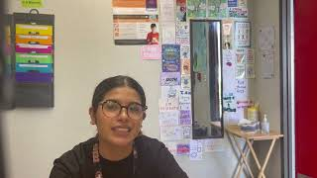
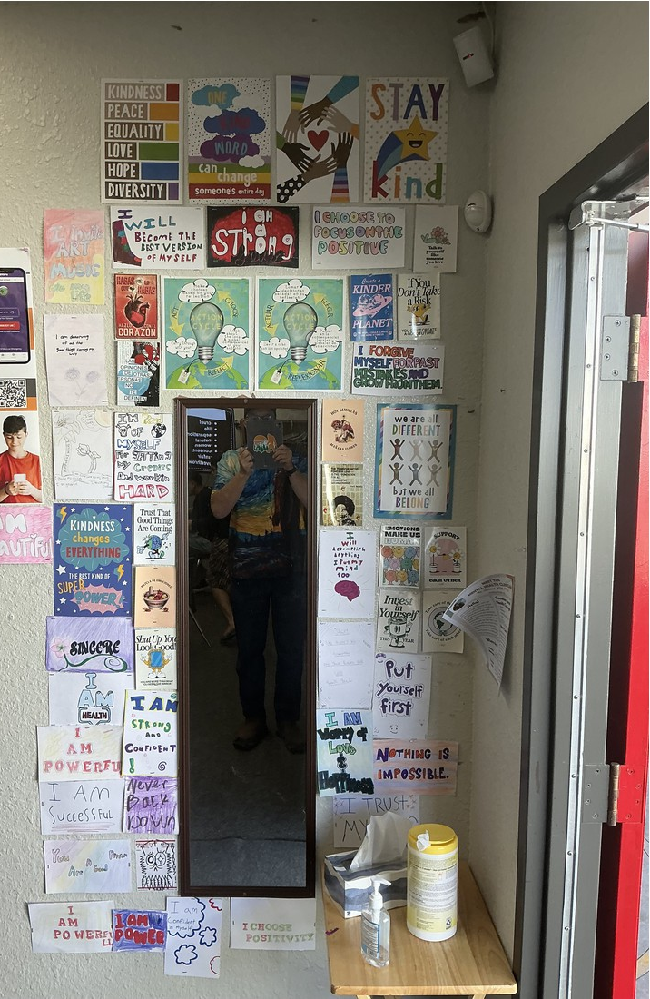
Mindfulness practices daily to facilitate healing and resilience
The Affirmation Wall
Students like to look at themselves in the mirror. Ms. Diaz has one set up at her door surrounded with Affirmations
Direct Link to Video

Slide 42

Mental Health & Wellness
Provides school based interventions that increases student’s access to education by tailoring short term personalized services to meet their holistic needs.
Services include:
Staff Consultation regarding student needs
Individual/Group/Parent Counseling
Crisis Intervention & Response
Conflict Mediations/Resolution
Link to Virtual Wellness Center

Slide 43
Why are talking about this in a Proficiency Scales presentation?
The whole concept of “Embracing Mastery Based Learning” is more than implementing “Proficiency Scales”. It is simply a part of the Humanized Education Model which includes the social emotional aspects of education. Especially as it pertains to the Economically Challenged portion of our communities that are often underserved and come into our school system with underlying trauma that affects their academic growth.

