Slide 1


Piloting a New PID:
Exploring Implementation of
Research Activity IDs (RAiDs) at UT Austin
Bryan Gee
Research Data Coordinator
The University of Texas at Austin
bryan.gee@austin.utexas.edu
0000-0003-4517-3290
Michael Shensky
Head of Research Data Services
The University of Texas at Austin
m.shensky@austin.utexas.edu
0000-0002-5817-6135
Notes:
Michael

Slide 2
What is a Persistent Identifier
Persistent Identifiers (PIDs) are globally unique, persistent, interoperable, and machine-readable/resolvable identifiers used to disambiguate entities providing a long-lasting reference to entities such as contributors, organizations, and objects
“
“
Source: https://library.noaa.gov/PIDs
Unlike a typical URL, PIDs are maintained by external archiving registries to ensure that they are kept permanent and persistent
Basically, PID links are designed to always work and direct users to the correct content
Notes:
Michael

Slide 3
PIDs and the FAIR Principles for Data
FINDABLE
ACCESSIBLE
INTEROPERABLE
REUSABLE
F
A
I
R
Metadata and data should be easy to find for both humans and computers, both manually and by automated processes.
Data should not just be discoverable, but also downloadable and not restricted by passwords or other access constraints
Data need to be able to interface with programs, workflows, or other data for analysis, storage, and processing.
Metadata and data should be well-described so that they can be replicated or repurposed in different settings.
Wilkinson, M.D., Dumontier, M., Aalbersberg, I.J., Appleton, G., Axton, M., Baak, A., Blomberg, N., Boiten, J.W., da Silva Santos, L.B., Bourne, P.E. and Bouwman, J., 2016. The FAIR Guiding Principles for scientific data management and stewardship. Scientific Data, 3(1), pp.1-9.
Notes:
Michael

Slide 4








Types of PIDs Used in Research
Research Entity Type | Established PID(s)
Organizations | ROR
Researchers | ORCID
Publications | DOI, ARK, handle (and more)
Samples | IGSN, RRID
Instruments, Facilities | DOI, PIDINST, RRID
Software | DOI, RRID, SWHID
Grants, DMSPs, etc. | DOI
Research Projects | ?
Notes:
Michael

Slide 5

Types of PIDs Used in Research:
Research Entity Type | Established PID(s)
Organizations | ROR
Researchers | ORCID
Publications | DOI, ARK, handle (and more)
Samples | IGSN, RRID
Instruments, Facilities | DOI, PIDINST, RRID
Software | DOI, RRID, SWHID
Grants, DMSPs, etc. | DOI
Research Projects | RAiD
Notes:
Michael

Slide 6
Addressing Gaps in the PID Ecosystem
2024: ARDC & DataCite
2025: start of
US RAiD Pilot
DOI
2000
IGSN
2004
ORCID
2012
RRID
2014
ROR
2019
RAiD = Research Activity Identifier
Metadata schema specifically designed for projects
Benefits researchers, funders, and institutions who can more easily track project inputs & impacts
2022: RAiD accepted as international standard ISO 23527:2022
2017: ARDC launches RAiD in Australia
Notes:
Michael

Slide 7

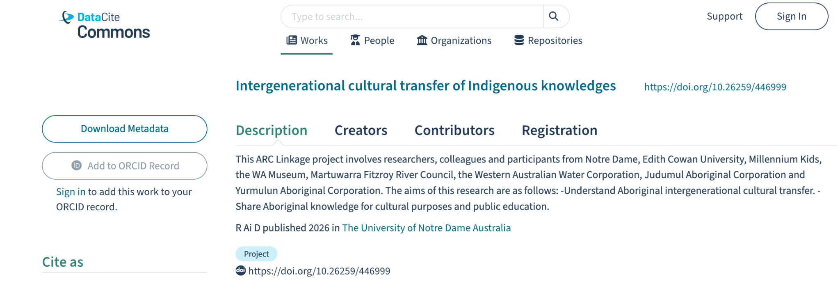





RAiD Infrastructure and Current Status
RAiD is a PID metadata schema and a research project registry https://www.raid.org/search
Uses DOIs minted by DataCite as RAiDs ("resourceTypeGeneral": "Project")
https://raid.org/prefix/suffix (e.g., https://raid.org/10.26259/446999)
RAiDs are issued by RAiD Registration Agencies appointed by ARDC
  Forthcoming rollout in Europe through SURF (Netherlands)
  NSF funded US pilot led by Lyrasis & San Diego Supercomputer Center
  Pilot in Canada through Digital Research Alliance of Canada
Notes:
Michael

Slide 8

RAiD Overview
Notes:
Bryan

Slide 9

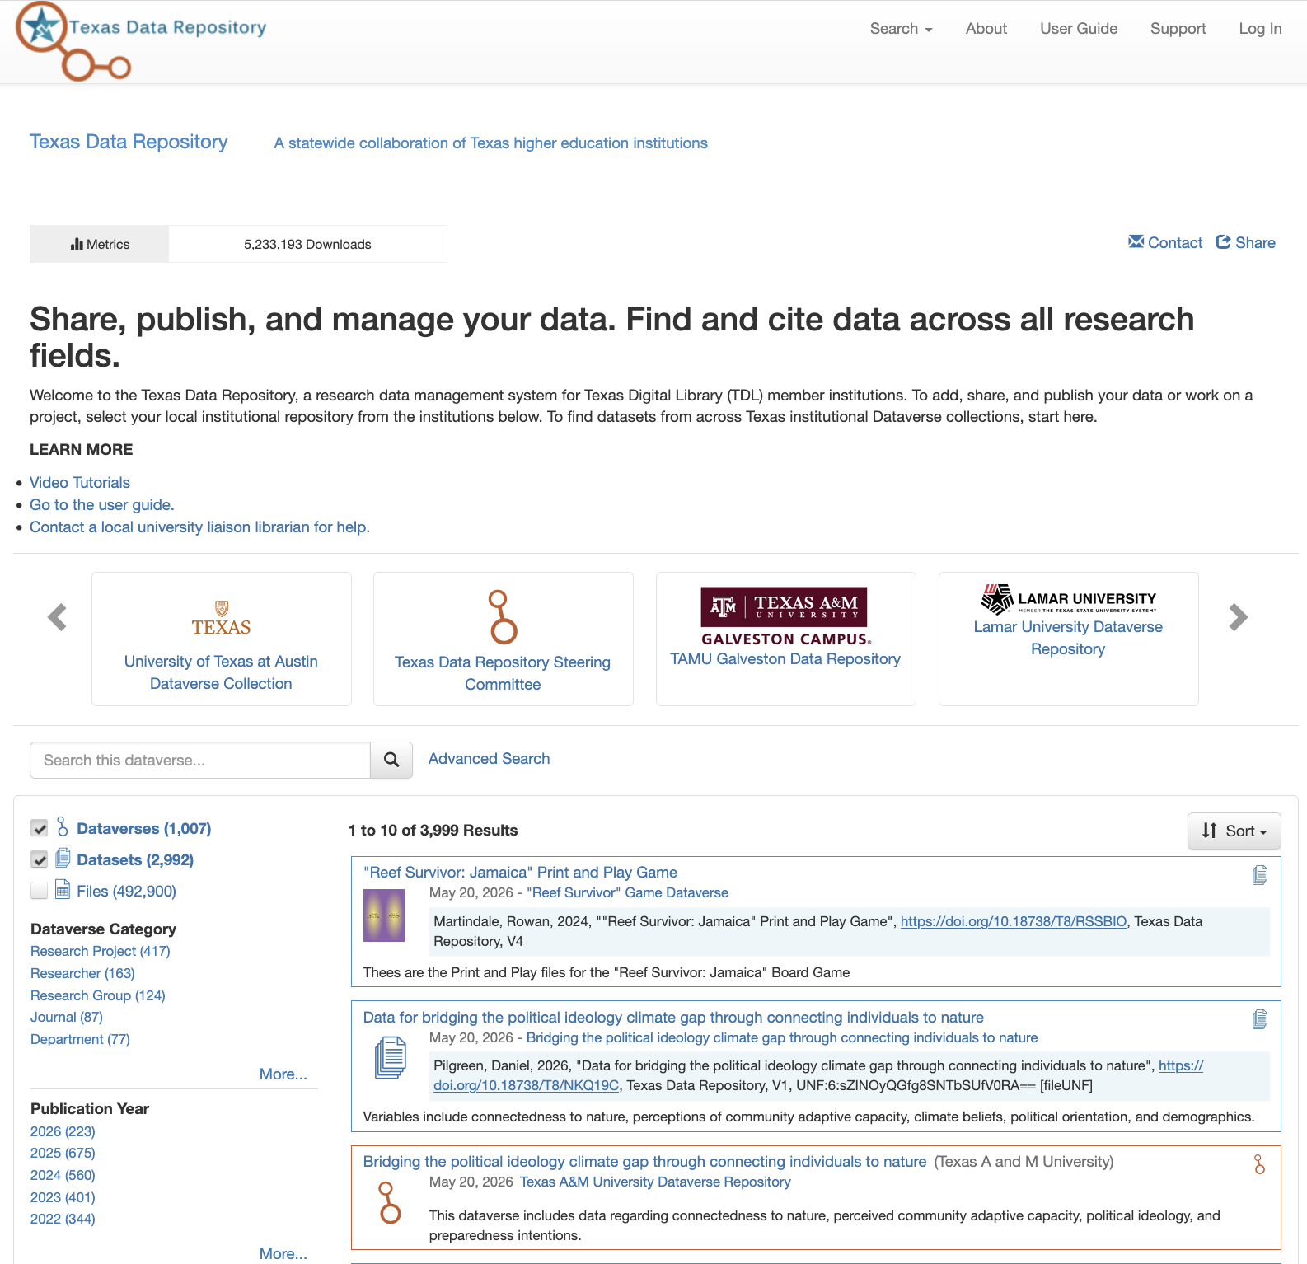

UT Austin RAiD Pilot Project Background
The Texas Data Repository (TDR) is a multi-institutional data repository running on Dataverse software
UT Austin has a Dataverse collection in TDR that serves as its institutional data repository and contains ~1,600 datasets
The TDR is hosted by the Texas Digital Library (TDL)
The UT Austin Dataverse collection is administered by the UT Libraries
Dataverse is a community-developed, open source data repository software project led by IQSS @ Harvard
~150 installations encompassing 900+ institutions world-wide
Notes:
Bryan

Slide 10

Dataset Metadata in Dataverse
The UT Libraries has been exploring way to increase use of PIDs in dataset metadata to facilitate structured metadata connections between entities
Using TDR as a case study since we have full control over metadata
Dataverse currently provides direct support for some PIDs in dataset metadata
  ORCID for author identifiers
  ROR for affiliation and funder identifiers
  DOI, ARK, handle, etc. for related publications
TDR recently added ORCID and ROR integrations developed by the Dataverse community
Notes:
Bryan

Slide 11
Initial Goals
Provide ability for researchers to connect published datasets in the Texas Data Repository to a related project using RAiD
  Identify how this process could be facilitated for researchers and TDR liaisons using the RAiD API and existing or new Dataverse functionality
How can we help researchers mint a RAiD if they don’t have one already?
What metadata field does RAiD information go into for a dataset?
How can RAiD metadata be updated if a new associated dataset is published?
Notes:
Bryan

Slide 12
Current Limitations
Infrastructure
Workflows
RAiDs have only recently been implemented into the DataCite schema (4.7)
Few platforms presently support infrastructure for adding RAiDs to other types of deposits within structured metadata schemas - Dataverse currently does not
Researchers are typically slow to learn about and to adopt PIDs
RAiD is primarily designed to be worked with through APIs, not GUIs - requires development of bespoke scripted workflows
Notes:
Bryan

Slide 13
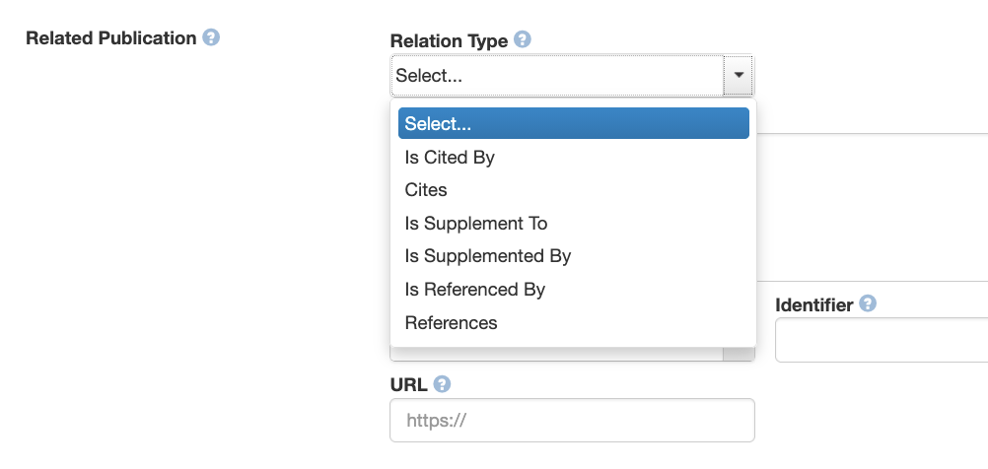
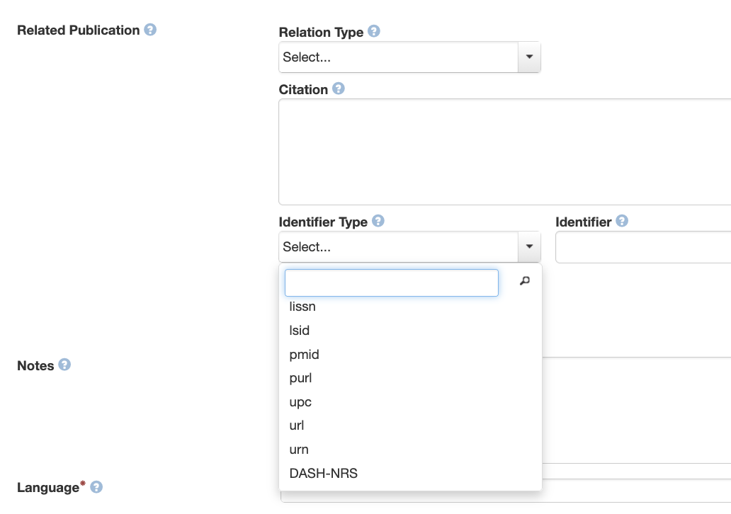
Dataverse Functionality
Existing relationship field mainly designed for publications (articles, preprints, dissertations, etc.)
  Need to add support for RAiDs
  Possible (theoretically) to do a “quick hack” local solution, but we want to identify a broader solution
Notes:
Bryan

Slide 14
Current Projects
Infrastructure
Workflows
Presentation at Dataverse Community Meeting and discussion with the larger Dataverse community
Developing API workflows to cross-walk metadata in order to:
  initialize one record based on the other’s metadata (e.g., dataset from RAiD)
  ensure reciprocal metadata connection (e.g., add RAiD to previously published dataset’s metadata)
Notes:
Bryan

Slide 15




RAiD Demo Testing
Retrieve all RAiDs through RAiD API and check for TDR datasets
Cross-reference records to ensure reciprocal connection & check for PID gaps
Use APIs to update records if only a one-way connection exists or if metadata can be enriched
Retrieve all TDR datasets through Dataverse API and check for RAiDs
Notes:
Bryan

Slide 16
Long Term Goals
Provide ability for researchers to easily create/enter RAiD metadata when publishing a dataset in TDR
Ensure reciprocal metadata connectivity between RAiD record and dataset record
Work with campus partners to reach researchers in early stages of the research life cycle to help them mint a RAiD before the data publication stage
Incorporate information about benefits of RAiDs into research data trainings and help drive adoption at UT Austin
Notes:
Bryan

Slide 17
Conclusion
RAiDs offer an opportunity to track scholarly activities at a level not presently captured by other PIDs
  Can be particularly useful for denoting granularity around contributions/roles, including participation by people who are not formal authors on any related outputs
Metadata and PID usage can only be as good as the infrastructure that researchers are using
Bryan Gee
Research Data Coordinator
The University of Texas at Austin
bryan.gee@austin.utexas.edu
0000-0003-4517-3290
Michael Shensky
Head of Research Data Services
The University of Texas at Austin
m.shensky@austin.utexas.edu
0000-0002-5817-6135
Notes:
Bryan

