Slide 1

Making Metadata Input Accessible:
Training Volunteers & Practicum Students for the Sherwin Carlquist Project
Presented by:
Samantha Ekberg, Digitization Technician
Botanical Research Institute of Texas Library
For Texas Conference on Digital Libraries, 2026

Slide 2

In this presentation:
01
02
03
Introduction
Metadata Training, Assigning, & QC
Evolution of the Metadata Guidelines
The institution, the grant, the botanist, the materials, the volunteers, & the practicum students
Training structure, how metadata is assigned, how we QC (quality check)
How the guideline document has changed over the 4 versions & why

Slide 3


01
Introduction
The institution, the grant, the botanist, the materials, the volunteers, & the practicum students

Slide 4

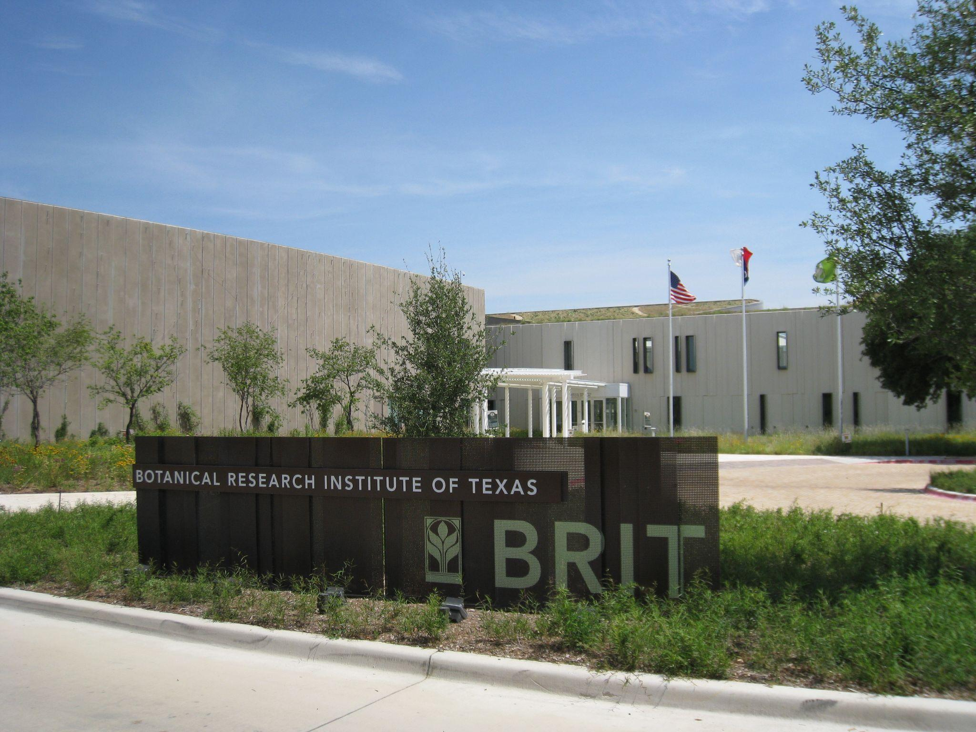
The Institution:
The Botanical Research Institute of Texas (BRIT)
Located in Fort Worth, Texas
The "research arm of the Fort Worth Botanic Garden" and "is an international scientific research and learning center dedicated to conservation and knowledge sharing." - fwbg.org
BRIT Library "houses one of the largest collections of botanical works in the southwestern United States." - fwbg.org
By MauriceJFox3 - Own work, CC BY-SA 3.0, https://commons.wikimedia.org/w/index.php?curid=19802284

Slide 5
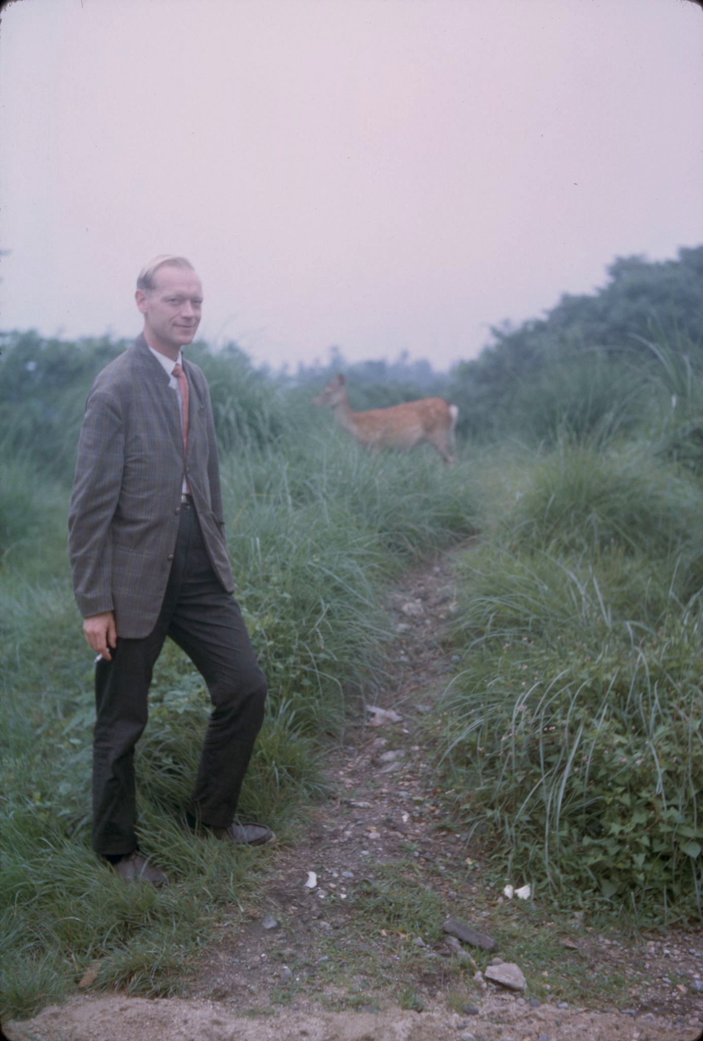
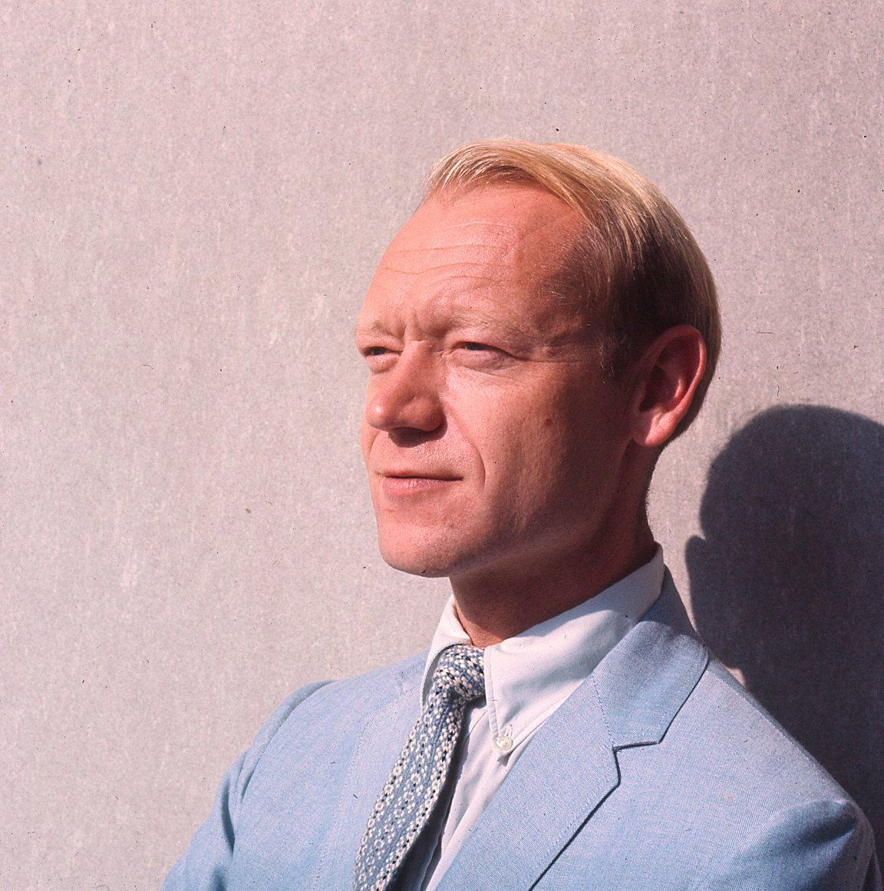
The Botanist:
Dr. Sherwin J. Carlquist (1930-2021)
American botanist specializing in island biogeography and wood anatomy
Published 8 botanical books, as well as a book on Japanese festivals, and multiple fine art photography books
Worked for:
  CalBG - Plant anatomist
  Claremont University - Professor
  UC Santa Barbara - Adjunct professor
  Santa Barbara BG - Research botanist
Most active collecting years from 1962-1982
Focused on unique and/or isolated regions all over the world

Slide 6




The Grant:
National Science Foundation - "Collaborative Research: Advancing the Extended Specimen Network: Curating and Digitizing the Sherwin Carlquist Collection"
Awarded to BRIT & California Botanic Garden (CalBG) in 2021
BRIT: Archival collection of Sherwin Carlquist
  ~ 200k objects (~150k color positive film slides, + field notebooks, b&w loose film)
CalBG: Biological collection of Sherwin Carlquist
  ~20k objects (wood/herbarium/fluid-
  preserved specimens, microscope slides)
Primary goals of the grant were to:
  Curate, digitize, publish the collections
  Link two collections through an Extended Specimen Network (ESN)

Slide 7
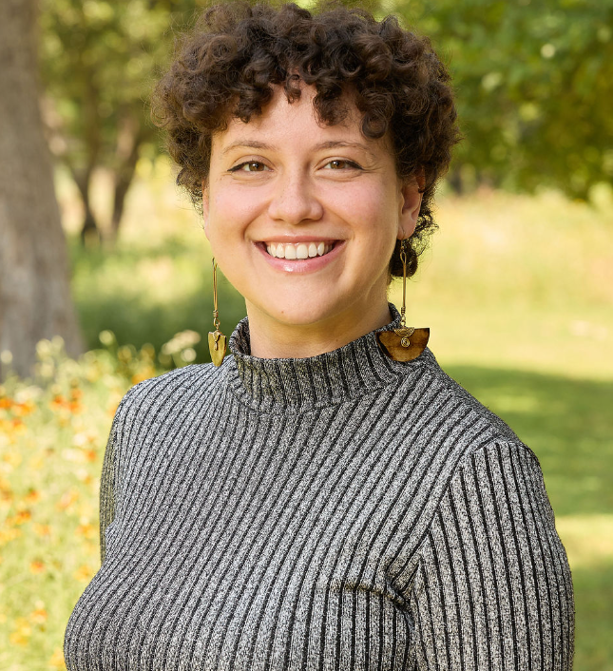
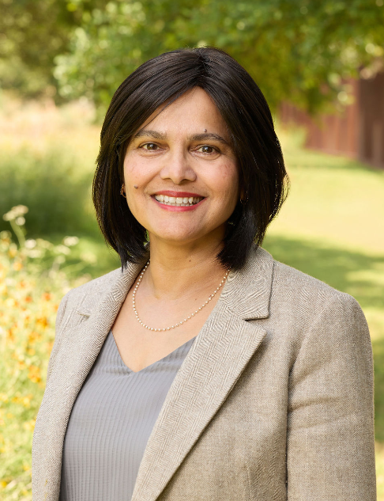
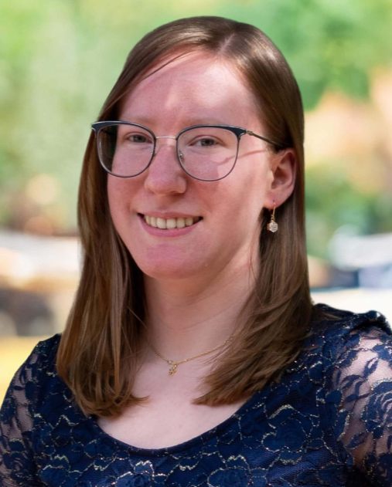
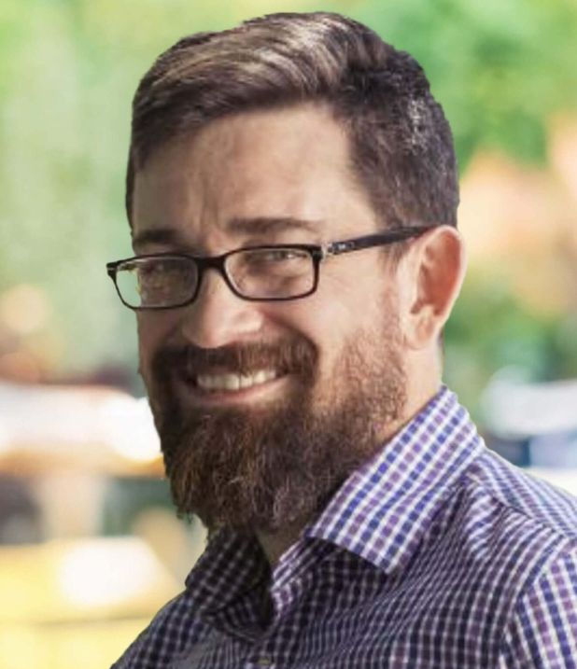

The Grant:
BRIT's NSF Carlquist Project Staff
Ana Niño
BRIT Librarian
Grant Co-PI
Krishna Shenoy
Project Archivist
Full-time Contractor
Samantha Ekberg
Digitization Technician
Full-time Contractor
Jason Best
BRIT Director of
Biodiversity Informatics
…and dozens of volunteers & practicum students!

Slide 8
The Grant:
Volunteers & Practicum Students
Volunteers:
Come from all backgrounds, and are very important to BRIT & FWBG
Wide range of computer/technical skills we have and will accomodate
Volunteers may work in other parts of BRIT, or even the gardens
Often given tasks outside the grant project
Within the grant project: Less structured, choice of tasks (don't always do metadata!)
Practicum Students:
College/university students
Library science, information science, botanical science, public history
Library hosts multiple college/university practicum (intern) students every semester
More structured, with varied tasks, primarily within grant project
Required to complete 1 metadata box (contains about 50 to 150 color positive slides)

Slide 9
02
Metadata Training, Assigning, & QCing
Training structure, how metadata is assigned, how we QC (quality check)

Slide 10
Timeline of NSF Carlquist Metadata
0.5
01
02
03
04
05
06
BCMI data input during imaging
Semesterly metadata training
Assigned first
"saltine" boxes
Complete first 20 metadata records
most basic info on the items
~ 5 hours long, in person, 2-8 trainees
answer questions, catch problems, practice
~50 - 150 records
First 20 records QCd
& corrected
Complete rest of the saltine box
Whole box QCd
& corrected
QC feedback
through email
questions/assistance in person or q. form
may assign another
when applicable

Slide 11
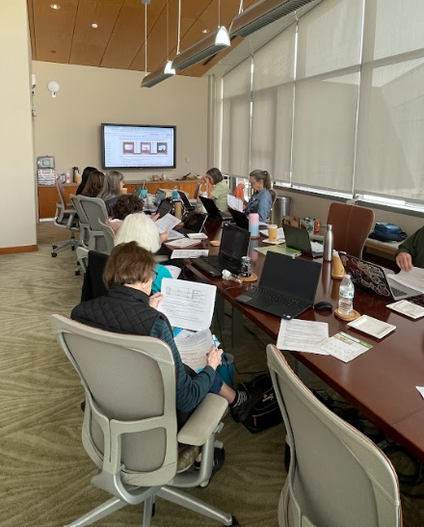
Intro to Metadata Training
Why in-person?
  One-on-one questions, practice records, in depth & detailed
  We can accommodate those with varying levels of technical/computer skills better in person during training
  Online training creation would take time to properly build
Training documentation/resources primarily use Google Docs, Google Sheets
  Ever-changing, multiple viewers/collaborators, generally familiar
Provide laptops as needed, refreshments, paper & digital metadata guidelines to follow
Training Session Structure:
Setting up accounts, document/spreadsheet access, introduce resources/websites
How to use portals, spreadsheets, documents
Go through Portal to Texas History Editor metadata fields, field-by-field
  Following the metadata guidelines, field/qualifier order as they appear in the Portal to Texas History
  Entry is done in a wide variety of ways/orders - training is an overview to introduce & connect fields/qualifiers, concepts, strategies
Assign saltine boxes & work one-on-one with records for remaining time

Slide 12
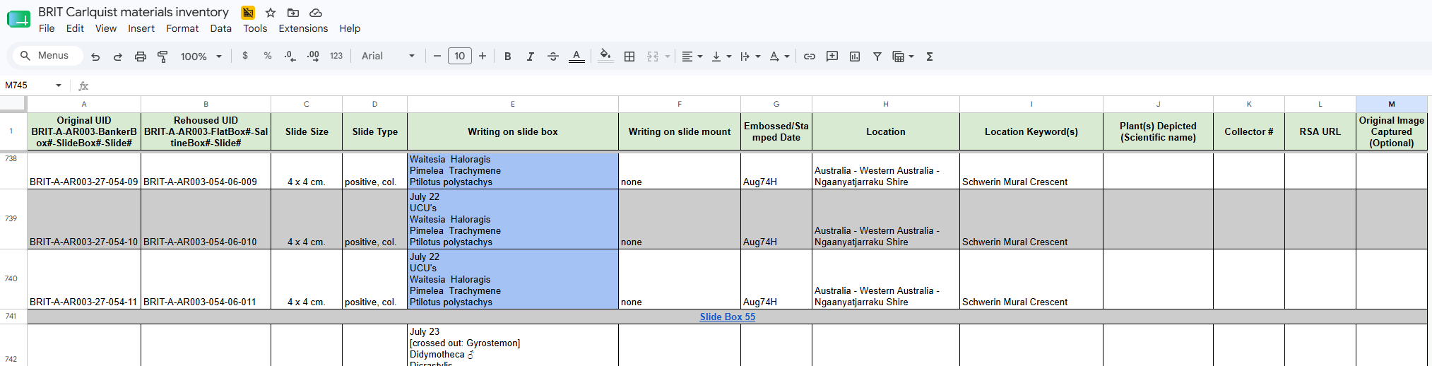

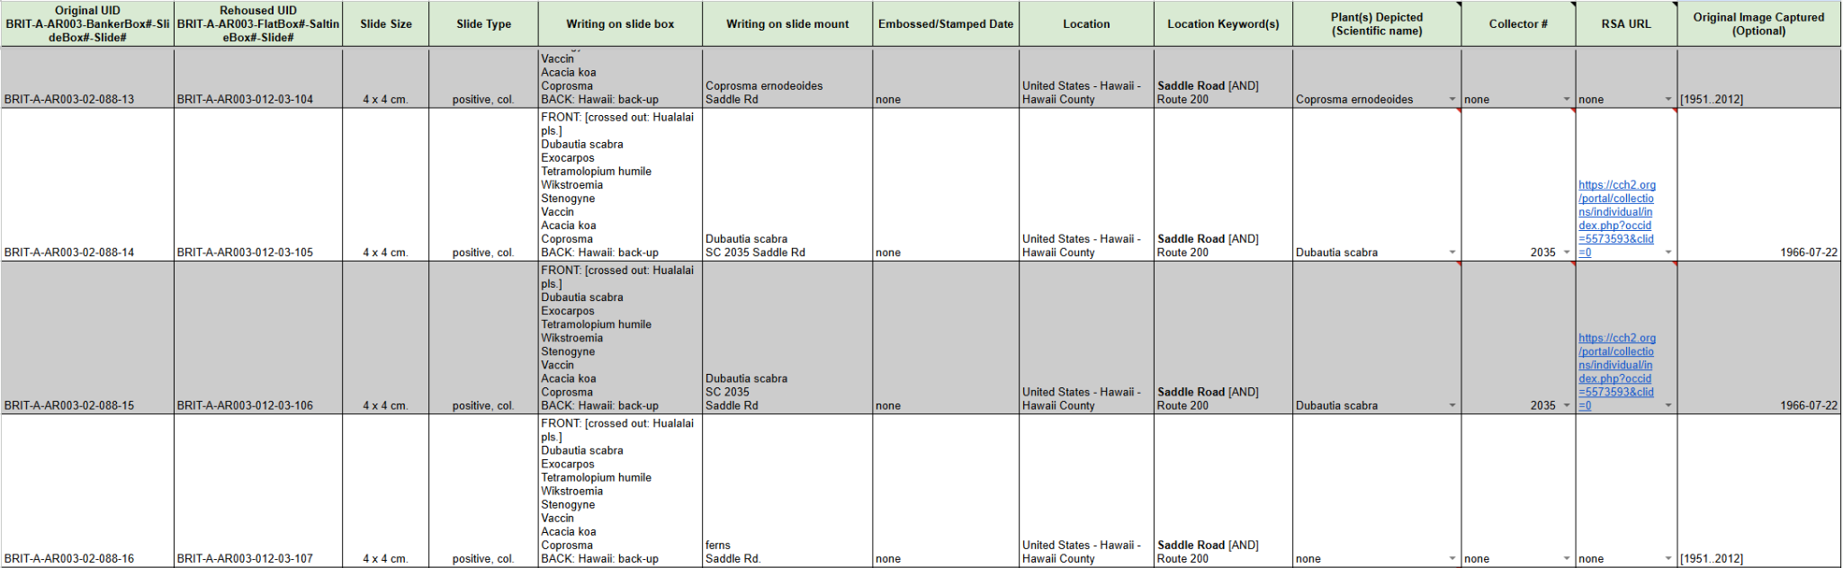


Notes:
Mention we have locked columns and created duplicate spreadsheets of a worker's specific assigned records.

Slide 13
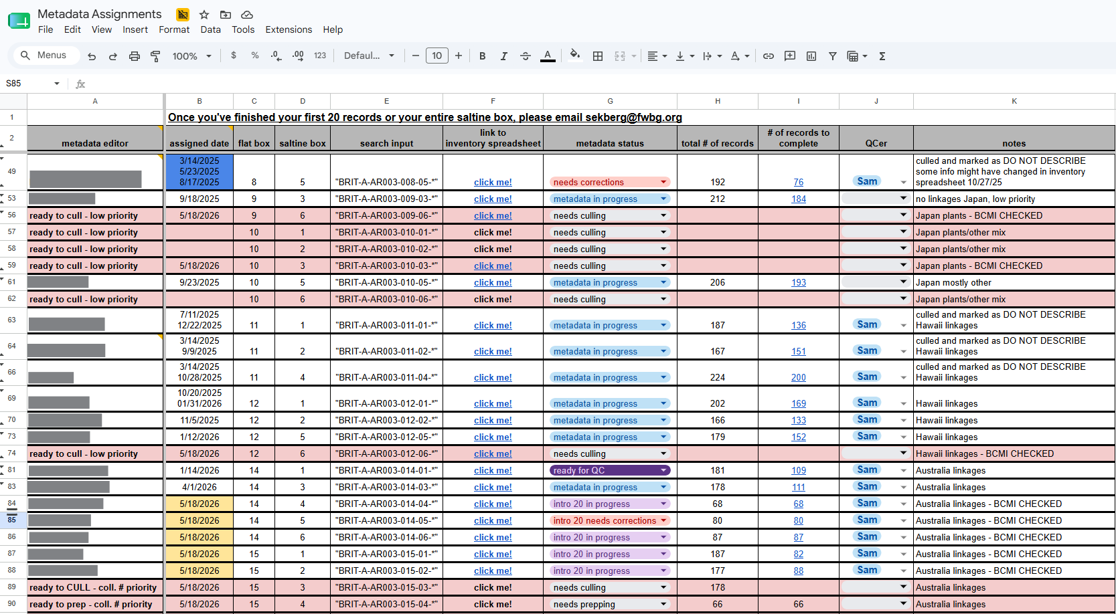

Slide 14
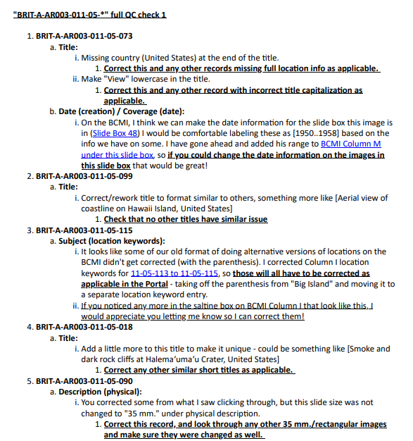
Metadata QC (Quality Checking)
Through email, to one primary QCer
First 20 records are all checked one-by-one, full box has ~30% checked (unless more needed)
Email links directly to relevant sections in guidelines, cells in spreadsheets, etc.
When a correction is listed for a record, a note is given indicating this correction should be applied to all other records where applicable
Sometimes corrections are given in multiple rounds to prevent overwhelm/confusion
Correction feedback may be more detailed depending on the metadata worker
Encourage worker to print correction email if they want to do so

Slide 15
03
Evolution of the Metadata Guidelines
How the guideline document has changed over the 4 versions & why

Slide 16
Intro to the Metadata Guidelines
Created with Google Docs
Currently has 4 versions - each version receiving dozens of minor edits
  Version 1 - early 2024
  Version 2 - mid 2024
  Version 3 - late 2024
  Version 4 (current) - started in late 2025, deployed in January 2026
New version created when major content/formatting changes are needed
  Changes/updates in field/qualifier guidance
  Improved formatting, structure to increase ease of use/comprehension for users
  Improvements primarily based on pain points seen in the QC process over several workers, and feedback

Slide 17
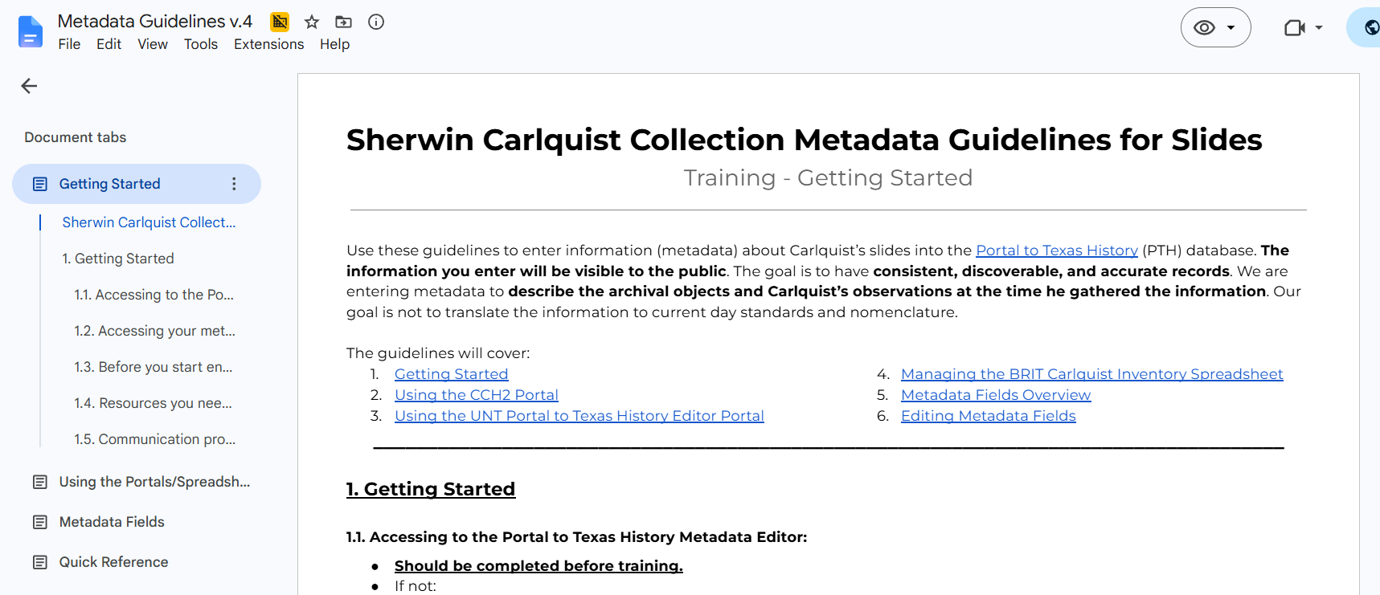
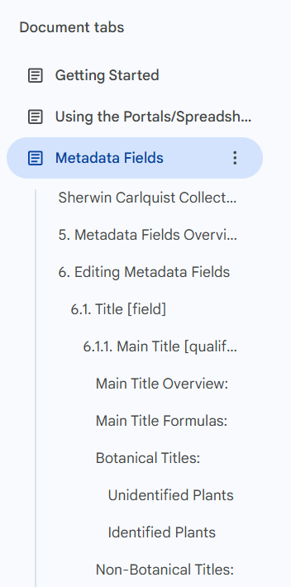
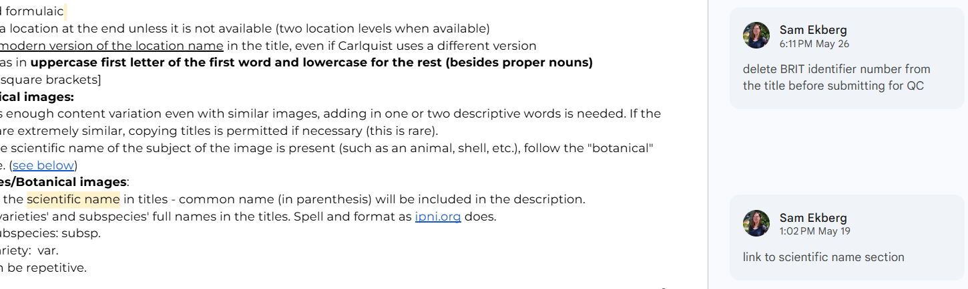
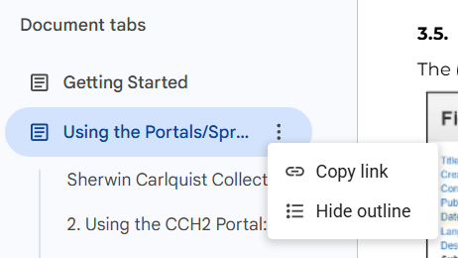

Slide 18
Noteworthy Changes Between Versions
Version 1 → Version 2
Simplifying text & unnecessary examples
Adding more necessary examples
More consistent formatting
More detail/clarity in some sections
Updating changed/incorrect field/qualifier guidance
Version 2 → Version 3
More variation in text hierarchy/multilevel lists, bolding, underlining, font sizes
More links to other sections
More image examples/updating images
Added more detail/clarifying sections - section intros
Deleted/added sections
Restructuring within field/qualifier sections
Added tables
Emphasis on important/often missed concepts
Version 3 → Version 4
Utilizing tabs to separate training-only sections from main "Metadata Fields" tab
Reducing page margins
Changing font sizes
Better section separation/headers
Deleting/combining/restructuring sections
Adding sections/more info to sections
Adding images
Reducing image sizes/making image sizing more consistent
Added color coding
Added more tables

Slide 19
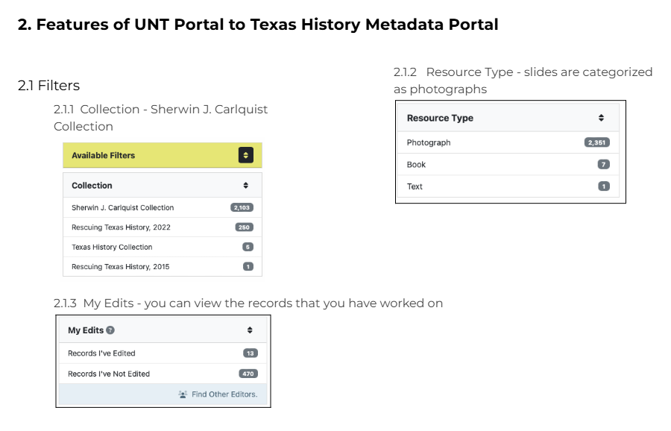
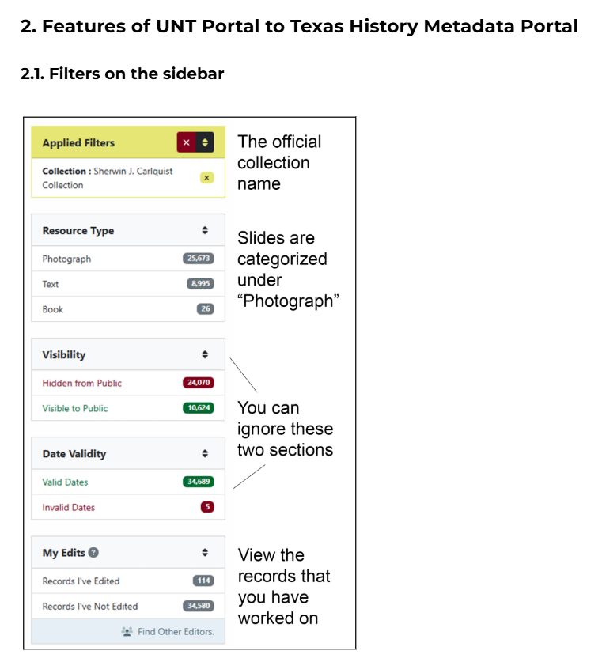
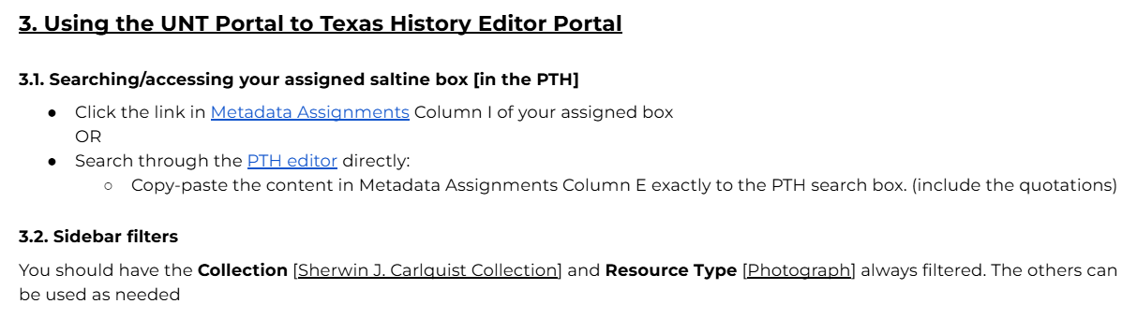
PTH Sidebar
V2
V4
V3

Slide 20
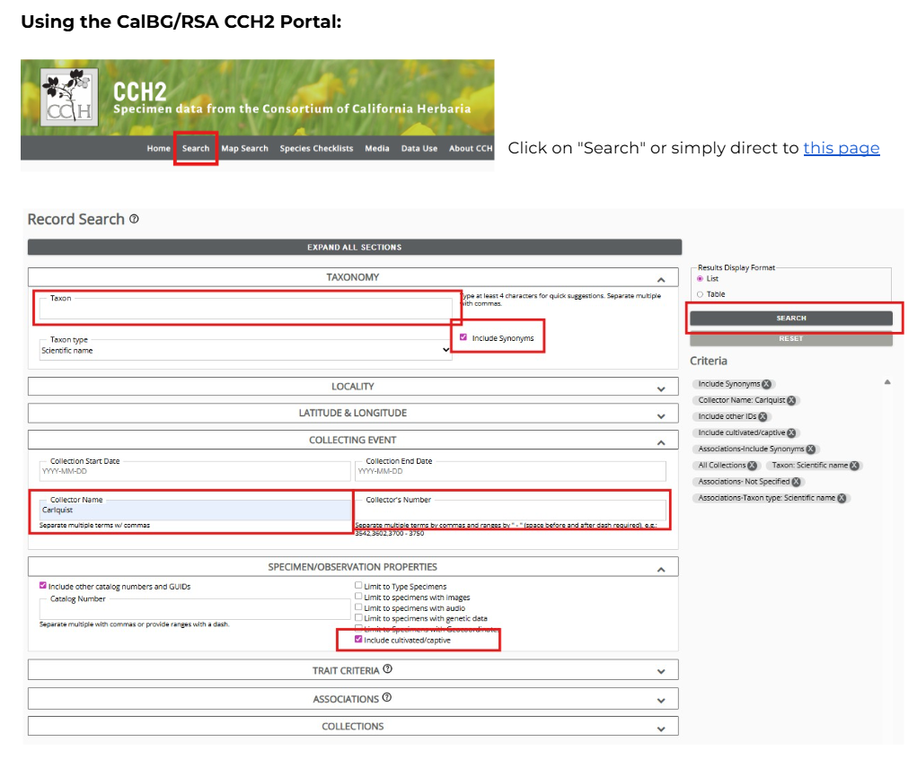
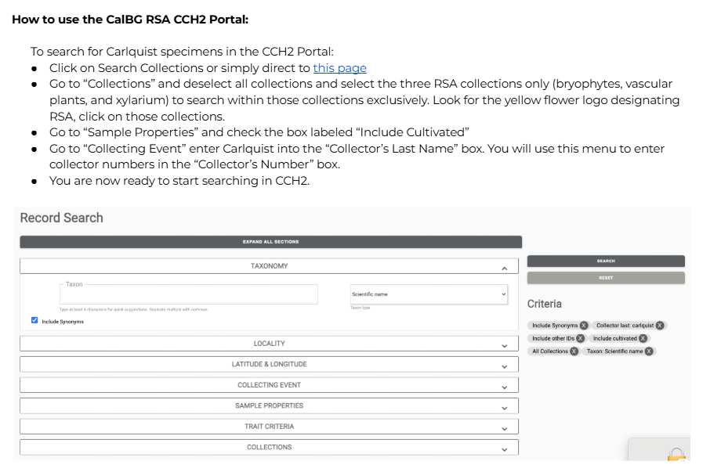
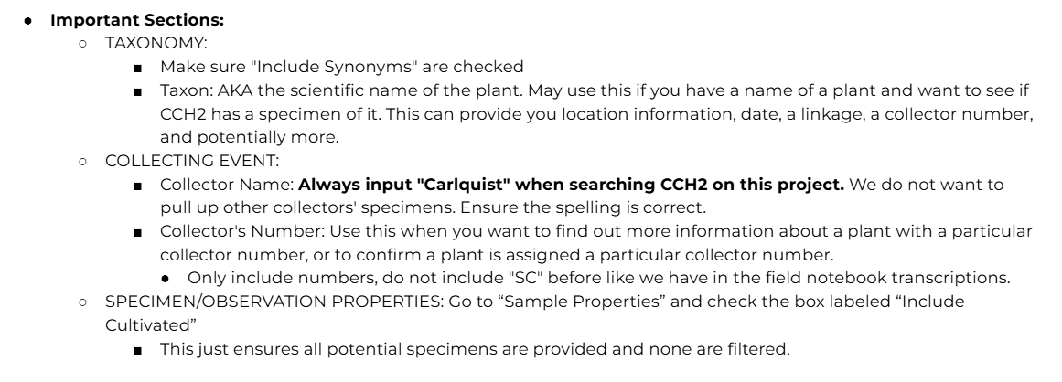
Using the CCH2 Portal
V3
V1

Slide 21
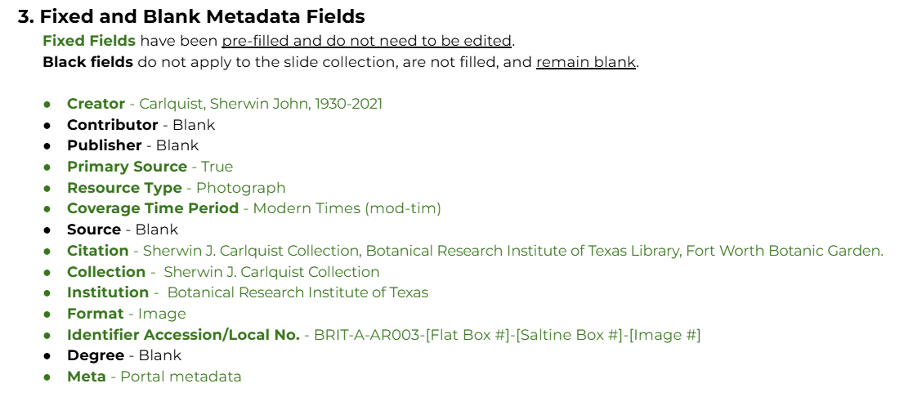
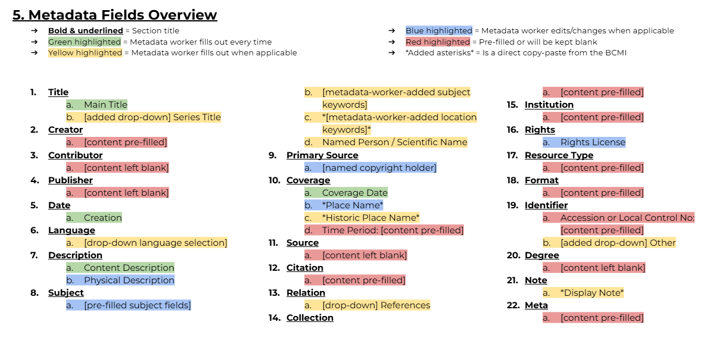
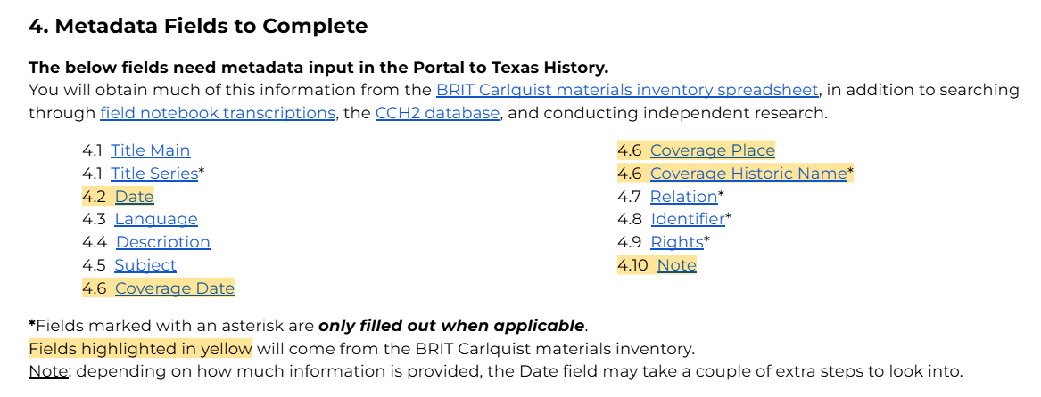
Field/Qualifier Overview
V3
V4

Slide 22
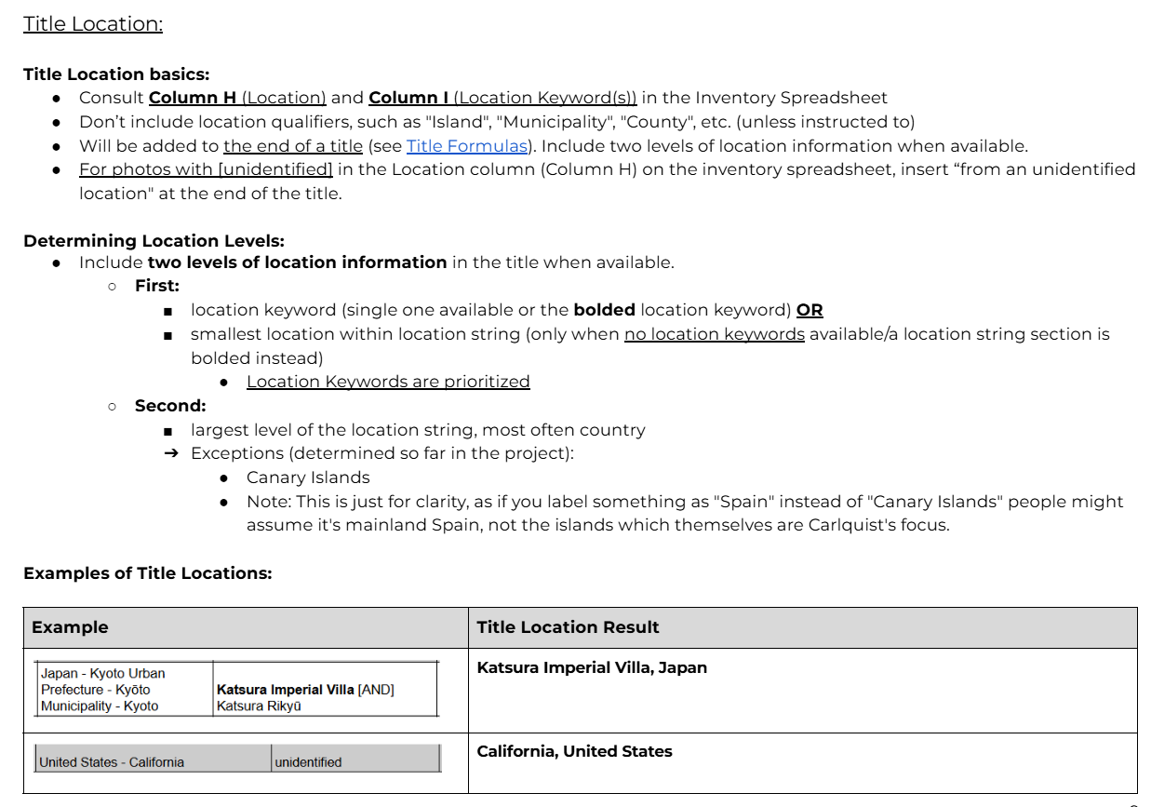
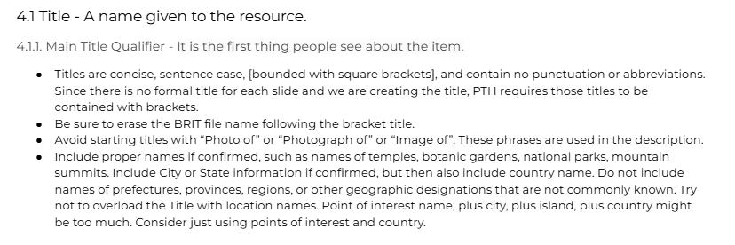
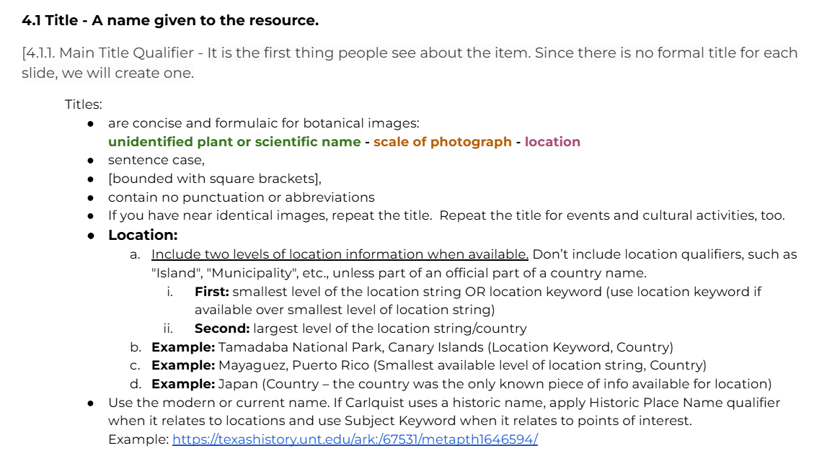
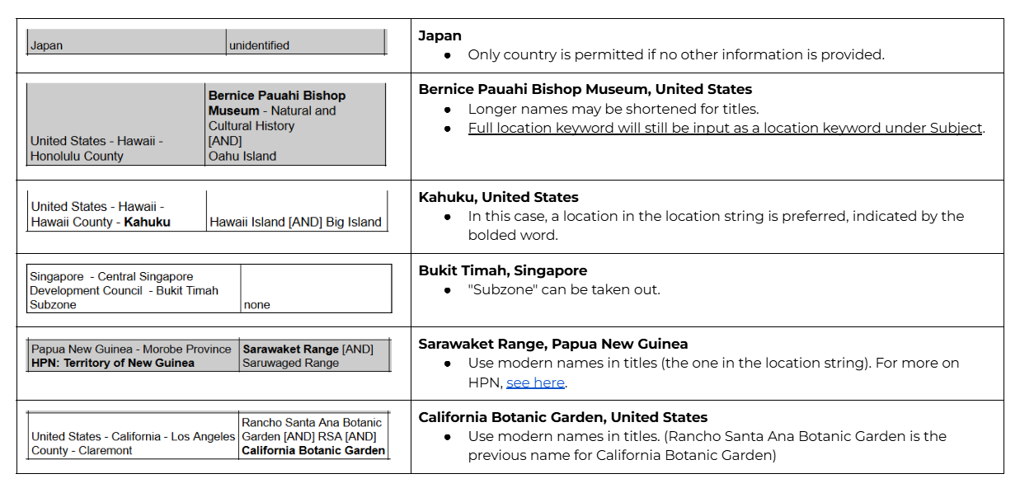
Title Location
V1
V2
V4

Slide 23
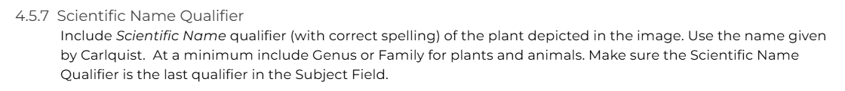
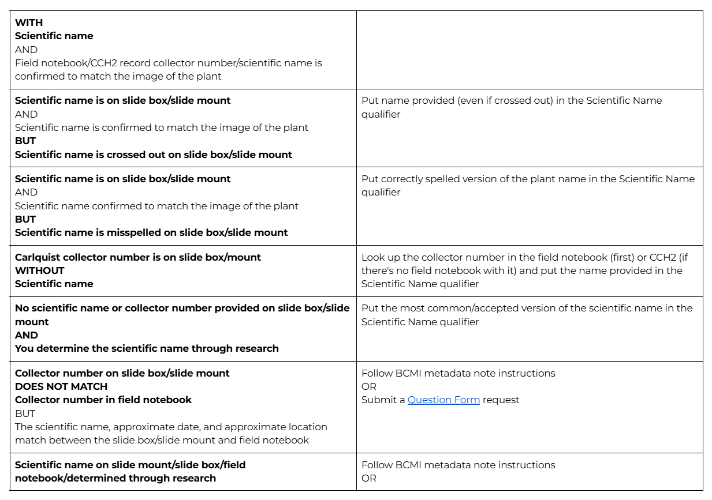
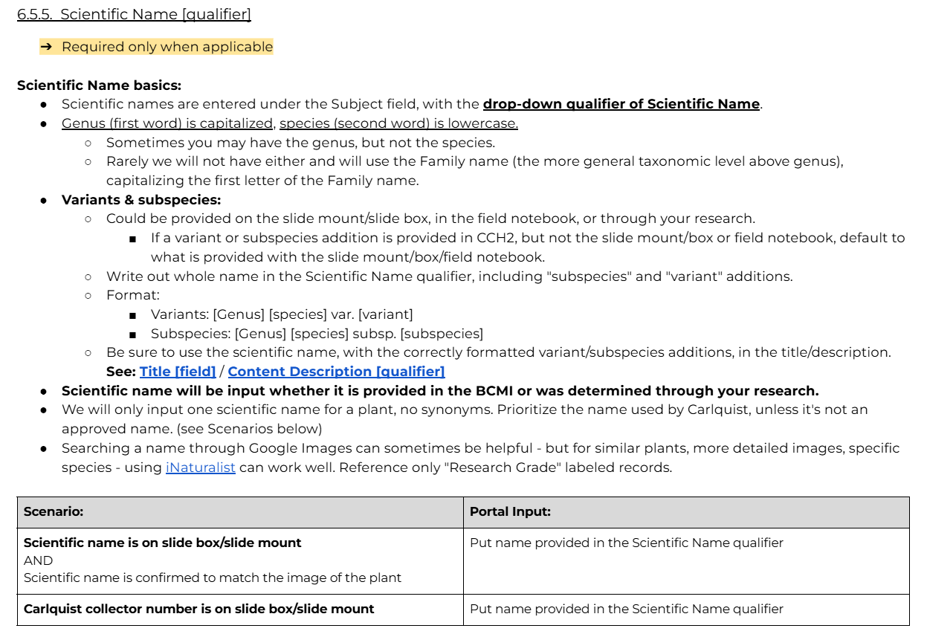
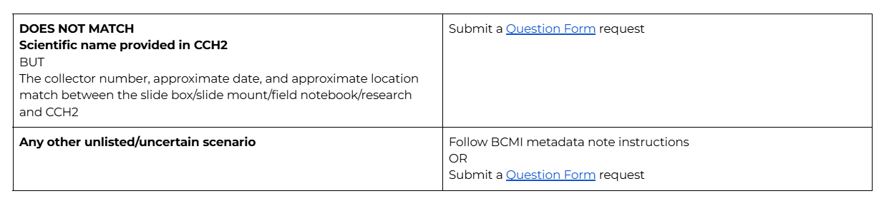
Scientific Name
V1
V4

Slide 24
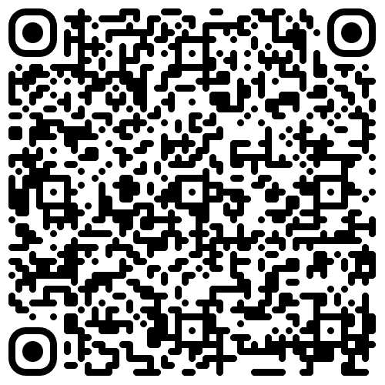
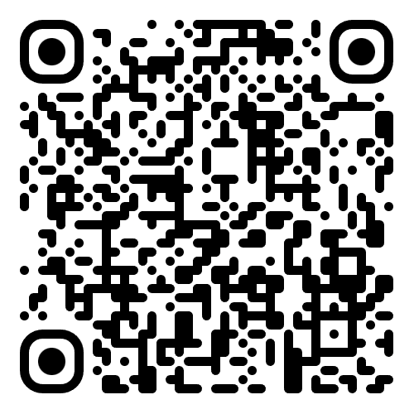
NSF Carlquist Exhibitions
Expeditions Through the Lens: Botanical Photographs of Sherwin Carlquist
Botanical Research Institute of Texas (BRIT) - Fort Worth, Texas
In-person exhibit
June 1st - September 30th (weekdays)
https://fwbg.org/full-calendar/exhibition-expeditions-through-the-lens-botanical-photographs-of-sherwin-carlquist/
Sincerely, Sherwin
The life and legacy of
Dr. Sherwin Carlquist,
a visionary botanist
California Botanic Garden (CalBG) -
Claremont, California
Online exhibit
https://storymaps.arcgis.com/stories/75f901d150b24d21a6ce0b6cfcaa7913

Slide 25
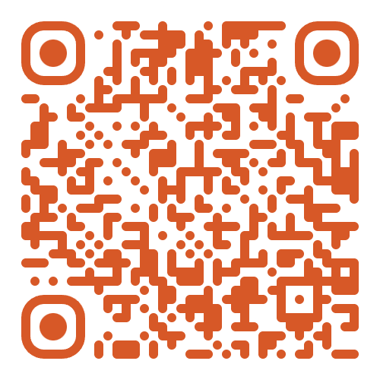
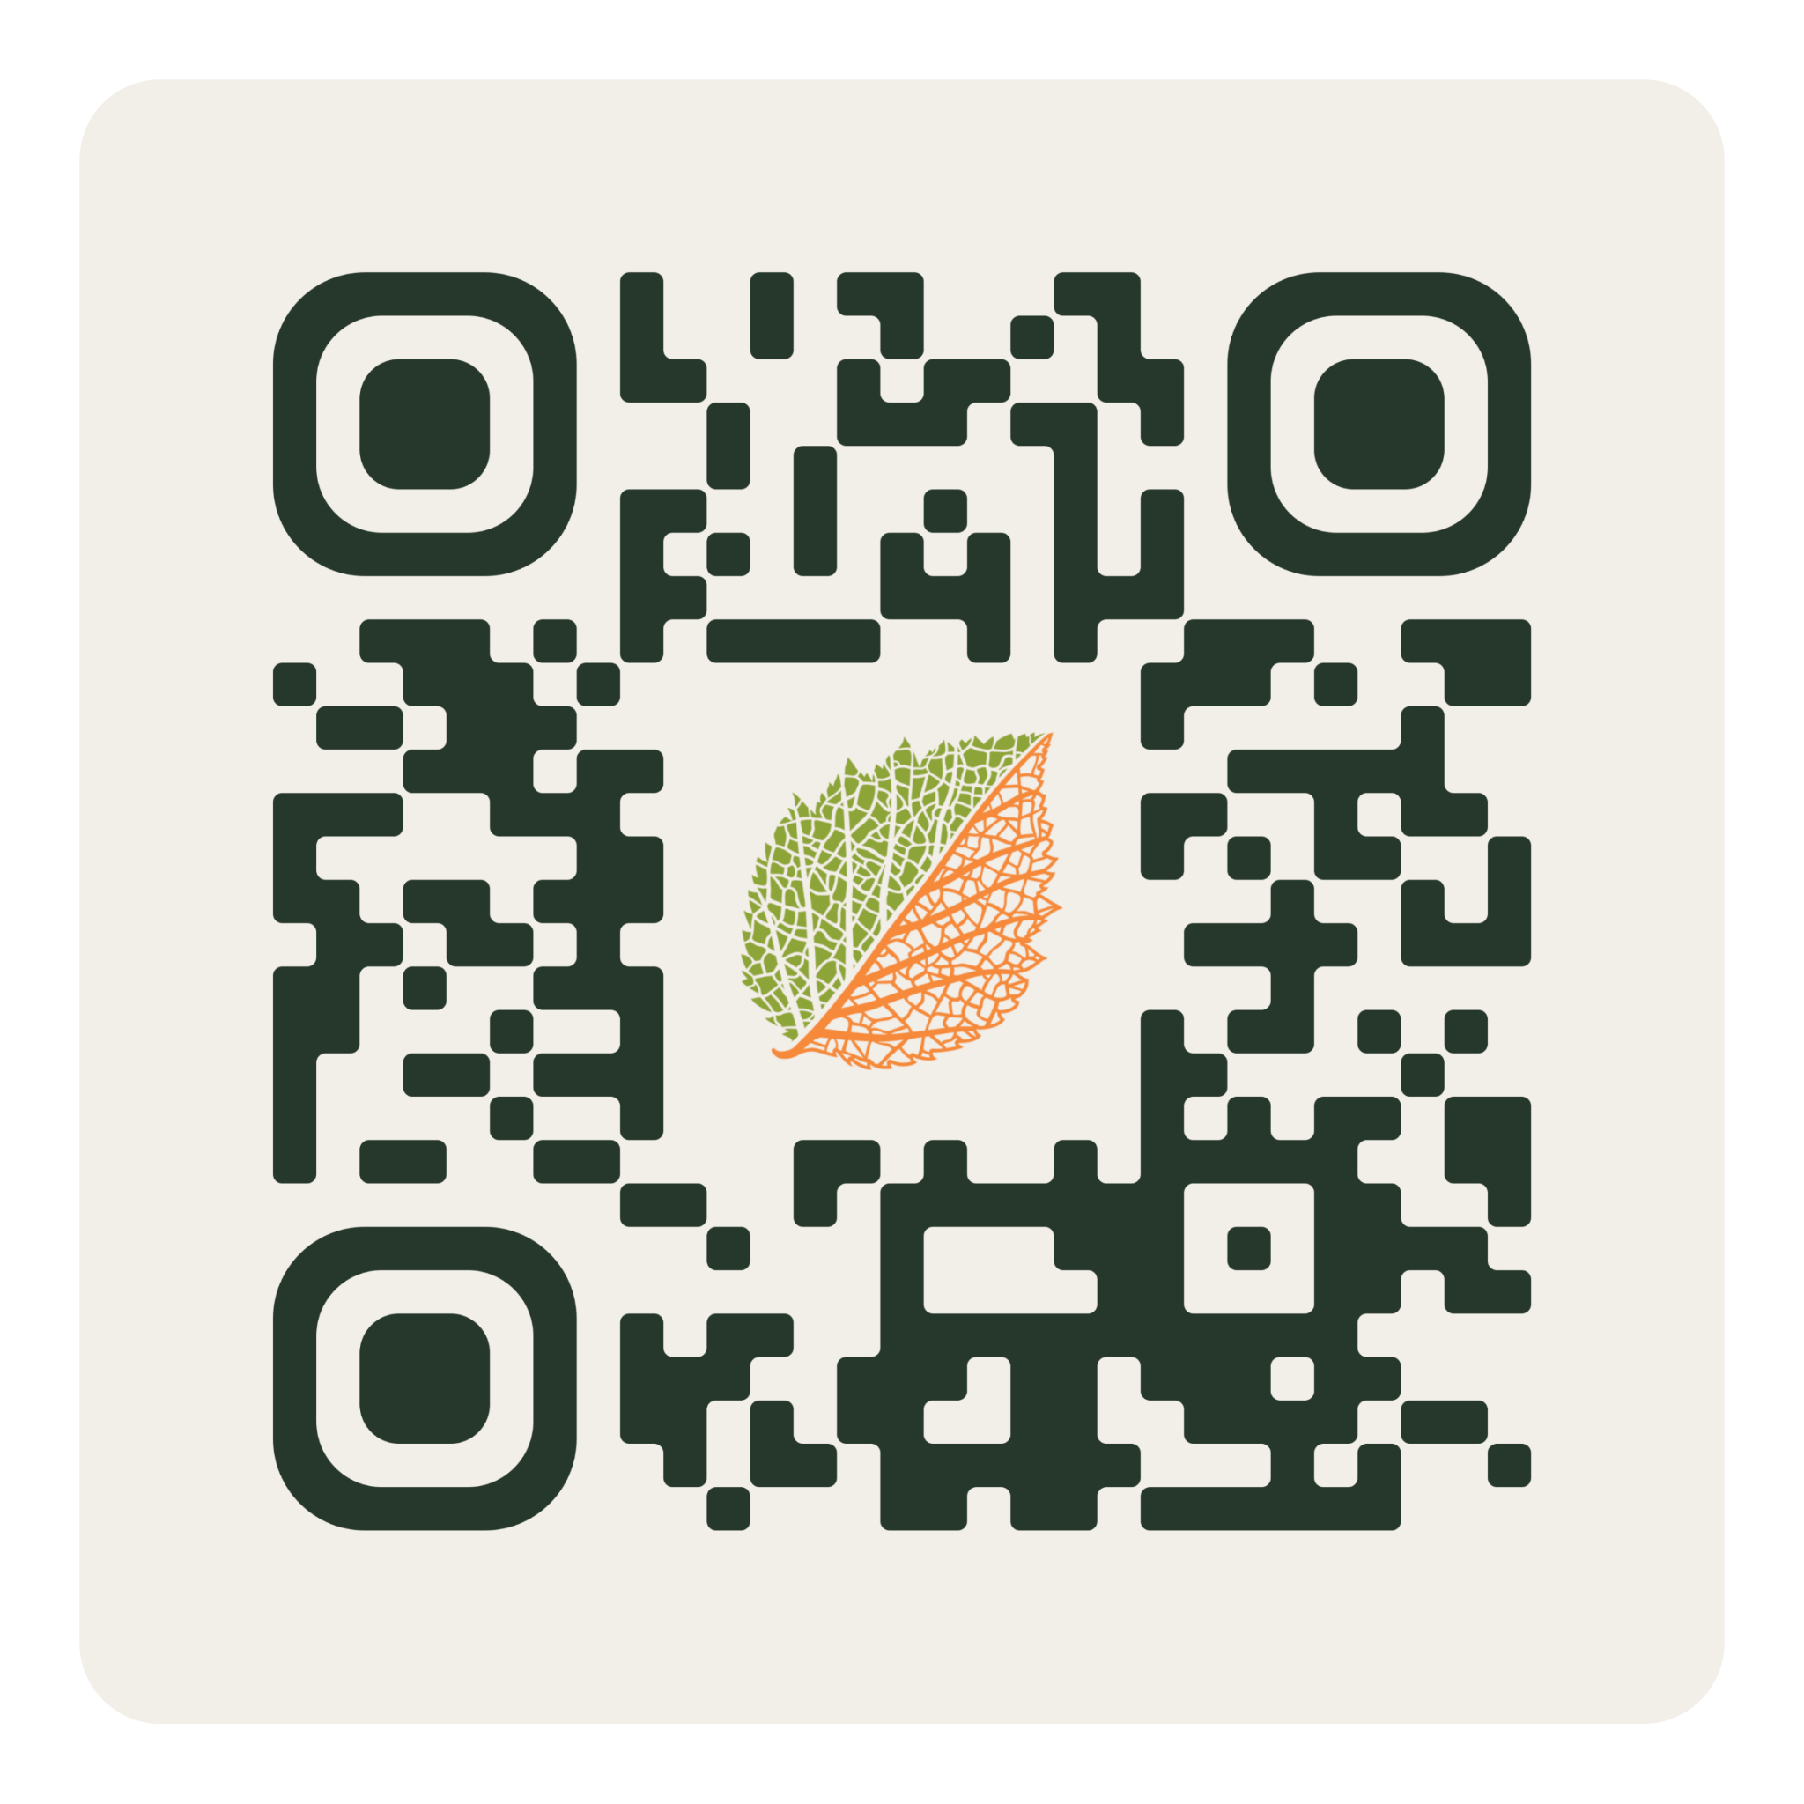
Thanks!
BRIT In-person exhibit
https://fwbg.org/full-calendar/exhibition-expeditions-through-the-lens-botanical-photographs-of-sherwin-carlquist/
Contact Samantha Ekberg at:
Email: sekberg@fwbg.org
LinkedIn:
CalBG Online exhibit
https://www.linkedin.com/in/samantha-e-479873178
https://storymaps.arcgis.com/stories/75f901d150b24d21a6ce0b6cfcaa7913
Carlquist collection on The Portal to Texas History
https://texashistory.unt.edu/

