Slide 1
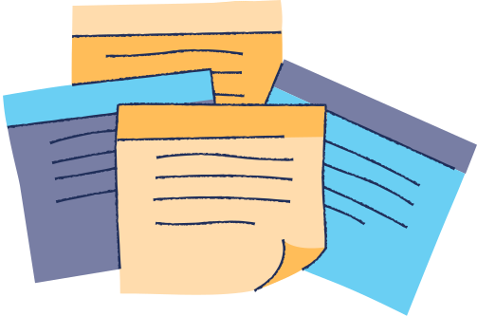

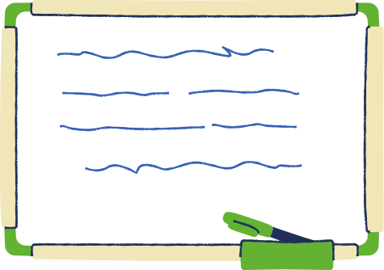
Shared Curiosity and Cross-collaboration: Key to expanding Digital Scholarship
Kiana Fekette, Karina Sánchez, & Yi Shan
University of Texas Libraries

Slide 2



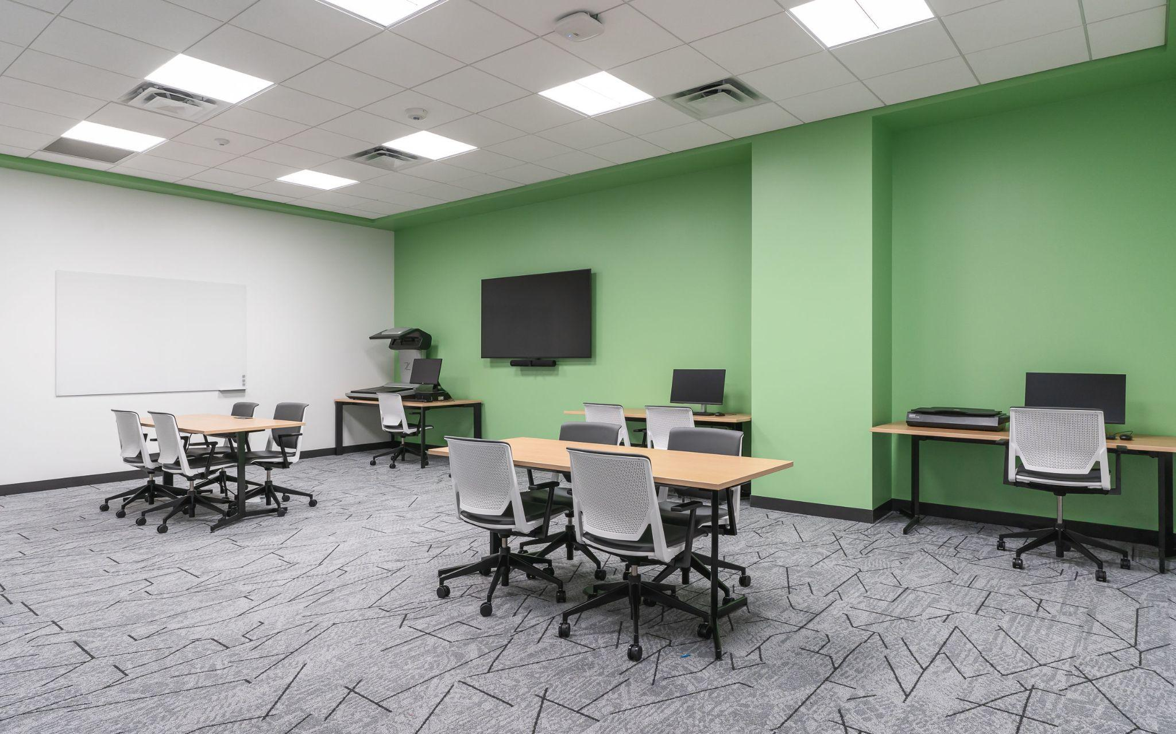
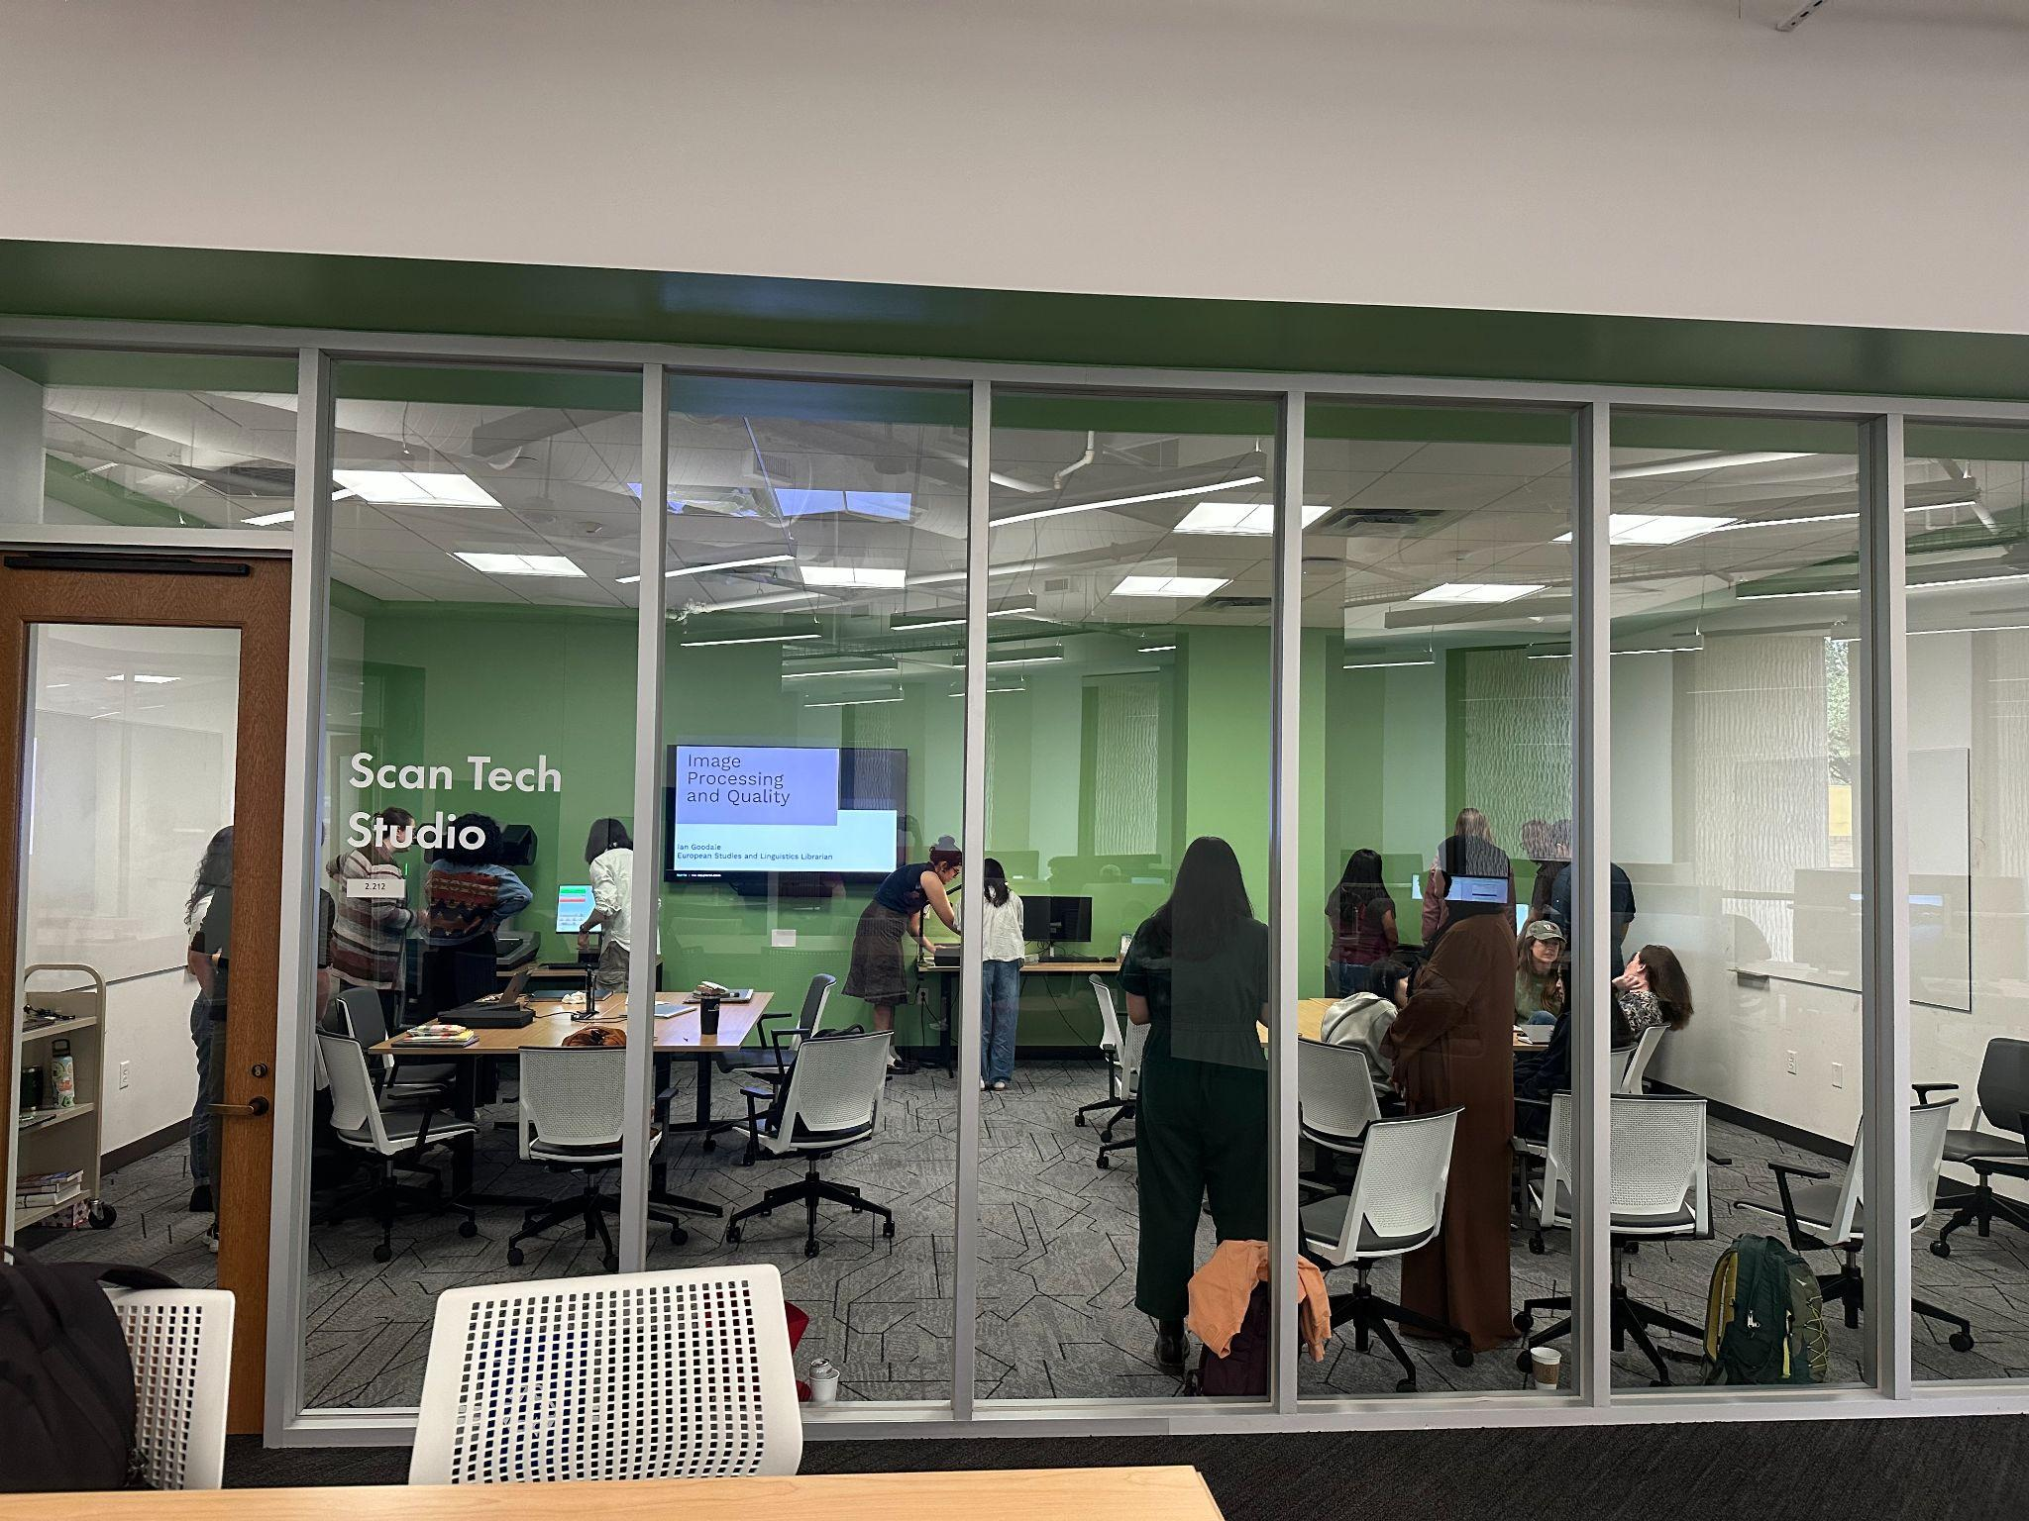
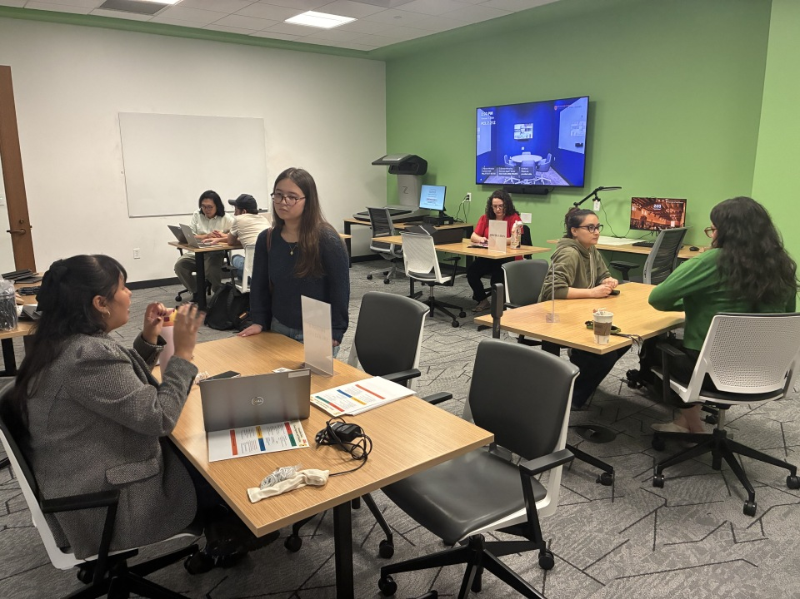

Scan Tech Studio
  Scan Tech Studio is a space located in the University of Texas at Austin Perry–Castañeda Library Scholars Lab, Digital Scholarship Center.
  Focuses on providing expertise support on digitization, digital archiving, Optical Character Recognition, and text analysis to researchers.
  Equipped with two high quality scanners and a PC with Abbyy FineReader
  Managed by Scan Tech Studio Working Group. Made up of 8 subject librarians, 2 digital stewardship experts, and 1 domain expert.

Slide 3

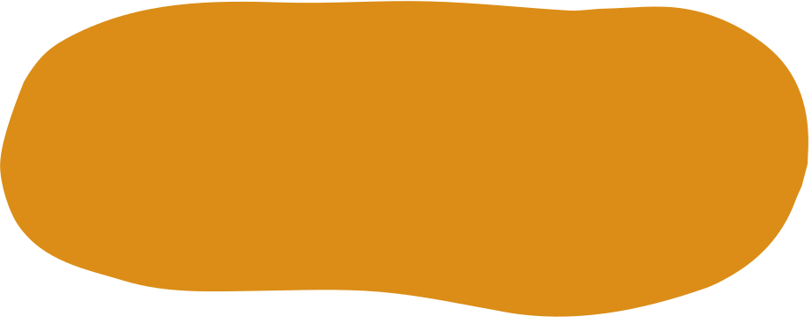


Roles
Digitization + Preservation
Digital Scholarship
Liaison
Outreach and promote our service and the space to user communities
Work with campus and community partners to organize events and workshops.
Digital + physical preservation = long-term access to collections and expansion of research potential
Best practices for small-scale digitization projects, equipment and software instruction, physical and digital storage, etc.
Export this design from Canva as a GoogleSlide template. This will provide you with all the fonts used and elements used in this presentation as listed on page 21. Learn more on slide 5.

Slide 4

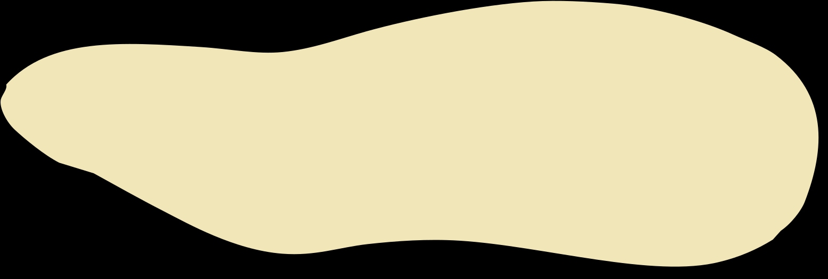
Collaboration

Slide 5


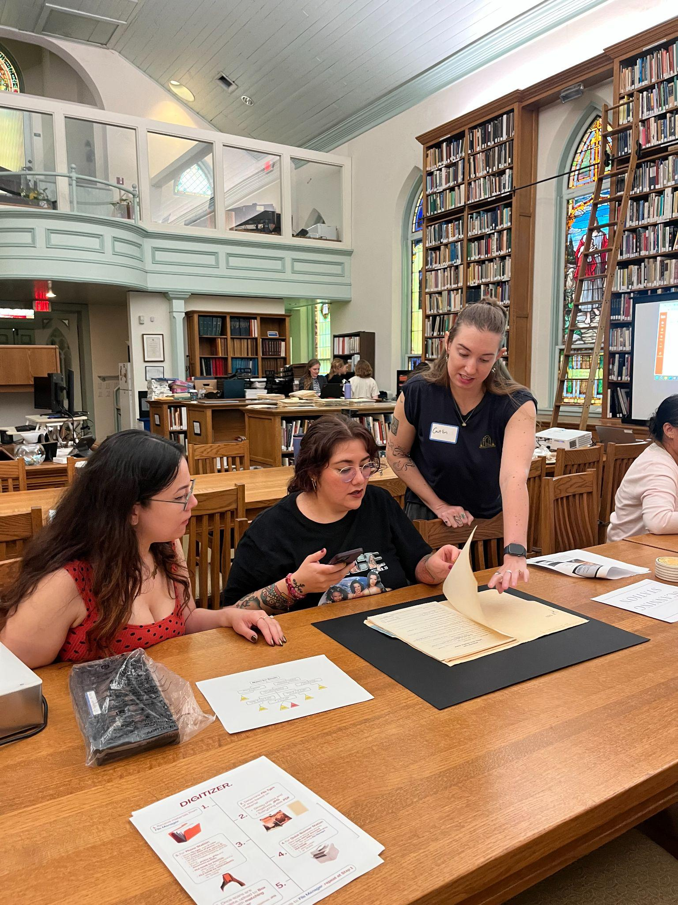
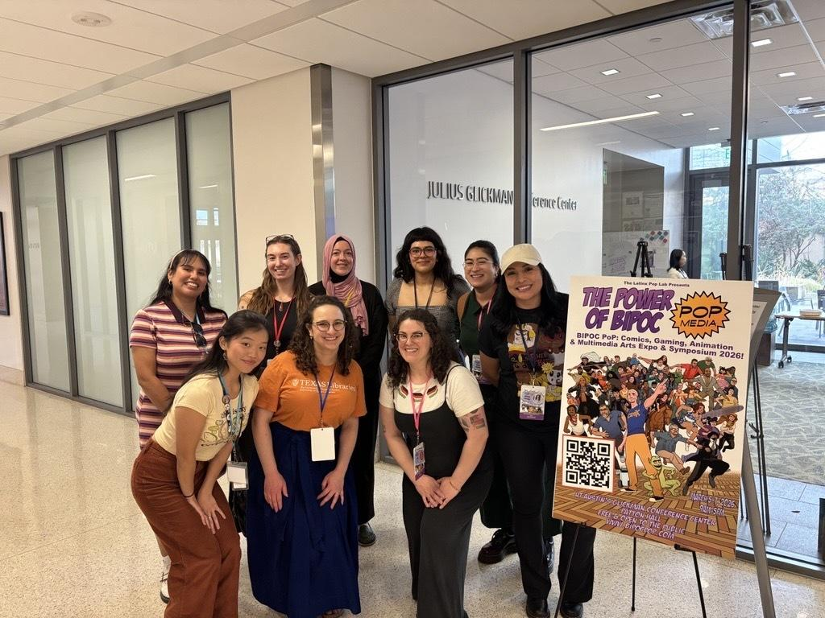
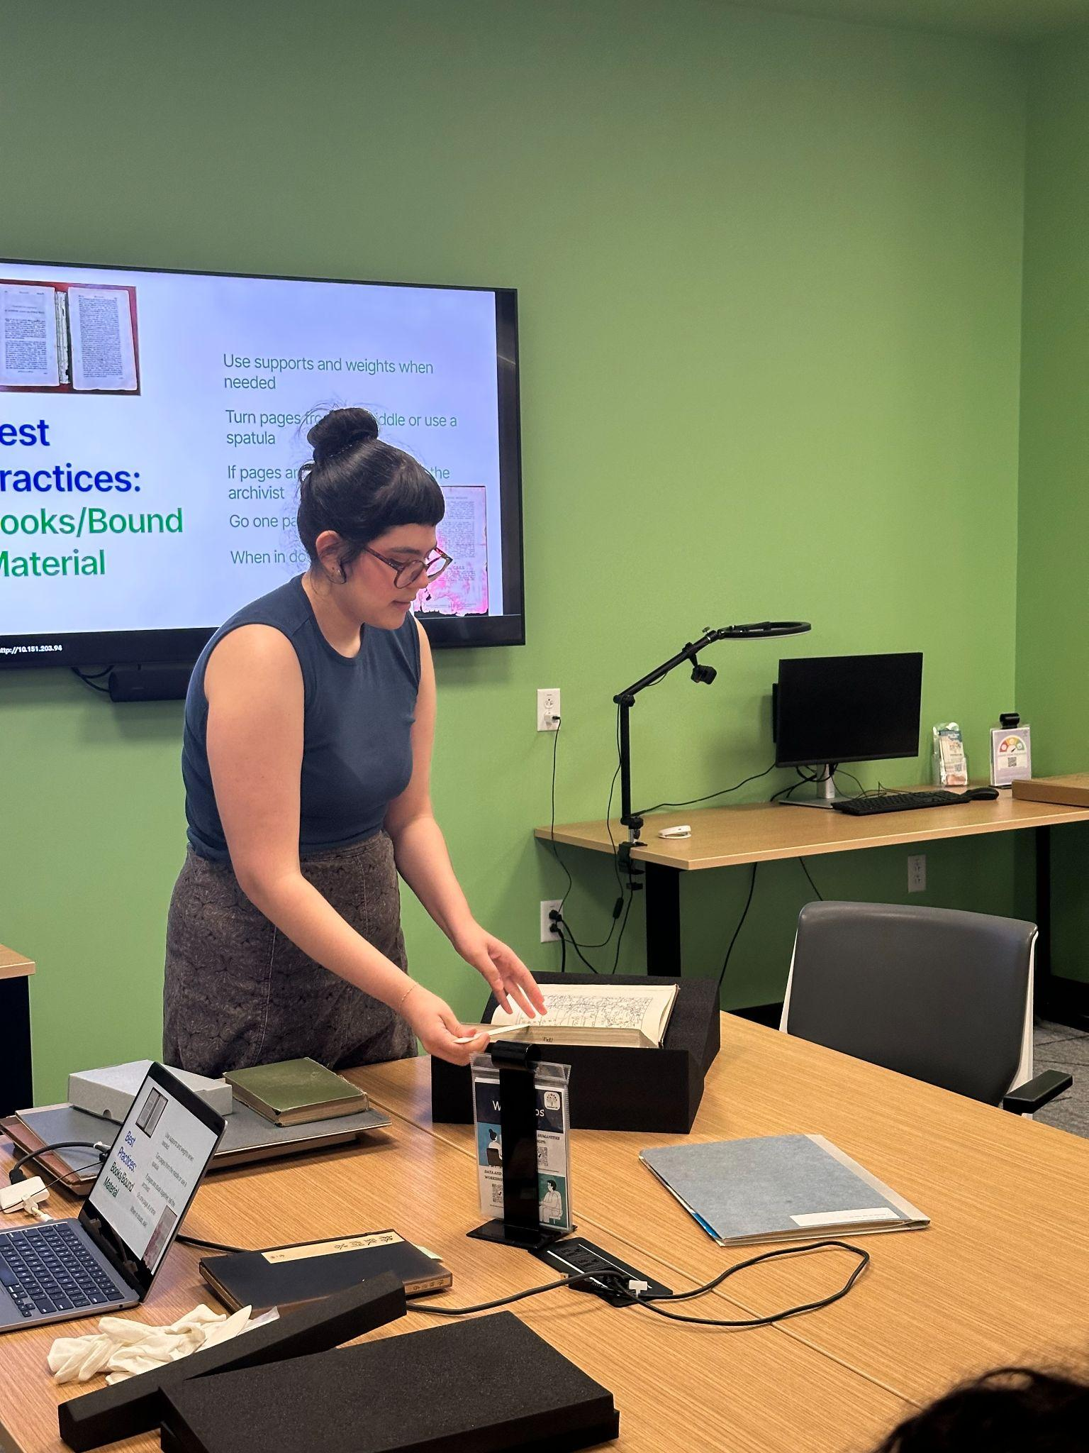
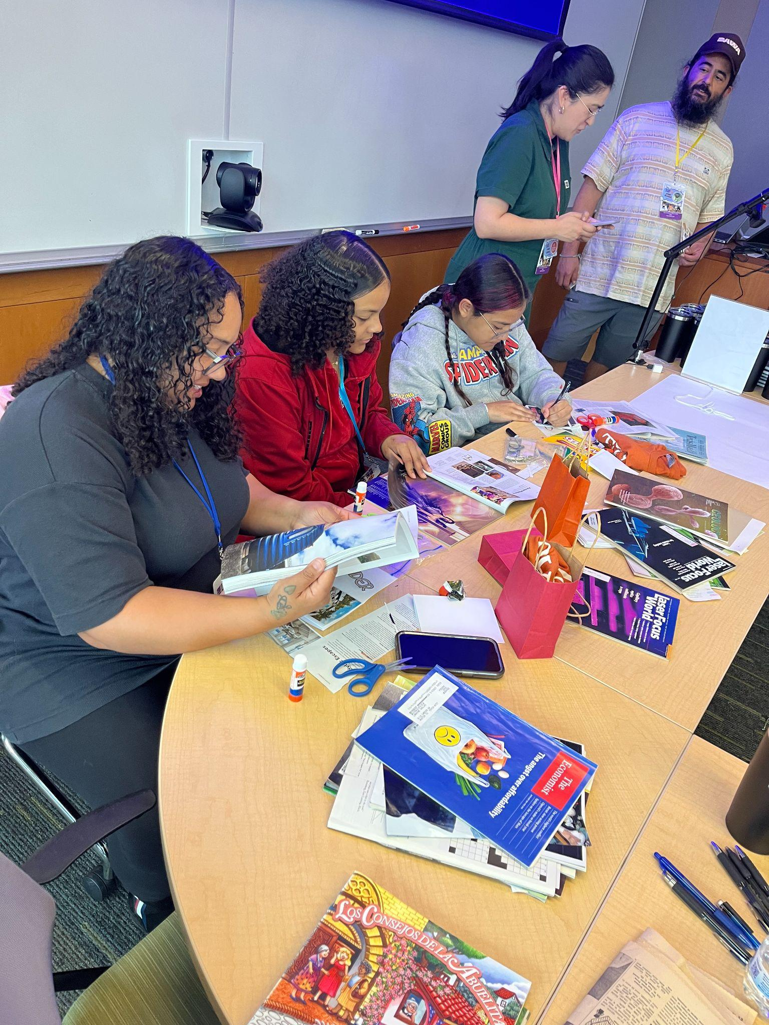
Meaningful Partnerships
Before You Go & When You Return Workshop Series
Introduce researchers to digital methods before and after their archival visits
BIPOC Pop by Latinx Pop Lab
Brings together creatives from comics, animation, and multimedia industries. STS hosted a DIY Archiving workshop focusing on zine creation, oral histories, and digital mapping.
Texas Historical Commission Scan-a-thon
STS worked with professor Monica Muñoz and Texas Historical Commission to create a digitization workflow, allowing students to scan THC materials in one day.

Slide 6

Internal Workshops on tools and workflows
  Over the past summer, we ran a series of workshops with us to learn the softwares, tools, and platforms. Including:
  Abbyy Finereader
  Transcribus
  Digitization and Handling best practices
  Language-specific projects and platforms
  AI
Skill
Building
Group Project - PCL History Project
  Since last year, our group has been working on a project to commemorate the 50th anniversary of the Perry-Castaneda Library. This project is also a group exercise to practice digitization, collection building, and digital exhibition skills.

Slide 7


Consultations
Digitization
OCR and HTR
Scanner and photography equipment instruction
Evaluating image resolution, file type, color space, etc.
Optimizing imaging for best OCR/HTR results
Abbyy FineReader, Transkribus instruction
Digital Scholarship
We’ve met with…
Digital exhibitions in collaboration with subject liaisons
Text analysis, data mining
Data visualization tools
Researcher transcribing difficult-to-read handwriting
PhD student preserving great-grandfather’s field journal
History professor integrating community archiving into coursework

Slide 8





Future
1.
2.
3.
  Continuing our successful workshop series and programming. Especially, the “before you go” and “when you return series”
  Deepening ties with our partners, including Texas Historical Commission, the JapanLab, Latinx Pop Lab, and other community outreach
  Finish the PCL History Project. The deliverables include a timeline built with Clivios and a story map digital exhibition.

Slide 9

Conclusion
The UTL Scan Tech Studio has successfully connected researchers with cross-disciplinary workflows to enhance scholarship, support individual learning, spark creativity, and promote community engagement
In just three years we…
Held dozens of in-demand workshops, trainings, and consultations on a variety of digital scholarship topics
Outfitted a dedicated workstudio complete with high-resolution scanners and OCR software
Hosted popups at campus community spaces like the Fusion Lab, Japan Lab, and Latinx Pop Lab
Collaborated with the Texas Historical Commission to develop a Scan-a-Thon event for a history course

Slide 10



Contact
  scholarslab@austin.utexas.edu

Slide 11



Credits
This presentation template
is for everyone to use thanks
to the following:
Canva Original Stickers for the images
Sketchify for the images
HAPPY DESIGNING!

