Slide 1
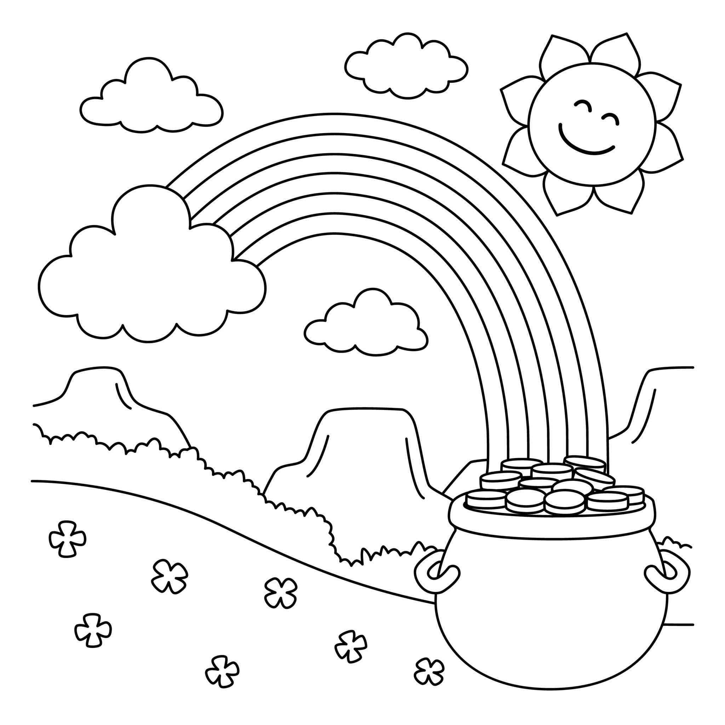
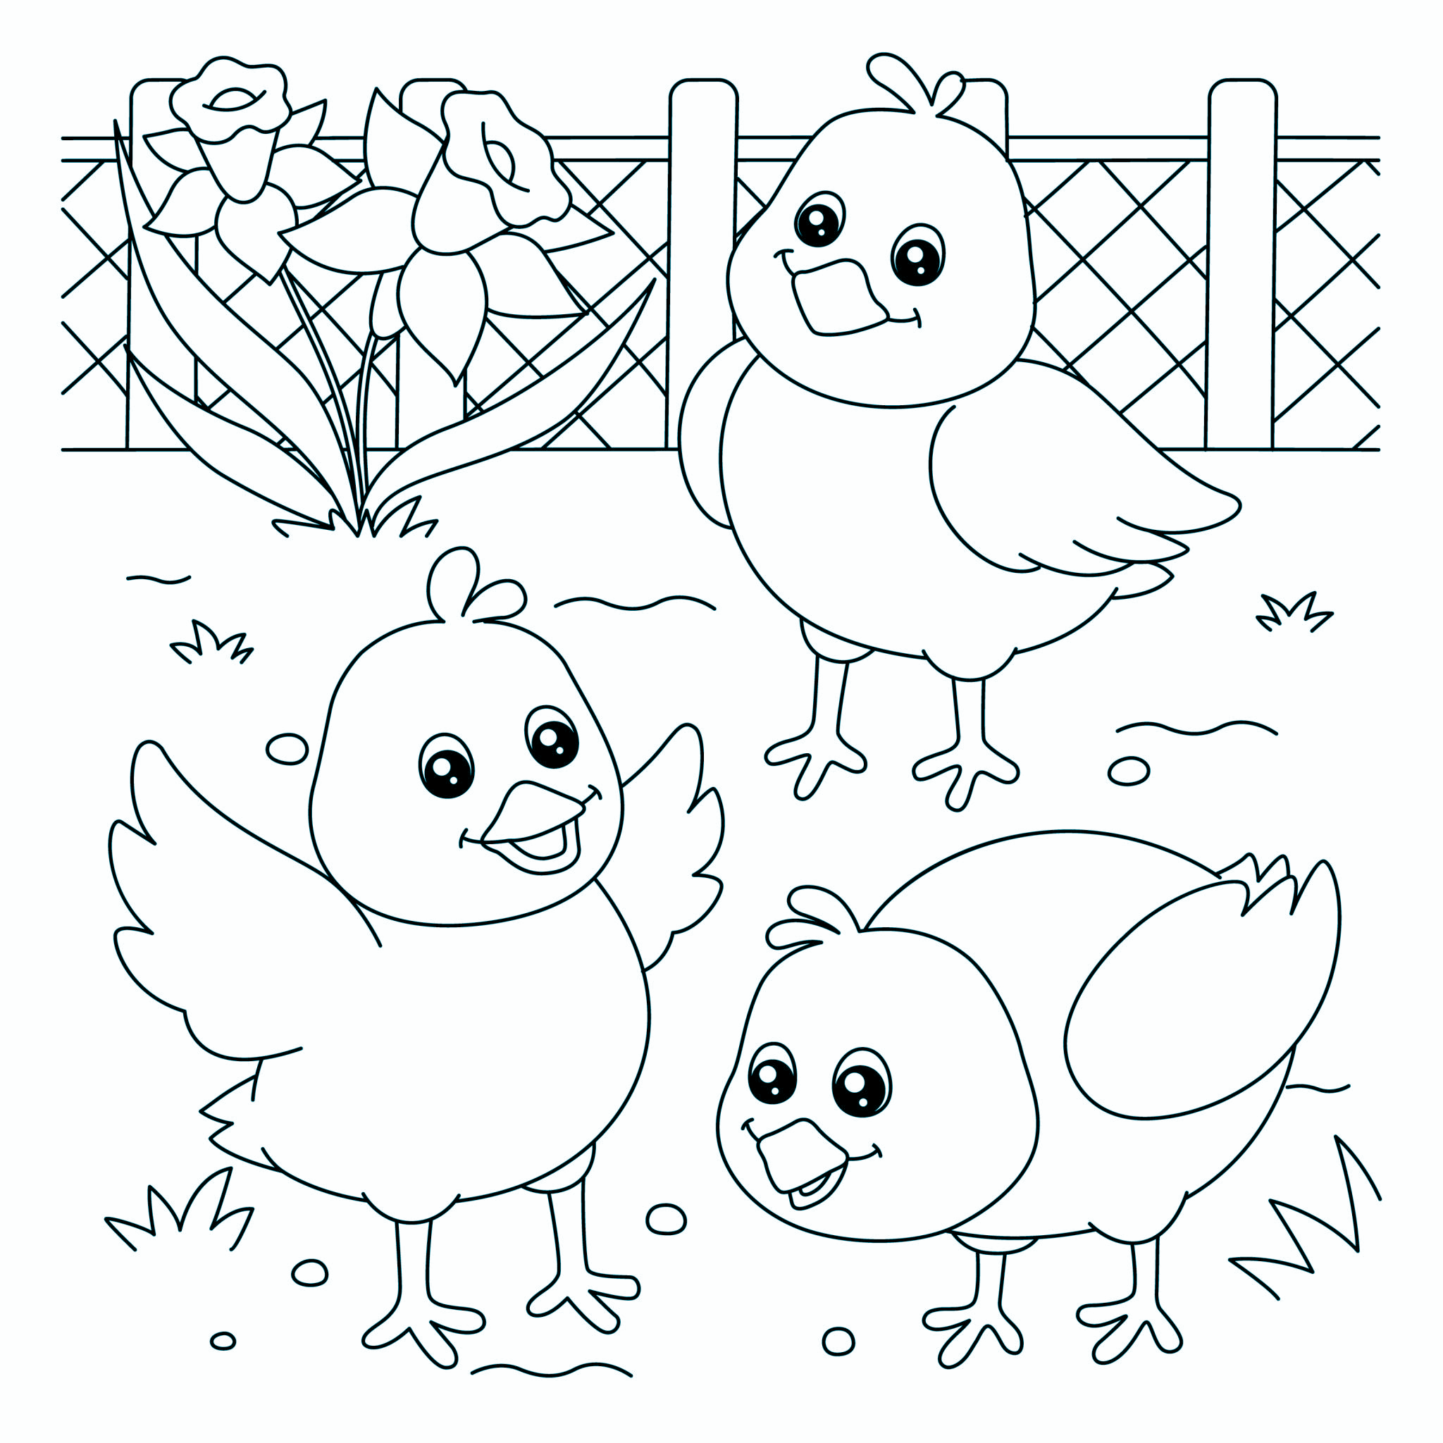
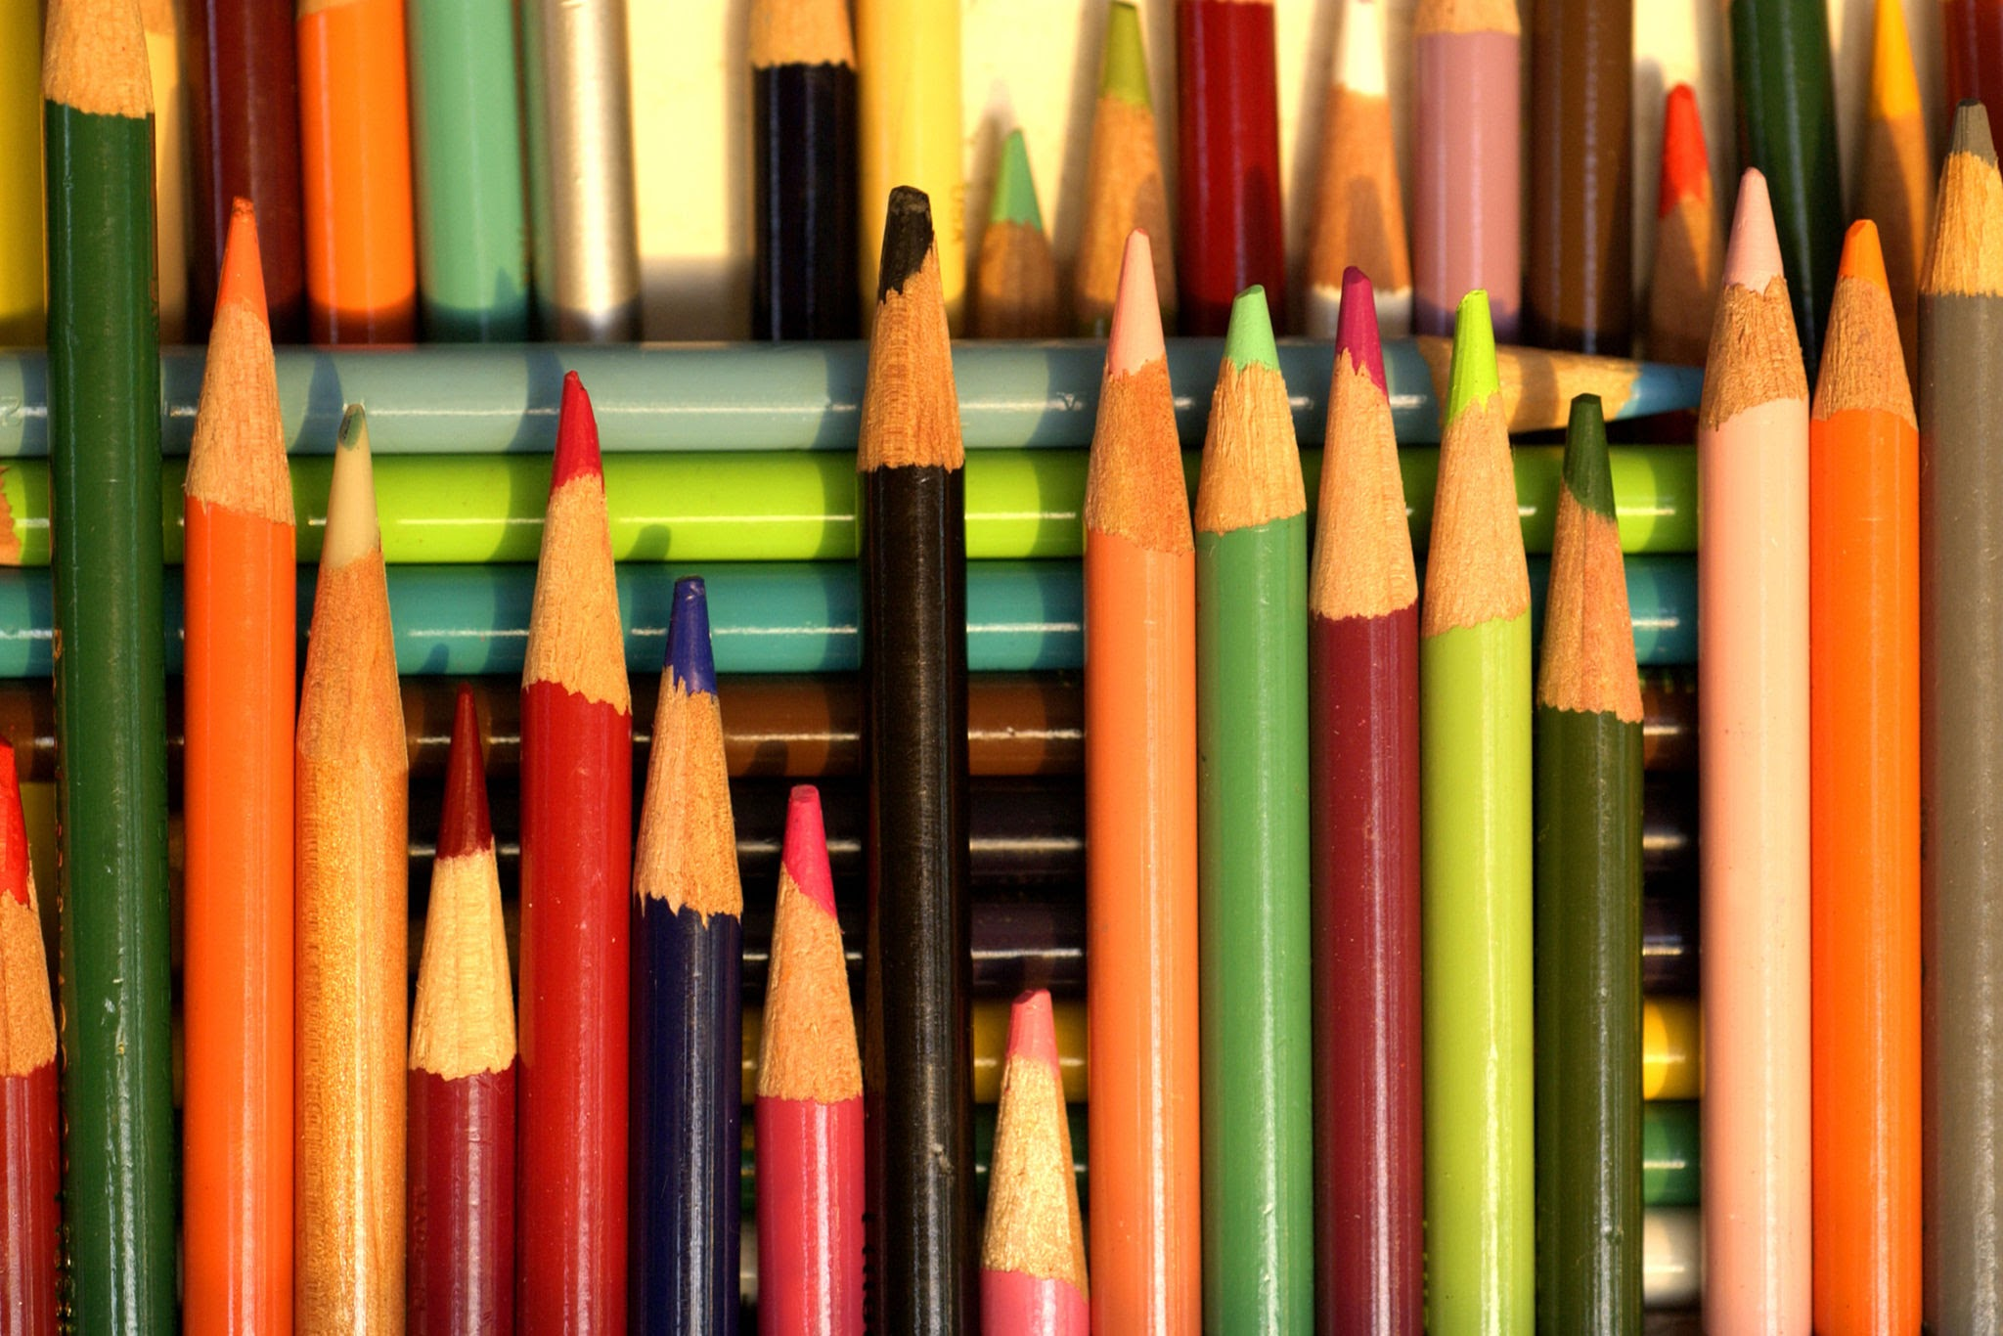
Welcome:
Before we begin, there is a fun activity to complete in the back.
Please choose one of the pages and a SINGLE colored pencil.
Color in that page to the best of your artistic ability using that SINGULAR colored pencil.
NO SHARING OF UTENSILS!!
You can show them off at the end of this session.

Slide 2
Hobbies: Keeping the Profession Alive
A Birds-of-a-Feather Discussion hosted by Jennifer Bussey

Slide 3
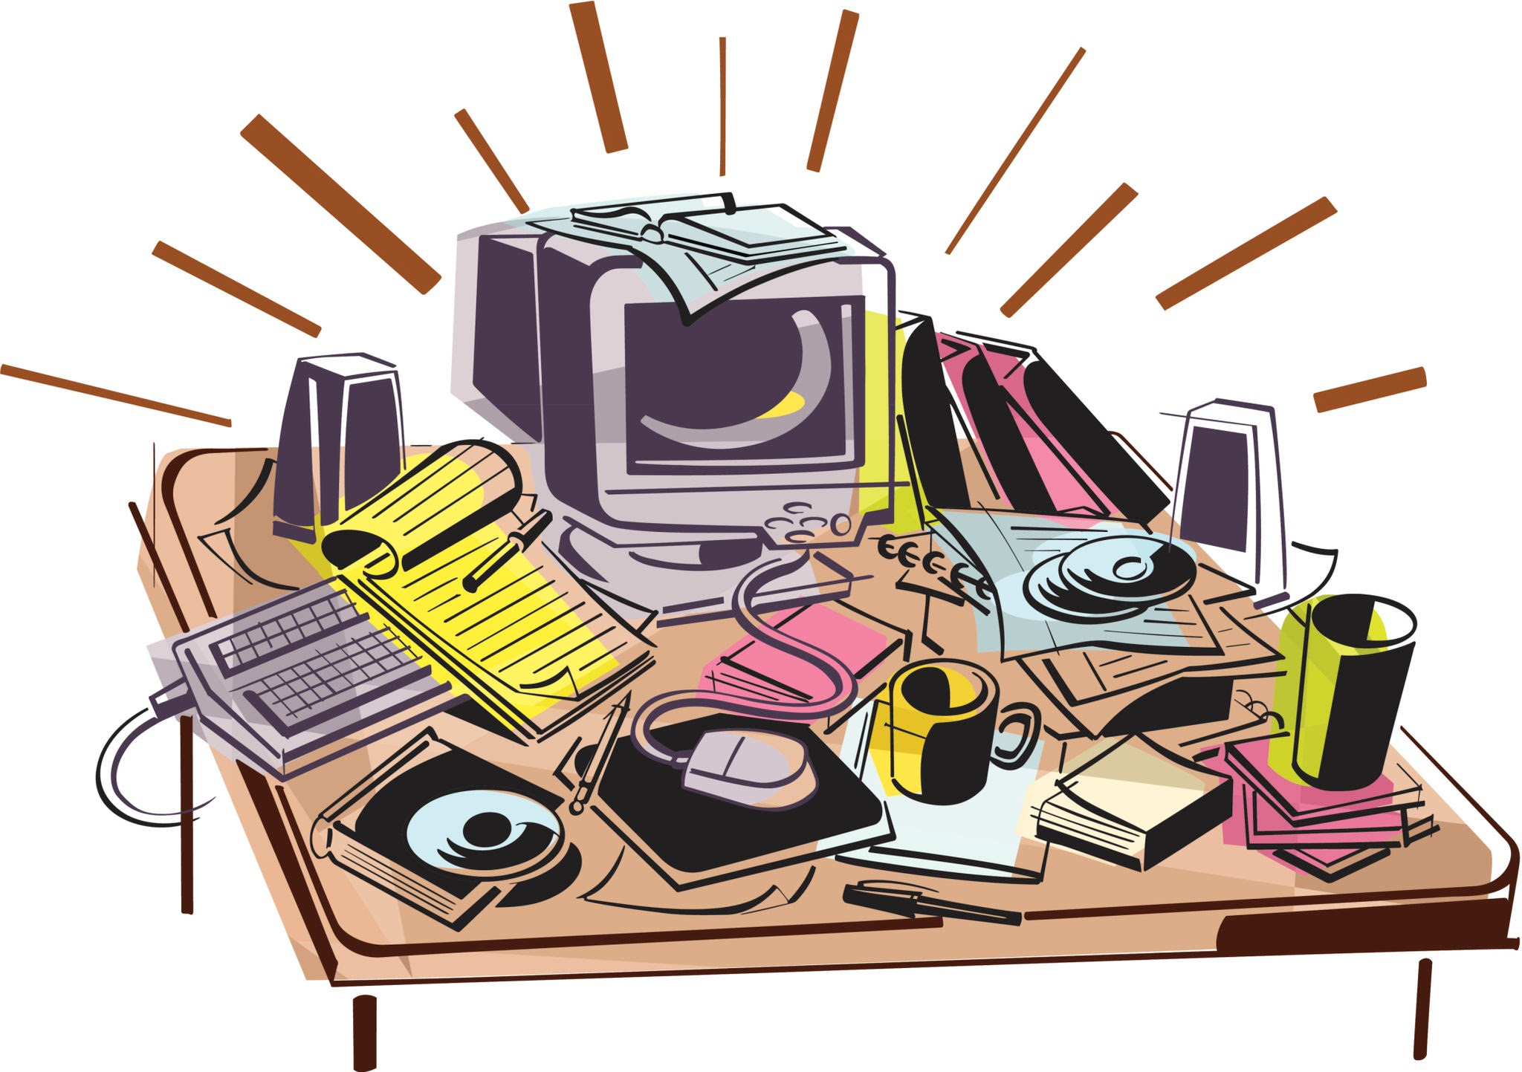
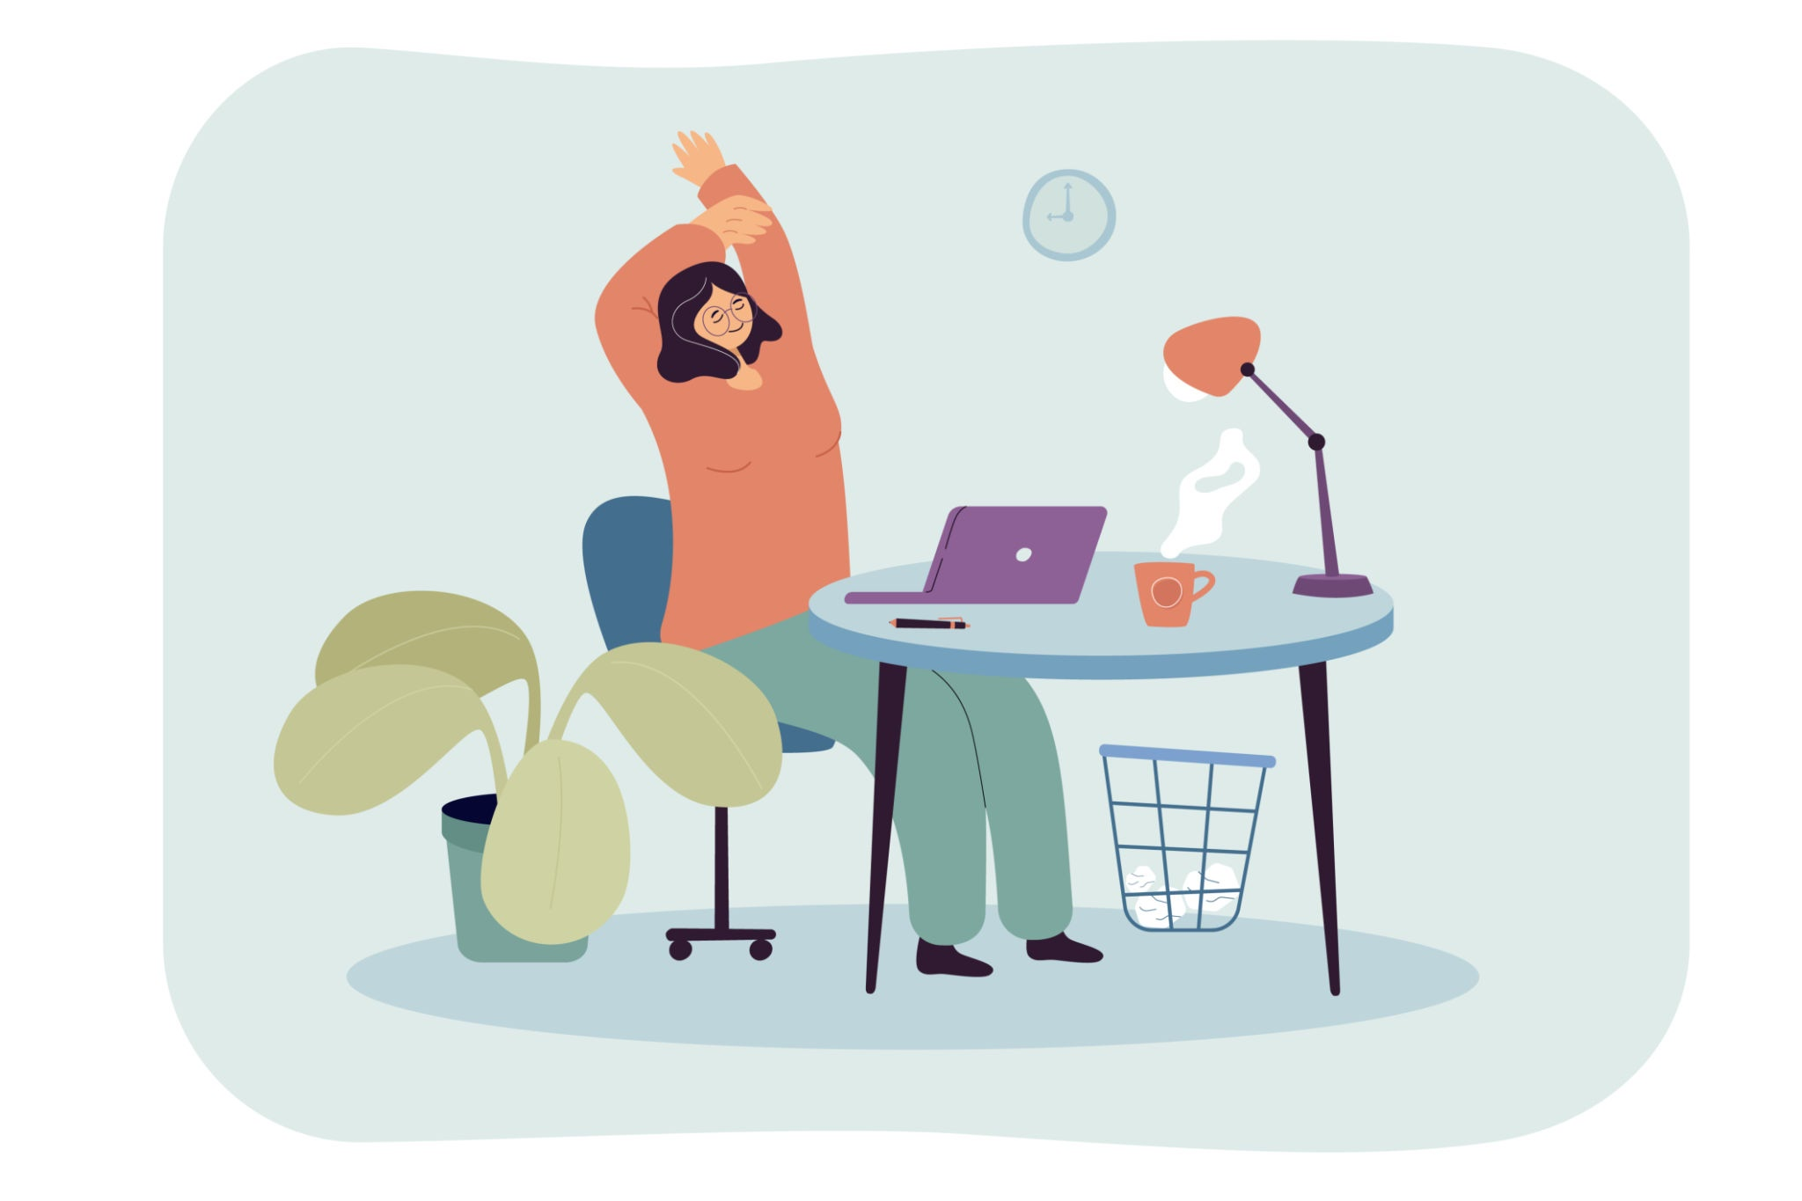
Would you consider any part of your work to be a “hobby” or part of “leisure time”?
“Scientifically speaking, leisure may be defined as uncoerced activity undertaken during free time. Uncoerced activity is positive activity that, using their abilities and resources, people both want to do and can do at either a personally satisfying or a deeper fulfilling level” (Stebbins, p. 619).

Slide 4
According to a survey conducted by Stephen Abram in 2010, out of 1,500 librarians:
Top 3 Activities
3. Cooking and Recipes
2. Music
Recreational Reading

Slide 5
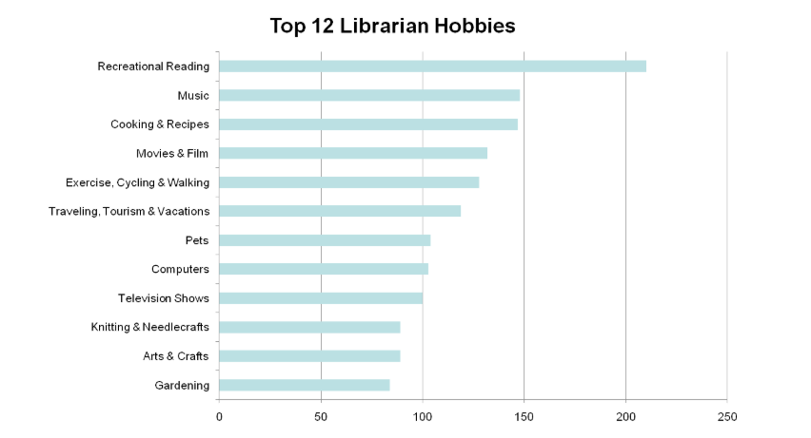
(Abram, 2010)
Do you think these results still hold true sixteen years later? What do you think the new results will show?

Slide 6


How has a hobby contributed to your professional development?
“The deepest implications of this quality (leisure time) for library and information science stem mainly from the knowledge and training components” (Stebbins, p.627).

Slide 7
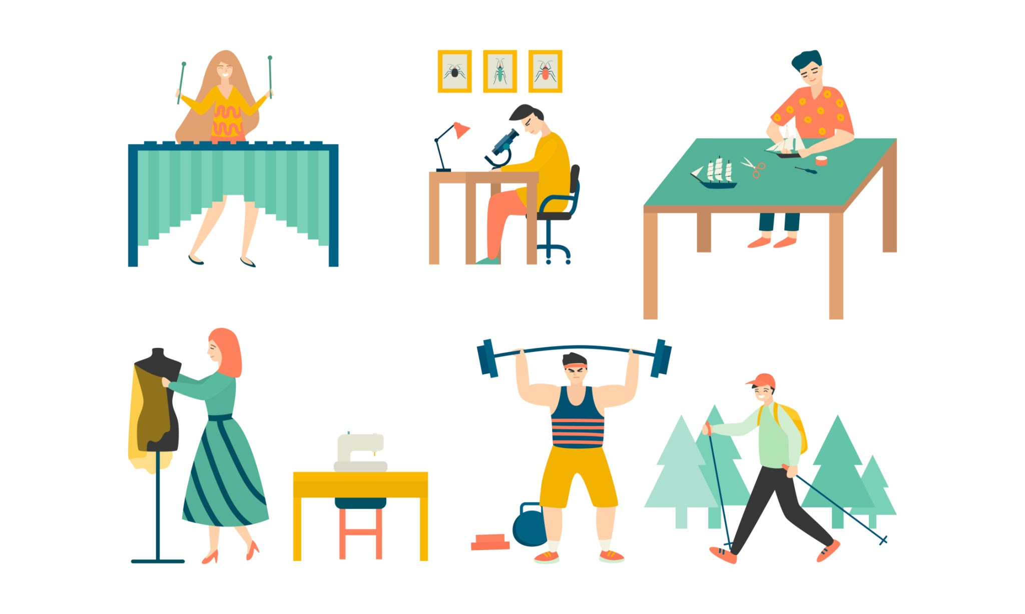
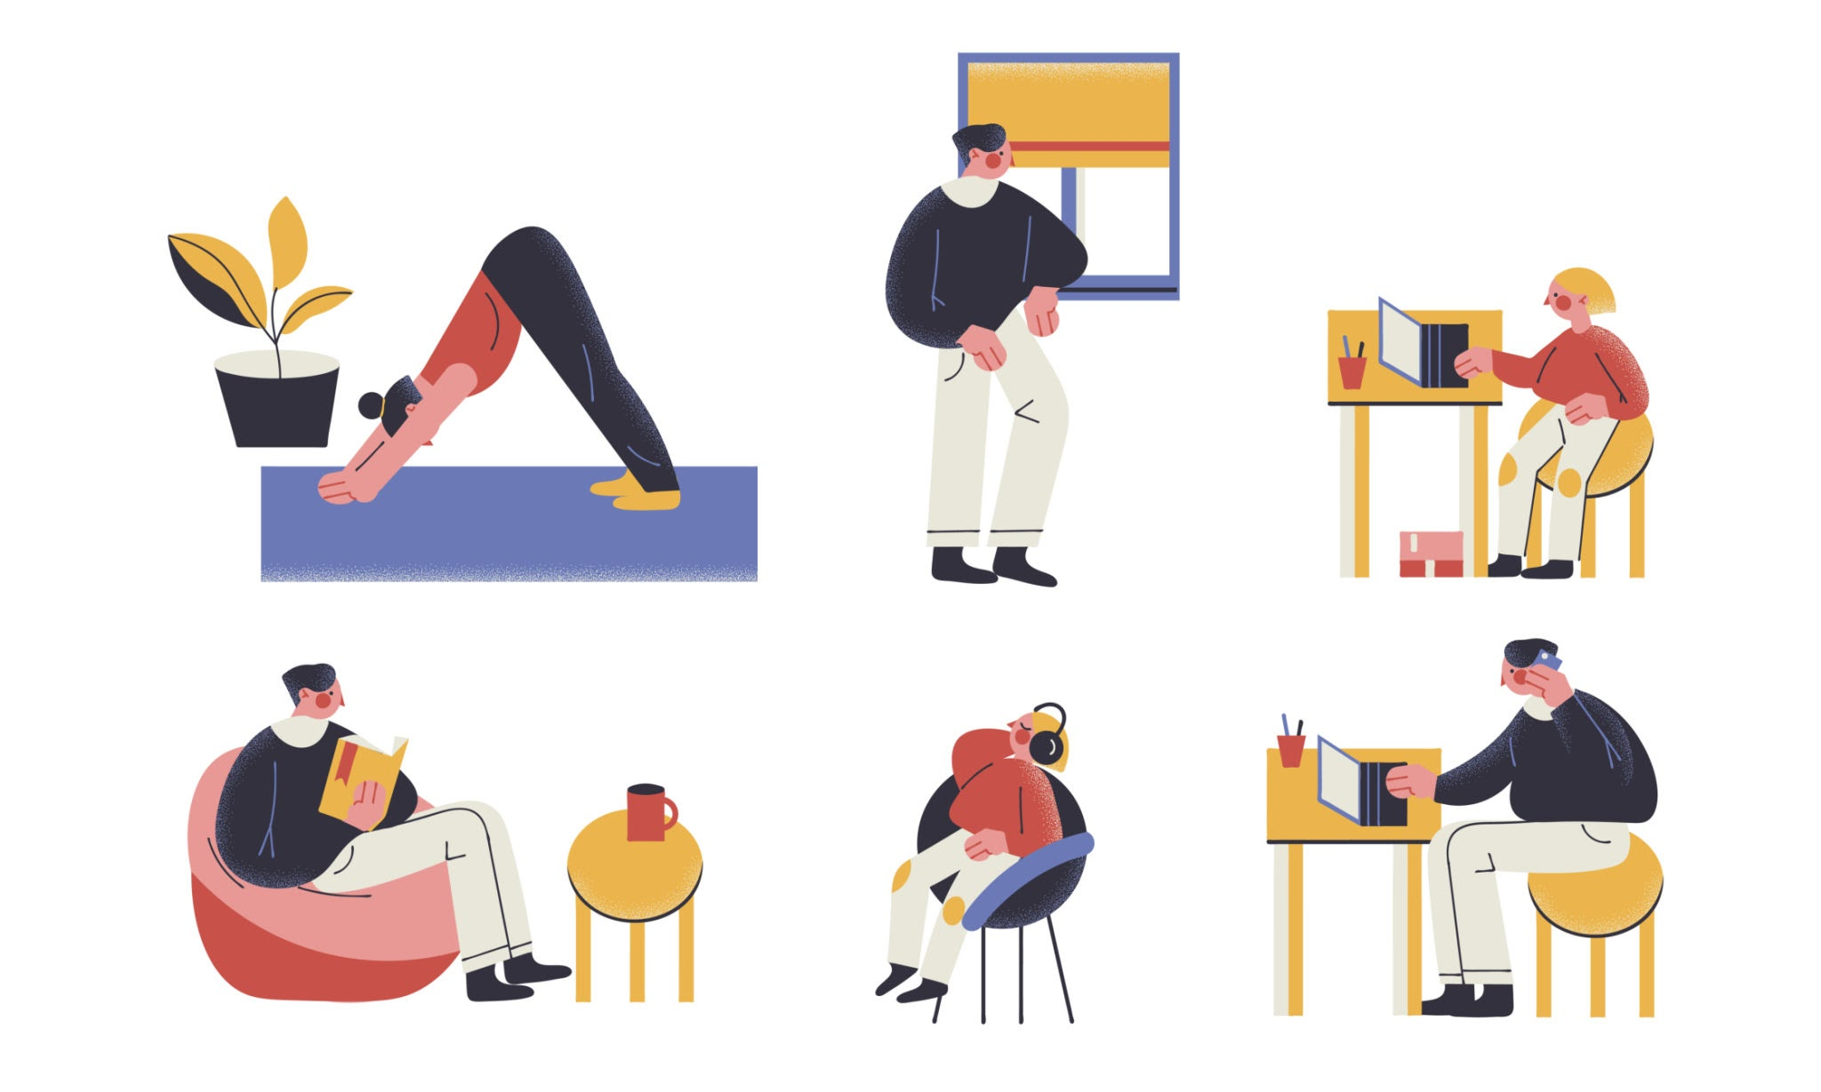
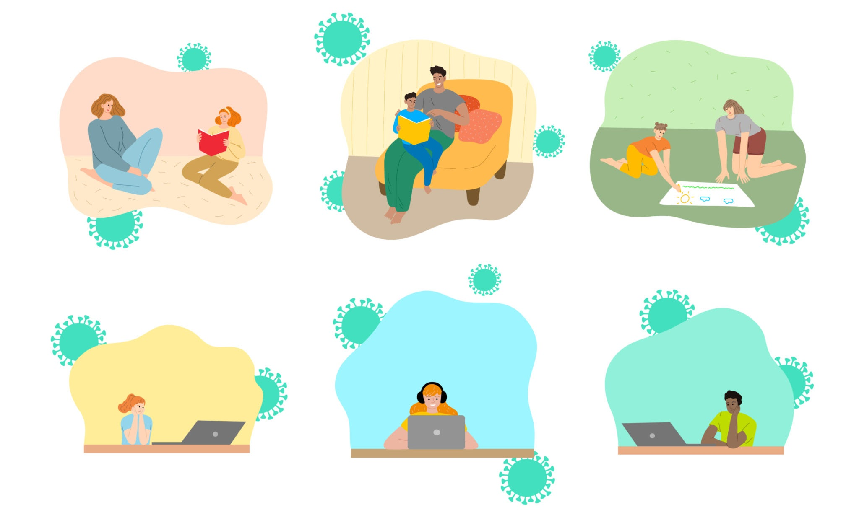
How has a hobby helped alleviate stress within your work environment?
“Stress is understood here … as a subjective experience or feeling which arises in situations of burden. It is often connected with the feeling that it will be difficult to cope with a certain task in a given time” (Hadler, p.404).

Slide 8
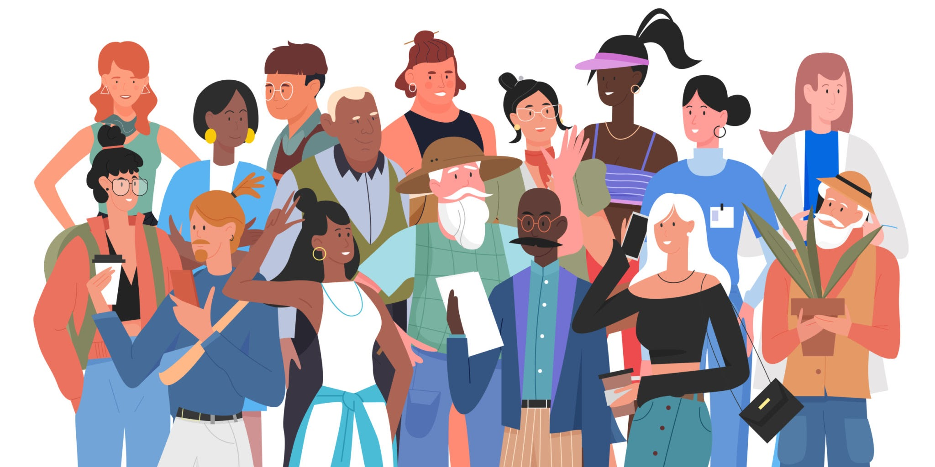
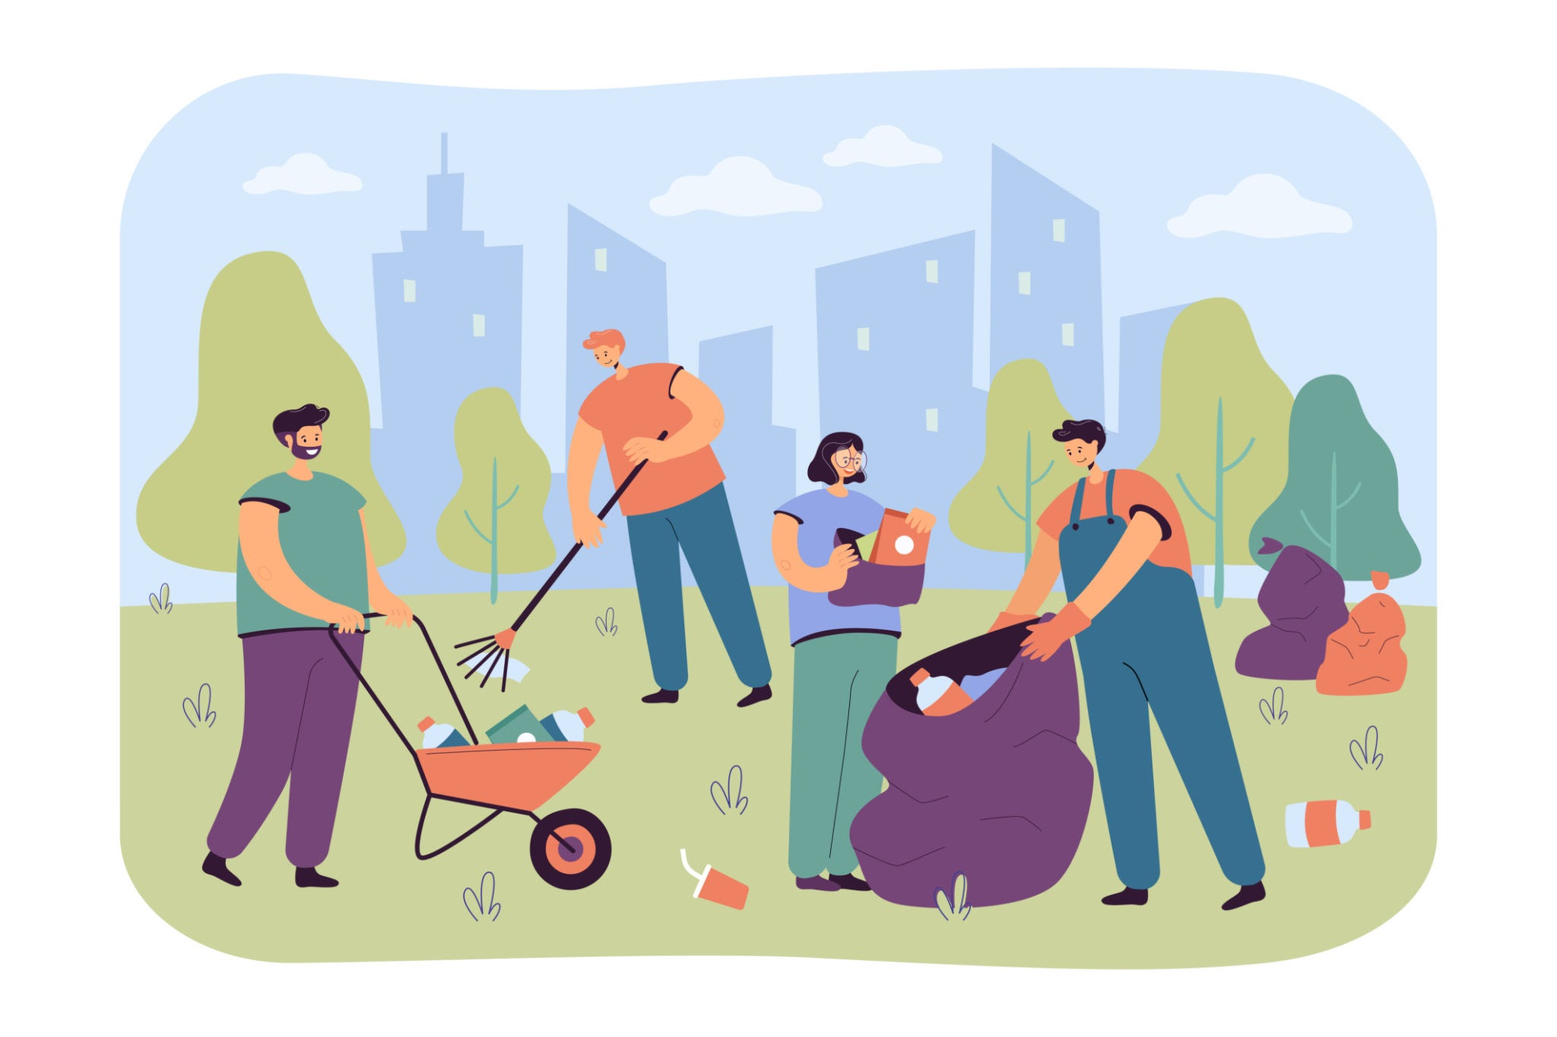
How has a hobby contributed to the creation of community within your institution?
“The unique ethos that grows up around each instance of it, a central component of which is a special social world where participants may pursue their free-time interests. Social worlds are characterized by voluntary identification, by a freedom to enter into and depart from them” (Stebbins, p.626).

Slide 9
Time to Show off your Creations!
“Research has shown that time filled with exciting activities is experienced as being shorter than the same period filled with boring activities or experiences” (Hadler, p.404).

Slide 10
Resources
Abram, S. (2010, October 31). Librarian Hobbies! Here are the results. Stephen's Lighthouse. https://stephenslighthouse.com/2010/10/31/librarian-hobbies-here-are-the-results/
Hadler, M., Haller, M., & Kaup. G. (2013). Leisure Time in Modern Societies: A New Source of Boredom and Stress? Springer, 111 (2), 403-434. https://www.jstor.org/stable/24719111
Stebbins, R.A. (2009). Leisure and Its Relationship to Library and Information Science: Bridging the Gap. Johns Hopkins University Press, 57 (4), 618-631. DOI:10.1353/lib.0.0064.
All images were sourced from Google Sheets Stock & Web search feature.

