Slide 1
Building a removable media workstation for Floppy DISK RECOVERY
Rose Goldey, digital archivist, Texas state university

Slide 2
What is removable media?
Data storage that can be attached, detached, and moved between different computing systems. Some examples include:
  Floppy disk drives
  Optical disks (CDs, CD-ROMs, DVDs, DVD-ROMS)
  Hard disk drives
  Flash drives
  SanDisk Cards

Slide 3
why do we need a dedicated workstation?
An air-gapped (not connected to the internet) device to safely access removable media.
Security:
  Data on removable media can be an unknown. Viruses, malware, and corrupted data can be dangerous to our networked devices and IT doesn’t like that.
  Privacy and Personal Identifying Information (PII) can be redacted and censored before our networked computers read them (and AI applications access/read them ”inadvertently”)
A large tower PC with lots of ports, peripherals, and interfaces is essential when working with a a variety of formats, cables, and hookups.

Slide 4
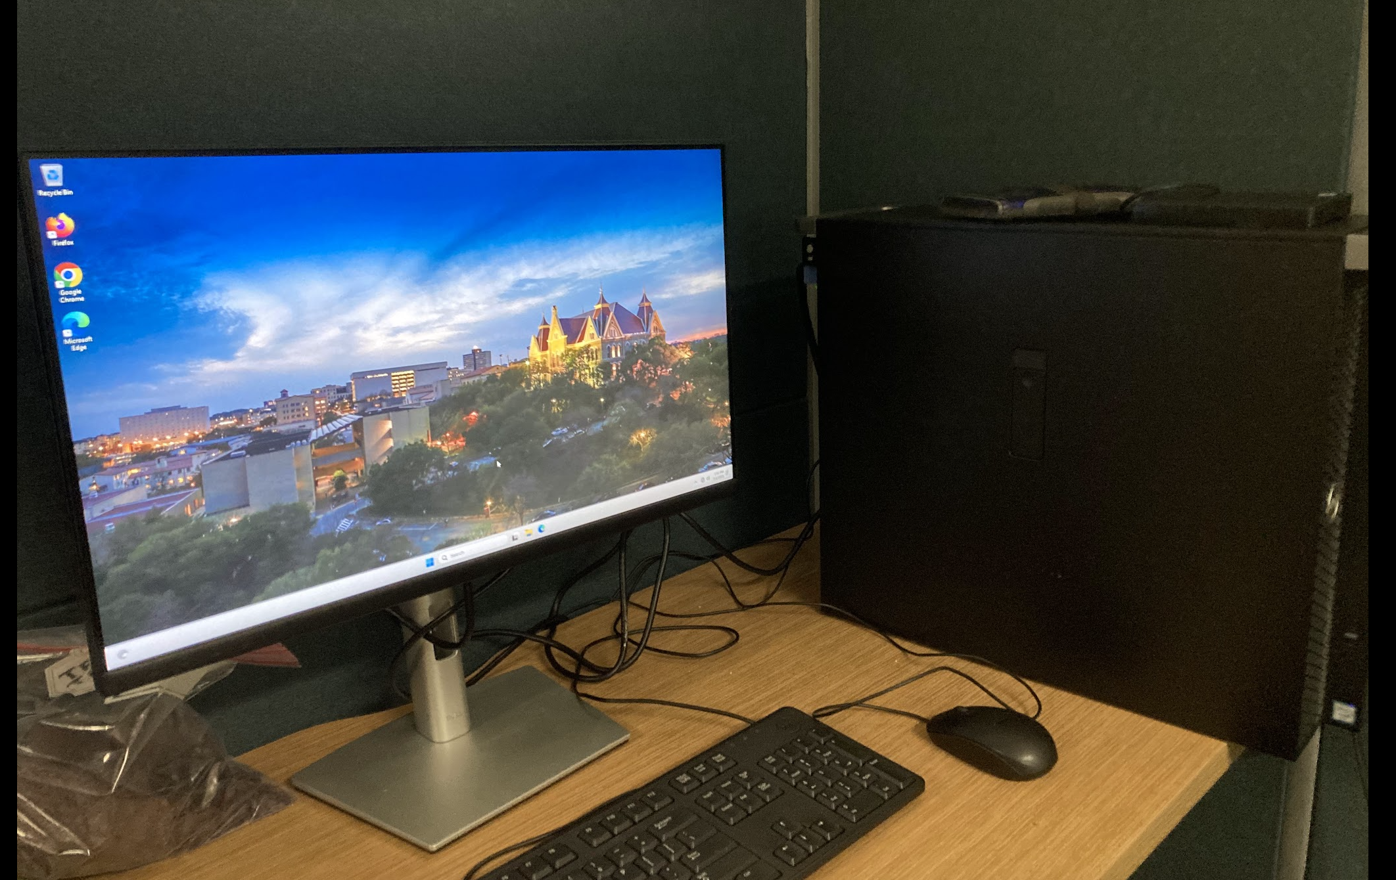
The removable media workstation
We used our old Audio Digitization PC (replaced as part of a re-vamp of our AV digitization systems)
All network cards/controllers disabled by IT
Currently can access:
  3 1/2” floppy disks
  CDs/DVDs
  Flash Drives
  SanDisk (SD) Cards
  iOmega zip drives
  SATA and PATA Hard Disk Drives

Slide 5


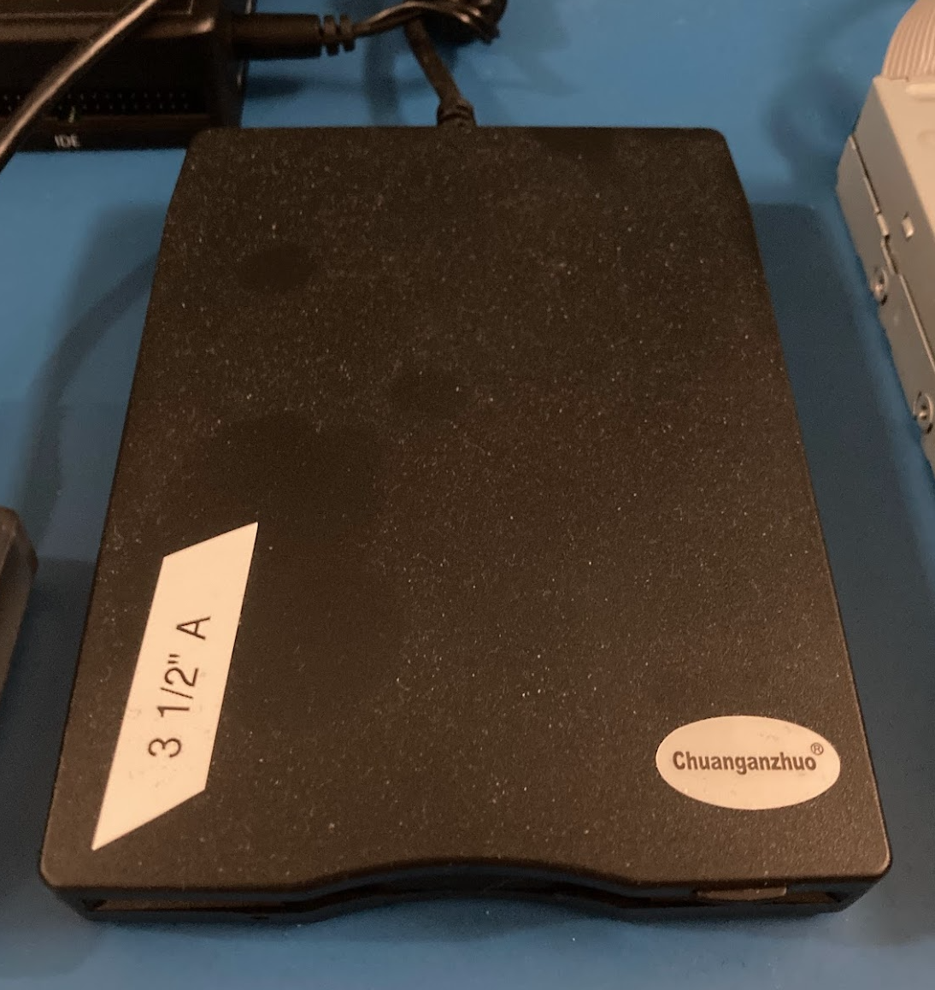
The challenge: Floppy disk drives
3 1/2” floppy disk drives are one of the most common uses of our RMW.
USB Floppy disk drives are sold.
  Do not buy one.
  Floppy drives are complex magnetic analog media that transform magnetic flux signal into digital data.
  USB drives can’t read the actual magnetic data. They cheat and skip major portions of the disk. It results in errors.
  Do not buy one.
DO NOT BUY THIS
Seriously, do not buy this.

Slide 6
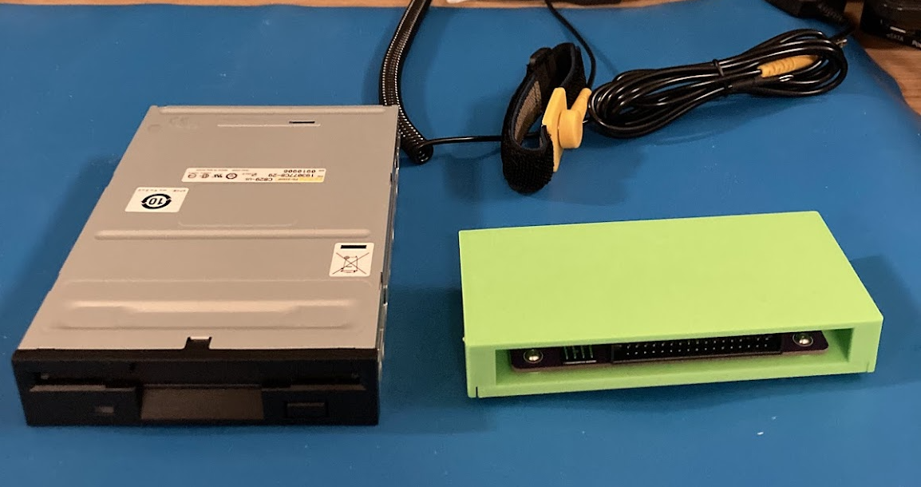

The Solution: Greaseweazle floppy disk controller and a vintage floppy disk drive
Create an emulator of how vintage floppy disks worked inside PCs.
Greaseweazle can read/access/repair/write-to the raw magnetic flux.
Built disk images from directly from the magnetic flux.
Connects via a 34-pin ribbon cable to analyze each sector of a disk.
Built a raw magnetic flux of the data (.scp)
Convert that data into a disk image. (.img)

Slide 7
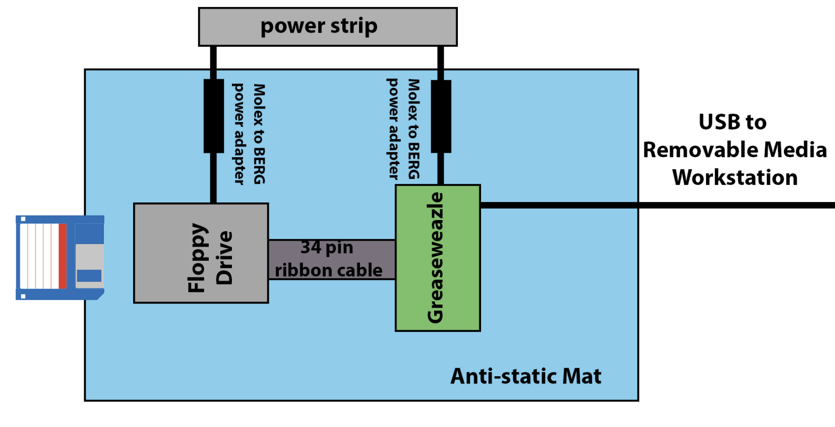
What our floppy disk set up looks like
Originally, these parts would be inside a PC tower.
Exposed circuit boards and chips are in danger of static shock causing permanent damage, so the entire set up must be on an anti-static mat.
Each element needs its own power supply.

Slide 8
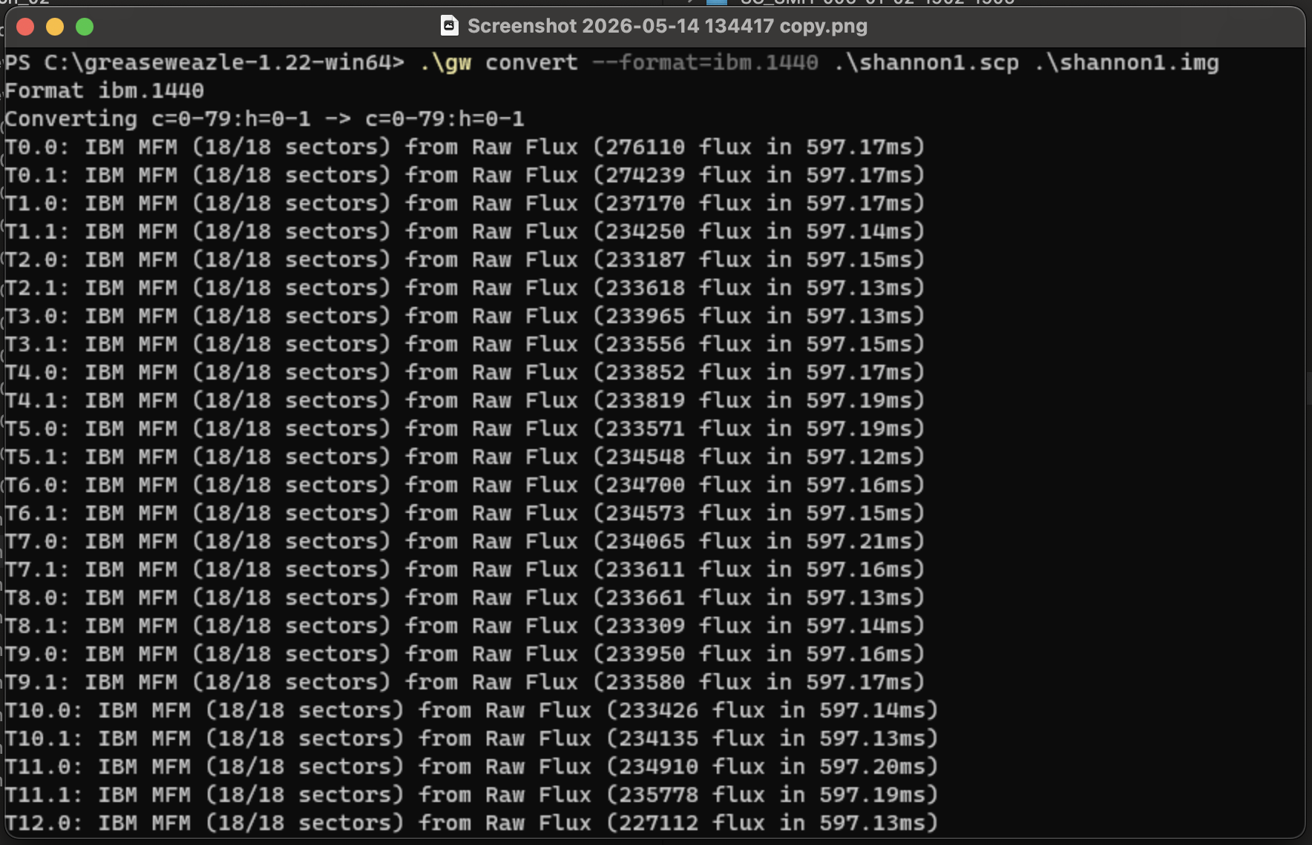
Greaseweazle software
Greaseweazle cmd line interface allows us to read the raw magnetic flux.
  Create an .scp raw flux file (72 megabytes)
  Then convert .scp to a .img (1.44 megabytes)
The .scp isn’t the actual preservation master. The img is. We discard the .scp once it has been made.

Slide 9
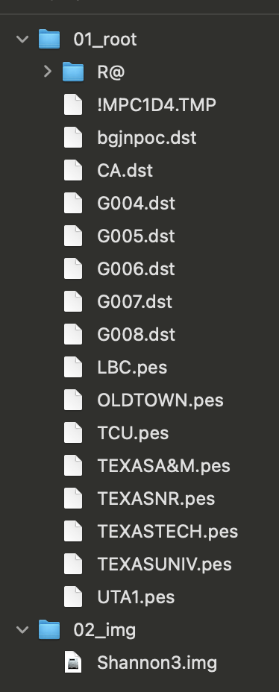
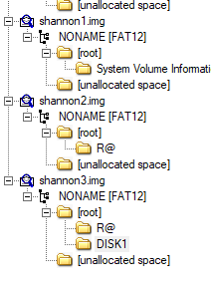
Run in ftk imager to access files
FTK Imager is a digital forensics tool to process disk images into accessible files.
Archivists can spot check for any erroneous files before running a virus/malware check.
Mounting a disk image emulates experience of putting a disk into a disk drive.
Generate checksums for file integrity.

Slide 10
Removable media workstation challenges
Air-gapped devices mean everything must be transferred over via flash drive.
  Including software and code.
  Troubleshooting issues with code is a nightmare.
  Using AI tools doesn’t work to help with code because AI is so network dependent.
“Vintage Computing” is a niche hobbyist space and expertise is often outside of archives and libraries.
Equipment is increasingly rare and hard to find.

Slide 11
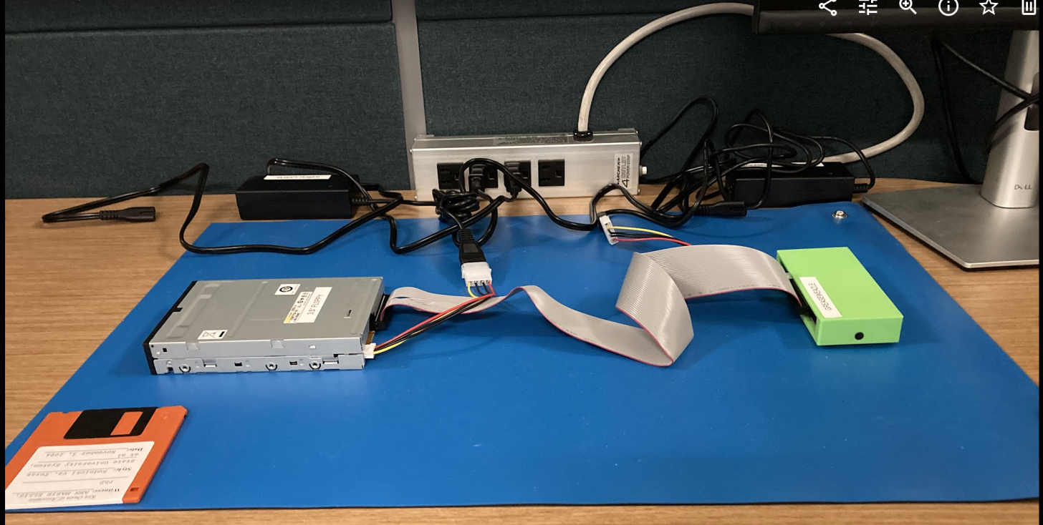
Next steps for the removable media workstation
Acquiring more vintage disk drives
  Greaseweazle works on all floppy disk sizes (3 ½”, 5”, 8”)
Build an all-encompassing python script to scan for viruses/malware and PII.
Automatic EAD and file list generation.

Slide 12
Thank you!

Slide 13
Resources
Bentley Historical Library’s Removable Media Workstation Documentation
https://sites.google.com/a/umich.edu/bhl-archival-curation/digital-curation/removable-media-workstations
Kilobytes of Cultural Heritage: Preserving Collections on Floppy Disks
  https://blogs.loc.gov/preservation/2021/08/kilobytes-of-cultural-heritage-preserving-collections-on-floppy-disks/
Greaseweazle https://decromancer.ca/greaseweazle/
Greaseweazle software https://github.com/keirf/greaseweazle

