Slide 1

Integrating scholarly communication concepts into liaison librarianship
Texas Conference on Digital Libraries
June 2026
Link to slides: https://bit.ly/TCDL-scholcomm
Notes:
Our proposal language: the course of their work with departments, liaison librarians may be asked to speak or answer questions about scholarly communication related topics like open access, repositories, copyright, and OER. While many liaisons are familiar with scholarly communication issues, they may be unsure of good resources to point their researchers to or how to engage their researchers in these discussions. Many library resources are focused on “skilling up” liaison librarians on scholarly communication topics, but there seem to be a lack of resources that discuss examples of integrating scholarly communication into liaison work. The presenters will try to fill this gap by talking about the ways they’ve integrated scholarly communication concepts into their liaison work, and about resources they’ve created to make it easier for others to integrate scholarly communication into their work.
We have 15-20 minutes plus time for Q&A

Slide 2
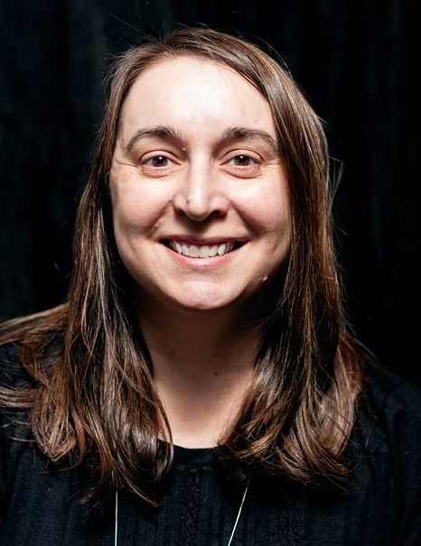
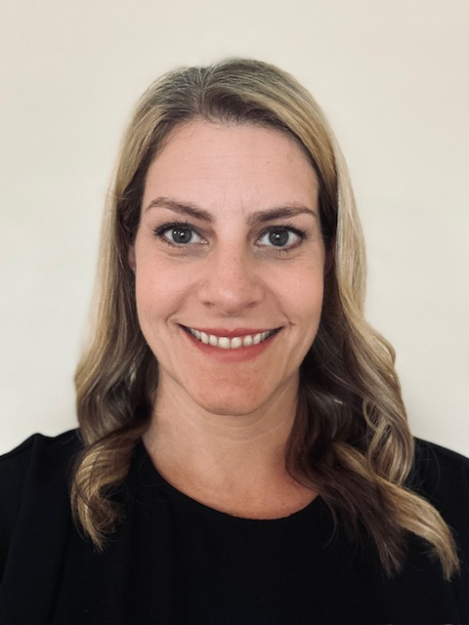
Meet the presenters
Colleen Lyon
Casey Ruegger
Engineering Librarian
Michigan State University
Education Librarian
University of Texas at Austin
Notes:
Colleen - I’m Colleen Lyon and since August 2025 I’ve been working at Michigan State University as the Engineering Librarian. Before that I worked at the University of Texas at Austin for almost 15 years doing scholcomm work. As the engineering librarian, I’ve been trying to incorporate scholcomm topics into my instruction, consultations, and communications with faculty.
Casey Ruegger - I’m Casey Ruegger. I’ve been at UT as the Education Librarian for close to 2 years. I feel like the 3 main routes that I have for communicating scholcomm topics are the LibGuide, in person presentations, and a bi-monthly newsletter. I’m working on developing more through Canvas, but I’m not sure how widely that will be used so I haven’t dug into that too much yet.

Slide 3
Agenda
01
Open access
02
Repositories
03
OER
04
Copyright
05
Publishing & Metrics
06
Resources
Notes:
Colleen
Here are the different topics we’ll discuss today.
This is not a session teaching you about these topics - many of those resources already exist - we’ll be showing you how these different scholarly communication topics are woven into the work we do with our departments. We also aren’t saying these are the best or only ways to incorporate scholcomm into liaison work. If you are doing this work too, we hope you will share your examples during the Q&A and after the session.
At the end we’ll share links where you can find this information.

Slide 4
Open Access
Notes:
Colleen
We’ll start with examples of how both of us are incorporating OA into our liaison work. I should also mention that we tried to focus on examples for this presentation that were easy to share in presentation form. Both Casey and I end up talking about aspects of scholarly communication in many of our interactions with faculty and students but many times those are just part of larger discussions and don’t lend themselves well to a shared example in a ppt.

Slide 5
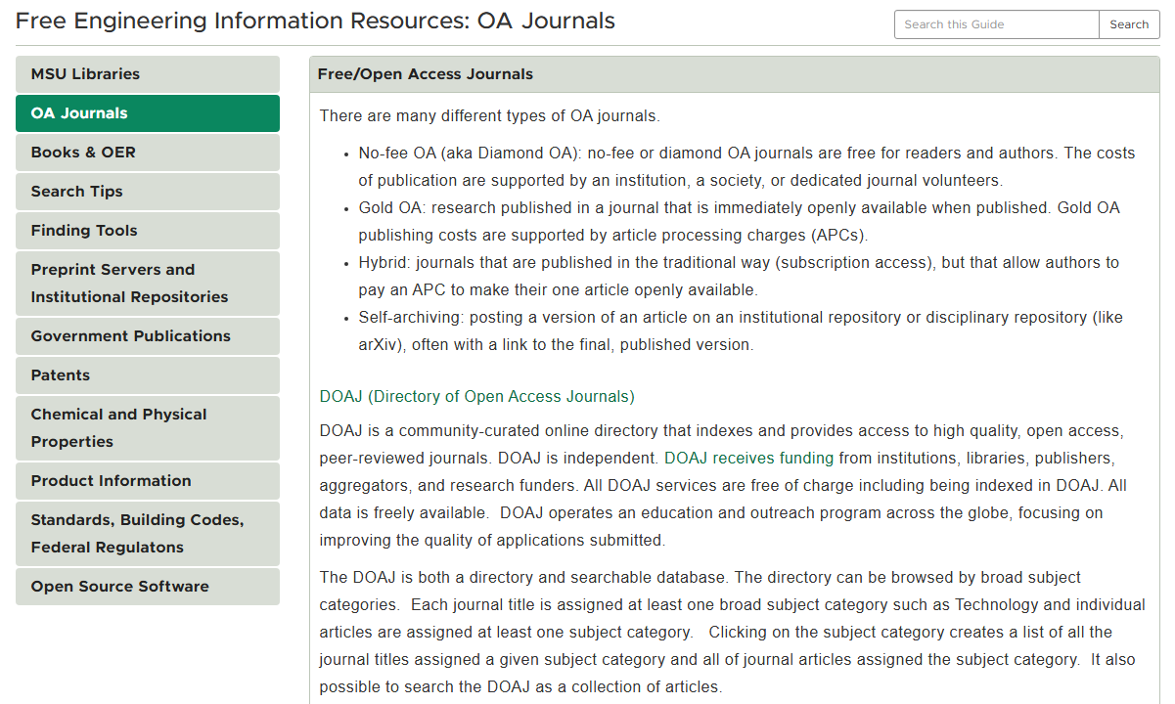
https://libguides.lib.msu.edu/freeengineeringresources
Notes:
Colleen
One of the easiest ways to share information is through LibGuides. Here’s an example of an engineering LibGuide with info about OA journals - both what OA is, and how users can find OA journals

Slide 6
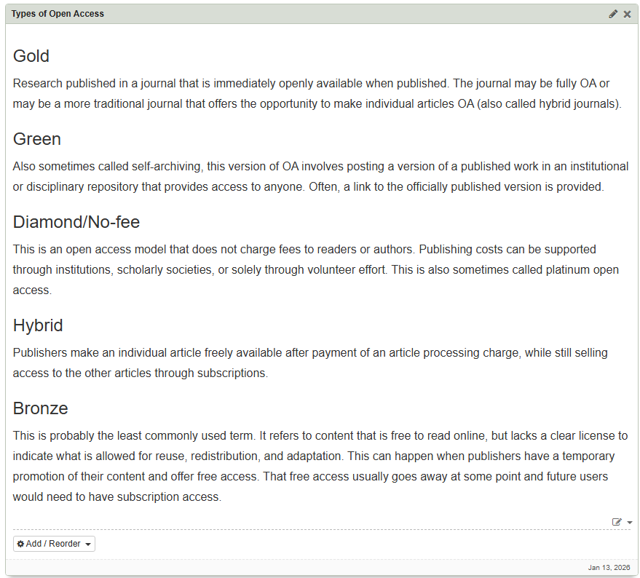
Scholcomm boxes & pages
https://libguides.lib.msu.edu/scholcomm
Notes:
Colleen
I also created some boxes that are meant to be reused by other liaisons and customized to fit their disciplines. This is an example of a box that describes the different types of OA. Ultimately, MSU focuses heavily on their website for disseminating information across disciplines and decided not to use LibGuides as our primary tool for communicating about OA. I’ve still maintained these boxes and pages as I find them useful for populating my own LibGuides. They are set to private in LibGuides, but anyone with the link should be able to access and copy them.

Slide 7
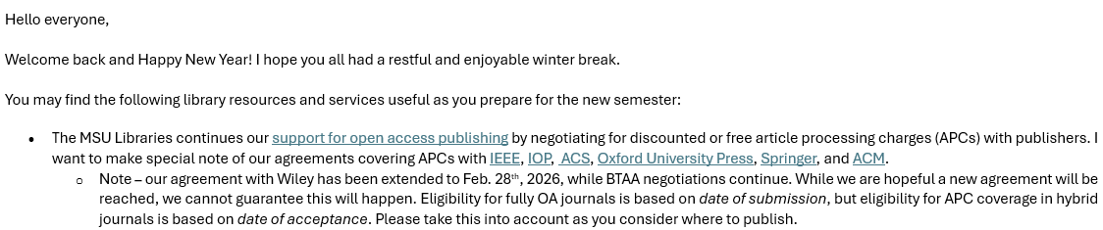
Mass email communication
Notes:
Colleen
It can be difficult to strike a balance between contacting your departments to share information, but not reaching out too much to the point they feel overloaded with communication. I’ll admit that line is different for different people. I’ve tried to reach out twice per semester unless there is something specific that needs to be communicating in between those messages (like a database cancellation). In the first message I sent this semester, I chose to highlight our OA agreements as the top bullet point. These agreements have been very popular with our faculty and probably are the number one question I receive from my departments.

Slide 8
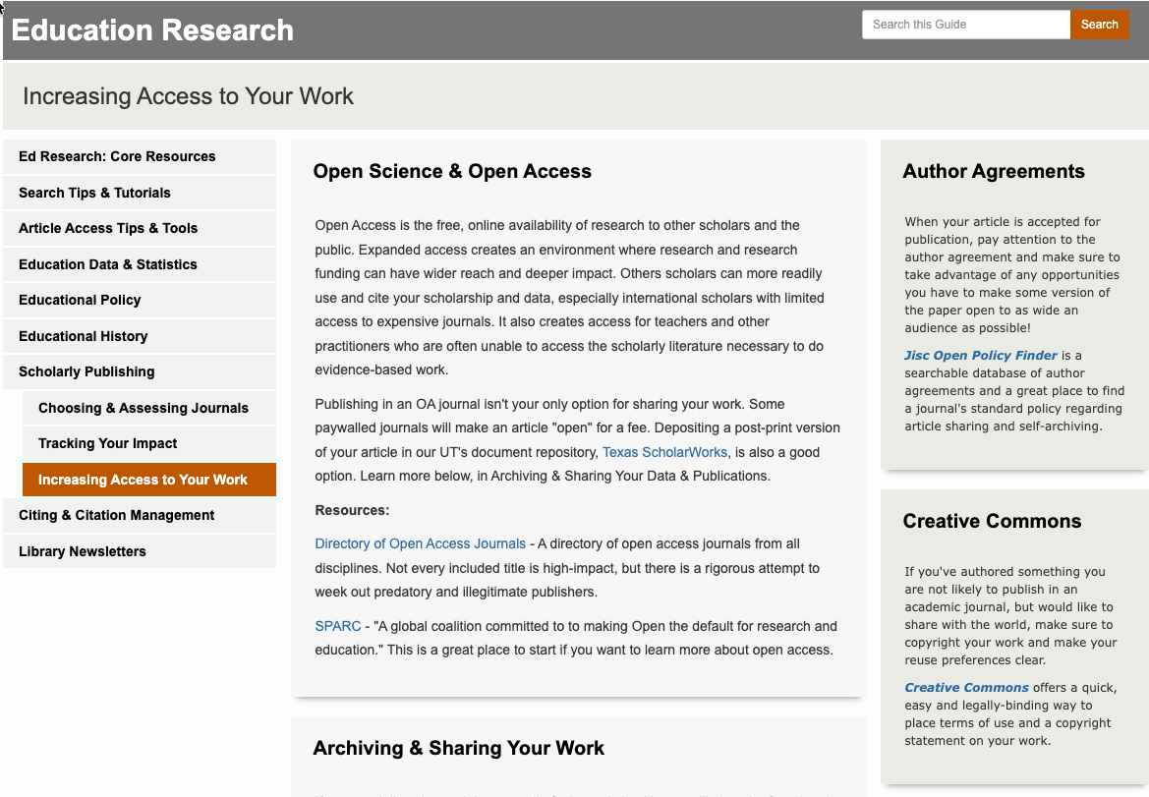
https://guides.lib.utexas.edu/education/publishing2
Notes:
Casey
I also use LibGuides to start the conversation on OA. We have had organizational changes at UT so new teams have been built out to further support OA initiatives which is fantastic. However, a lot of my community use the Education LibGuides so I want to make sure I have quick resources here with the basics of what they need to know in order to start learning about OA. From there, students can access the Library’s OA guide or reach out to me for more information.

Slide 9
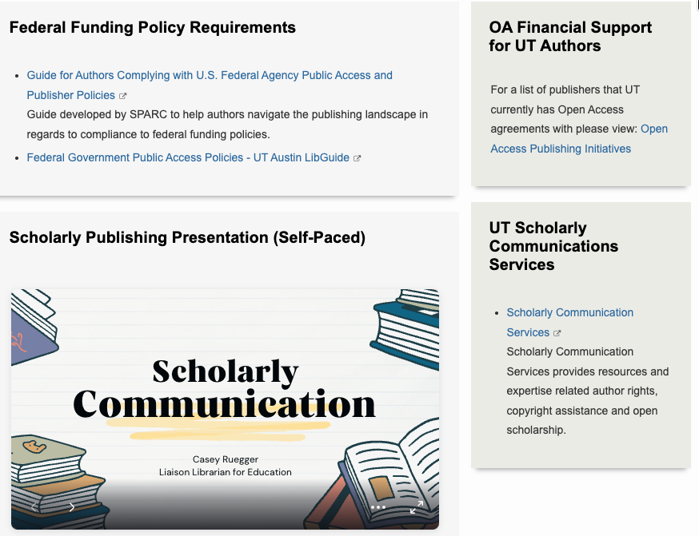
Scholcomm boxes & pages
https://guides.lib.utexas.edu/c.php?g=493788&p=3378830
Notes:
Casey
Again, I wanted to make sure the community that uses my pages has quick access to resources, as many are working full time. They are also used to presentations with a more little pizzazz than our LibGuides currently allow for, so I used Canva to create an overview of Scholarly Communication. It embeds easily and if I update anything in Canva, it will update on the LibGuide too.

Slide 10
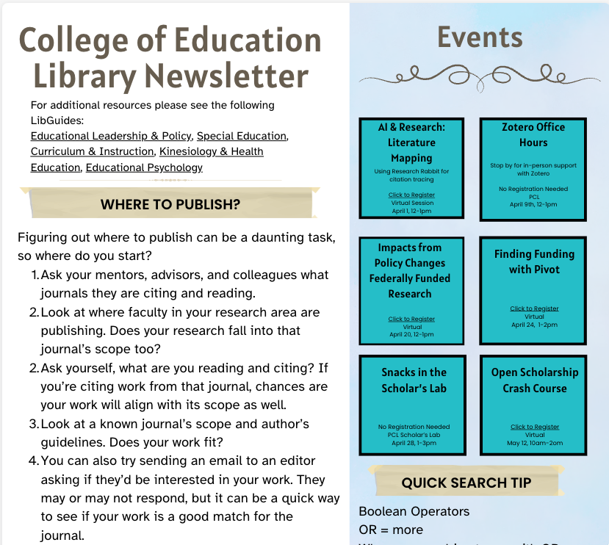
Mass email communication - newsletters
Notes:
Casey
For me, making connections within the department has also helped get more information out there. I cannot get on any of the listservs for the CoE, so I contacted the AD for research and graduate studies. She agreed to send out a bi-monthly newsletter on my behalf. This is where I’ll put a short paragraph on scholcomm topics and then events or other important library-related information. I use Canva for this as well because I can track the number of views.

Slide 11
Repositories
Notes:
Casey

Slide 12
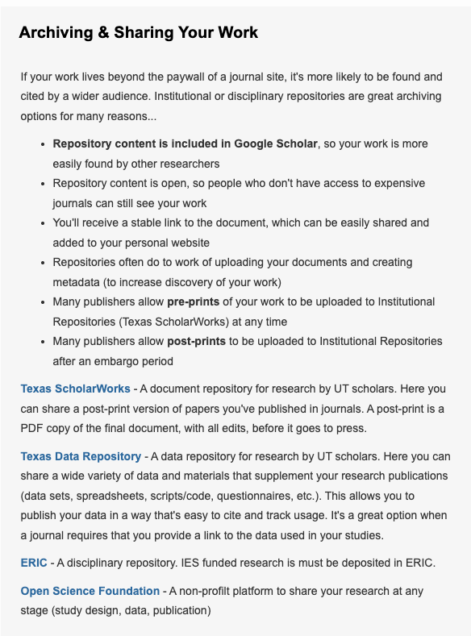
Archiving & Sharing Your Work
Notes:
Casey
We have access to Texas ScholarWorks and Texas Data Repository so I recommend using those when possible. I’m sure TDR will be used a lot more by the community I work with now with the federal funding policy updates. Users must also submit a full text peer reviewed version in ERIC if they were funded by IES so I’ve also included that. I try to mention registering a protocol with OSF, although for many researchers I work with, this is still a fairly new idea, but it’s here for when they’re ready for it. I will probably also add research.gov this summer for projects supported by NSF.

Slide 13
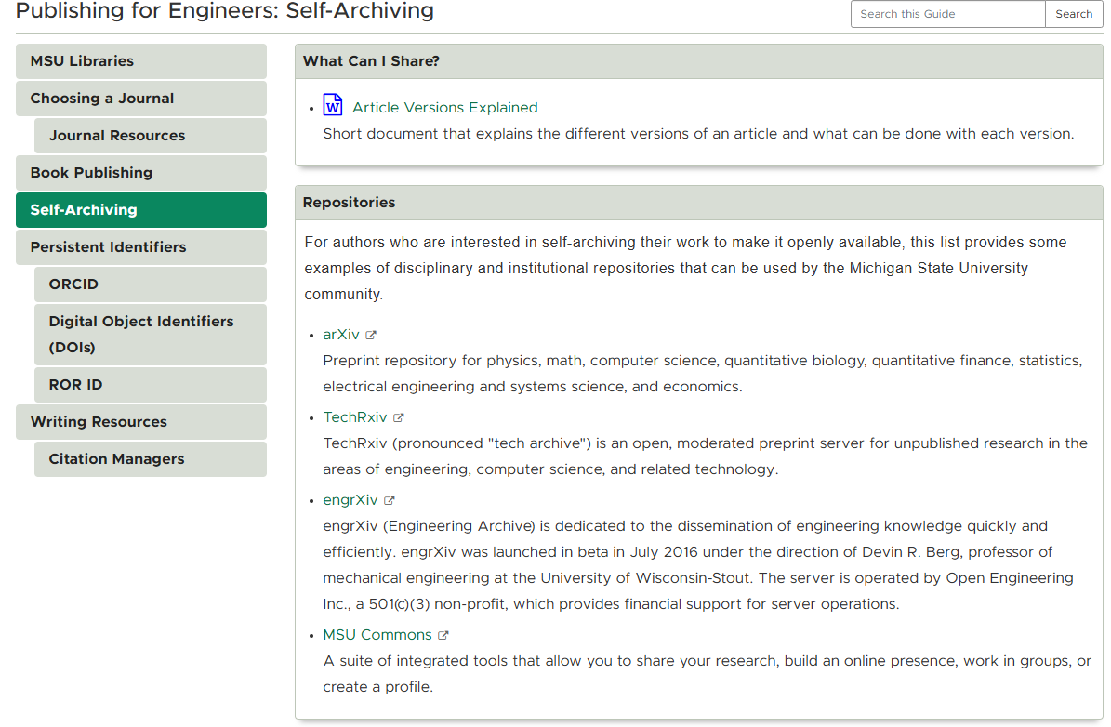
Archiving & Sharing Your Work
https://libguides.lib.msu.edu/publishingengineers/selfarchive
Notes:
Colleen
MSU doesn’t have an institutional repository similar to UT Austin, but they do have a repository that faculty can use. I typically point people towards disciplinary repositories. For engineering, the main repositories are arXiv, TechRxiv, and engrXiv. To a lesser extent, they may also use BioRxiv and PubMed Central.

Slide 14
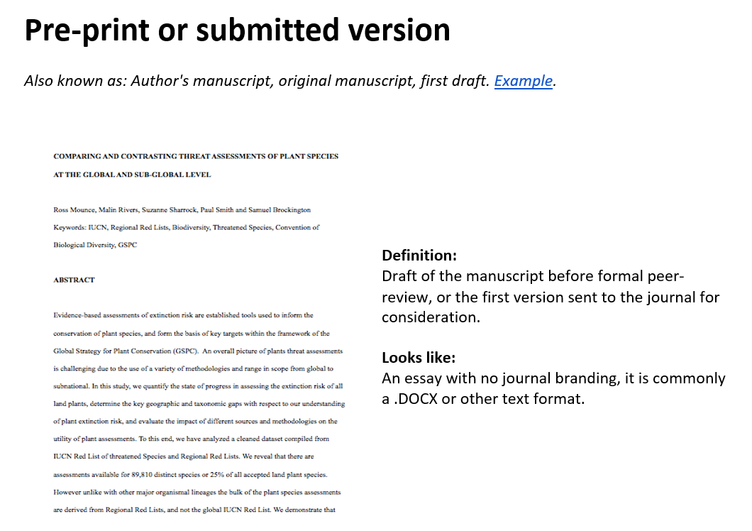
Archiving & Sharing Your Work
Article Versions Explained
Notes:
Colleen
You may have noticed a link on the previous slide to a document called Article Versions Explained. This is based off another resource I found. I wanted to be able to show examples of what pre-prints, post-prints and versions of record look like, where they can be found, and how they can typically be shared. It’s linked on this slide and is CC-0 so you can use it however you like

Slide 15
Open Educational Resources
Notes:
Colleen

Slide 16
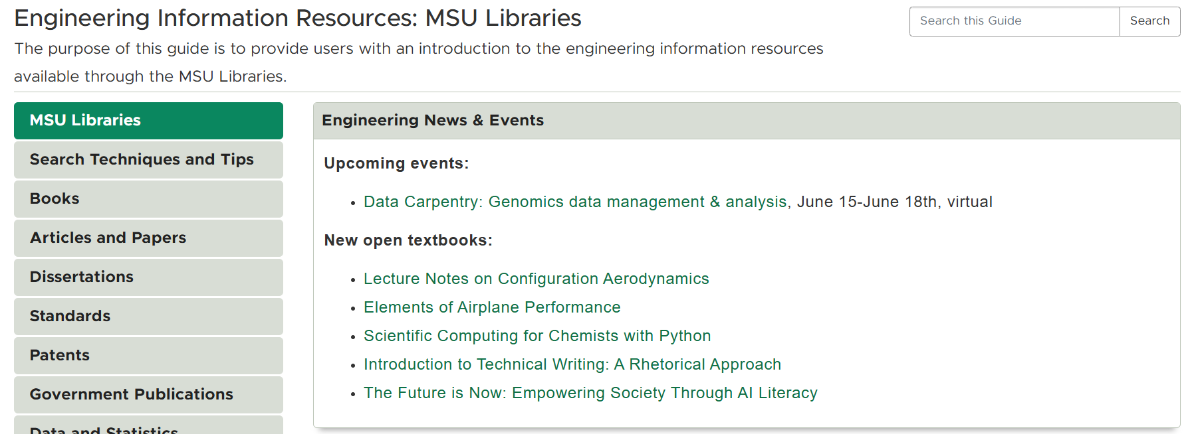
https://libguides.lib.msu.edu/engineeringresources
Notes:
Colleen
I follow notifications from the SPARC OE Forum and the LibOER email list to find out about new open textbooks and add those to my LibGuides when I learn about them.

Slide 17
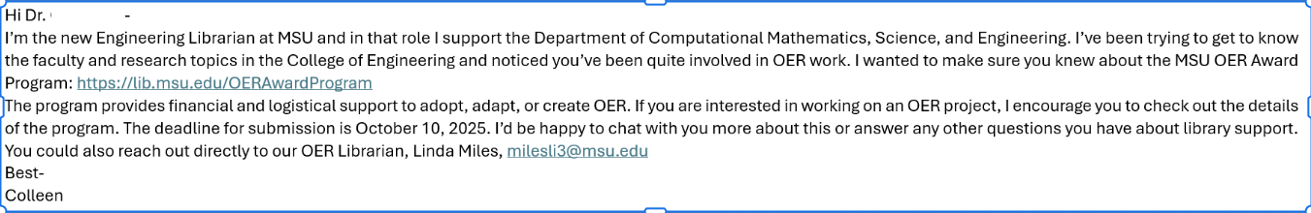
Individual messages
Notes:
Colleen
I also try to find opportunities to specifically bring up OER with our faculty. In this case I’ve emailed a professor who was active in OER work to encourage them to apply for our OER Award program. I’ve also reached out to individual faculty asking if they’d like me to do a search for relevant OER. So far no takers on that.

Slide 18
Copyright
Notes:
Colleen

Slide 19
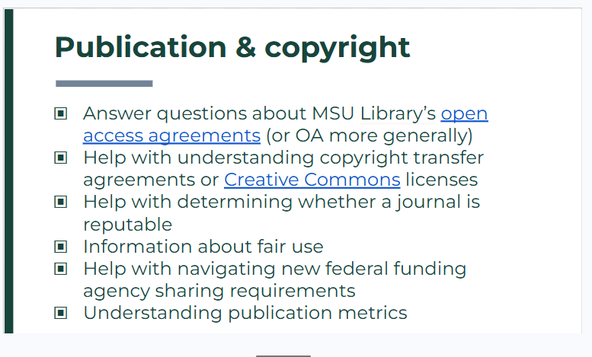
Notes:
Colleen
I was asked to talk with faculty from the Chemical Engineering department about library services. I wanted to make sure they knew about services beyond course reserves, purchasing books and journals. They were surprised that I could help answer copyright and CC questions and I actually got to answer a couple questions during that faculty meeting.

Slide 20
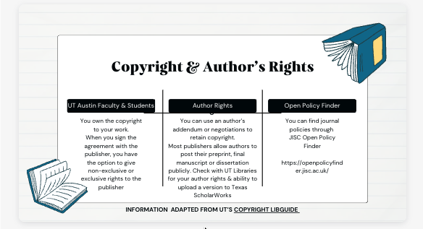
Notes:
Casey
This is an area where I’m still learning so after talking with Colleen and viewing the copyright libguide, I created this slide to communicate the basics to users. I don’t get as many questions about copyright, they typically go to our Open Scholarship team, but I’m assuming I’m going to get more questions about author’s rights as gen AI scrapes more data. I’m hoping to add to this page or create a new learning object in the future to address this.

Slide 21
Publishing/Metrics
Notes:
Casey

Slide 22
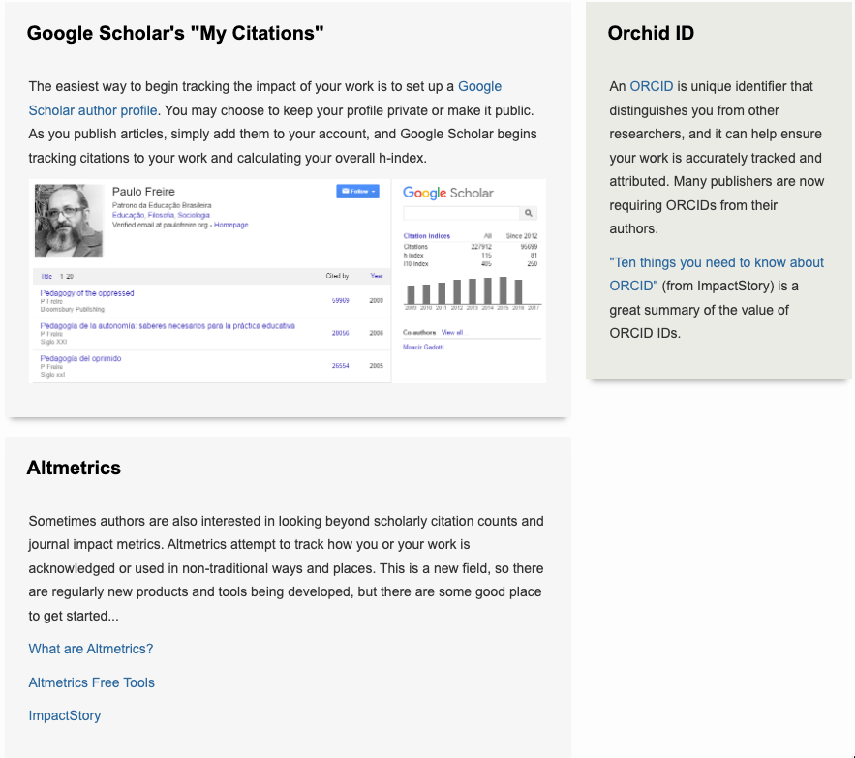
Tips for tracking impact
Notes:
Casey
This is typically an overwhelming topic for ed since the numbers are very sub-subject specific. I try to teach this in person when possible so I can answer questions, but there’s also a LibGuide page as a stable source that users can refer back to. For faculty, I lead an in-person presentation at a faculty tenure/promotion meeting where we spend time discussing Author h-impact, creating orchid ID and journal metrics.

Slide 23
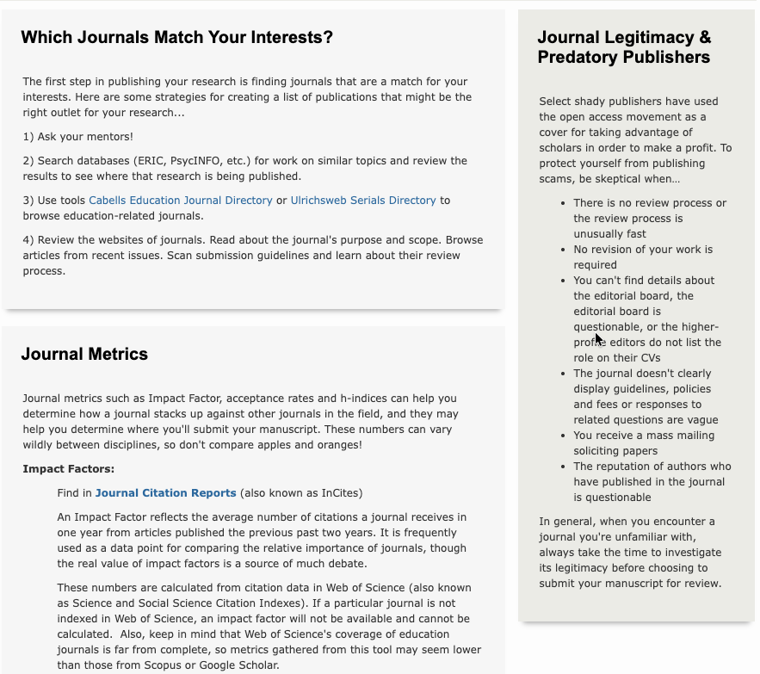
Choosing & Assessing Journals
Notes:
For students, I try to sprinkle this information into class presentations. I might just say look for Q1 journals for masters level or new doctoral students and then go into more depth based on questions they ask or if a faculty member requests that as part of the presentation. Again, this is an area that I find overwhelms a lot of people in the social sciences since the metrics don’t usually tell the full story. We also have access to Cabell’s so I’ll point out submission rates and publishing timelines to show other ways you can assess a journal.

Slide 24
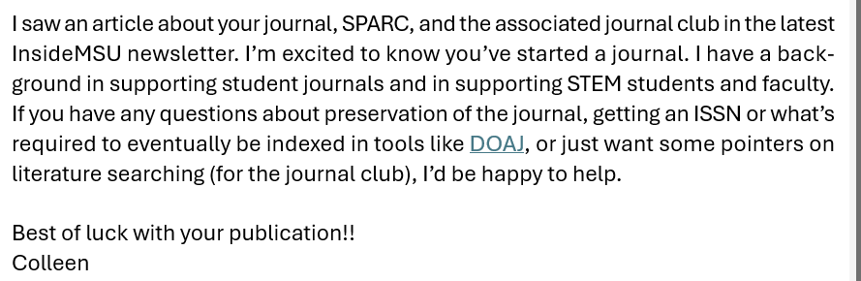
Reaching out to journals
Notes:
Colleen
I try to read all the newsletters from the college of engineering and from the university in general. Sometimes they turn up an outreach opportunity like this one. A STEM journal was just starting up and I reached out to them about helping them get their journal started. We were able to sign them up for DOIs, start the DOAJ application process and get them an ISSN. I’m now serving on their advisory board.

Slide 25
Resources
ACRL - Skilling Up
ACRL Scholarly Communication Toolkit: https://acrl.libguides.com/scholcomm/toolkit
Share yours!
MSU
https://bit.ly/clcr2026
Scholcomm boxes & pages for LibGuides: https://libguides.lib.msu.edu/scholcomm
UT Austin
Copyright Crash Course: https://guides.lib.utexas.edu/copyright
Link to slides: https://bit.ly/TCDL-scholcomm

Slide 26
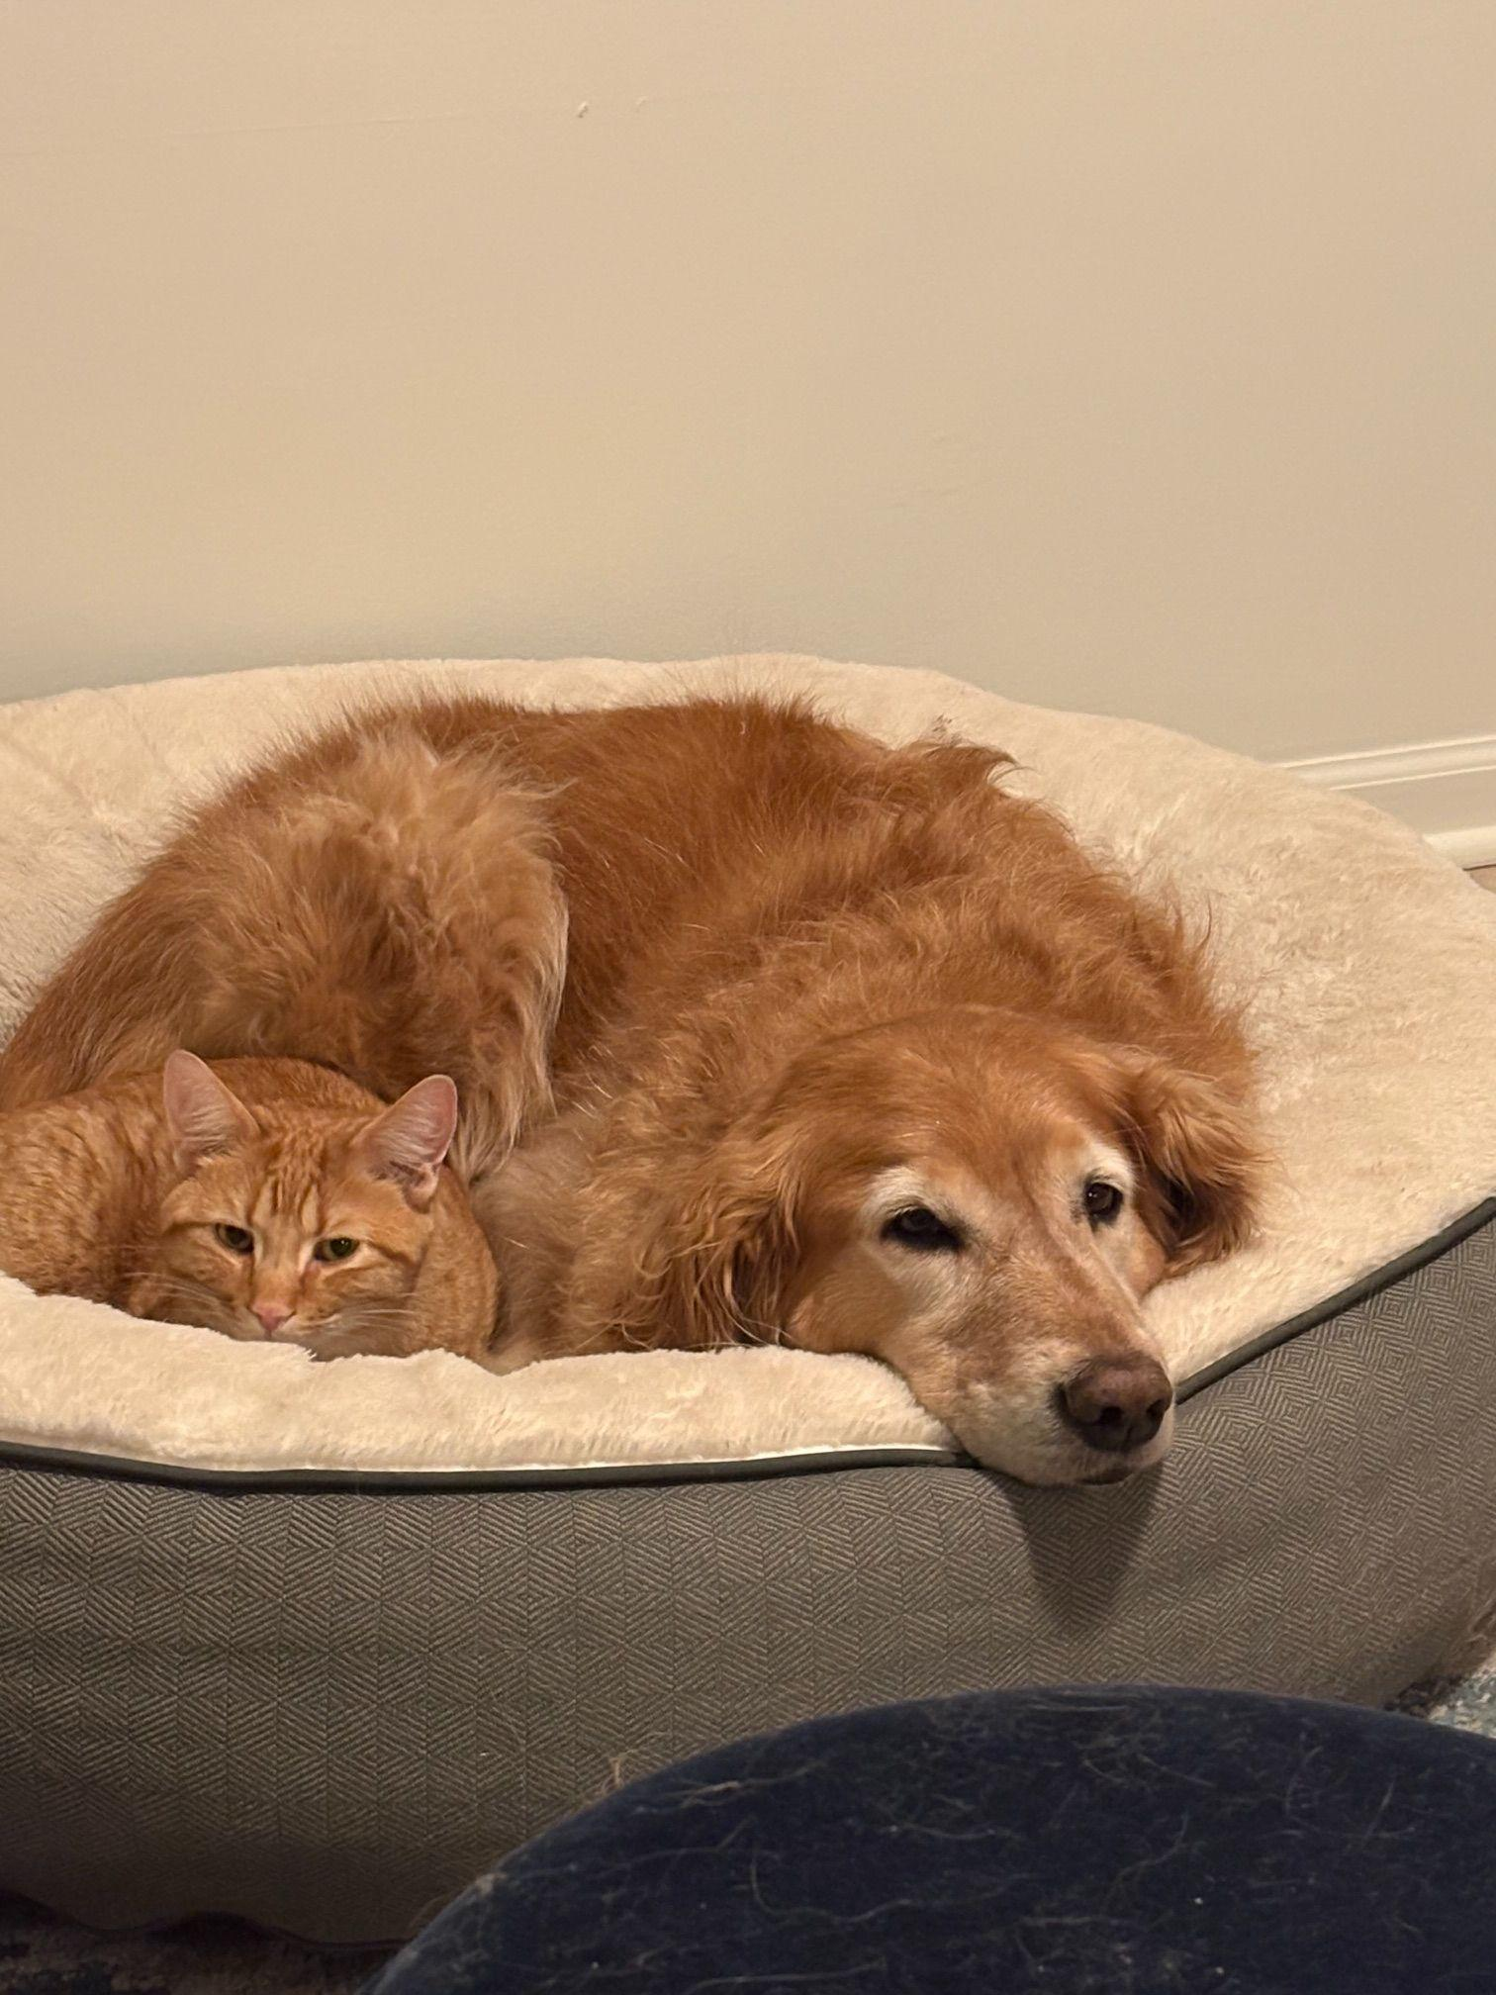
Finn & Harley say
Thank you!
Colleen Lyon
lyoncoll@msu.edu
Casey Ruegger
casey.ruegger@austin.utexas.edu
Share your resources
https://bit.ly/clcr2026
Lyon, C., & Ruegger, C. (2026). Incorporating scholarly communication concepts into liaison librarianship. Except as otherwise noted, this presentation is licensed CC-BY 4.0.

