Slide 1
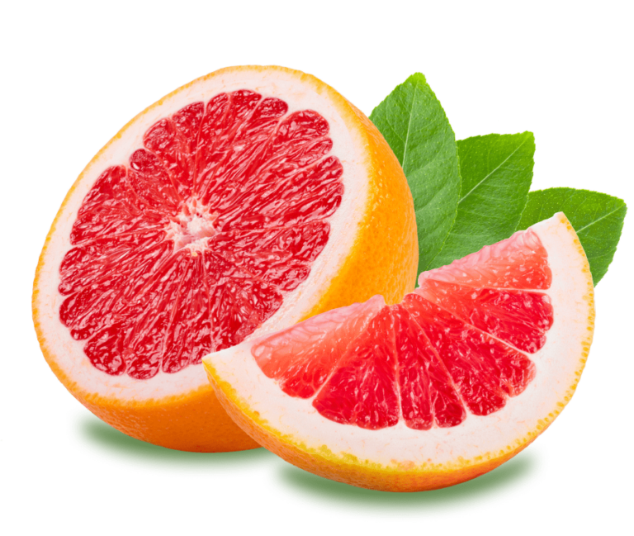
“EPIC” Gamification
Applying the EPIC Model for Iterative Metadata Improvement
Sophie Walker, Graduate Metadata Student Assistant, Digital Libraries, University of North Texas Libraries
Sarah Lynn Fisher, Digital Collections Librarian, University of North Texas Libraries
Jacob Lord, Digital Libraries, University of North Texas Libraries

Slide 2
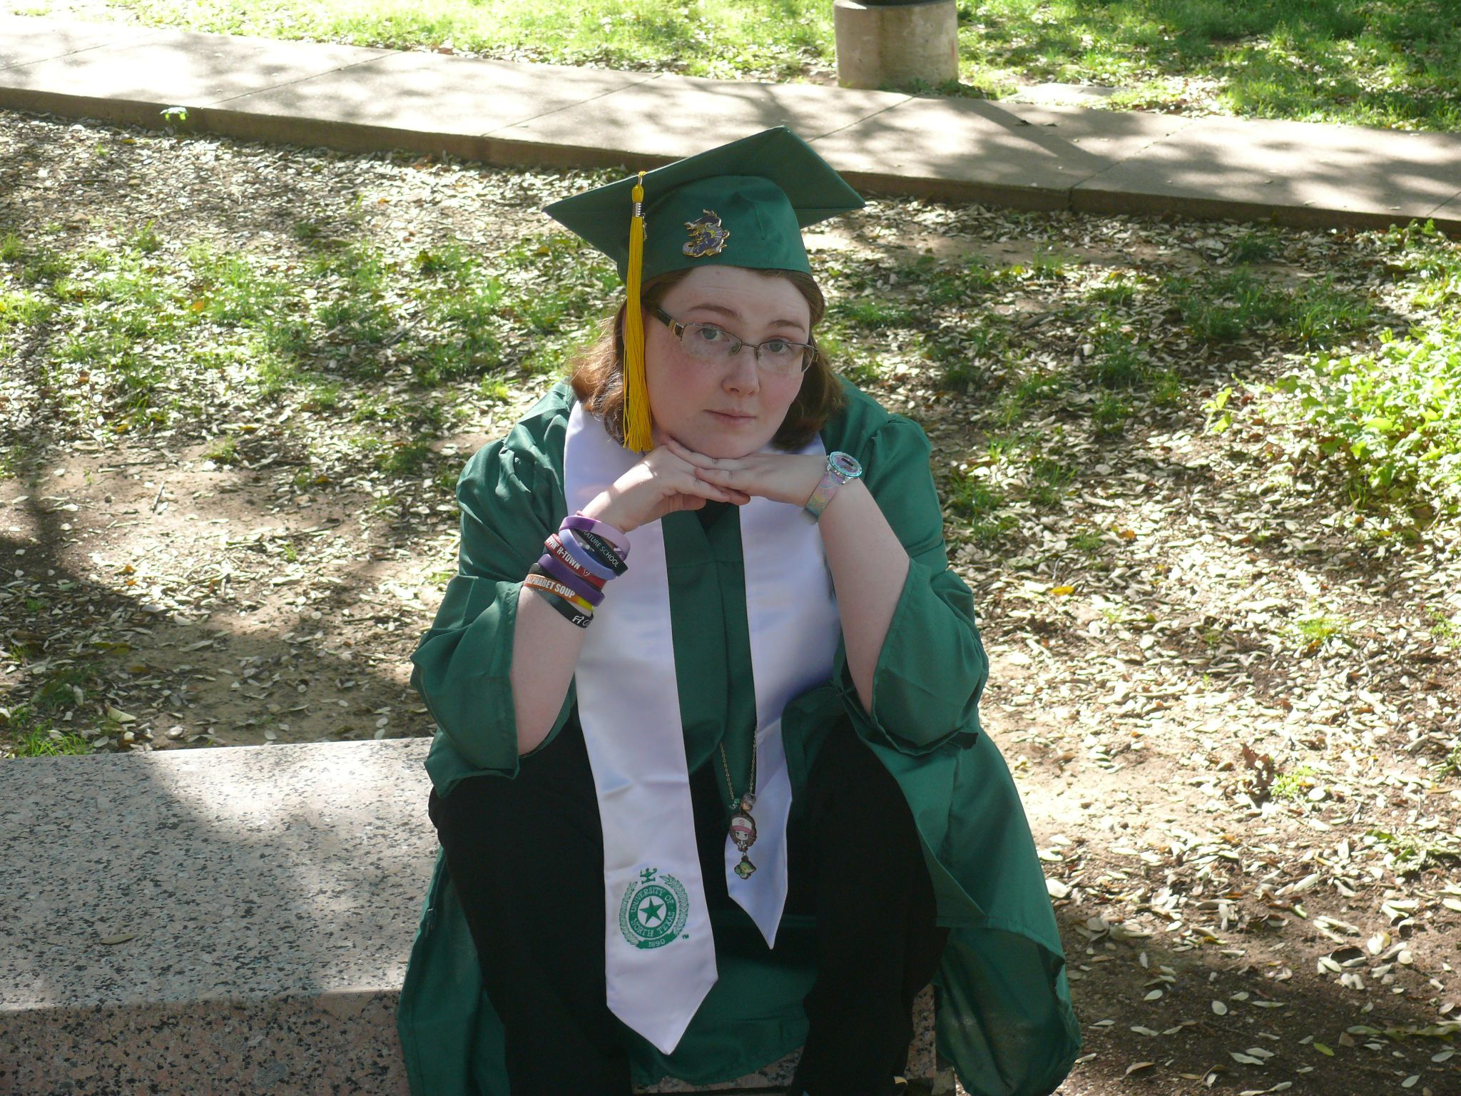
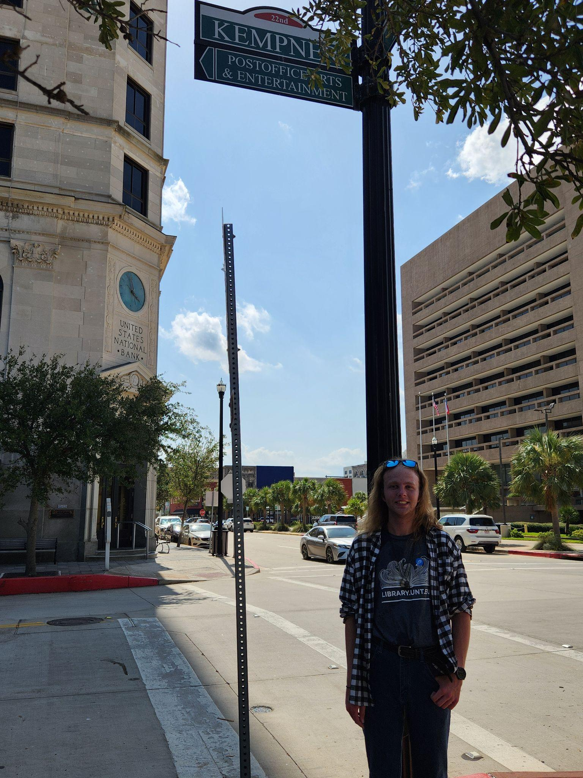

MEET YOUR PRESENTERS!
Sophie Walker
Graduate Metadata Student Assistant
University of North Texas
Jacob Lord
Former Student Metadata Assistant,
University of North Texas
Current Archival Intern,
National Museum of the Pacific War
Sarah Lynn Fisher
Digital Collections Librarian
University of North Texas

Slide 3
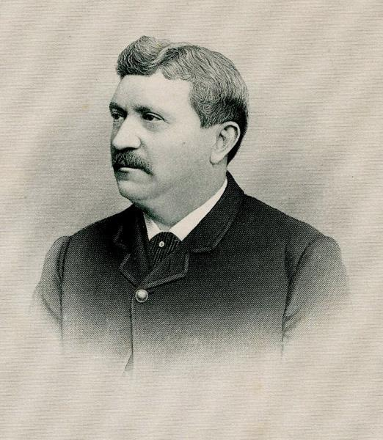
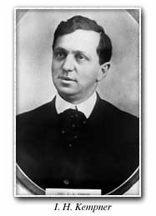
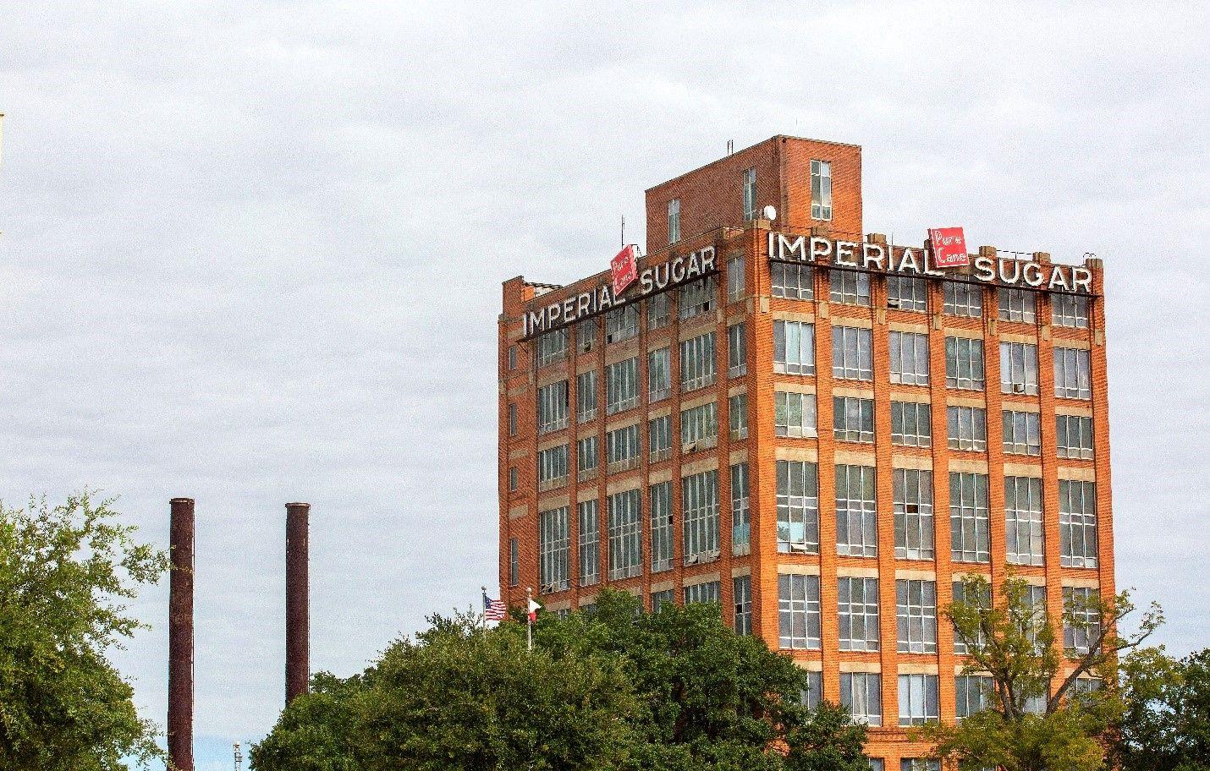
Meet the Kempners
Prominent entrepreneurial family from Galveston
Business interests in grocery, finance, sugar, cotton, and lots more
Notable figures include:
  Harris Kempner (1837-1894)
  Isaac Herbert Kempner (1873-1967)
  Daniel Webster Kempner (1877-1956)
  Harris Leon Kempner (1903-1987)
Notable endeavours:
  Imperial Sugar Company
  United States National Bank
  H. Kempner Cotton Company

Slide 4
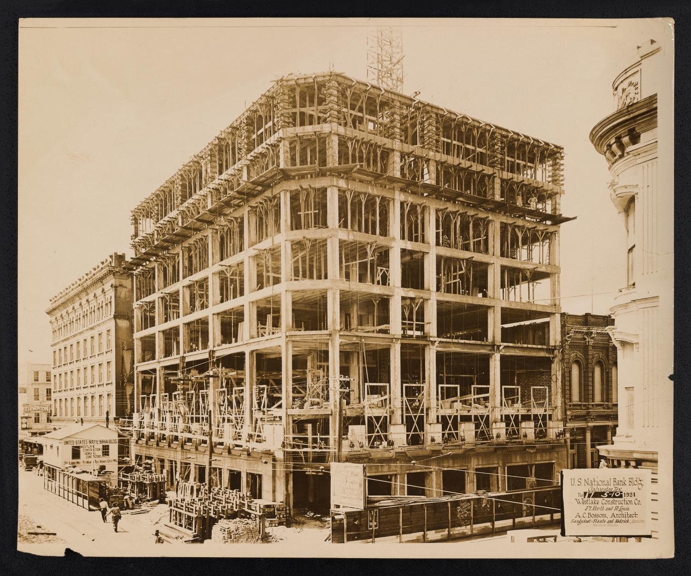
The Harris and Eliza Kempner Collection
Digitized from the Rosenberg Library
Process began in 2017; ended in 2025
Contains nearly 67,000 items
Mostly letters, but includes many other materials as well
Over 50 different editors worked on the metadata
Can be found online at https://tinyurl.com/PTH-Kempner
[Photograph of United States National Bank Building Construction, #13]

Slide 5
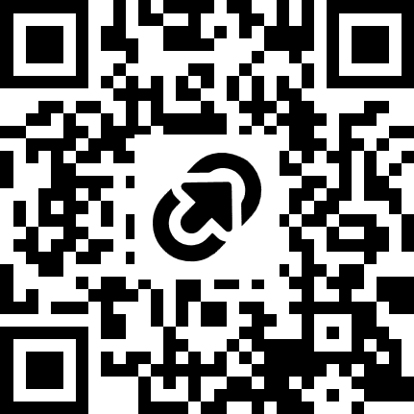
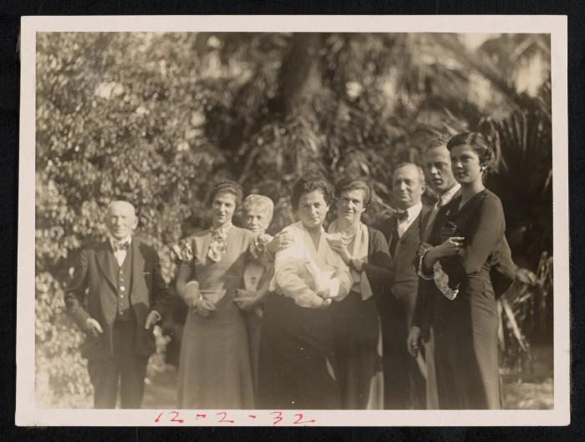
The Harris and Eliza Kempner Collection https://tinyurl.com/PTH-Kempner
[Photograph of Kempner Family Members with Rabbi #1]

Slide 6
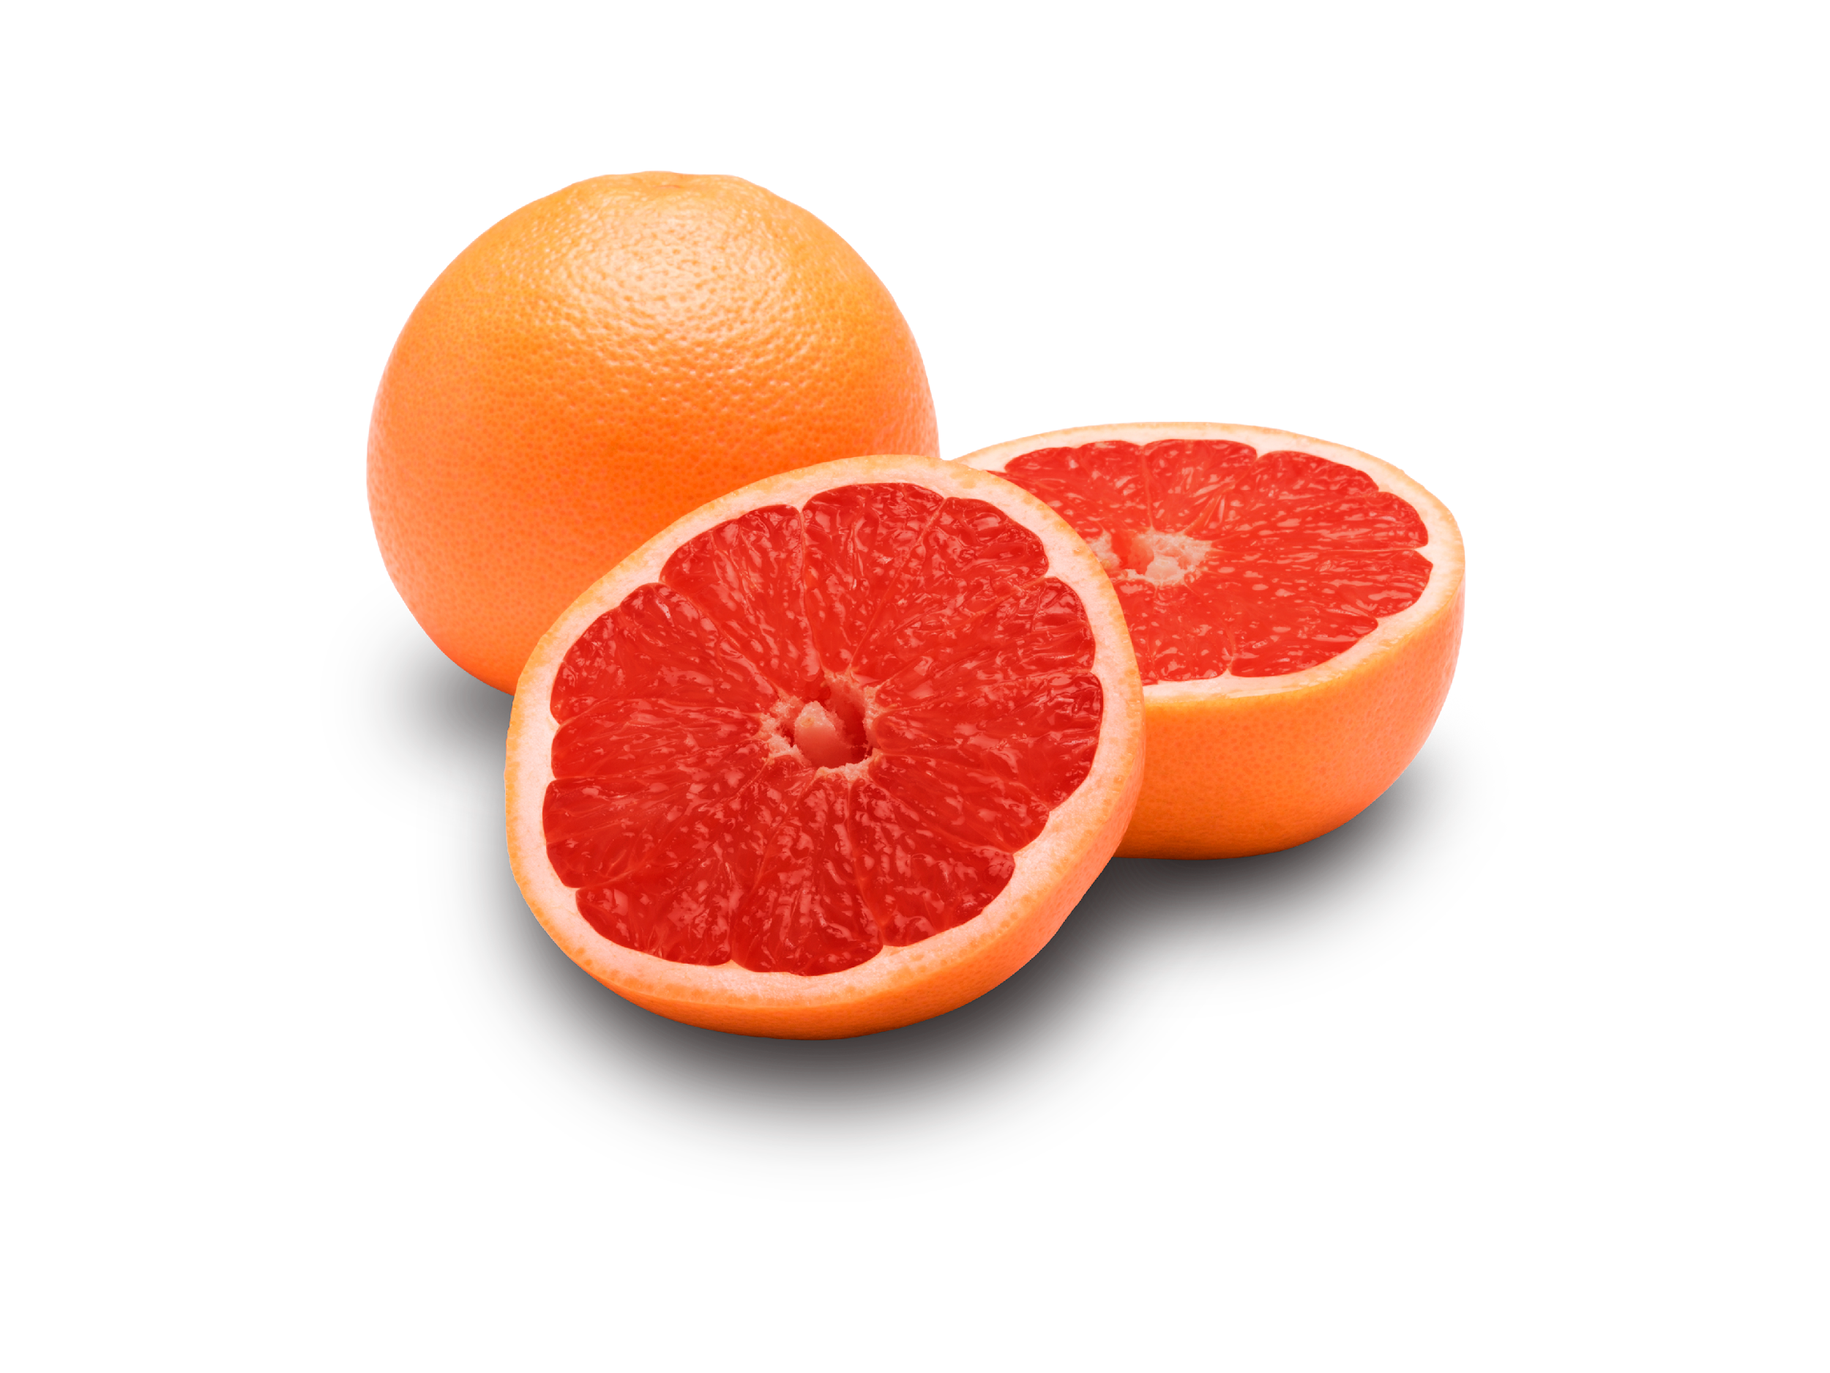
Metadata problems that add up over time
Inconsistent creator/contributor names
Changes in name authority
Relations that don’t link or aren’t reciprocal
Improperly formatted subjects
Lack of adherence to controlled vocabulary

Slide 7
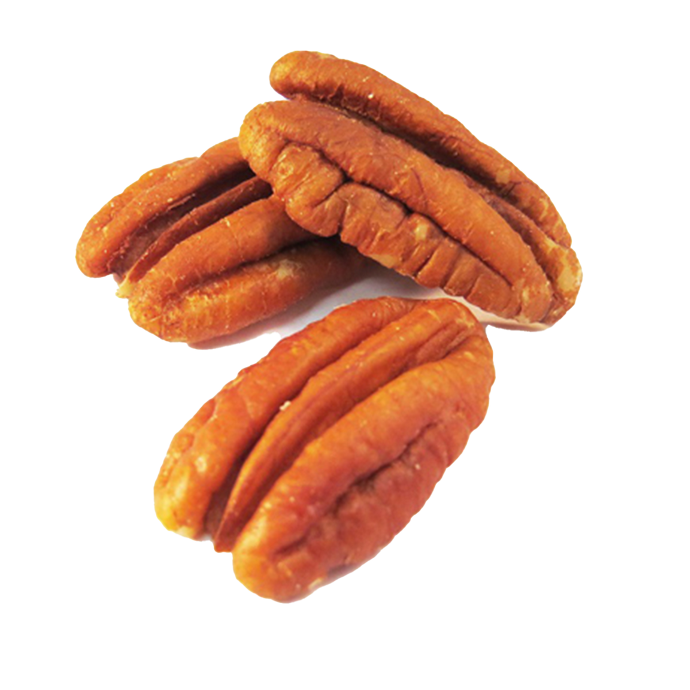
Why is this a problem?
Lack of colocation
Fewer access points
Related items don’t link to each other
Inhibits discoverability
More difficult for researchers to use

Slide 8

Collection size:
66,920 items
Where do you even begin with a collection that big?

Slide 9
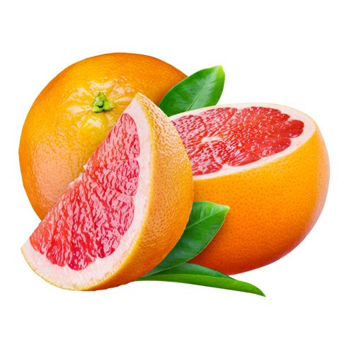

Enter: The EPIC Model
Proposed by Hannah Tarver and Mark Phillips in 2021
Discussed as a case study in this 2022 paper
Breaks down the process into smaller, less
intimidating tasks
Separates things we NEED from things
we would LIKE to do

Slide 10
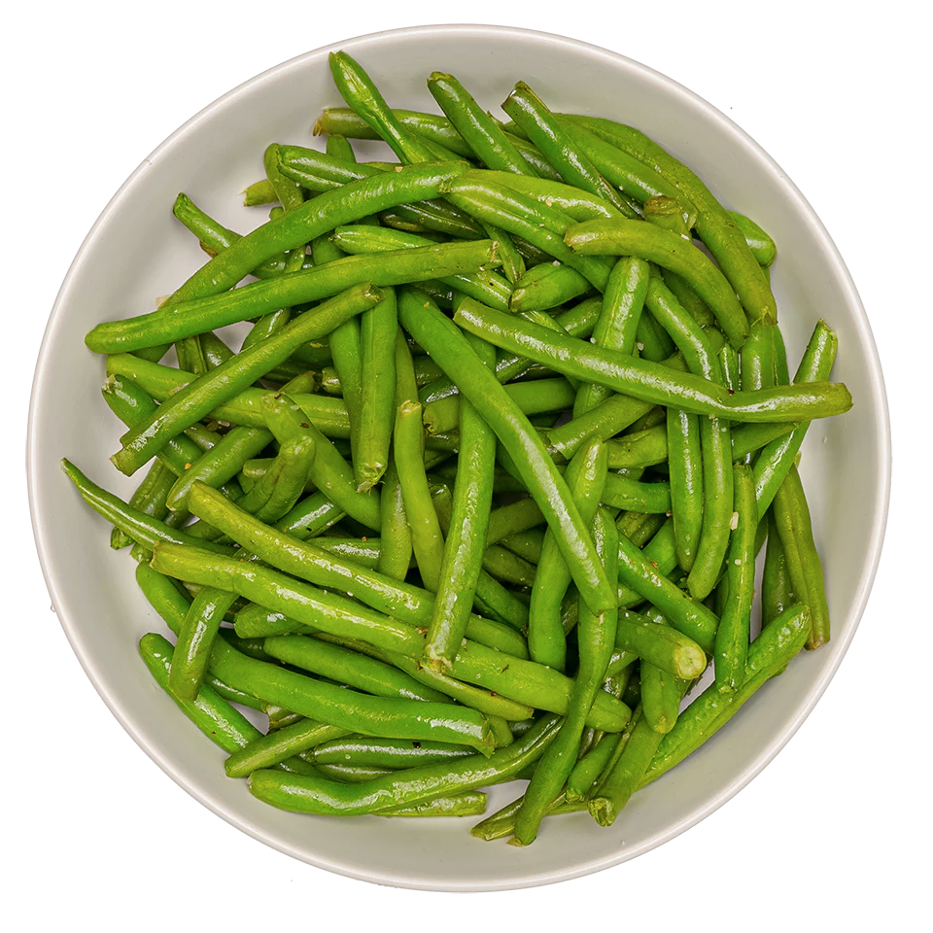
How does the model work?
Evaluate
What are the problems?
Prioritize
Which issues should we focus on first?
Identify
How do we find the items that need fixing?
Correct
Fix the items!

Slide 11
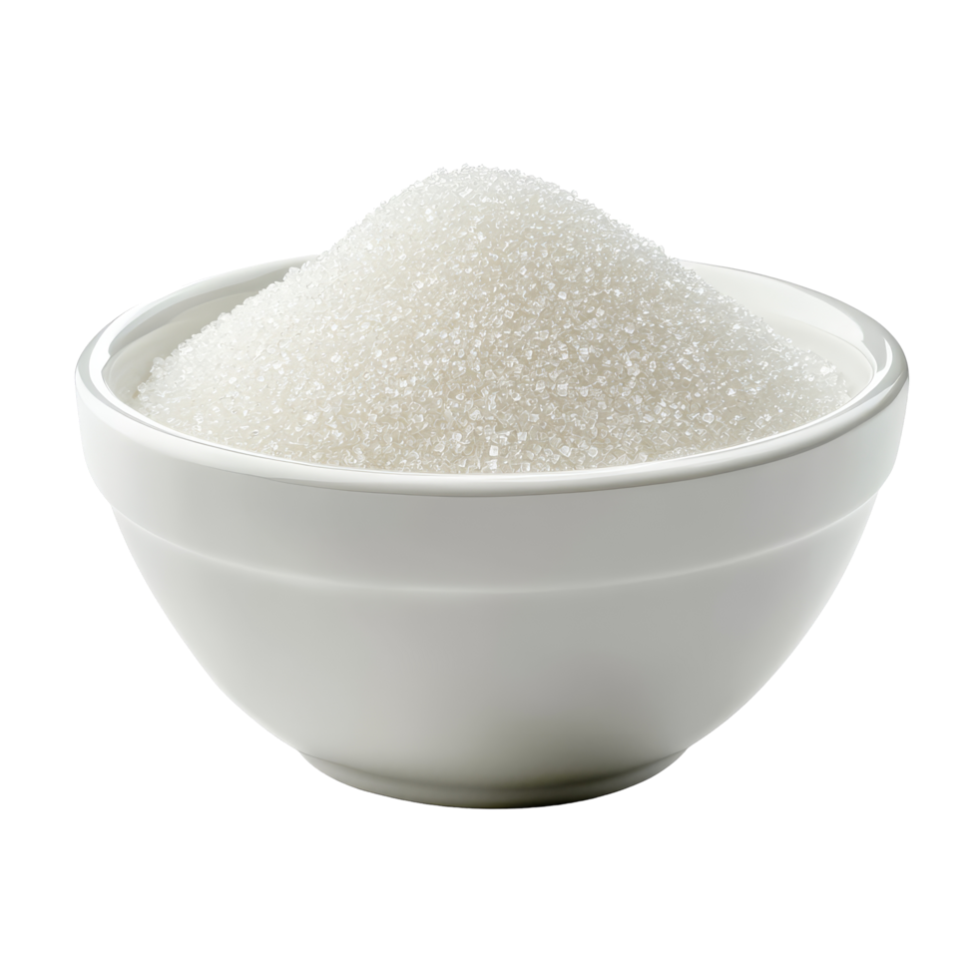
Things to consider:
Available resources
Number of records affected
Amount of time/expertise needed
Importance of quality aspect
Impact on user interfaces
Organizational goals

Slide 12
Step 1: Evaluate
Lists compiled while describing the collection
Some issues already fixed
Digital Projects Unit “General Collection Checklist” form
List of nonspecific “ongoing issues”
Checked which issues still applied to the Kempner collection
Compiled everything into a single document for transfer onto the spreadsheet

Slide 13
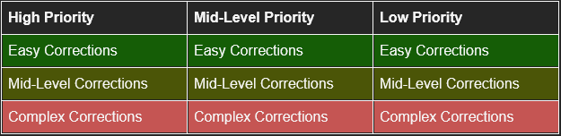
Step 2: Prioritize
Color-coded spreadsheet had two axes:
  High/mid/low priority
  Easy/medium/complex corrections
Start with high-priority easy corrections and work our way down

Slide 14
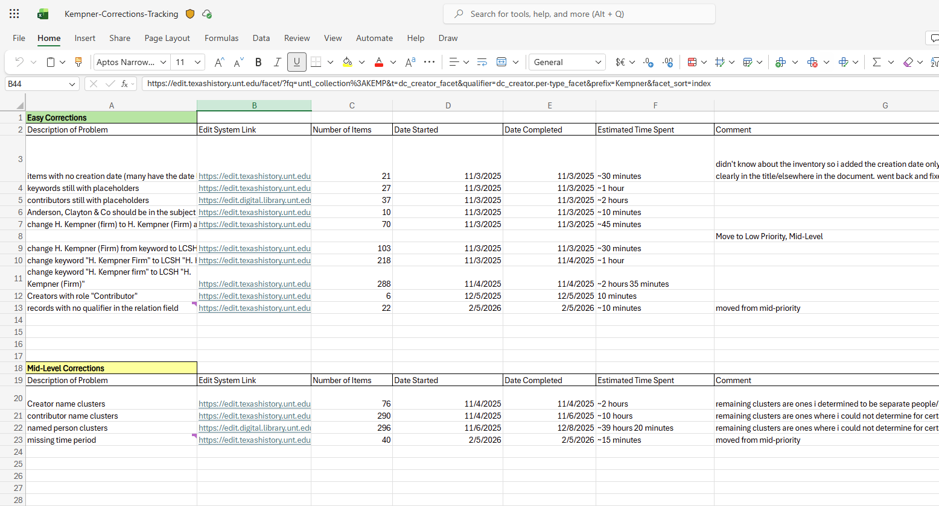

Slide 15
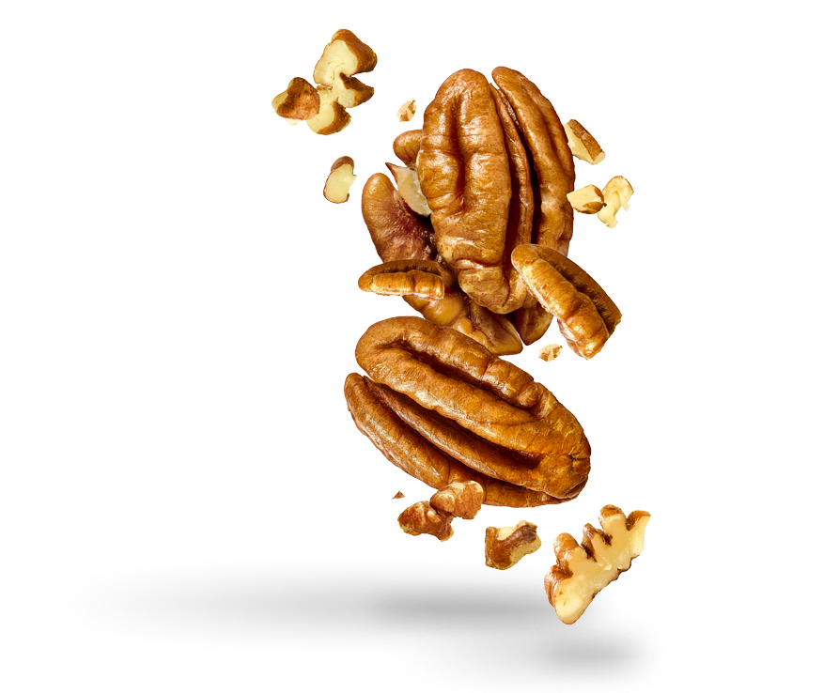
Factors to consider
How will this affect the user?
How long will this take to correct?
Is this correction necessary to reach minimal standards?

Slide 16
Step 3: Identify
Use the search functions in UNT’s in-house metadata editing system
Count tool: Finds how many records have a certain number of entries for a given field
Facet tool: Finds every value that has been entered into a given field
Cluster tool: Similar to facet, but groups together like-objects
Basic keyword search function

Slide 17
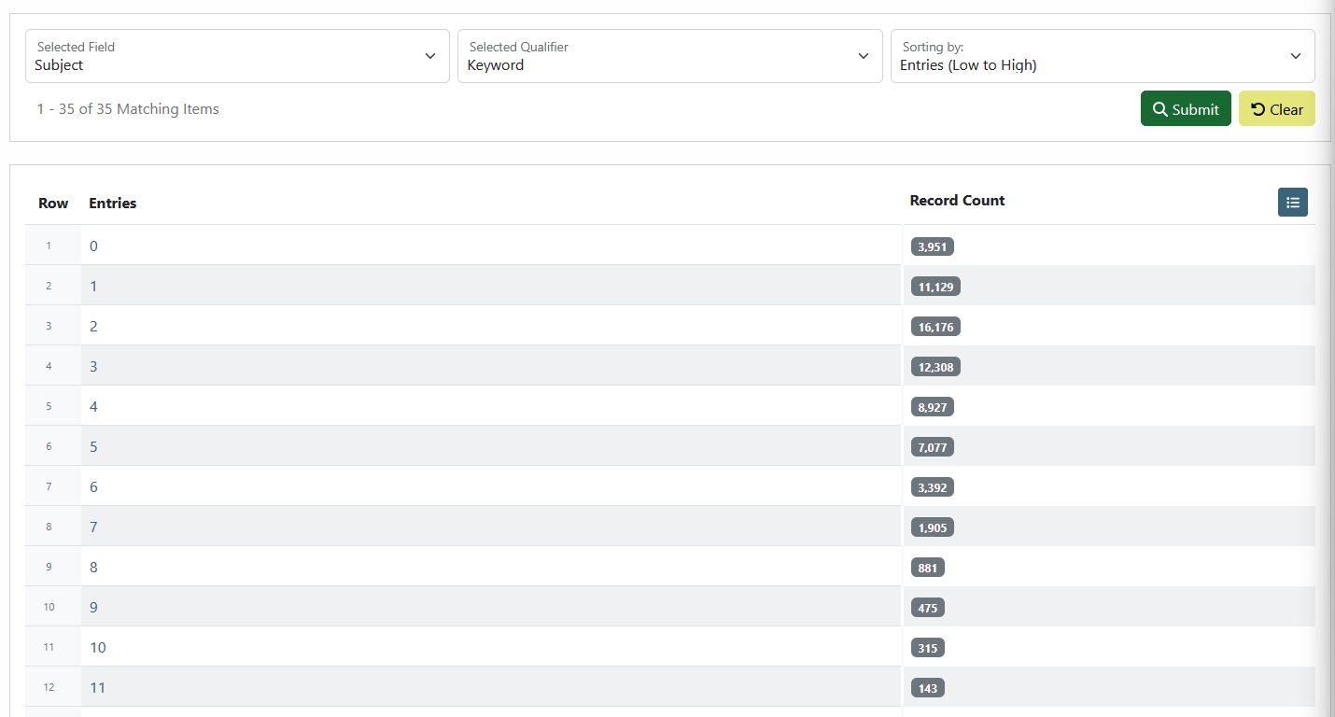
The Count Tool

Slide 18
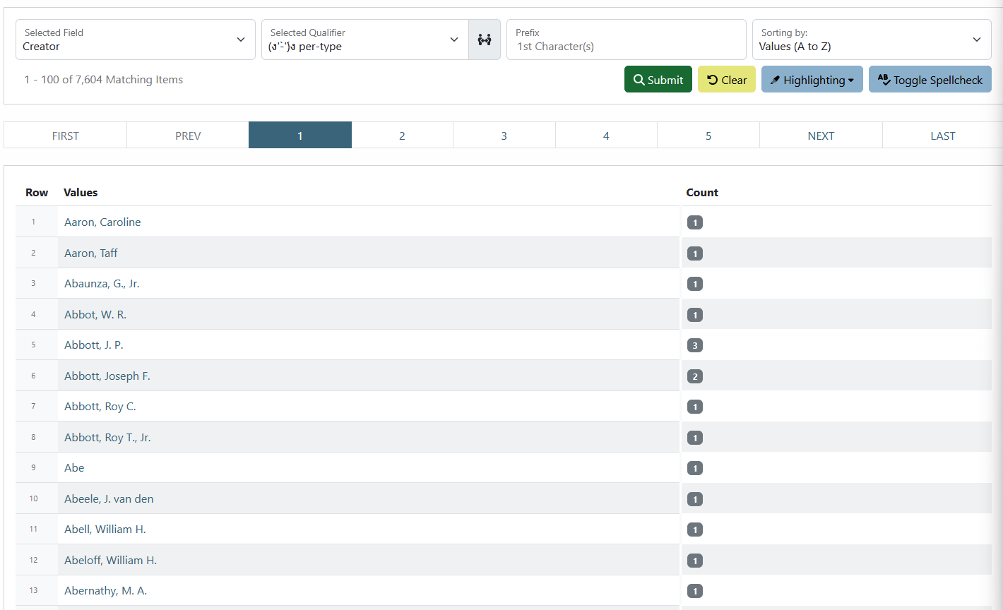
The Facet Tool

Slide 19
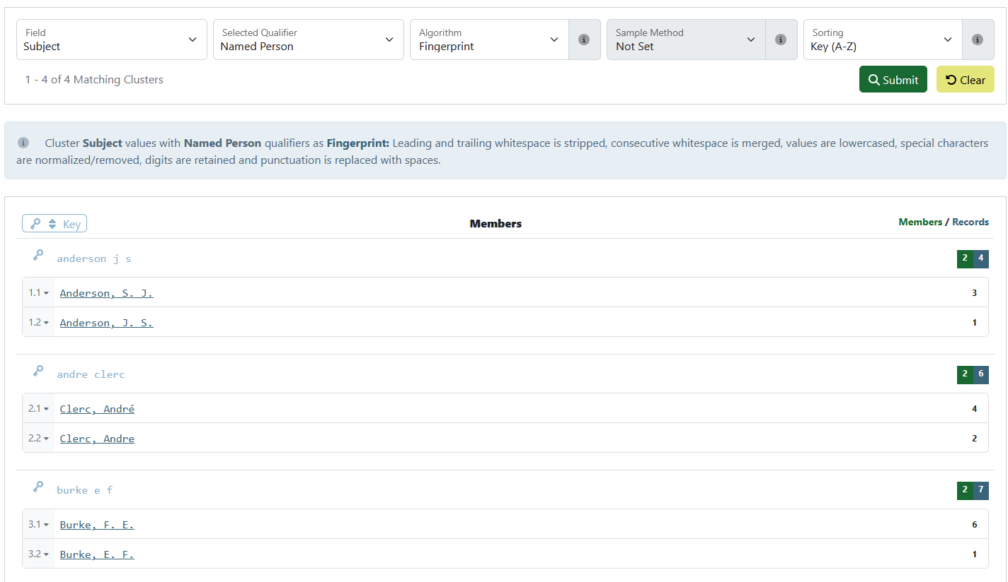
The Cluster Tool

Slide 20
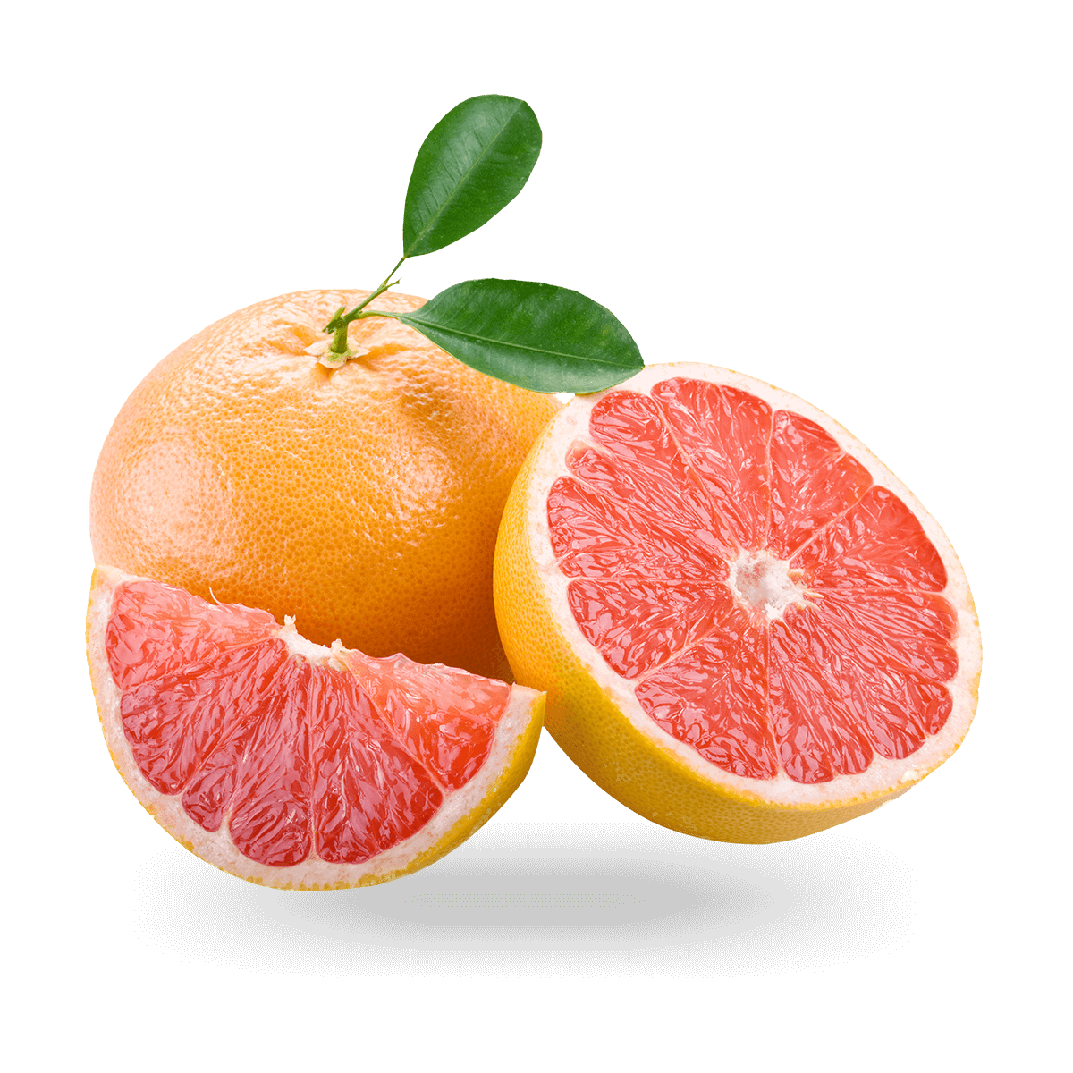
Step 4: Correct
November 2025 - March 2026
One person, 20 hours per week
Finished all high priority tasks, approximately half of mid-priority tasks
No low-priority tasks were completed
Some corrections took about ten minutes (shortest: 2 minutes)
Others took over ten hours (longest: 30 hours, 20 minutes)

Slide 21

Developments
Repeatedly returning to the Evaluate and Prioritize stages
Changing the priorities of certain tasks
  Took longer or were more complex than initially believed
  Human error due to lack of experience
Discovering new issues while working with the collection
Amount of records impacted is the most important factor in how long it will take
Experience of the one doing corrections is an unexpected variable

Slide 22
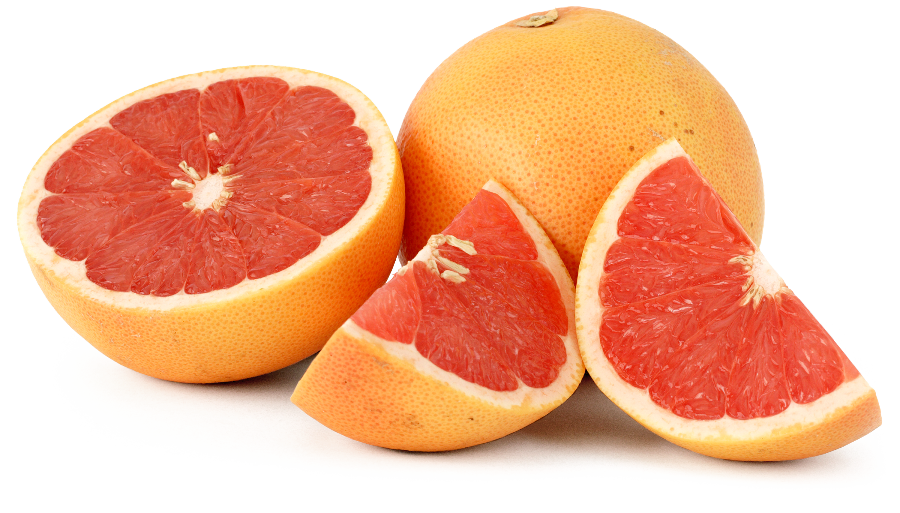
Conclusions
Makes the formidable process into something feasible
Gamifies a tedious process
Iterative and low-stakes with room for errors
Not everything needs to be completed at once
Much room for improvement

Slide 23
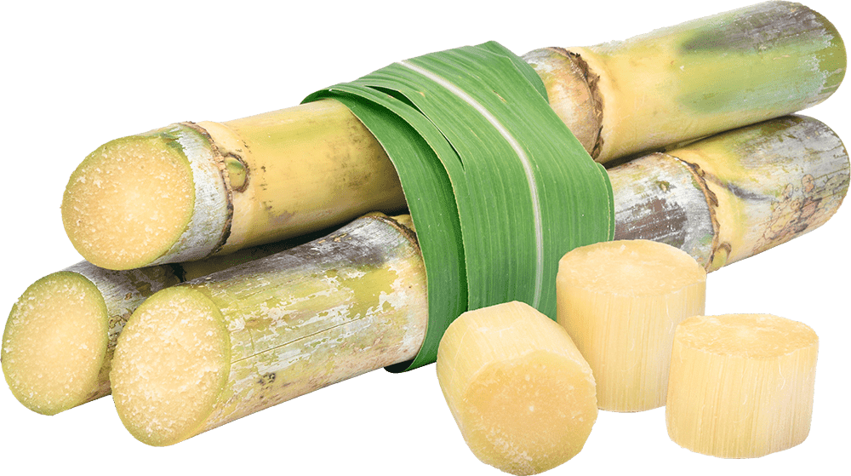
Areas for further study
How do these changes actually impact things on the user end? Do they notice? Will it increase the collection’s use?
How can we use the lessons from this project to further streamline the process in future projects?

Slide 24
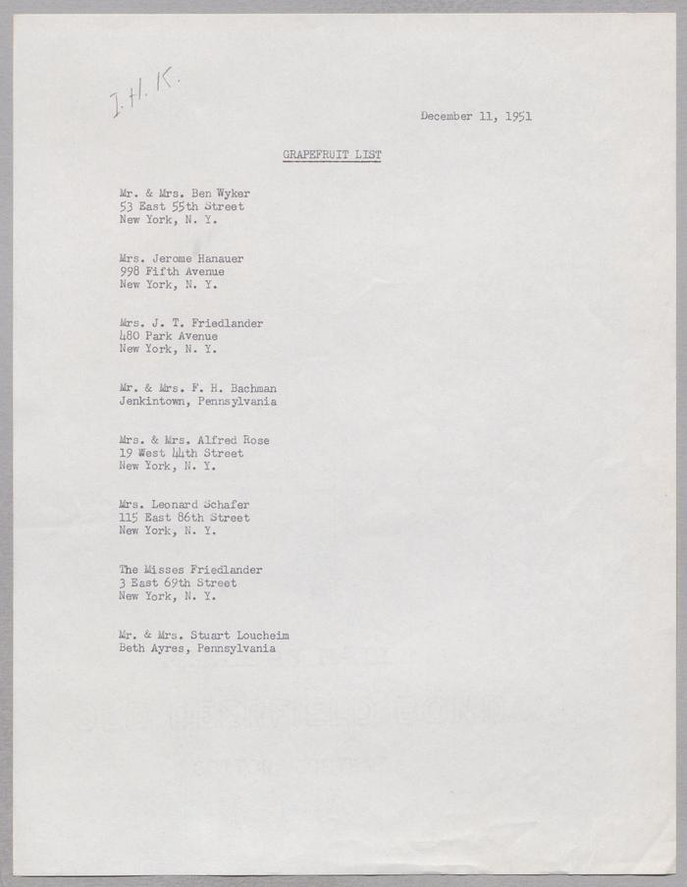
Thank you and we welcome your questions!
sophie.walker@unt.edu
sarahlynn.fisher@unt.edu
jacobclord@gmail.com
[Grapefruit List for I. H. Kempner, December 11, 1951]

Slide 25
References
Alemneh, D. G.; Belden, D.; Hartman, C. N.; Phillips, M. E., Reis, N. (2006). The UNTL Metadata Guidelines: [Version-2, 2006], UNT Digital Library. https://digital.library.unt.edu/ark:/67531/metadc29314
Cluster tool. (2022). UNTL Metadata Documentation. Retrieved April 17, 2026, from https://library.unt.edu/metadata/tools/cluster-tool.html
Correspondence guidelines. (2022). UNTL Metadata Documentation. Retrieved April 17, 2026, from https://library.unt.edu/metadata/guides/correspondence.html
Count tool. (2022). UNTL Metadata Documentation. Retrieved April 17, 2026, from https://library.unt.edu/metadata/tools/count-tool.html
DLF-AIG Metadata Assessment Working Group (2025). Summary Benchmarks. Metadata Quality Benchmarks. https://dlfmetadataassessment.github.io/MetadataQualityBenchmarks/
Facet tool. (2022). UNTL Metadata Documentation. Retrieved April 17, 2026, from https://library.unt.edu/metadata/tools/facet-tool.html
Harris and Eliza Kempner collection. (n.d.). The Portal to Texas History. Retrieved April 16, 2026, from https://texashistory.unt.edu/explore/collections/KEMP/
Minimally-viable records. (2022). UNTL Metadata Documentation. Retrieved April 17, 2026, from https://library.unt.edu/metadata/minimally-viable-records.html
Preserving the Kempner heritage. (n.d.). Harris and Eliza Kempner Fund. Retrieved April 16, 2026, from https://www.kempnerfund.org/preserving-the-heritage
Quality control in metadata. (2022). UNTL Metadata Documentation. Retrieved April 17, 2026, from https://library.unt.edu/metadata/tools/metadata-tools.html
Rhodes, M. (2024, December 5). Telling the story of the Harris and Eliza Kempner Collection. The Portal to Texas History. https://news.texashistory.unt.edu/2024/12/05/telling-the-story-of-the-harris-and-eliza-kempner-collection/
Subject. (2022). UNTL Metadata Documentation. Retrieved April 27, 2026, from https://library.unt.edu/metadata/fields/subject
Tarver, H., & Phillips, M. E. (2021). EPIC: A proposed model for approaching metadata improvement. In E. Garoufallou & M. A. Ovalle-Perandones (Eds.), Metadata and semantic research. MTSR 2020. Communications in computer and information science, vol. 1355 (pp. 228-233). Springer Nature Switzerland AG.
Tarver, H., Phillips, M. E., & Krahmer, A. (2022). EPIC: An iterative model for metadata improvement. International Journal of Metadata Semantics and Ontologies, 15(4), 244-253.
Tarver, H., & Phillips, M. E. (2025). Utilizing the EPIC Framework to Improve Metadata Infrastructure. Proceedings of the International Conference on Dublin Core and Metadata Applications, 2025. https://doi.org/10.23106/dcmi.952584682

