Slide 1

WEB ARCHIVING TEXAS INTEREST GROUP
Shannon Willis (TXST) and Lauren Ko (UNT)

Slide 2

AGENDA
Intro to Group
How can WATXIG serve you? (Activity)
Collaborative Web Archiving Project
Open Discussion (Time Permitting)

Slide 3

GROUP HISTORY
Began in 2020
Was sunset in 2022
Rebooted in 2025

Slide 4
MISSION OF WATXIG
“The TDL Web Archiving Texas Interest Group (WATXIG) aims to build a community around web archiving in Texas, bring people together to share skills and resources to accomplish shared goals, and amplify our work that impacts the national and international web archiving community.”

Slide 5
SPACES
Listserv: tdl-watxig@utlists.utexas.edu
Texas Digital Library Wiki Page: https://tinyurl.com/WATXIG
Channel on TDL Slack:
  #watxig
  https://tinyurl.com/JoinTDLSlack
Google Drive space
  Agendas and meeting notes
  Other documentation

Slide 6
WHAT HAS HAPPENED SO FAR
Kick-off meeting
(October 29, 2025)
Quarterly meetings
(January 28 and April 29, 2026)
Group business
Member presentation of their web archive
Discussion of pre-chosen topic
Open Chat
(March 25, 2026)
Informal and open discussion
No agenda or planned topics
Browsertrix Workshop
(February 25, 2026)

Slide 7
WHERE SHOULD WE GO FROM HERE?

Slide 8
GUIDING QUESTIONS
Meeting formats
  Do you want a member to present a project or archive at every meeting?
  Do you want to give/hear updates on members' projects?
  Do you like open discussion meetings with less agenda?
Events
  What sorts of presentations would be most useful for you?
  Are you interested in an annual WATXIG in-person event?
Discussion Topics
  What challenges do you face?
  How do you advertise your web archive?
  What new tools are you using or want to use?
Collaboration
  What projects/presentations could we work on together?
  What would you want to help with?
  What would you NOT want to help with?
Other
  Do you want social time with colleagues?
  Do you want icebreakers and/or games at meetings?

Slide 9
ACTIVITY: GUIDE OUR FUTURE
Categories:
  Events
  Meeting Formats
  Discussion topics
  Collaboration (things we could do or make together)
  Other
Submit Ideas and Thoughts Via Sticky Note:
  Place ideas for what you would like from WATXIG under each broad category
  Ideas can be specific (e.g. an exact event or topic) or more general (e.g. what you do or do not want)
  Add +1 to a sticky note when you like the suggestion
Time for:
  People to post their ideas
  People to review and upvote others’ ideas
  Review as a group

Slide 10

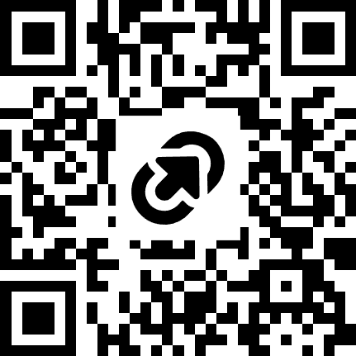
TEXAS AMERICA 250 WEB ARCHIVE PROJECT
Collaborative web archive project
Work together to find seeds to add to a collection that documents America 250 celebrations in Texas
Add seeds to UNT’s seed collection tool
UNT will crawl selected seeds and host the collection in The Portal to Texas History
Seed nomination tool open now:
https://digital2.library.unt.edu/nomination/texasamerica250/
Hosting event on July 1 @ 2pm to work on finding and adding seeds together
Anyone can participate!

Slide 11
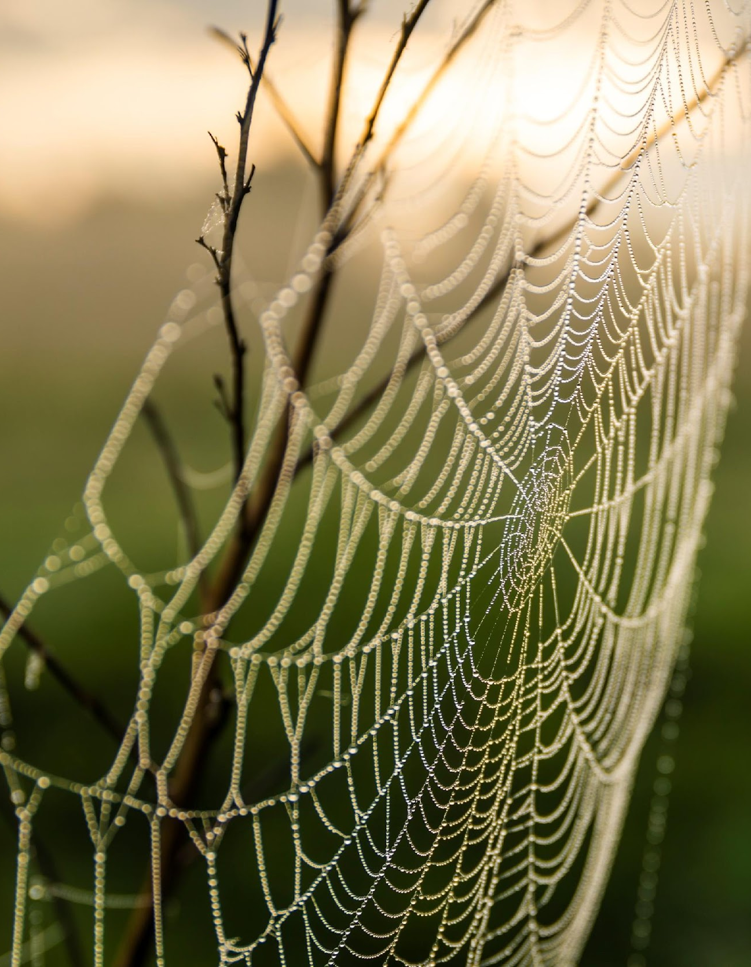
OPEN DISCUSSION
Issues, Problems, Successes, Projects, Questions, Etc.

