Slide 1

Open Access in Practice
Journal Policy Development for Library Publishing

Slide 2

Welcome!
Let us know a little about your current library publishing practices.

Slide 3
Overview of TDL Hosted Service
Started 2009 using Open Journal Systems (currently running OJS 3.3.x)
Supports Diamond OA Library Publishing
Member institutions fund the service through member fees
Collaborative service model
  TDL OJS Users Group

Slide 4
Journal Stats
12 TDL member institutions
96 hosted journals (not all actively publishing)

Slide 5
Series Description
This year-long series brings together library publishing liaisons and OJS users to explore practical strategies, share experiences, and collaborate on solutions for supporting open access journal publishing. Each session focuses on a different aspect of OA publishing, offering an open forum for discussion and peer learning.
Purpose
Foster community knowledge-sharing among libraries supporting OA publishing.
Provide actionable insights on technical, policy, and outreach challenges.
Encourage collaboration and innovation across institutions.
Support libraries in building sustainable, impactful OA programs.

Slide 6
Discussion Series Schedule
DATE | DISCUSSION TOPIC
February 5, 2026 | What does library support for OA journal publishing look like at different institutions?
April 2, 2026 | Working Together: Sharing Insights and Resources
June 3, 2026 (TCDL) | Policy Development for OJS Journal Support
August 6, 2026 | DOI registration and maintenance
October 1, 2026 | Marketing and promotion
December 3, 2026 | Communicating with inactive journals

Slide 7

Discussion Guide and Format
TCDL Discussion Format
Consists of 4 discussion points
Opening prompt via Poll Everywhere
Guiding questions provided
  Depending on number of attendees we may break into smaller discussion groups
Brief discussion in whole group to share small group insights.
Share resources and templates
Policy Development Discussion Topics
Formalizing OJS Support
Defining and Communicating Boundaries
Onboarding and Ongoing Support
Continuity, Succession, and Sunsetting
Discussion Guide available for all to follow along: https://tinyurl.com/OAdiscussion

Slide 8
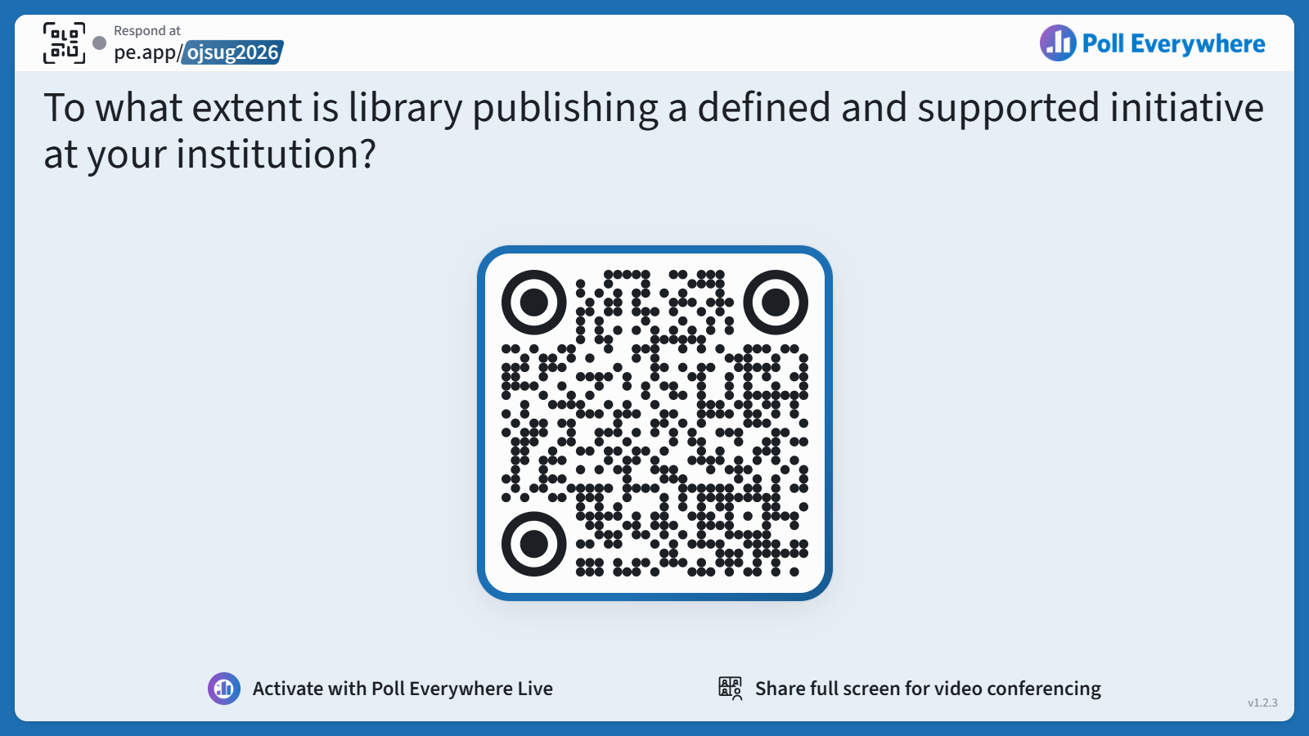
Question 1
To what extent is library publishing a defined and supported initiative at your institution?
Respond at
pe.app/ojsug2026
Notes:
One of the things we discovered early on was that library publishing looks very different from one institution to the next in terms of

Slide 9
Formalizing OJS Support
Should OJS support be explicitly written into:
  Job descriptions
  Strategic plans and goals
  Other?
If it’s already documented specifically at your institution, where is written and what roles are responsible?
  Are you able to share that documentation?
  If a dedicated position didn’t exist before and now does, how did you advocate for that?
What services/features/supports has the library committed to? (DOI, ORCiD, TDL-OJS, other?) What expectations, if any, exist for this service?
Should policies address situations where demand exceeds capacity?
Discussion Guide available for all to follow along: https://tinyurl.com/OAdiscussion

Slide 10
Available Resources for Formalizing OJS Support
Library Publishing Coalition Job Board
Maintains a list of jobs that incorporate library publishing roles. Job descriptions and postings date back to 2013.

Slide 11
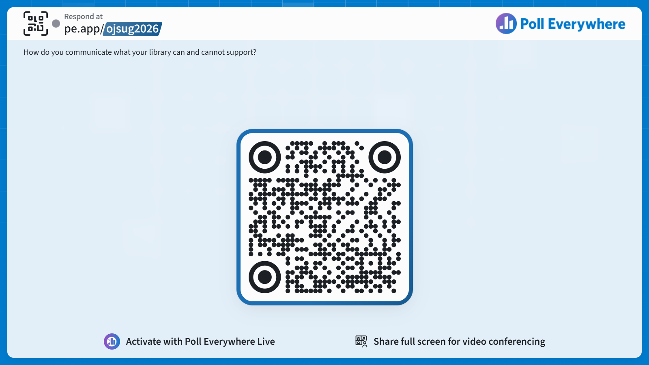
Question 2
How do you communicate what your library can and cannot support?
Respond at
pe.app/ojsug2026

Slide 12
Defining and Communicating Scope of Support
What do you find to be the most effective way to communicate service boundaries and policies?
What is the bare minimum of service features a library publishing program should provide? What features or services would be a hard no?
What minimum standards must journals be required to meet? (accessibility, open access, ethical considerations?)
  What level of responsibility does the library have for reviewing policies and enforcing standards?
  Should compliance be tied to access to services?
Discussion Guide available for all to follow along: https://tinyurl.com/OAdiscussion

Slide 13
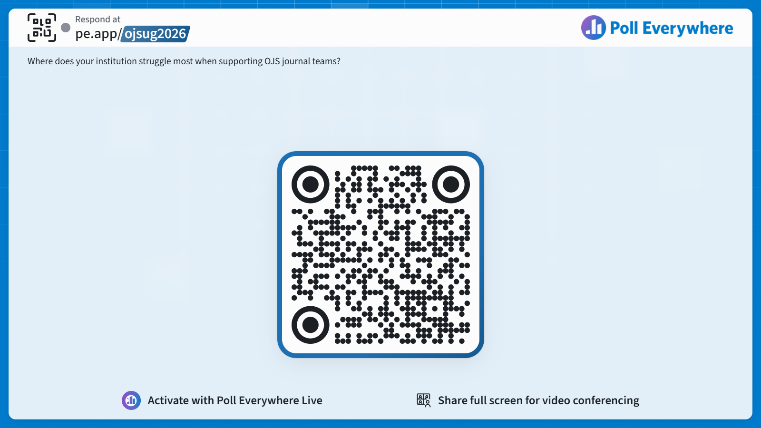
Question 3
Where does your institution struggle most when supporting OJS journal teams?
Respond at
pe.app/ojsug2026

Slide 14
Onboarding and Ongoing Support
What components should be required in onboarding (intake forms, policy drafts, kickoff meetings)?
Should library agreements require:
  Completion of training (e.g. PKP School)?
  Editorial team members and line of succession
For those who selected ongoing support and requests, what drives repeated requests?
  Could policy or more readily available documentation reduce these requests or challenges?
Does anyone have any successful local training practices to share?
Discussion Guide available for all to follow along: https://tinyurl.com/OAdiscussion
Notes:
Onboarding - might be strongest existing setup; most seem to do the same thing
New Journal Request form
Training and Re-training
PKP resources
Accessibility resources

Slide 15
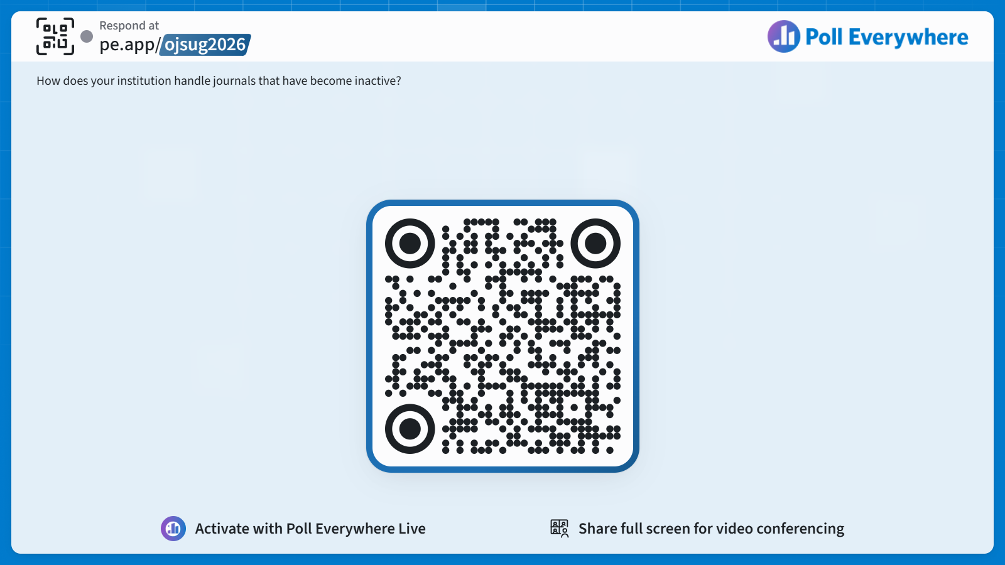
Question 4
How does your institution handle journals that have become inactive?
Respond at
pe.app/ojsug2026

Slide 16
Continuity, Succession, and Sunsetting Policies
What internal documentation does your institution maintain to ensure continuity when library staff change roles or leave?
  How might institutional memory (documentation of decisions, contacts, workflows) be maintained?
Do you have any policies in place to handle editorial turnover, faculty retirement, etc.?
Should journals be required to submit to the library:
  primary and secondary contacts?
  Succession plans
What defines an inactive journal? (TDL wiki)
Does your institution have a successful process for sunsetting journals that stop publishing?
  Preservation policies?
  Maintain DOIs?
Discussion Guide available for all to follow along: https://tinyurl.com/OAdiscussion
Notes:
Internal documentation - library policy, records for each journal, structure for annual check ins to identify current contacts and needs. Helps maintain continuity in case of library turnover.
Could be a simple email, google form, place on library website to provide this info?
Can identify journal teams that will need more upcoming support for transitions - proactive! Or provide a heads up to journals that are not active that they may lose the site?
Sunsetting - this is our biggest area of opportunity to maybe establish policy at a consortial level.
Existing policy in TDL wiki, we aren’t currently acting on this though.

Slide 17
Available Resources
Library Website & LibGuide examples
*Note: many LibGuides are available to the Springshare community to copy and use.
TXST Digital Publishing
UNT Journal Hosting
TAMU Publishing a Journal
TTU OA Journals
Thompson Rivers University Journal Hosting
Tulane Journal Hosting
University of Toronto Journal Hosting
Policies, Resources, and Templates
TDL Journal Hosting Policy
OJSUG Shared Resources
OSU Journal Policies

