Slide 1




Are We the Bots?
Yes!
Exploring Tools to Automate Digital Archiving Tasks
Texas Conference on Digital Libraries
June 2026
Notes:
[Daniella]
Hello!
We are a project team from The University of Texas at San Antonio. We would like to share our digital collections project we've titled "Are We The Bots? Exploring Tools to Automate Digital Archiving Tasks"
Our project involved figuring out how to migrate a large collection of born-digital photographs from an online digital asset management system into Special Collections preservation storage.

Slide 2
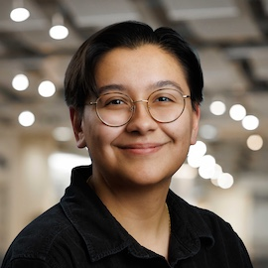
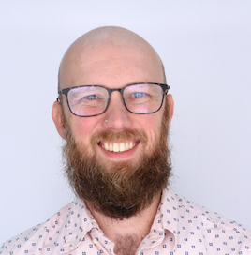
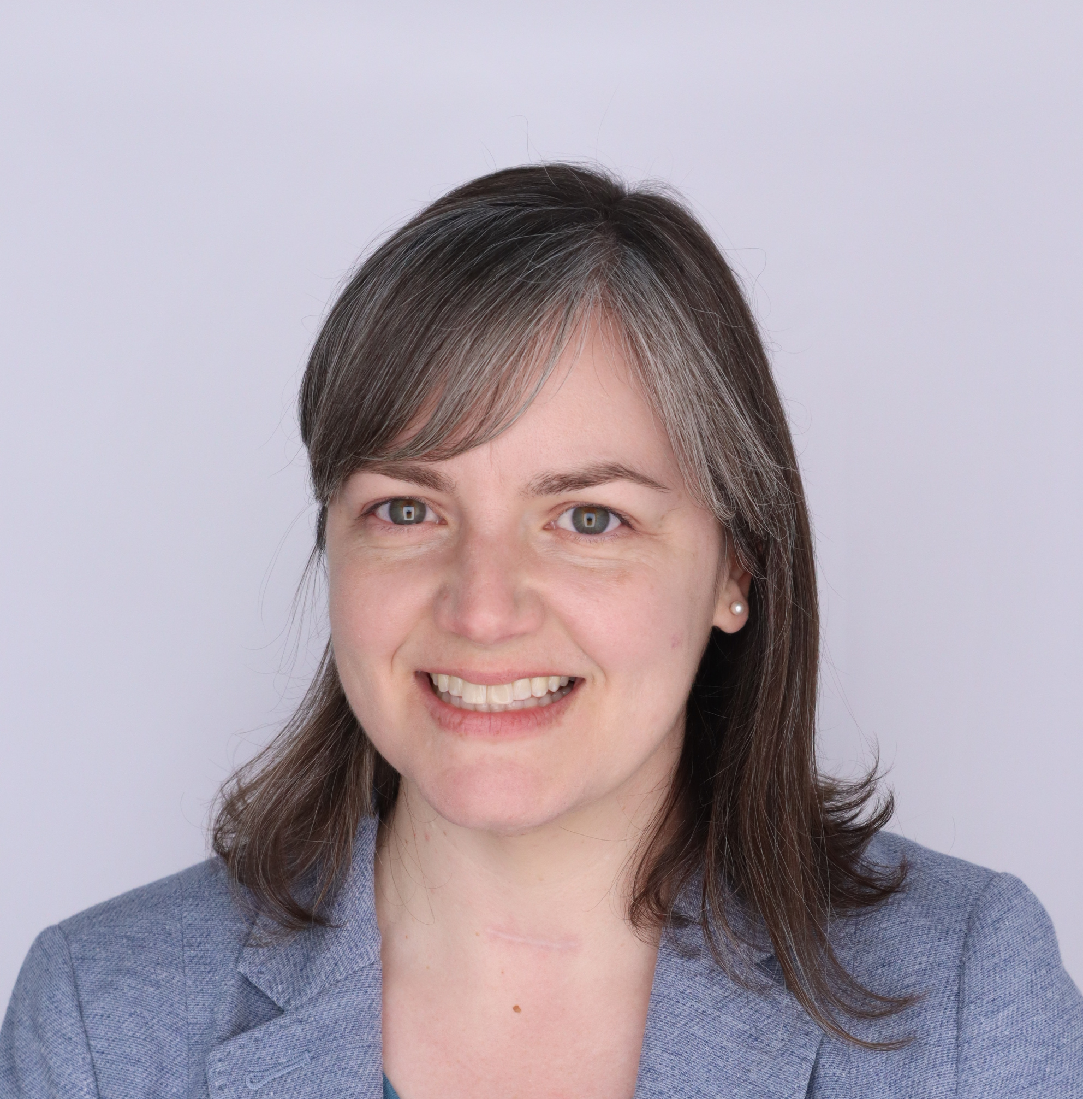
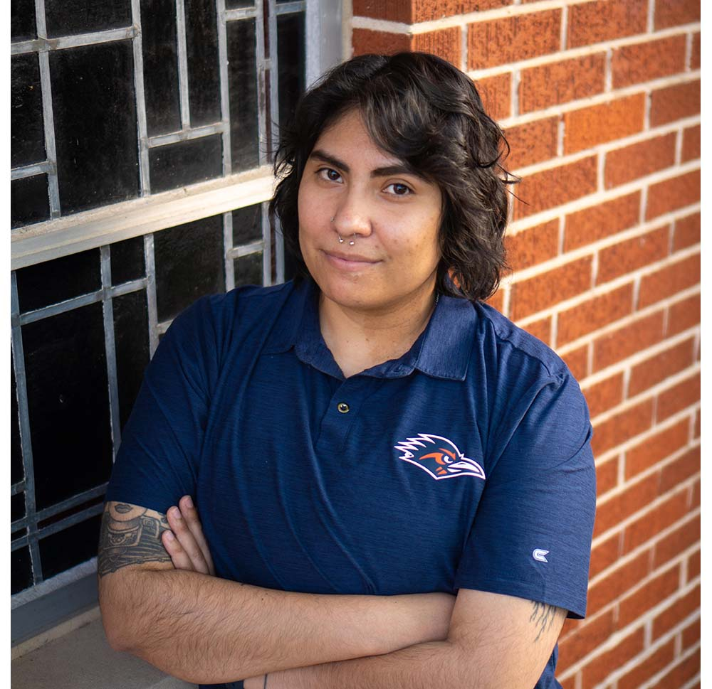
Project Team
Daniella Flores
Digital Archivist
Elliot Williams
Metadata Strategist
Kristin Law
Digital Asset Manager
Vic Rocha
Digital Collections Specialist
Notes:
[Daniella kicks off introduction]

Slide 3
Collection Background
Original collection: UA 16.01.01 The University of Texas at San Antonio. Office of University Communications Photographs, 1972-2001
University Photographer wanted to give Special Collections the archive of digital photos from 2000-2016. Over time, he gave us CDs, DVDs, and even his desktop computer.
The Mac Tower contained:
  More than 300,000 images (about 1.5TB)
  Mostly TIFFs and JPEGs (with a couple of oddballs)
  Photos were from 2000-2016
  Obsolete DAM software: Media Pro
  Photos contained tagged keyword metadata
  Pictures of academics, students, faculty, sports,
  events, groundbreakings, buildings, and more.
  Password came written on a post-it note!
Notes:
[Daniella]
So, here's some collection background.
The Office of University Communication Photographs (UComm) was originally a collection comprised of negative film photographs, dating from the 1970s to the 1990s. This collection continues to be one of the most used collections in our archival holdings. The university switched to digital photography around the year 2000.
The lead photographer, who had worked at UTSA since the 1990s, recognized that the collection of photographs he was creating was a valuable archive of university history. He connected with Special Collections to safeguard his legacy. He outlasted several generations of archivists, so he kept giving copies in different formats to whomever was the current archives team. Over the years, he gave the archives CDs, DVDs, and eventually even his desktop computer.
In 2016, he turned over his Mac Tower to Special Collections.
The Mac Tower contained:
More than 300,000 images (about 1.5TB)
Mostly TIFFs and JPEGs (with a couple of oddballs)
Photos were from 2000-2016
Obsolete Digital Asset Management System: Media Pro
Photos contained tagged keyword metadata (sometimes)
Contained a wide range of academics, students, faculty, sports, events, groundbreakings, buildings, and anything that fell under the university umbrella. {should we move this sentence to the next slide with Rowdy photos?}
Password came written on a post-it note!
We knew this was a significant collection that was worthy of the effort needed to process it. We just weren't sure what "processing" the collection would mean, yet.
Incoming photos!

Slide 4
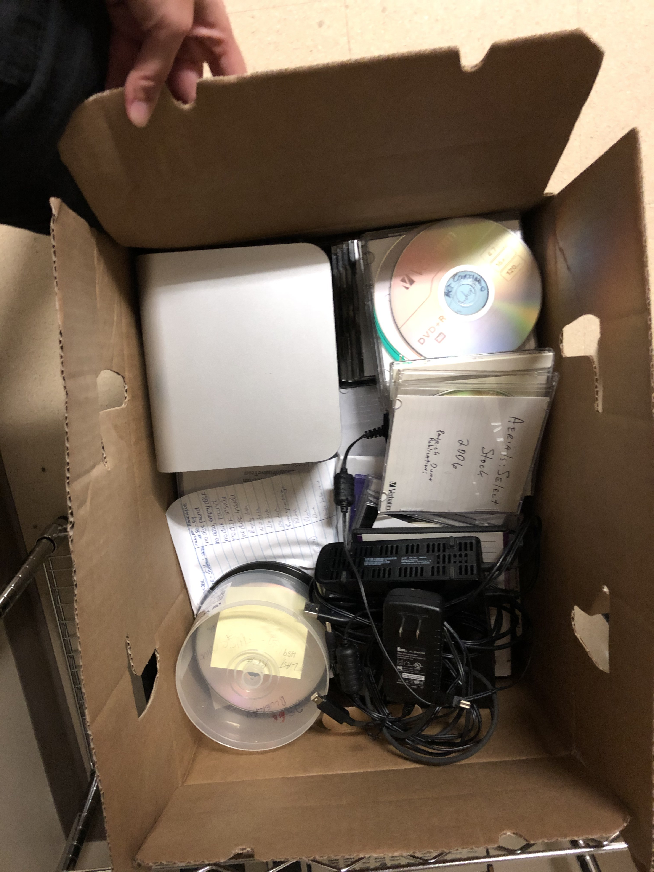
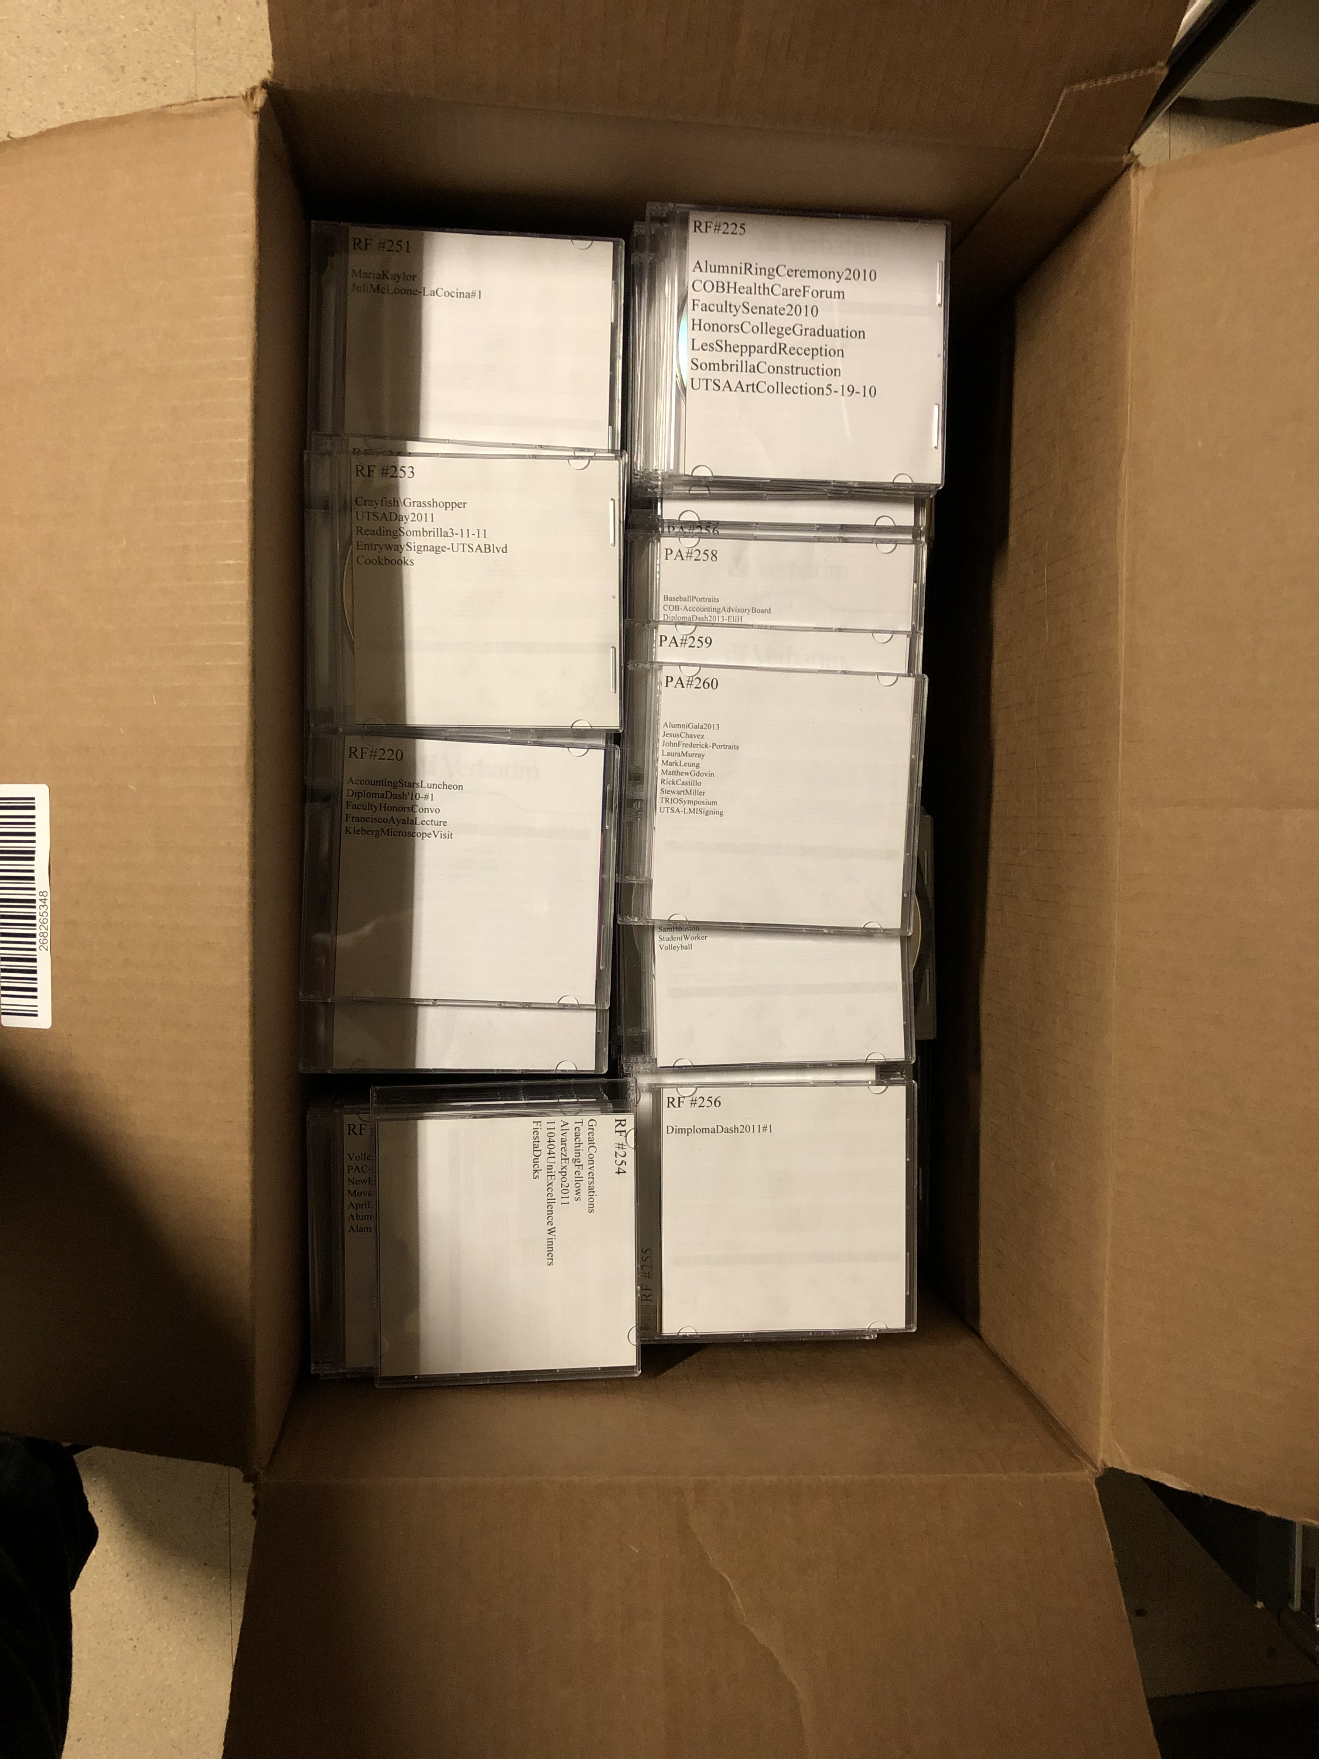
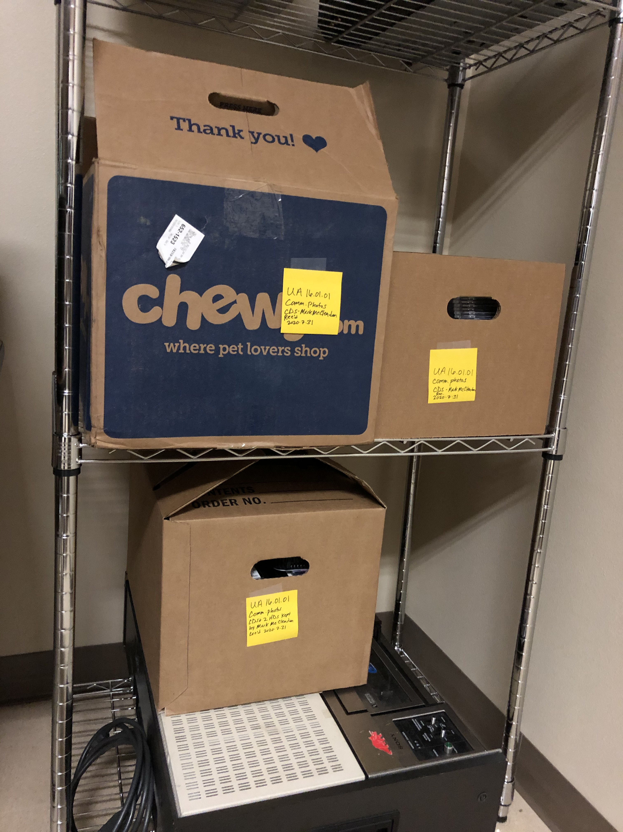
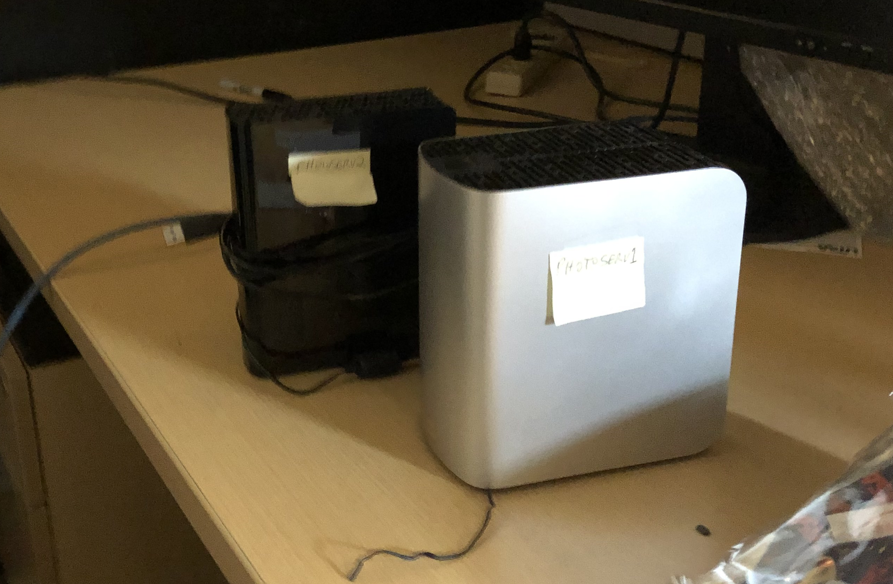
The Physical Footprint of a
Born-Digital Collection
Notes:
[Daniella] Even though this is a born-digital collection, it also possessed a massive physical footprint.

Slide 5
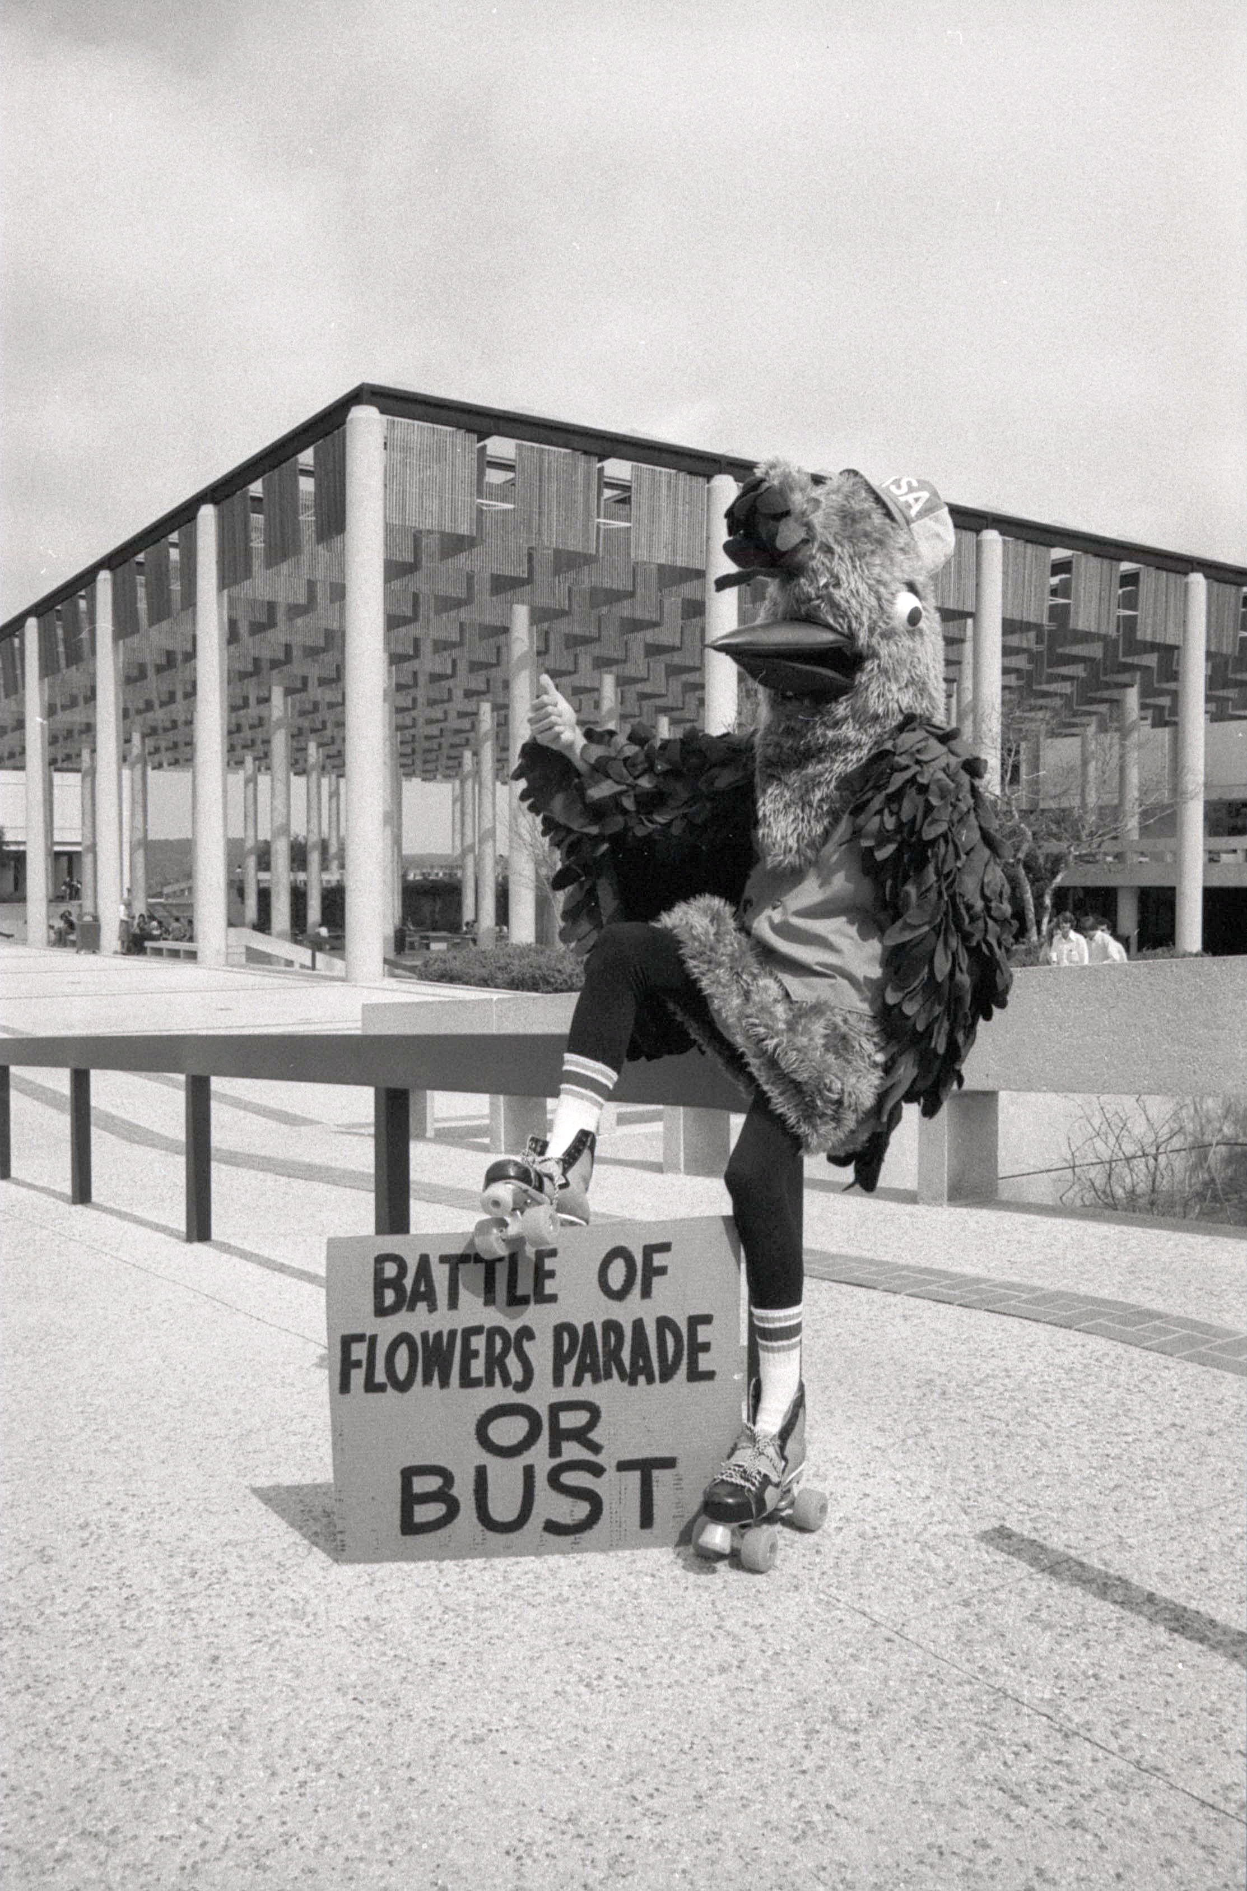
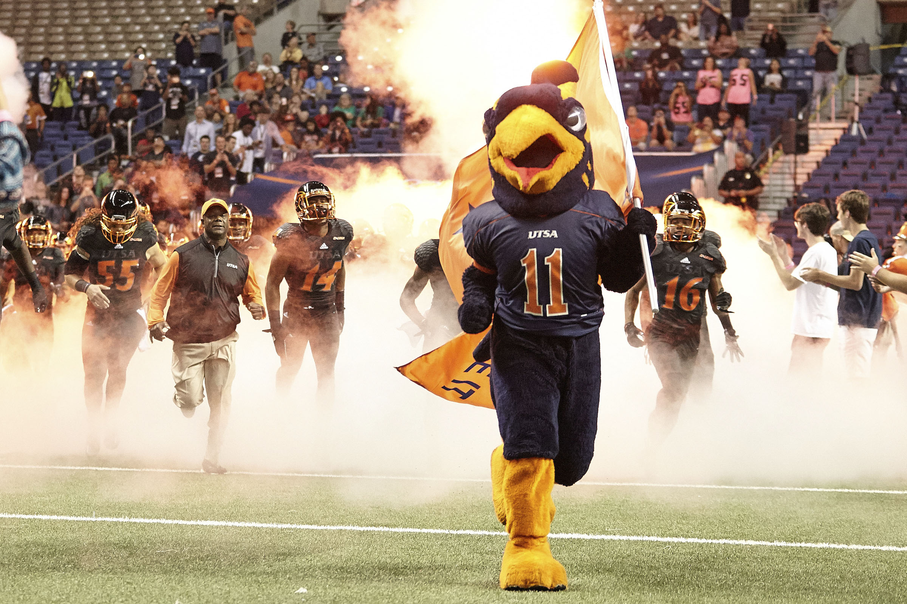
Why Does This Collection Matter?
Notes:
[Kristin]
Now that we've given details about the collection, what is the content of these photos? Why is this collection worthy of so much time, effort, and brainpower to preserve it?
Simply put, university history is most easily accessed through pictures. Current students might only ever see decades-old "throwback" photos on social media. That may be their only experience with the University Archives while they are a student.

Slide 6
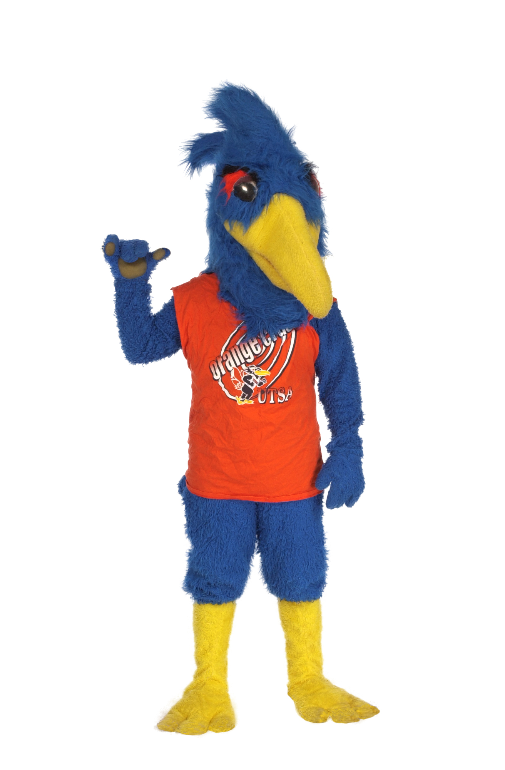
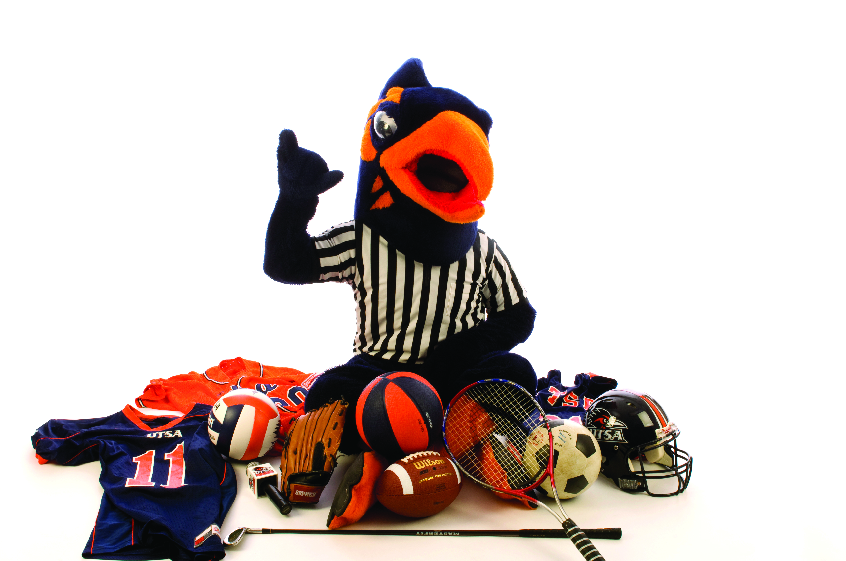
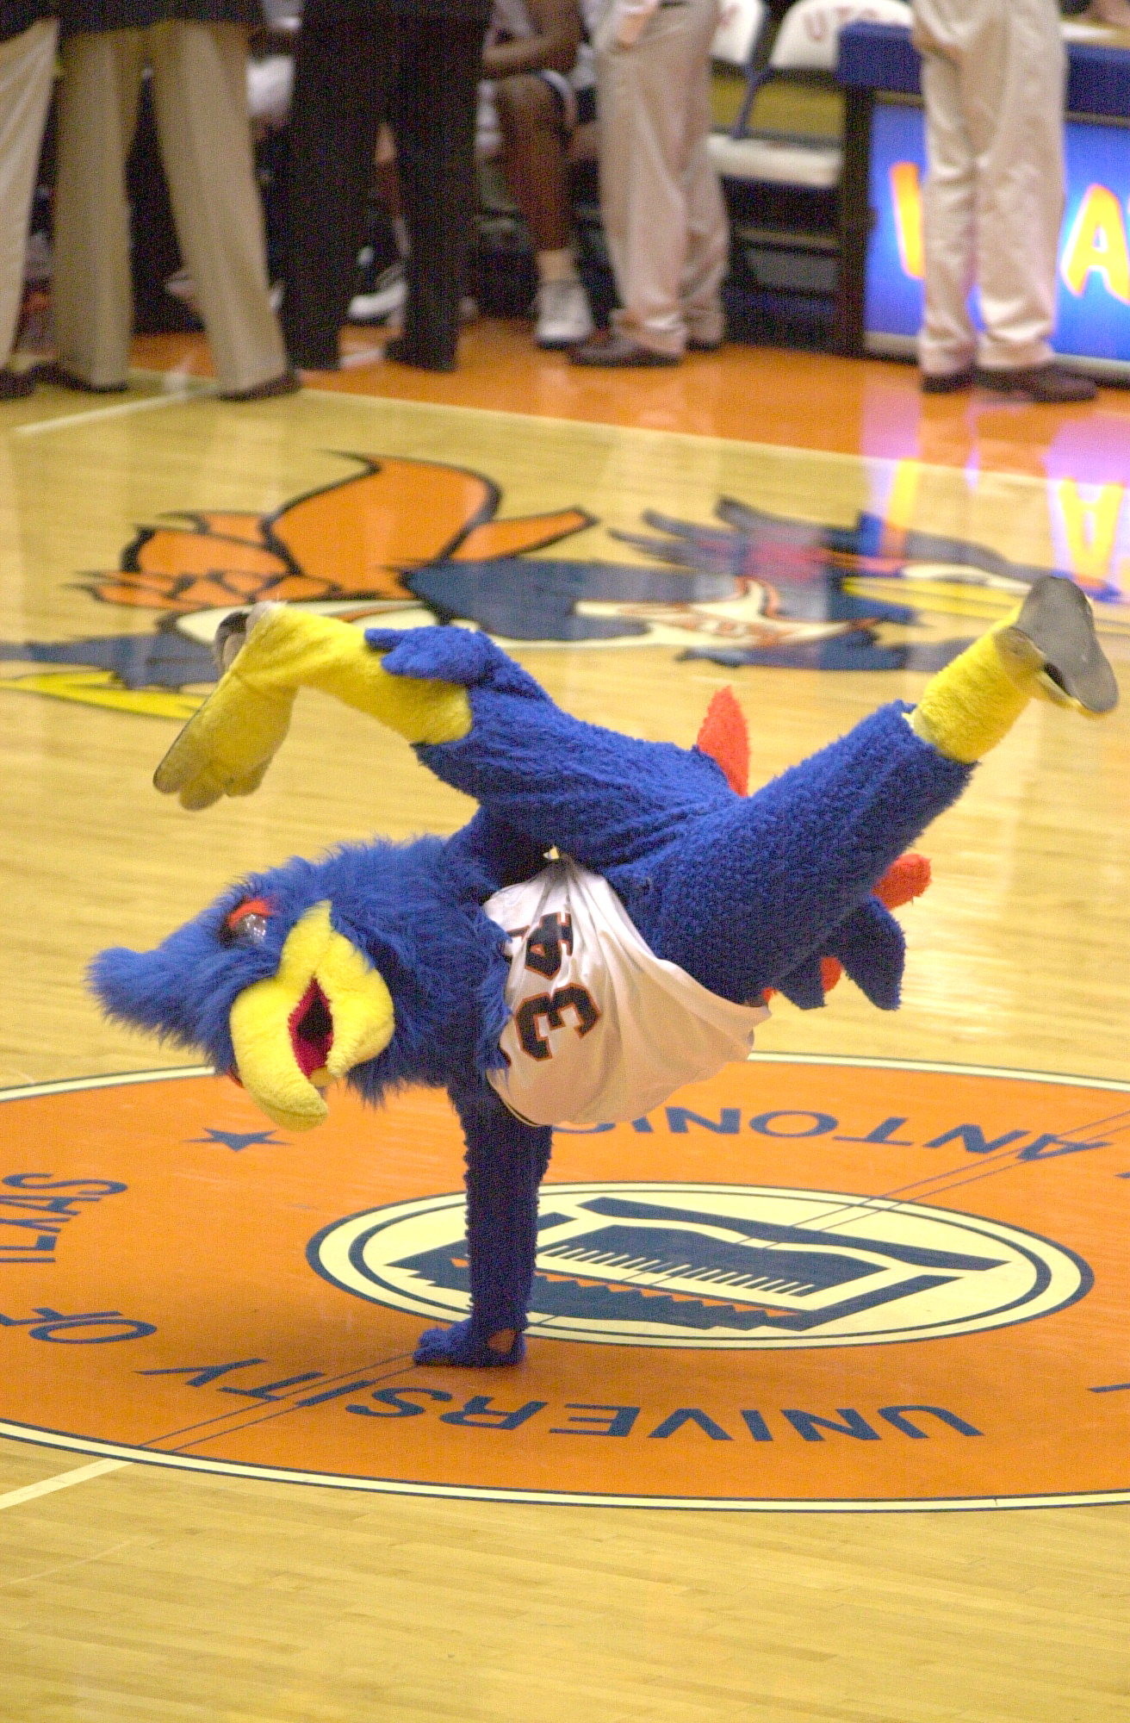
Our Mascot Through the Years
Notes:
[Kristin]
As we said, these photos cover a broad range of university life. Here we are sharing a handful of photos of Rowdy, our roadrunner mascot, showing how the mascot has evolved over the years.

Slide 7
Goals
Complete transfer of the digital photo archive taken by UT San Antonio's official photographers into UTSA Libraries Special Collections.
Special Collections
  Access to the most complete copy of images, metadata, and relevant structure
  Long-term preservation of photographs through Special Collections’ preservation workflow
University Marketing
  Can focus on managing active (current) assets
Notes:
[Kristin]
Our project team includes staff from Special Collections, and from University Marketing (the department that the University Photographer is now part of). We had the shared goal of wanting the complete transfer of the digital photo archive taken by UTSA's official photographers into UTSA Libraries Special Collections.
We also had our own motivations: Daniella wanted to provide access to the most complete copy of the collection—including images, metadata, and relevant structure. She wanted the collection to be processed through Special Collections' preservation workflow to ensure long-term preservation.
Kristin from University Marketing wanted to be able to focus our resources on managing current, active assets, and not having to worry about taking care of the archive, also.

Slide 8
Problems
Duplicates (Copies and copies oh my!)
  CDs
  DVDs
  His old Mac Tower desktop computer, which came with a DAM database (Media Pro)
Preservation
  Which copy was complete?
  Could the metadata from Media Pro be captured and exported?
Access
  As of 2016, access only possible on one computer, in the Special Collections Digitization Lab, under the supervision of an archivist
Notes:
[Kristin]
Now that we've shared about the contents of the collection, we would like to talk about some of the problems that we encountered as we dug into the project.
Duplicates
Preservation
Which copy was complete? How could we migrate the content through a digital preservation workflow?
Could the metadata from Media Pro be captured and exported?
Access
Access was also an issue. Since he gave the MacTower to the archives in 2016, access was only possible on one computer, in the Special Collections Digitization Lab, under the supervision of an archivist. We also knew that having one copy, on an aging desktop computer, wasn't a sustainable solution.

Slide 9
Early Exploration
In 2016, graduate student Helen Stevens-Martin completed a practicum project exploring the collection on the Mac Tower and in MediaPro.
In 2020, Kristin became the Digital Asset Manager (part of University Marketing and Communications) after working as the University Archivist since 2015.
  Discovered that the current cloud-based DAM platform (PhotoShelter) was acquired in early 2016 and included a collected titled "Archive (do not alter this folder)".
  Spot checked the PhotoShelter copy with Helen's directory print from the Mac Tower. Everything matched.
  Requested an API key from Photoshelter and started using Curl to
  access the API with simple requests.
Notes:
[Kristin]
In 2016, Special Collections hosted a graduate student, Helen Stevens-Martin, who completed a practicum project. She did an extensive exploration of the collection and of MediaPro. Her work laid a foundation for our project.
In 2020, I became the Digital Asset Manager (part of University Marketing and Communications) after working as the University Archivist since 2015.
I discovered that the current cloud-based DAM platform (PhotoShelter) was acquired in early 2016 and included a collection titled "Archive (do not alter this folder"). I spoke with the newly-retired university photographer and verified that this was indeed a copy of the archive, duplicating what he had given to Special Collections via his Mac Tower.
I spot checked the PhotoShelter copy with a directory print/inventory of the Mac Tower that Helen had made. Everything matched, including the structure of the folders and the folder/path names.
I learned that PhotoShelter had their own API, and I started to wonder if that could be a tool we could utilize to migrate the archive. In Summer 2020, I requested an API key from Photoshelter. PhotoShelter didn't ask any questions. I started using curl (command line utility) to access the API with simple requests. I could successfully use the API enough to believe a batch export was possible, but I quickly hit the limit of my scripting skills.

Slide 10

So Many Copies
In 2023, Daniella and Vic joined Special Collections and realized how many duplicates the collection had.
We worked on an extensive de-duplication project to verify that the CDs/DVDs, Mac Tower/Media Pro, and hard drives all held the same content that was in PhotoShelter.
We wanted to keep only the best and most complete copy
Notes:
[Daniella]
In 2023, Daniella and Vic joined Special Collections and realized how many duplicates the collection had.
We worked on an extensive de-duplication project to verify that the CDs/DVDs, Mac Tower/Media Pro, and hard drives all held the same content that was in PhotoShelter.
We wanted to keep only the best and most complete copy of this collection. We identified PhotoShelter as the best copy and were able to dispose of the duplicates.
--[Extra Info, DO NOT READ]--
In 2023, Daniella and Vic joined Special Collections. To make more space in the Digitization Lab, Daniella began to investigate if it would be possible to deaccession/discard the MacTower and the boxes and boxes of CDs/DVDs.
In Spring 2024, Vic and Daniella worked with Kristin to complete a CD Verification project, cross-checking the CDs in boxes with what was held in the "Archive" collection in PhotoShelter. The hope was that if the contents matched, the CDs/DVDs could be tossed.
We had around 500 CDs we had to rehouse into standard linear foot boxes, then we developed a spot-check workflow. We figured that if we spot checked around 25% of all CDs and DVDs, and we found that a majority of them were duplicates, then we would be in the clear to dispose of them. Spot checking for us meant running a CD, checking all (or at max 5) of its directories, looking up the file names in PhotoShelter, and seeing the photos matched up. We keep an inventory of the media we spot-checked in a excel sheet. We found that most photographs on the CDs were complete duplicates of what was in PhotoShelter.
We also spot checked the hard drives and were able to determine that out of the 2 hard drives that were functional, they were complete duplicates of what was in PhotoShelter.
Transferring the photograph archive off of the Mac Tower was a complete nightmare (it ran on Mac OS 10.6 AKA Snow Leopard), but once we were able to get the 2 TB of materials off of it onto a modern hard drive, we found that the Tower was just a copy of everything from PhotoShelter.

Slide 11
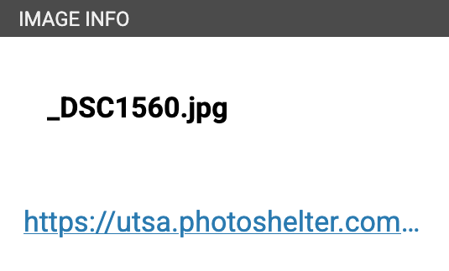
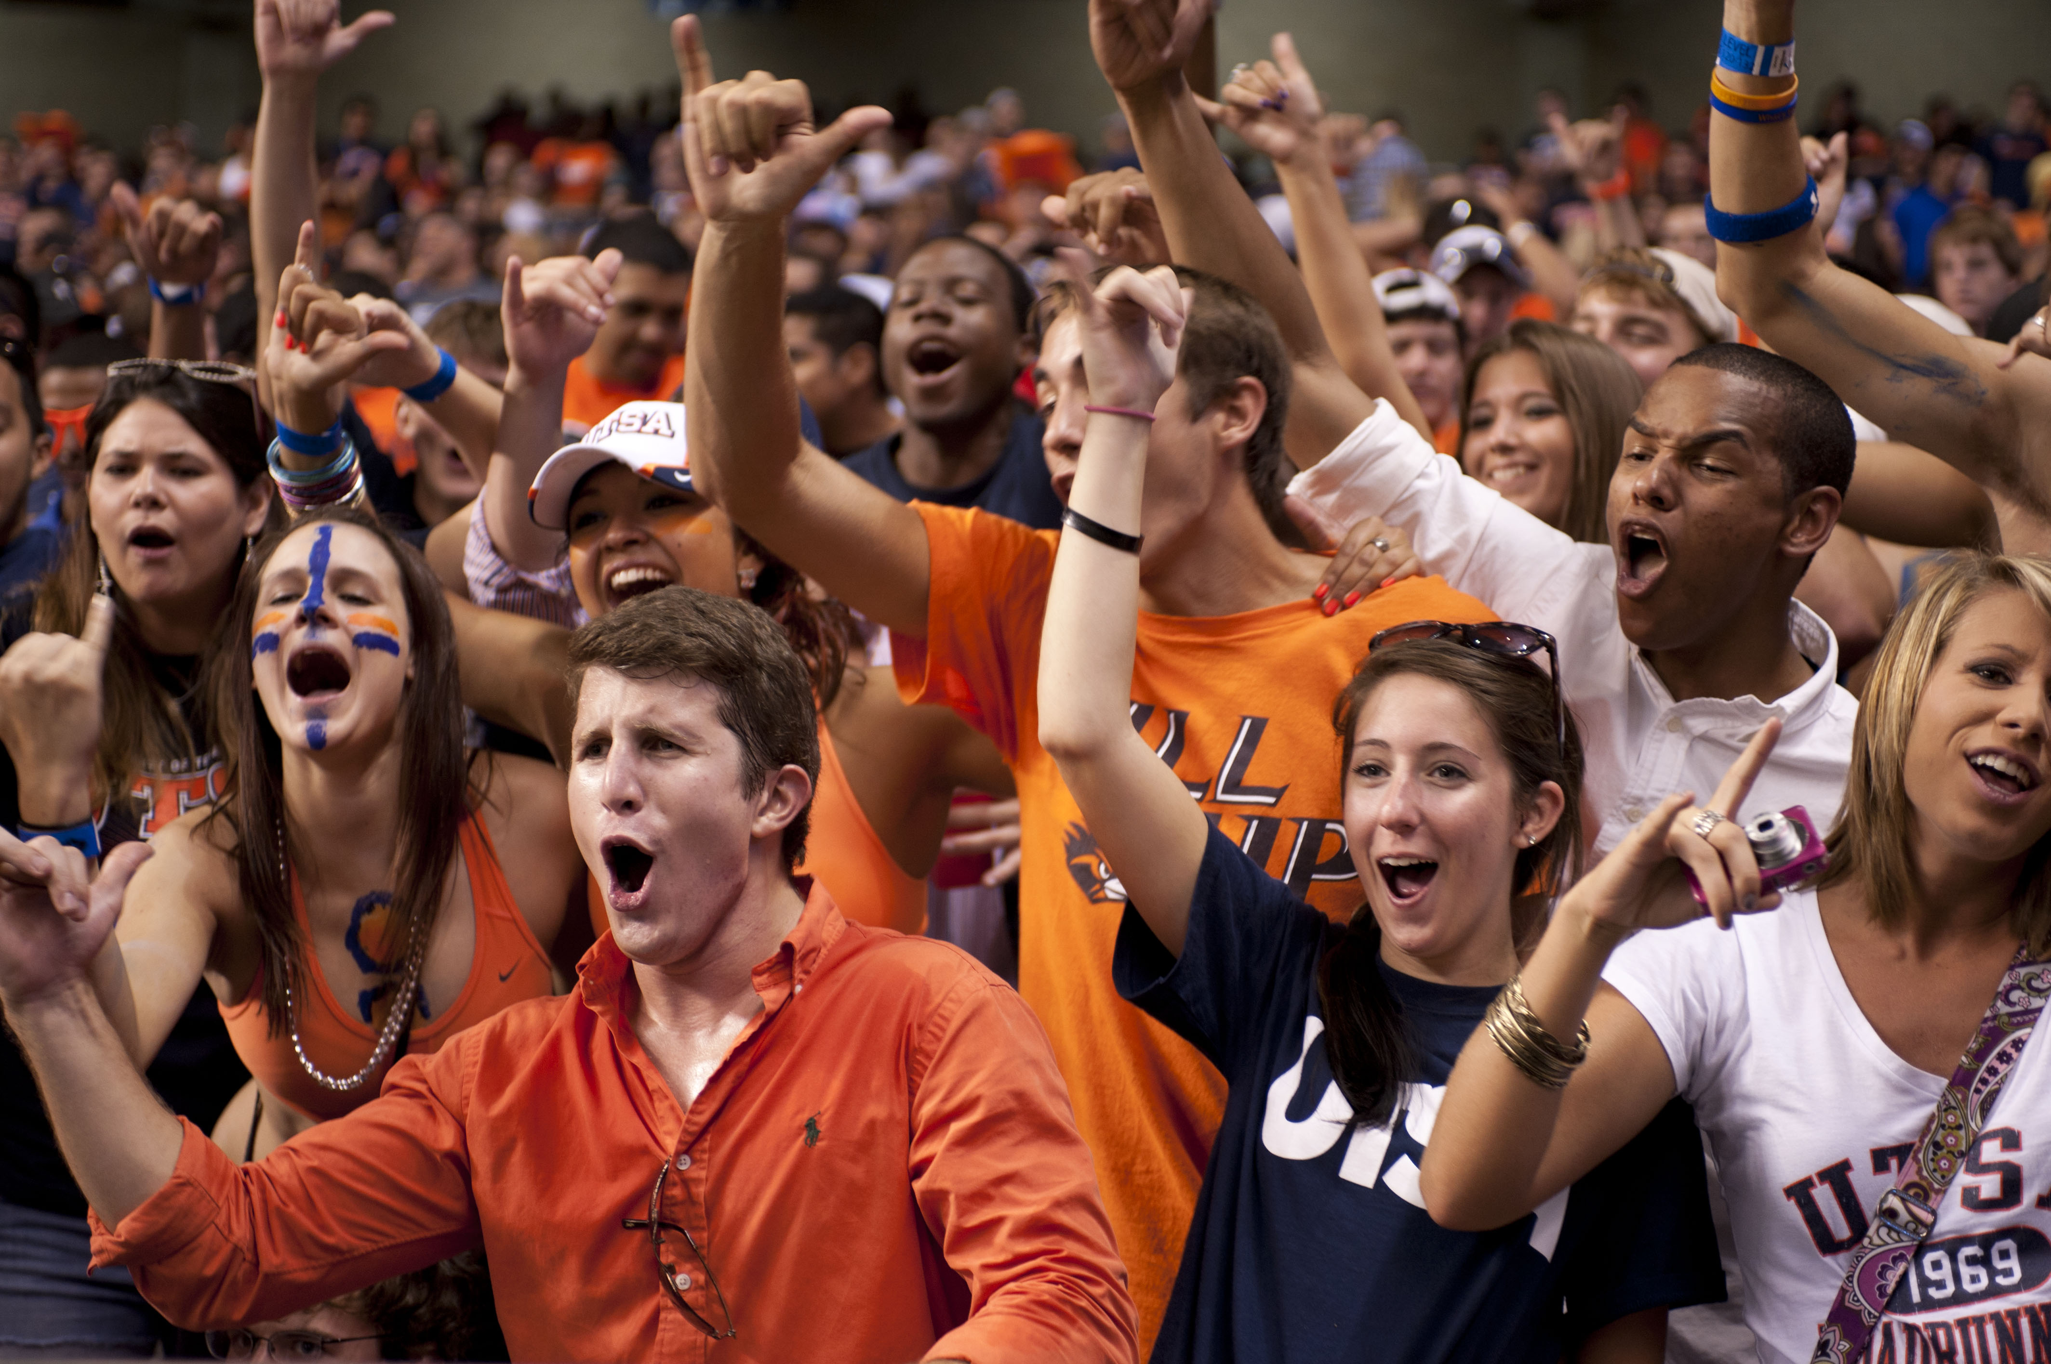
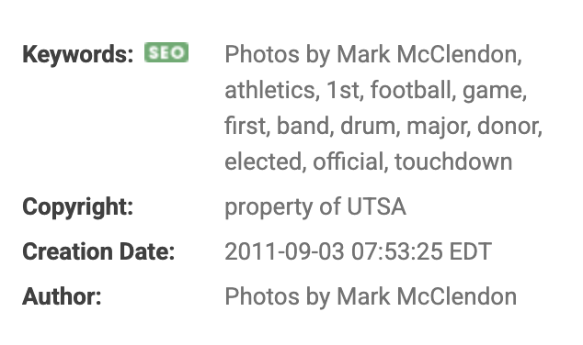

Metadata
/Volumes/library_data/UA 16.01.01/Archive/Disk-212-236/PA#235/1stFootballGame/_DSC1560.jpg
Notes:
[Kristin]
In figuring out how to migrate this collection out of PhotoShelter, we knew we needed to keep the photos, metadata, and the collection structure. The metadata—when it exists—is mostly keywords, creation date, and the photographer's name. It exists embedded in the photos or in the DAM database. The collection structure (the filepath to each gallery) often includes important names or other contextual information that doesn't exist at the file level.
You can see in the screenshots above how this information is presented in PhotoShelter. You can also see how this image has a generic filename, but there is some contextual information in the keywords and the name of the gallery. You can also see that the gallery name/path is the same as it appears in the directory print.

Slide 12

Project Team Formation
By the fall of 2024, Daniella and Kristin were interested in pursuing this project. They convened a team with different areas of expertise and institutional knowledge.
Daniella
  Was familiar with the collection
  Wanted to de-accession the CDs/DVDs/Mac Tower
Kristin
  Wanted to jettison the archive from PhotoShelter
Elliot
  Worked extensively with digital collections
  Had experience with APIs and scripting
Vic
  Worked on the CD de-dupe project, so was very familiar with the collection
Notes:
[Kristin]
By the fall of 2024, Daniella and Kristin were interested in pursuing this project. We formed a team with different areas of expertise and institutional knowledge.
Daniella was familiar with the collection and wanted to de-accession the CDs/DVDs/MacTower.
Kristin wanted to jettison the archive from PhotoShelter so there would be more space for the active collection.
Vic had worked on the CD de-dupe project, so was very familiar with the collection.
In addition to the three of us who had been working with the collection, we asked Elliot to join us. This was critical, because not only did he have experience with digital collections, he actually had worked with scripting and using APIs!

Slide 13

Collection Structure in PhotoShelter
Within PhotoShelter, the images was organized into "collections" and "galleries". Galleries contain the image files themselves.
PhotoShelter has robust APIs that would let us download the images and metadata – but they have to be run on individual galleries
First idea: Use OpenRefine & the PhotoShelter API to download metadata. This would be a fairly manual process
Then we discovered that there were 12,612 galleries... 😱
Notes:
[Elliot]
Once we had our team in place and knew what our goal was, we started really investigating PhotoShelter and thinking about tools that we could use.
As Kristin mentioned, PhotoShelter has a fairly robust suite of APIs that we could use to download the images and all of the metadata associated with those images. The challenge, though, was that the API endpoints for downloading media have to be run on individual galleries – which are the lowest level of the collection hierarchy, which can be many levels deep. And when we started this project, we didn’t know how many galleries there actually were in the collection.
Being a metadata librarian, my first instinct in most situations is to use OpenRefine to solve problems. So I started testing a process to use OpenRefine to interact with the PhotoShelter API and manipulate the metadata. It worked pretty well, but would require a fair amount of manual work for each gallery, and also wouldn't handle actually downloading the images.
[click!]
Then… I mapped out the whole collection structure in PhotoShelter and discovered that there were over twelve thousand galleries. So all of a sudden, doing that manual OpenRefine process on each gallery no longer seemed like a viable option.

Slide 14

Tool Development and Testing
Pivoted to a Python script – easier to run on a large number of galleries, could design it to do multiple pieces of the workflow (download images, get metadata, format metadata, etc.)
Elliot had some experience with Python, but mostly small scripts for personal use. Had to learn how to write a script that was efficient and reusable.
  Things like logging, reducing the number of API calls, code structure & style
Meanwhile, Vic was learning Python/OpenRefine
Notes:
[Elliot]
We pivoted towards creating a python script to download and manipulate the images and metadata. A python script could be easily run on a large number of galleries at a time (saving us from that extensive manual work), and it could string together multiple API calls and other operations, to complete multiple pieces of the workflow.
Before this project, I had some experience writing simple python scripts, including ones that interact with APIs (shoutout to the DPLA API, the first API I ever worked with). But it was mostly for personal hobby projects or fairly short one-off scripts. I’d never attempted something this complex before, or something that was intended to be reusable by multiple people. So the process of writing this script, for me, included a lot of learning how to write code that was efficient and reusable, especially things like logging errors, reducing the number of API calls, and documenting the code extensively.
Throughout the process, we thought a lot about how to make this an accessible workflow for other projects and other people in the future.
[Vic]
I was essentially new to all things Python and OpenRefine! It was daunting, but Kristin and Elliot assured me there was a plethora of resources geared for total beginners. I started out experimenting with OpenRefine, learning how to do simple tasks like cleaning and manipulating metadata. I then moved to resources that touched on using APIs with OpenRefine for downloading metadata.
When we decided to use a Python script for the project, I started searching for resources like YouTube videos, LinkedIn courses, and tutorials. I settled on a Python LinkedIn course as a starting point and relied on the available documentation on the Python website. My goal was to at least know the basics in the structure of a script, how to navigate a CLI in general, and write out what specific steps I'd take to get the whole downloading workflow up and running.
When we saw how much of the downloading process could be automated with a Python script, it became clear this wouldn't be something I could do on my regular work laptop, which is a Windows machine. I'd need a separate workstation where I could monitor the downloads as they ran uninterrupted. This ended up being a Mac machine we had in the office that wasn't being used at the time... which meant I'd need to work out what would be different between the two environments.

Slide 15
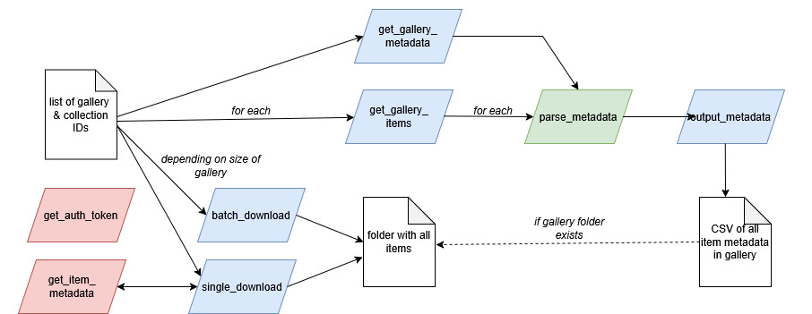
Python Script Diagram
Notes:
[Elliot]
This diagram shows the overall flow of how the script works. It's part of our local documentation about the whole process – again, thinking about how to make this script understandable and usable by people who aren't part of this team right now.
When you run the script, you give it a list of gallery IDs and their corresponding collection IDs. For each gallery in that list, the script first downloads the images. Then it gets the metadata about the gallery itself and the metadata for each item in that gallery, and then parses that metadata to extract the elements we wanted to include. Finally, it zips up all of the image files and a metadata CSV into a zip file, and also saves a copy of the metadata CSV outside of the zip file, as well, to be used for searching the collection.

Slide 16

Running the Project
Prep work: Putting the python script, credentials, and a CSV file with a list of gallery IDs for a batch all in one place
Determine the acceptable size of the batch
Creating the batch list road map
Monitoring the downloads, spot checking, and confirming numbers
Reviewing error logs and re-doing problem galleries
Combining metadata CSV sheets into one master metadata sheet using OpenRefine
Notes:
[Vic]
By the time Elliot’s script was ready, I'd learned enough of the technical basics like how to understand the general structure of a Python script, what I'd be writing in the Mac Terminal, and designating where I wanted the galleries and metadata saved to on the computer.
Now that I could understand what the script was doing, I started on the prep work for actually running this portion of the project. Prep work, in this case, just consisted of making sure the python script, a text file with the PhotoShelter API credentials, and a CSV file with the list of galleries and collections to be downloaded were all located in the same folder. In doing that, I'd then be able to point to this folder from the Mac Terminal and just watch it do its thing.
My next step was to determine the size of the batches. Using the map Elliot made of the collection structure, I copy/pasted a batch of 50 galleries to put in the CSV. Those 50 galleries downloaded pretty quickly, so I started to increase the number to 100, then 200... After we identified initial script hiccups, the number of galleries was close to about 300-400 galleries in a batch. Once I got to this final amount, I was able to make a batch list road map from the collection map. This made it easy for me to just copy/paste the gallery IDs into the CSV file, making it a pretty streamlined process.
Once I got into the flow of getting these batches and metadata downloaded, most of the time was spent keeping an eye out for any errors, excessively long download times, spot checking recently downloaded galleries and their metadata sheets, and confirming the correct number of galleries and images were where they were supposed to be.
When completing all the batches I had laid out in my road map, I reviewed any error logs I couldn't initially fix and re-downloaded any problem galleries.
After two rounds of quality checks to confirm everything was accounted for, I combined the metadata CSV sheets from each gallery into one master sheet using OpenRefine.

Slide 17
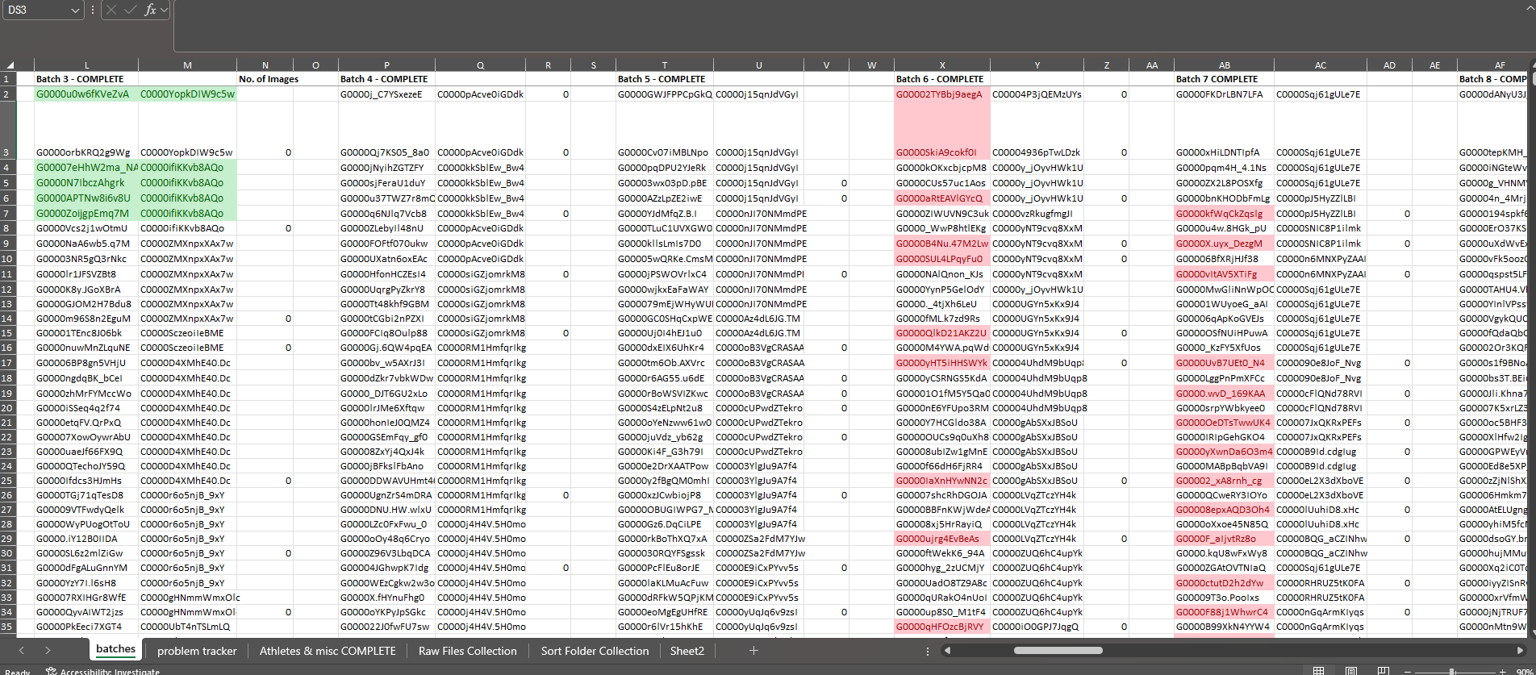
Controlled Chaos
Notes:
[Vic] A small glimpse into the batch list road map I used.

Slide 18

Issues Encountered
PhotoShelter error - are we the bots?
Incomplete metadata CSVs
Missing file extensions and using ExifTool to correct it
Failed downloads
Notes:
[Kristin]
While Vic was running the script and downloading thousands of images each day, something funny happened. An unrelated staff user let me know her PhotoShelter account wasn’t working. I spoke to the vendor, and they said “there had been a lot of bot traffic recently, so they were tightening security.” They fixed the issue for the user, but the conversation scared me and led me to ask my project colleagues: “are we the bots? Were our bulk downloads getting flagged in PhotoShelter’s system? Were we going to get in trouble?” We talked amongst ourselves and determined that no, what we were doing was fair and shouldn’t raise any red flags at the vendor. The timing was just a coincidence. We had a good laugh and a good conversation about automation, and scripting, and what is a bot anyway, which eventually led to our presentation title.
[Vic]
For galleries with >500 images, the metadata CSV would only include the first 500 rows of metadata. Elliot found the API was only making a single call for the metadata, which meant it would only get metadata for the first 500 items per page of results in PhotoShelter. Adjusting the python script fixed this, along with creating an option to download the metadata only for a gallery.
Some images ended up downloading without file extensions, and Kristin showed me how to use ExifTool to identify the original file types to correct it
I was finding that galleries with only one image would fail to download. Elliot determined this was because if a gallery only had a single image, it would not get packaged into a zip file. The Python script was written to download a zip file of the gallery and didn't know what to do when it came unzipped, so it would automatically fail.
In the end: These challenges (aside from our "bot" mishap) were overcome by a combination of trial and error, Python script rewrites and additions, and relying on one another for the unique experiences and knowledge we all brought to the project!

Slide 19

Preservation Workflow
Long-term digital preservation of the transferred materials
Tested a reference workflow
  Used two real world reference requests
  We searched in the "archive" in PhotoShelter and in the metadata
  worksheet now in Special Collections
  Our results matched and were executed in an equivalent amount of time
Once these tasks were done, the project was complete.
Notes:
[Vic]
After wrapping up quality checks and taking care of any problem areas, I began the process of transferring this material to our local drive, where the next step would be for me to prepare to send a copy of the material to long term storage (Chronopolis).
We also tested the reference workflow to make sure that searching the metadata worksheet would work for finding specific images in the collection. Kristin gave Vic two specific requests from university staff asking for photos from the “archive”. Both Kristin and Vic looked for the photos – in the “archive” still in PhotoShelter, and in the metadata spreadsheet. We were relieved to see that both methods had similar results in a comparable length of time.
Once these tasks were done, we felt like the project was complete.

Slide 20

Moving Forward
Found joy as we completed a 10-year project!
Repeating this in the future for the next generation of born-digital photographs
Using our new skills on other projects!
  Daniella and Vic are thinking about python for other digital archives projects and photograph collections
  Vic is understanding GitHub scripts for other projects
  Kristin has already used OpenRefine/API for capturing metadata
  from PhotoShelter for other collections
  Elliot is using his python skills for other cataloging projects
Notes:
[Vic]
Perhaps most significantly, we found joy in completing a project that we have been thinking about for TEN YEARS!
We are thinking about how our workflow can be repeated for future generations of born-digital photographs.
Each of us is also using the skills that we built for this project on our other projects: openrefine, APIs, scripting, python, github.
For example: Vic has been able to use their very basic Python knowledge to interact with GitHub scripts for other projects with more confidence! Even though I might not always understand the more complex scripts, I at least have enough knowledge to know what's confusing me and what questions to start asking.

Slide 21
Appendix: Tools Used
Tools used
Python
OpenRefine
PhotoShelter API
Postman
EXIFTool
Excel
Learning resources
Python for New Programmers
Cleaning Data with OpenRefine
OpenRefine user manual
Real Python
Getting Started with Python in VS Code
PhotoShelter API v4 Documentation
Notes:
Here is a list of tools and resources we used for this project!
Thank you!

