Slide 1
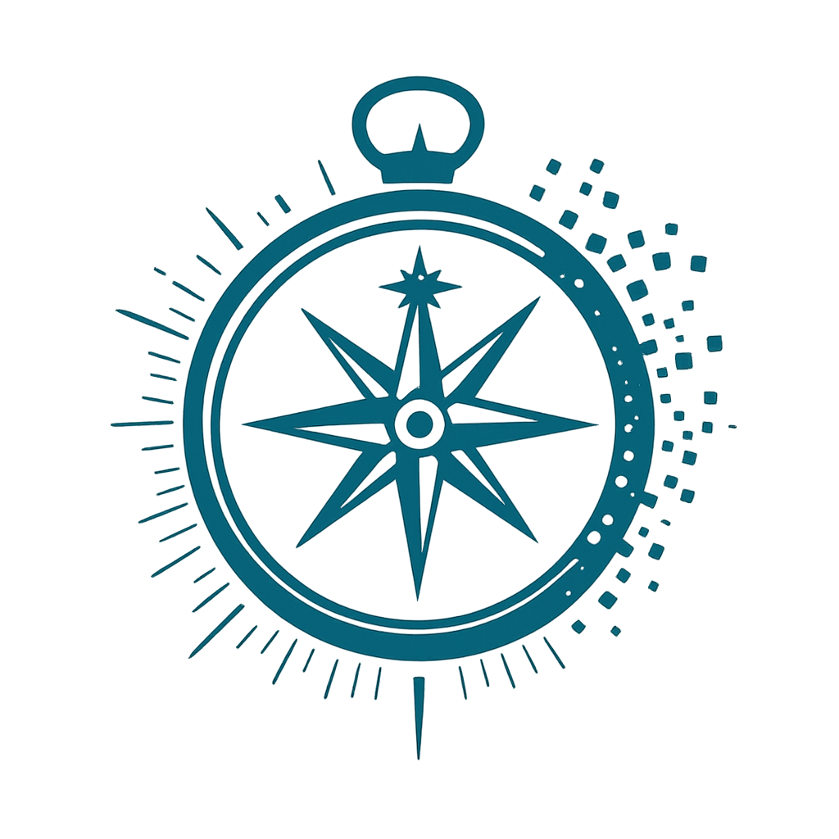

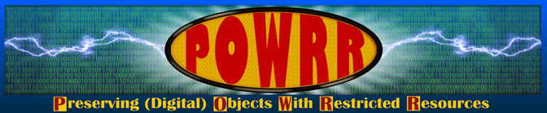
NAVIGATING UNCERTAINTY TOGETHER:
A DIGITAL POWRR REFLECTION WORKSHOP FOR DIGITAL PRESERVATION PRACTICE
Texas Conference on Digital Libraries - June 2, 2026
Stacey Jones (Co-Lead, Digital POWRR & Digital Preservation Librarian, University of Arizona)

Slide 2

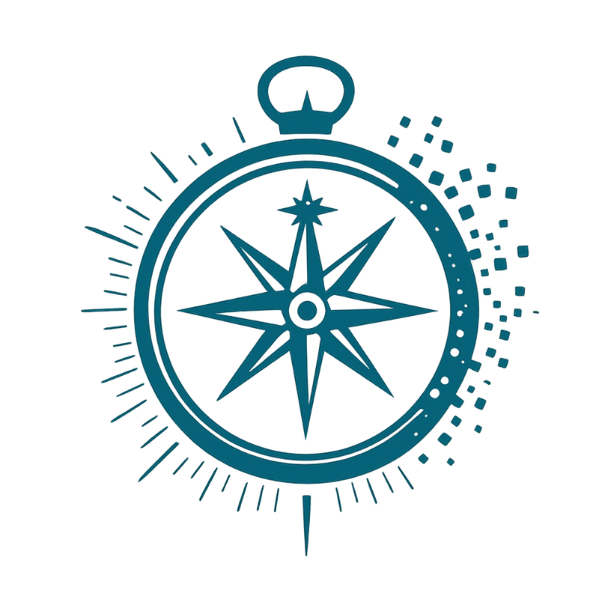
  A brief introduction to the Navigating Uncertainty framework
  Individual reflection using the framework
  Paired conversation and shared discussion
  Interactive activities with sticky notes / wall mapping
  Space to reflect on what sustains digital stewardship work
Welcome &
What to Expect Today

Slide 3

Community Agreements
  Share only what feels comfortable
  You are always welcome to pass
  Listen for resonance, not comparison
  No expectation to “solve” one another’s challenges
  Speak from your own experience
  Honor confidentiality in the room
  Be gentle with yourself and others

Slide 4
Introductions
Please share:
  Your name
  Your preferred pronouns
  Your role/title
  Your institution
About me:
  Stacey Jones, she/her
  Co-Lead of Digital POWRR
  Digital Preservation Librarian @ University of Arizona

Slide 5

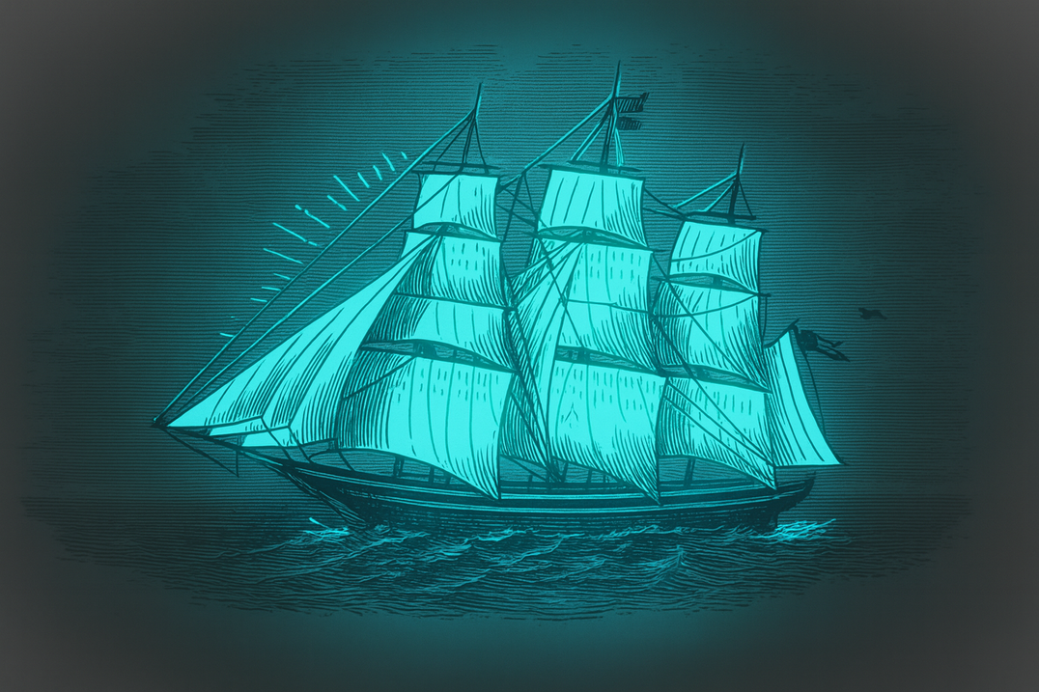
  Launched in 2011 with IMLS support as a research project
  A community-created and centered training initiative
  Helps practitioners take practical, achievable steps towards stewardship
  Built around access, confidence, and “good enough” action
  Sustained through $1.6M+ in NEH and IMLS funding
What Is Digital POWRR?

Slide 6

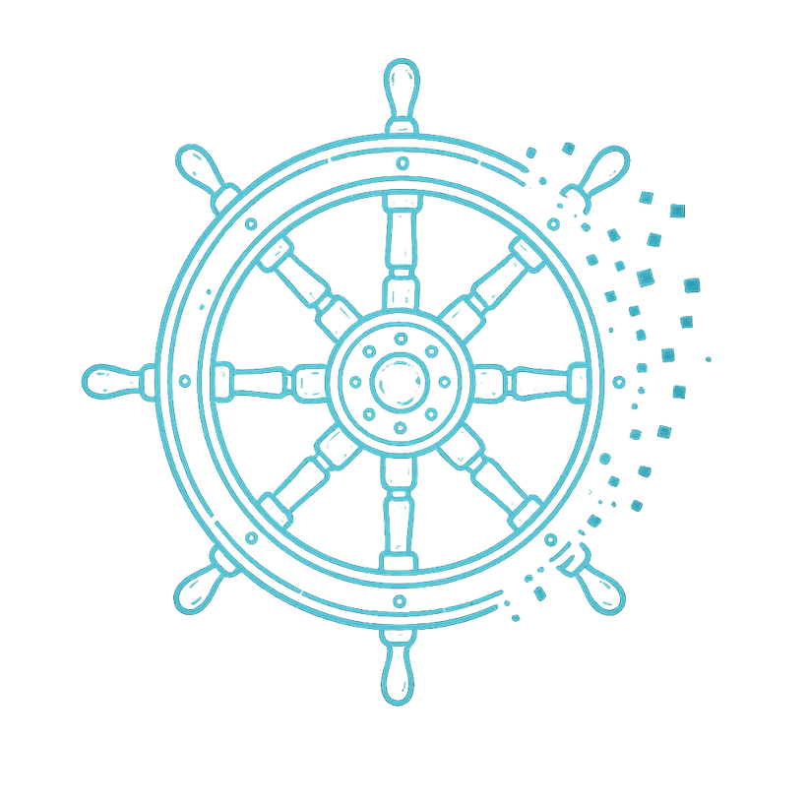
A NEW COURSE: THE POWRR PEER ASSESSMENT PROGRAM
  IMLS-funded (2021–2025) pilot for community-centered assessment.
  36 participants across 6 cohorts, guided by 6 mentors.
  Combined: structured learning + self-assessment + peer mentorship.

Slide 7
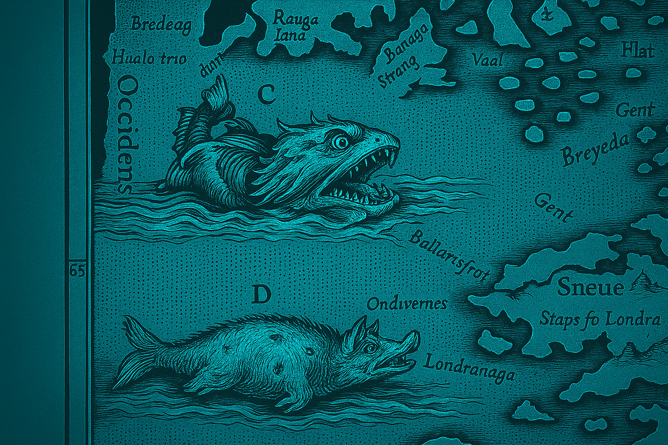
  In the program, peer connection normalized uncertainty and imperfection.
  Mentorship fostered safety and reflection.
  Emotional scaffolding mattered as much as technical skill.
Currents Beneath the surface: the emotional work of preservation

Slide 8
  Emerged from the emotional insights of the Peer Assessment Program
  Recognizes uncertainty as a constant condition, not a failure
  Offers reflection prompts rather than metrics
  Complements technical frameworks by centering the human experience of stewardship
Navigating Uncertainty:
A Human Centered Assessment Compass for Digital Preservation Practitioners

Slide 9
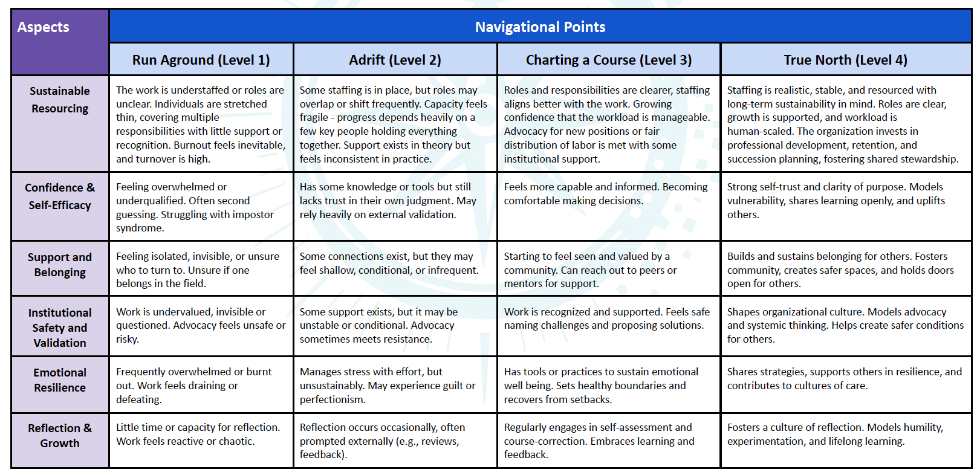
The Framework

Slide 10
  Each “aspect” from the framework is written on a giant post-it on the wall:
    Sustainable Resourcing
    Confidence & Self-Efficacy
    Support & Belonging
    Institutional Safety & Validation
    Emotional Resilience & Sustainability
    Reflective Practice & Growth Mindset
  For each of the 6 aspects, place one dot in the quadrant that best reflects where you are today.
    Level 1: Run Aground
    Level 2: Adrift
    Level 3: Charting a Course
    Level 4: True North
Mapping the Room Activity:
“Where Are We Navigating Today?”

Slide 11

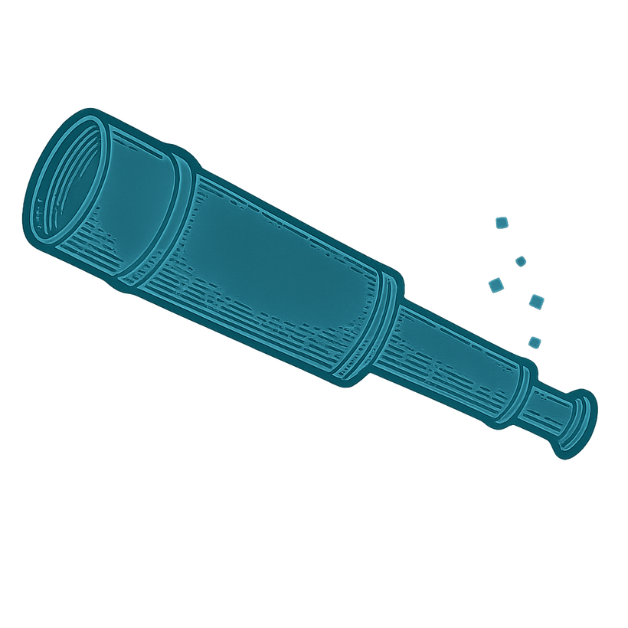
Reflecting
Together
  Get into pairs or small groups.
  Read through “Sample Reflection Prompts” and “Using the Framework in Challenging & Supportive Workplaces” sheets
  For orientation, begin discussion with “Which aspects feel most challenging to me right now, and why?”
  Then as a group, decide a discussion lens to focus on:
    Navigating Challenge: For those reflecting on barriers, uncertainty, precarity, or sustainability challenges
    Building Supportive Practice: For those reflecting on leadership, support structures, culture-building, or sustaining others

Slide 12
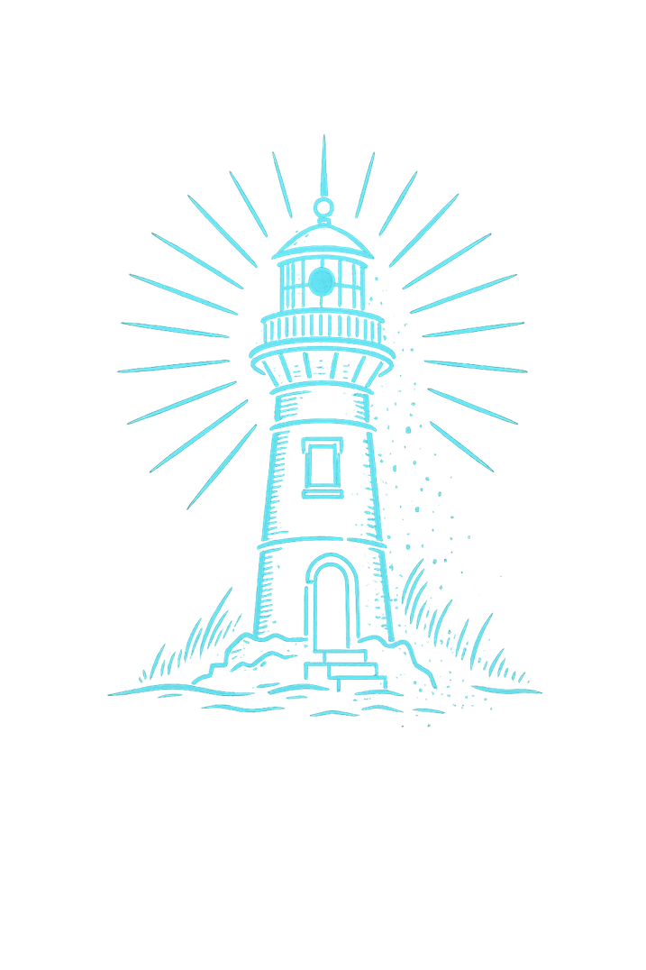
Use the markers & post-its to help create our collective “Navigation Chart.”
Please share:
  practices
  relationships
  resources
  reminders
  or habits
that help sustain your work.
Then post your notes on the wall.
Finding Safe Harbor:
What Helps You Navigate Uncertainty?

Slide 13
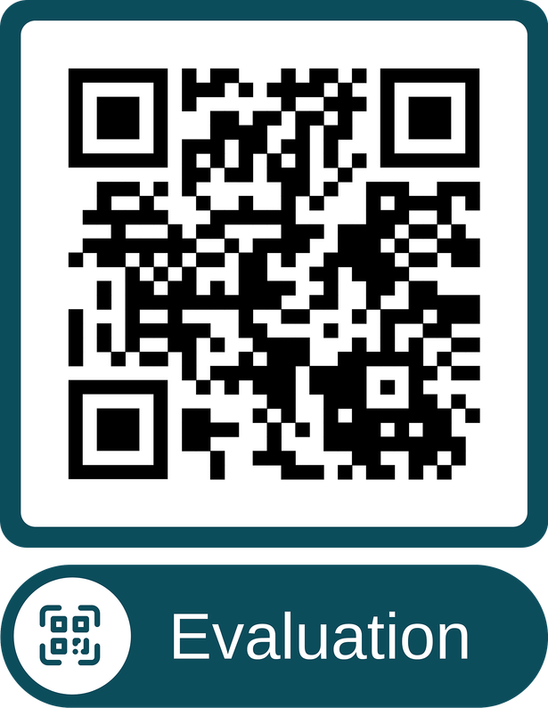
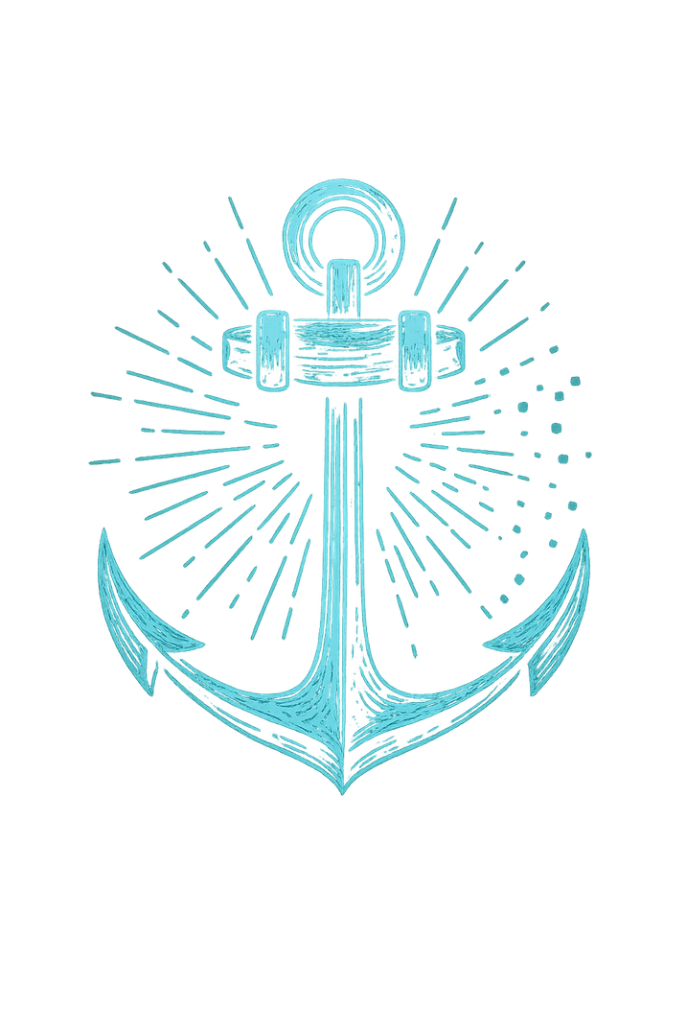
Closing
Reflections
What are you taking with you today?
What feels grounding, resonant, or worth carrying forward?
http://bit.ly/TCDLPOWRR

Slide 14
THANKS FOR YOUR PARTICIPATION
Get in Touch with Further Comments or questions - staceynjones@arizona.edu

