Slide 1



Family
Identity

Slide 2

scripture
From him the whole body, fitted and knit together by every supporting ligament, promotes the growth of the body for building itself up in love by the proper working of each individual part.
Ephesians 4:16 (CSB)

Slide 3
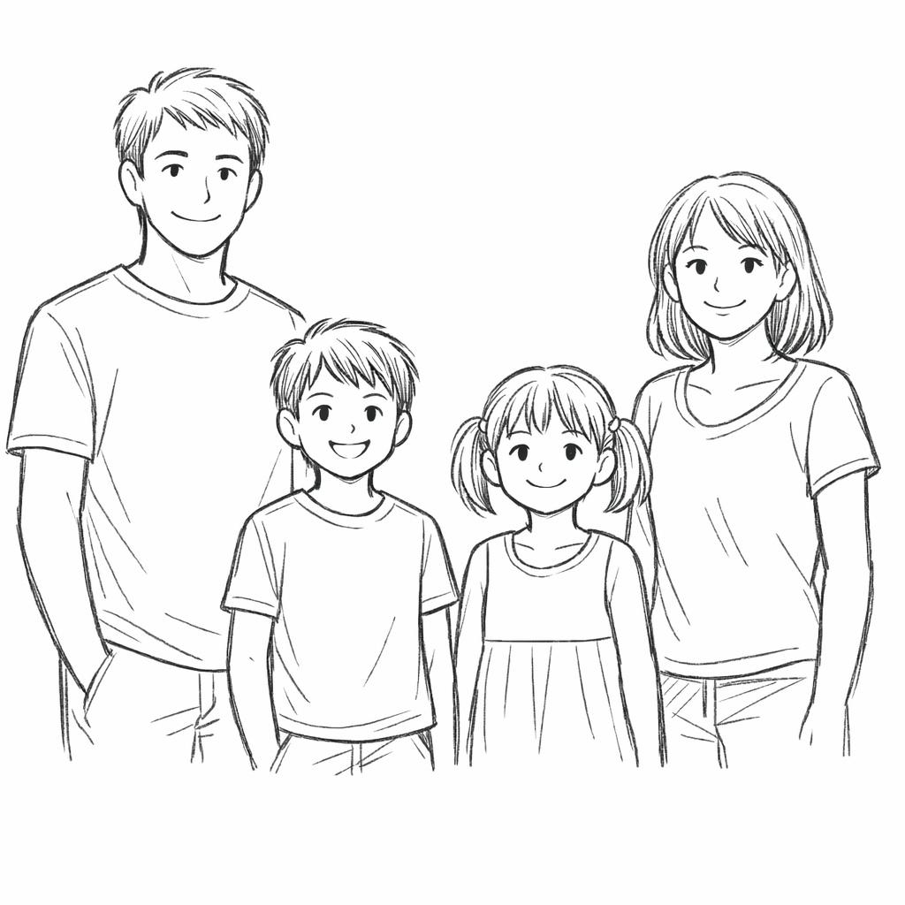


story time
Family
Dr. Son
Dr. Daughter

Slide 4

why do
you homeschool?
Take a moment to think about why you TRULY homeschool.

Slide 5
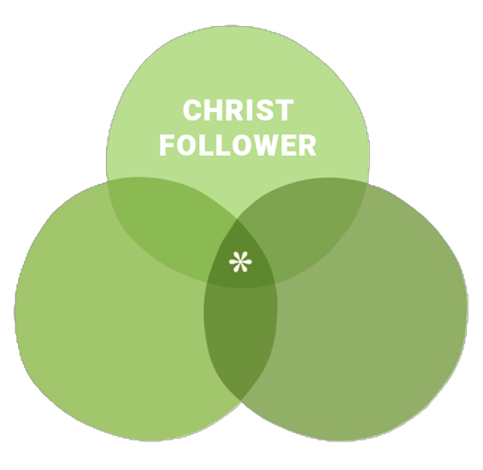
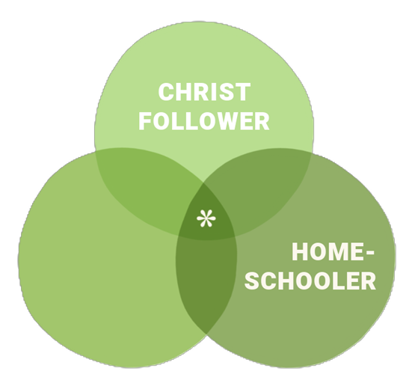

assumptions
God
Community
Family

Slide 6
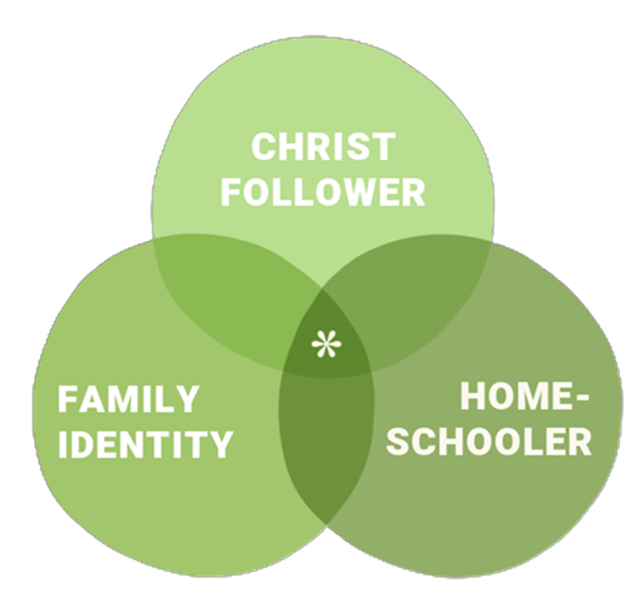
belonging and purpose

Slide 7
definitions
intentional
family
adjective, done on purpose; deliberate
noun, a group of one or more parents and their children living together as a unit
identity
one-anothering
noun, the characteristics determining who or what a person or thing is
verb, the actions encouraged in the Bible to take care of one another

Slide 8
identity
Identity is shaped by cultural, social, political, spiritual, and historical contexts.
Race
Ethnicity
Sex
Economic class
Ability and disability
Profession
Relationship status
Religion
Values and Beliefs
Citizenship and nationality
Hobbies
Skills
Ancestry
Physical appearance
Birth order
Languages spoken
Political views
Personality AND …
FAMILY

Slide 9
identity formation
Discovering and developing one’s potential
Choosing one’s purpose in life
Finding opportunities to practice that purpose

Slide 10
who I am IN Christ
--compiled by
Dr. Bob Kellemen
Matthew 4:19; Mark 1:17
Matthew 5:13
Matthew 5:14
Matthew 28:19; Luke 14:27; John 8:31; 13:35; 15:8;
Acts 6:1, 7; 11:25-26, 29; 14:20-22; 16:1
Luke 24:48; Acts 1:8
John 3:16-18; 10:28-29; 17:3; Romans 5:21; 6:23; 1 John 5:11
John 8:32, 36
John 10:10
John 14:26; 16:13
John 14:27; 16:33
John 15:3
John 15:4, 5, 8, 16; Romans 7:4
John 15:5
John 15:11
John 16:33
John 17:16
Acts 2:44; 4:32
Acts 5:20
Acts 8:3; 2 Corinthians 1:1
Acts 11:26
Acts 13:39; Romans 3:24, 26, 28, 30; 4:25; 5:1, 9, 18; 10:10; 1 Corinthians 6:11; Titus 3:7
Acts 20:32; 1 Corinthians 6:11
Romans 1:6
Romans 1:7;1 Corinthians 6:1, 2; 2 Corinthians 1:1; Ephesians 1:1; Philippians 1:1; 4:21, 22; Philemon 4; Jude 3
Romans 3:24; 1 Corinthians 1:30; Ephesians 1:7; Colossians 1:14
Romans 3:21-26; 4:3, 5, 6, 9, 22, 23, 24; 5:17, 19; 1 Corinthians 1:30; 2 Corinthians 3:9
Romans 5:17
Romans 5:18
Romans 6:2
Romans 6:3
Romans 6:4
Romans 6:5
Romans 6:6
Romans 6:7
Romans 6:8
Romans 6:11
Romans 6:13
Romans 6:14
Romans 6:18, 22
Romans 6:19
Romans 6:22
Romans 7:4
Romans 7:6
Romans 7:22
Romans 7:25
Romans 8:1
Romans 8:2
Romans 8:4
Romans 8:5
Romans 8:9
Romans 8:29
Romans 8:37
Romans 9:23
Romans 10:9, 10, 13
Romans 15:14
Romans 15:16
1 Corinthians 1:2
1 Corinthians 1:2;
Ephesians 5:26;
Colossians 3:12
1 Corinthians 1:8
1 Corinthians 1:30
1 Corinthians 2:16
1 Corinthians 3:9
1 Corinthians 3:16-17;
2 Corinthians 6:16
1 Corinthians 6:11
1 Corinthians 6:19
1 Corinthians 6:20
2 Corinthians 2:14
2 Corinthians 3:6
2 Corinthians 3:10
2 Corinthians 3:18
2 Corinthians 4:16
2 Corinthians 5:17
2 Corinthians 5:18
2 Corinthians 5:20
2 Corinthians 5:21
2 Corinthians 8:9
2 Corinthians 11:2

Slide 11
who I am IN Christ
--compiled by
Dr. Bob Kellemen
Galatians 1:4
Galatians 2:20
Galatians 3:13-14
Galatians 6:1
Ephesians 1:1
Ephesians 1:4
Ephesians 1:17-19
Ephesians 2:5
Ephesians 2:5, 8
Ephesians 2:6
Ephesians 2:10
Ephesians 2:15
Ephesians 2:21
Ephesians 2:22
Ephesians 3:16
Ephesians 3:17
Ephesians 3:18
Ephesians 3:19
Ephesians 3:20
Ephesians 4:13
Ephesians 4:22
Ephesians 4:23
Ephesians 4:24
Ephesians 5:8
Ephesians 5:9
Ephesians 5:26
Ephesians 5:27
Philippians 2:1
Philippians 2:13
Philippians 2:15
Philippians 3:9
Philippians 3:10
Philippians 3:20
Philippians 4:13
Philippians 4:19
Colossians 1:2
Colossians 1:12
Colossians 1:13
Colossians 1:22
Colossians 2:10
Colossians 2:11
Colossians 2:12
Colossians 2:13
Colossians 2:14-15
Colossians 2:20
Colossians 3:1
Colossians 3:3
Colossians 3:9
Colossians 3:10
1 Thessalonians 3:13
1 Thessalonians 5:23
2 Thessalonians 2:14
2 Timothy 1:7
2 Timothy 2:3-4
2 Timothy 2:5
2 Timothy 2:6
Titus 3:5
Hebrews 1:3
Hebrews 2:10
Hebrews 2:11
Hebrews 7:25
Hebrews 8:10; 10:16
Hebrews 9:12
Hebrews 9:14
Hebrews 9:15
Hebrews 9:26-27
Hebrews 10:2
Hebrews 10:10
Hebrews 10:14
Hebrews 10:22
1 Peter 1:3
1 Peter 1:18-19
1 Peter 1:22
1 Peter 1:23
1 Peter 2:5
1 Peter 2:9
1 Peter 2:9-10
2 Peter 1:3
2 Peter 1:4
1 John 2:20
1 John 4:4
1 John 4:4, 6
1 John 4:7; 5:1
1 John 5:4-5
Jude 24
Revelation 1:5
Revelation 1:6
Revelation 19:7-8, 14

Slide 12
who I am TO Christ
--compiled by
Dr. Bob Kellemen
Matthew 6:26
Matthew 9:2;
Mark 2:5
Matthew 9:36-38
Matthew 10:31;
Luke 12:7
Matthew 12:12
Matthew 18:10-14
Mark 3:34-35
Luke 6:35
Luke 12:4
Luke 20:36; John 1:12;
Romans 8:14-17; 1 John 3:2
John 1:13
John 3:6
John 3:16
John 8:35
John 10:28-30
John 13:33
John 15:5
John 15:9
John 15:14
John 15:15
John 16:27
John 17:23
Acts 10:43
Acts 20:28
Acts 20:28;
1 Corinthians 1:2
Romans 1:7
Romans 4:7-8
Romans 5:1; Ephesians 2:14-17; Colossians 1:21-22
Romans 5:2; Ephesians 2:18
Romans 5:5
Romans 5:6-8
Romans 5:9
Romans 5:10-11; Colossians 1:20
Romans 8:1, 33-34
Romans 8:14
Romans 8:15; Galatians 4:6
Romans 8:17; Galatians 4:7; Ephesians 3:6; Titus 3:7
Romans 8:17
Romans 8:23
Romans 8:31
Romans 8:37-39
Romans 9:25
Romans 9:26
Romans 10:11
Romans 11:5
Romans 14:3
Romans 15:7
Romans 15:16
1 Corinthians 1:9-10
1 Corinthians 12:27;
Ephesians 4:12; 5:23
2 Corinthians 1:22
2 Corinthians 5:5;
Ephesians 1:14
2 Corinthians 5:18-19
2 Corinthians 6:18
2 Corinthians 11:2
Galatians 3:26;
Galatians 4:6-7
Galatians 3:27
Galatians 3:28
Galatians 3:29
Galatians 4:5
Galatians 4:7, 31
Galatians 4:28

Slide 13
who I am TO Christ
--compiled by
Dr. Bob Kellemen
Ephesians 1:4-6
Ephesians 1:5
Ephesians 1:7;
Colossians 1:14
Ephesians 1:13
Ephesians 1:14
Ephesians 2:10
Ephesians 2:13
Ephesians 2:19
Ephesians 2:22
Ephesians 3:6; 4:25; 5:30
Ephesians 3:6
Ephesians 3:12
Ephesians 3:18
Ephesians 3:19
Ephesians 4:12
Ephesians 4:30
Ephesians 5:1
Ephesians 5:2
Ephesians 5:25
Ephesians 5:29
Ephesians 5:31-32
Colossians 1:21-22
Colossians 1:22
Colossians 3:12
Colossians 3:13
1 Thessalonians 1:4; 2 Thessalonians 2:13
1 Thessalonians 1:4
2 Thessalonians 2:1
2 Thessalonians 2:16
Hebrews 2:12
Hebrews 3:1
Hebrews 4:16
Hebrews 7:19
Hebrews 8:12
Hebrews 9:6-14
Hebrews 9:15
Hebrews 9:26
Hebrews 10:2
Hebrews 10:17
Hebrews 10:19
Hebrews 10:22
1 Peter 2:6
1 Peter 3:18
1 Peter 3:21
1 John 3:1
1 John 3:16
1 John 4:9-11
1 John 4:17-18; 5:14
Revelation 1:5
Revelation 19:7

Slide 14
one-anothering
--compiled by
Dr. Bob Kellemen
Matthew 18:15-19
Matthew 22:35-40
Matthew 23:23-26
Matthew 28:18-20
Mark 9:50
Luke 10:25-37
John 13:14
John 13:34-35
John 15:12-13, 17
John 17:20-26
Acts 2:42-47
Acts 4:32-37
Acts 6:1-7
Acts 11:22-26
Romans 1:11-12
Romans 12:3-8
Romans 12:10
Romans 12:15
Romans 12:16
Romans 13:8-10
Romans 14:13
Romans 14:19
Romans 15:1
Romans 15:2
Romans 15:5
Romans 15:7
Romans 15:14
Romans 16:16
1 Corinthians 1:10
1 Corinthians 4:6
1 Corinthians 10:24
1 Corinthians 12:4-27
1 Corinthians 12:25
1 Corinthians 12:26
1 Corinthians 12:26
1 Corinthians 13:1-8
1 Corinthians 14:1-3
1 Corinthians 16:20
2 Corinthians 1:3-11
2 Corinthians 2:7-11
2 Corinthians 5:14-21
2 Corinthians 13:12
Galatians 5:13
Galatians 5:15
Galatians 5:26
Galatians 6:1-3
Ephesians 4:1-7
Ephesians 4:11-16
Ephesians 4:25
Ephesians 4:29
Ephesians 4:32
Ephesians 5:19
Ephesians 5:21
Philippians 2:1-5
Philippians 4:2
Colossians 1:25-2:2
Colossians 3:9
Colossians 3:12-14
Colossians 3:15-17
1 Thessalonians 2:12
1 Thessalonians 3:12
1 Thessalonians 4:9
1 Thessalonians 4:18
1 Thessalonians 5:11
1 Thessalonians 5:13
1 Thessalonians 5:14
1 Thessalonians 5:15
2 Thessalonians 1:3
2 Thessalonians 3:15
1 Timothy 5:20
2 Timothy 2:2
2 Timothy 2:22-26
2 Timothy 3:16-17
2 Timothy 4:1-8
Titus 1:6-11
Titus 2:1-15
Hebrews 3:7-19
Hebrews 10:24
Hebrews 10:25
Hebrews 13:1
James 2:8
James 4:11
James 5:9
James 5:13-16
1 Peter 1:22
1 Peter 3:8
1 Peter 4:8
1 Peter 4:9
1 Peter 4:10
1 Peter 5:5
1 Peter 5:14
1 John 1:7
1 John 2:7-17
1 John 3:11-15
1 John 3:16-18
1 John 4:7-21
2 John 5

Slide 15
comparison
Individual Identity
Family Identity
Creates self-awareness
Creates others-awareness
Provides direction and motivation
Provides direction and motivation
from a clear understanding of personal values and interests
for the whole family through communication & growth
Enables healthy relationships
Enables healthy relationships
through meaningful connections with people who appreciate and respect you for who you are
by respecting and utilizing individual differences as well other’s strengths for the goodness of the whole family
Keeps you grounded
Keeps us grounded
by helping you remember what truly matters at the end of the day
by allowing each of us to see that we have weaknesses as well and one-anothering is what matters at the end of the day
Improves decision-making
Improves decision-making
by making choices that are consistent with your values, beliefs, and long-term goals
because it gives you a support system to turn to …
Iron sharpens iron
Fosters community participation
Fosters community participation
to express your unique perspective and contribute to positive societal change
by expressing yourself within the safety of the family unit and the family unit’s community participation

Slide 16
comparison
Individual Identity
Family Identity
by experience
intentional intimacy

Slide 17


options

Slide 18

option 1
Take a moment to list 5-7 qualities that make up your family.

Slide 19



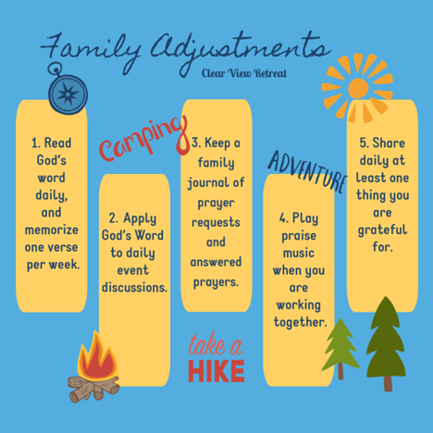

option 2
Listen to a 5-part
walk-through of “Building an Intentional Family Identity” on the
Five Minute Family podcast
(only five minutes each)
04/14/2020 – 05/12/2020

Slide 20
Galatians 4:6-7
2 Corinthians 5:17
John 1:12
Ephesians 1:5
1 Corinthians 6:17
1 Peter 2:9
1 John 3:1-2
2 Corinthians 13:13
Ephesians 3:18
Ephesians 6:18
Philippians 4:22
Psalm 34:9
option 3a
A five-step,
five-minute-at-a-time
Family Identity Challenge

Slide 21
option 3b
Discuss what our identity is in Christ.
Sit in silence for five minutes and contemplate what you heard.
Share a part of God’s identity for His children that you find hard to believe.
Review verses that specifically touch on God’s truth about our identities in Christ.
Choose a worship song and then close in prayer and praise.
A five-step,
five-minute-at-a-time
Family Identity Challenge

Slide 22



option 4
Come join us for a FAMILY CAMP at
CLEAR VIEW RETREAT!

Slide 23

If you’d like more information about family identity
and other biblical relationship principles,
please check out our podcast – the Five Minute Family.

Slide 24
conclusion
Solid family health
requires
a solid family identity.

Slide 25
I pray that the eyes of your heart may be enlightened so that you may know what is the hope of his calling, what is the wealth of his glorious inheritance in the saints, and what is the immeasurable greatness of his power toward us who believe, according to the mighty working of his strength.
– Ephesians 1:18-19 (CSB)

Slide 26
q&a time

Slide 27

thank you!
Come take a photo in our booth - #312

