Slide 1

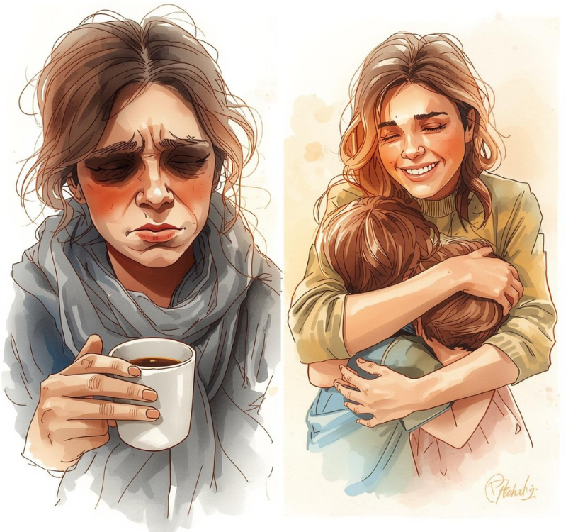

7 Steps to Replace Stress with Joy
By Karen Whiting
Booth
718
By Kaen Whig
Notes:
Moms and Dad have lots of stress. Ist outing with James
We need to know what causes the stress and then consider how to replace it.

Slide 2
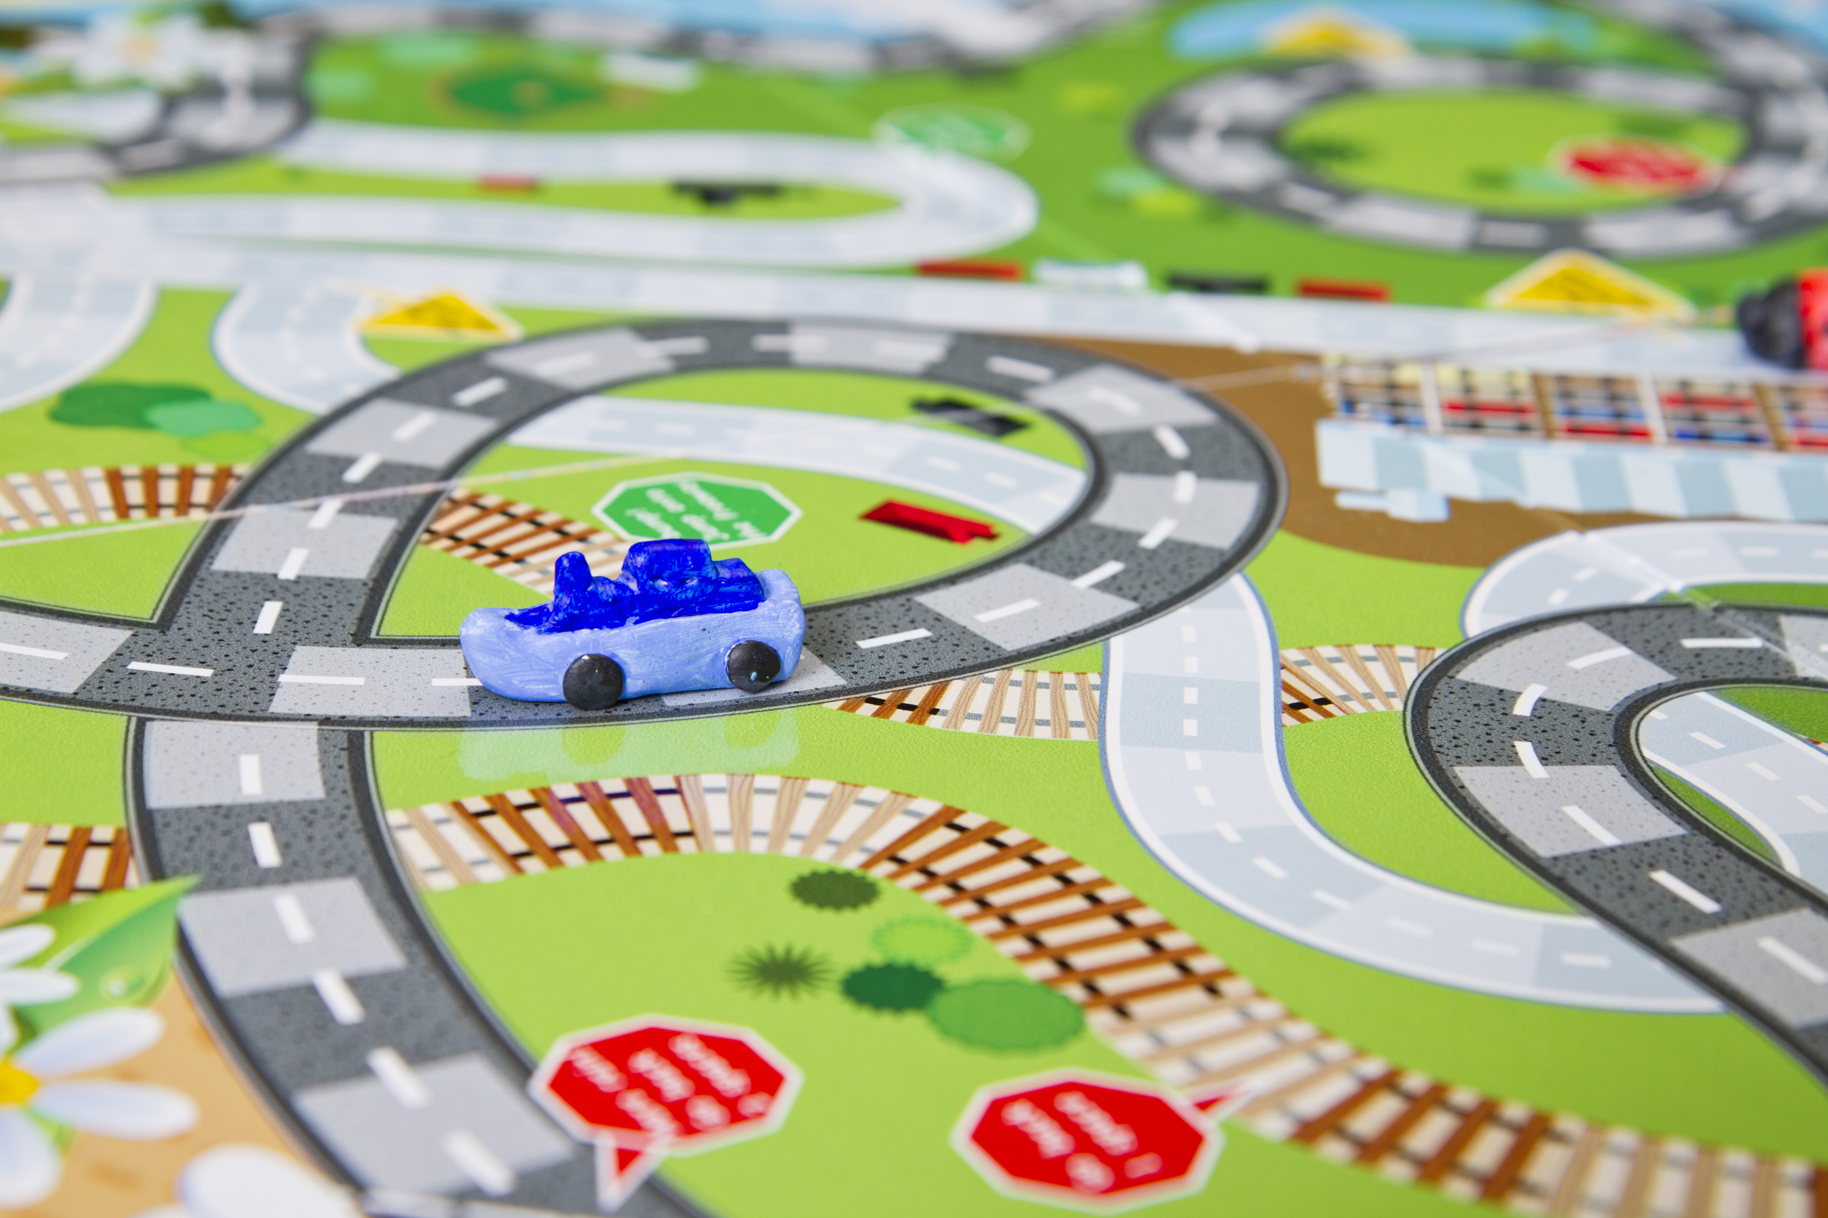
Distress and Eustress
When we dwell on the stress and continue the same pattern …….. = Distress
When we let the stress motivate us to change.
It’s Eustress
We let go of negative emotions and can choose joy
When we dwell on the stress and continue the same pattern it gets worse and can become distress
When we let the stress motivate us to
Hyperstress and Hypostress
Notes:
Stressed by drivers cutting you off but consider it a call from God to help you forgive

Slide 3
Identify Stressors
__Coworkers __Weather __Self-esteem __Family
__Boss __Noise __Fear __Finances
__Deadlines __Safety __Worry __ Calls
__Advancement __Space __Anger __Church
__Work conflicts __Comfort __Jealousy __Disorder
__Pressure __Travel __Perfectionism __Health
__Commitments __Pets __Guilt __ Spills
__Volunteering __Extended family

Slide 4
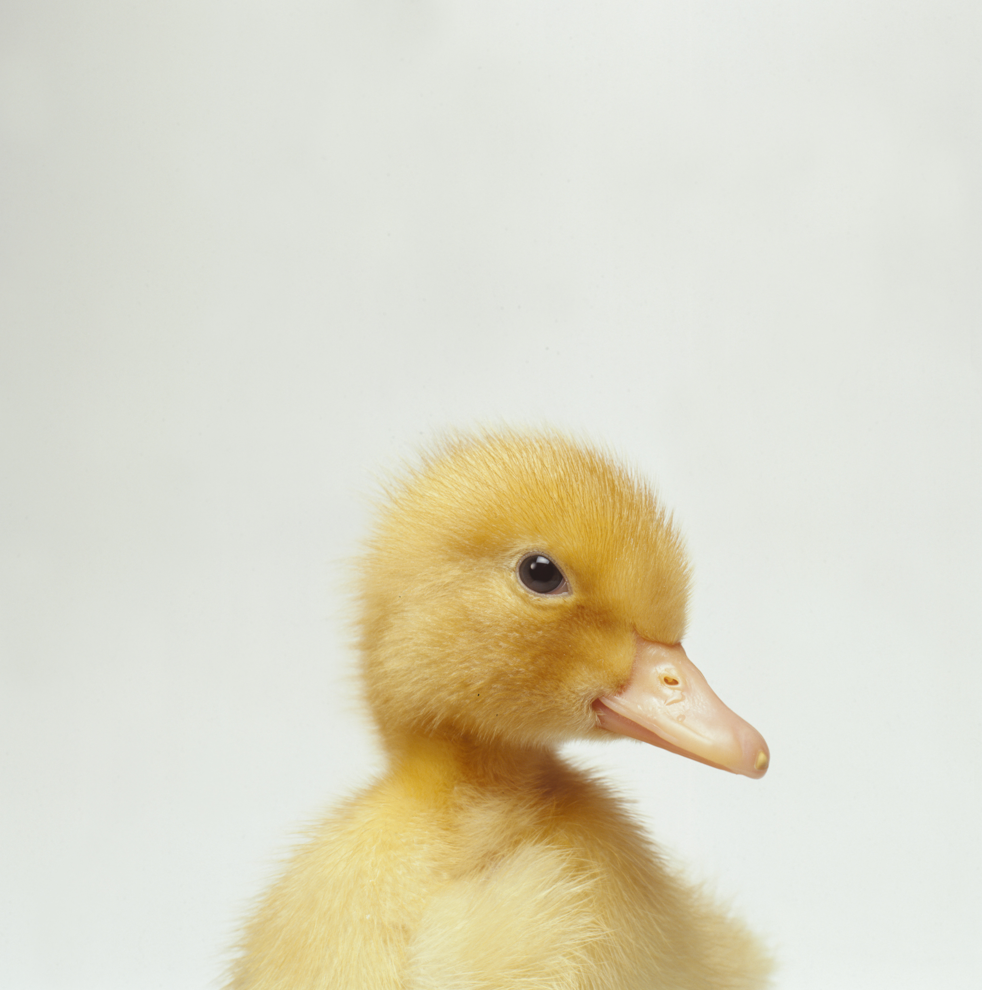
1. Replace anger
  Calm down
  Communicate
Forgive
Ask
Reflect
Notes:
Costume story

Slide 5

2. Reframe the Struggle
Consider it joy-James 1:1-2
Look for the blessings
Ask for God’s perspective
Notes:
Hurricane Andrew

Slide 6

3. Give Thanks and Choose Joy
Trust God
is in Control
Notes:
Bicycle trip

Slide 7

4. Replace Self-pity & Selfishness
Choose to Bless Others
Whoever brings blessing will be enriched, and one who waters will himself be watered. Proverbs 11:25-26
Notes:
Rhonda and mother’s day

Slide 8


5. Replace Busyness with Mindfulness
Work but see failure
Busy but nothing gets done
Pause ~ Assess ~ Evaluate ~ Guidance ~ Process
Notes:
Sister helps

Slide 9


6. Support System
Call a mentor
Gather with moms
Pray with spouse or pray warrior
Call person who always answers with a smile you hear

Slide 10

7. Replace Unhealthy Choices with Healthier Ones
Call kids to hug or give surprise not just to yell
Soft voice instead of loud
Praise effort and work done well
Better brain food snacks and meals
Delegate instead of burning out
Less stuff
Notes:
Garbage bag to lower clutter and trade out for work

Slide 11
Have phrases to lower stress
Thank you for sharing that!
Notes:
Demon cast out and seven more returned

Slide 12
Communicate clearly
Are you understood? Let child echo your words
Let child know time frame.
Be clear about schoolwork
Limit each subject time – no infringing on next
Time cushions for catch up or pick up
Notes:
Clean up after

Slide 13

Color for each child and parent
Fill in priorities
Add in activities. Circle transportation problems/conflicts
Find family time to do an activity.
Simplify

Slide 14

For hard work
For accomplishments
For great smile
For sense of humor
Positive words-
It takes 10 positive comments to overcome
1 negative comment

Slide 15


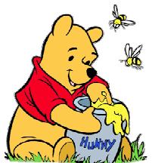

Getting Along--Personalities
Popular
Talkative/loud
Life of party
Impulsive
Affectionate/expressive
Bouncy/energetic
Bright colors
Friendly
Natural leader
Controlling
Direct/to point
Organizer
Goal oriented
Active/capable
Confidant/strong-willed
Shy/sensitive
Artistic
Perfectionist/talented
Good listener
Loyal
Thoughtful/problem solver
Deep thinker/analytical
Peaceful
Easy-going
Balanced and consistent
Good mediator
Lazy/finds easy way
Diplomatic
Conflict solver
Notes:
Judy and 1st trip

Slide 16

Karen WHITING Books
Booth
718

Slide 17

Replace negative words of people with God's words & encouraging words.
Replace pain and anger with forgiveness.
Pause when you feel angry and clam down. Smile at a joyful thought.
Let go of tasks that are not your responsibility and embrace your choices.
Always Add hugs.
Replace worry with hope and prayer.
Look above chaos and struggles to God and the future.
Replace your reaction to people with reflecting God's blessings for you. Pray for those who cause pain/struggles and then let go.

