Slide 1

“Mathematics is the language with which God has written the universe.”
-Galileo Galilei

Slide 2
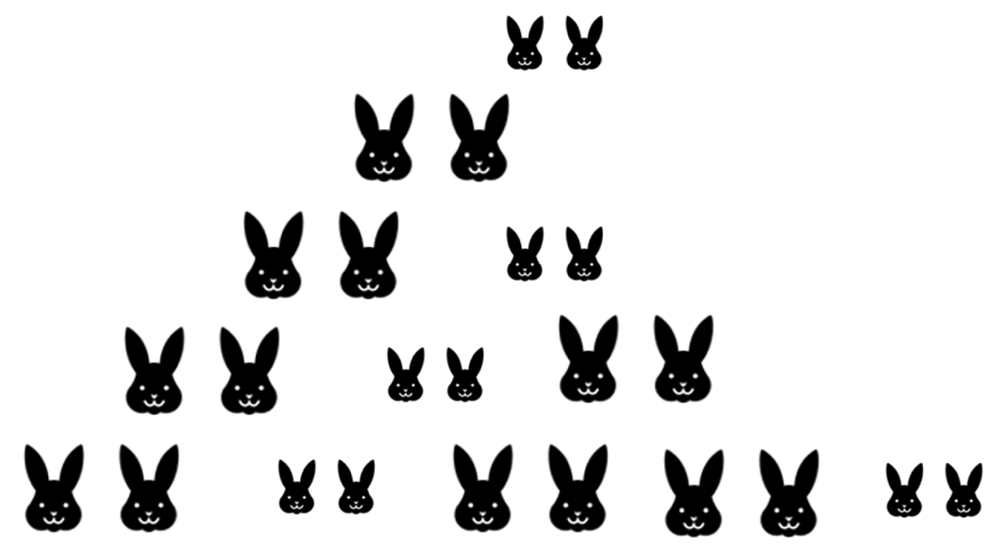
“Beginning with a single pair of rabbits, if every month the productive pair bears a new pair, and when the new pairs are one-month old, they bear another pair and every pair continues bearing a new pair every month, how many rabbits will there be in a year?”
Notes:
Put numbers on white board. Talk about Leonardo de Pisa and being advisor to Emperor Frederick II. Introduces hindu-Arabic numeral system to Europe.

Slide 3
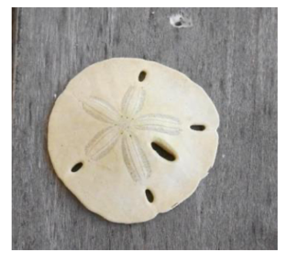
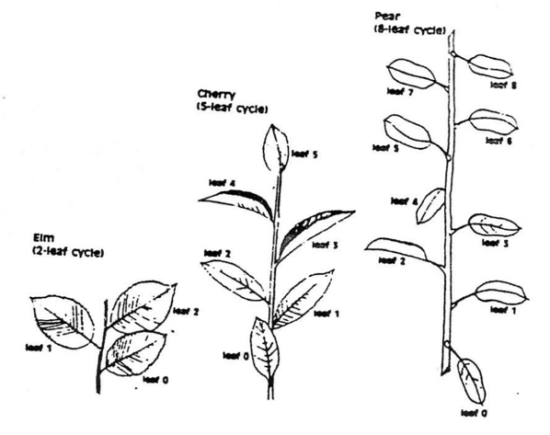
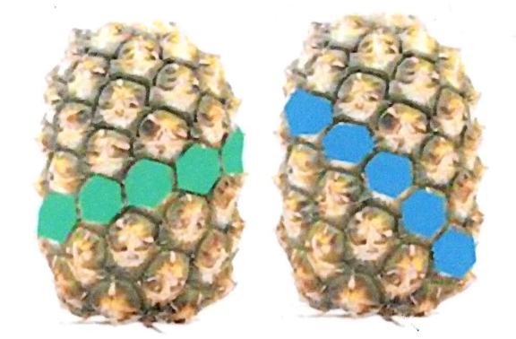
Fibonacci Numbers 1,1,2,3,5,8,13,21,34…
What is the next number? Look at the two numbers before any number.
Notes:
Pass around pine cones. Talk about the four leaf clover being an anomaly.

Slide 4
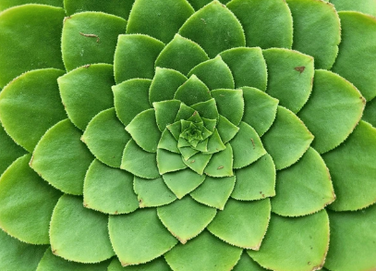

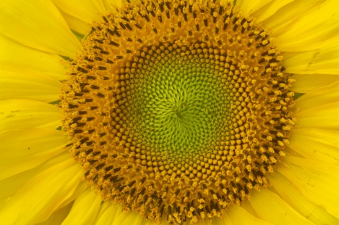

The spirals of seeds or the number of petals are all Fibonacci numbers.

Slide 5
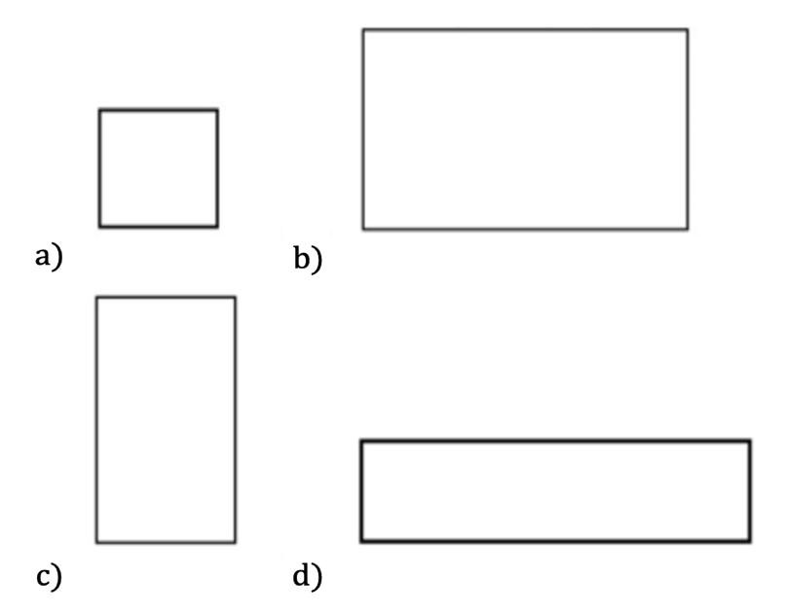
Pick your favorite rectangle.
Notes:
Have audience vote on this. Write on white board. Length divided by width is the golden ratio. Length is about 1 and one half the width.

Slide 6
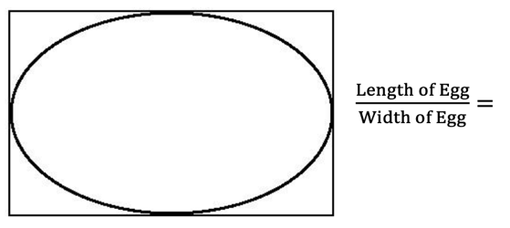
The Golden Ratio is approximately equal to 1.618… Φ Phi
Notes:
Talk about transcendental numbers pi and phi and e. All the numbers of your life are found in that string.

Slide 7
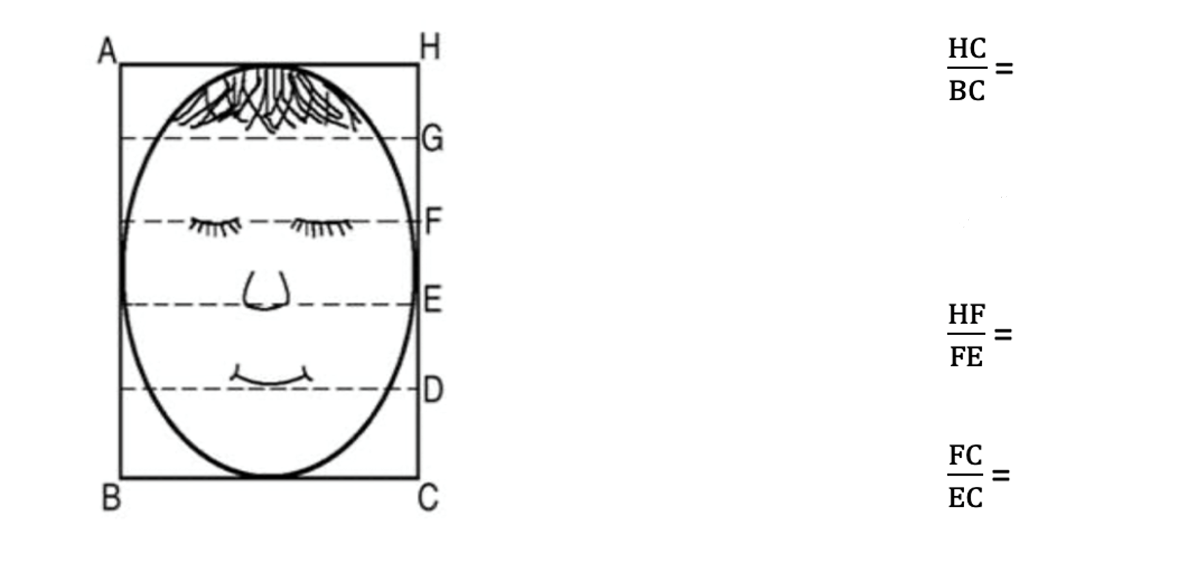
Psalm 139: 13 – 14 “For thou didst form my inward parts; Thou didst weave me in my mother’s womb. I will give thanks to Thee, for I am fearfully and wonderfully made; Wonderful are Thy works, And my soul knows it well. “
Notes:
Ask for volunteers. Take tape measure and have them measure arm and then from elbow and divide. Write on white board.

Slide 8
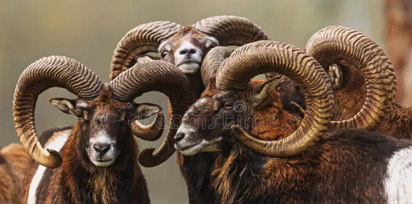
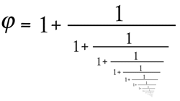
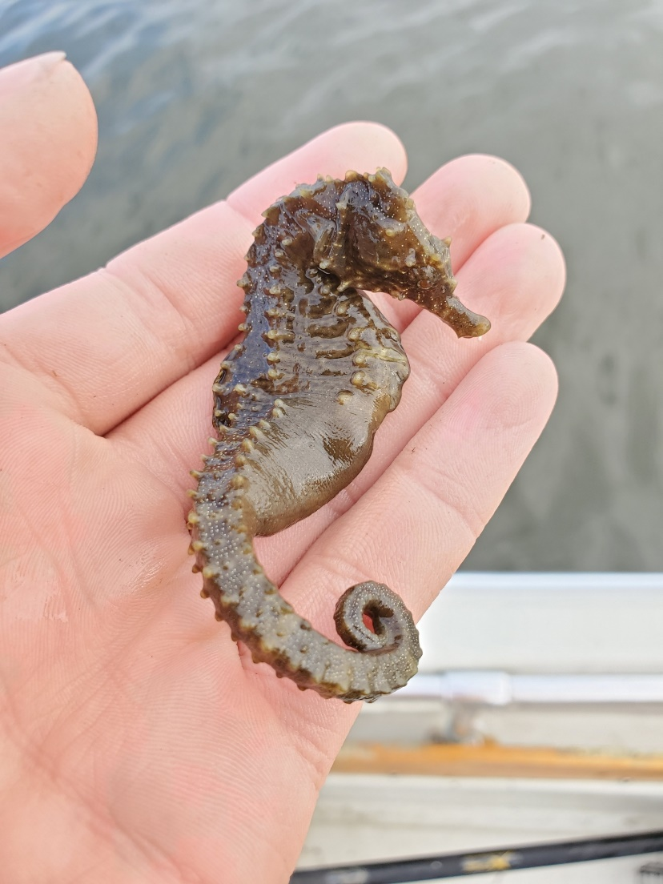
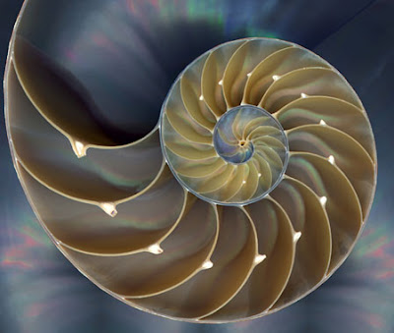
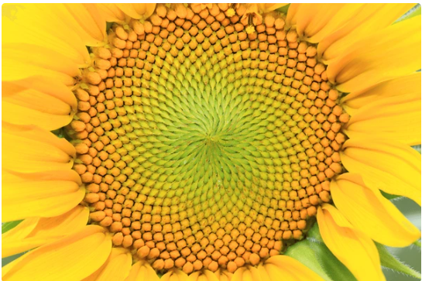
The Golden Ratio in God’s Natural World

Slide 9
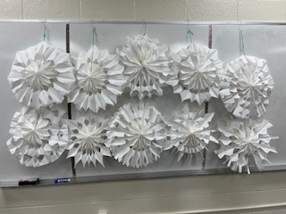
Every snowflake is unique like you. You are made in the image of God.
Notes:
DNA is uniquely you. 1 in a google.

Slide 10
Blaise Pascal
Blaise Pascal was a mathematician who spent time looking for mathematical probabilities in gambling after a gambler came to him with a specific problem (letters between Pascal and fellow mathematician Pierre de Fermat later confirmed they laid the foundation for probabilities). Pascal used his triangle to verify his conclusions about gambling. You can read more about this online if you are interested.
For now, we will examine Pascal’s greatest wager. He thought it best to gamble on faith and not wager on unbelief. He said: “Belief is a wise wager. Granted faith cannot be proved, what harm will come to you if you gamble on its truth and it proves false? If you gain, you gain all; if you lose, you lose nothing. Wager then, without hesitation, that He (God) exists.” How would you explain to a friend what Pascal means by this?
When one gambles, or places a wager, there is a risk of loss. God warns us against this. There is no guessing with God; faith in Him and what He will do for you is a sure thing!
We will end this section with another quote from Pascal: “There is a God-shaped vacuum in the heart of every man which cannot be filled with any created thing, but only by God, the Creator, made known through Jesus.”
Notes:
Pascals Wager. Tell his story.

Slide 11
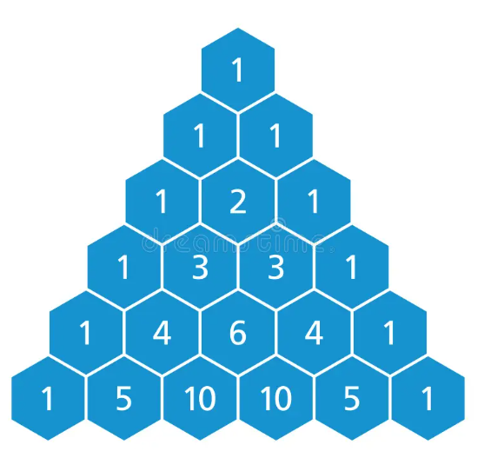
Pascals Triangle- What is the next row of numbers? Look at the row above.
Notes:
Say to look at the two number above each number.

Slide 12
Pascals Triangle and Coin Tosses
Flip One Coin
0 Heads___1___1 Head___1___
Flip Two coins
0 Heads___1___1 Head___2___2 Heads___1___
Flip Three Coins
0 Heads___1___1 Head___3___2 Heads___3__3 Heads___1___
Do you recognize these numbers?

Slide 13
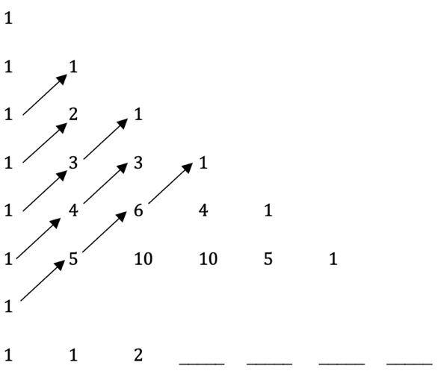
Pascals Triangle and other Numbers- Add the diagonals of Pascals Triangle. Do you recognize these numbers?

Slide 14
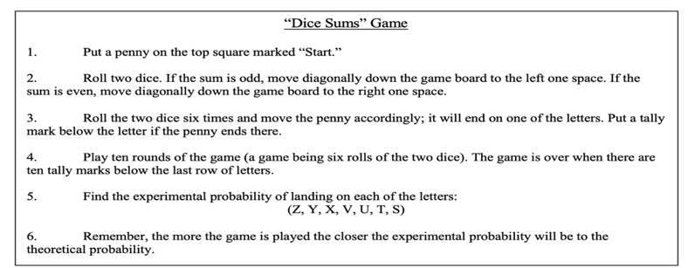
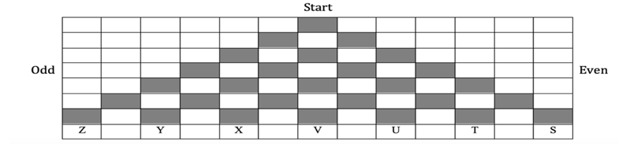
Pascals Triangle and Games

Slide 15
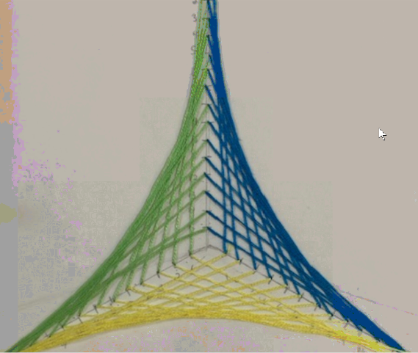
Art Projects follow patterns and design.

Slide 16
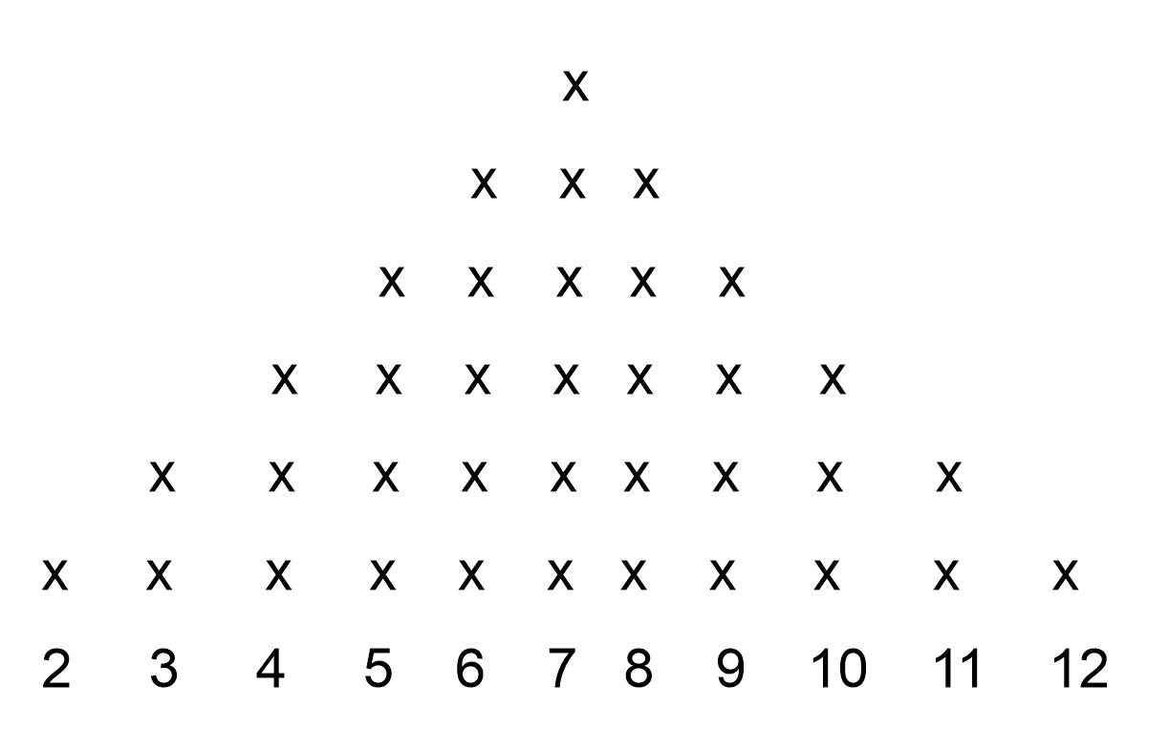
Penny Parade
What numbers are missing?
What shape is the experimental probability?
2 | 3 | 4 | 5 | 6
8 | 9 | 10 | 11 | 12

Slide 17
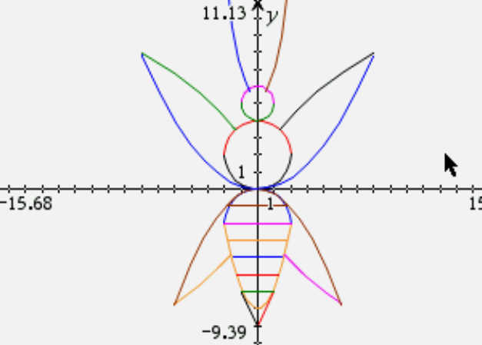
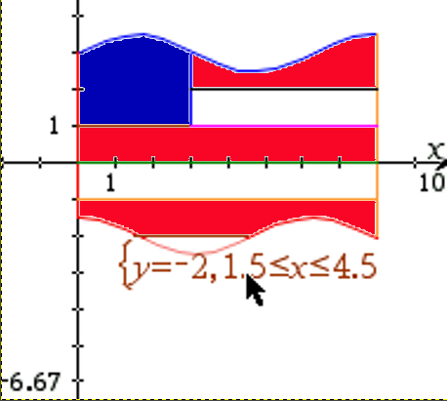
Every line in God’s Universe can be modeled by a function.

Slide 18
Free Resources desmos.com
Free graphing calculator and student activities
Goegebra.com
Free graphing resources and tools for Algebra and Geometry
mathwithmrsbrown.org
Over 2,000 free daily lesson and solution videos for Grades 1-12.
Free homeschool sewing lessons @Creating_Joy

Slide 19
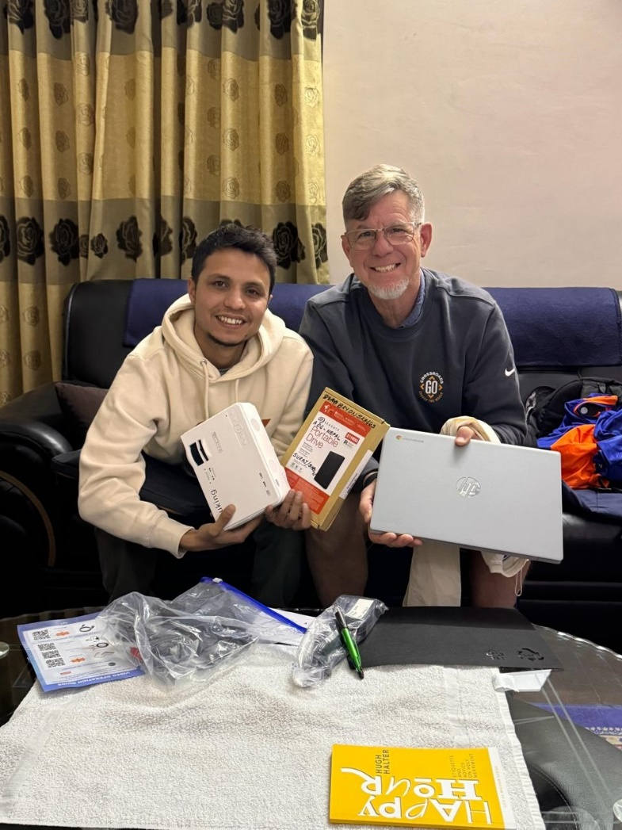
Teachers at missions schools are using the hands-on mathematics curriculum.
They received it on a hard drive along with a new computer and projector.
The same materials were sent to teachers in Nepal, India, Sri Lanka, Kenya and South Africa.
Trainings were provided for teachers in each country via zoom meetings.
The materials are translated into other languages as needed.

Slide 20
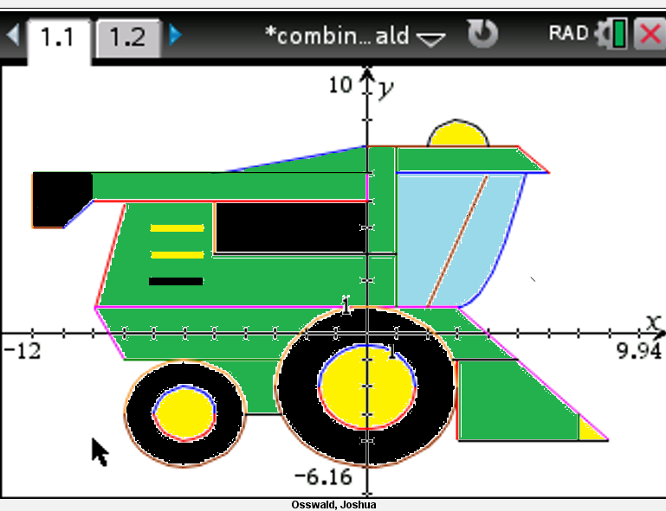

Slide 21
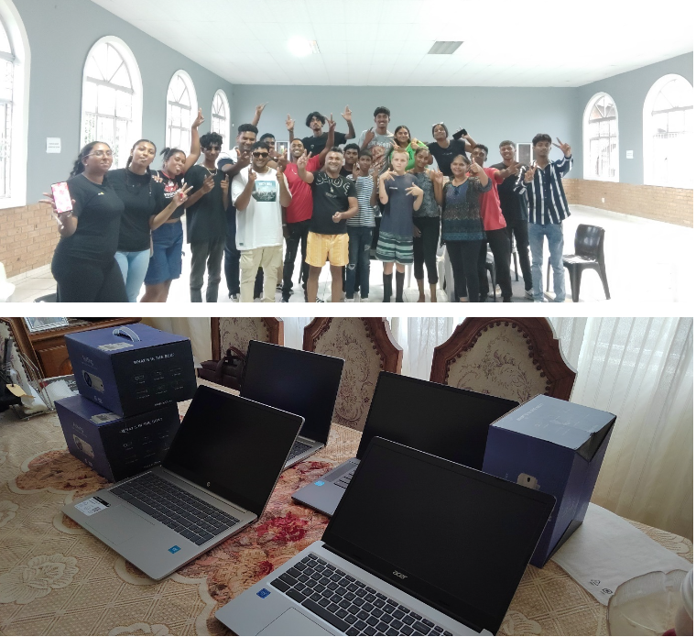

Slide 22
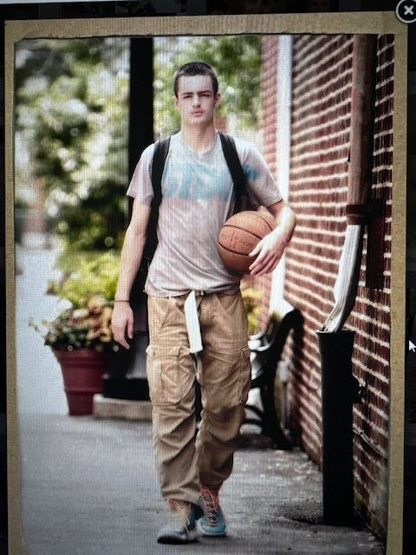
Thank you to Mosley Brown (May 15, 1996 – November 3, 2023) for ten years of editing, typing, and uploading videos for your mother’s curriculum.

