Slide 1
TeachX: Fostering Collaborative Learning Communities in the Classroom: From Insecurity to Support
Presenter: Sarah Shepherd-Manandhar, Adjunct Instructor, UIC & Wilbur Wright College
For the best experience please have the following ready to go:
A piece of paper or document you can write notes in
Access to the powerpoint slides so you can reference them during breakout groups (Google slides link in chat, in the conference program, or in an accessible powerpoint format)
Access to the learning log document
Be ready to share your thoughts!

Slide 2
The fine print 🙂
Because we are all educators, I have condensed and overlapped techniques in this workshop so that you can leave here with a long list of methods to try
I will spend more time modelling techniques and letting you experience them than I will spend time just explaining. At moments this might feel challenging, but we will figure it out together
Finally, I want to be clear: Don't try this at home! :) I recommend using no more than 2 techniques in a normal class period to keep the cognitive load comfortable for college students

Slide 3
What “counts” as collaboration today?
Having your camera on (when possible) so we can see each other's active listening
Answering questions in the chat when I pose them.
Using reactions to let others know when you agree, disagree, or appreciate what was shared
Asking questions when you have them, either in the main room or the breakout room
fulfilling your group role in the breakout room or asking for help when you need support
Any other way you can think of to share some part of yourself with us. The knowledge and experience you bring to the table is what’s really going to make today’s workshop shine!

Slide 4
Find your break out room! (self sort)
We are going to be working in breakout rooms for several of the activities today!
To help your group get off to the best start possible, please join the breakout room that best fits your dream vacation:
Breakout rooms:
Room 1: Plenty of sun, sand and ocean!
Room 2: Long hikes, beautiful views!
Room 3: Museums, libraries, and an evening at the theater!
Room 4: Anywhere I’m laughing with my friends!
Room 5: Cozy writing cabin in the woods!
Room 6: Skydiving, scuba diving, anything adventurous!
Your first task in the breakout rooms will be to come up with a team name for your collaborative team! The sillier the better! When we get back from breakout rooms, please share your team name in the chat!
Notes:
Additional vacation ideas if other groups are needed:
Food and Wine Tours! Yum!
It doesn’t matter where, as long as I’ve never been there before!

Slide 5
Breakout Room: Team Name
2 minutes - Introduce yourselves in the breakout room and come up with a team name. Choose one person to share the team name in the chat when we return.

Slide 6
Pick Group Work roles
Your second task in your collaborative team is to pick group work roles for each person. You may have more than one person assigned to a specific task as long as you have at least one of each of the roles listed below:
Encourager: Makes sure that everyone understands all of the material and that everyone gets an opportunity to contribute
Coordinator: Makes sure that the group moves through the different activities at a good pace and keeps discussions on topic
Instructor Wrangler: Recognizes when the group has run into trouble or needs clarification or assistance
Recorder: Records the group's answers and either shares on behalf of the group or delegates ideas to be shared to other team members

Slide 7
Group Work Roles Continued
Depending on our group sizes today, and the group sizes in your classrooms, the following roles may also be used:
Consensus Builder: Makes sure the group comes to agreement on what answers to write down or share in the larger discussions
Questioner: Makes sure the group doesn’t arrive at answers too quickly and double checks answers to make sure they are correct
Wild Card: Assists with any group needs not addressed by the other group roles. The wild card role can also play a supporting role if one of your group members needs additional help fulfilling the role assigned to them.

Slide 8
Breakout Room: Group Roles
2 minutes - Choose group roles. Please have at least one person in each of the following key roles: Encourager, Coordinator, Instructor Wrangler, and Recorder. Fill the following roles as you are able depending on your group size: Consensus builder, Questioner and Wild Card. You may duplicate roles if needed.

Slide 9
Pre-work brainstorm
With your team, take 3 minutes to list as many collaborative learning techniques as you can think of.
Your recorder should write down the full list for your team.
The team with the longest list will be the winner.
Prize ideas:
exam topic veto,
5 min lecture pause,
eliminate 1 choice on multiple choice exam questions,
earn back a point that was lost when students made a mistake on an assignment

Slide 10
Breakout Room: Brainstorm Contest
3 minutes - As a team, make a list of as many collaborative teaching methods as you can. When we come back, your recorder should share the total number of methods you came up with in the chat.

Slide 11
Collaborative Padlet
Now that we’ve got our lists, let’s share them to Padlet.
Your recorder should divide the list of ideas up amongst your group so that they do not need to type everything themselves
If you notice that another team has already shared something you were about to add, add a reaction instead of re-posting the technique. (Don’t worry if you accidentally duplicate something. We are just airing out ideas! No need to be perfect)

Slide 12
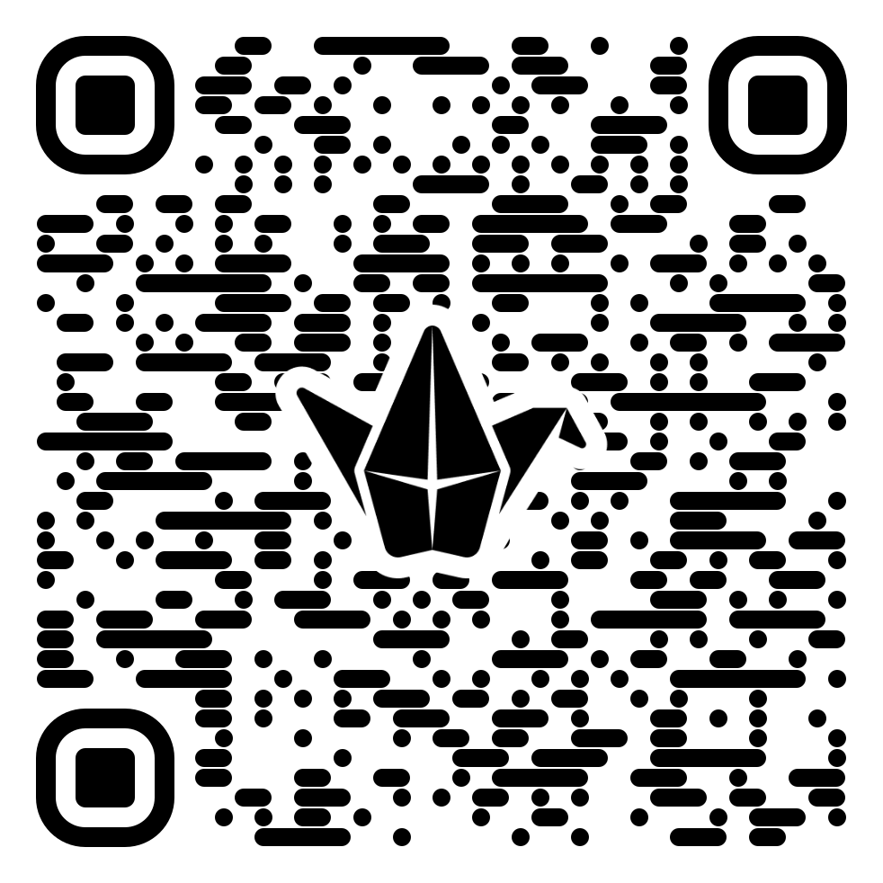
Breakout Room: Padlet
2 minutes - The recorder should assign each person in the group a few items from the list to share in our padlet. If someone has already posted something you were going to share, please use a reaction instead.

Slide 13

List Winners
•Winners: Placeholder
Team Name Shoutouts:
Placeholder
Notes:
Review Padlet After this slide

Slide 14
Spicy Challenge
Spicy Challenge: (1 minute) Have you recognized any techniques that I’ve already used in today’s activities? Add them to the padlet if you have!
If you already see them posted, please add a pepper 🌶 emoji to mark them!

Slide 15
Insight Partners
We will go back into breakout groups in a moment. When we do, please complete the following steps:
Choose an insight partner from within your group. This is a person you will listen to more closely for the rest of the workshop.
When you hear them say something interesting or insightful, make a quick note of what they said.
We will share our favorite insights from our insight partners with them at the end of the workshop.

Slide 16
Breakout Room: Assign Insight Partners
2 minutes - Within your collaborative team, assign insight partners. You do not need to be in pairs, so if you have an odd number of people on your team, allow one person to have two insight partners that will be listening closely to them.

Slide 17
Learning Logs
Link to the Learning Log Document
What I learned or found interesting from the presented material | What I learned or found interesting from my team's conversation | How I plan to use what I’ve learned in my classroom
(To be filled out while I discuss new content) Example: Having students quickly make a list of ideas (list contest) related to a topic before they are presented with new material will support scaffolding and give the instructor a sense of what students already know. | (To be filled out while having your collaborative team meeting) Example: Because all of the prizes benefit the whole class, the competition is less likely to turn overly competitive, and students are essentially competing to be the most helpful to their classmates. | (To be filled out independently later) Example: This would be a great technique to uncover myths about how evolution works that students may believe.

Slide 18
Activity 6: Learning Logs In Action
In a moment, I’m going to go over the techniques we have experienced and experimented with so far. While I do, you should take notes of any new or interesting information for your learning log.
When I have finished going over the techniques, we will go back to our collaborative teams. Share what you took notes on, and make note of anything interesting or exciting that your teammates share with you. Don’t forget to listen closely to your insight partners thoughts!

Slide 19
Break down of methods used so far
Defining multiple modes of collaboration
Self sort
Team Names and playfulness
Group Roles
List Contest and shared prizes
Insight Partners
Padlet Collaboration
Spicy Challenges
Learning Logs

Slide 20
Other Methods You May Want To Try
Assignment FAQS
Service to the Community Extra Credit
Brackets and expanding teams
Reciprocal Learning (See the excellent Cult of Pedagogy Reciprocal Learning Video for more information)

Slide 21
Breakout Room: Learning Log check in
5 minutes - Share what you recorded in the first column of your learning log and take notes on the insights of others

Slide 22
Collaboration is great, but it needs the right questions
Read through the 2 examples of a collaborative activity below. In your breakout group, decide which activity you think would be more successful in a course and list at least 3 reasons for your choice. Your recorder should make sure that your reasons get shared to the upcoming padlet.
In groups, discuss the pros and cons of globalization. Be sure to support your arguments with evidence. Be prepared to share your thoughts with the class.
In your collaborative team, take a vote as to whether you see globalization as a positive or negative force. Then write a list of 5 supporting arguments. Each argument should have 1 piece of evidence from the assigned readings. We will share your contributions in a padlet and use the likes system to rank the strongest arguments.

Slide 23
Breakout Room: What makes a good collaboration prompt?
3 minutes - Discuss the 2 collaborative prompt examples and decide which might be more effective. List 3 reasons for your choice. Share your 3 reasons to Padlet.
In groups, discuss the pros and cons of globalization. Be sure to support your arguments with evidence. Be prepared to share your thoughts with the class.
In your collaborative team, take a vote as to whether you see globalization as a positive or negative force. Then write a list of 5 supporting arguments. Each argument should have 1 piece of evidence from the assigned readings. We will share your contributions in a padlet and use the likes system to rank the strongest arguments.

Slide 24
Collaborating through our own insecurities
Now we are going to switch gears.
I will be sharing two more in-depth collaboration techniques, but we will be using them to start formulating plans for adding and supporting collaboration in our classrooms.

Slide 25
Introduction to Generative Knowledge Interviews
Generative Knowledge Interviews are a 3 step process, usually used in groups of 3 students to prompt deep reflection and to help students tap into knowledge they may not realize they already have.
All students begin by responding to a short reflection prompt. Prompts that require deep reflection on personal experiences work very well.
Then students break into groups of 3.
Within the group, each student takes turn in one of 3 roles. The interviewee, the interviewer, and the notetaker.

Slide 26
Generative Knowledge Interview Roles
The interviewee shares their written reflection with the other two group members, who should be listening carefully.
Then the interviewer should spend 2-3 minutes asking the interviewee questions.
As they do so, the notetaker should take notes on the conversation, paying special attention to any patterns or themes that emerge.
Students should then switch roles and repeat the process.
DePaul Teaching Commons has an excellent Generative Knowledge Interview video.

Slide 27
Let’s make a plan: Peer Editing
Independently, take 3 minutes to write about how you could incorporate 1 of today's methods into one of your classes. Be sure to include any concerns you have about student engagement with the method you chose.
When the 3 minutes is up, send your plan to your insight partner through the private chat.
When you have received your insight partner’s plan, respond with 1 suggestion and propose 1 solution to one of the shared concerns.

Slide 28
Individual Work: Application Brief Reflection
3 minutes - Independently, write about how you could incorporate 1 of today's methods into one of your classes. Be sure to include any concerns you have about student engagement with the method you chose. Share your plan in the private chat with your insight partner.

Slide 29
Chat Work: Respond to your Insight Partner’s plan
3 minutes - Independently, respond in the private chat to your insight partner, with 1 additional suggestion and 1 possible solution for one of the concerns they raised

Slide 30
General practices for supporting collaborative work
Free form collaboration puts a lot of extra executive functioning work on students who may not be used to working together. The more structured and specific you can be, the more likely students will collaborate the way you want them to
Lower the pressure - playful and silly can also feel safe
Present a big puzzle, but break it down into smaller pieces. Separate gathering evidence and reasons from making analysis or doing deeper level thinking.
Be specific about what participation looks like, and have more options than just sharing ideas or opinions
The timing sweet spot - I like to have just enough time that students can have a few seconds of side conversations so that they get to know each other and get a little mental break, but not enough time that they can get off track or really engaged. In person, I walk between groups and monitor this. In breakout rooms, I’ve tried to rely on short timed sessions.
At the end of the day, collaboration depends entirely on classroom community. The more time you spend helping students build community, the better their collaboration will be.

Slide 31
Making Space for our own insecurities
Try one thing at a time. Baby steps are still progress
Remember that when students struggle to collaborate it means they need more practice, not less
Challenge yourself to stick out an activity for a few minutes more when it starts to flounder before you pivot, but allow yourself to pivot when you need to
Before you leave, please make sure you send your insight partner a private chat with what you appreciate about their contributions today
Need more support or want more community? Let’s talk!
Sarah’s email: ssheph2@uic.edu

Slide 32
The List! All the methods and ideas we played with today
Defining multiple modes of collaboration
Self sort
Team Names and playfulness
Group Roles
List Contest and shared prizes
Insight Partners
Padlet Collaboration
Spicy Challenges
Learning Logs
10. Assignment FAQS
11. Service to the Community Extra Credit
12. Brackets and expanding teams
13. Reciprocal Learning
14. Generative Knowledge Interviews
15. Peer Editing
I have created a methods summary document with instructions on how to use each of these techniques and my personal notes on how to make them effective

Slide 33
Feedback for me
I would love to know what your thoughts are on the following teaching decisions I made in this presentation! Feedback Form Link
Were breakout rooms more effective than previous experiences you’ve had with breakout rooms?
I decided to have you frequently enter and leave breakout rooms so that you were doing one thing in the breakout room at a time. Did this work well or would you have preferred to have multiple tasks per breakout room meeting?
Any other thoughts you’d like to share?
Thank you so much for all your hard work today!

Slide 34
Extra Slides if Time

Slide 35
Modified Generative Knowledge Interviews
We will be doing a modified version of GKI today to accommodate our online format.
First, you will take 3 minutes to write a short answer to the following prompt: Reflect on a collaborative activity you have done in one of your classes in the past. What makes the experience memorable for you? What did you do well or what did you struggle with in the collaborative experience?
Normally, I would keep you within your collaborative teams for this activity, but because of zoom constraints, you will be working with new people for this activity
In breakout rooms, each of you will fulfill each of the roles one time.

Slide 36
Individual Work: Brief Reflection
3 minutes - Independently, write on the following prompt. Be ready to share you answer with your collaborative team.
Reflect on a collaborative activity you have done in one of your classes in the past. What makes the experience memorable for you? What did you do well or what did you struggle with in the collaborative experience?
Notes:
Alternative question: Think of a time where you considered having students collaborate in class, but either decided against it, or tried it and it didn’t work out. How has this shaped the way you approach collaboration in your classroom today?

Slide 37
Breakout Room: Generative Knowledge Interview
15 minutes - Take turns sharing your answers to the reflective question (5 minutes each). One group member should play the role of the interviewer and one group member should play the role

