Slide 1


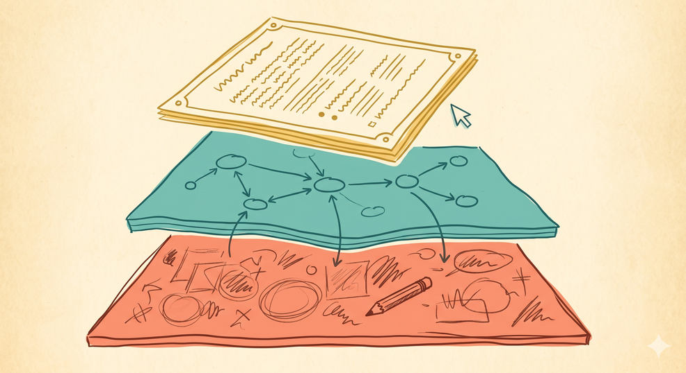
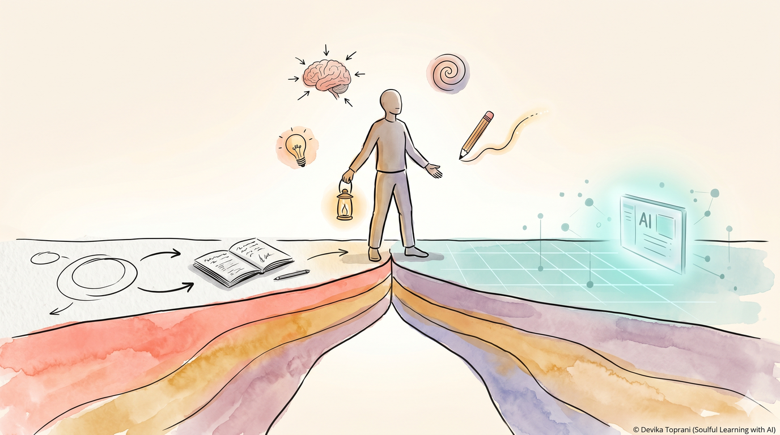
Northwestern University | May 13, 2026
Soul-Made Learning
Bridging the Clarity Gap Between AI and Human Sensemaking
Devika Toprani
Systems Architect for Human-Centered Learning & Responsible AI Adoption
Creator, Somagraphic Learning™ Framework
USPTO Trademark (filing active)
Toprani, D. (2026, April 22). Somagraphic Learning™ Framework: A human-first, AI-supported visual cognitive approach. OSF Preprints.
https://doi.org/10.35542/osf.io/fnk7z_v2
1/24
© 2026 Devika Toprani | Somagraphic Learning™ Framework
Notes:
1.7.2013
1
‹#›

Slide 2
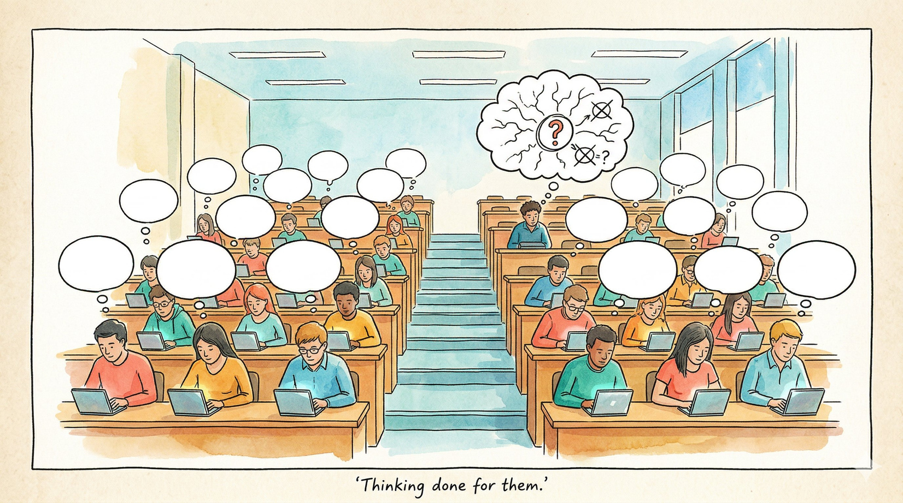



The Gap Between Saying It and Actually Knowing It
STUDENTS GET
RESULT?
INSIGHT
  Dense Text (vs. 3 sec Reels)
  Terminology, Formulas
  AI output before clarity
  Confusion
  Lack of interest
  Overwhelm
  In a low-attention world, learners need clarity first.
  The question isn't whether AI belongs in class
  The question is when it enters - and what students lose when it enters first
2/24
© 2026 Devika Toprani | Somagraphic Learning™ Framework

Slide 3
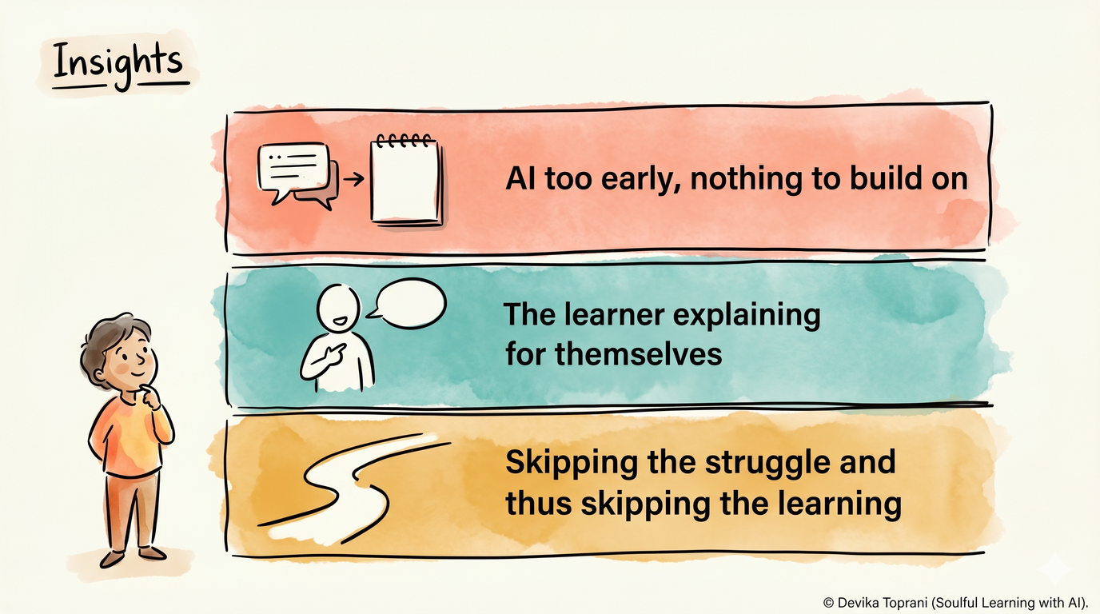

AI-First Learning Makes Students Less Capable, Not More
What Research Shows
Students given AI summaries learned less deeply than those who built understanding themselves
(Melumad & Yun, 2025)
Students felt more confident after ChatGPT explanations but understood less
(Elsayed & Verheyen, 2024)
Melumad & Yun (2025), PNAS Nexus · Elsayed & Verheyen (2024), 46th Annual CogSci Conference
3/24
© 2026 Devika Toprani | Somagraphic Learning™ Framework
Notes:
1.7.2013
2
‹#›

Slide 4
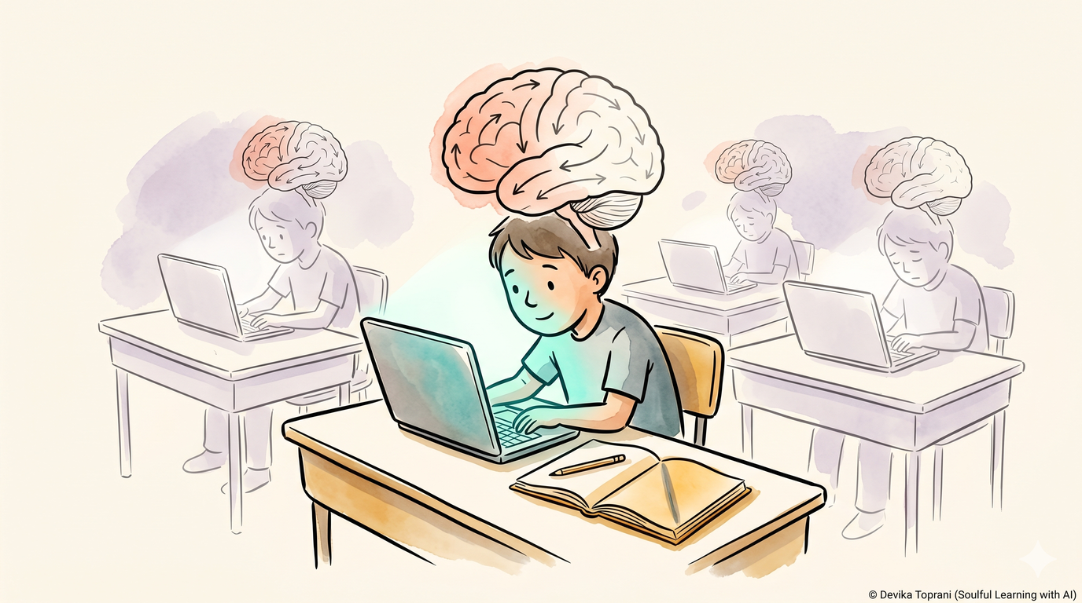
What Happens Over Time When AI Does the Thinking
Cognitive Atrophy... happening quietly in classrooms
Students who repeatedly used ChatGPT for essays showed significantly weaker brain connectivity vs. independent writers
(Kosmyna et al.)
AI becomes harmful when it does the thinking for you - weakening the very skill you're meant to develop
(Risko & Gilbert, 2016; Gerlich, 2025)
Kosmyna et al. (2025), arXiv:2506.08872 ★ Preliminary · Risko & Gilbert (2016) · Gerlich (2025), Societies
4/24
© 2026 Devika Toprani | Somagraphic Learning™ Framework
Notes:
1.7.2013
2
‹#›

Slide 5
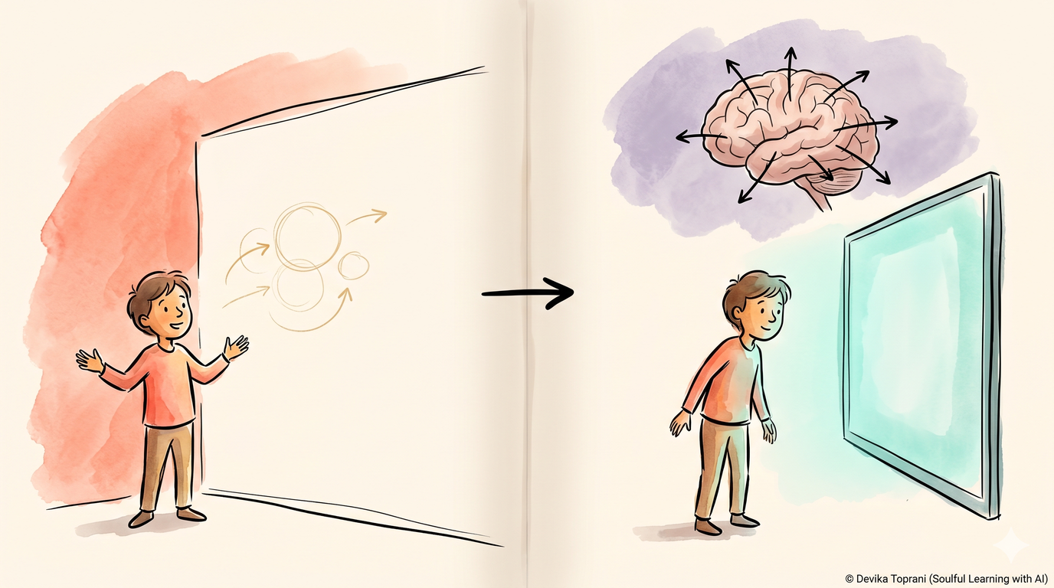
This Isn't About Lazy Students. It's How the Brain Works.
When people lack their own mental model, they defer to the machine - even when it's wrong. This is automation bias.
(Skitka et al., 1999; Endsley, 2016)
AI here isn't just a tool - it acts as a mediational agent, shaping thought before the student has generated any of their own
(Tate, Ritchie & Warschauer, 2026)
The problem isn't the student. It is the sequence.
Skitka et al. (1999), IJHCS · Endsley (2016), Human Factors · Tate, Ritchie & Warschauer (2026), EdArXiv
5/24
© 2026 Devika Toprani | Somagraphic Learning™ Framework
Notes:
1.7.2013
2
‹#›

Slide 6
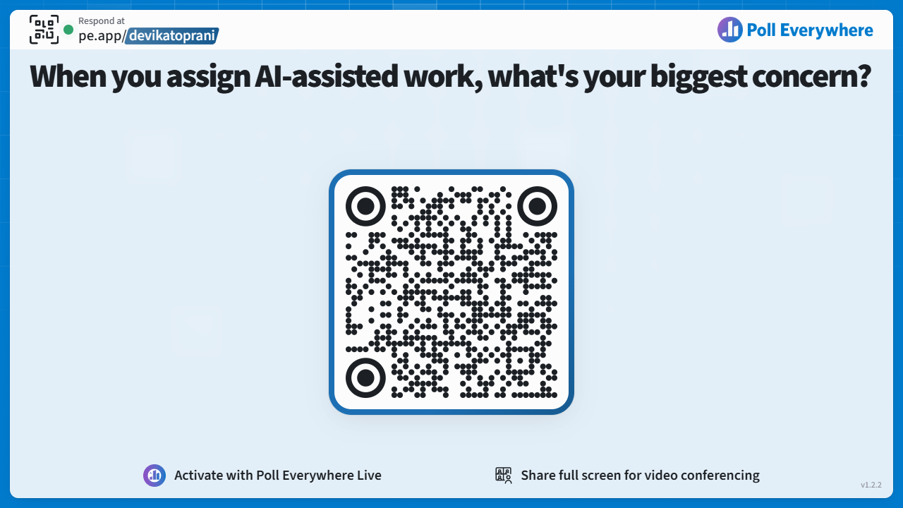
6/24
© 2026 Devika Toprani | Somagraphic Learning™ Framework

Slide 7
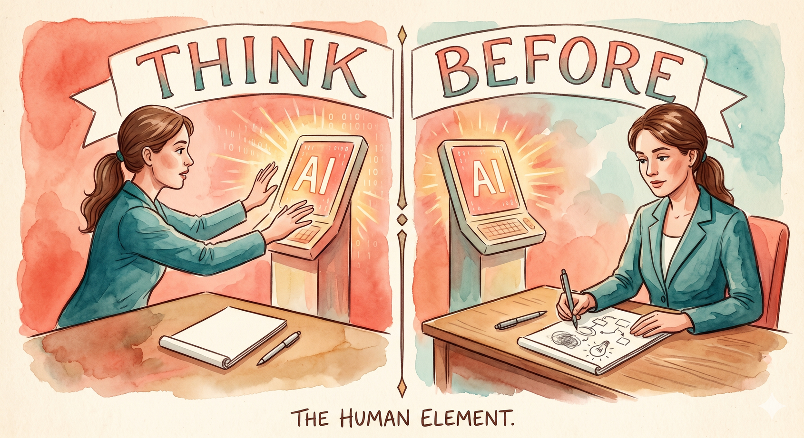
The Difference: Sequence, not tool
7/24
© 2026 Devika Toprani | Somagraphic Learning™ Framework

Slide 8
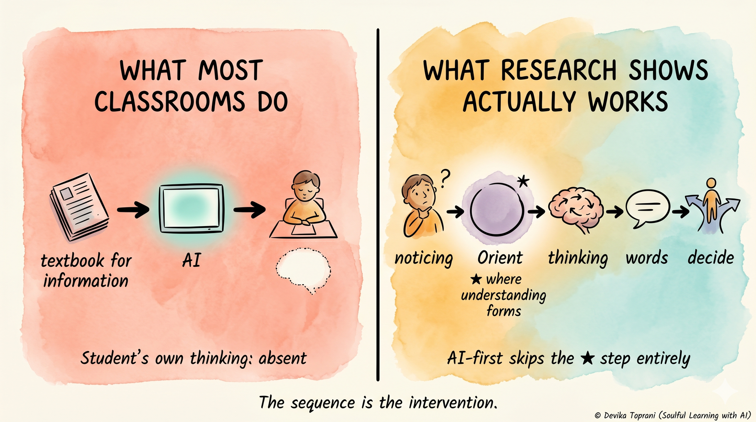
Should AI be in Classrooms or Not? The Debate Is Wrong. It's AI... When?
Lakoff & Johnson (1999), Philosophy in the Flesh · Wilson (2002), Psychonomic Bulletin & Review
8/24
© 2026 Devika Toprani | Somagraphic Learning™ Framework
Notes:
1.7.2013
2
‹#›

Slide 9
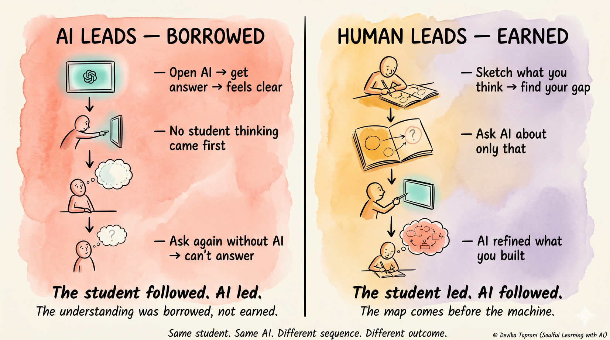
Repositioning AI: As Follower, Not Leader
9/24
© 2026 Devika Toprani | Somagraphic Learning™ Framework
Notes:
1.7.2013
2
‹#›

Slide 10

A Pre-Verbal Language That Anchors Understanding
Before a Single Prompt Is Typed
Circle → Safety (Psychological Safety, Attachment Theory) | (Bar & Neta, 2006), (Bowlby, 1969)
Square → Structure (Schema Theory, Cognitive Framing) | (Bartlett, F. C. (1932), (Goffman, 1974)
Triangle → Activation (Arousal Theory, Goal Orientation) | (Yerkes & Dodson, 1908), (Elliot & McGregor, 2001)
Spiral → Learning & Growth (Constructivist Theory) | (Bruner, 1966), (Piaget, J. (1972).The Psychology of the Child. New York: Basic Books., 2021)
Density → Cognitive Load (Cognitive Load Theory) | (Sweller, 1988), (Sweller et al., 2011)
Open Space → Clarity (Gestalt Principles, Attention Restoration) | (Koffka K., 1935), (Kaplan & Kaplan, 1989), (Kaplan, 1995)
Note: Perceptual cues, not symbolic rules. Meaning emerges through learner sense-making.
10/24
© 2026 Devika Toprani | Somagraphic Learning™ Framework

Slide 11
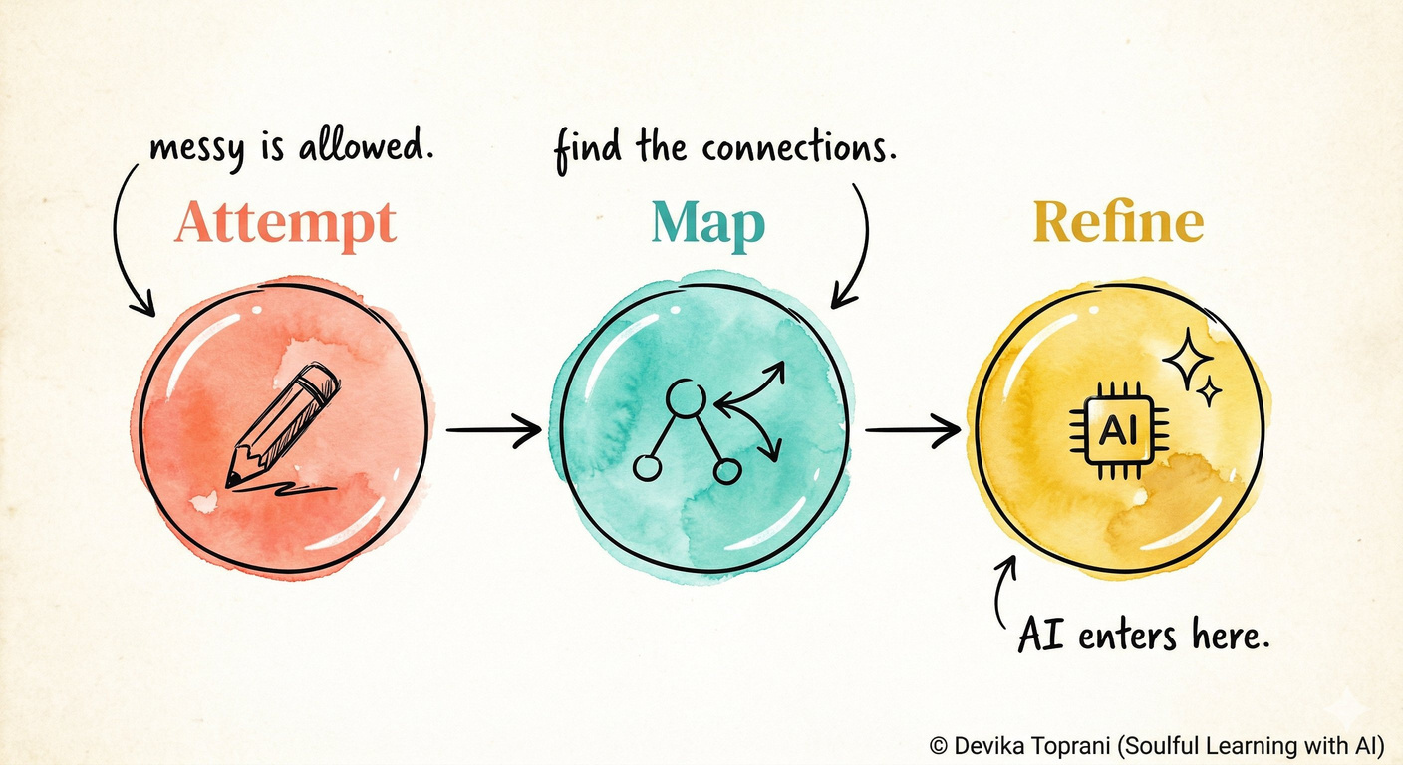
Somagraphic Learning™ Framework
A structured pre-AI, human-first thinking model based on (Attempt → Map → Refine) that reduces automation bias in learning environments.
THEORETICAL GROUNDING
Embodied Cognition · Cognitive Load Theory · Human-AI Interaction
11/24
© 2026 Devika Toprani | Somagraphic Learning™ Framework
Notes:
1.7.2013
2
‹#›

Slide 12
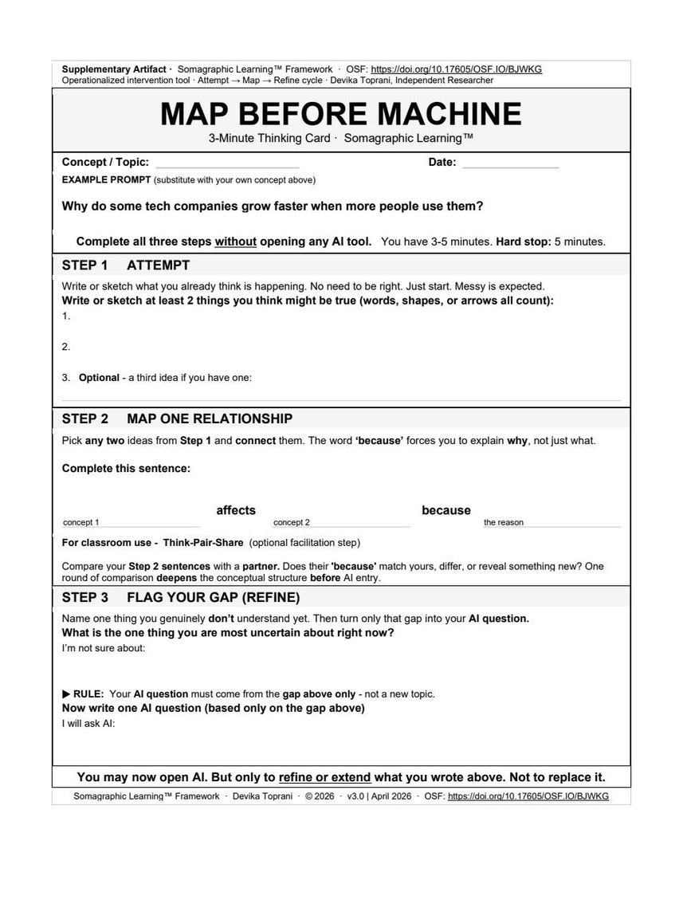
Map Before Machine™ Card
STEP 1 ATTEMPT
    Minimum floor: name 3+ concepts you already know.
    Forces cognitive entry, not compliance. Maps to SLF Attempt stage.
STEP 2 MAP ONE RELATIONSHIP
    "___ affects ___ because ___" — BECAUSE is load-bearing.
    It forces mechanism, not just naming two ideas side by side.
STEP 3 FLAG YOUR GAP (REFINE)
    Converts vagueness into a targeted AI question.
    Repositions AI from answer-generator to thinking partner. SLF Refine trigger.
The card IS the SLF framework applied, operationalized in under 10 minutes.
Not anti-AI. A human-first on-ramp before AI enters.
12/24
© 2026 Devika Toprani | Somagraphic Learning™ Framework
Notes:
1.7.2013
5
‹#›

Slide 13
User Research & The Delta
Participant A
Participant B
Participant C
UX Design
Health Informatics
STEM Instructor
STEM learner · Independent-first
STEM learner · Surface-level baseline
Technology Management
Method: Zoom · 60-sec baseline (no card) → 3-min card session → debrief · 3 interviews
THE DELTA · Participant B (Health Informatics)
BEFORE · 60-sec baseline (no card)
AFTER · Card-prompted Step 3
"Why do some tech companies grow faster when more people use them?"
"I think I get the basics."
"Before, the question was really vague. Now it's something that can actually get something out of. The prompt itself was becoming more specific."
"With three steps there's an organized plan - gives me more time to think through the question."
— Participant B
"This just strategically slows down the brain enough to make connections and then jump to AI."
— Participant A
13/24

Slide 14
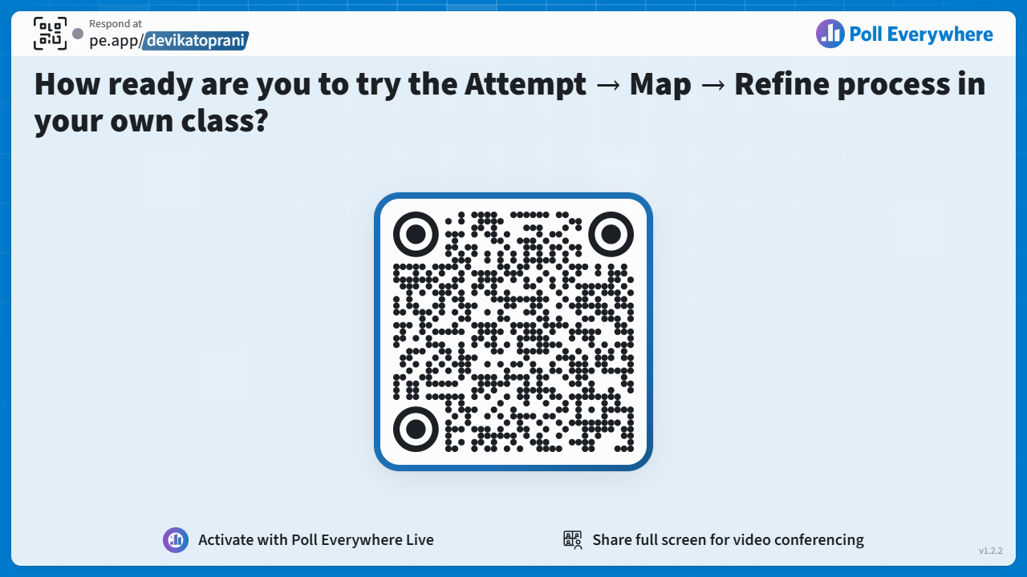
14/24
© 2026 Devika Toprani | Somagraphic Learning™ Framework

Slide 15
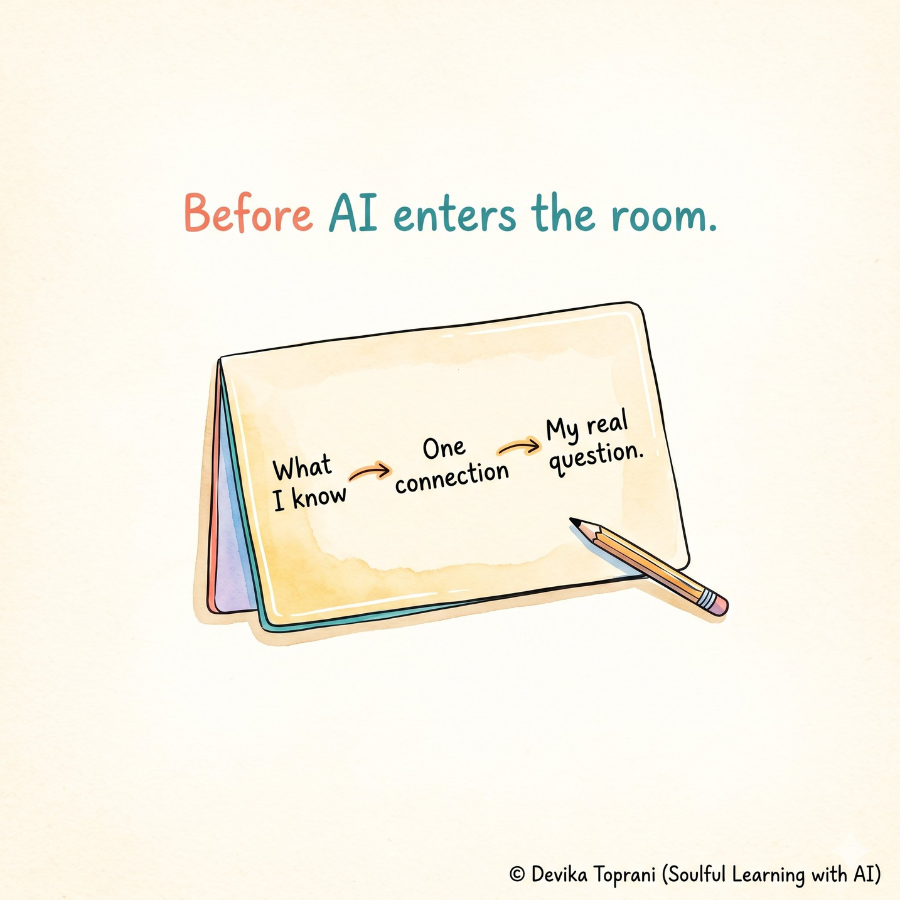
Deployable Tool:
Map Before Machine™ Card
  Printable or LMS-ready (Canvas, Moodle, etc.)
  No special tools required
  Max 10 minutes
  Classroom, individual, or digital use
  Think-Pair-Share facilitation optional
  OSF registered
  USPTO trademark active
  CC BY-NC-ND 4.0
  Aligned with Universal Design Learning
  Built to bridge the Global Clarity Gap
15/24
© 2026 Devika Toprani | Somagraphic Learning™ Framework

Slide 16
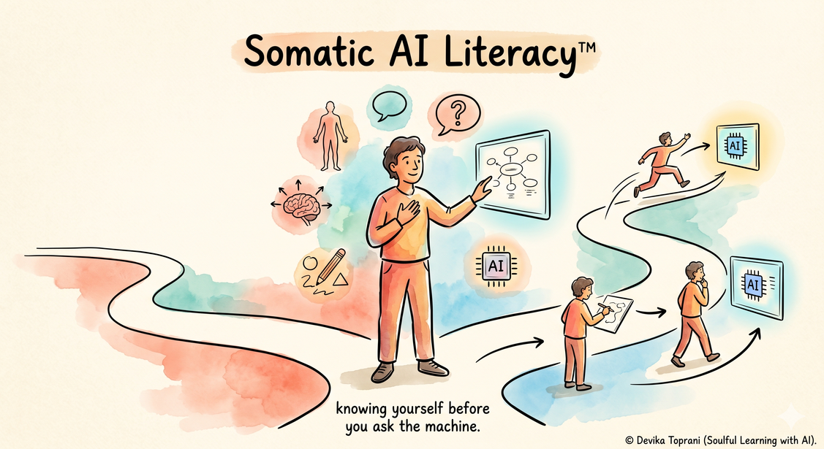
Somatic AI Literacy™
Your body thinks before you prompt.
3 questions that reveal it:
01
Did you think before you prompted?
02
Is your AI question gap-based — not generation-based?
03
Did you modify the output — or just accept it?
16/24
UNESCO, ISTE, CSTA address AI outputs. None address the cognitive conditions of entry. · Toprani, 2026
© 2026 Devika Toprani | Somagraphic Learning™ Framework

Slide 17

What Somagraphic Learning™ Is Not
Not art therapy Drawings are not interpreted for diagnosis Focus = Shared structure.
Not learning styles Everyone starts from the same visual entry point.
Not a replacement for theory or rigor Provides clarity before complexity
Not AI-generated understanding Learners hand-draw AI supports reflection, not comprehension.
Not a closed system Research-ready framework under development Open to pilots, testing, and refinement.
17/24
© 2026 Devika Toprani | Somagraphic Learning™ Framework
Notes:
1.7.2013
2
‹#›

Slide 18
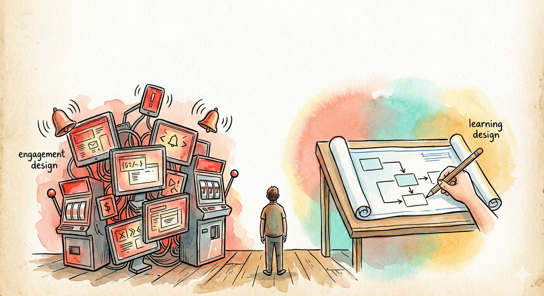
Who do AI-first
workflows leave out?
Multilingual learners
AI workflows are text-first and English-dominant. This framework is pre-verbal. Shapes, not words.
Neurodivergent thinkers
Visual-first processing is not a workaround.
It's the native mode. The framework meets it.
Low-literacy adults
Text-first AI adds a compounding barrier.
This removes it by design.
18/24
© 2026 Devika Toprani | Somagraphic Learning™ Framework

Slide 19
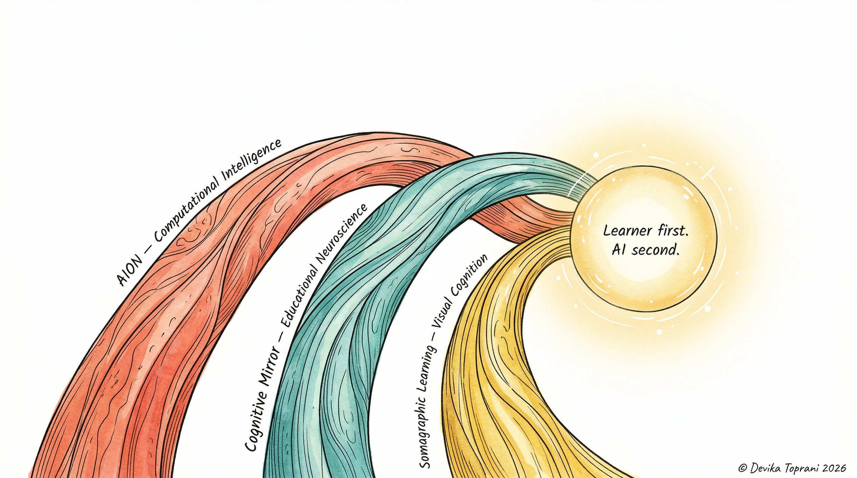
Three Streams. One Truth.
A human-first framework.
Visual cognition before AI output.
19/24

Slide 20
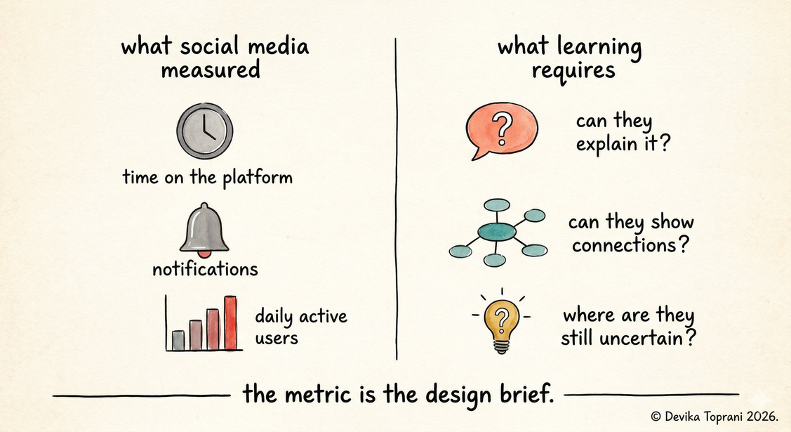
Two gaps no human-AI model has closed.
GAP 1 · Universal Design
GAP 2 · Academic Integrity
The visual grammar is pre-verbal.
No English needed. No drawing skill needed.
AI detection asks: did AI write this?
This framework asks: did you think first?
Reaches:
multilingual learners
neurodivergent thinkers
low-literacy adults
No existing human-AI sequencing model
has used a UDL lens. Somagraphic™ Learning does.
CAST, 2018 · Wilson, 2002
20/24
© 2026 Devika Toprani | Somagraphic Learning™ Framework

Slide 21
This framework is research-ready.
And practice-ready.
01 INSTITUTIONAL PILOTS
02 EDUCATIONAL CONSULTING
One cycle. One classroom. IRB-ready protocol on file. Co-authorship on findings. Refer to Pilot Protocol doc.
Human-first sequencing for EdTech, L&D, onboarding, and team AI workflows.
03 INSTITUTIONAL LICENSING
04 PRE-SEED STRATEGIC INVESTMENT
Embed the framework + card into your LMS or PD programming. By arrangement.
Learning science × AI ethics × workforce readiness. Protected IP. Clear pathway.
21/24
© 2026 Devika Toprani | Somagraphic Learning™ Framework

Slide 22
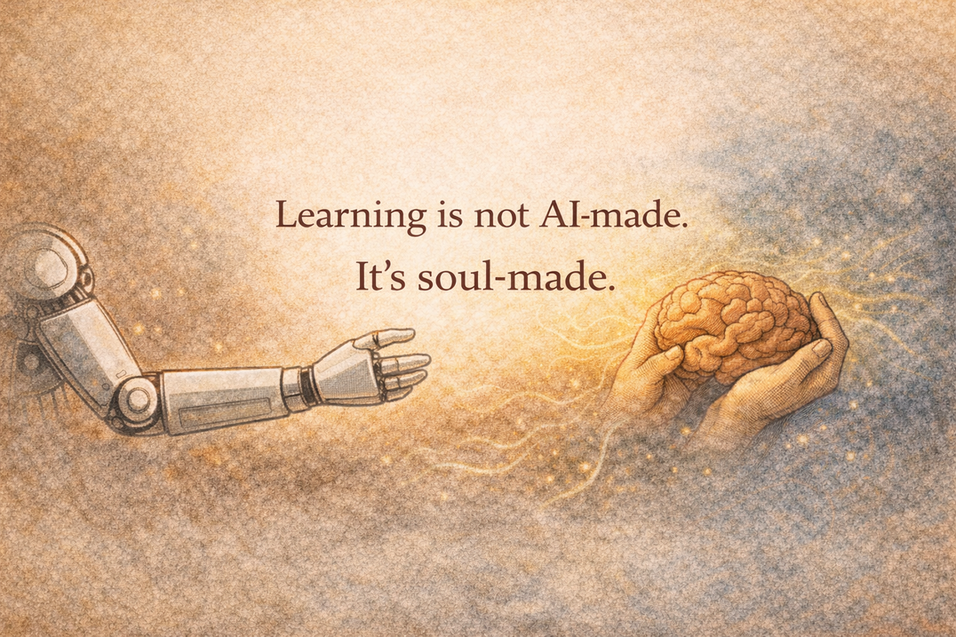
A Personal Philosophy on Learning...
The learner remains the architect.
AI amplifies (later).
22/24
© 2026 Devika Toprani | Somagraphic Learning™ Framework

Slide 23

Let’s connect: Pilots, Research & Collabs
SOCIAL MEDIA
  Devika Toprani on LinkedIn
  Soulful Learning with AI on Substack
  Website & Bio
  DoodlesByDevika on Instagram
EMAIL
OSF PREPRINT (EDARXIV)
devikatoprani1171@gmail.com
Toprani, D. (2026, April 22). Somagraphic Learning™ Framework: A human-first, AI-supported visual cognitive approach. OSF Preprints.
https://doi.org/10.35542/osf.io/fnk7z_v2
PILOTS OPEN
Medical Education · LMS Integration · K-12 · Higher Education · Non-profits · Career Mapping · Workforce Strategy
EDUCATOR PRO: IN DEVELOPMENT
ATTEMPT → MAP → REFINE
Experimenting in Playlab · Early stage · Ideas welcome!
Goal: Make concept relationships visible - before AI writes.
© 2026 Devika Toprani · Somagraphic Learning™
All Rights Reserved · US Copyright Pending
23/24
© 2026 Devika Toprani | Somagraphic Learning™ Framework

Slide 24

24/24
© 2026 Devika Toprani | Somagraphic Learning™ Framework

Slide 25
R E F E R E N C E S ( A – M )
Amershi, S., et al. (2019). Guidelines for human-AI interaction. CHI 2019. doi.org/10.1145/3290605.3300233
Fernbach, P. M., et al. (2013). Political extremism and illusion of understanding.
Psychological Science, 24(6). doi.org/10.1177/0956797613481633
Bar, M., & Neta, M. (2006). Humans prefer curved visual objects. Psychological Science, 17(8).
doi.org/10.1111/j.1467-9280.2006.01759.x
Flavell, J. H. (1979). Metacognition and cognitive monitoring. American Psychologist, 34(10).
doi.org/10.1037/0003-066X.34.10.906
Bartlett, F. C. (1932). Remembering. Cambridge University Press.
Gartner. (2025, Oct 21). Top predictions for IT organizations 2026 and beyond. gartner.com
Bjork, R. A., & Bjork, E. L. (2020). Desirable difficulties in theory and practice. JARMAC, 9(4).
doi.org/10.1016/j.jarmac.2020.09.003
Gerlich, M. (2025). AI tools in society: cognitive offloading. Societies, 15(1).
doi.org/10.3390/soc15010006
Bowlby, J. (1969). Attachment and loss: Vol. 1. Basic Books.
Kapur, M. (2016). Examining productive failure. Educational Psychologist, 51(2).
doi.org/10.1080/00461520.2016.1155457
Bruner, J. S. (1966). Toward a theory of instruction. Harvard University Press.
Kirsh, D. (2010). Thinking with external representations. AI & Society, 25(4).
doi.org/10.1007/s00146-010-0272-8
CAST. (2018). Universal design for learning guidelines v2.2. udlguidelines.cast.org
Koffka, K. (1935). Principles of Gestalt psychology. Harcourt, Brace.
Clark, A. (2008). Supersizing the mind. Oxford University Press.
Kornell, N., & Bjork, R. A. (2008). Learning concepts and categories. Psychological Science, 19(6).
doi.org/10.1111/j.1467-9280.2008.02127.x
Clark, A., & Chalmers, D. (1998). The extended mind. Analysis, 58(1). doi.org/10.1093/analys/58.1.7
Kosmyna, N., et al. (2025). Your brain on ChatGPT. arXiv:2506.08872.
★ Preliminary — not yet peer-reviewed
Deslauriers, L., et al. (2019). Measuring actual learning versus feeling of learning. PNAS, 116(39).
doi.org/10.1073/pnas.1821936116
Lakoff, G., & Johnson, M. (1999). Philosophy in the flesh. Basic Books.
Elliot, A. J., & McGregor, H. A. (2001). A 2×2 achievement goal framework. JPSP, 80(3).
doi.org/10.1037/0022-3514.80.3.501
LinkedIn. (2026). Skills-first: Reimagining the labor market. LinkedIn Economic Graph.
Elsayed, Y., & Verheyen, S. (2024). ChatGPT and the illusion of explanatory depth.
46th Annual CogSci Conference. escholarship.org/uc/item/2m38s5xm
Melumad, S., & Yun, J. (2025). LLMs vs web search on depth of learning. PNAS Nexus, 4(10).
doi.org/10.1093/pnasnexus/pgaf316
Endsley, M. R. (2016). From here to autonomy. Human Factors, 59(1). doi.org/10.1177/0018720816681350

Slide 26
R E F E R E N C E S ( P – Z )
Pedersen, I. (2023). The rise of generative AI in postsecondary education. Frontiers in AI.
pmc.ncbi.nlm.nih.gov/articles/PMC10448509
Toprani, D. (2026a). Somagraphic Learning™ Framework (v2). OSF Preprints.
doi.org/10.35542/osf.io/fnk7z_v2
Piaget, J. (1972). The psychology of the child. Basic Books.
Toprani, D. (2026b). Pilot Protocol (v2.0). OSF Supplementary Document.
doi.org/10.17605/OSF.IO/BJWKG
Risko, E. F., & Gilbert, S. J. (2016). Cognitive offloading. Trends in Cognitive Sciences, 20(9).
doi.org/10.1016/j.tics.2016.07.002
Toprani, D. (2026c). Soulful Learning with AI. Substack. substack.com/@devikatoprani
Roediger, H. L., & Karpicke, J. D. (2006). Test-enhanced learning. Psychological Science, 17(3).
doi.org/10.1111/j.1467-9280.2006.01693.x
UNESCO. (2023). AI competency framework for students.
unesco.org/en/digital-education/ai-competency-framework
Rozenblit, L., & Keil, F. (2002). The misunderstood limits of folk science: illusion of explanatory depth.
Cognitive Science, 26(5). doi.org/10.1207/s15516709cog2605_1
Varela, F. J., Thompson, E., & Rosch, E. (1991). The embodied mind. MIT Press.
Skitka, L. J., et al. (1999). Does automation bias decision-making? IJHCS, 51(5).
doi.org/10.1006/ijhc.1999.0252
Wilson, M. (2002). Six views of embodied cognition. Psychonomic Bulletin & Review, 9(4).
doi.org/10.3758/BF03196322
Sweller, J. (1988). Cognitive load during problem solving. Cognitive Science, 12(2).
doi.org/10.1207/s15516709cog1202_4
Zimmerman, B. J. (2002). Becoming a self-regulated learner. Theory Into Practice, 41(2).
doi.org/10.1207/s15430421tip4102_2
Tate, T. P., Ritchie, D. R., & Warschauer, M. (2026). Generative AI as a mediational agent. EdArXiv.
osf.io/preprints/edarxiv/wcpj5_v1
★ Kosmyna et al. (2025) is a preliminary preprint — not yet peer-reviewed. Presented as a directional signal only, not a confirmed finding.

